Slide 1
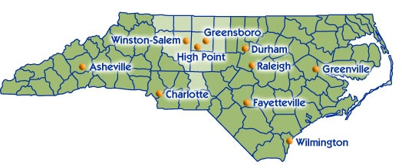
Everyone Eats: Food Systems and Wealth Creation
CREATIVE REGIONAL SOLUTIONS
Jennifer Bedrosian- Food Systems Coordinator

Slide 2
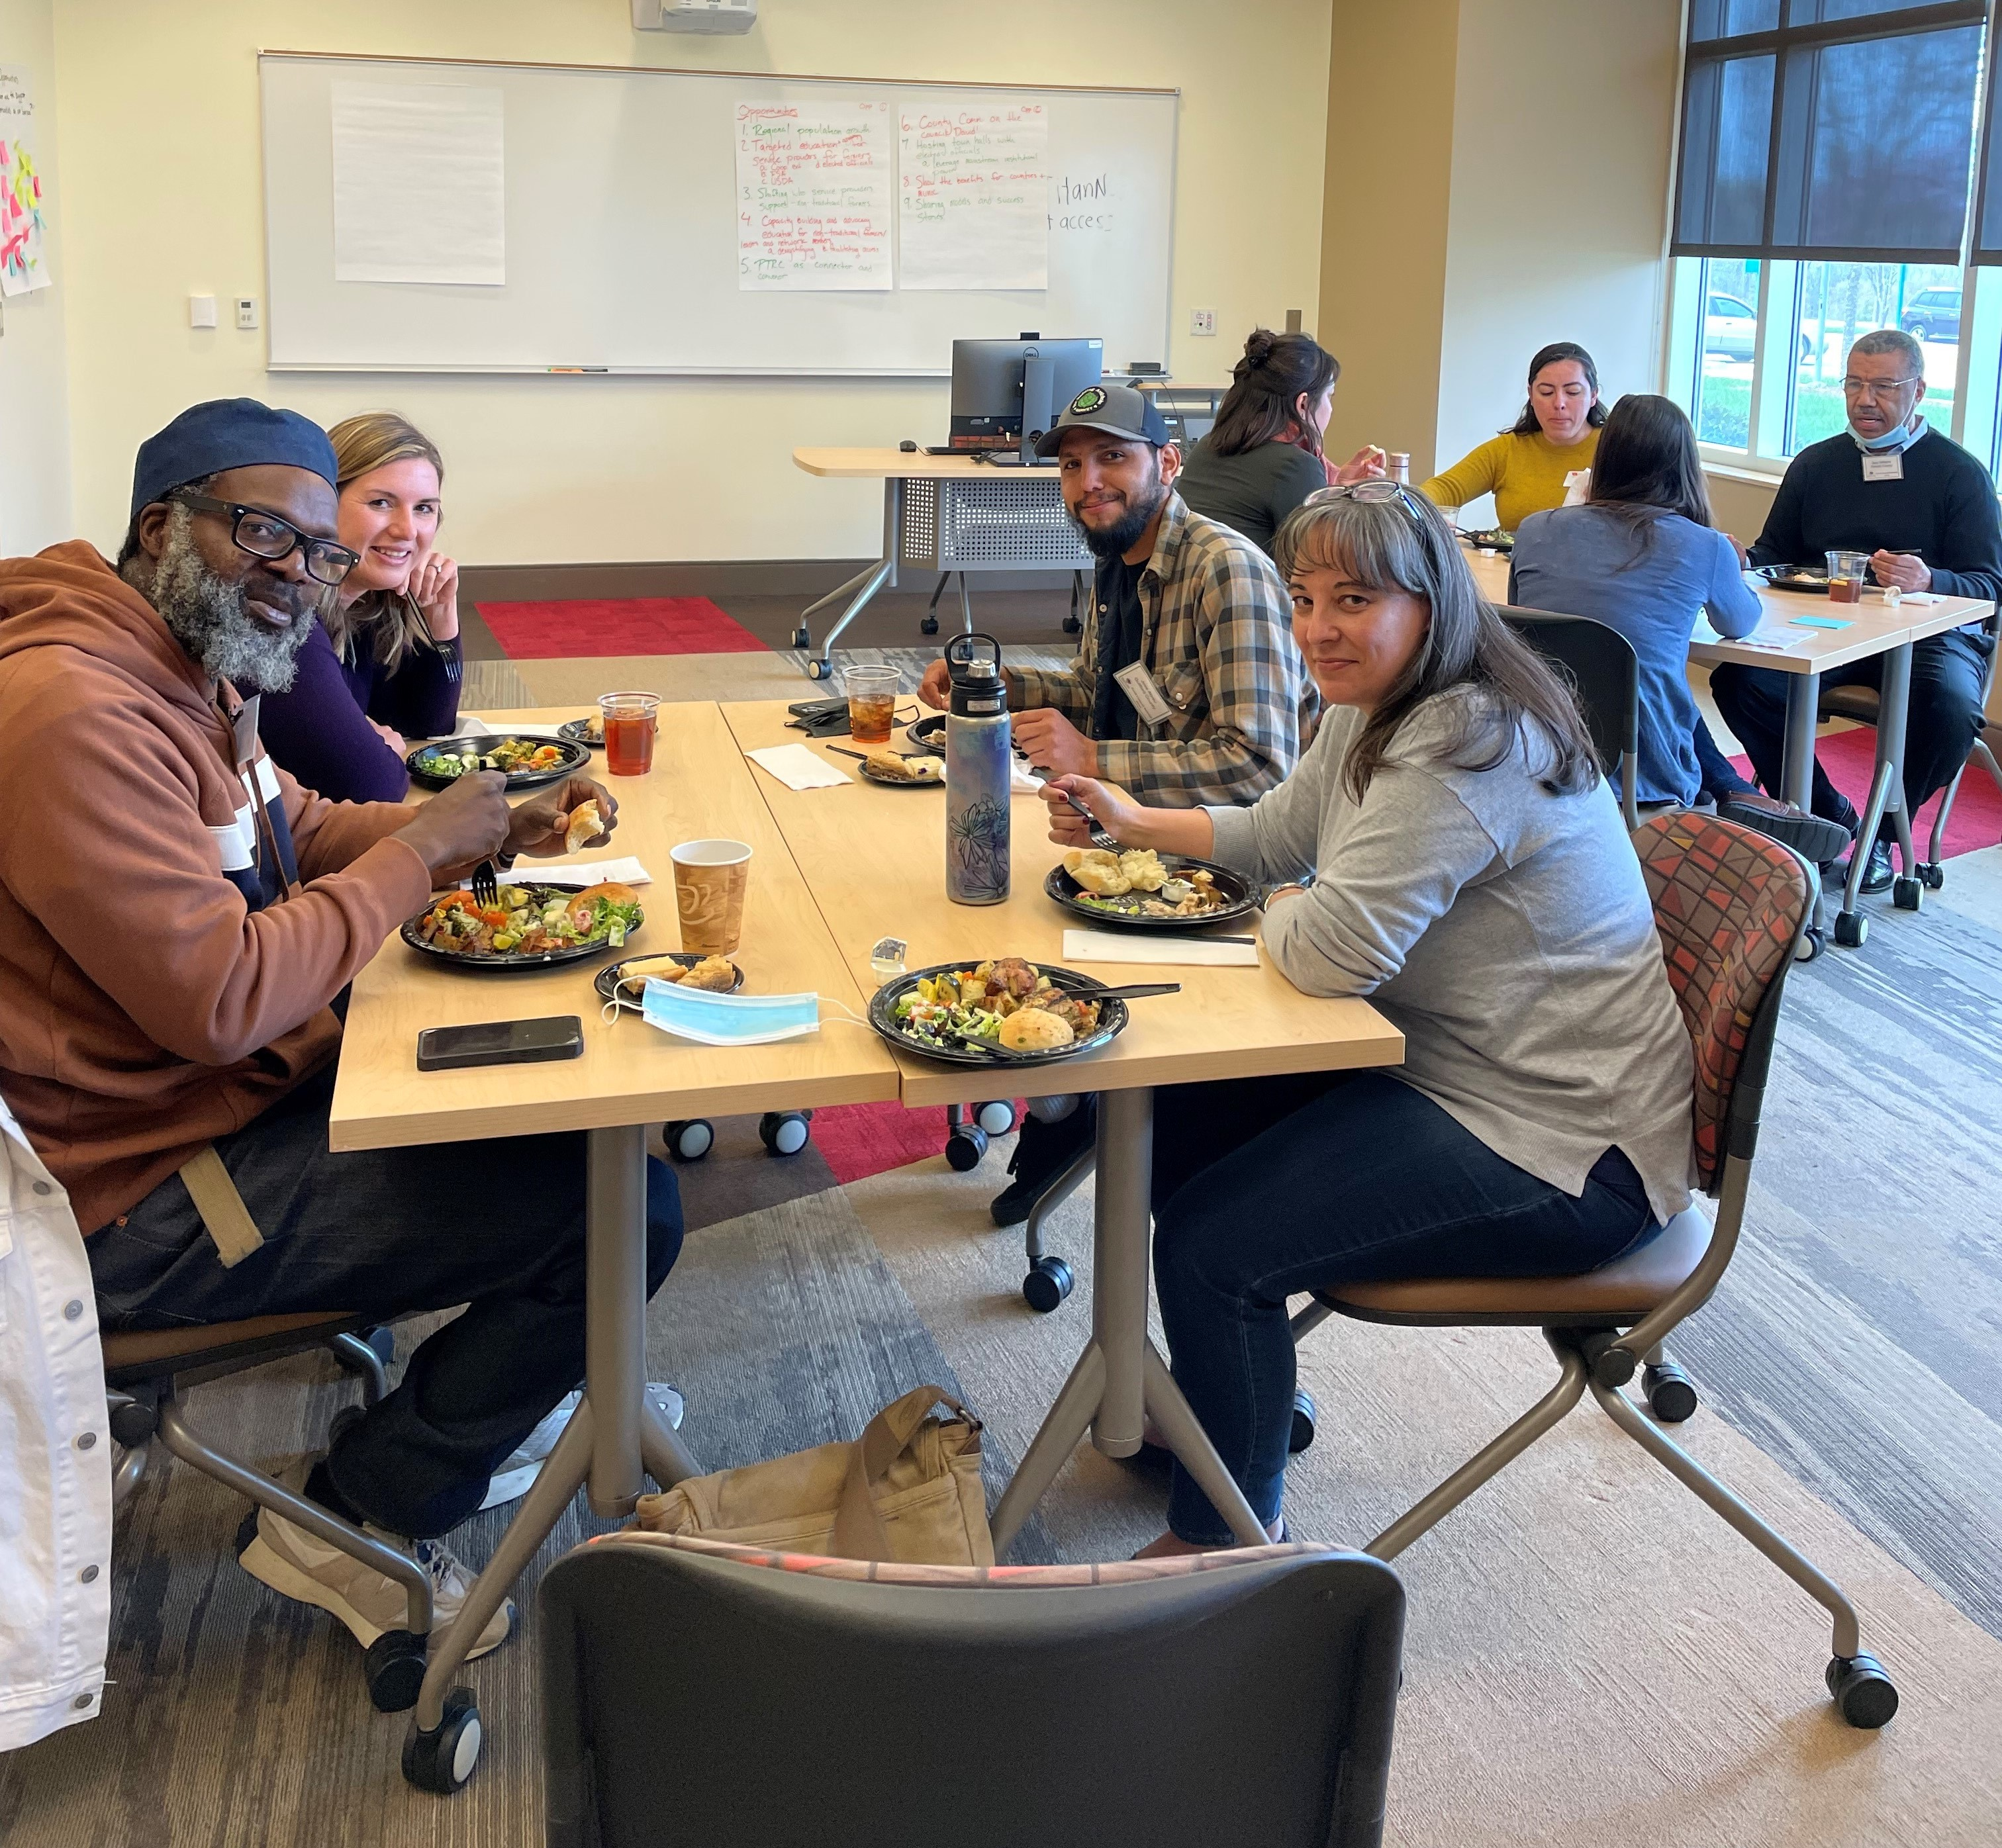
Who we are
Piedmont Triad Regional Food Council
The PTRC is one of the largest regional councils in NC serving the Piedmont Triad Region, serving 77 members in 12 counties and 65 municipalities.
Formed in 2019 and represented by ~25 diverse partners and community members across the 12 Triad counties, the PTRFC aims to balance various perspectives in the food system.
What we do
CREATIVE REGIONAL SOLUTIONS

Slide 3
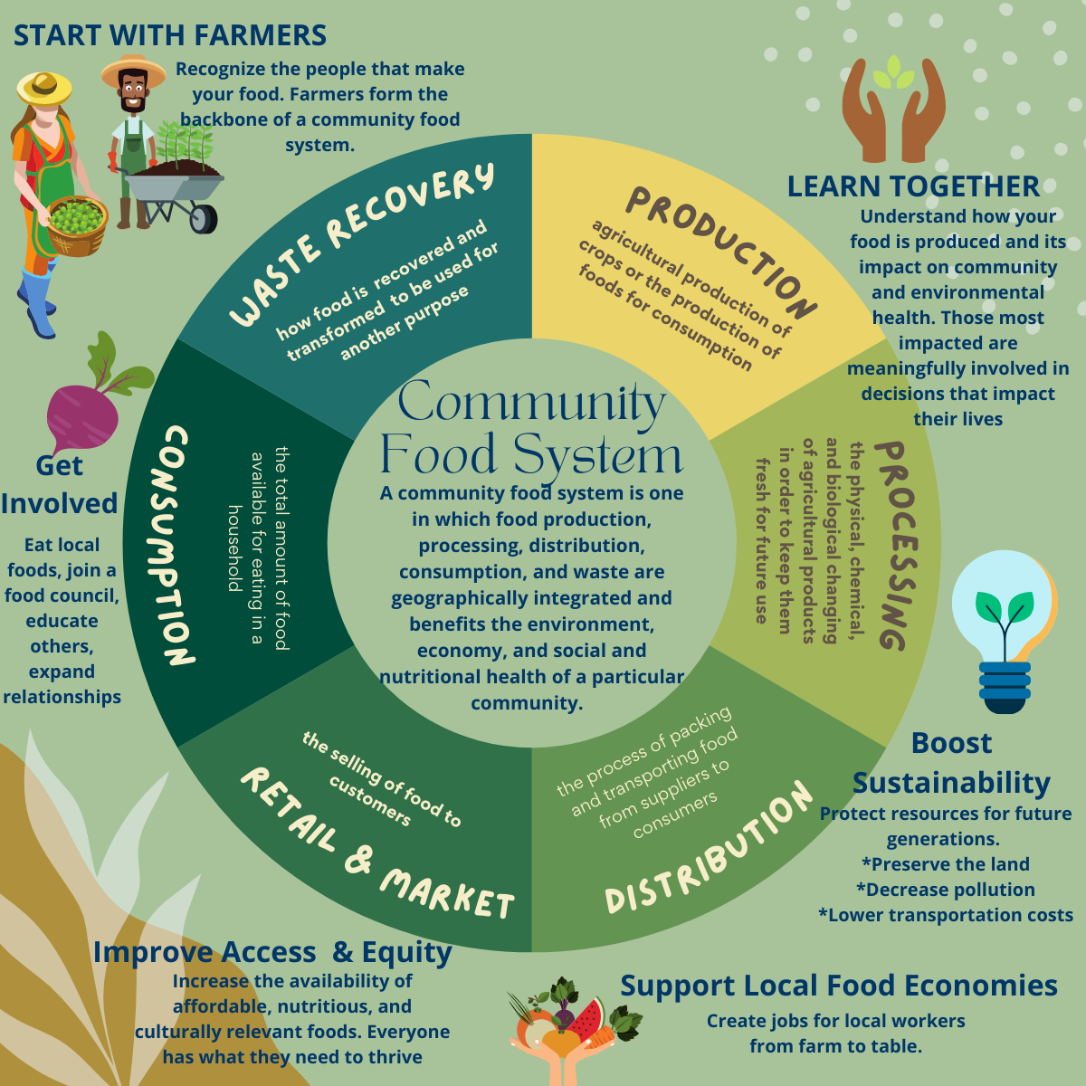
Entry Point
Food Consumption, Food Security & Equitable Access
In 2015, the Food Research and Action Center (FRAC) ranked the Greensboro-High Point Metropolitan Statistical Area as number one in the nation in food hardship and number four in food insecurity.
Since that time, it has moved to hover around number 14.
CREATIVE REGIONAL SOLUTIONS
Notes:
Food systems work requires building relationship and trust. Food systems work can have different entry points. To take action, we need to determine community energy and make it clear which pieces we are working on

Slide 4
Regional
Food Systems
Food Systems Change
Entry Point
Recommendations from 2020 Regional Food System Assessment:
Engage leaders of color and small grassroots organizations to co-create strategies;
Reduce administrative burden to participate in programs and relationships;
Expand partnerships;
Integrate food system needs into local and regional economic development strategies;
Build small grant programs that support food access at micro level;
Mapping micro farms and food infrastructure; and
Work with existing lenders to expand access to capital for underserved food businesses.
CREATIVE REGIONAL SOLUTIONS

Slide 5
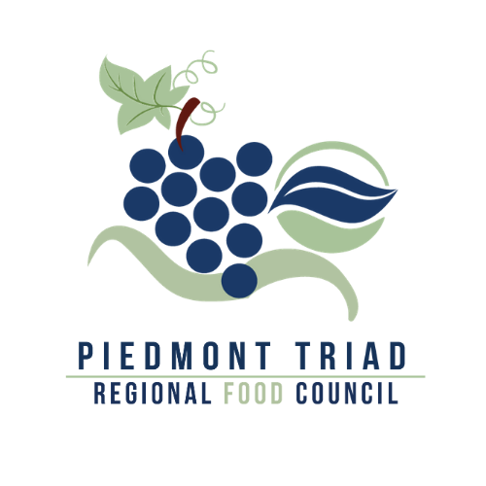
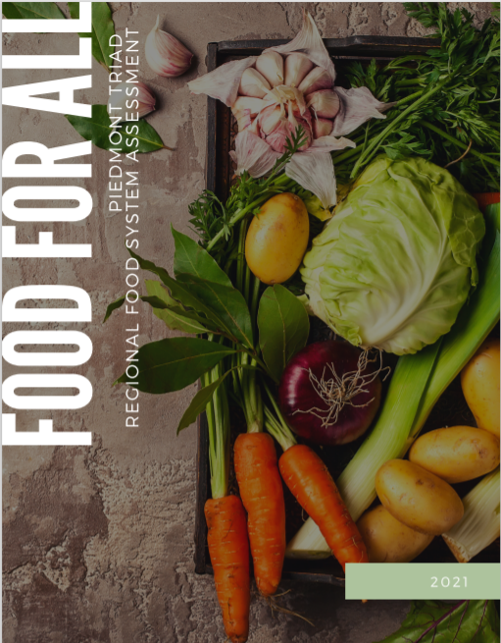
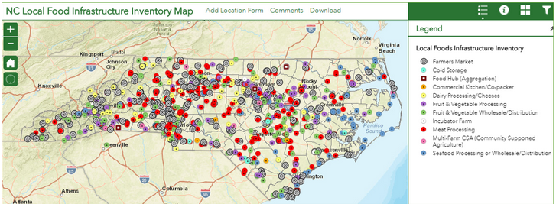
Engaging in Food Systems
Convene and Facilitate Partnerships: share best practices and resources to increase collaboration, align programs, and energize the work
Strengthen Systems : analyze local food system economic development and policy opportunities
NC Growing Together project, from 2013-2018 Task Force→ Regional Food Council, 2019 Regional Food System Assessment, 2019-2020 Learn Build Eat, 2021
Center for Environmental Farming Systems (NC State) USDA National Institute for Food and Agriculture Grant
Highly collaborative, over a dozen partners across the state
NC Local Food Infrastructure Map- inventory of businesses that serve as intermediary steps in food supply chain
Housed on PTRC website (GIS)
USDA NIFA Grant awarded to PTRC- food council start up & website development
Partnered with statewide entity for support to form a Task Force
Leverage funding for Regional Food Council & staff position (BCBS NC Foundation)
Conduct regional food system assessment, including equity findings, community survey, focus groups, hosting Food Talks webinars
Learn Build Eat virtual launch event
Presentations to partners and county commissioners
CREATIVE REGIONAL SOLUTIONS

Slide 6
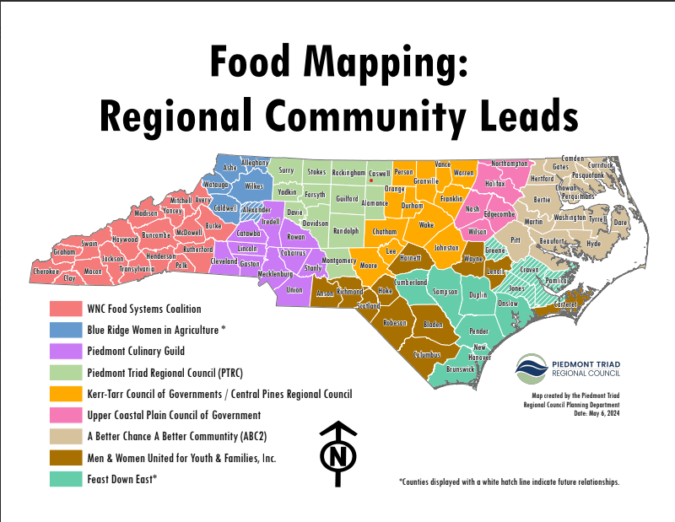
Engaging in Food Systems
Triad Food System Symposium, 2023
Triad Food Symposium to showcase food efforts, celebrate local food, and promote networking
More than 120 attended to engage in conversations on Building Equitable Farmer Support and Creating Resilient Food Hubs in the Triad
Results summarized as part of a collaborative process to develop a grant proposal
Healthy Food Financing Initiative Grant Award, 2024
PTRC was one of 16 groups across the nation awarded
For five years, PTRC provides a technical assistance hub to inform, engage and train those needing external funds for food projects.
PTRC also offers grants and incentivizes loans from lending partners to eligible projects.
USDA RFSP Application, 2024
Mapping the Pathway to Resilient Regional Food Systems in North Carolina -to raise awareness about food system infrastructure that can help farmers gain access to markets, address equity issues, and identify opportunities for high-impact investment in distressed communities
PTRC, The Conservation Fund (TCF), and North Carolina State University (NCSU) partnered
Community-based approach to data collection will "ground truth" the locations of food system entities throughout NC
CREATIVE REGIONAL SOLUTIONS

Slide 7
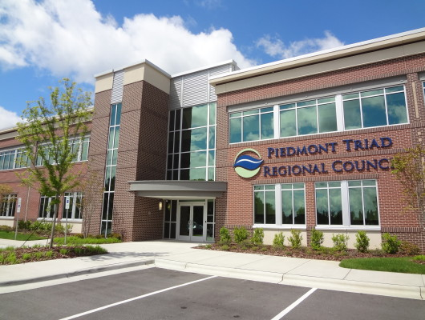
Build Relationships, Build a Stronger Food System
To learn more about Piedmont Triad Regional Food Council, please visit:
www.ptrc.org/triadfoodcouncil
Jennifer Bedrosian
Food Systems Coordinator
jbedrosian@ptrc.org
336-904-0300
www.ptrc.org
CREATIVE REGIONAL SOLUTIONS

