Slide 1
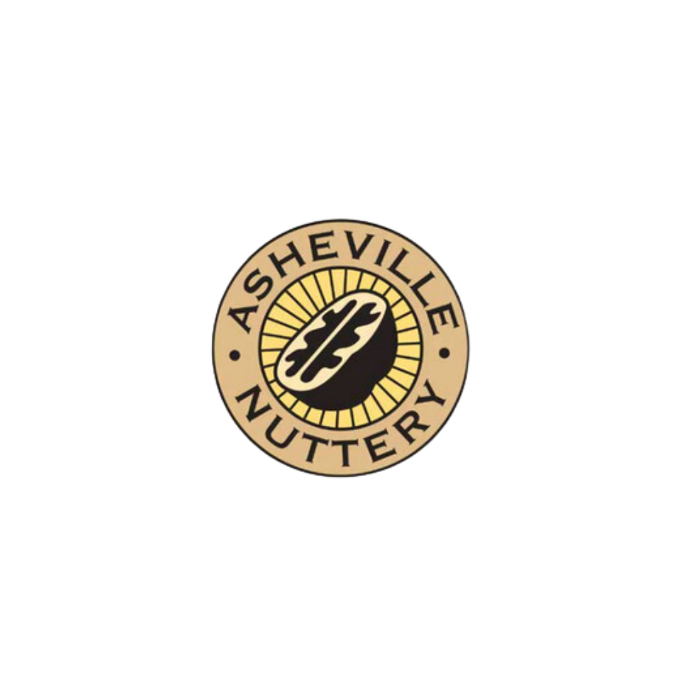
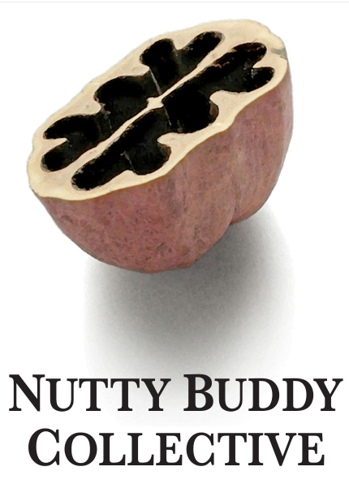
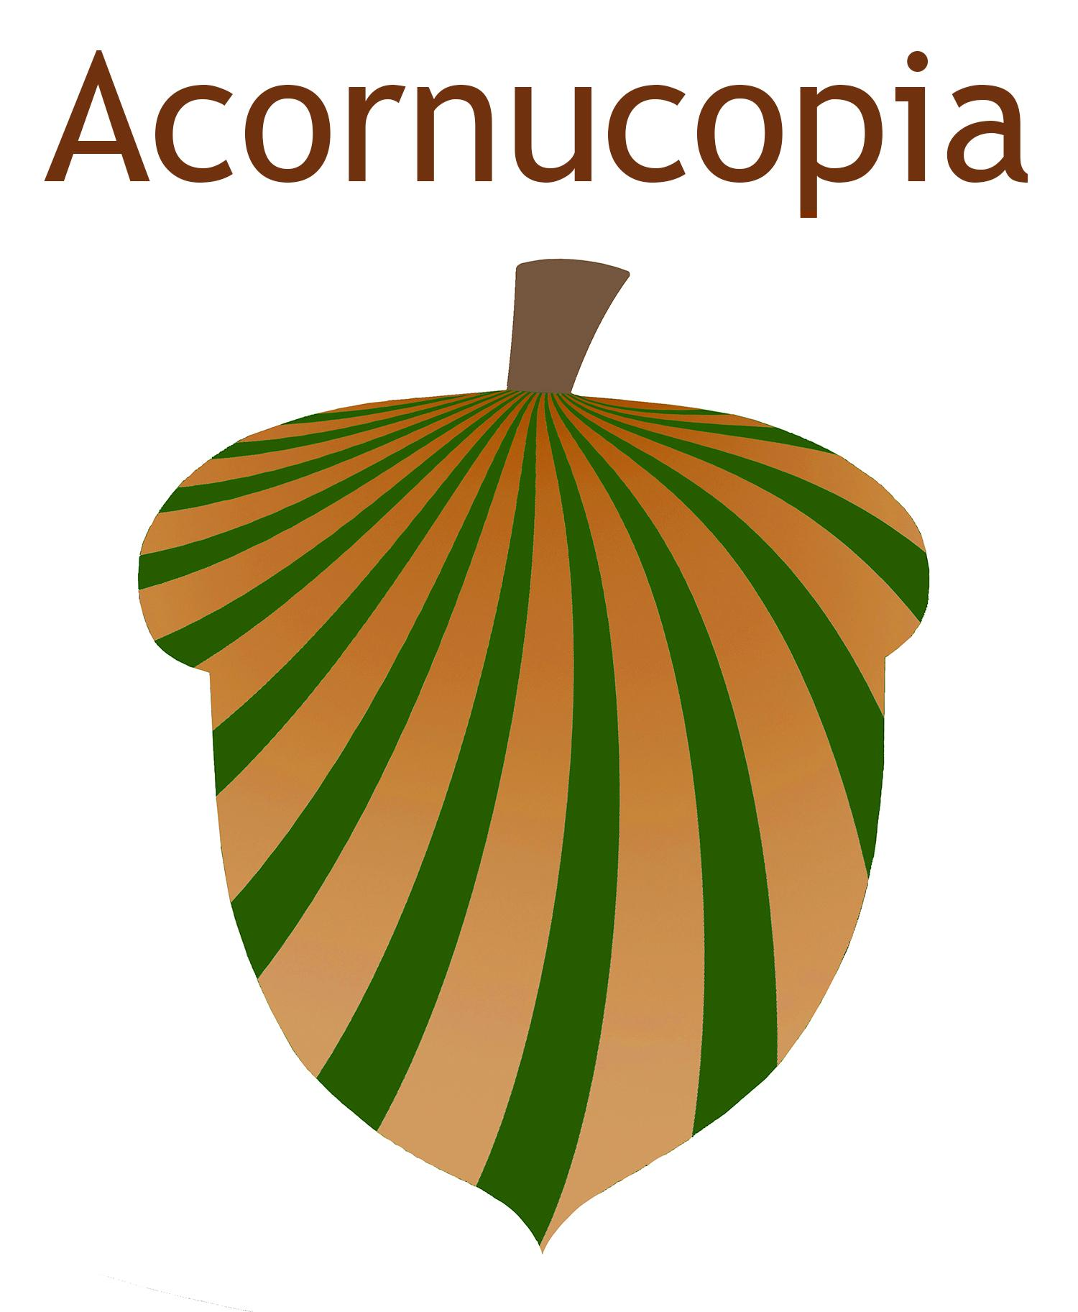
Nuts for Nuts
A regional nutwork of
adaptive, community-driven agroecology
Asheville Nuttery
Nutty Buddy Collective
Acornucopia Project

Slide 2
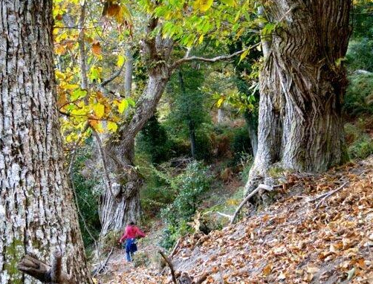
800 year old chestnut orchard in Corsica (and a glimpse of our past and future?)
photo credit: Ben Falk

Slide 3
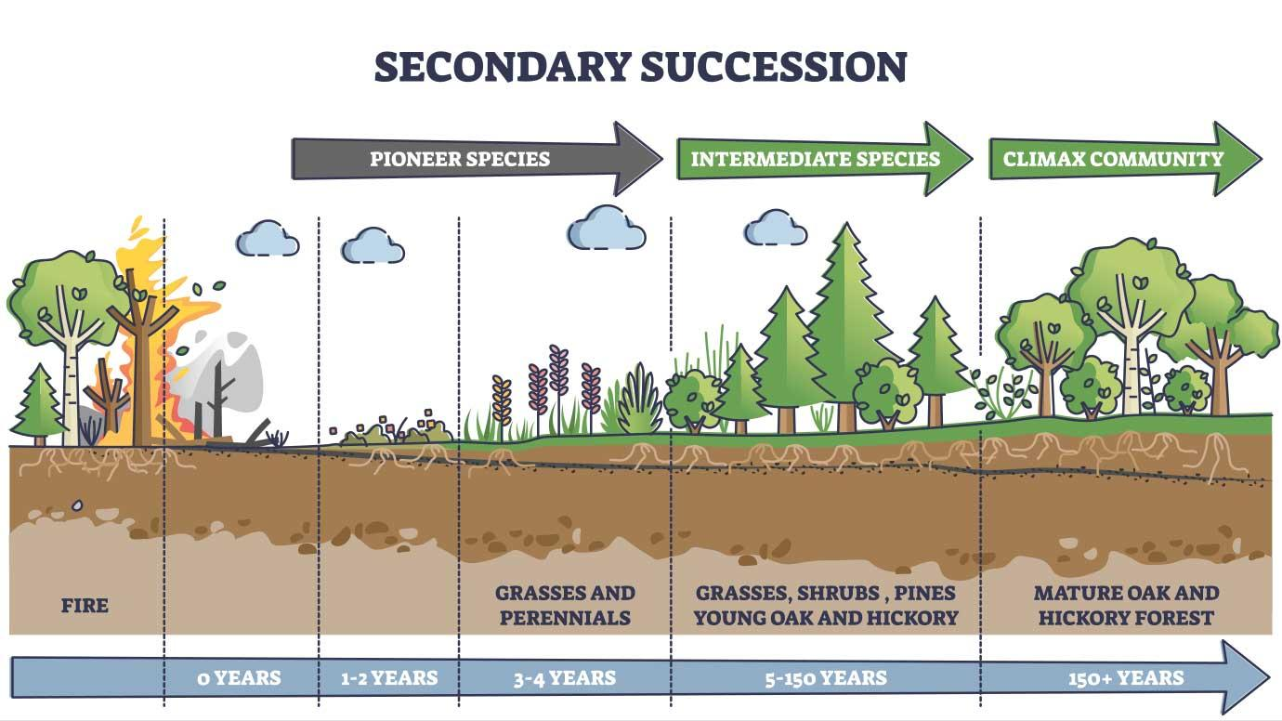

Slide 4
Native Americans as active and passive promoters of mast and fruit trees in the eastern USA, Abrams, M. D., & Nowacki, G. J. (2008)
“We conclude that Native American land-use practices not only had a profound effect on promoting mast and fruit trees but also on the entire historical development of the eastern oak and pine forests, savannas and tall-grass prairies. …We attribute the multimillennia domination of the eastern biome by prairie grasses, berry-producing shrubs and/or mast trees primarily to regular burning and other forms of management by Indians to meet their gastronomic needs. Otherwise, drier prairie and open woodlands would have converted to closed-canopy forests and more mesic mast trees would have succeeded to more shade-tolerant, fire-sensitive trees that are a significantly inferior dietary resource.”

Slide 6
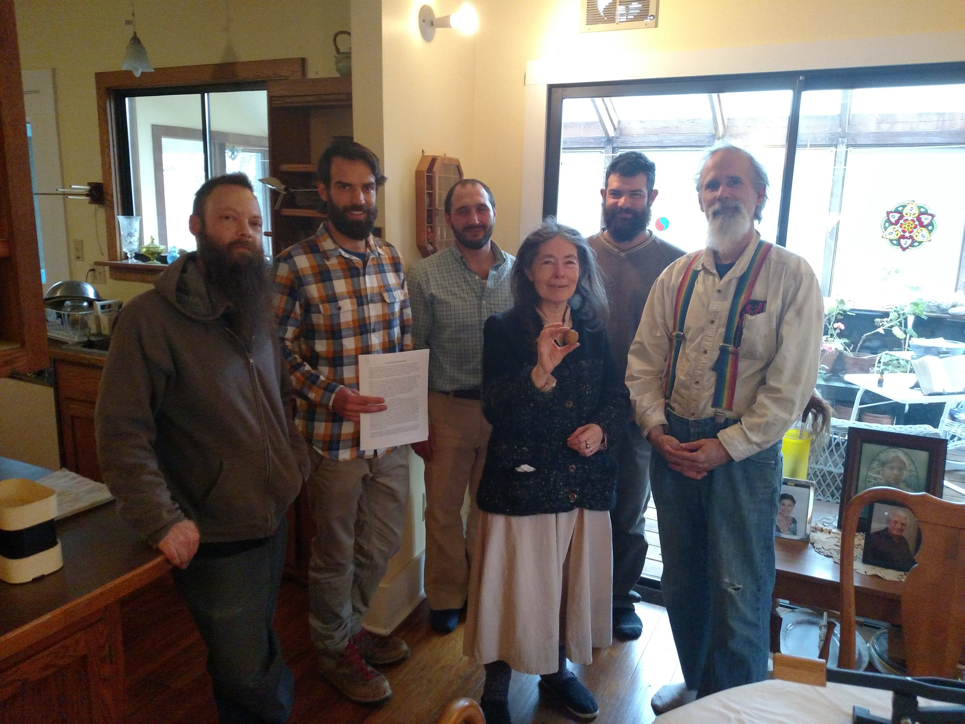
Nutty Buddy Collective signing a 99-year lease

Slide 7
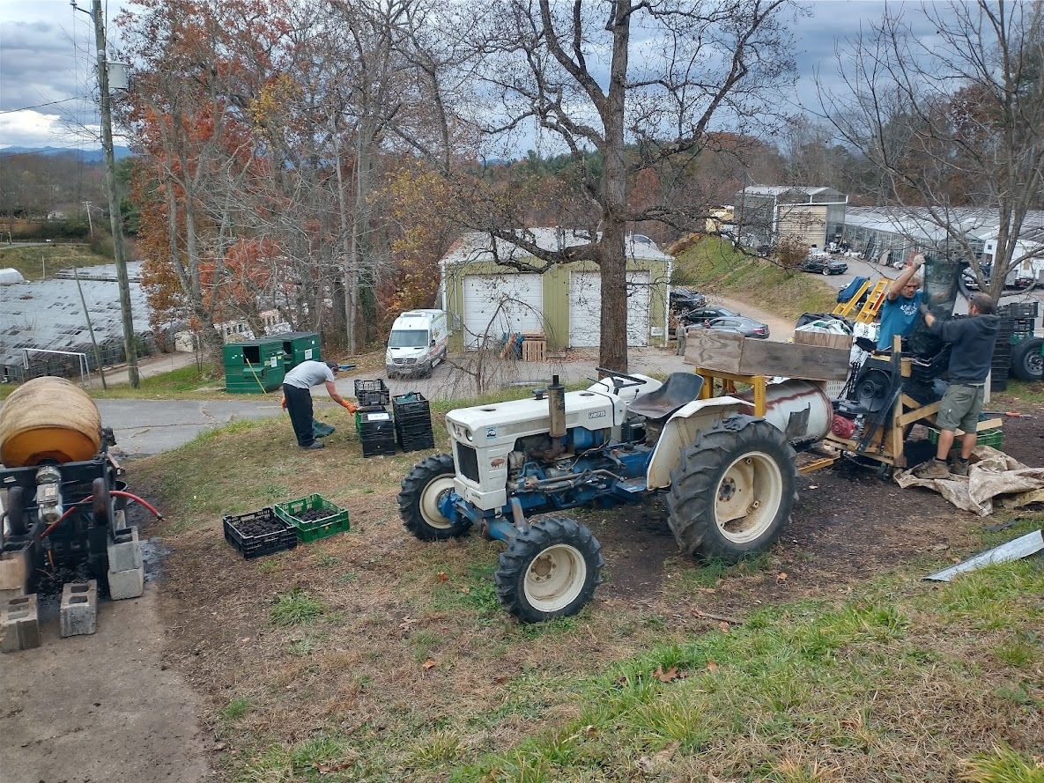
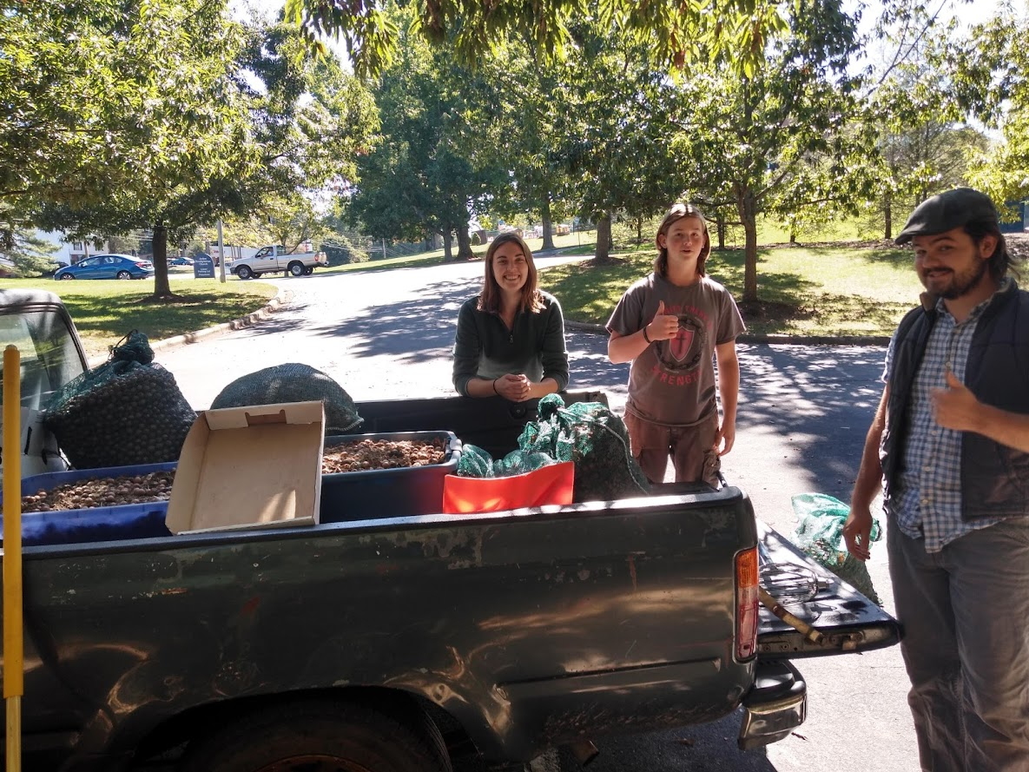
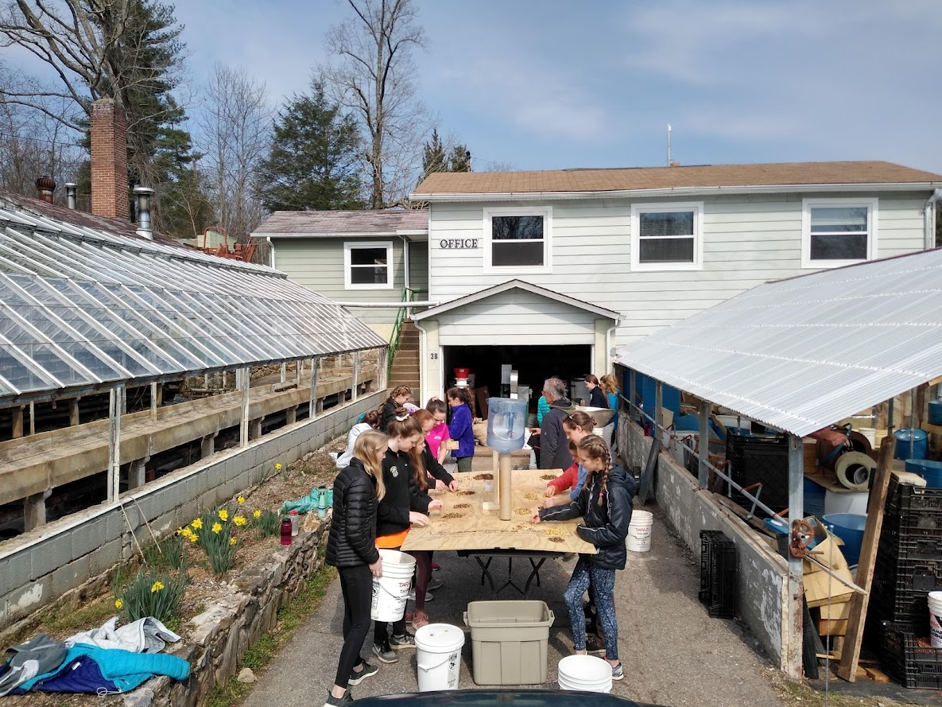
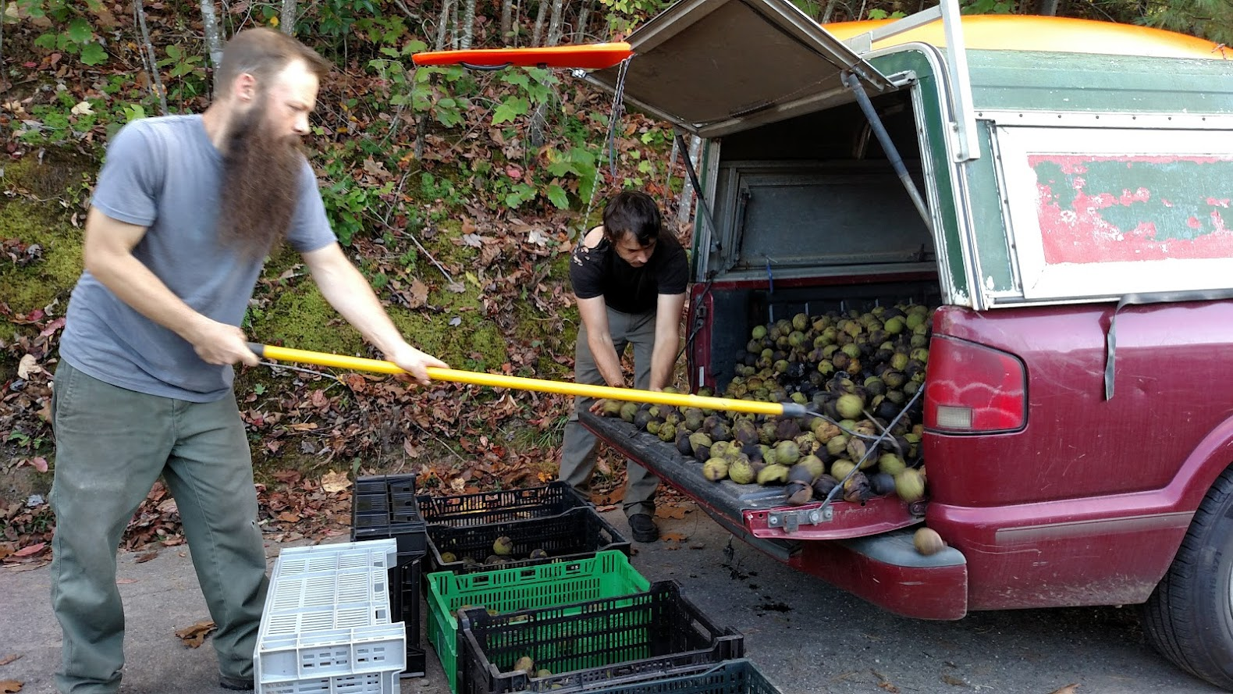

Slide 8
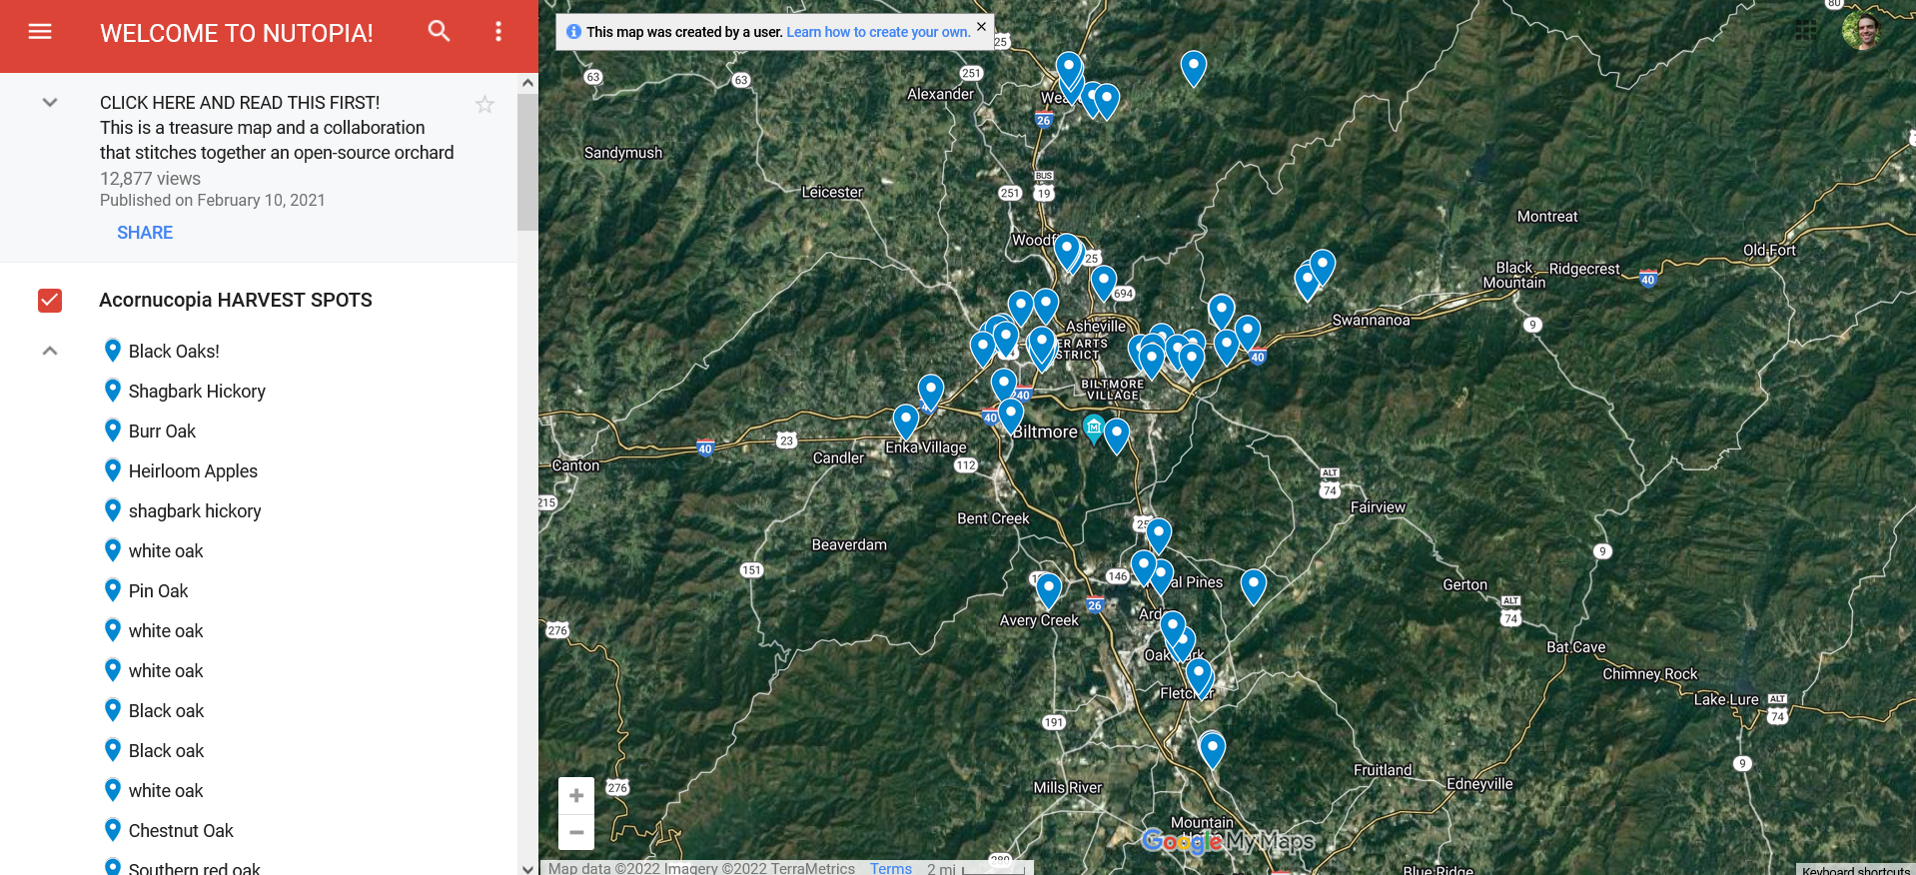
Acornucopia Project and Asheville Nuttery

Slide 9
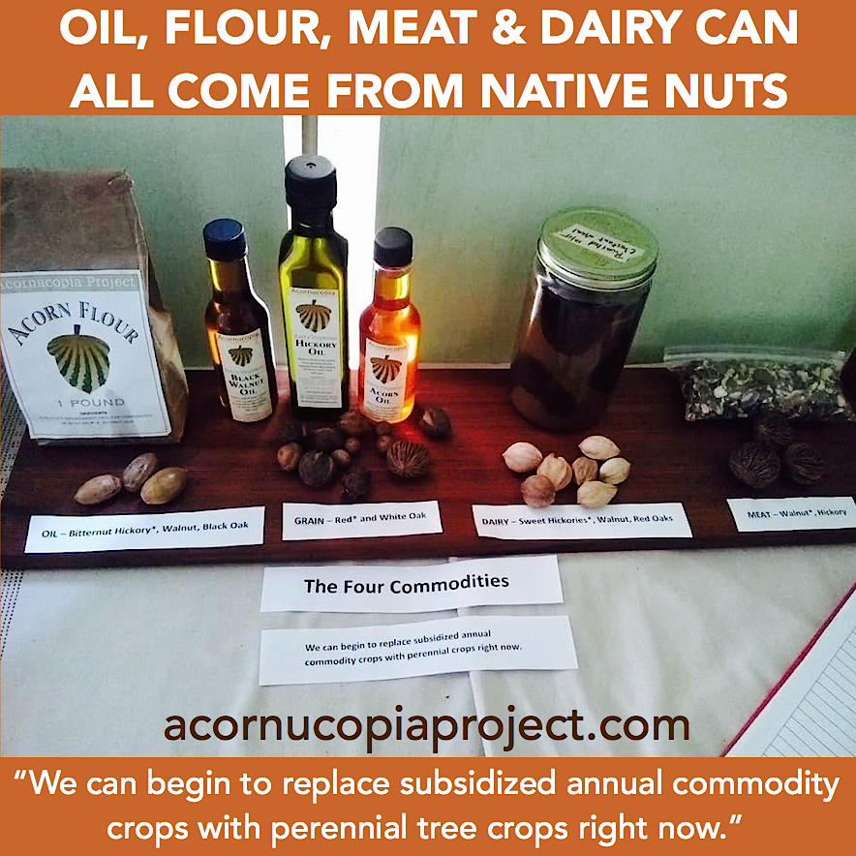

Slide 11
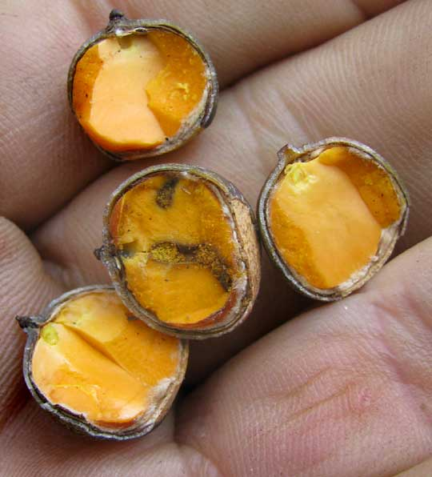
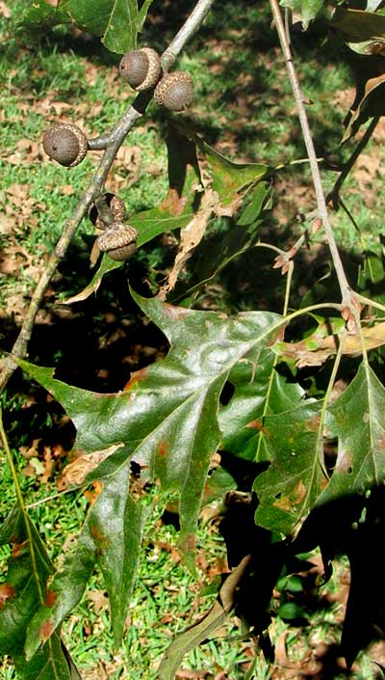
Oil Oaks
(Black, S. red, pin, water, shingle, others)

Slide 12
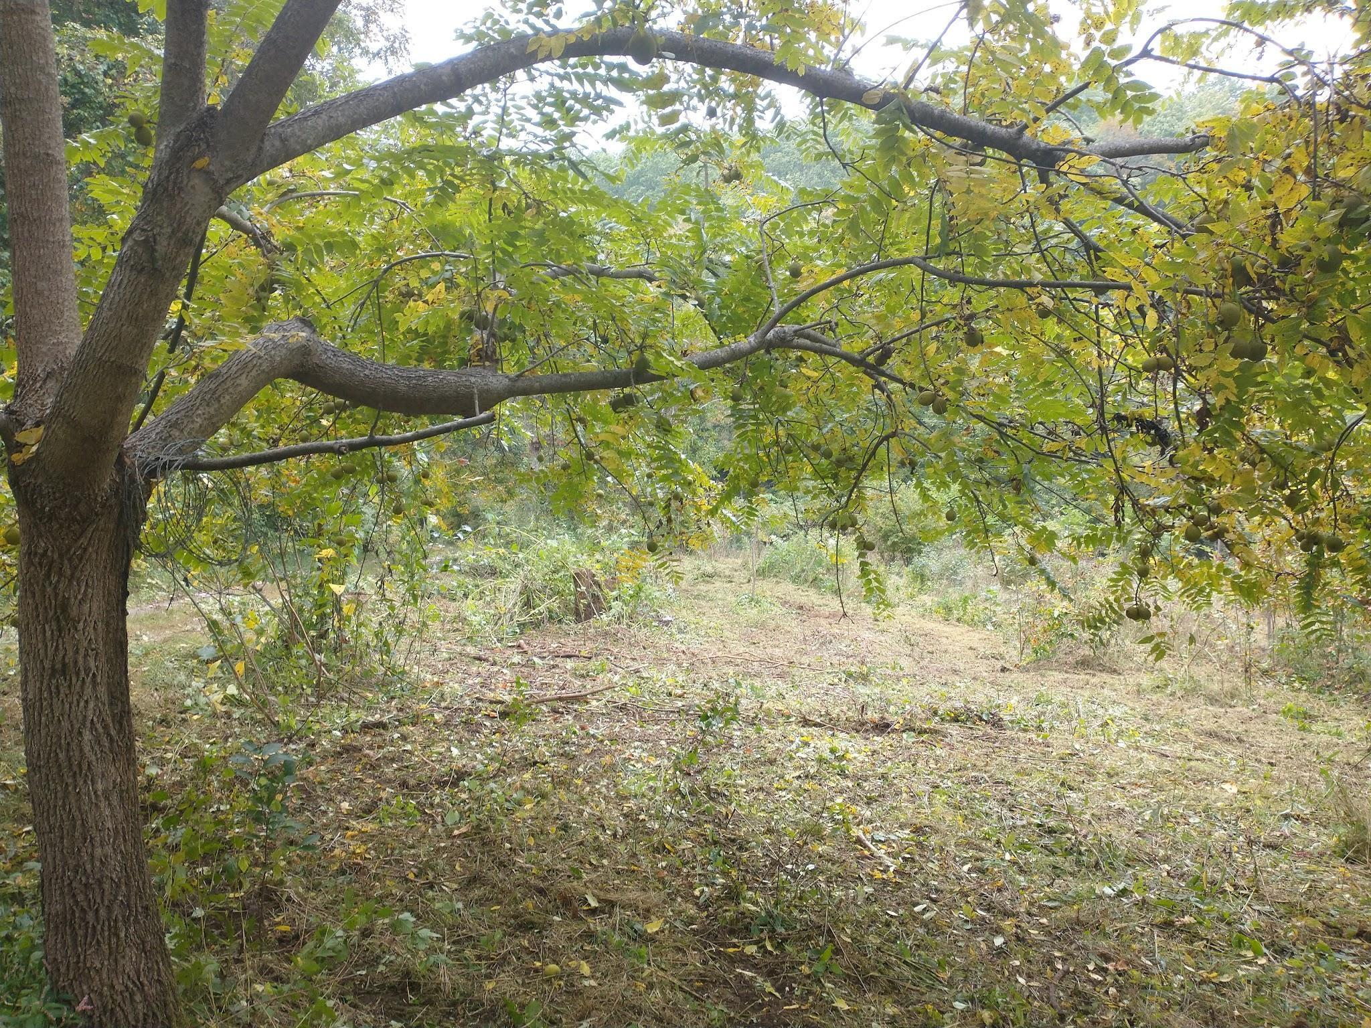
Black walnut
Juglans nigra

Slide 13
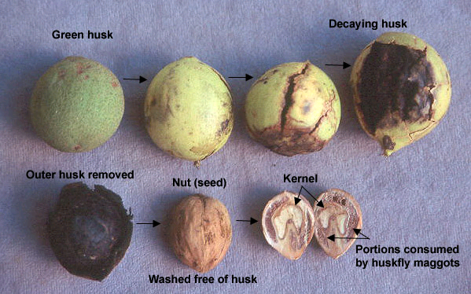

Slide 14
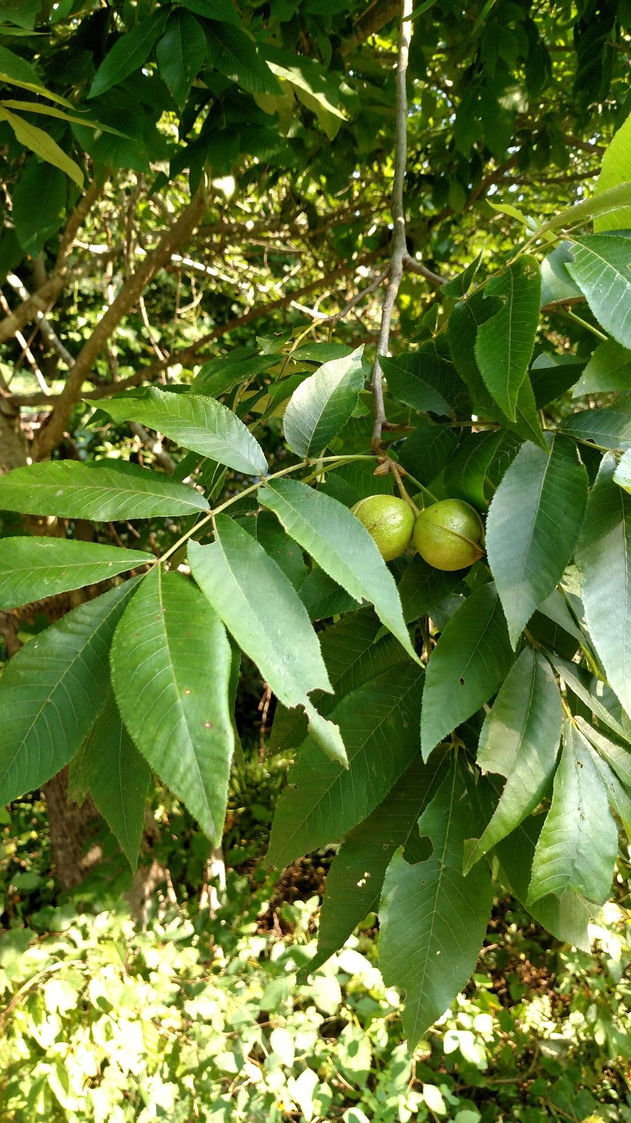
Bitternut hickory (Carya cordiformis)

Slide 15
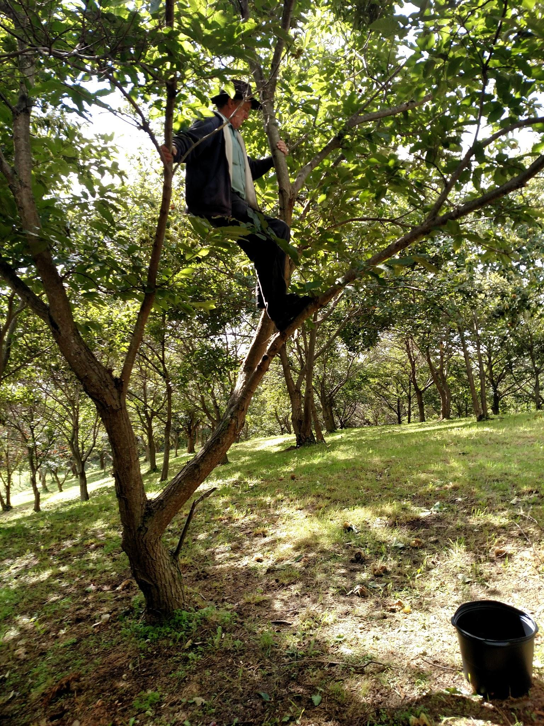
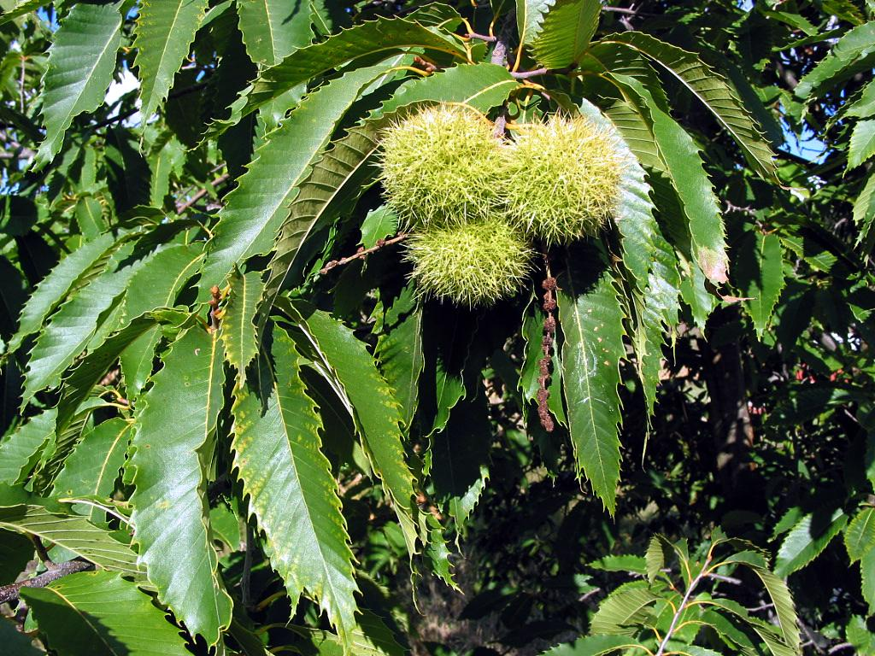
Chestnut species and hybrids

Slide 16
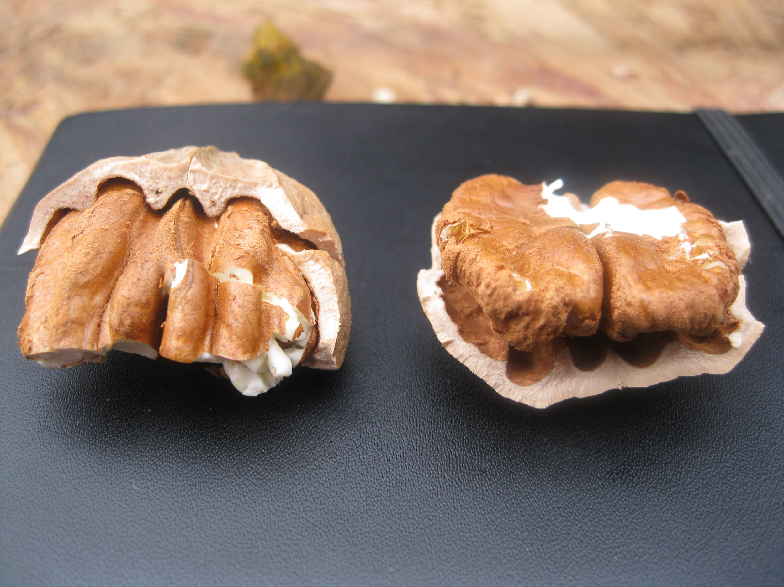
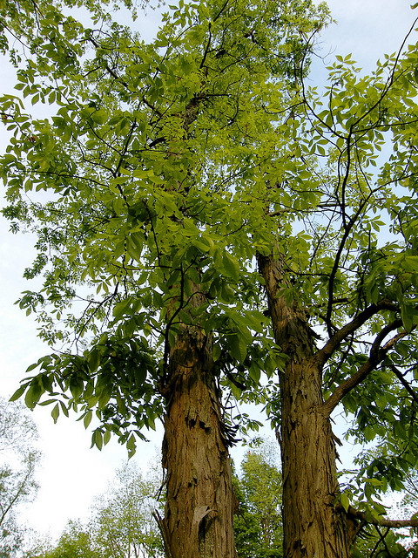
‘Grainger’ Shagbark hickory
(Carya ovata)

Slide 17
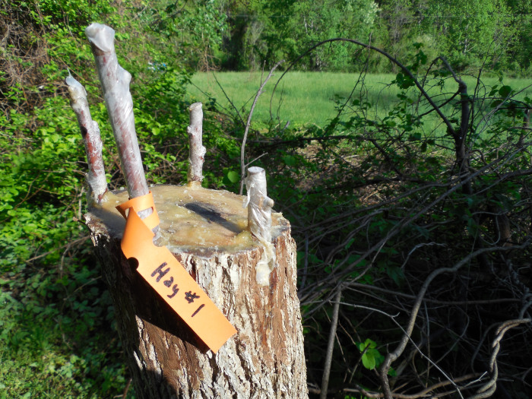
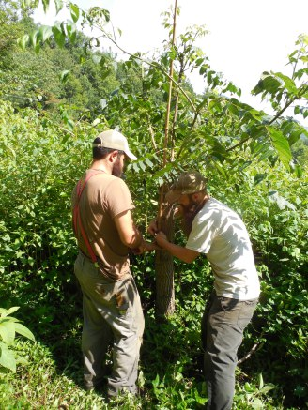
Grafting improved selections to increase yield and commercial viability of native nut trees

Slide 18
You’ve Gotta Be Nuts: Visions of Nutopia Now
I.
Cultural and Culinary
Delicious
Nutritious
Terroir
Seasonal
Celebratory
Place-making and cultural preservation
II.
Ecological and Adaptive
Climate: both adaptation and mitigation
Ecologically sound and regenerative
III. Communitarian
Land tenure
Regionally networked, community-scale nut mills
Commons and commoning

Slide 19
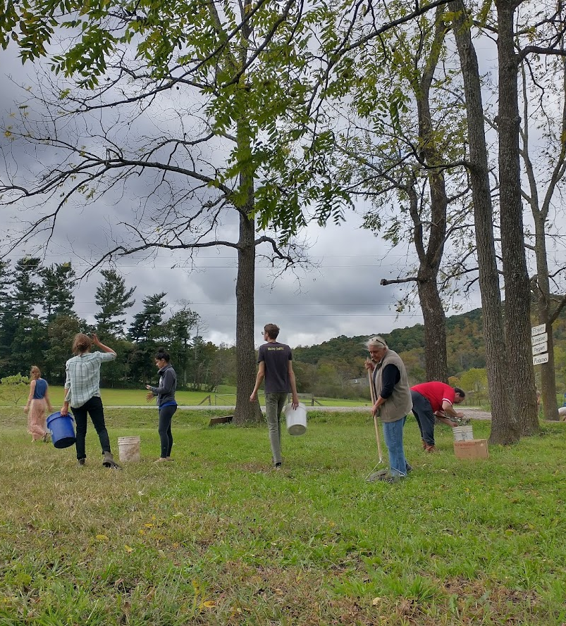
ASHEVILLENUTTERY.COM
ASHEVILLENUTTERY@GMAIL.COM

