Slide 1
Blair South Bypass
NADO Regional Transportation Conference
Metropolitan Area Planning Agency (MAPA)
July 2024

Slide 2
MAPA Background
Council of Governments
79 Members across six counties
9-member Board of Directors composed of local elected officials

Slide 3
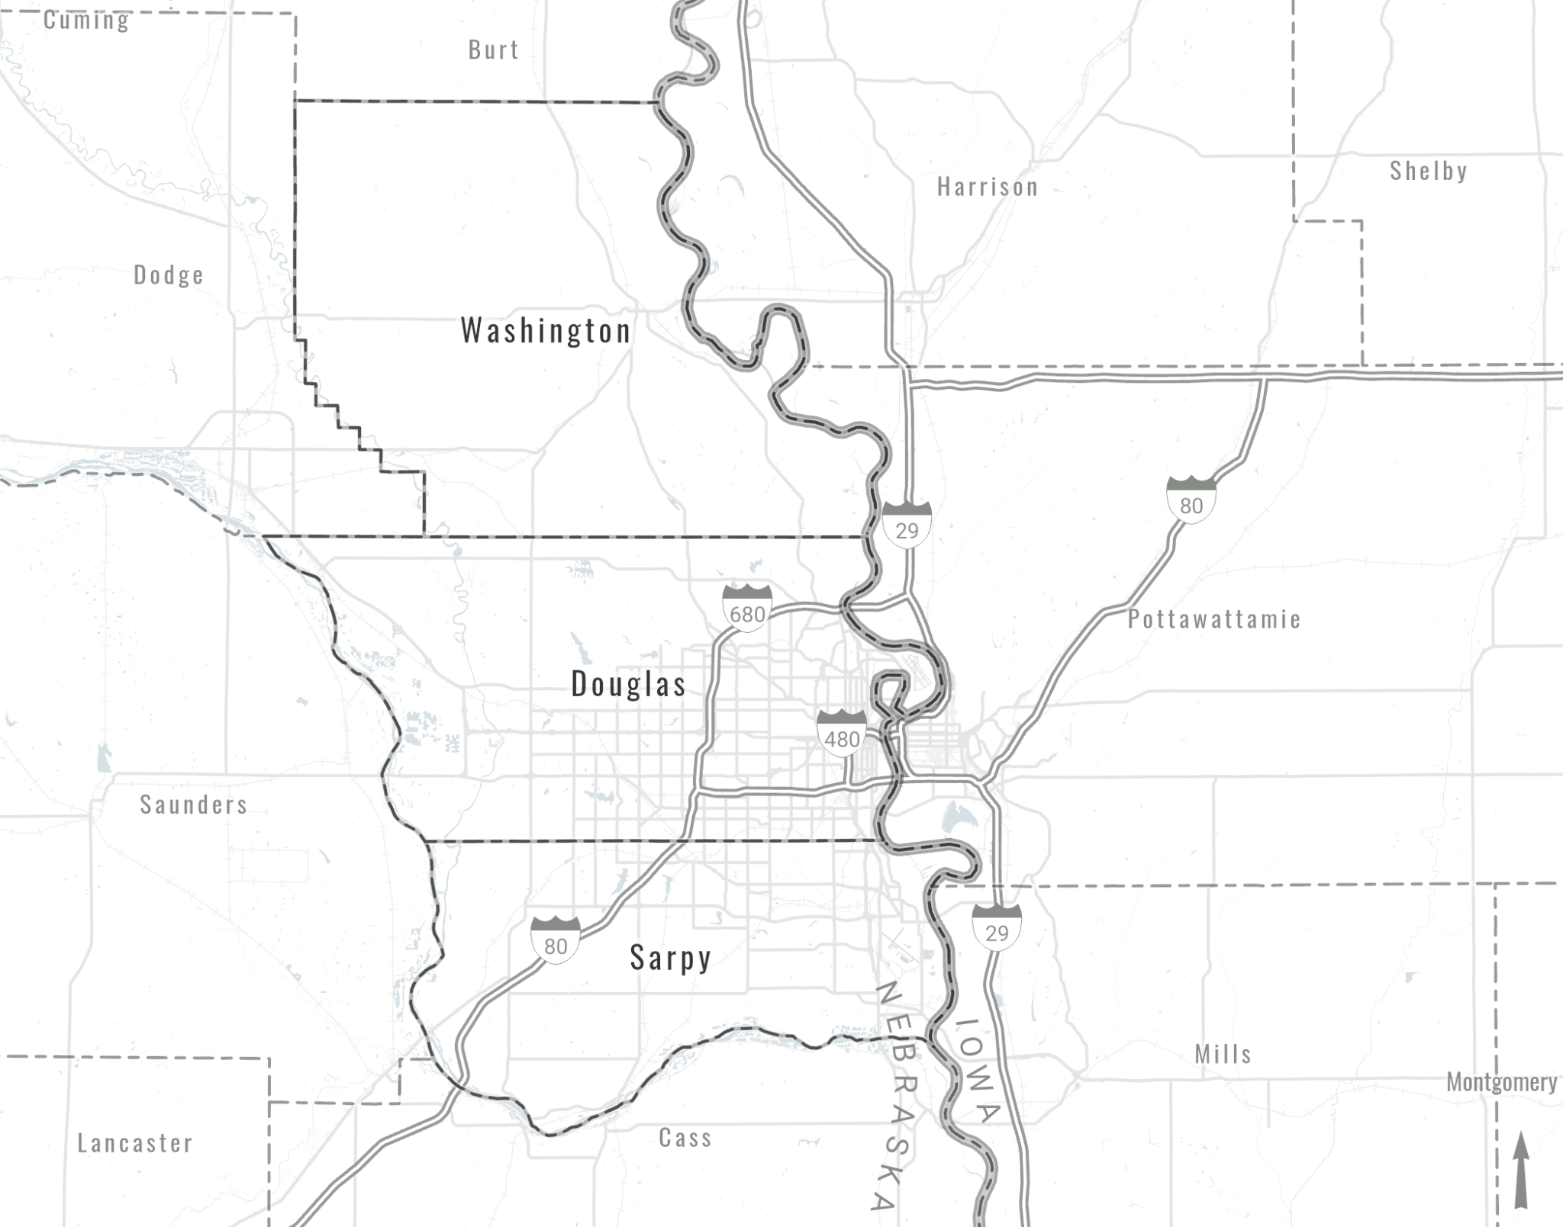
City of Blair, NE
25 Miles North of Omaha
Pop: 7,962 (2022)
US Highways 30 and 75
City of Blair
Omaha
Council Bluffs
Bellevue

Slide 4
City of Blair
City of Blair
■ MAPA TMA
■ PartialTMA
■ RPA-18
Metropolitan Planning Organization (MPO)
Transportation Planning
Regional Funding
Technical Assistance
Economic Development District (EDD)
Community Development
Disaster Recovery
Infrastructure

Slide 5
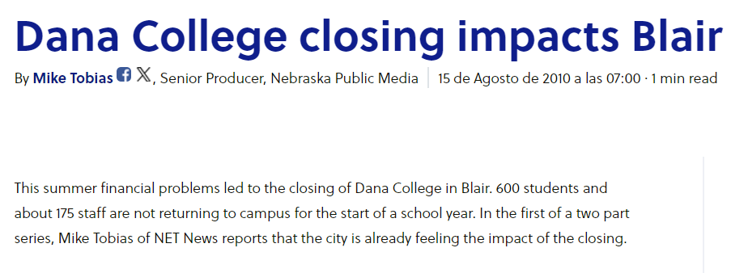
Economic Stresses

Slide 6
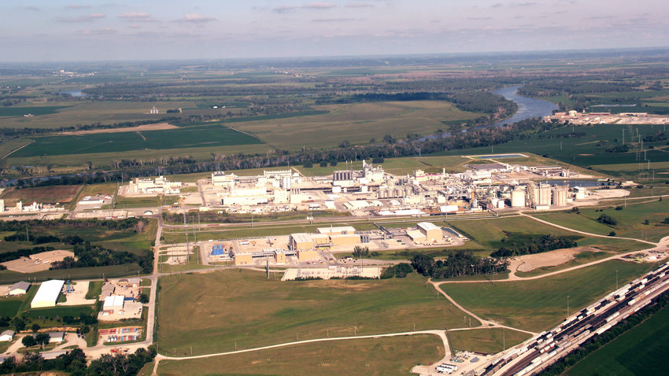
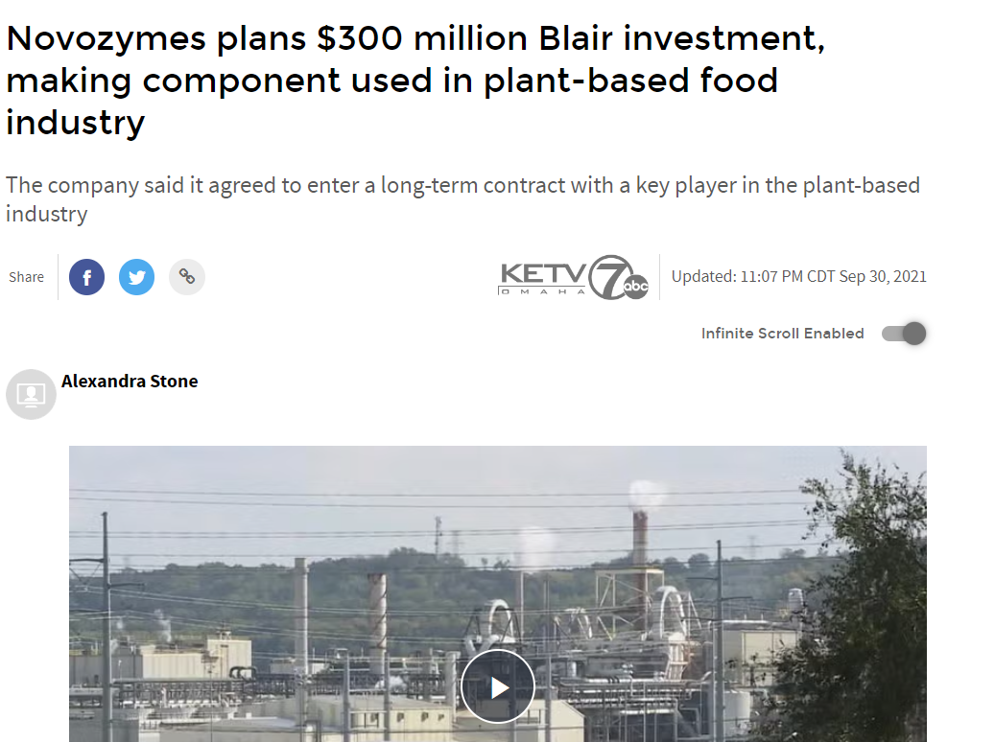
Economic Development
Cargill Biocampus - Blair, NE

Slide 7
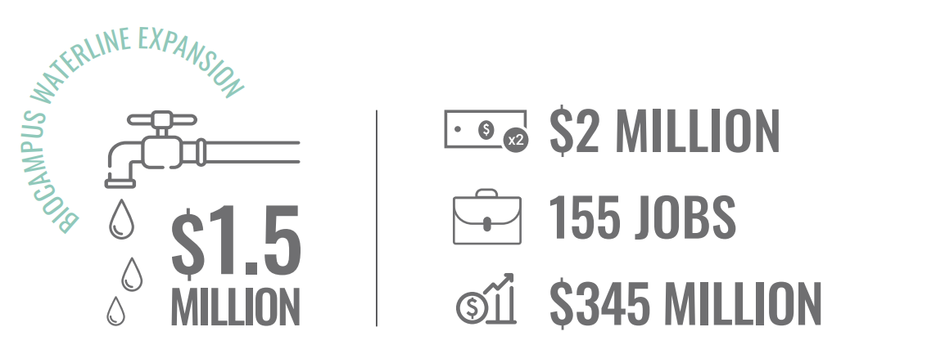
Blair South Bypass
Rural Workforce Housing Fund | Dana Suites

Slide 8
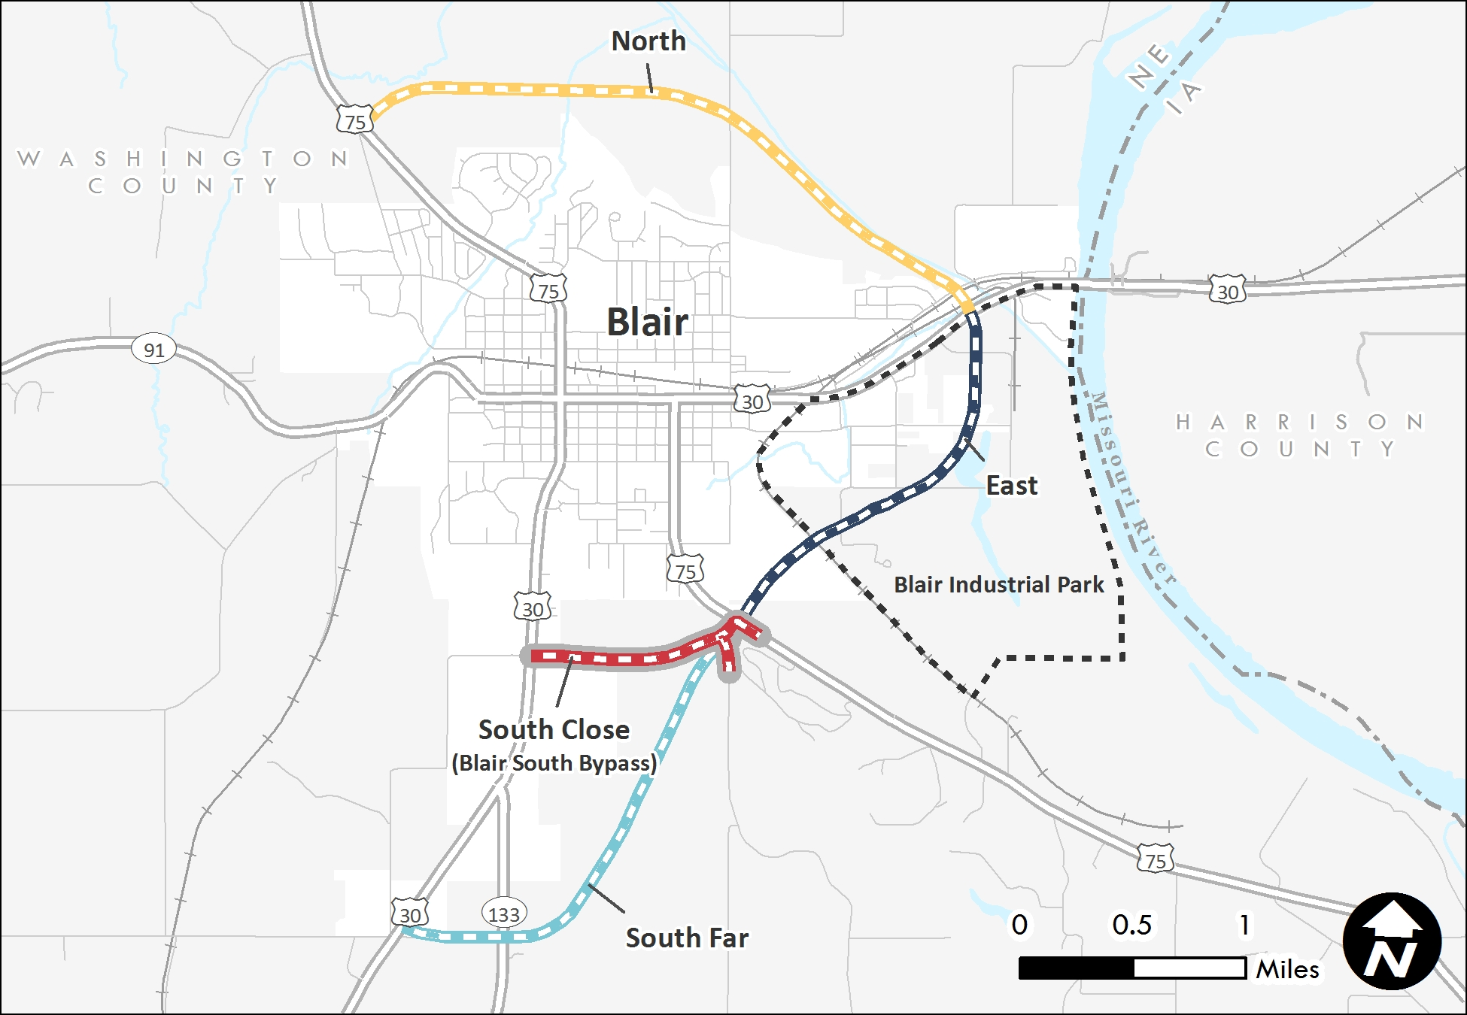
Blair Bypass Alternatives
Transportation Plan (2004)
Initially advanced as an EIS
South Bypass advanced independently beginning around 2012

Slide 9
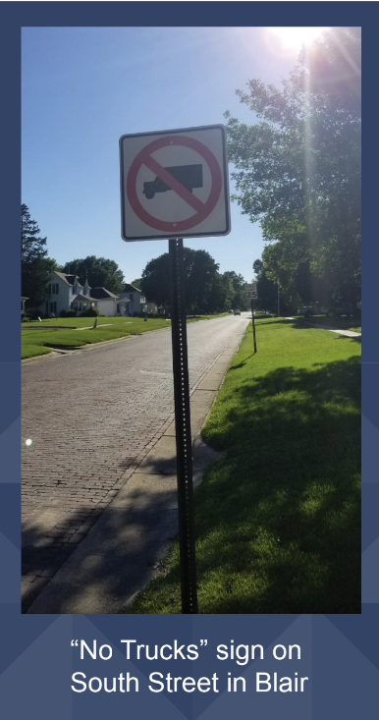
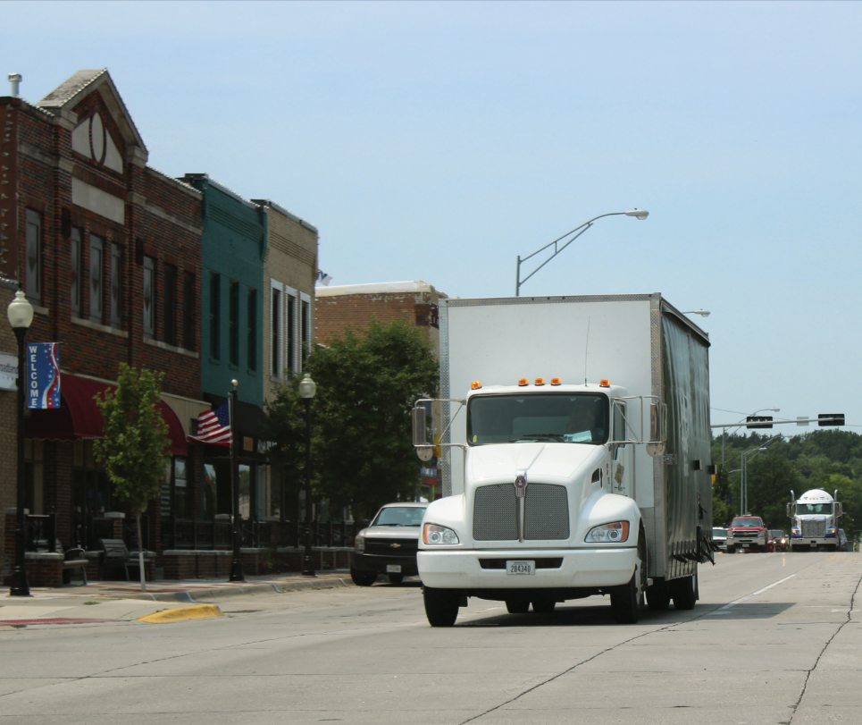
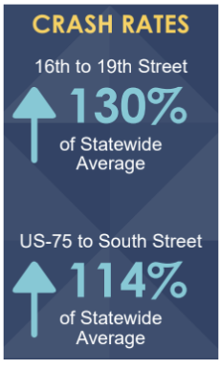
Freight Conflicts & Traffic Safety
Washington Street - Blair, NE

Slide 10
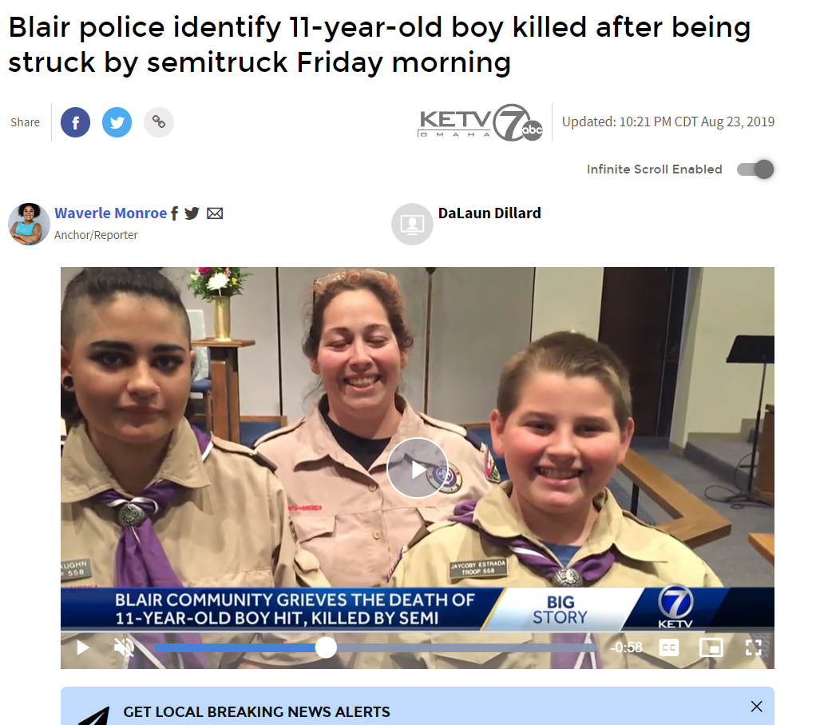
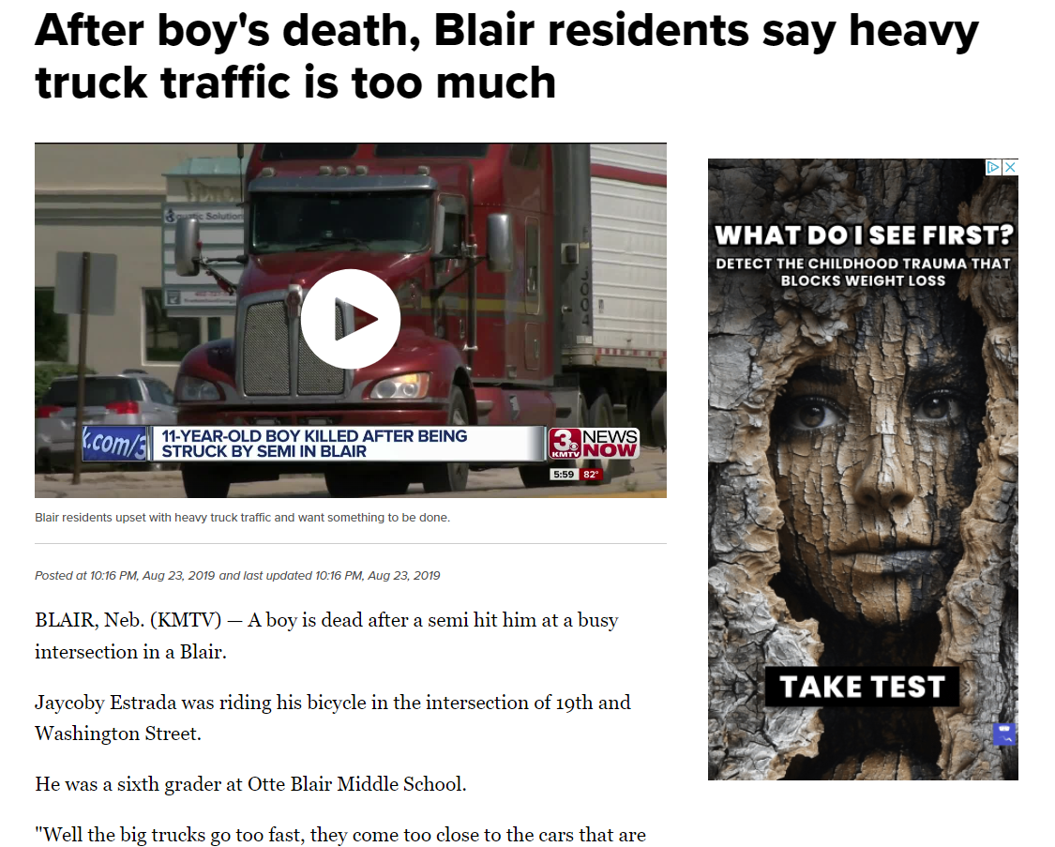
Jaycoby’s Death

Slide 11
Project Elevation | Super 2

Slide 12
Blair South Bypass
Opening Day | August 2024

Slide 13
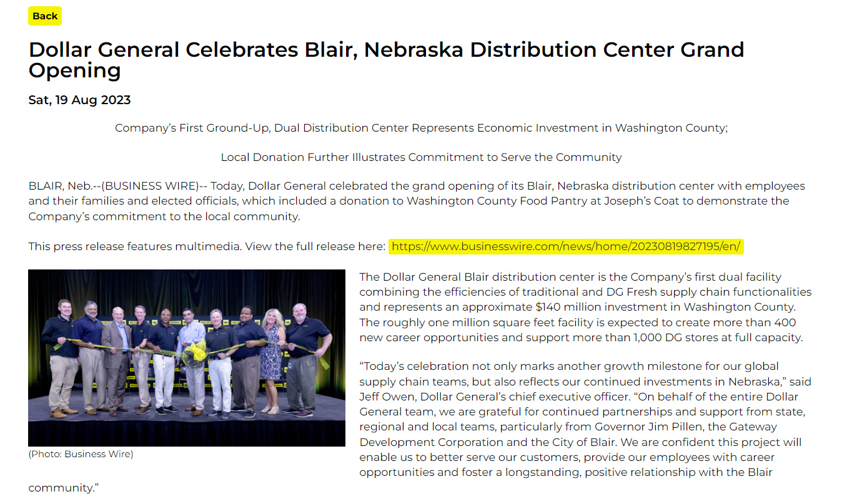
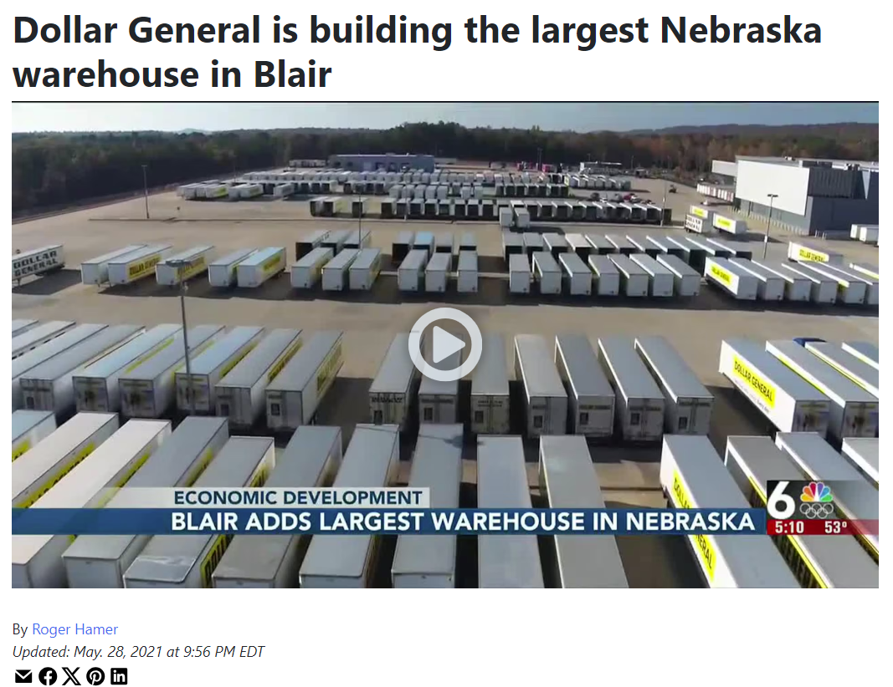
Economic Development Success

Slide 14
What’s Next?
Revisiting the Blair Transportation Plan
Washington Street
Complete Streets Approach
Blair North Bypass
Railroad Conflicts
Future Industrial Site Locations
North Bypass
Washington Street
Rail Conflicts

Slide 15
Thank You!
Michael Helgerson
Executive Director
mhelgerson@mapacog.org
402-444-6866

