Slide 1
EXAMPLE Measuring Graduate Outcomes
Outcome: High School students will complete their degrees on-time
Indicator: Percent of students graduating on-time
School District | Baseline | Targets (State Goal) |  |  | Current Year
 | 2018 | 2020 | 2026 | 2035 | 2023
Beaufort | 86.0% | 83.8% | 86.3% | 90.0% | 87.2%
Colleton | 85.0% |  |  |  | 75.9%

Slide 2
EXAMPLE Measuring Graduate Outcomes
Question: What do schools in Colleton County School District do to improve on-time high school graduation rates?
We know and believe that… | doing these… | will help us get there.
75.9% of students in Colleton County School District graduated on time. But this figure doesn’t meet the baseline and the 2020 state goal. |  | High School students completing their degrees on time. Benchmarks 2026: 86.3% 2035: 90.0%
?
Inputs | Activities | Outputs | Outcomes
? | ? | ? | ?

Slide 3
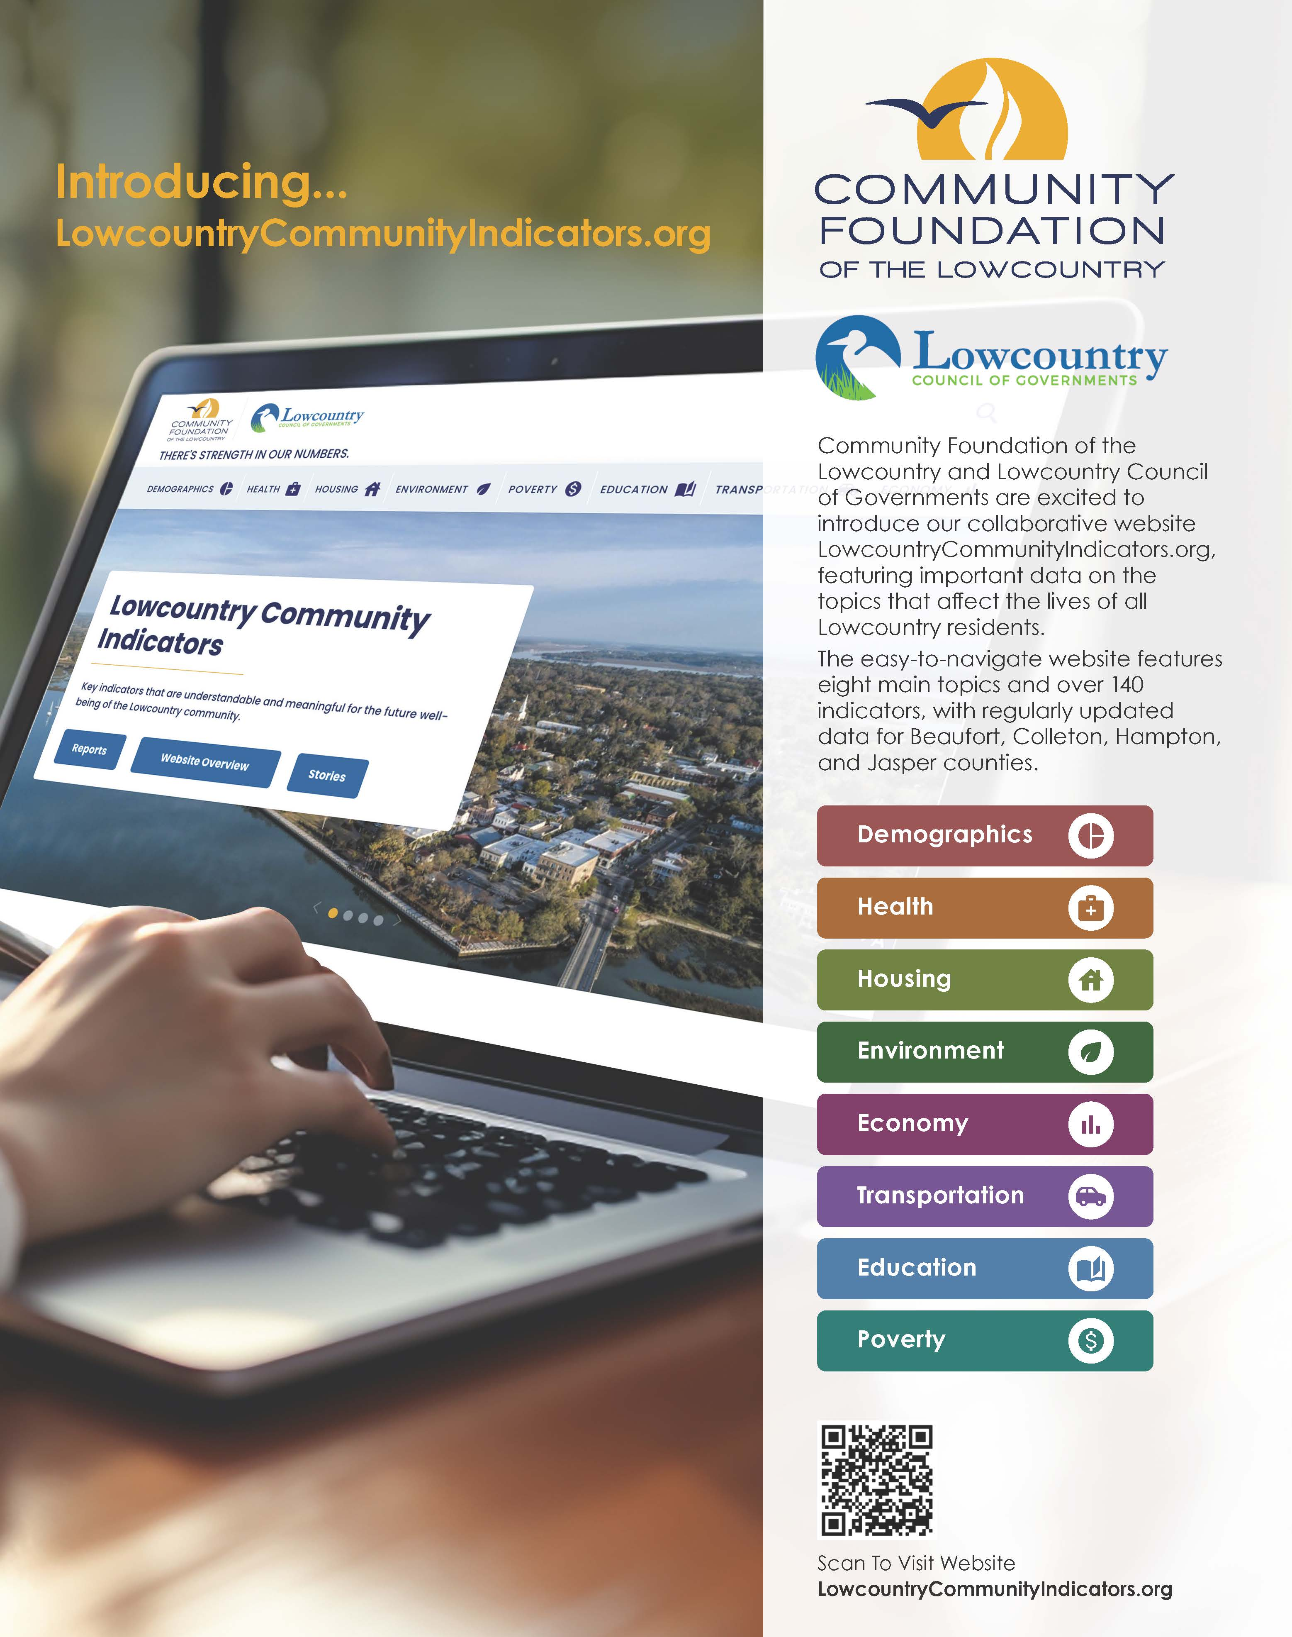
THANK YOU Maleena Parkey, PhD mparkey@lowcountrycog.org www.lowcountrycommunityindicators.org

