Slide 1
Marketing Safety & Systemic
Kevin Elliott, Marketing Manager

Slide 2
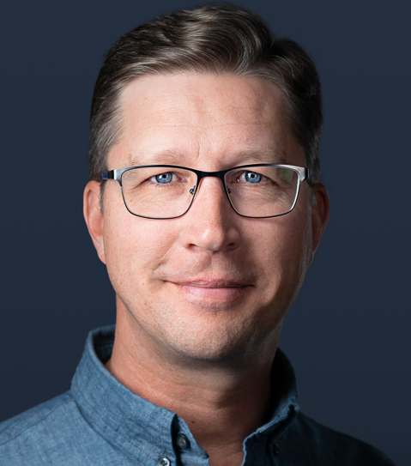
Kevin Elliott
Lives in Panama City, FL
MS, Corporate & Public Communication
Marketing Background
Raises Chickens

Slide 3
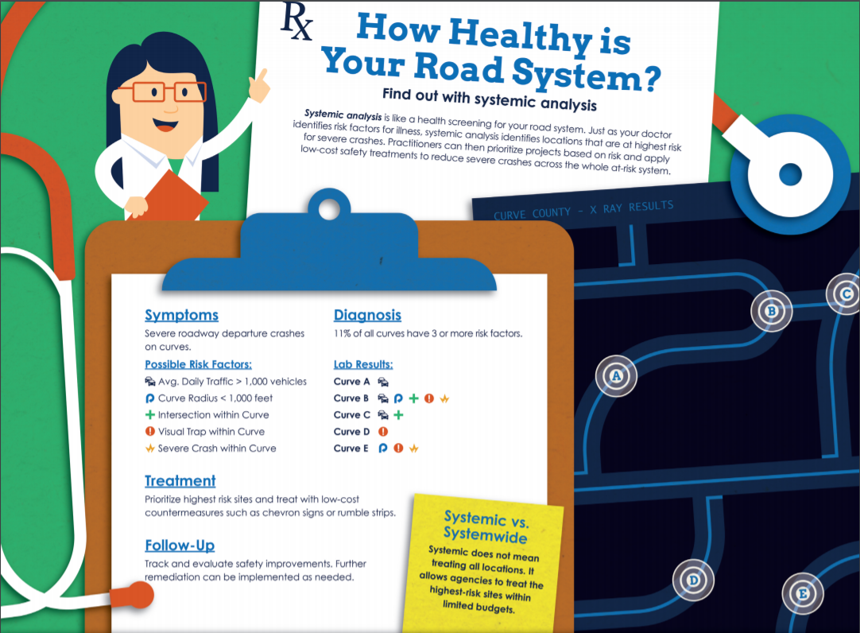
Marketing Safety & Systemic
Start With Why
Visualize
Use Analogies
Two Marketing Words

Slide 4
Start With Why

Slide 5
Start With Why Simon Sinek
What
Why
How
What
Why

Slide 6
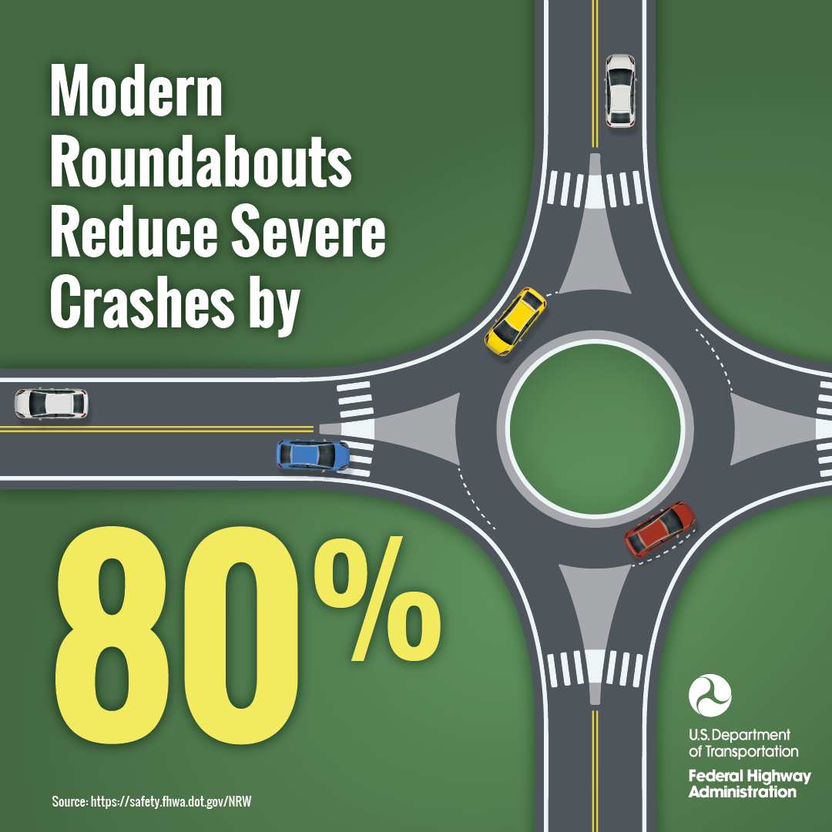
Example: Roundabouts
What
Why
How
What
Why

Slide 7
Visualize

Slide 8
How do you visualize LRSPs?!

Slide 9
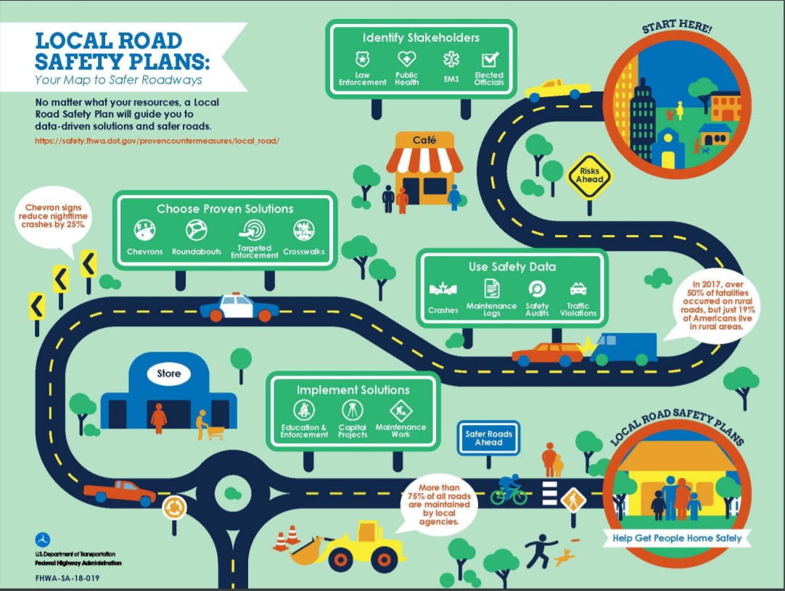

Slide 12
Use Analogies

Slide 13
Smoking

Slide 14
Two Marketing Words

Slide 15
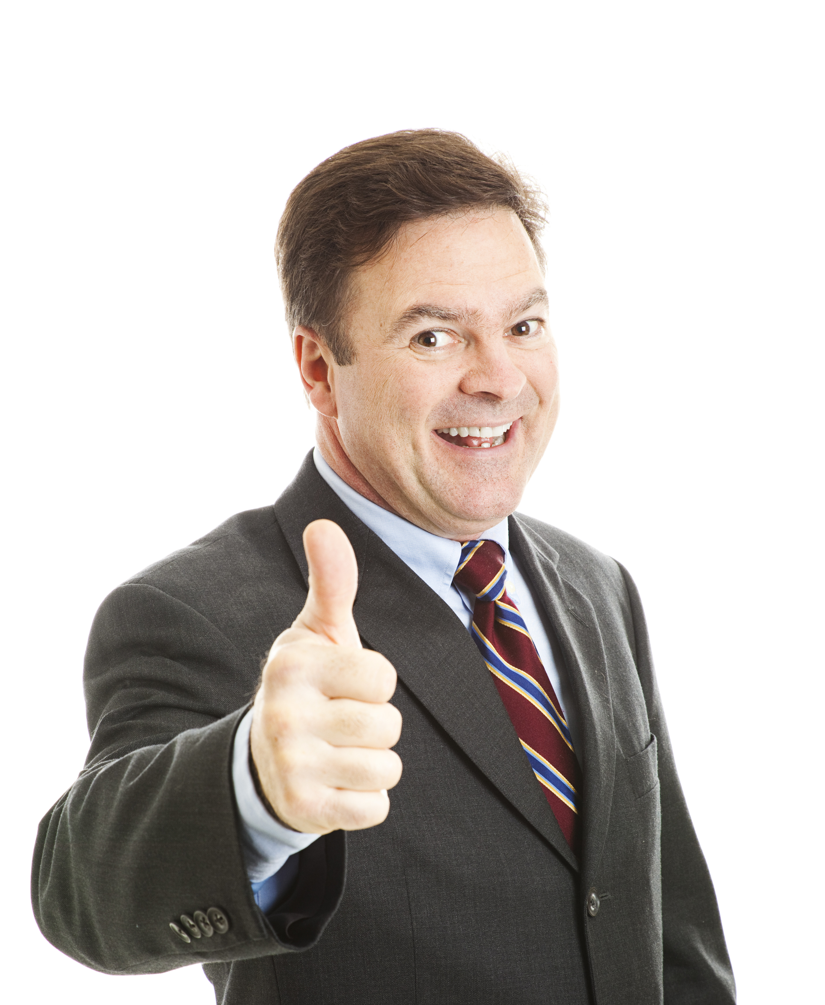
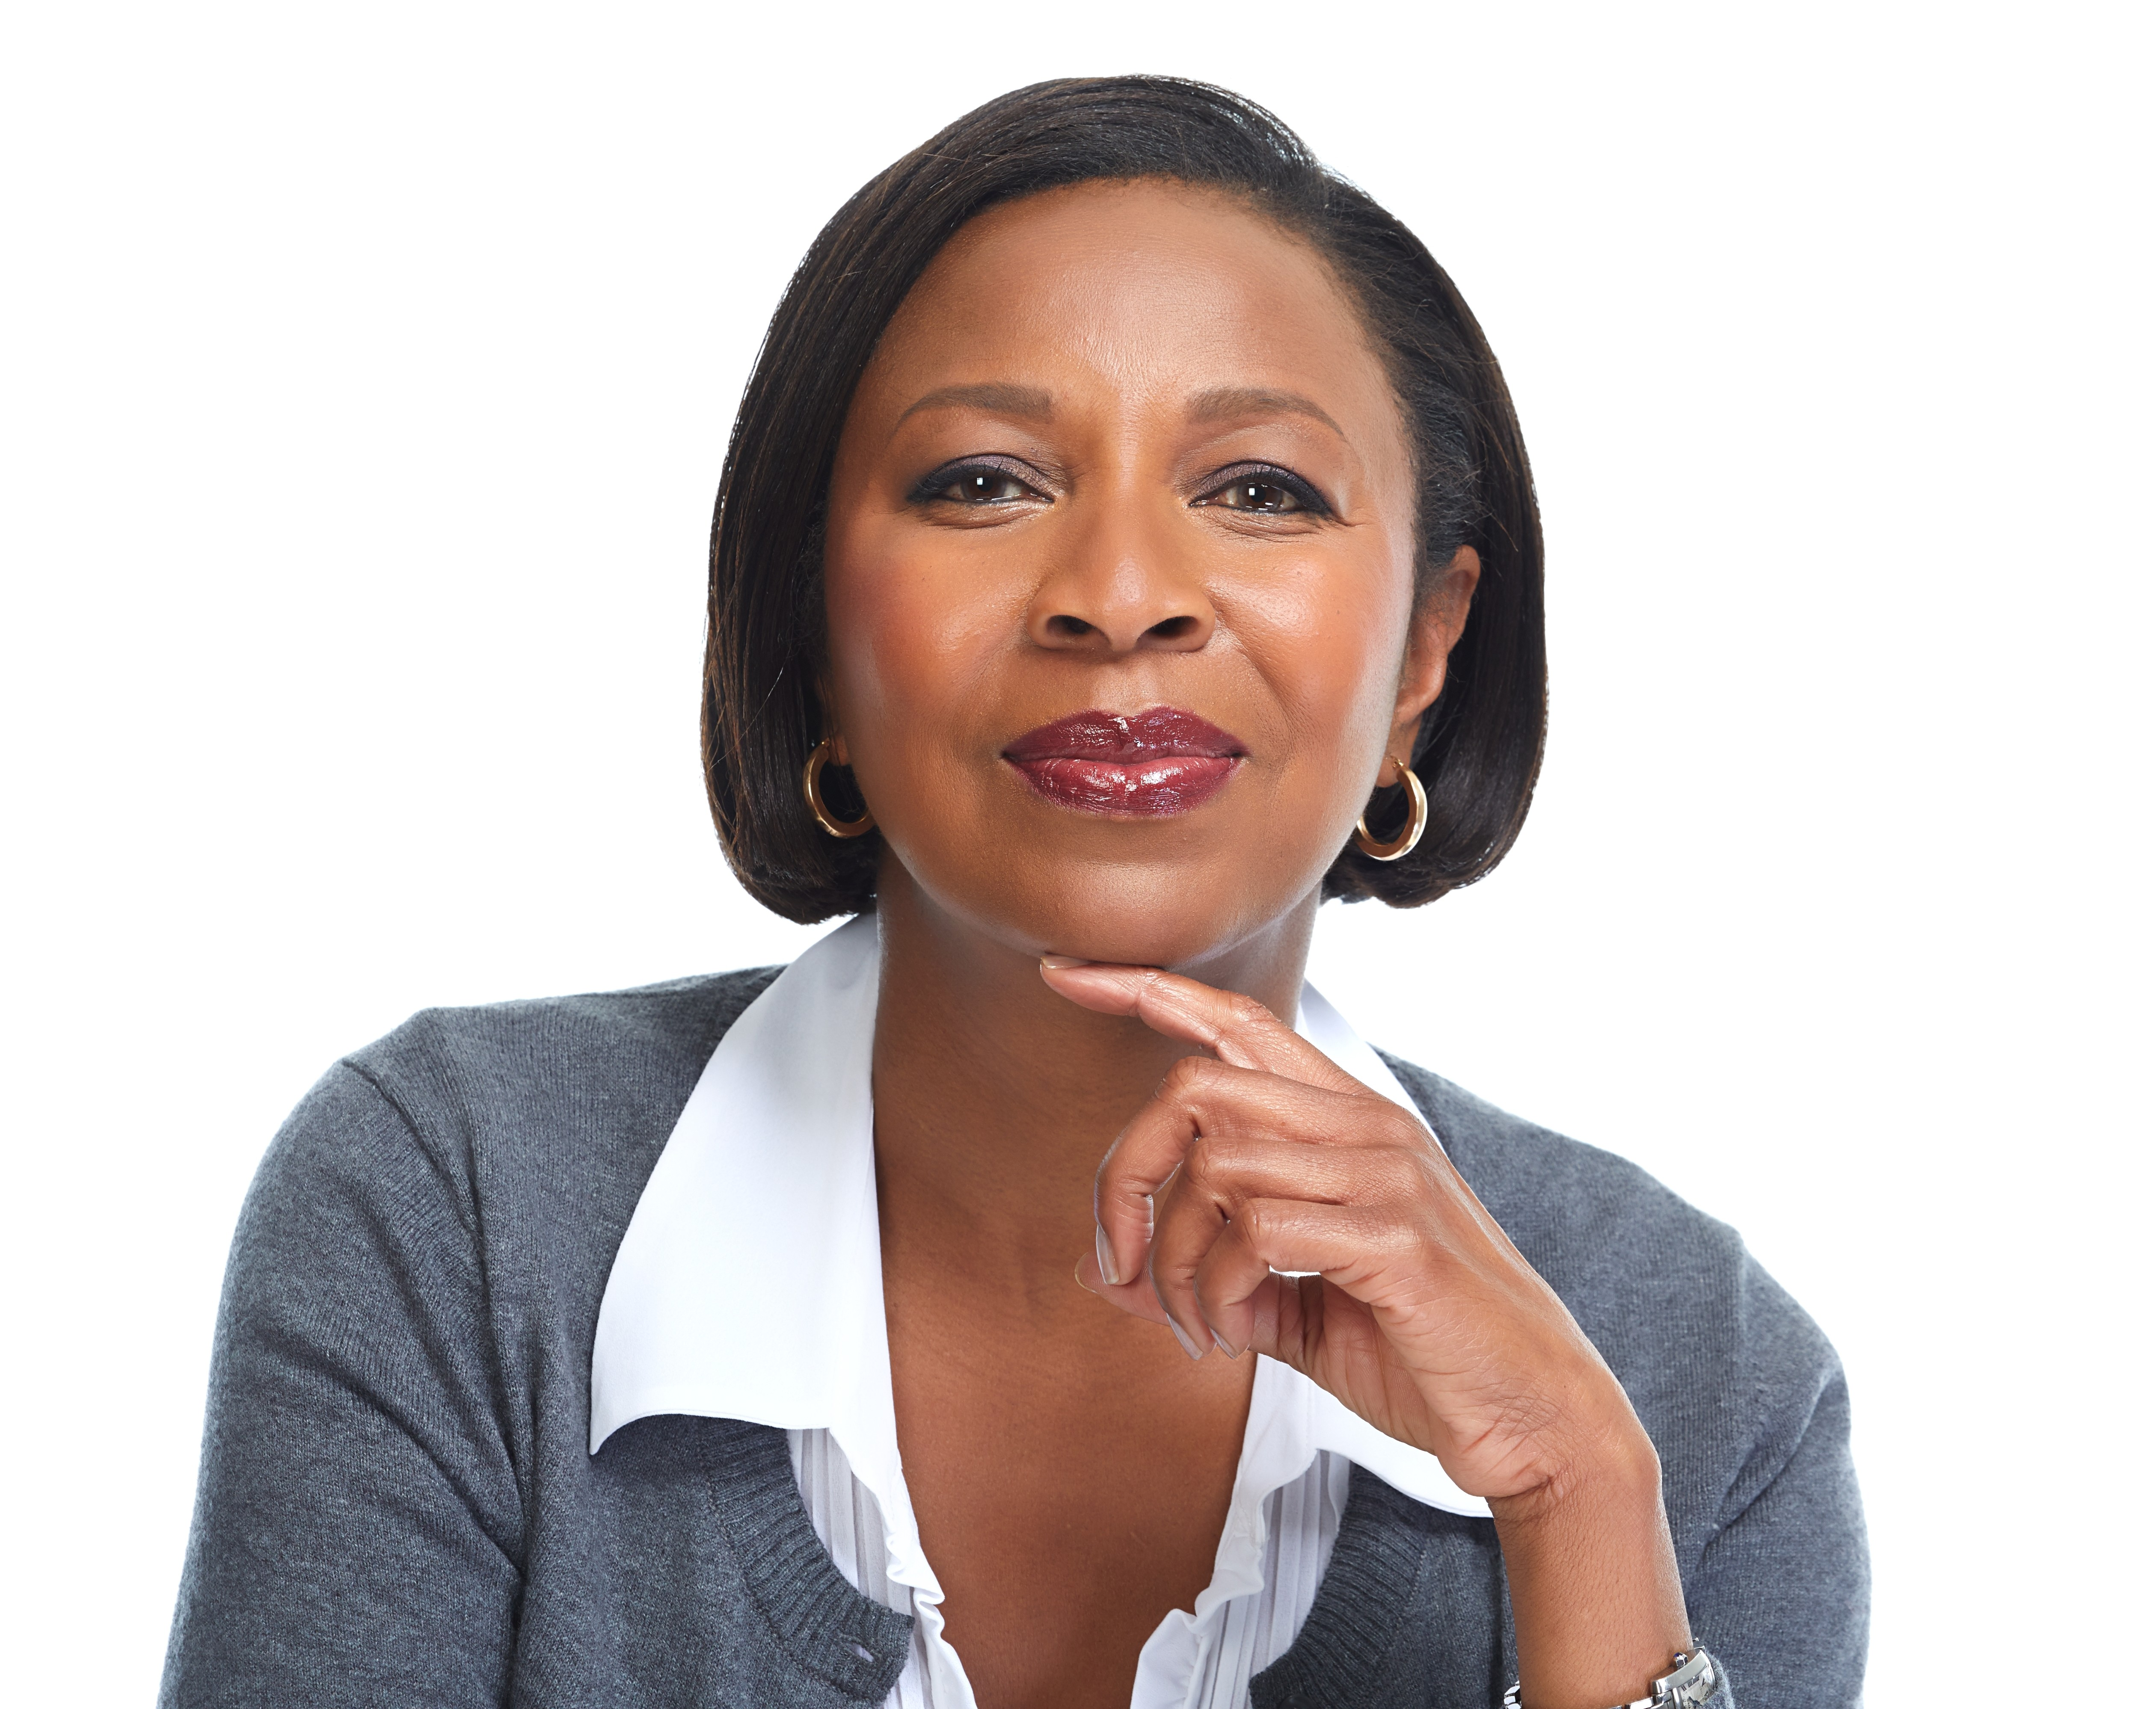
Two Marketing Words
Reach
Frequency
Message
Message |
Message
| Message

Slide 16
How Long Does This Take?!

Slide 17
Smoking

Slide 18
Integrated Marketing Communication
Consistent messages, multiple channels
Conversation vs. Campaign
No “silver bullet” thinking
The larger the ask, the longer the task (decades, not years)
Message
Message
Message

Slide 19
Free Stuff

Slide 20
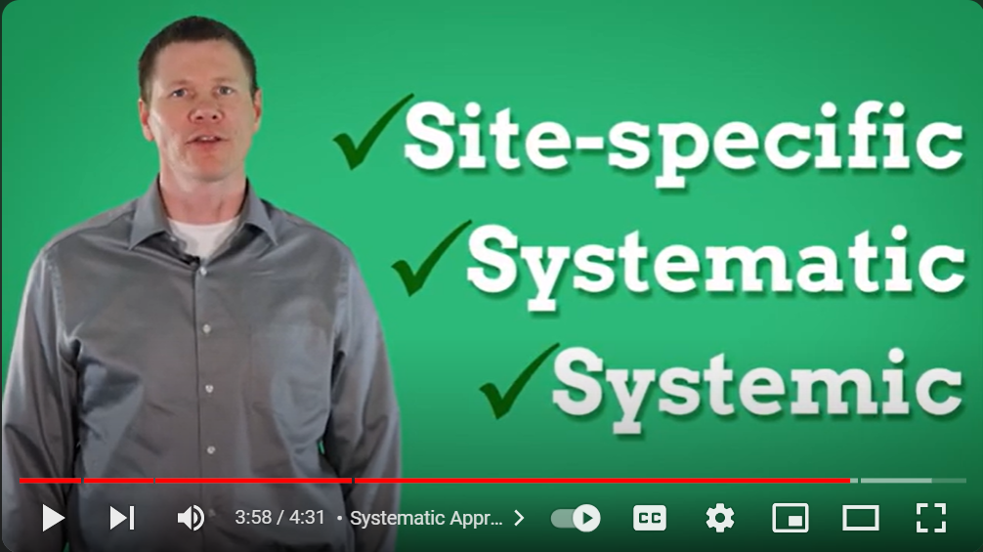
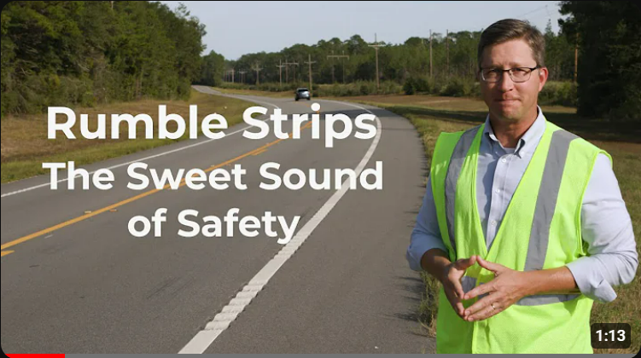
Take our stuff

Slide 21
Marketing Safety & PSAs
Start With Why
Visualize
Use Analogies
Two Marketing Words

Slide 22
Questions?
Kevin Elliott, Marketing Manager kevin@ruralsafetycenter.org

