Slide 1

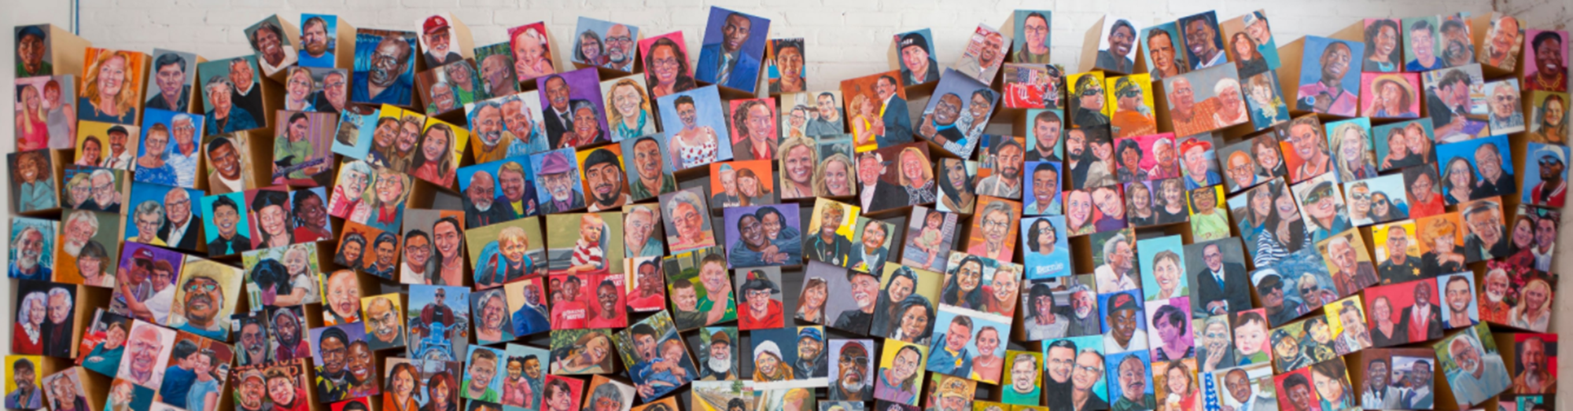
Introduction to Heart & Soul
Creating a Community Planning and Development Measurement Tool
NADO Wealth Creation Summit
Greenville, SC – August 2, 2024
Notes:
Introduction – Alexis Halbert

Slide 2
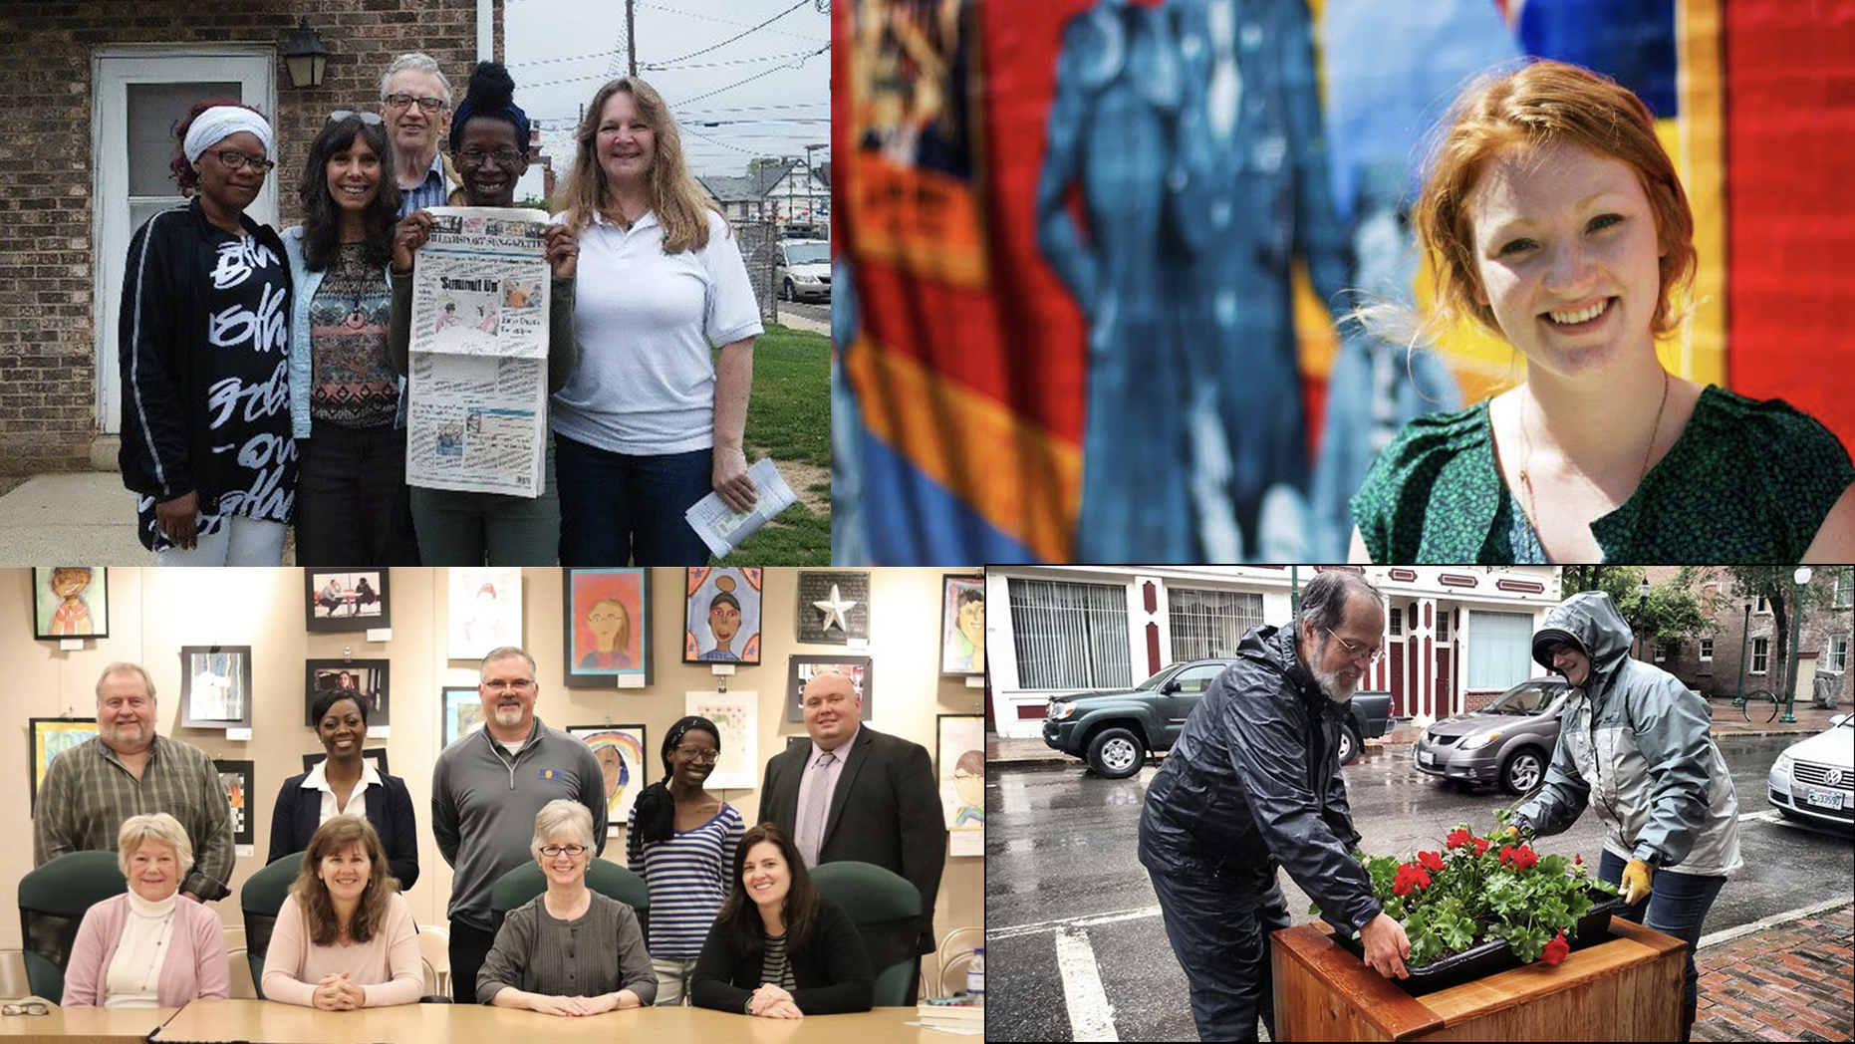

What You’ll Hear About Today
What You’ll Hear About Today
Overview of Community Heart & Soul
community planning and development model
Impact Tracker Pilot –
Development and use of a participatory evaluation framework (2018 – 2020)
Evolution to the “Achievements Tracker”
(2023 - 2024)

Slide 3
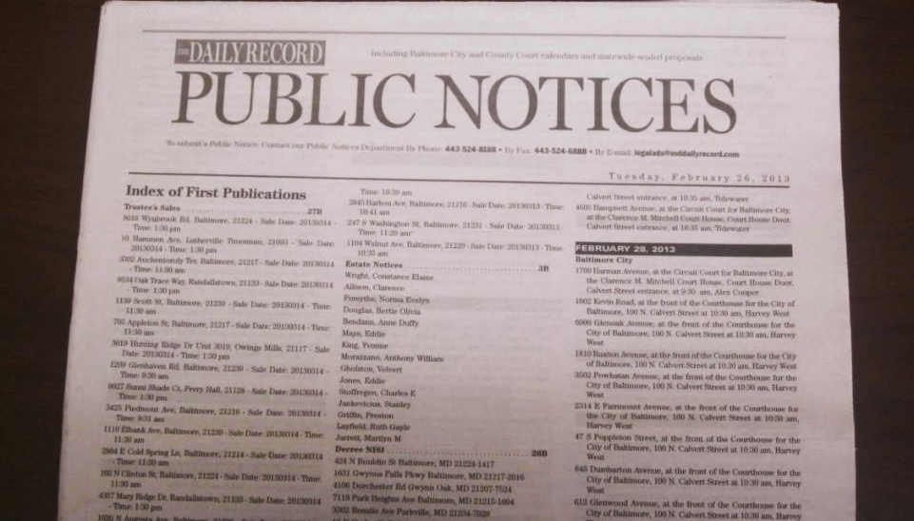
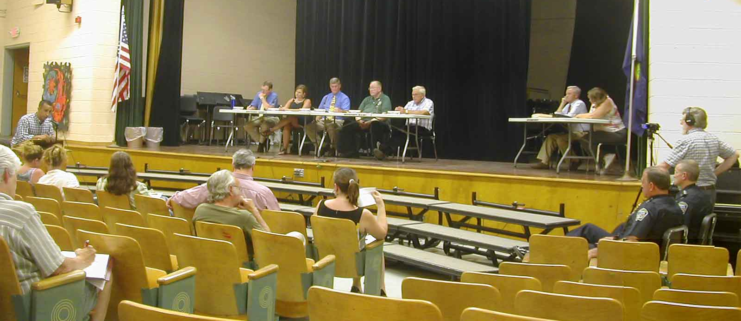
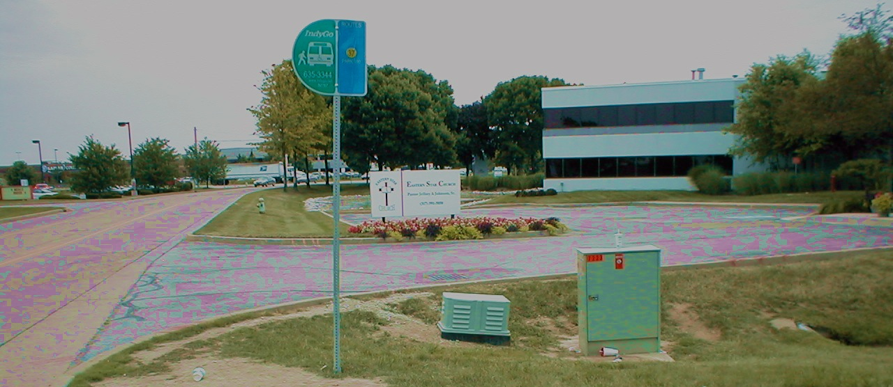
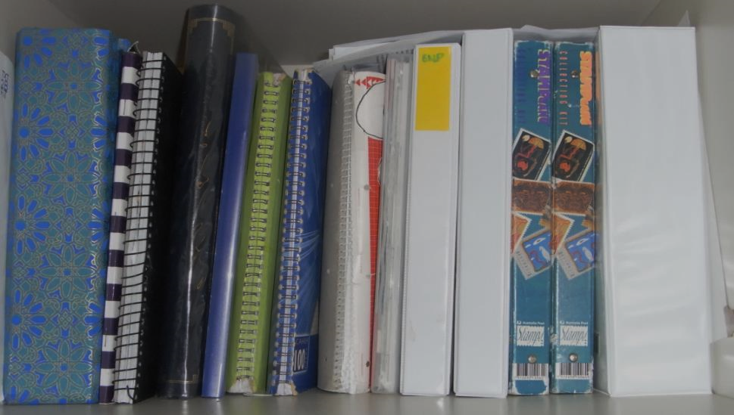

How Are Decision Made in Your Community?
How Are Decisions Currently Made in Your Community?
Notes:
Heart & Soul asks: Is community involvement and participation in planning all that it could be in your town?
The imagery in this slide is designed to prompt considerations about typical public engagement processes:
Rhetorical questions to ask participants: How well are some of these traditional forms of decision-making and planning processes working in your community? What’s missing from these approaches?
When decisions need to be made about something like zoning and development, who is involved and how does the process work?
Public notices are often issued in the newspaper or on a bulletin board to attend a meeting and provide input. Who are such notices designed to reach? How well do they work in drawing people in? What do they reveal about why people should care about these decisions? Public notices do not reach everyone.
Bottom right picture: Well-meaning and professional comprehensive plans too often sit on a shelf and don’t get implemented. Does this sound familiar? Why don’t these plans get implemented? Because very few people owned the ideas contained within or felt personally invested;
Top right picture: When people do show up at a public meeting, how do these events look and feel? Is there robust participation? Are they welcoming, interesting, focused, fun? What opportunities are there for input and dialogue beyond 3 minutes at the microphone? Do your meetings allow for people to contribute ideas in ways they feel comfortable communicating and getting their voices heard? Not everyone relishes standing in front of a crowd or talking across rows of people to a panel of people sitting at a table. Do people have a chance to get to know the other people who attend? Are meetings held at times and places that mostly work best for those putting on the event….or is there attention paid to making it work for those you’d really like to get input from?

Slide 4


Seed Grants
Years of Dedication, Research, & Practice
Community Heart & Soul®, a nonprofit organization, builds stronger, healthier, and more economically vibrant small cities and towns across the United States through the Community Heart & Soul model, a resident-driven process that engages the entire population of a town in identifying what they love most about their community, what future they want for it, and how to achieve it.
Notes:
More information about Seed Grants on Community Heart & Soul website.
Note: May want to customize this slide or make an additional slide listing other local, regional sources of funding

Slide 5
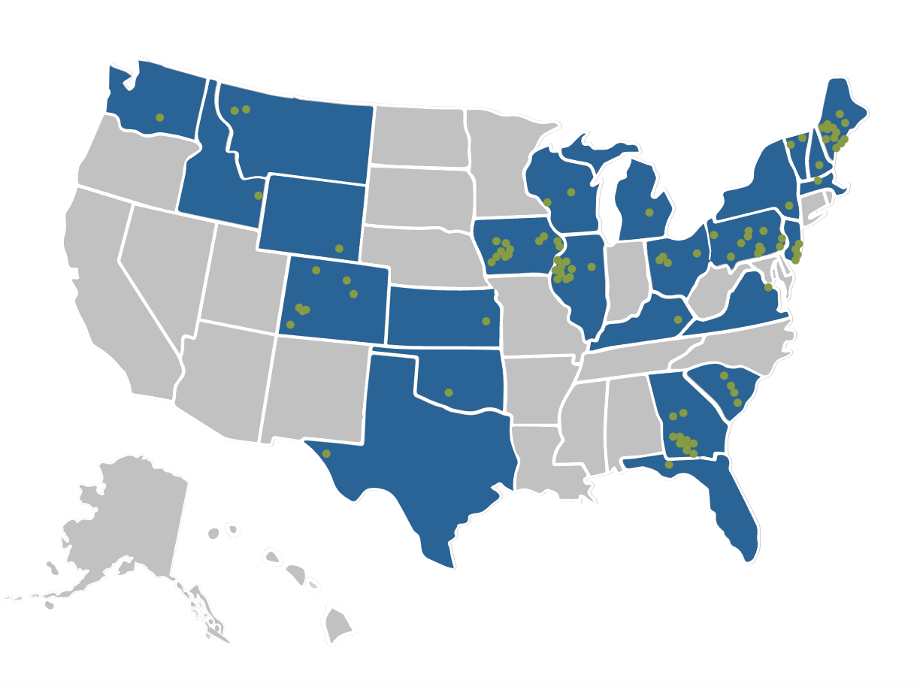
Heart & Soul Growth Across the U.S.
Heart & Soul Growth Across the U.S.
Notes:
Heart & Soul is a field-tested model over 20 years in the making, thoughtfully designed and tested, in small cities and towns across the country. CH&S is in action in 19 states and almost 100 communities.,
Video - Lyman Orton and what motivated him to create Heart & Soul. Youtube https://www.youtube.com/watch?v=udmrJp_IsFM

Slide 6
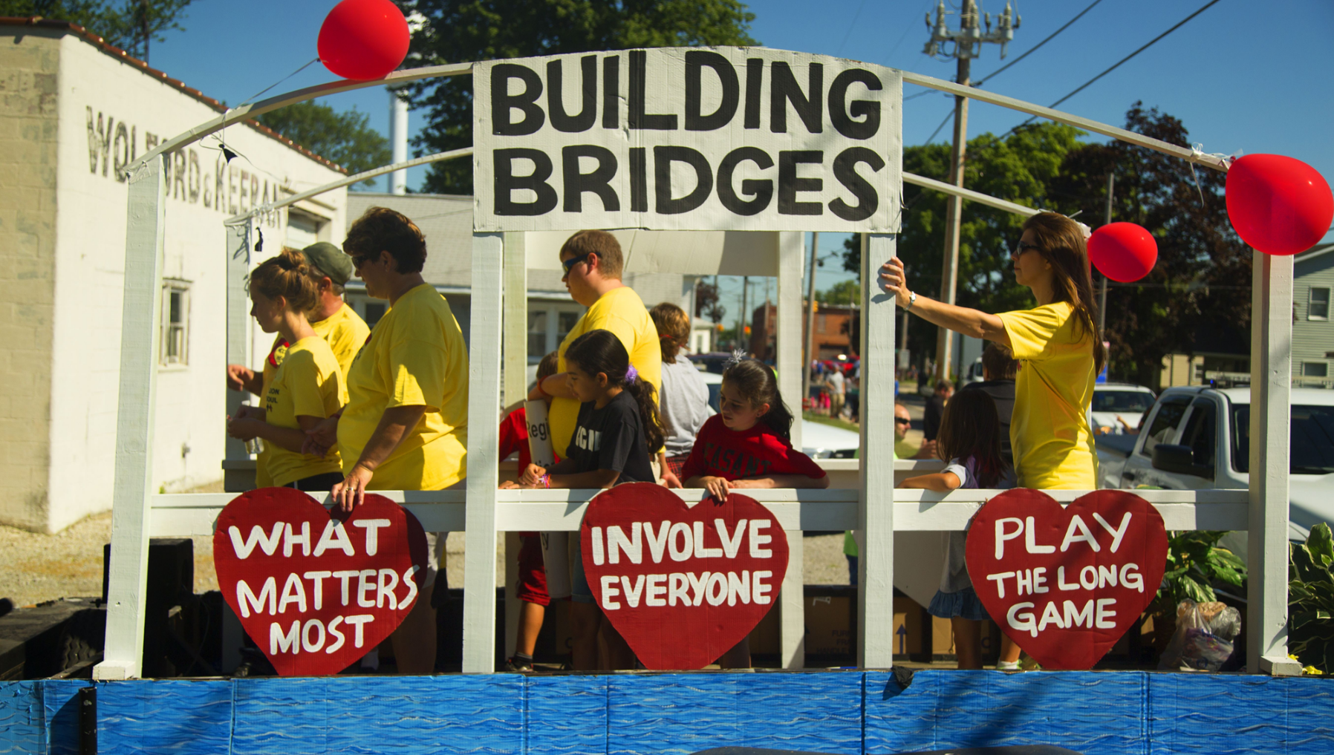
3 Principles of Heart & Soul
3 Principles of Heart & Soul
Notes:
USE THIS SLIDE TO BRIEFLY INTRODUCE AND NAME THE PRINCIPLES—THE FOLLOWING 3 SLIDES ALLOW YOU TO TALK ABOUT EACH IN GREATER DEPTH
Photo: McComb, Ohio. Spreading the word about their Heart & Soul effort during a community parade.

Slide 7
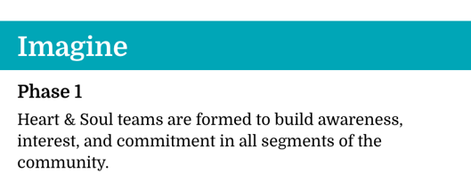
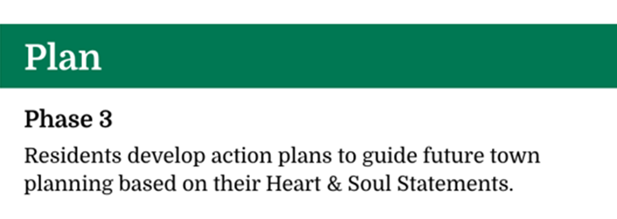
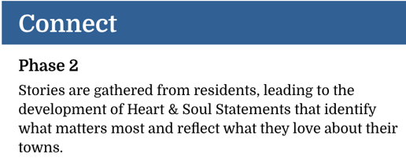
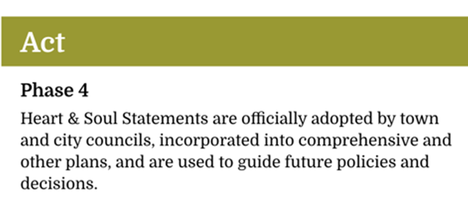
The Heart & Soul Model
The Heart & Soul Model: A Four Phase Program
Notes:
USE THIS SLIDE FOR JUST THE OVERVIEW OF THE PHASES—THE FOLLOWING SLIDES GO INTO GREATER DETAIL
So, what is the Heart & Soul approach? It is a four-phase program aimed at increasing community engagement (and sustaining it!) so that more people are involved and invested in the decisions made about their community.
The program helps people in a town like yours come together in new ways to set a clear direction for the future and take action based on what matters most. Since it actively works to get many people to “pitch in” in big and small ways, it becomes the catalyst for launching all sorts of meaningful projects that enhance what people already love in their community or make new things happen to make it even better.
Each phase builds on the one before it in order to build a diverse coalition of people from across the community ready and willing and invested in the part they can play to make things happen. Let’s take a quick look at what is happening in the community in each of the four phases.

Slide 8
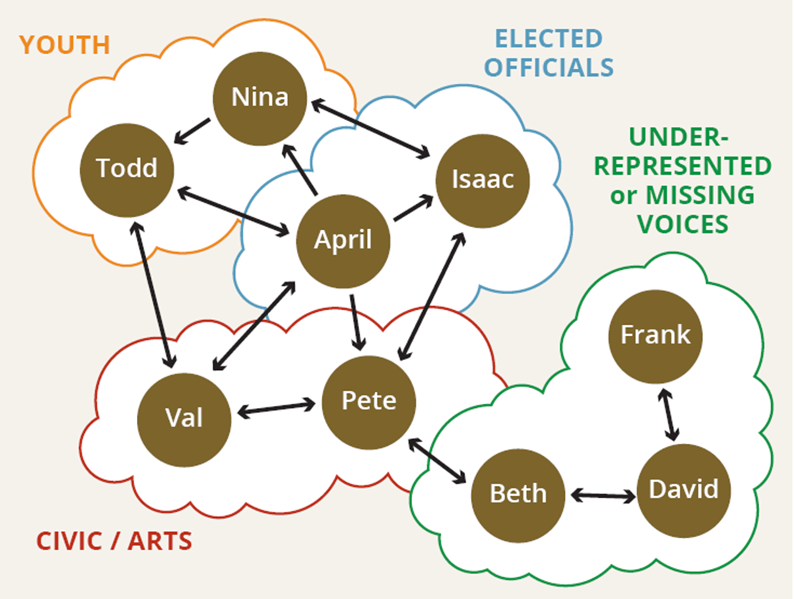
The Importance of Connectors
The Importance of Connectors
Notes:
The Community Network Analysis is the guiding tool throughout Community Heart & Soul. It helps communities understand the full scope of who lives, works, and play in your community and how best to reach them. It involves tapping into local knowledge to brainstorm ways to engage different people, groups, and networks. This is one of the things we teach you how to do.
Knowing the composition of your community is essential for achieving diverse engagement. It also leads to a new appreciation for the depth and breadth of resources in your community as well as the incredible potential for greater collaboration.
In this illustration, we see a number of individuals and the groups or roles they are associated with. Each person, in turn, is connected to people in other groups. There are always a set of individuals in a community who are connected to many people and groups. As you can see, April-- who is an elected official --knows a lot of people: she’s connected to folks in the arts realm, with youth groups, other elected officials, and so forth. However, she is not directly connected to Beth or David or Frank. A CNA helps you reach people who may not be directly connected to the most visible groups (those who are already in the room.) Since Pete knows Beth and Beth knows David, these connections can help reach Frank.
Note: For all you planners out there who are familiar with a “stakeholder analysis,” the Community Network Analysis is not the same things as stakeholder analysis. It goes far beyond just identifying interested parties and how to “keep them in the loop” about a project—it has a different intent as well. It is about purposefully looking at different roles in the community to make connections between groups and individuals, get them talking with each other, and building relationships,. It’s about expanding opportunities for involvement, building trust, and collaboration to make positive things happen in the community.

Slide 9
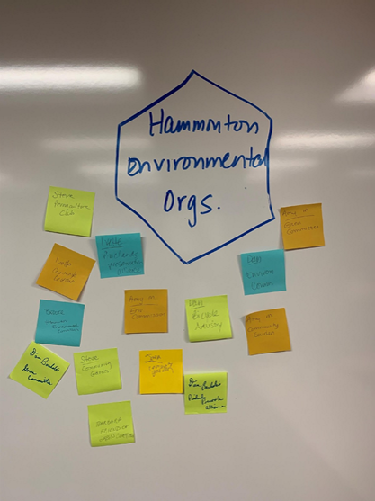
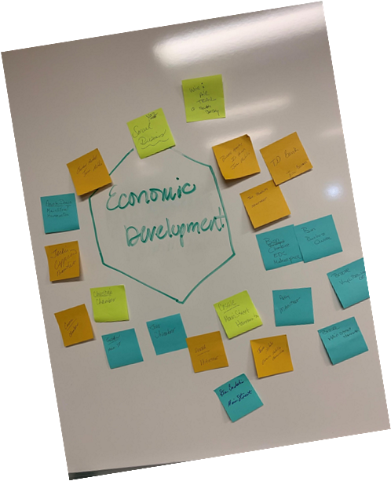
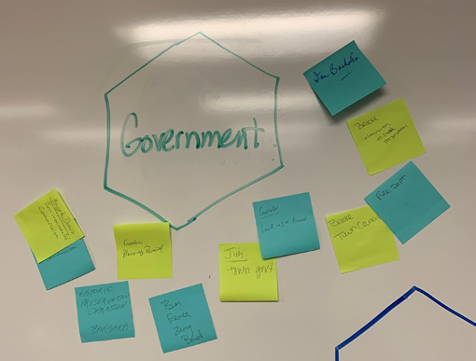
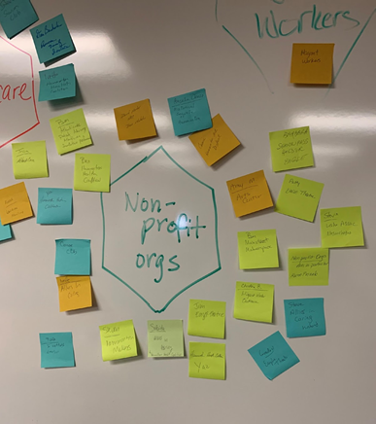
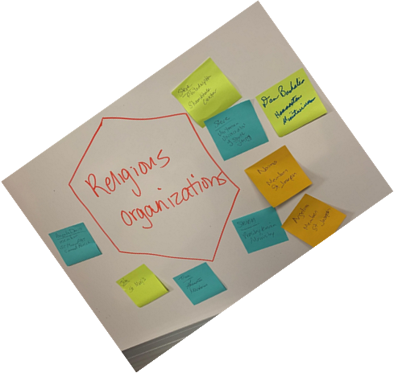
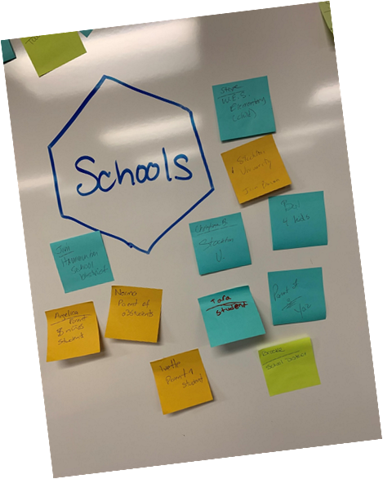
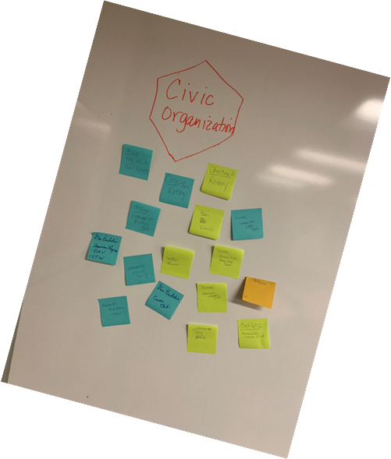
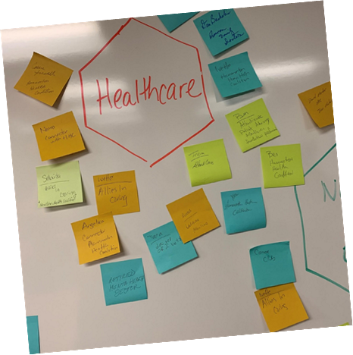
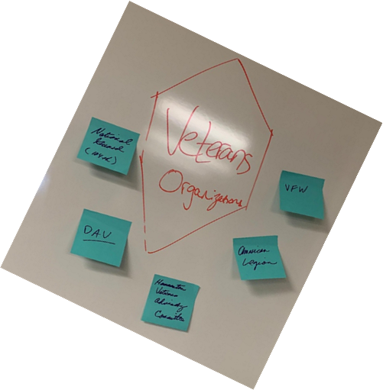
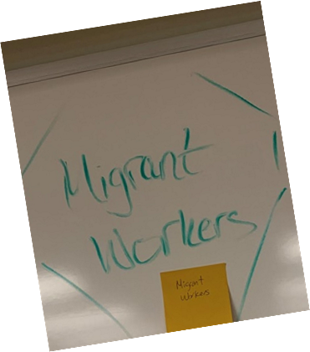
Identify Community Networks
Identify Community Networks: Who Lives, Works, and Plays in Your Community?
Notes:
The Community Network Analysis is about looking around your community at all the networks that exist. Each community has their own set of networks. It could be networks such as schools/education, government, civic/service organizations, business community, faith communities, or any number of networks as shown in this illustration. Next, you map out the informal and formal groups in your community and the names of individuals who are connected to those groups so you can shape a strategy for involving them.
Optional activity: If time, could do a quick mapping out of Networks and Groups in the community. See Who Lives, Works, and Plays activity in Getting Started workbook for instructions
Photo: Hammonton, NJ Heart & Soul mapped out who lives, works, and plays in their community on flip charts.

Slide 10
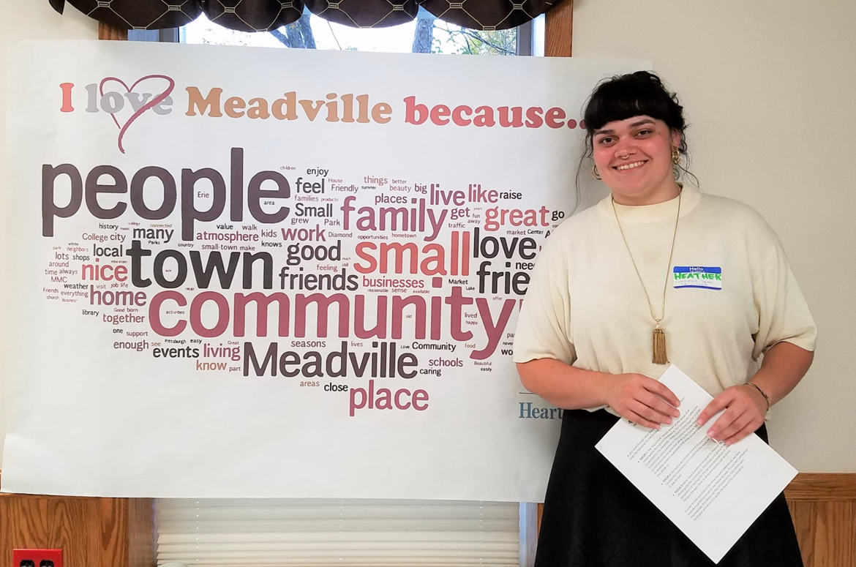
Activity: What do you love most about your community?
What do you love most about your community?
What are your hopes and concerns for the future
of your town?
What are your ideas for action
based on your community’s common cause
(H&S statements/community values)?
Your Town is Home
Notes:
Activity/Participant engagement to demonstrate the power of storytelling and importance of relationship building. Customize the question asked on this slide for what you think would work well with the participants.
Choose ONE of the following ideas for this activity:
Idea #1: Pair share.
In-person: Get up! Find someone in the room you don’t know (or don’t know well.) Pretend this person is coming to visit your town for the first time. Where would you want to take them? What should they see or experience in your community? Each person takes 2 minutes to talk about the place they chose and why. Virtual modification: Use break-out rooms for 2 or 3 people to share—place participants in rooms randomly with the same instructions as above.
Idea #2: Whole group.
In person: Go around the room and have each person describe a favorite memory of their town. (This works well with a smaller group 8-12 people and if you have the time since you would need to plan on 15-30 mins with the “whole group shares one-at-a-time” approach.)
Virtual modification: Ask for a volunteer to raise their hand if they would be willing to describe a favorite memory. Invite them to unmute and share their story. Ask follow up questions to get at some of the things they love and why they love it. If time, hear from more people, one at a time.
DEBRIEF with the whole group: Show of hands: How many of you heard someone mention similar things about your town?
As you listened to each other’s stories, what resonated with you? Do you share similar memories? What did you learn about what others care about and why? Do you care about these things, too? Did you want to hear more?
If you saw each other around the community in the next week or two, would you feel comfortable smiling, waving, or even stopping to chat?
Sharing stories and talking about what you love sows seeds of connection, trust-building, and finding common ground. You learn new things, see the community through someone else’s eyes, and are reminded about what is good or what gives the community its identity. Opportunities for story-telling and listening about real-life experiences are fundamental to Heart & Soul.
Photo—team members from Upper Chichester, PA

Slide 11
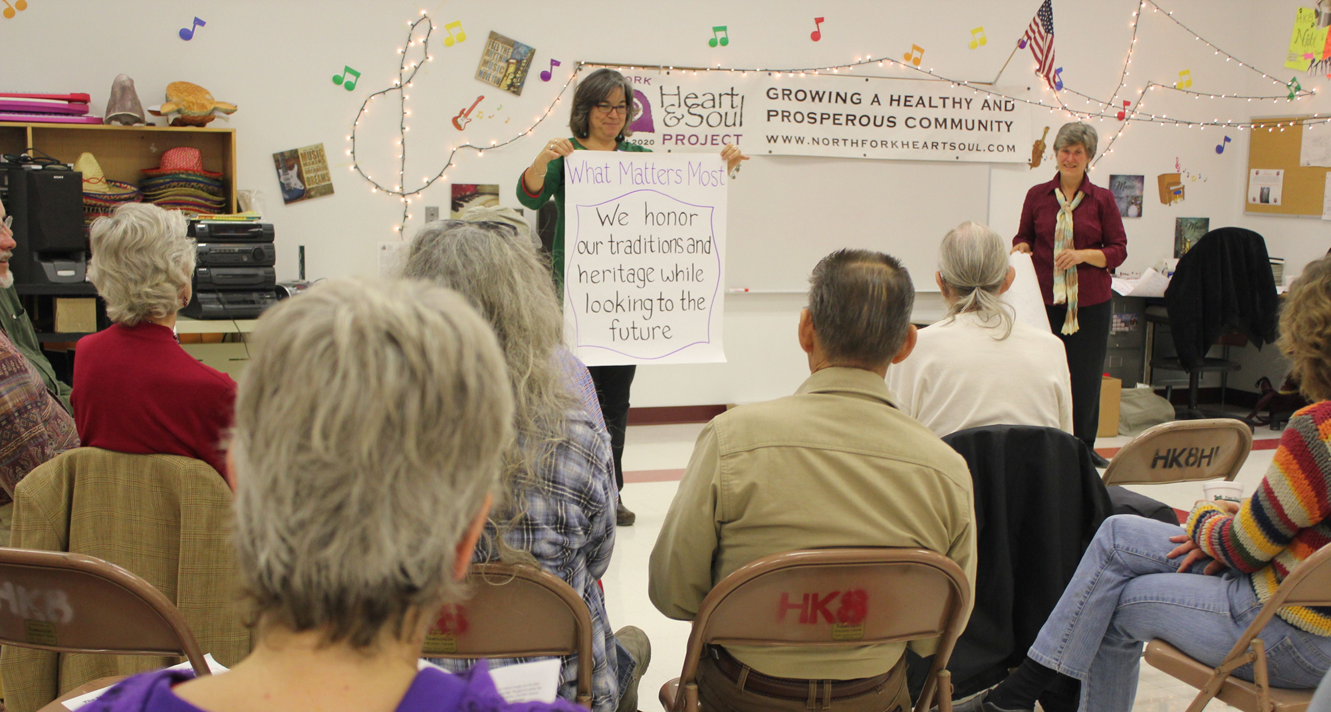
Heart & Soul Statements: From Stories to Data
Heart & Soul Statements: From Stories to Data
Notes:
What do we do with all these stories that get gathered? Remember, we are looking for what people’s stories are telling us about what they care about and prioritize in their community.
Information from all of the stories become your data for Heart & Soul statements. We teach the team how to extract the data from the stories and turn them into Heart & Soul statements that reflect what matters most to the community. These become the guideposts for community priorities and decision-making. By the time you are done with phase 2, you should have a clear picture of what matters most to the community through the stories that you have gathered.
Photo: The North Fork Valley, CO community crafting and discussing their Heart & Soul Statements.

Slide 12
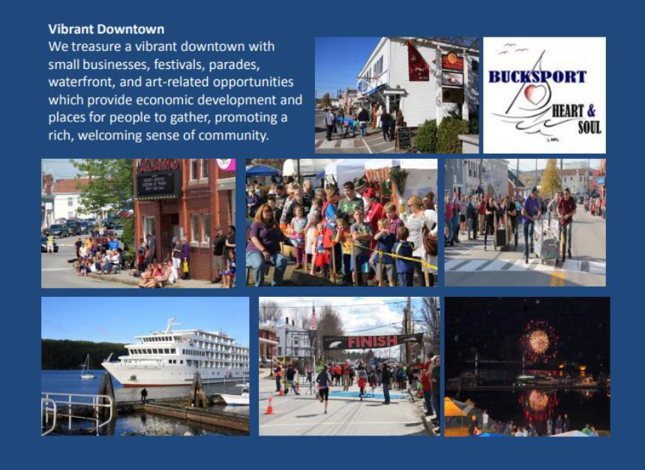
9 Heart & Soul Statements Adopted
9 Heart & Soul Statements Adopted
Notes:
As a result, Bucksport developed 9 Heart & Soul statements to guide their future. These are posted in the Town Council meeting room for the elected leaders and residents to reflect on and guide them throughout their discussions and decision making. This is an example of HOW decision-making changes.

Slide 13
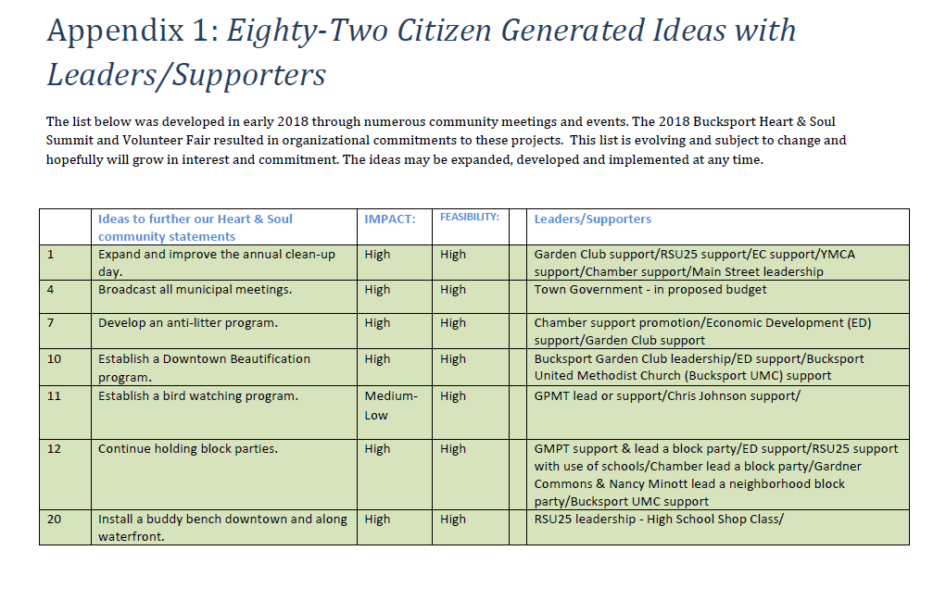
82 Community Generated Idea Adopted
82 Community-Generated Ideas Adopted
Notes:
Through their story gathering, the team heard dozens of ideas for actions as well as what matters most to the community. They turned this into a draft action plan with 82 ideas for action. They gathered commitments from organizations to host or lead these actions. I’d like to tell you about a few of these so you can see the range of ideas that they then acted on as a community,

Slide 14
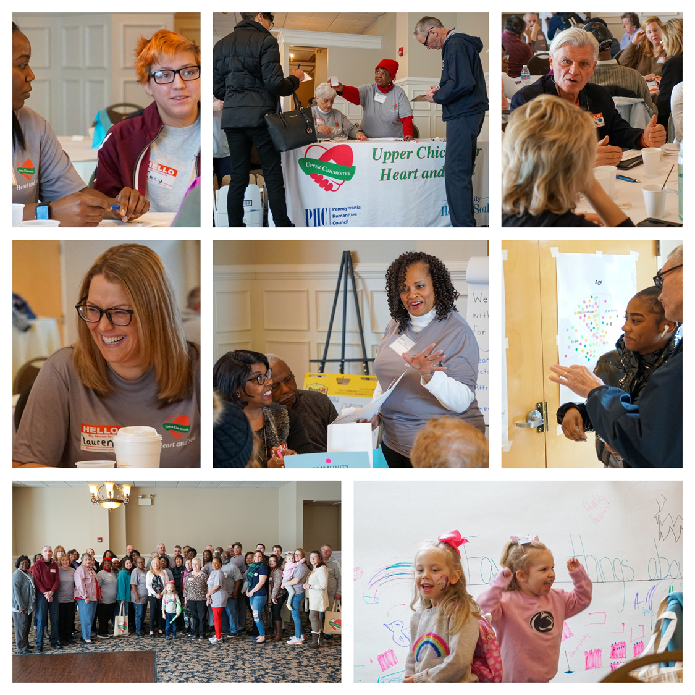
A Different Approach to Community Participation
Purpose-built
Not cookie-cutter
Work is face-to-face
Data-driven
Action-oriented
Interactive
Dialogue centered
Representative
Resident-driven
Relationship-focused
A Different Approach to Community Participation
Notes:
How would you like community input sessions to look like this? Interactive, dialogue-centered, with a wide range of participants. Heart & Soul transforms towns because residents do the work, not outside consultants. It gets people out and meeting one another so that relationships are built, people learn from one another, and a plan for action is developed together.
Photo collage: Upper Chichester, PA “Community Summit” Early March 2020 (Town that participated in the pilot)
To achieve this kind of representative participation, we use a tool developed by Community Heart & Soul called the Community Network Analysis
First, it makes sure you really know who is in your community
So you can figure out where to bring the table
And hear from all demographics
To then prioritize ideas and actions together
I’ll talk a little more about this in a bit.
It’s not an outside consultant writing a report—it’s about those who live, work and play in the community learning more about each other, discussing community priorities, and designing their future together. “The more you touch it, the more you own it.”

Slide 15
Impact Tracker Pilot – (2018 – 2020)
“The main reason to do evaluation is not to determine whether a program worked but to help it work.” -- Randy Stoeker
Participatory Evaluation Cycles
Power – Knowledge – Action Cycle Participatory Action Research Cycle
Power
Knowledge
Action
Diagnose
Prescribe
Implement
Evaluate
Notes:
“Participatory Action can strengthen relationships and improve action by involving people in the cycle of participatory knowledge and its relationship to action and power…When community members are involved in producing and using knowledge themselves, rather than having others do it for them, they develop skills to become self-sufficient knowledge producers, which it itself begins to change power relations” (Stoecker 2013).

Slide 16
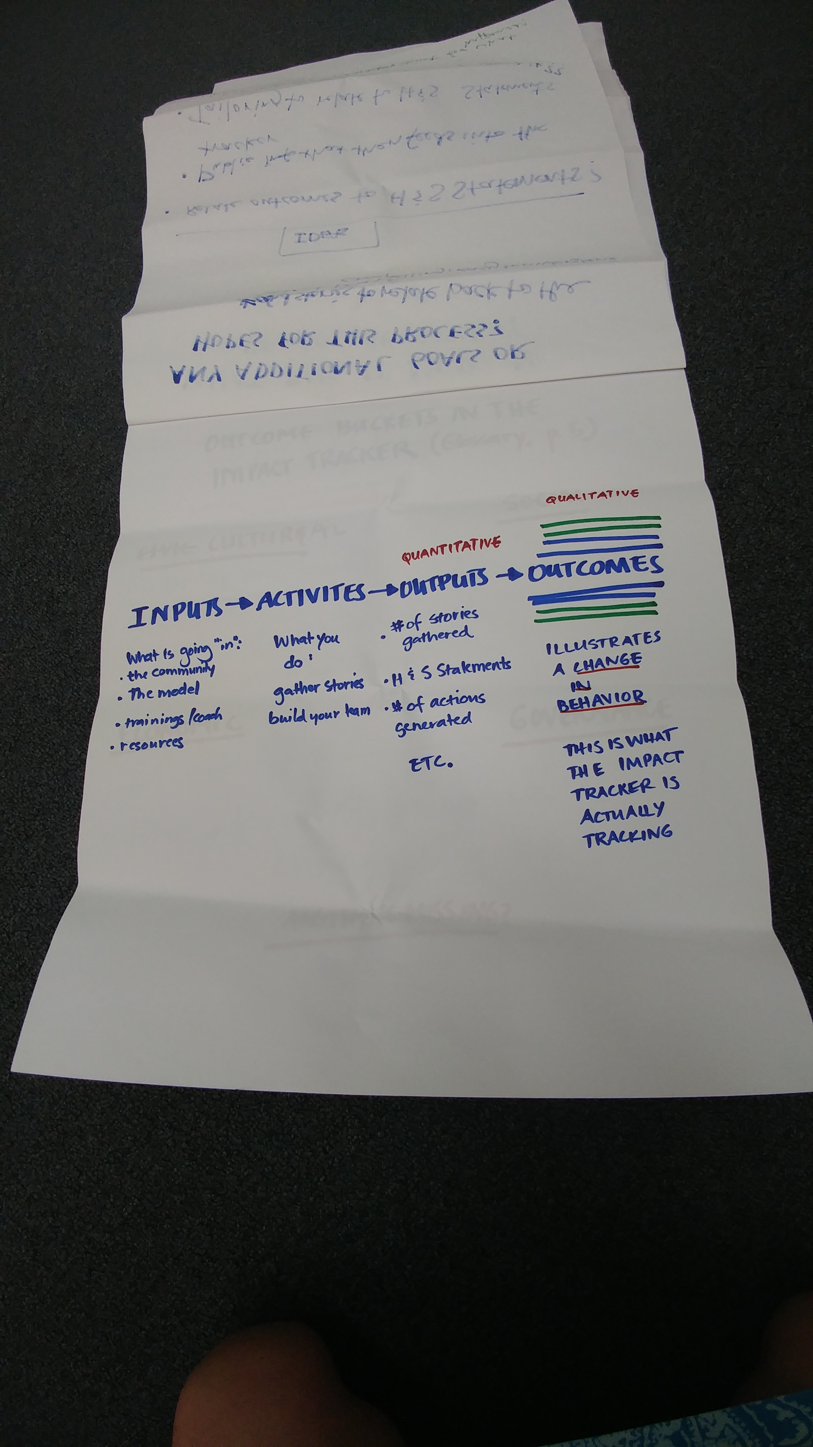
Heart & Soul Growth Across the U.S.
Notes:
Heart & Soul is a field-tested model over 20 years in the making, thoughtfully designed and tested, in small cities and towns across the country. CH&S is in action in 19 states and almost 100 communities.,
Video - Lyman Orton and what motivated him to create Heart & Soul. Youtube https://www.youtube.com/watch?v=udmrJp_IsFM

Slide 17

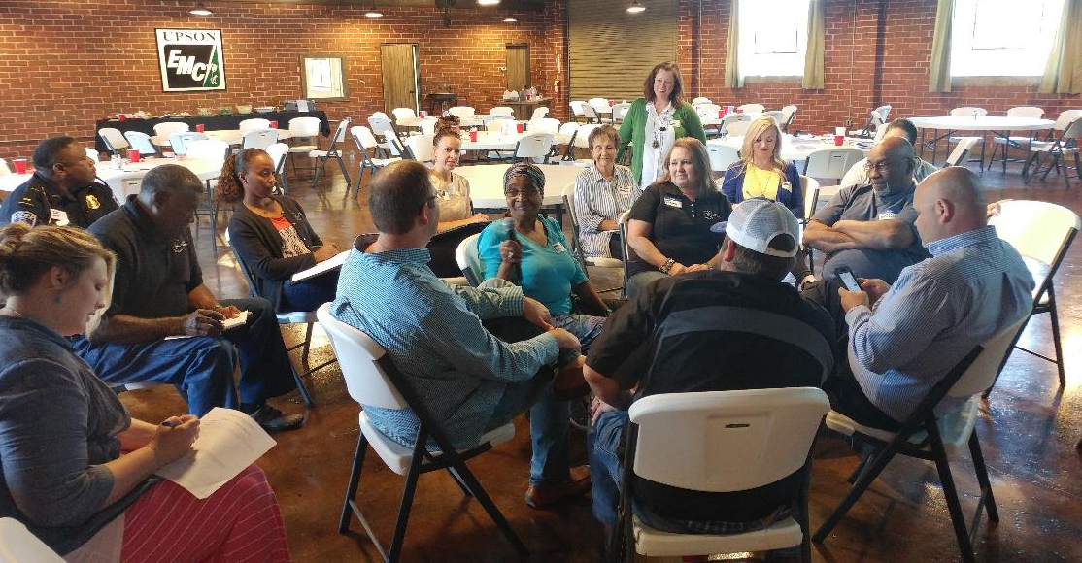
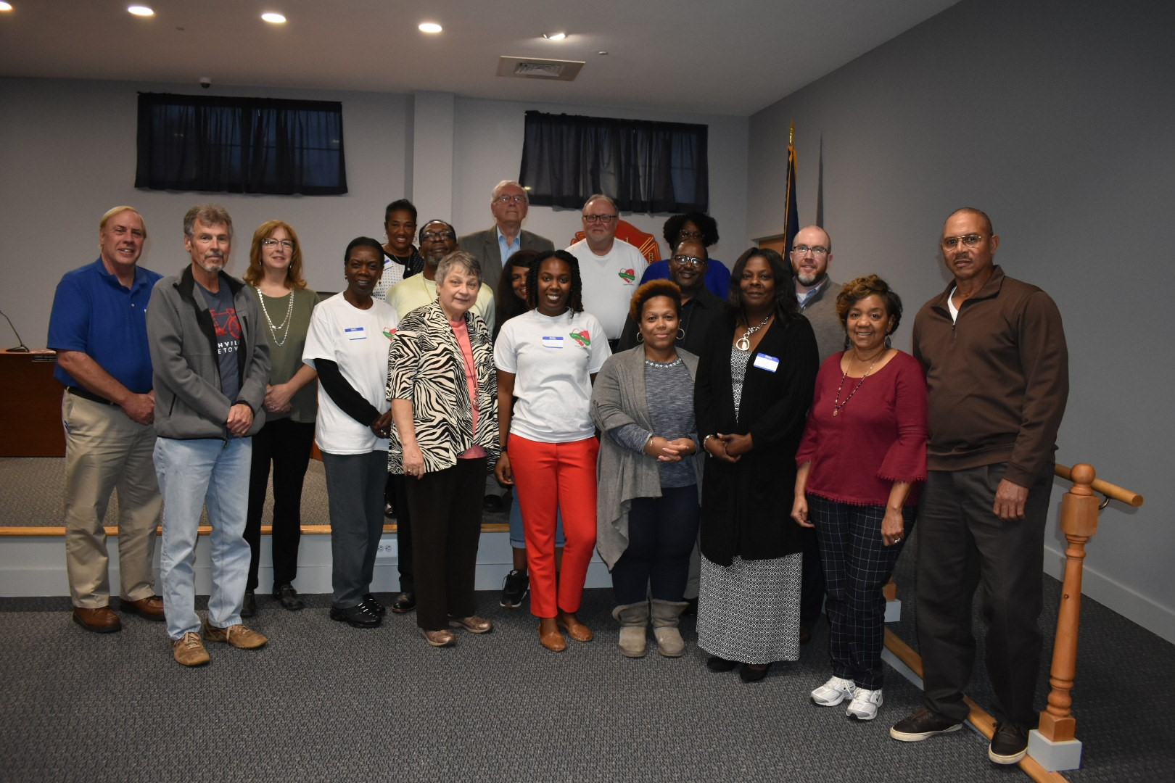
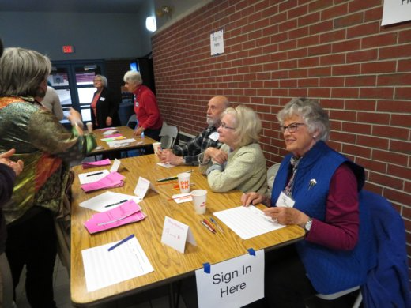
Goals for the six-month pilot program:
Impact Tracker Pilot + Methodology Highlights
Podio software goals
Shared Learning goals (process and community capital framework)
Participatory evaluation goals (knowledge and power)
Narrative and communications goals
Thomaston-Upson, GA
Upper Chichester, ME
Mahoosucs, ME
Notes:
Worked with an experienced evaluator – Lindsay Barber Green, PhD of Impact Architects
Involved current national partners + collaborative development
Worked alongside communities every step of the way
Paid participation
Comprehensive written materials (terminology, theory of change, logic model, principles of PE, power-knowledge-action cycle)
Town goals for participation
Defined collaboration (partnership)
Continuous evaluation (+/Delta)
Ongoing changes in materials
In-person onboarding
Technical assistance – Software, building narrative, capacity building
Final evaluation survey and in person meeting
Participant contribution to written conclusions

Slide 18
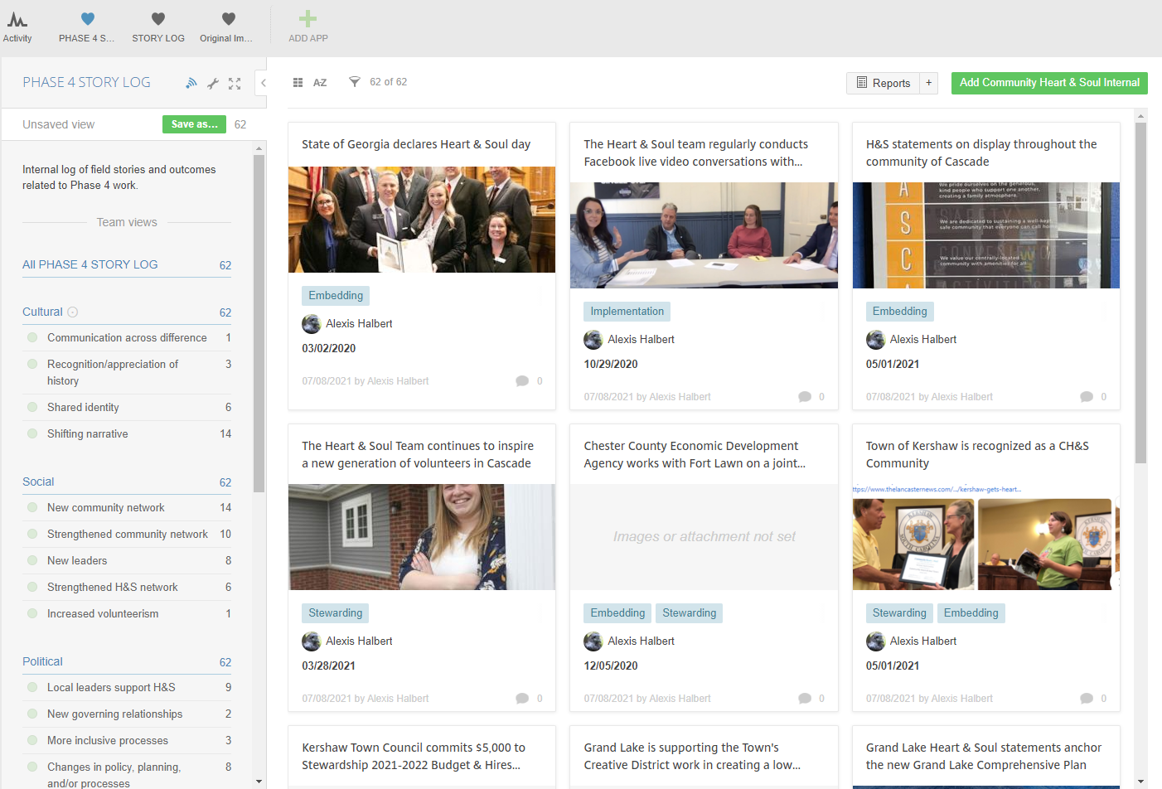

Slide 19
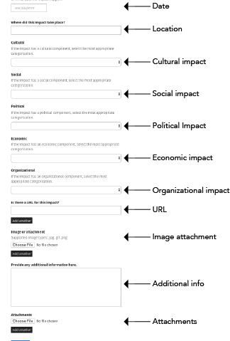
Cultural Outcomes –
Impact that changes the way people feel, think, and identify.
Communication across difference
Recognition / appreciation of history
Shared identity
Shifting narrative
HOME
Notes:
Communication across difference: Community members interacting with other community members with whom they do not have previous relationships.
Recognition / appreciation of history: Community members creating shared understanding of history.
Shared identity: Community members creating shared understanding of what it means to be part of the community.
Shifting narrative: CH&S work changes how communities talk about themselves.

Slide 20
Social Outcomes -
CH&S generates new and or strengthened relationships among community members
New community networks
Strengthened community networks
New leaders
Strengthened CH&S network
Increased volunteerism
HOME
Notes:
New community networks: Individuals in communities form new relationships.
Strengthened community networks: Existing networks grow, engage in new work, and gain prominence and power.
New leaders: New community members gain confidence and capacity and emerge as leaders.
Strengthened CH&S network: H&S core team members create relationships among themselves and their networks to support the H&S work.
Increased volunteerism: Community members engage in new and more volunteerism.

Slide 21
Governance Outcomes –
CH&S processes result in changes in governance processes and distribution of community power.
New community networks
Local leaders support CH&S
New governing relationships
More inclusive processes
Changes in policy planning and processes
Resident engagement
HOME
Notes:
New community networks: Individuals in communities form new relationships.
Strengthened community networks: Existing networks grow, engage in new work, and gain prominence and power.
New leaders: New community members gain confidence and capacity and emerge as leaders.
Strengthened CH&S network: H&S core team members create relationships among themselves and their networks to support the H&S work.
Increased volunteerism: Community members engage in new and more volunteerism.

Slide 22
Economic Outcomes –
CH&S results in strengthened, more inclusive, local economies that are more vibrant.
Local buzz
Business growth and development
Resources for CH&S actions
HOME
Notes:
Local buzz: Community members, businesses, and others refer to the community as a good place for businesses.
Business growth and development: New businesses are established and/or existing businesses experience growth.
Resources for CH&S actions: New and/or increased resources are made available by various sectors of the community for H&S projects.

Slide 23
Outcomes:
The Mahoosucs in Maine - Using the impact tracker helped Cat to see the full story of how the towns of Bethel, Greenwood, Newry, and Woodstock are developing a commonly agreed upon future through shared initiatives and the building of a shared identity and narrative.
Thomaston-Upson, GA - Reflecting together on what they had recorded allowed them to see that they were at a critical juncture where they might succeed or fail. They had officially moved into Phase 4, but realized that they needed to continue to reinforce the connections between people and that what individuals did mattered to the future in order to successfully move into the action phase.
Upper Chichester, PA- The impact tracker influenced how they interacted with the community. The impact tracker helped them to see the need to do more engagement with groups across different parts of their community so they could create a greater sense of connection and pride across the many neighborhoods.

Slide 24
Lesson Learned:
Onboard, in-person, at the outset of the Community Heart & Soul Process.
Provide toolkit that includes examples of how towns use qualitative data to inform strategy and to craft narratives. Information on how to use and manage the platform.
Baseline data on engagement, leadership, economic vitality and other pre-Community Heart & Soul conditions could be helpful to see change over time.
Language of the tracker is not always intuitive.
.

Slide 25
Changes in Language: Achievement Tracker
Goal: Open, effective governance
Heart & Soul Towns embrace what matters most to their residents in planning and decision-making. Public institutions achieve lasting changes in the way that they operate by increasing and sustaining communication and civic engagement.
2. Goal: Improved resident initiative and sense of belonging
Heart & Soul restores people’s pride and increases their sense of belonging. Residents feel connected to the place where they live and can engage in community life in a meaningful way.
3. Goal: Networked, aligned community organizations/non-profit sector
Heart & Soul builds networks and alignment across organizations to give purposeful direction over time to the community’s collective future.
4. Goal: Strengthened local economies
Heart & Soul strengthens investment in local economies and increases commitment to creating vibrant places. People refer to the community as a good place to do business.
.

Slide 26

Questions
Questions?
Contact Information:
www.communityheartandsoul.org
Alexis Halbert --- ahalbert@orton.org
Ian Moran --- imoran@orton.org
Notes:
Activity/Audience Engagement: Invite questions. Reference FAQ sheet

