Slide 1
Office of Planning
NADO National Regional Transportation Conference 2024
Communication and Public Outreach to Support Bike/Ped Planning
By: Joe Sturm, P.E. – SCDOT Regional Mobility Program Chief
July 2024
Guillermo Espinosa, AICP – SCDOT Active Transportation Planning Manager

Slide 2
Introduction
Who are we?
Joe Sturm, P.E.
Chief, Regional Mobility Program
Guillermo Espinosa, AICP
Active Transportation Planning Manager
What do we do?
Coordinate the rebranding and technical support for the MPO/COG Program (aka Guideshare)
Coordinate the development of guidelines for SCDOT’s Complete Streets policy
Research and provide recommendations on planning initiatives and potential projects with generational impacts
Main Takeaways
Expertise + Technical Information + Coordination = Success
Planning Framework and Programs must be Context Sensitive
Presentation Outline
Intro + Main Takeaways
Transportation Planning Across Government
SCDOT Regional Mobility Program
Complete Streets Policy
Pilot Regional Bike-Ped Accommodation Plans
Next Steps
Notes:
Sec. Hall/ Leadership of 21 MPOs and COGs; developed Summer 2023.
Previously did not include RSA, Bike/Ped, Transit,
Consider how each of these program types require further coordination with SCDOT offices and additional organizations

Slide 3
Transportation Planning Across Levels of Government
Federal
Requirements
Critical Coordination Considerations
SCDOT as steward of the state-owned roadway network (41k miles, 4th largest in the USA)
Home rule state = local government manages land use around roadways
Private development and non-profit initiatives may influence all stakeholders and outcomes
SCDOT must interact/coordinate with all entities requesting access to roadways
State
Government
County
Government
SCDOT
Non-Profit
Initiatives
Municipal
Government
Private
Development
Notes:
Focusing on intra and inter-agency coordination = FHWA/FTA, MPO/COG, and between SCDOT offices/districts
SCDOT has a broad mission and responsibility to provide access to the network, but what happens around that network is mostly out of its hands.
Planning as a way to coordinate across and within levels of government. Going to speak to developing the foundation for transportation planning in the agency, and how that takes both

Slide 4
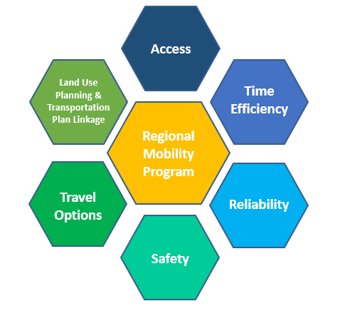
SCDOT Regional Mobility Program – Policy Elements
Program Pilot Approach
1. Identify Corridors (Data-Driven)
2. Prioritize Corridors (People-Informed)
3. Create Regional Project Database
4. Develop Long Range Plans
5. Implement Projects
Continually Evaluate
∞

Slide 5
SCDOT Regional Mobility Program – Program Types
Selected Program Types
1. Intersection Improvement
2. Access Management & Safety
3. Signals/ITS
4. Road Safety Audits
5. New Lane Miles
6. Bike/Ped Improvement
7. Transit Improvement
Notes:
Sec. Hall/ Leadership of 21 MPOs and COGs; developed Summer 2023.
Previously did not include RSA, Bike/Ped, Transit,
Consider how each of these program types require further coordination with SCDOT offices and additional organizations

Slide 6
RMP – Identifying Corridors (Data-Driven)
1. (D) Delay
2. (G) Growth
3. (S) Safety
4. (M) MPO-COG Feedback
Highest Need Moves On
Future RMP Data Components
5. (A) Active Transportation
6. (T) Transit
Notes:
Most deserving of further study…
We’ll ask you:
Are there any corridors you would add?
Do you think any of the termini needs to change and why?

Slide 7
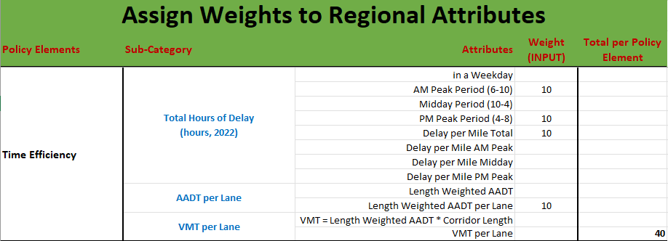
RMP – Prioritizing Corridors (People-Informed)
… Top corridors advance!
Notes:
We’ll ask you:
1) Is there any other publicly accessible data set that you would like to use for ranking corridors?

Slide 8
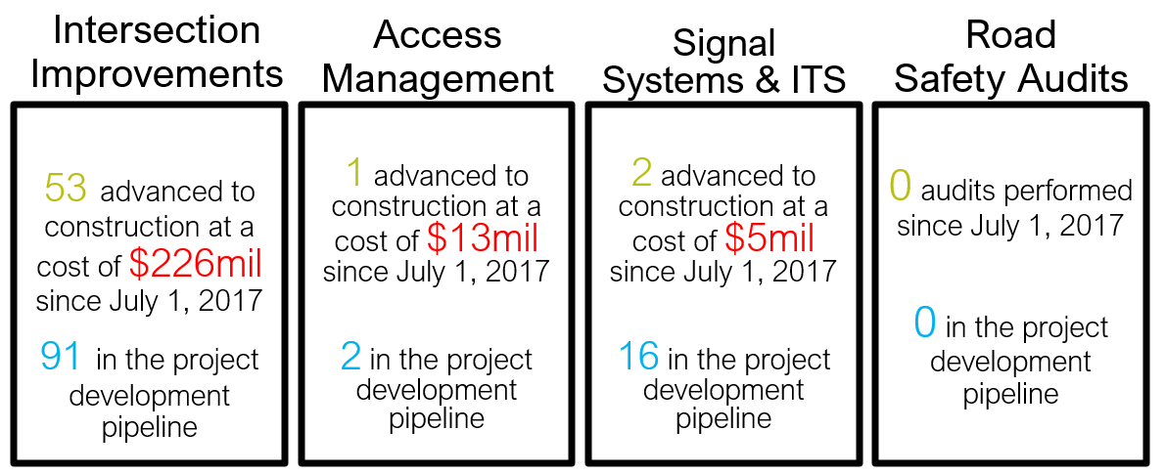
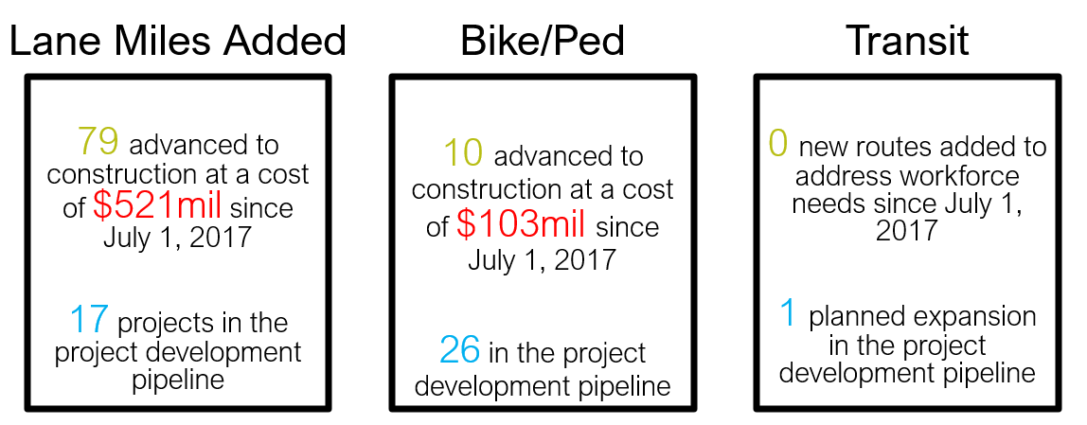
RMP – Continually Evaluate Implementation
Where are the investments going?
Are projects moving… or stagnating?

Slide 9
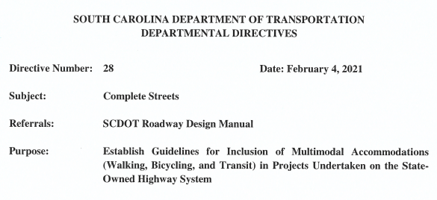
SCDOT Complete Streets Policy – Going Multimodal
Complete Streets Policy is an umbrella policy, with generational goals and impacts
Comes into effect when roadway projects overlap with regional multimodal planning priorities
It’s an opt-out policy! You need justification to not integrate multimodal if it’s a regional priority (e.g., constructability)

Slide 10
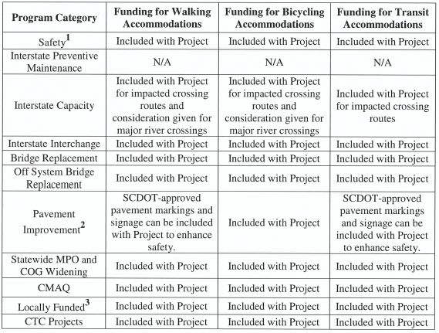
SCDOT Complete Streets Policy – Coordination
Programs Impacted by Policy
Impacts the coordination of multiple programs managed within and outside SCDOT.
Coordination has to support existing SCDOT project phasing and programs.
Involves statewide communications, training, and coordination to continue supporting implementation.
Notes:
Note that none of these don’t work in a vacuum:
Internal Coordination
Road Safety Audits
Communication and graphic design
Project Development Teams
Transportation Alternatives Program
Business analytics
Engineering District support

Slide 11
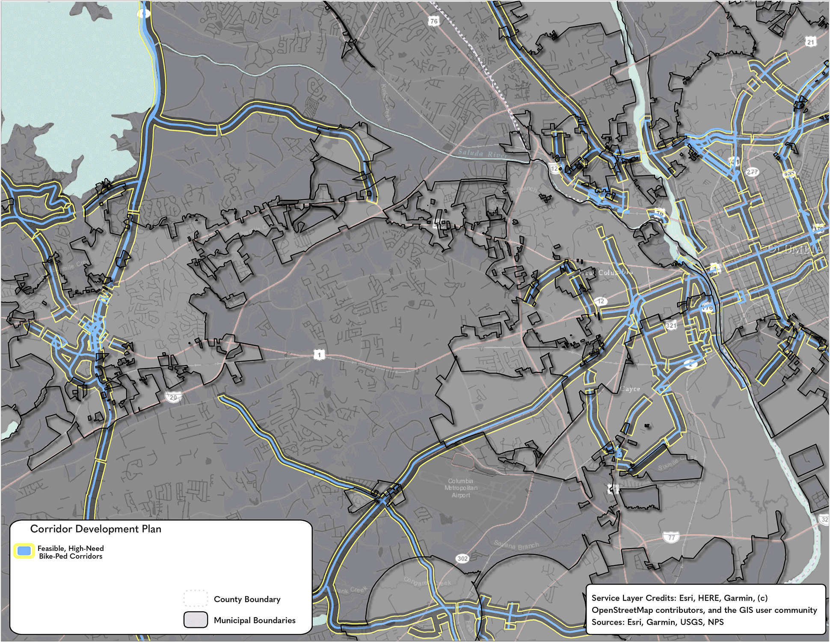
Pilot Studies: Regional Bicycle-Pedestrian Accommodations Master Plan (RBAMP)
Critical Considerations
Identifying areas of high need and high risk
Identifying corridors with comparatively high retrofit costs
Developing a prioritized active transportation network
Consistent formatting guidelines for planning documents
Notes:
Clear, consistent communication is critical for coordination

Slide 12
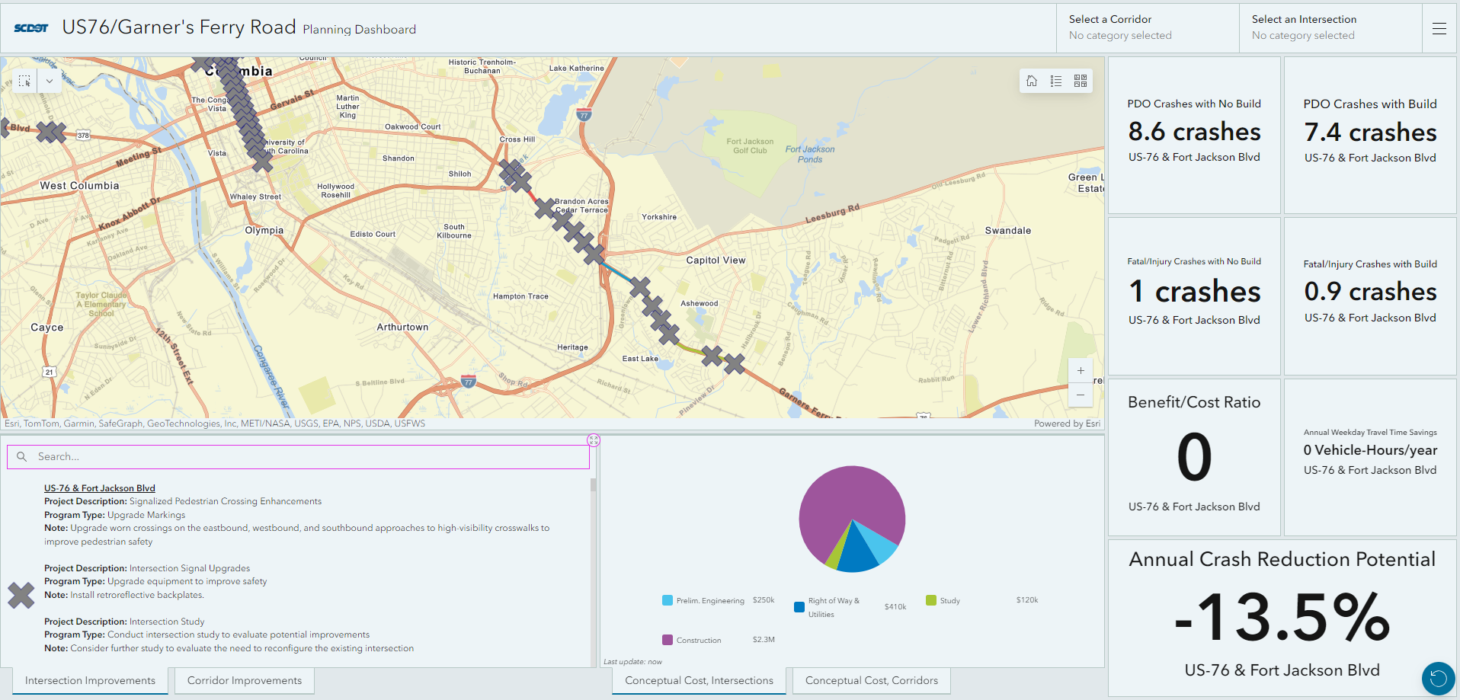
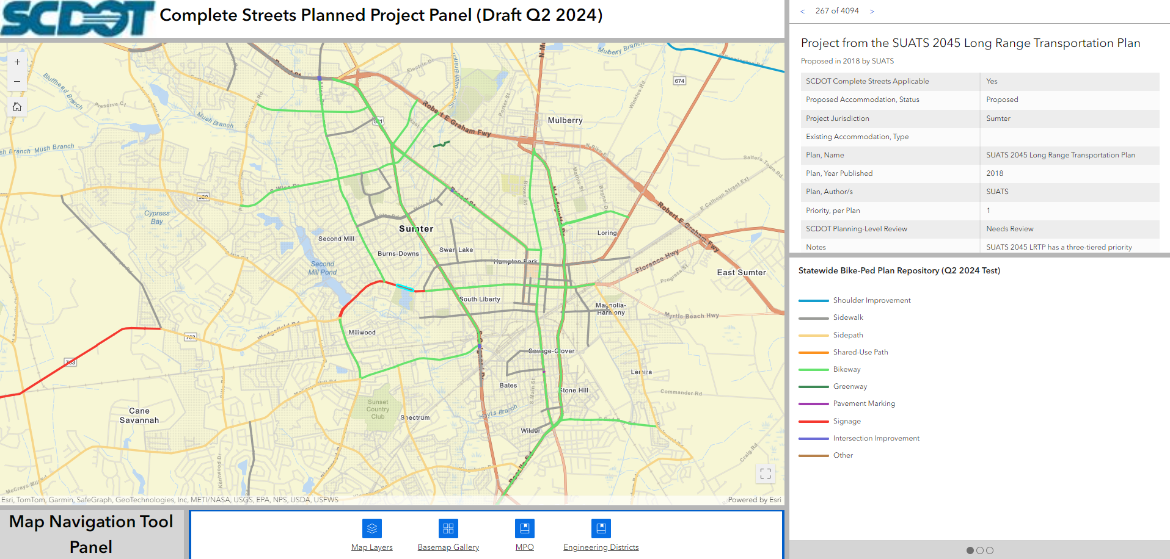
Pilot Studies: RMP and RBAMP Expected Outcomes
Planning-level feasibility screening
Regional project recommendations
Webmapping applications for internal/external coordination

Slide 13
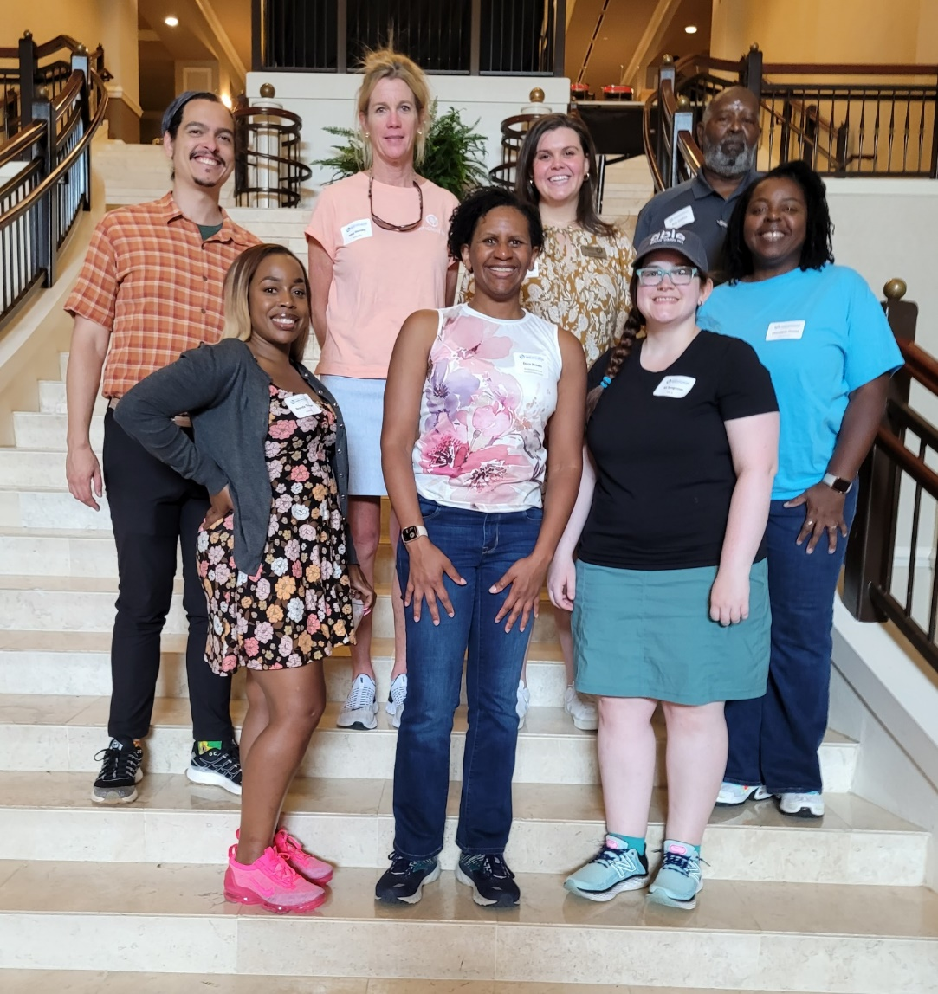
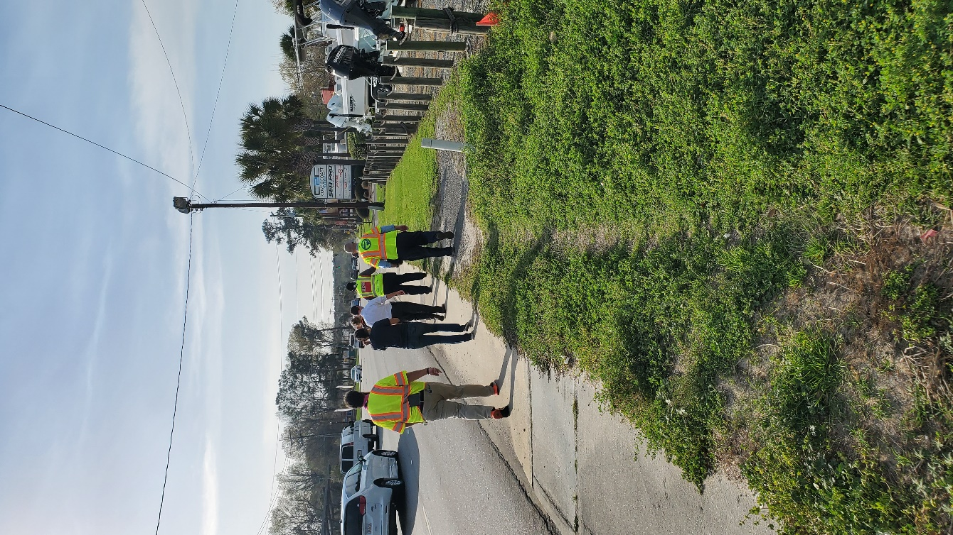
…in the meantime
Corridor & Feasibility Studies
Project Development Teams
Road Safety Audits
Stakeholder-driven initiatives
Notes:
External Coordination
Metropolitan Planning Organizations & Councils of Governments
County and local governments
Other Public Agency Initiatives

Slide 14
Questions/Discussion?
Joe Sturm, P.E.
Chief, Regional Mobility Program
Email: SturmJP@scdot.org
Guillermo Espinosa, AICP
Active Transportation Planning Manager
Email: EspinosaGJ@scdot.org

