Slide 1


Economies for People and Planet
Phil Allen, Liability Brewing/Bricolage Dynamics
Sheryl Guarniero, Making GVL Greener
Sarah Lyons, Piedmont Community Alliance
Brannon Andersen and Michael Ross, Furman University Dept. of Earth, Environmental, and Sustainability Sciences
NADO 2024 Wealth Creation Summit
Greenville, SC
August 1, 2024

Slide 2
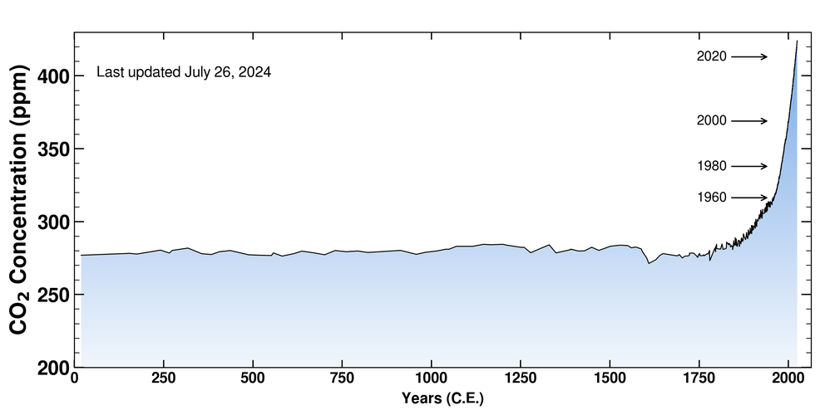
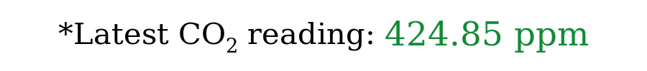
https://keelingcurve.ucsd.edu/

Slide 3
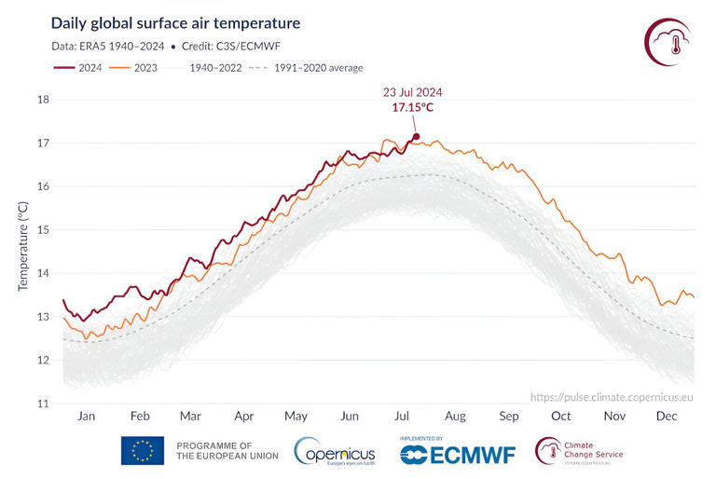

Slide 4
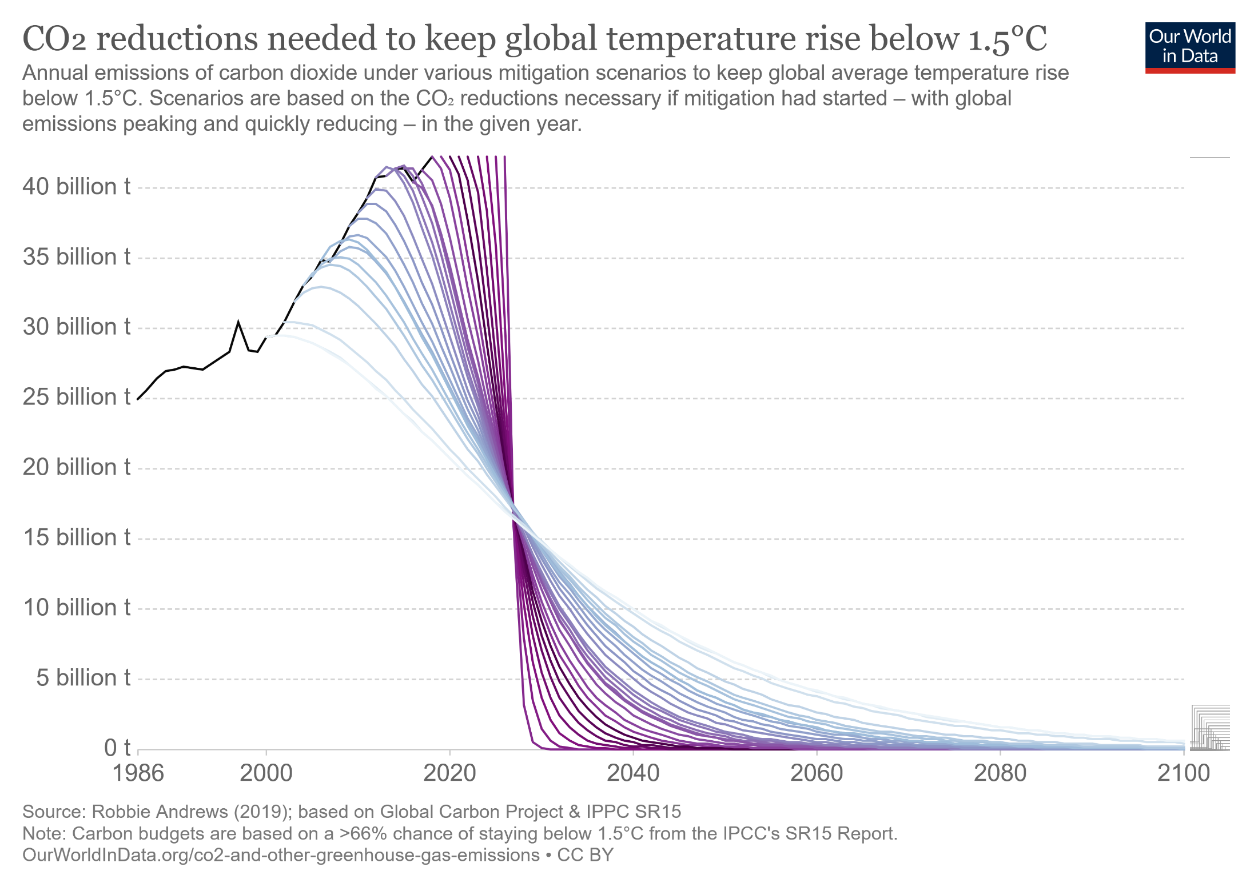
Required CO₂ reductions will not happen under the current economic model of profit maximization dependent on growth by extraction from both people and planet.

Slide 5
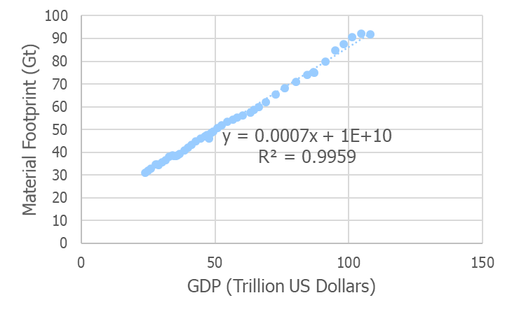
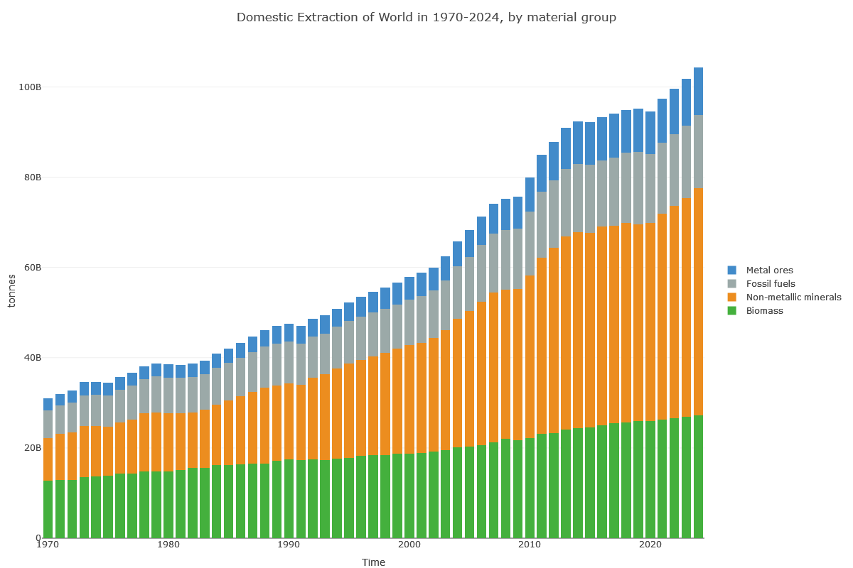
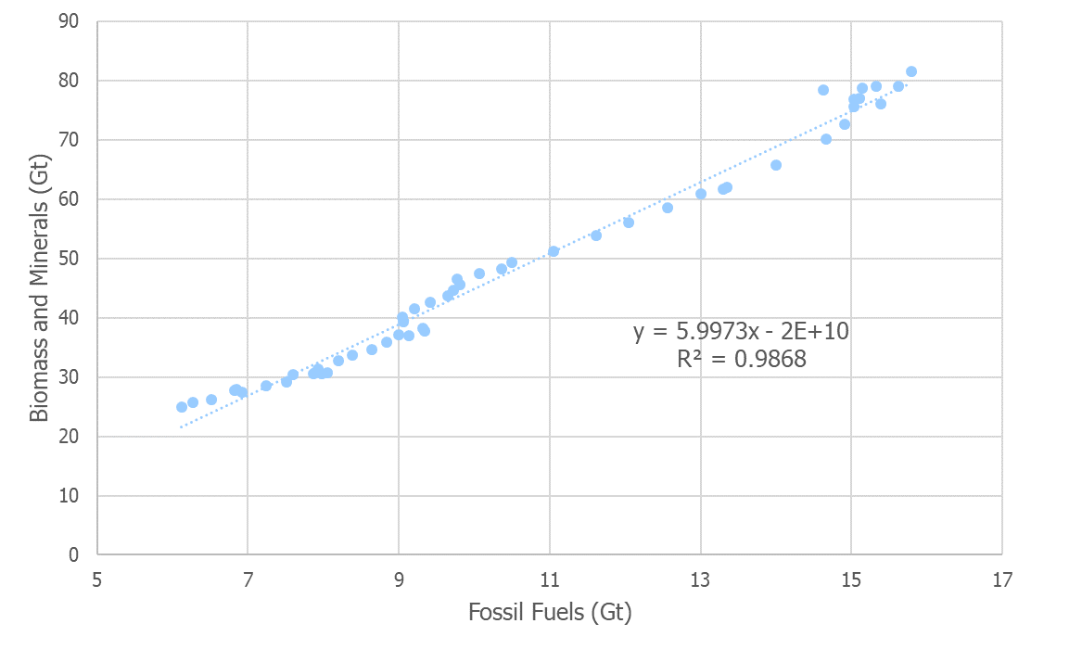
The Grand Challenge
Environmental Degradation and
Social Inequality
are Features of
The Current Global Economic System
Global Material Footprint
Estimated 2024 extraction: 105 Gt/y
Estimated sustainable extraction
50-70 Gt/y
GDP data from Our World in Data, material footprint data from Material Flows.

Slide 6
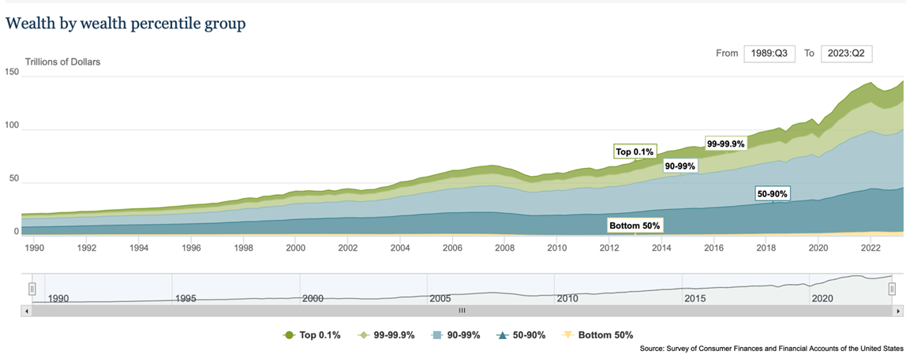
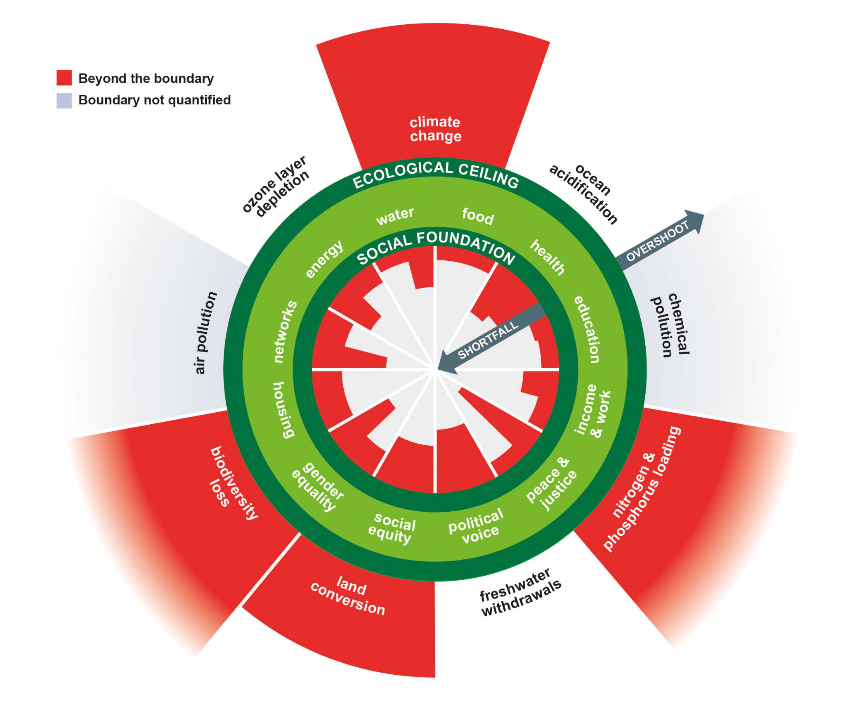
The Extractive Economy
Currently, the creation of wealth leads to increased social inequality, environmental degradation, and the extraction of wealth from a community.
Sources: U.S. Federal Reserve 2023, Raworth 2017
Need an economy that aims to facilitate generative wealth through a relocalization of business and economy.

Slide 7
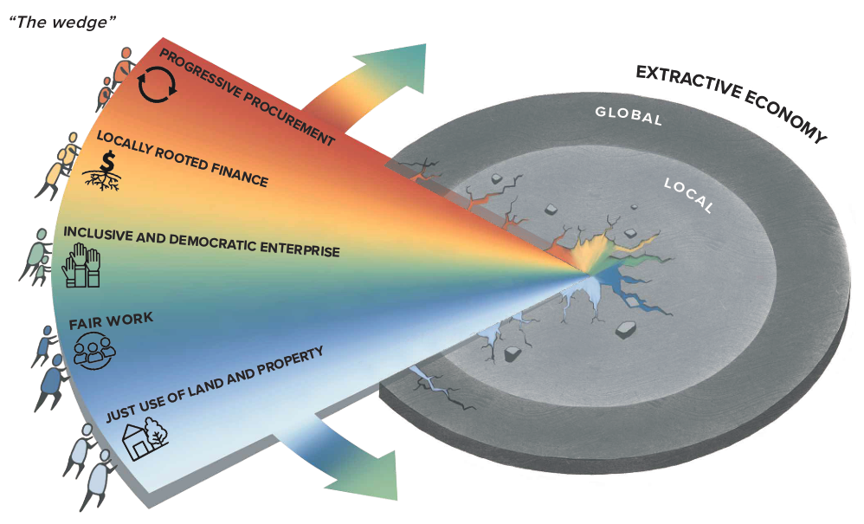

Community Wealth Building (CWB)
Transforms local economies based on democratic community ownership and control of assets in place.
Addresses wealth inequality at its core in order to produce broadly shared economic prosperity, racial equity, and ecological sustainability.

Slide 8



Community Wealth Building
An Economy that Serves People and Planet

Slide 9















The Five Pillars of Community Wealth in Greenville
Just Use of Land and Property
Locally Rooted Finance
Fair Work
n = 6
n = 7
n = 4
n = 8
n = 41
Progressive Procurement
Inclusive and Democratic Enterprise

Slide 10
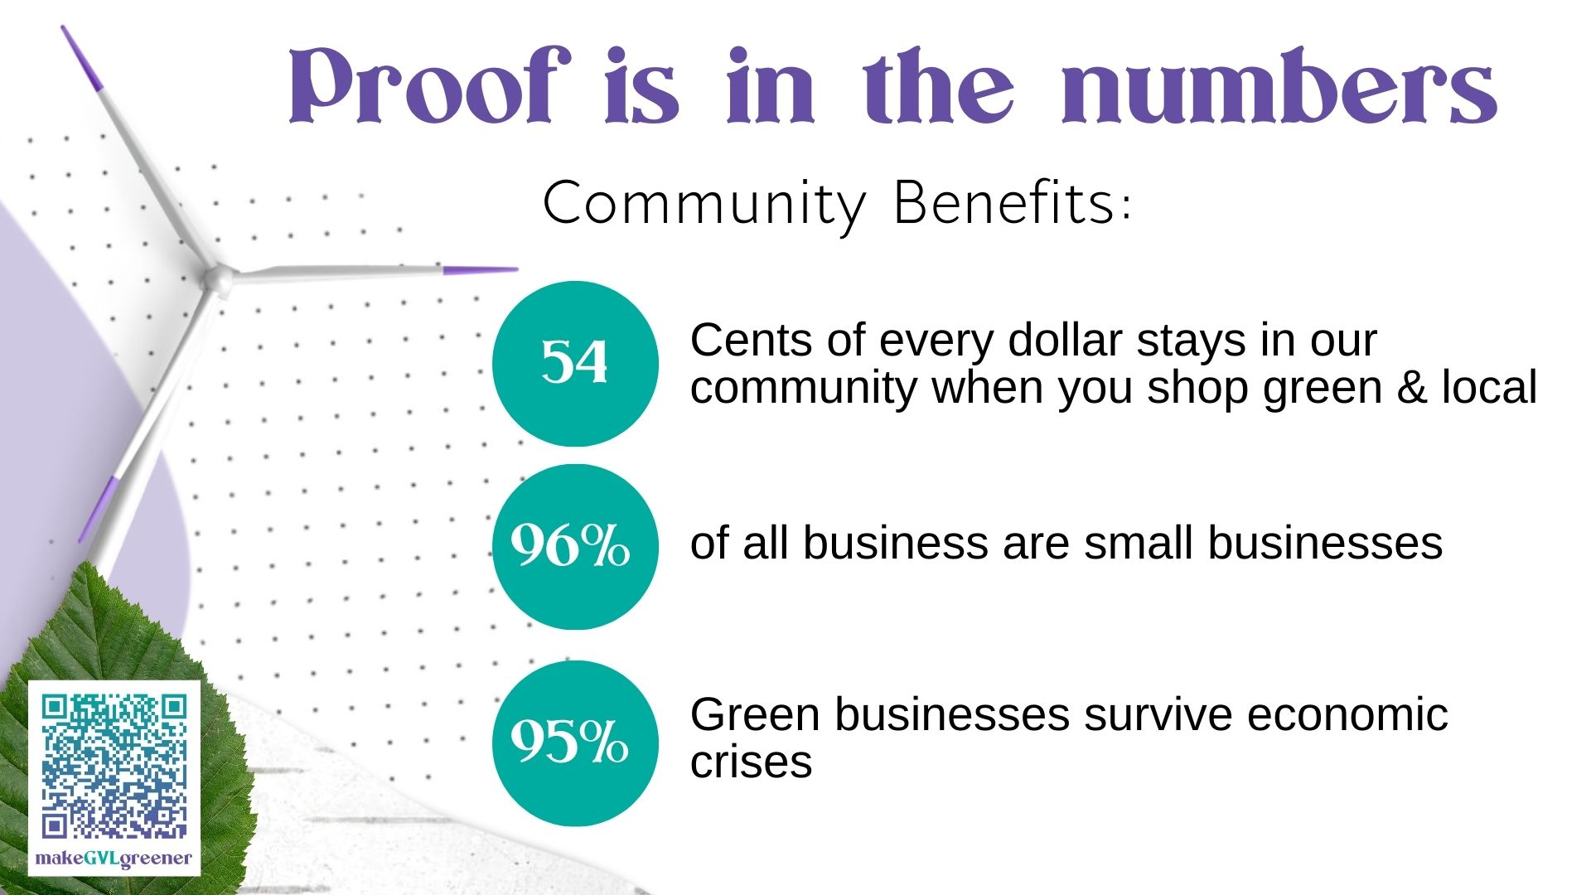

Slide 11
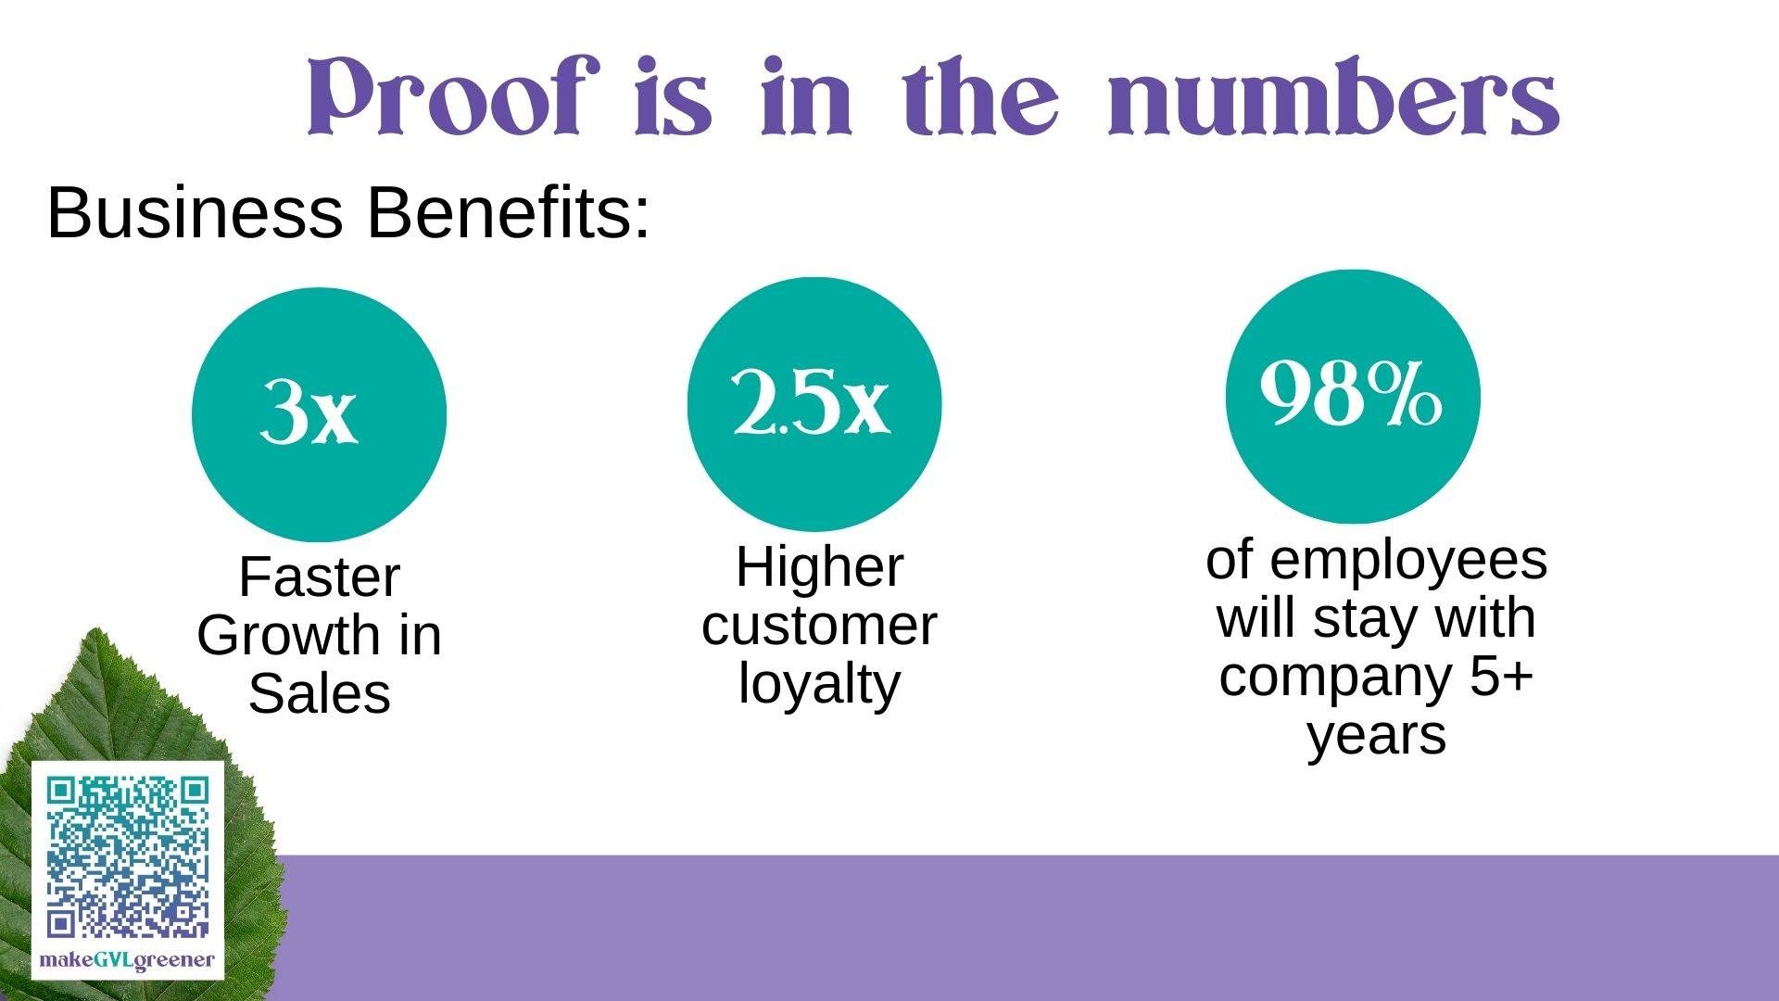

Slide 12
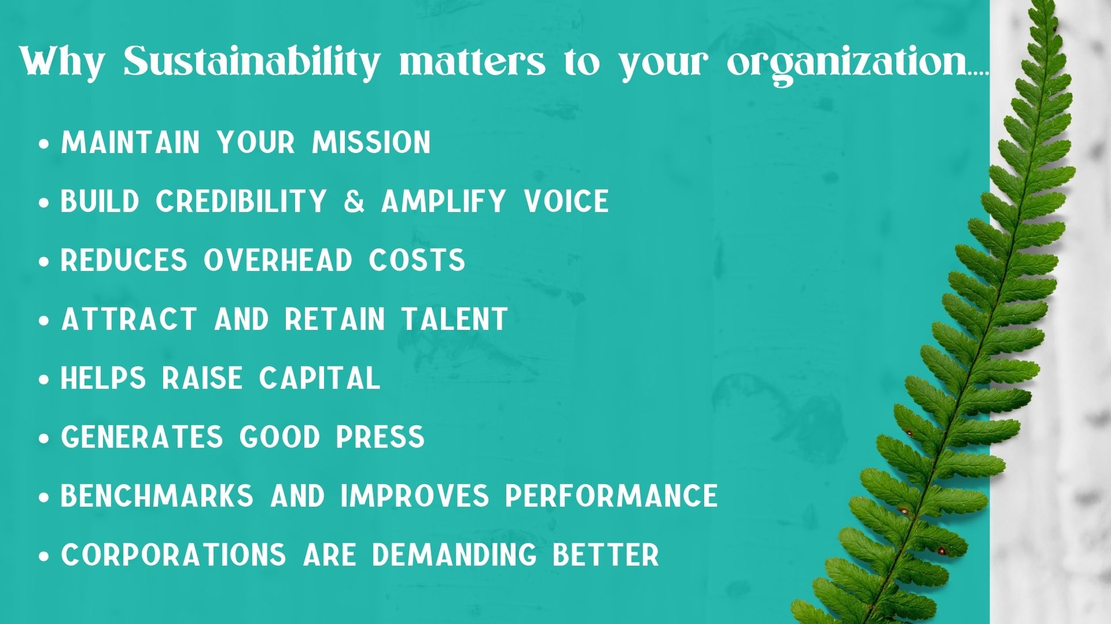

Slide 13
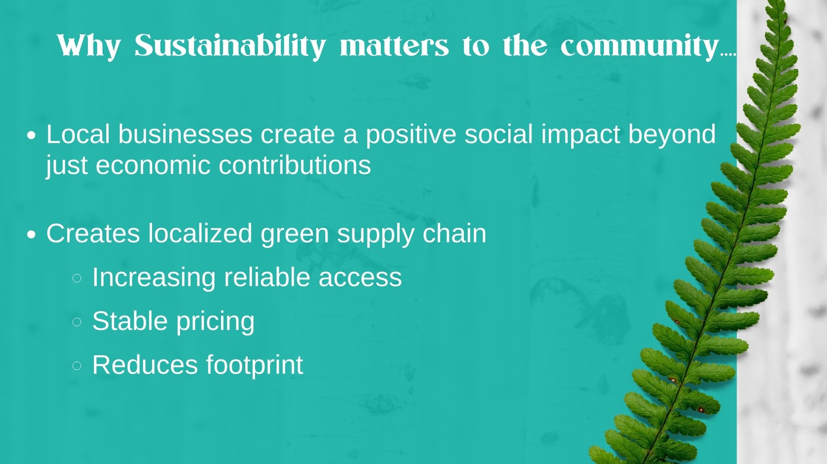

Slide 14

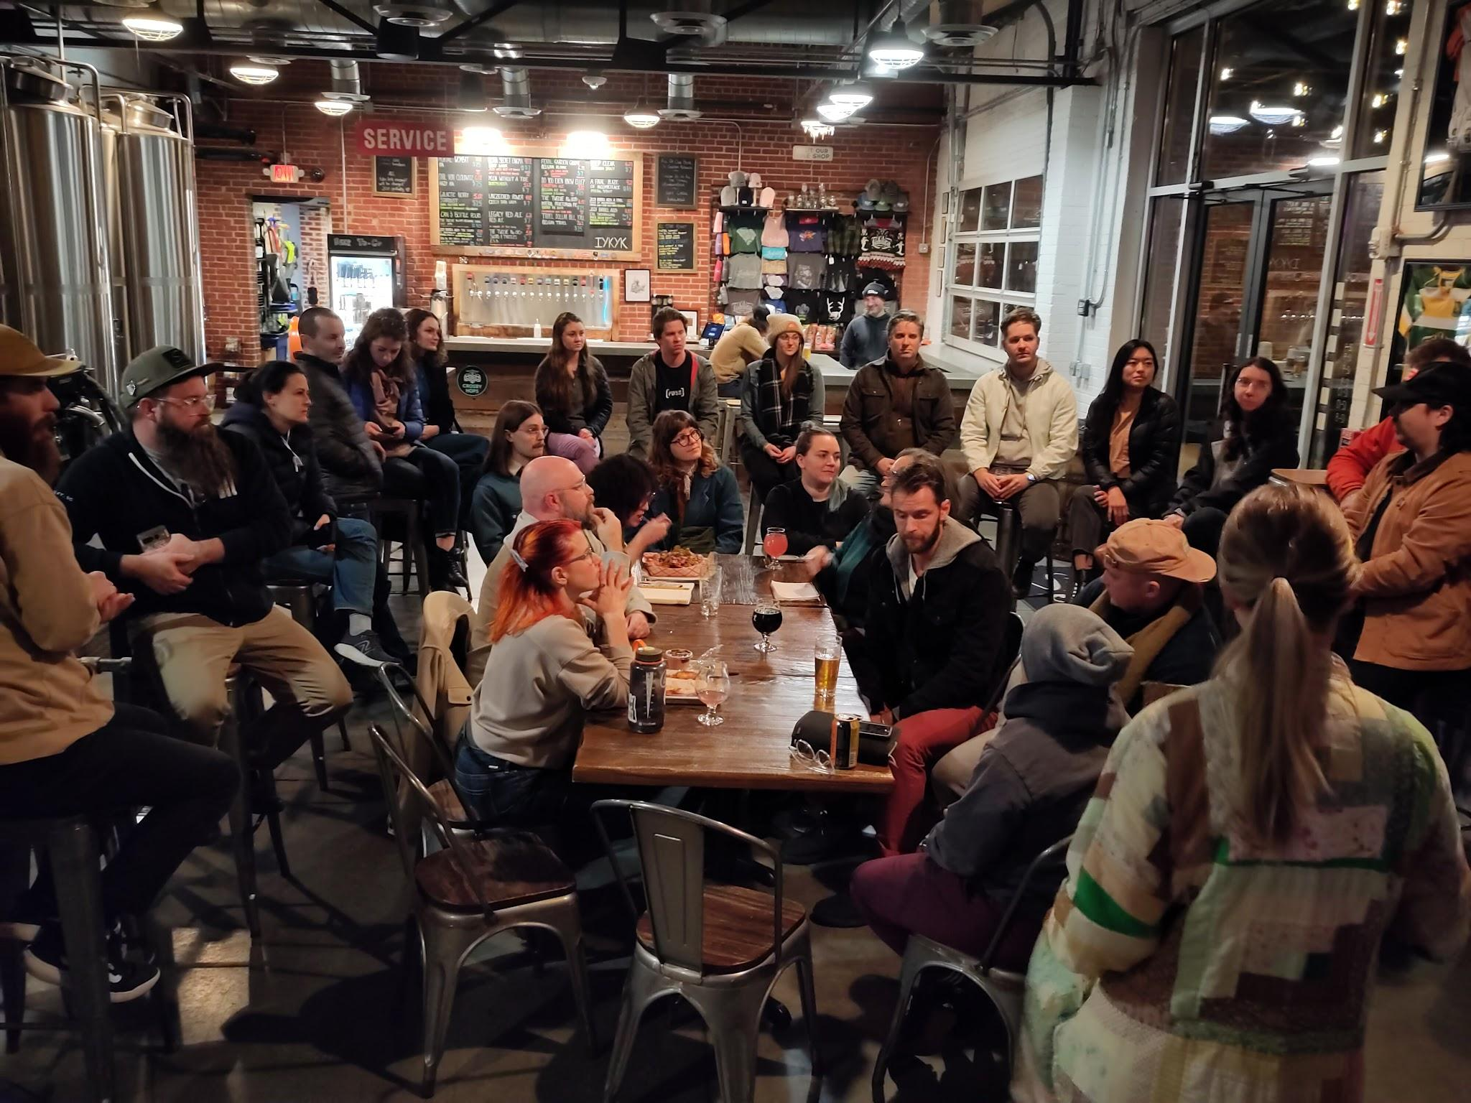
Founded by Phil Allen (Bricolage Dynamics/Liability Brewing Co.) and Kendall Daly (Amend Market)
Created to establish a network of mission focused local business owners and non-profit organizations to advocate for inclusive and sustainable growth for Upstate South Carolina.

Slide 15
Topics
Events
Pain points
How to get participation from customers/employees/general public
Guest speakers (Brandy Amidon & Erin Predmore)
Periodic goal check-ins
Current Projects
Light the Trail
Circularity of glass recycling
Looking ahead
UIC volunteer days
Public involvement
501(c)3 status
County Council Presence

Slide 16
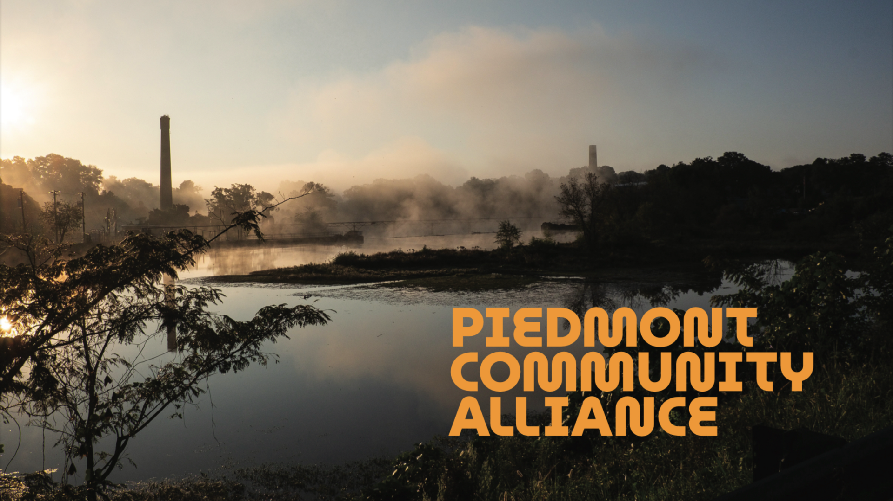

Slide 17
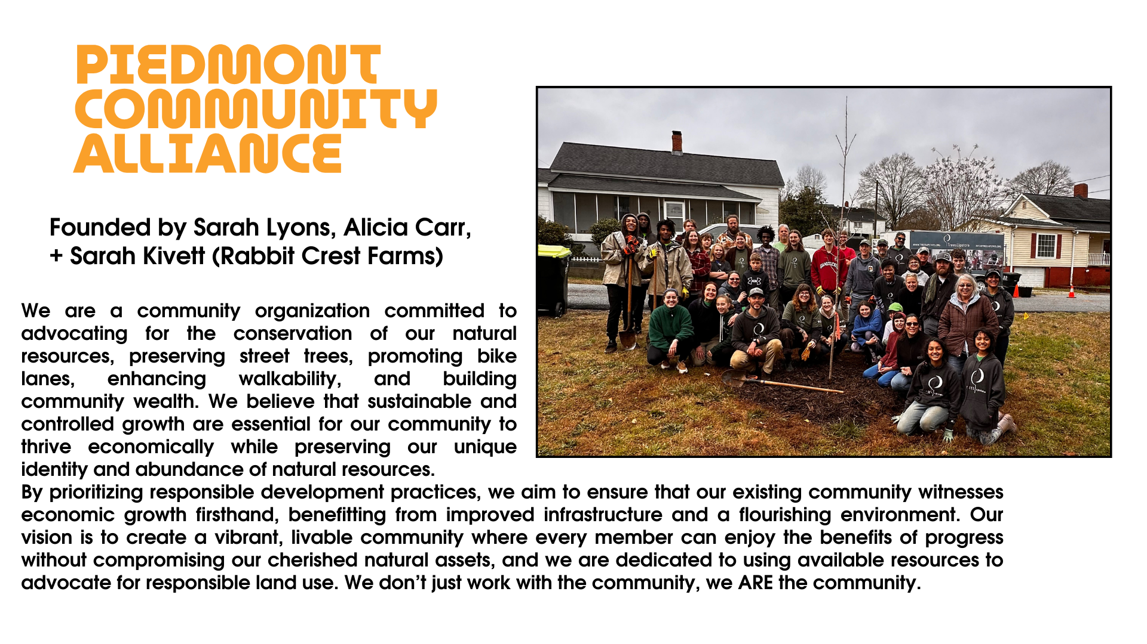

Slide 18
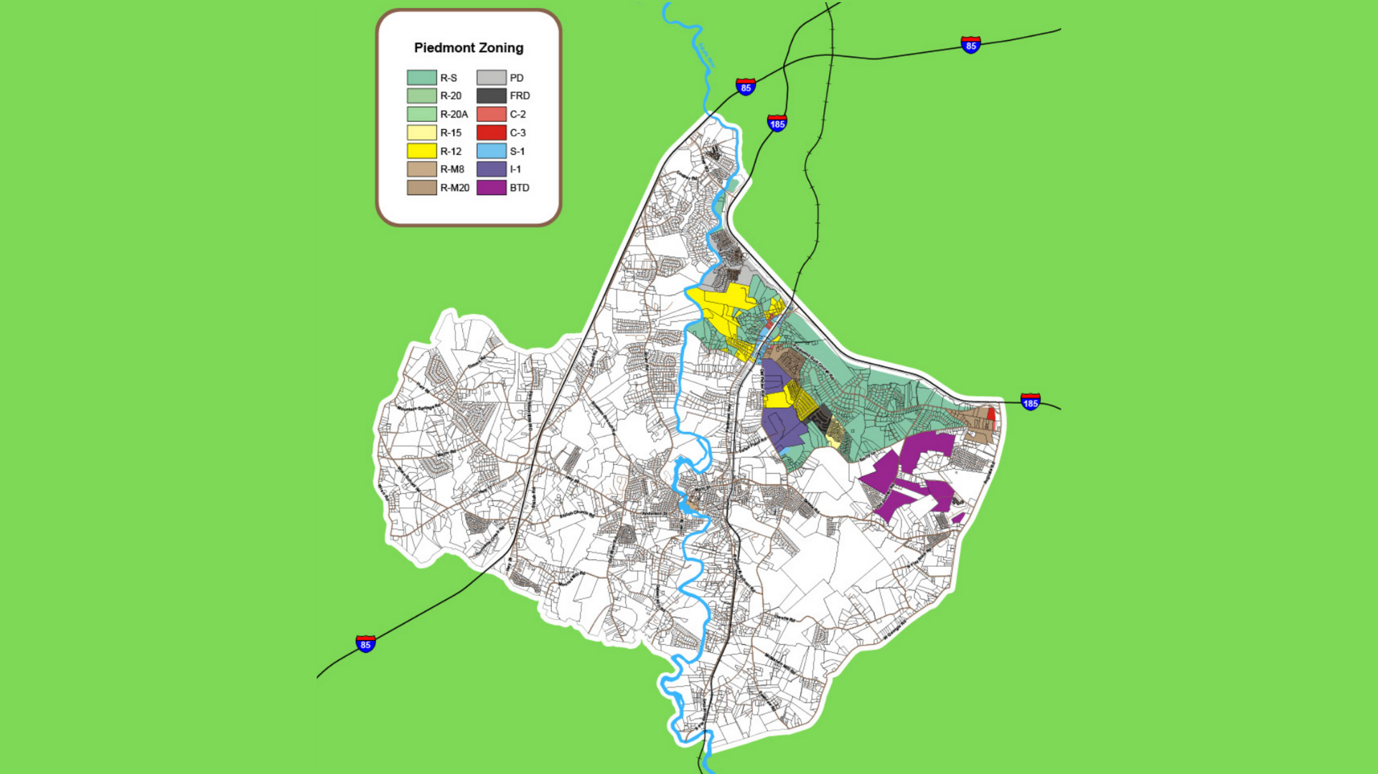

Slide 19
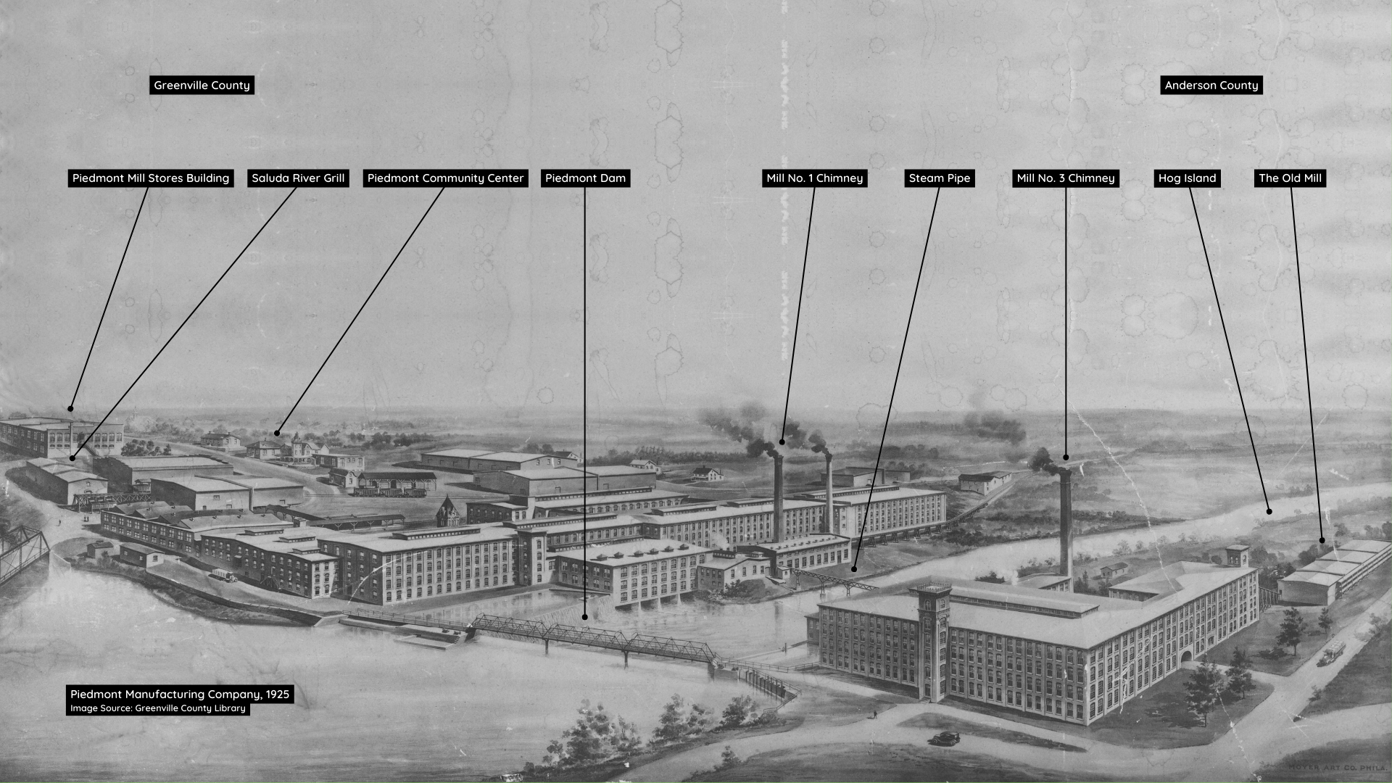

Slide 20
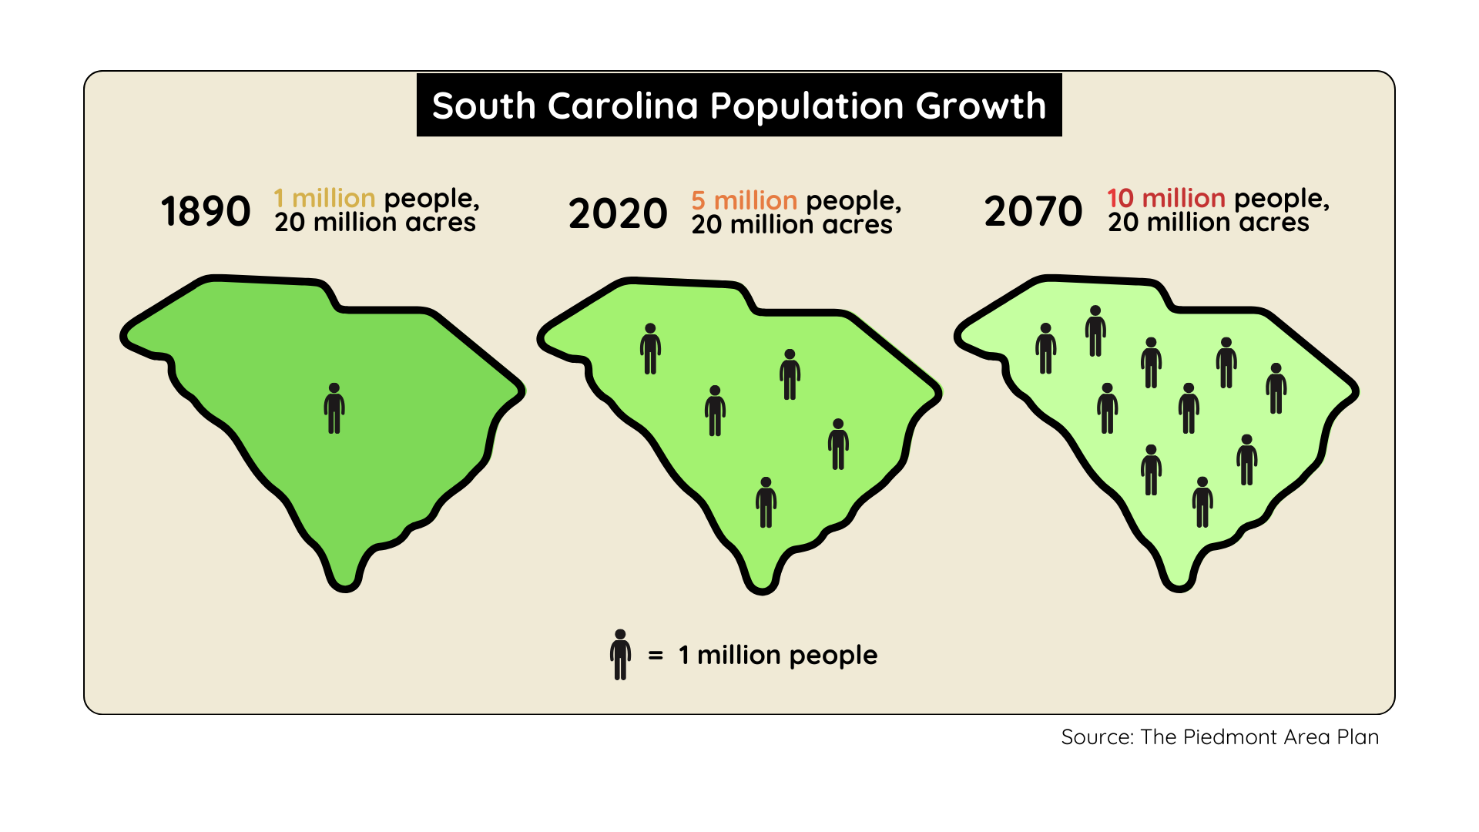

Slide 21
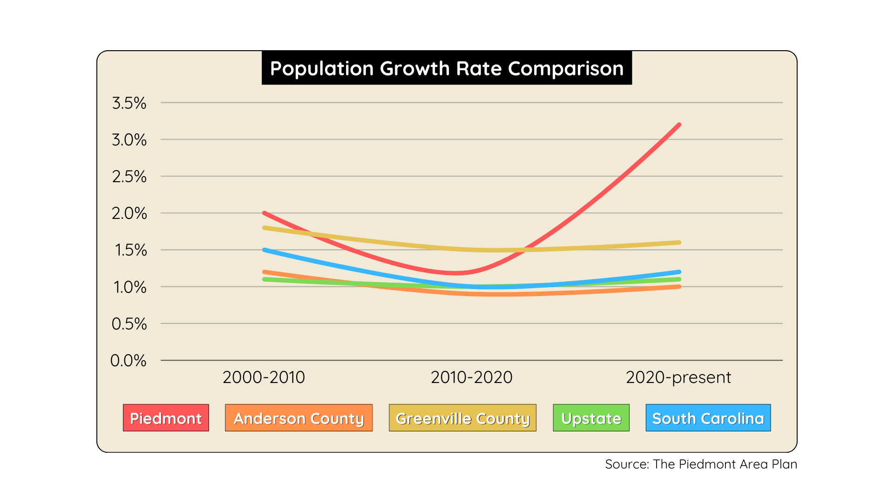

Slide 22
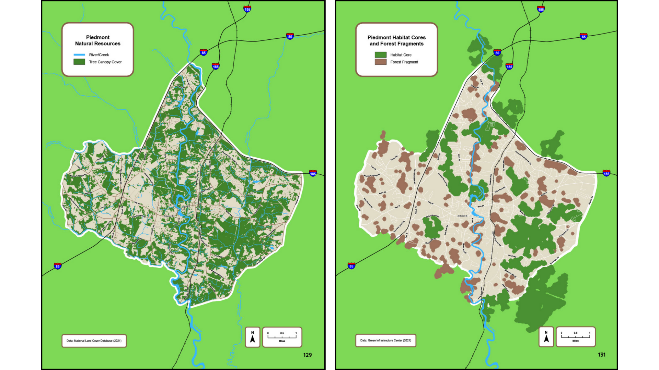

Slide 23
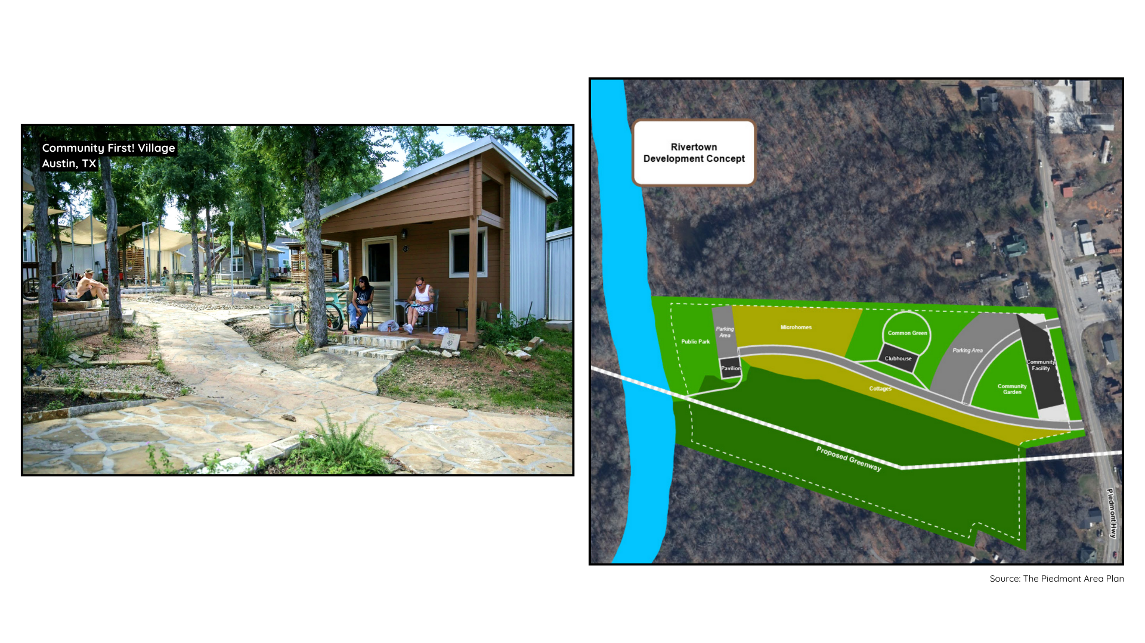

Slide 24
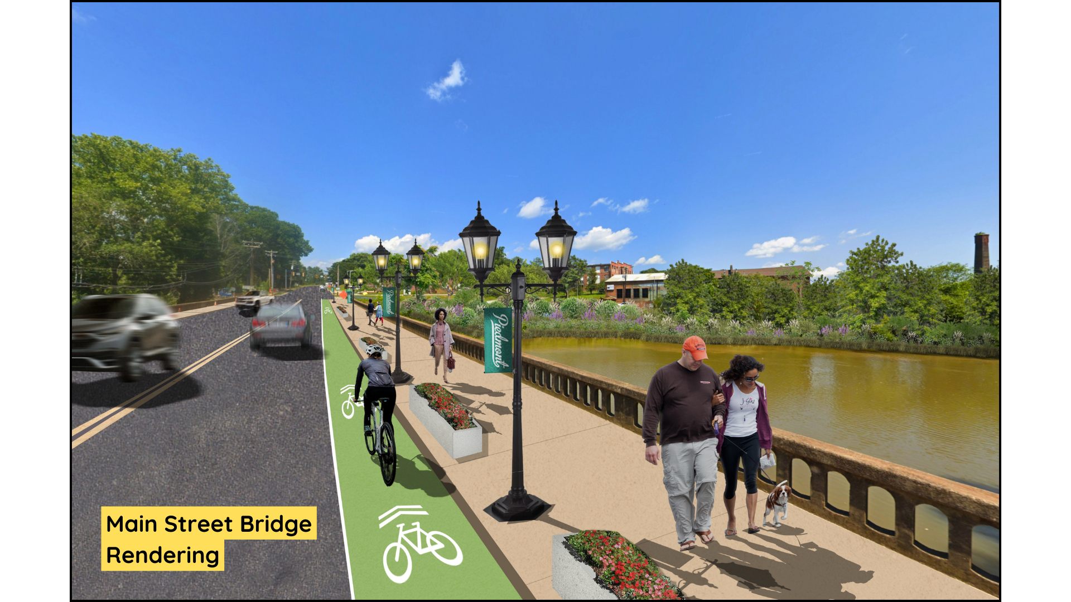

Slide 25
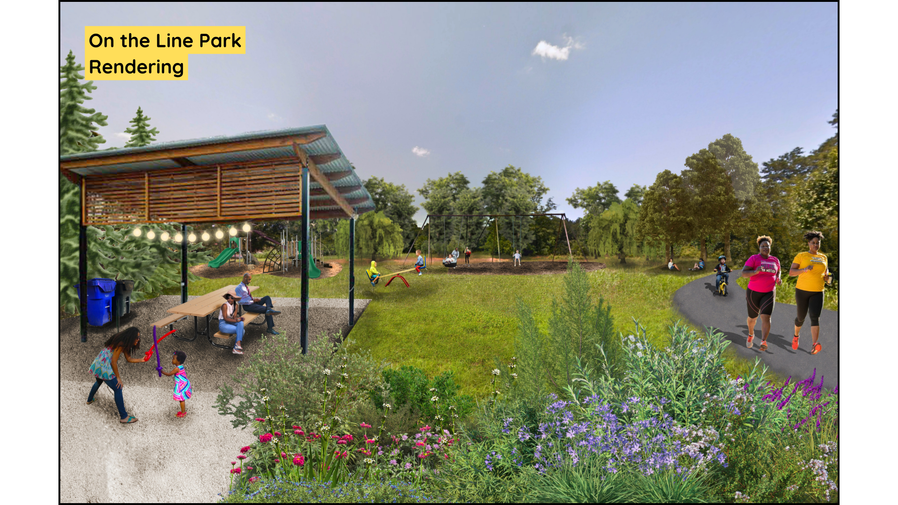

Slide 26
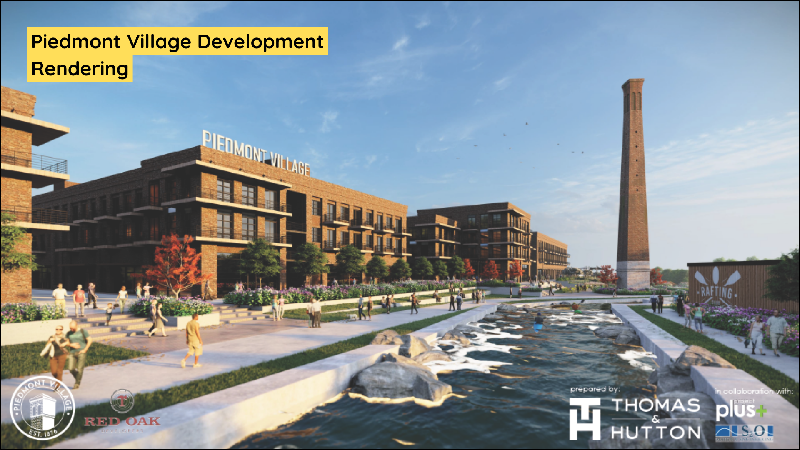

Slide 27
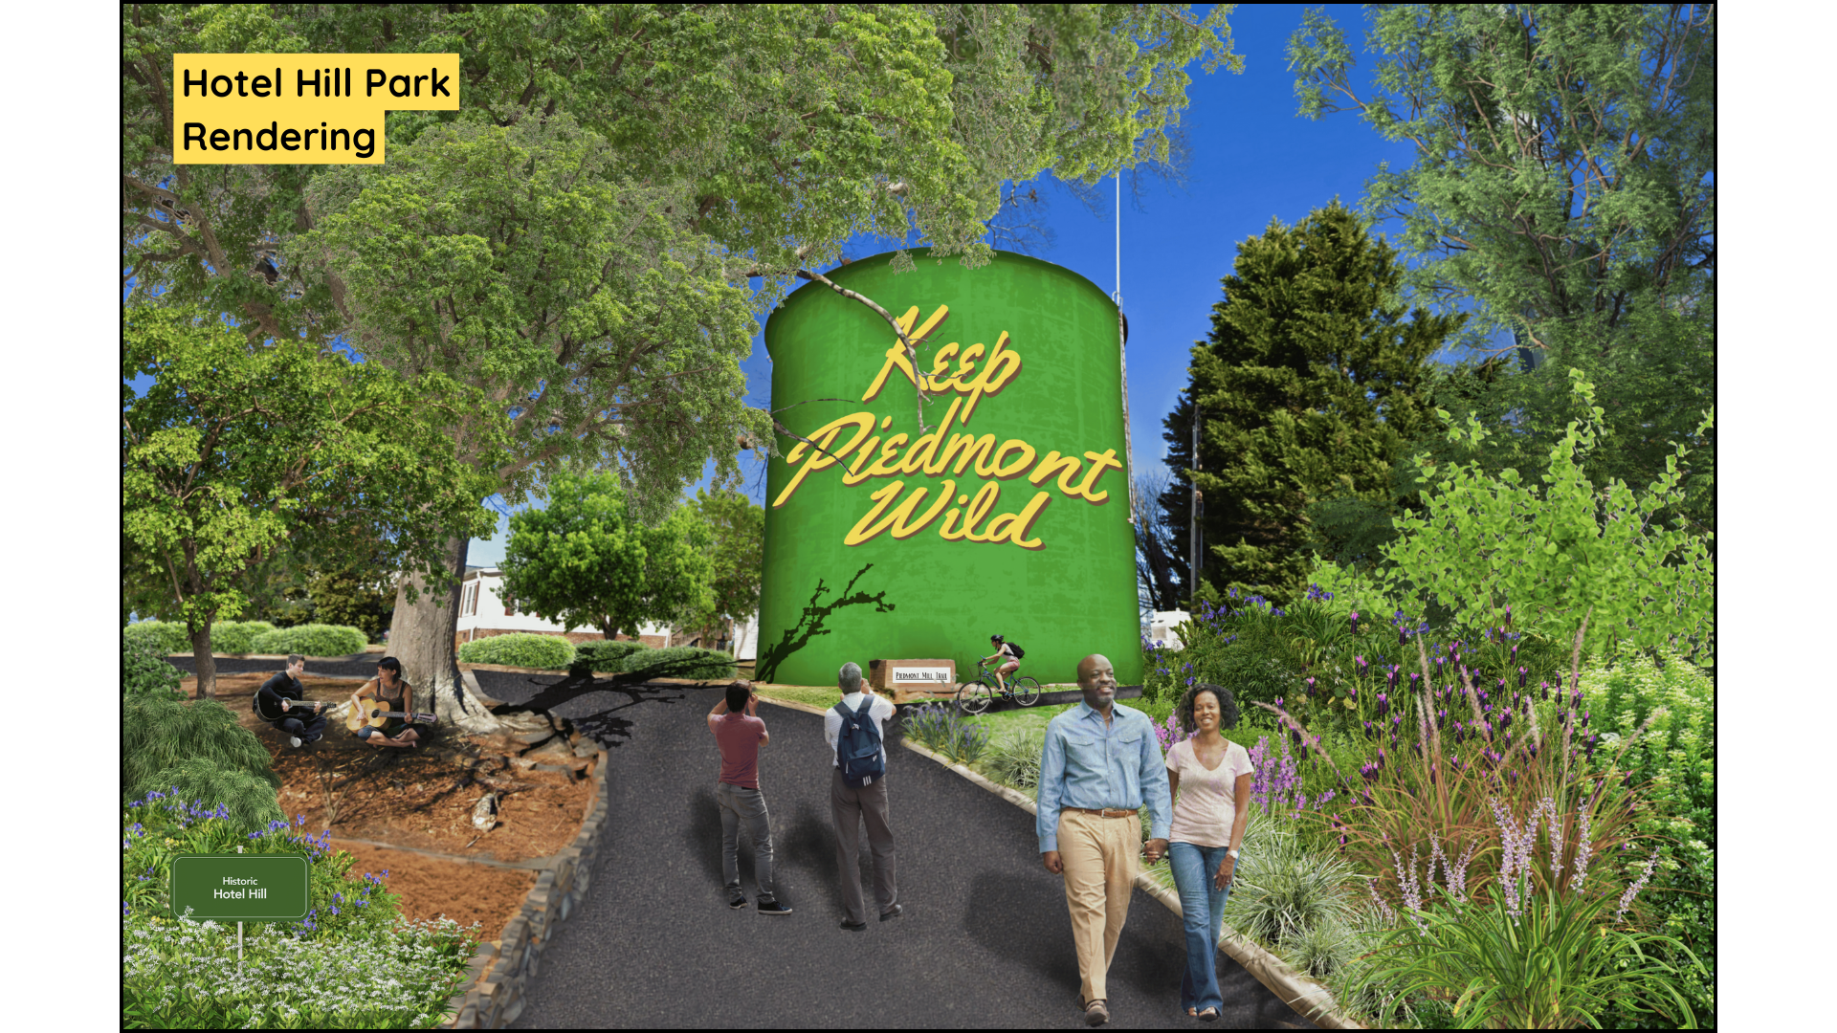

Slide 28
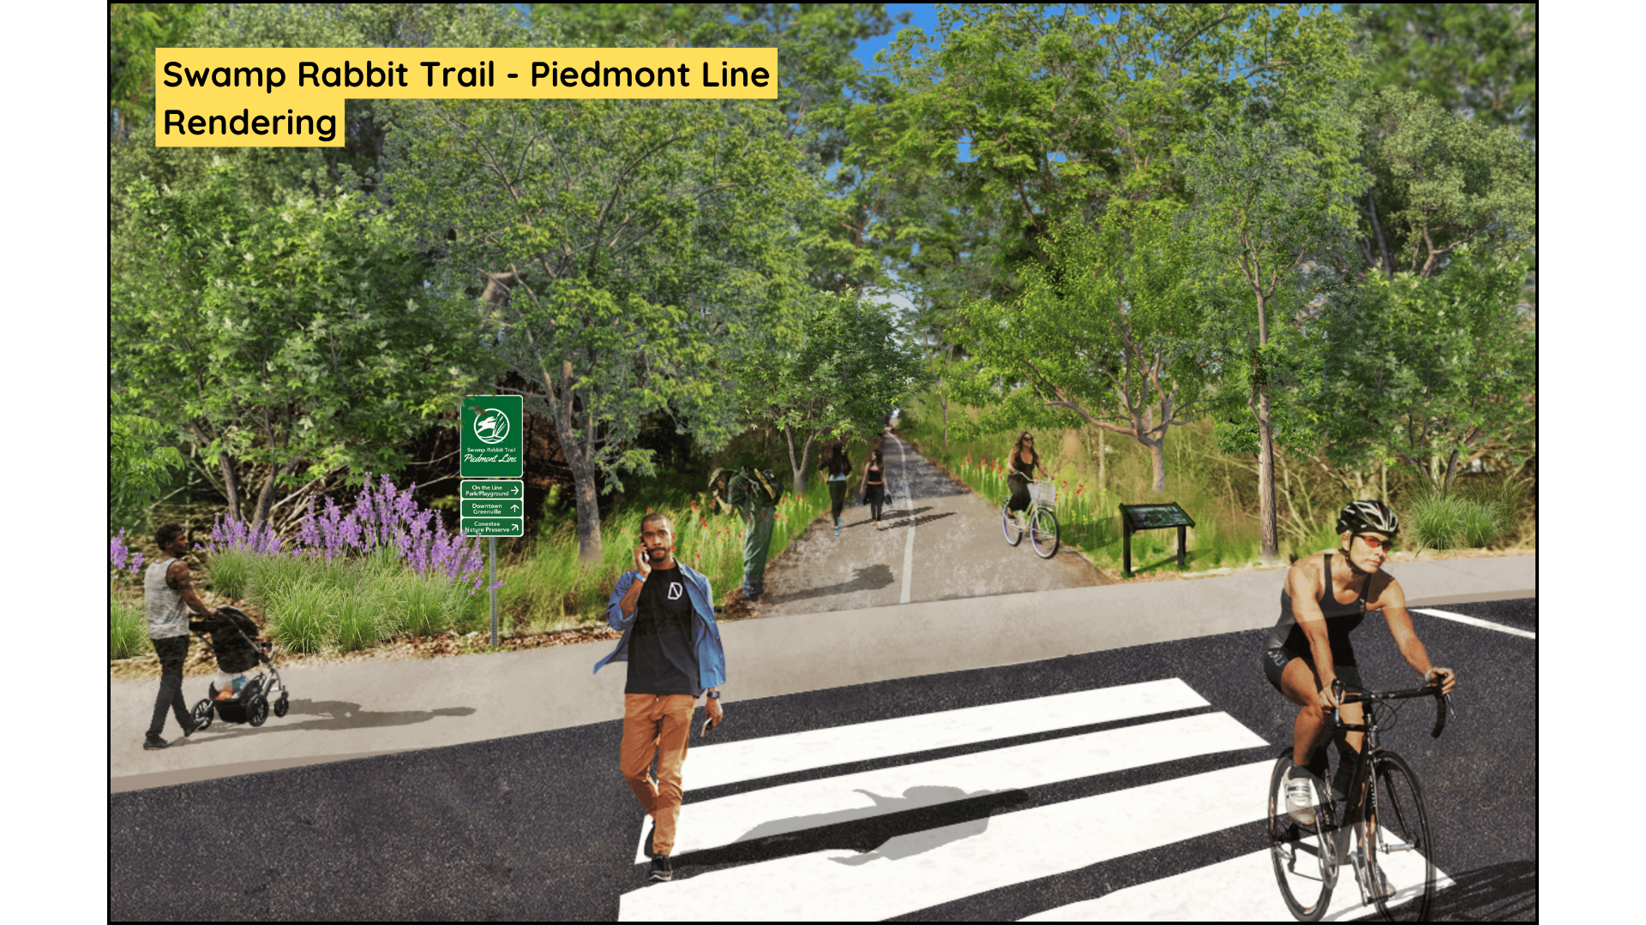

Slide 29
