Slide 1
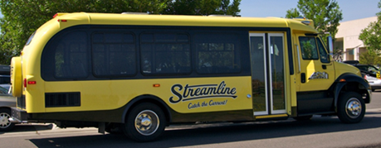
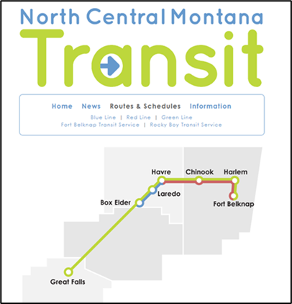
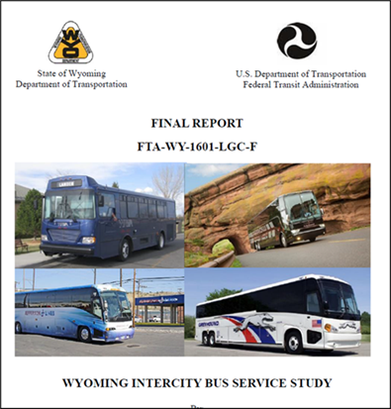
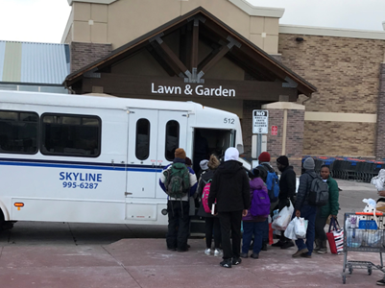
Mobility and Microtransit
Presentation for the 2024 NADO
National Regional Transportation Conference
David Kack
Director - Small Urban, Rural and Tribal Center on Mobility
Program Manager – Mobility and Public Transportation
Western Transportation Institute

Slide 2
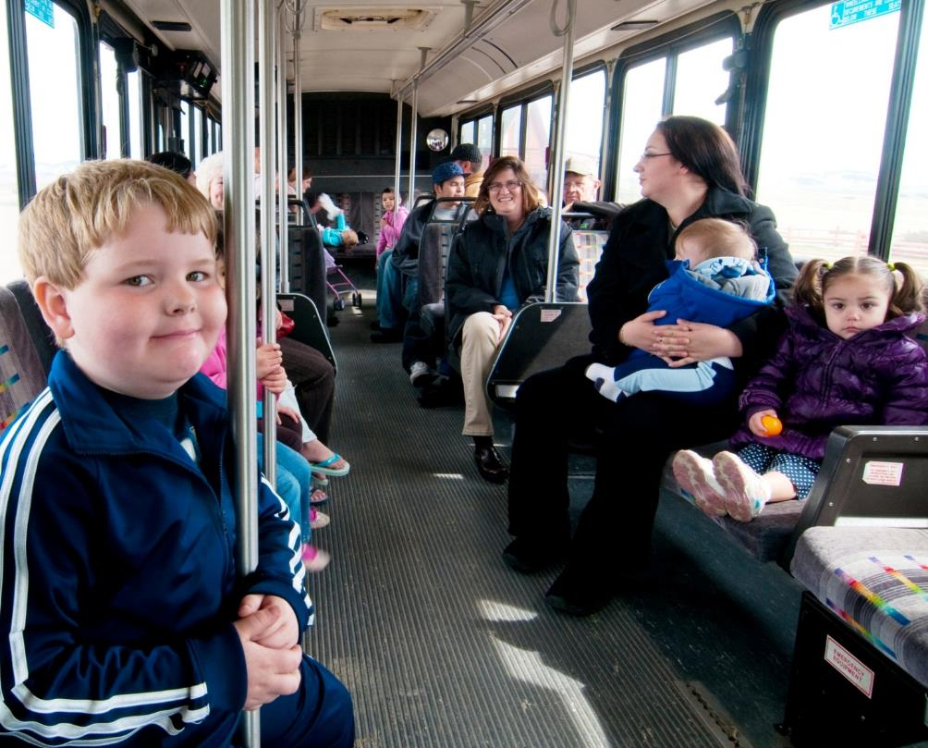
Mobility: A Means To An End

Slide 3
Cost of Mobility
Source: 2022 Consumer Expenditures. Bureau of Labor Statistics, U.S. Department of Labor
Note: In 1917 transportation was 2% of the budget, or the 6th highest expense

Slide 4
Cost of Mobility
Annual Cost to Own & Operate a Car
Annual Mileage | Small Sedan | Medium Sedan | Large Sedan | Small SUV | Medium SUV | Minivan | Pickup | Weighted Average
10,000 | $6,521 | $7,607 | $9,822 | $7,188 | $8,586 | $8,805 | $9,653 | $8,236
15,000 | $7,516 | $8,734 | $11,182 | $8,362 | $10,036 | $10,101 | $11,308 | $9,561
20,000 | $8,528 | $9,880 | $12,566 | $9,560 | $11,518 | $11,419 | $13,004 | $10,914
Note: Based on 250 working days,
10,000 miles equals 40 miles per day (20 miles each way)
15,000 miles equals 50 miles per day
20,000 miles equals 80 miles per day
Source: AAA Your Driving Costs 2020 Edition

Slide 5
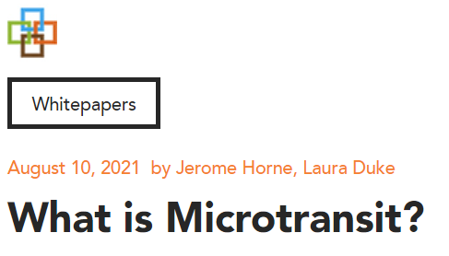
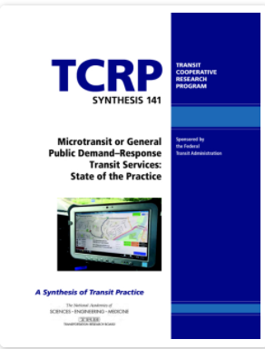


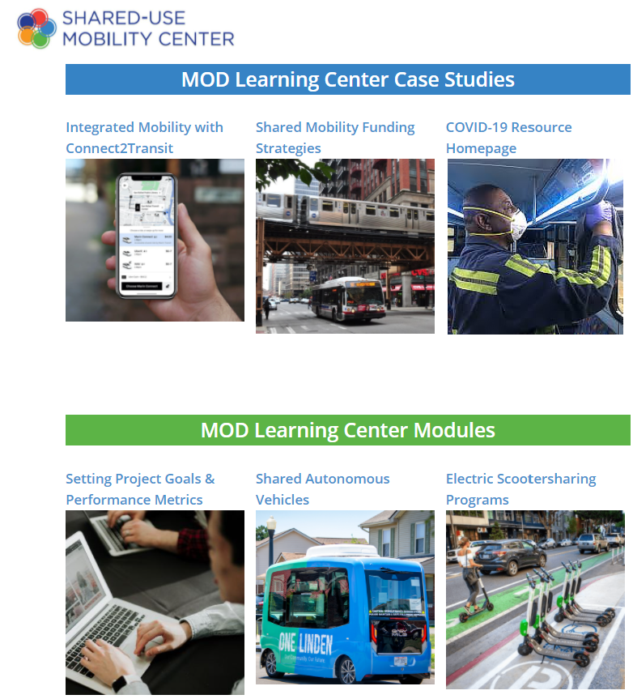

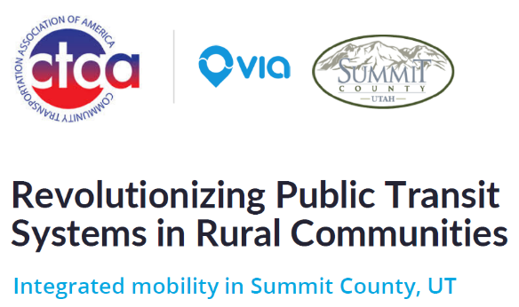
Key Sources
Full White Paper
Full Report
Recording
Reports
Webinars
Case Studies
Recording
Recording
Learning Center
Recording

Slide 6
What are the primary goals of transit? What is successful transit?
Performance Measures
Activity Participation
Trips Per Capita
Riders Per Hour
Cost Per Vehicle Hour
Cost Per Trip
Foregone Parking Expansion
Retail Sales
Dwelling Units Per Acre
Social Service
  Enable Upward Mobility
  Enhance Quality of Life
Resource-Efficient Movement
  Enable High Utilization of Assets
  Limit Space Needed for Travel Lanes & Parking
Catalyst for Economic Development & Land Use Changes
  Stimulate Densification
Source: Just Around the Corner: The Future of U.S. Public Transportation (Polzin, 2018)

Slide 7
Why not always choose fixed route transit?
Significant Access Burdens
  Only Useful for Trips Starting/Ending Near Fixed Stops or For Those Willing/Able to Undertake Access Trips
  Riders Must Adhere to Schedules & Stop Locations
Efficiency Depends on Load Factors
  Empty or Mostly Empty Buses Can Be As Resource Intensive As SOVs
  Most Communities in the US Remain Reluctant to Reduce Parking
  Complementary Paratransit Required by ADA
Densification Takes Time
  Auto Ownership Remains High Even in Many Transit Rich Areas
  Complementary Investments May Get Stalled

Slide 8
When is microtransit the
right fit for your community?
Improve Upon Traditional Dial-a-Ride Demand Response
  Attract New Riders
  Meet On Demand Customer Expectations
Provide Service and Test the Market In Areas or At Times of Low Demand
  Test Previously Unserved Market
  Replace Underperforming Fixed Route
Provide Equal Access Across a Service Area
Provide Service In Areas With Inadequate Infrastructure for Fixed Routes (e.g. Sidewalks, Lighting)
Get Started
  Incremental, Customizable, Rapidly Deployed
“Set realistic goals. This is a low ridership service for low-density and low-demand areas or times.”
-TCRP Synthesis 141 (Volinski, 2019)

Slide 9
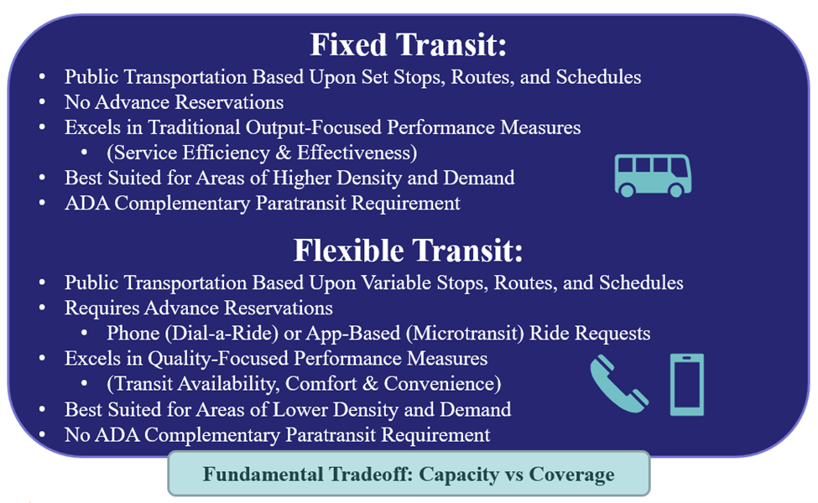

Slide 10
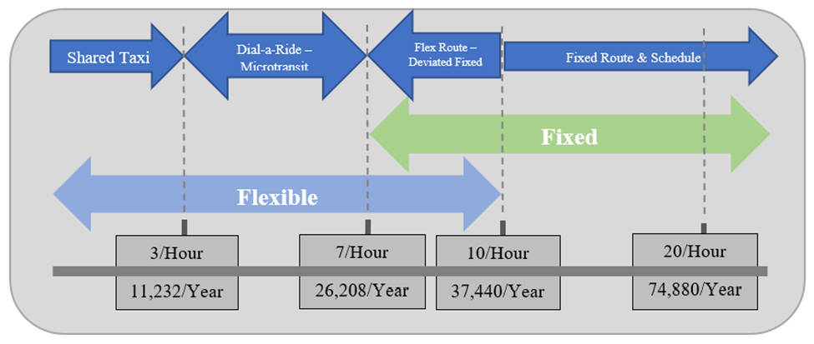
Riders per hour translated into annual estimates by WTI based upon 12 revenue hours per day, 6 days of service per week, and 52 weeks of service per year.

Slide 11
What are the next steps to bringing microtransit to your community?
Do you have a transit service budget?
  What is per capita transit funding (e.g., historically, peer communities)?
Do you already have drivers and vehicles you would like to retain?
  Software as a Service (SaaS)
  Competitive market with many vendors
  Typically contracted as per vehicle subscription with upfront installation fee
Do you prefer an all-in-one/turnkey service?
  Transportation as a Service (TaaS)
  Limited market
  Typically contracted as overall service fee with optional farebox sharing
Do you have existing transit providers to coordinate with?
Get started!
  Reach out to peers with microtransit programs
  Contact vendors
  Develop RFP

Slide 12
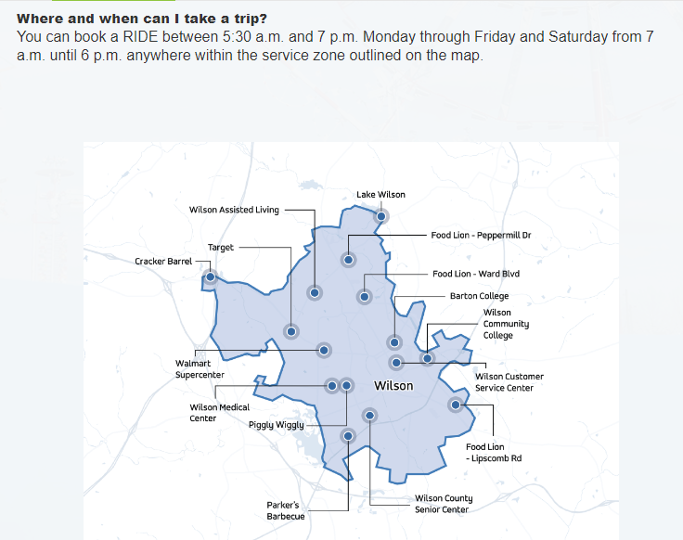
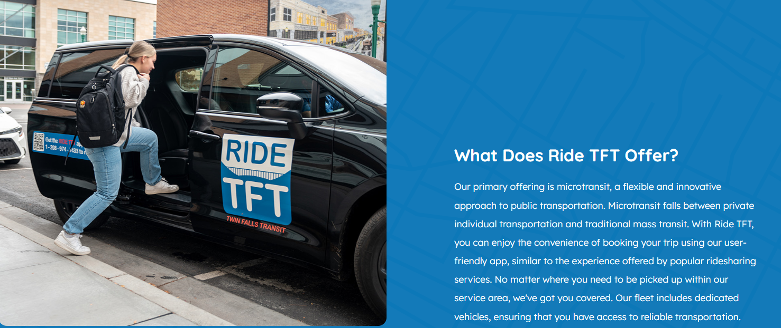
Microtransit Implementation
Wilson, NC (RIDE September 2020)
Idaho Falls, ID (Greater Idaho Falls Transit “GIFT” June 2022)
Twin Falls, ID (Twin Falls Transit “TFT” July 2023)
Gastonia, NC (July 1, 2024)

Slide 13
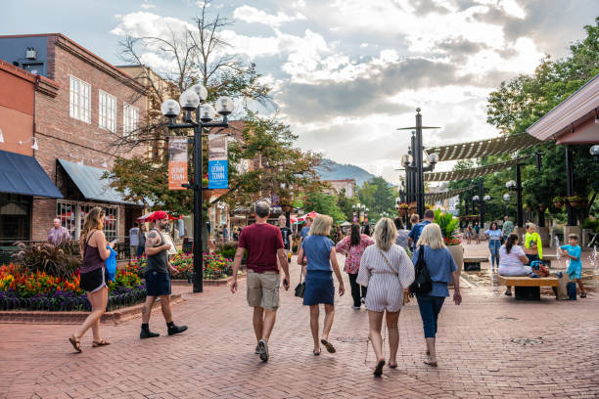
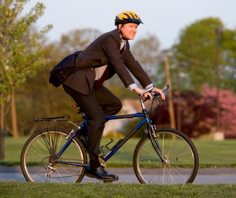
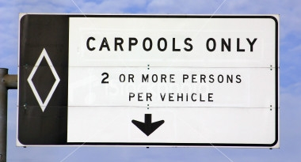
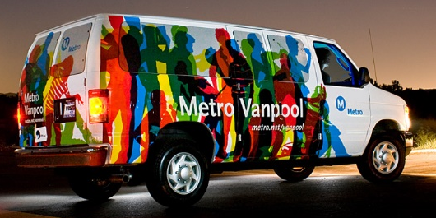
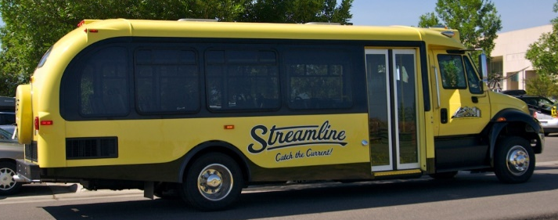
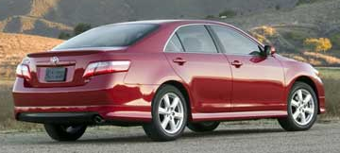
Continuum of Transportation

Slide 14
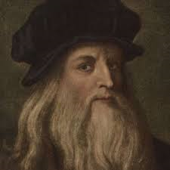
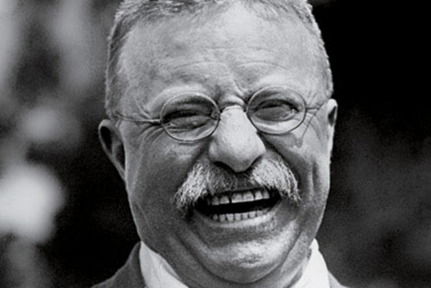
Inspiration
“I have been impressed with the urgency of doing. Knowing is not enough; we must apply. Being willing is not enough; we must do.”
-Leonardo Da Vinci
“Progress is accomplished by the man who does things”
-President Theodore Roosevelt

Slide 15
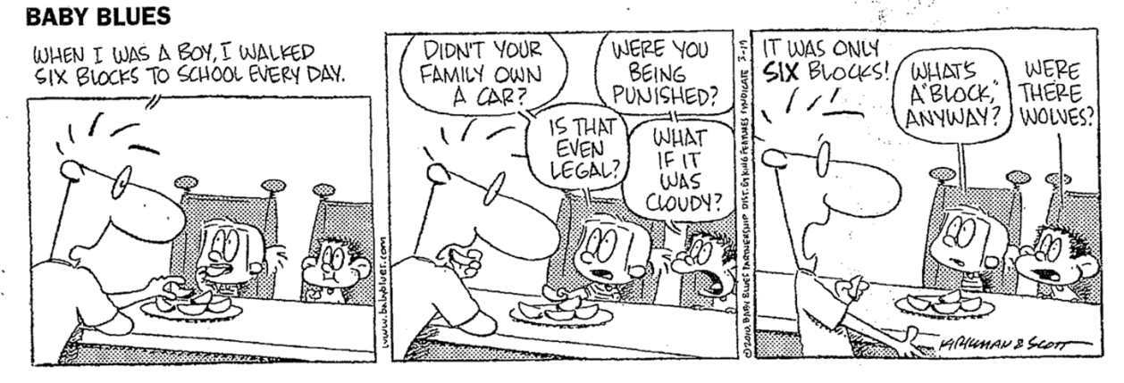
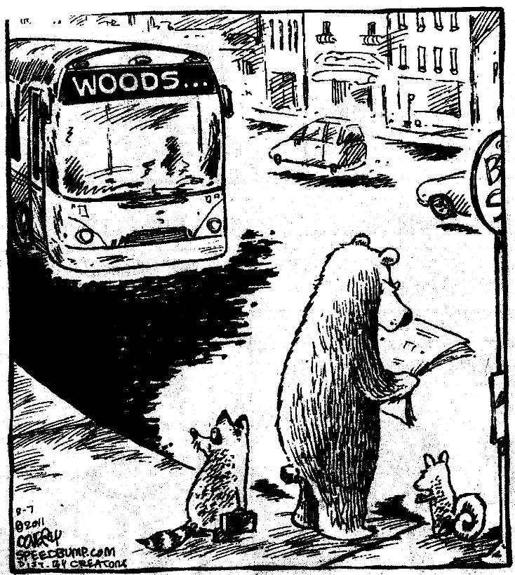
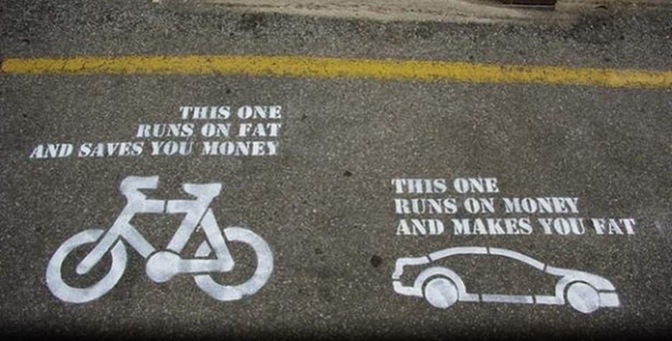
Questions & Discussion

