Slide 1
Get ‘NERDE’: A Data Deep Dive with Argonne National Laboratory
May 16, 2024
Alison Turner
Argonne National Laboratory
Southwest Region Economic Development Association Annual Conference 2024

Slide 2
Quick Disclosure
The statements, findings, conclusions, and recommendations are those of the author(s) and do not necessarily reflect the views of Argonne National Laboratory nor our sponsors at the Department of Energy nor the United States Economic Development Administration.

Slide 3
National Economic Research & Resilience Center (NERRC)
About Us
We provide innovative and transparent economic data access, research, and analysis to support and strengthen economic development and resilience in communities across the nation.
Find us at: https://www.anl.gov/dis/national-economic-research-resilience-center

Slide 4
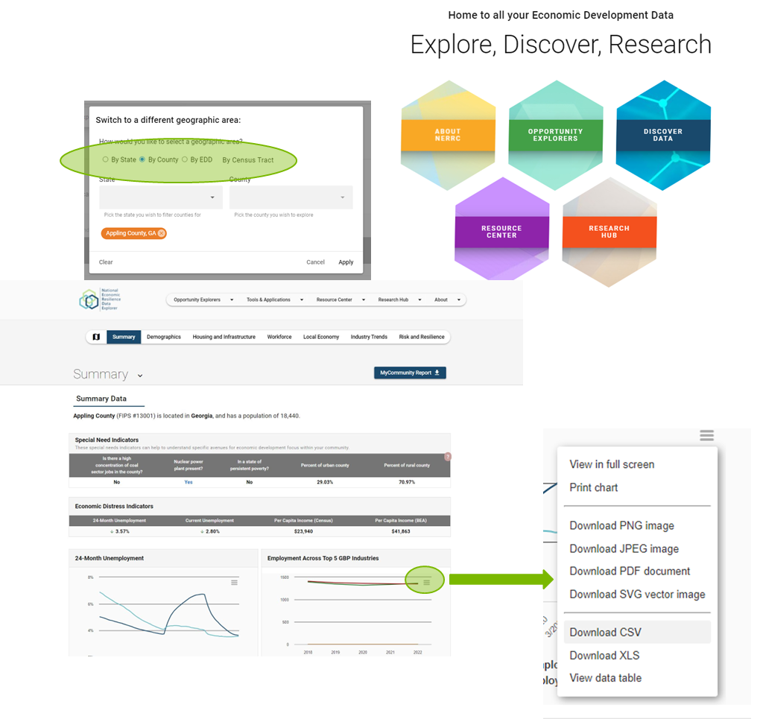
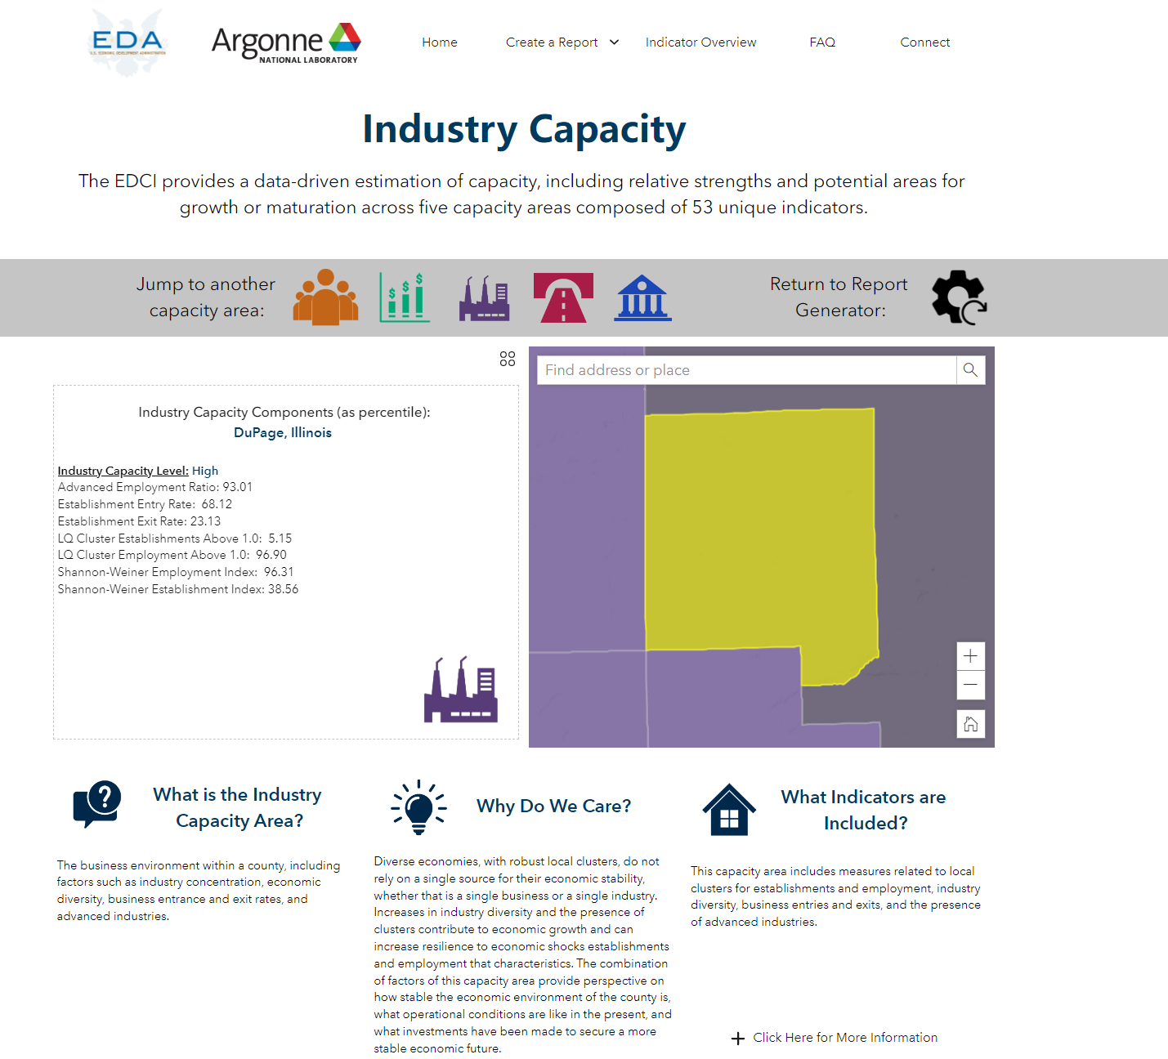
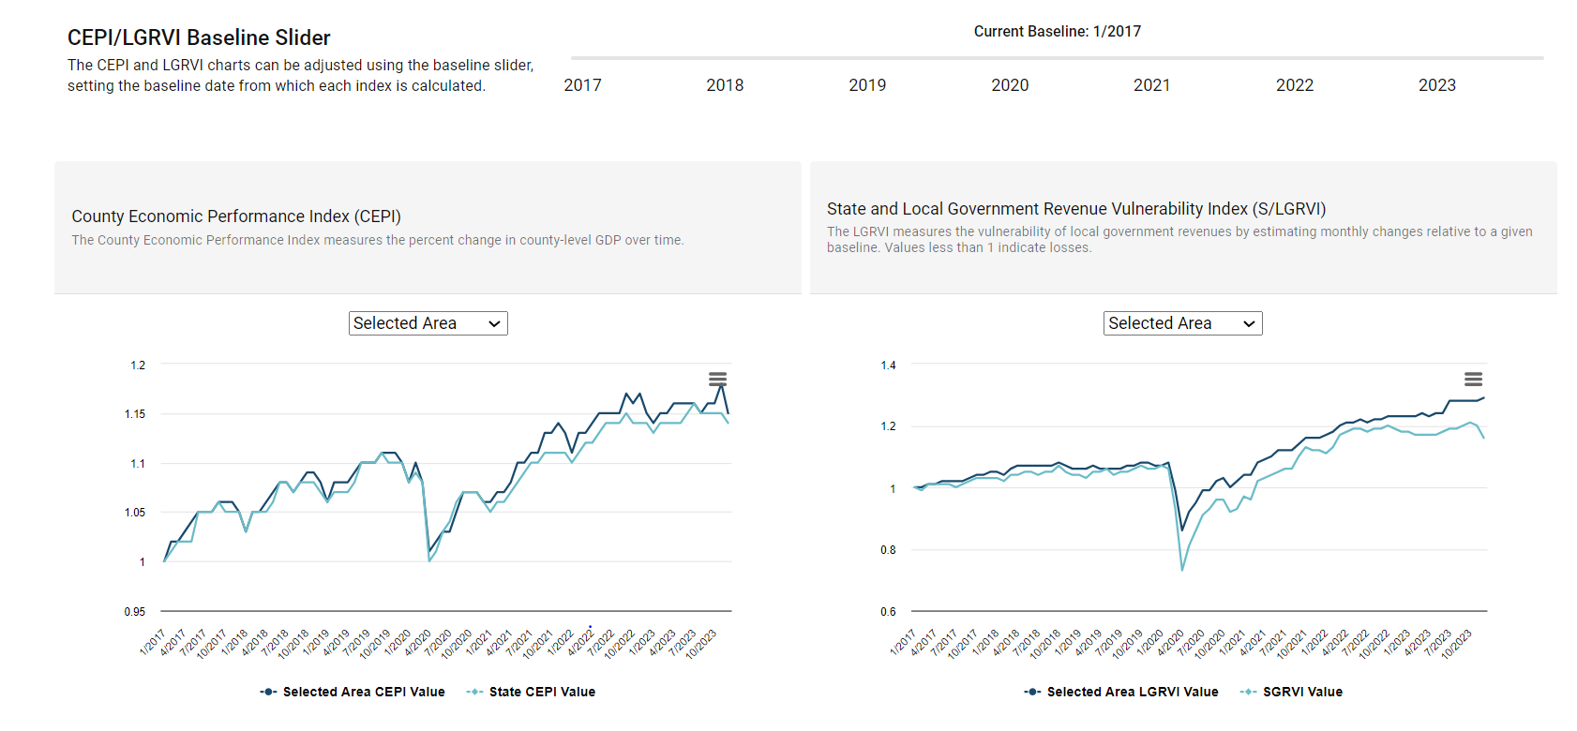
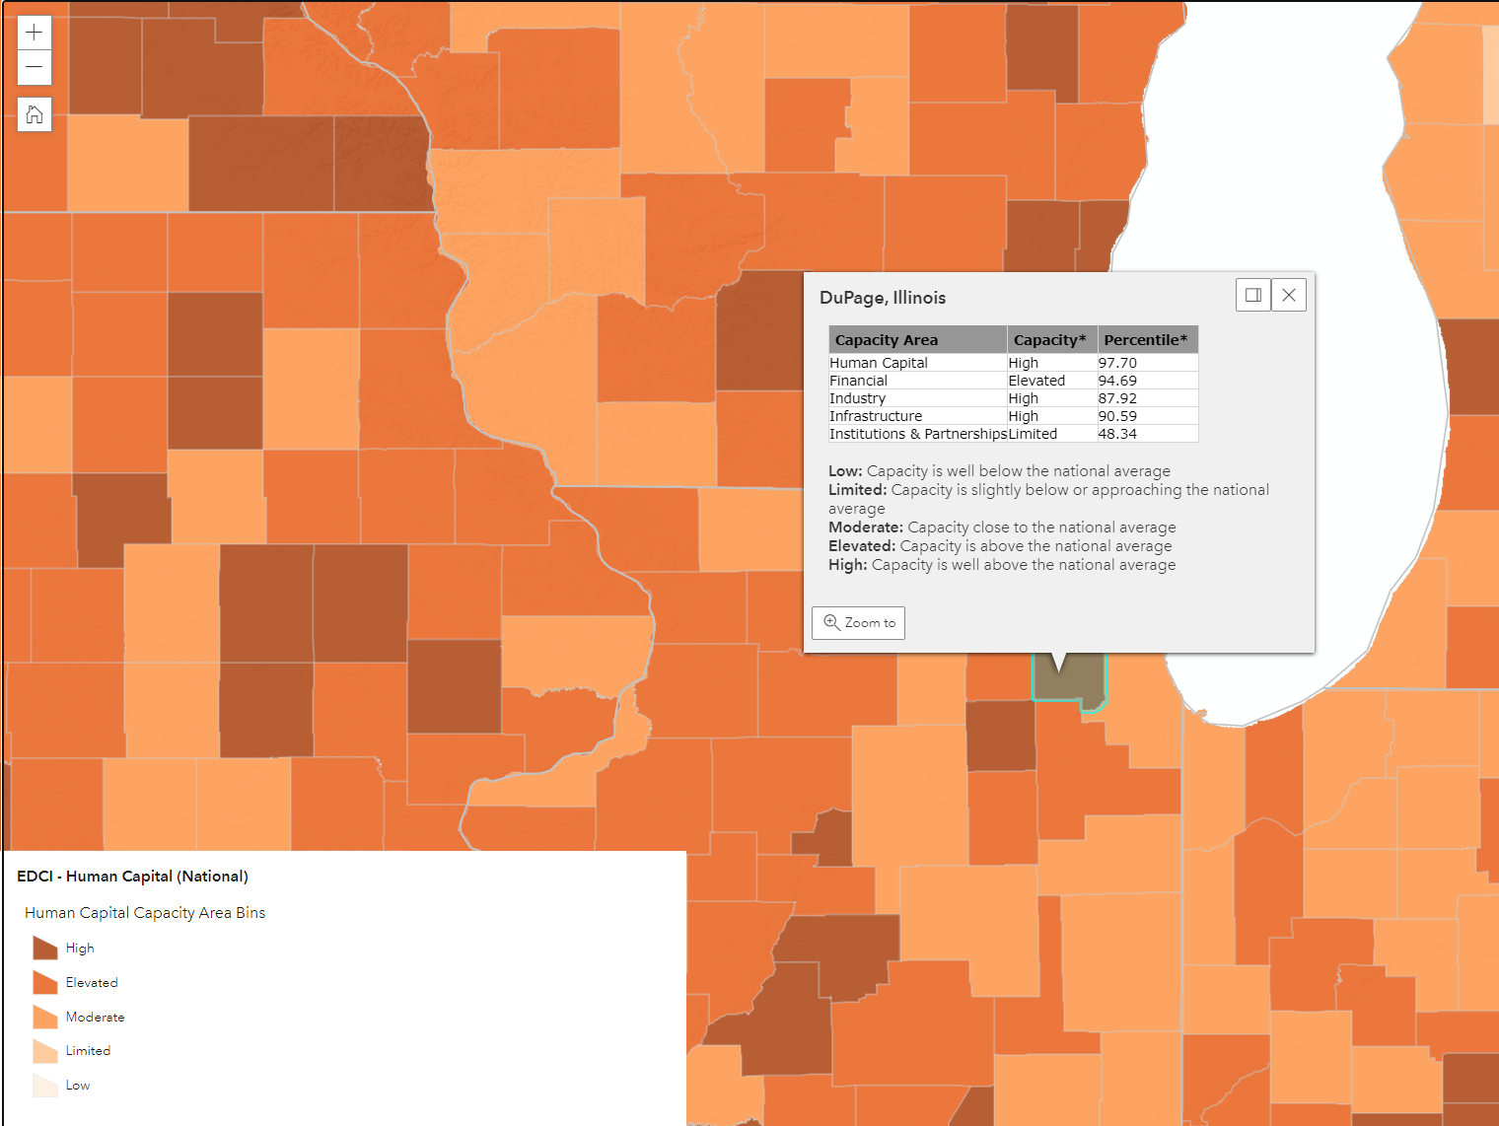
Tools and Models
National Economic Resilience Data Explorer
Economic Development Capacity Index
Economic Performance and Government Revenue Indices
Near-real time measures of economic activity
Assessment of county-level capacity, strengths, and opportunities for investment
Baseline economic context

Slide 5
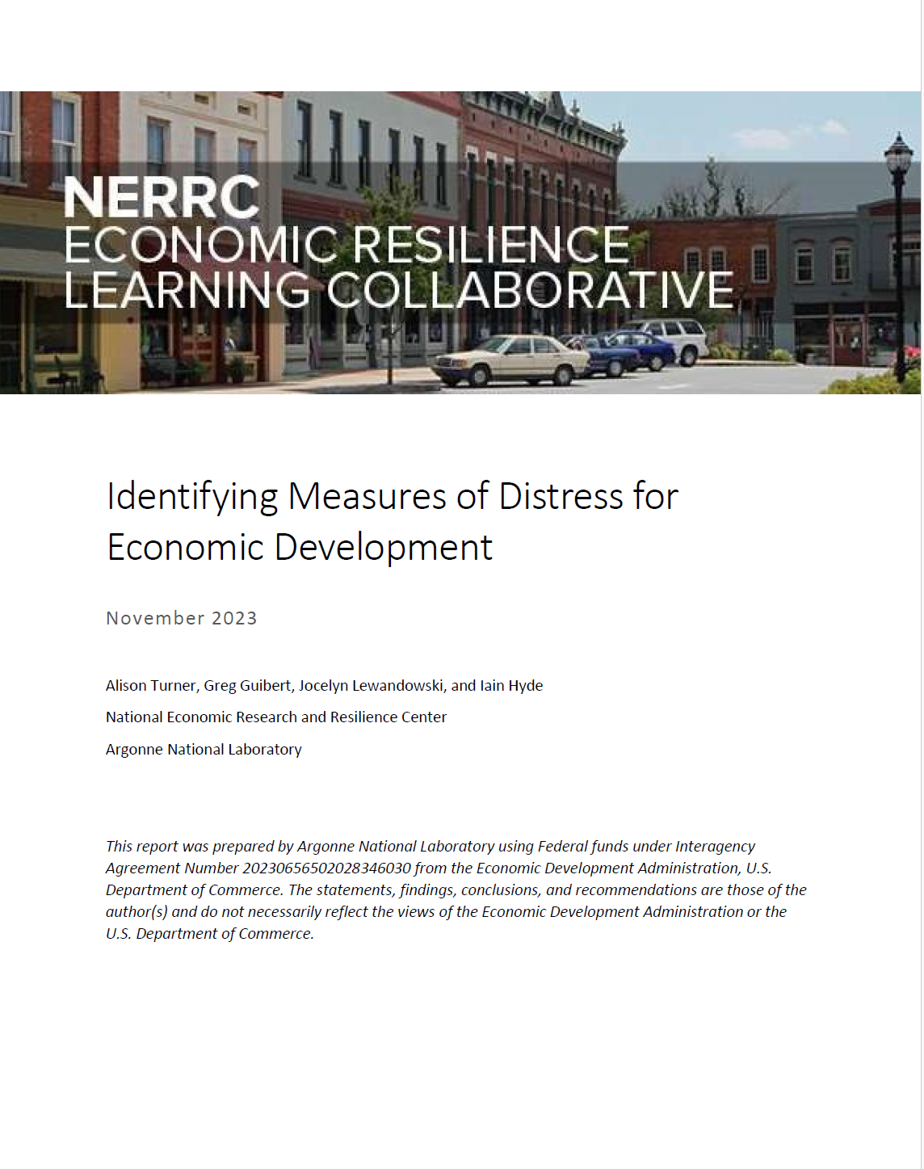
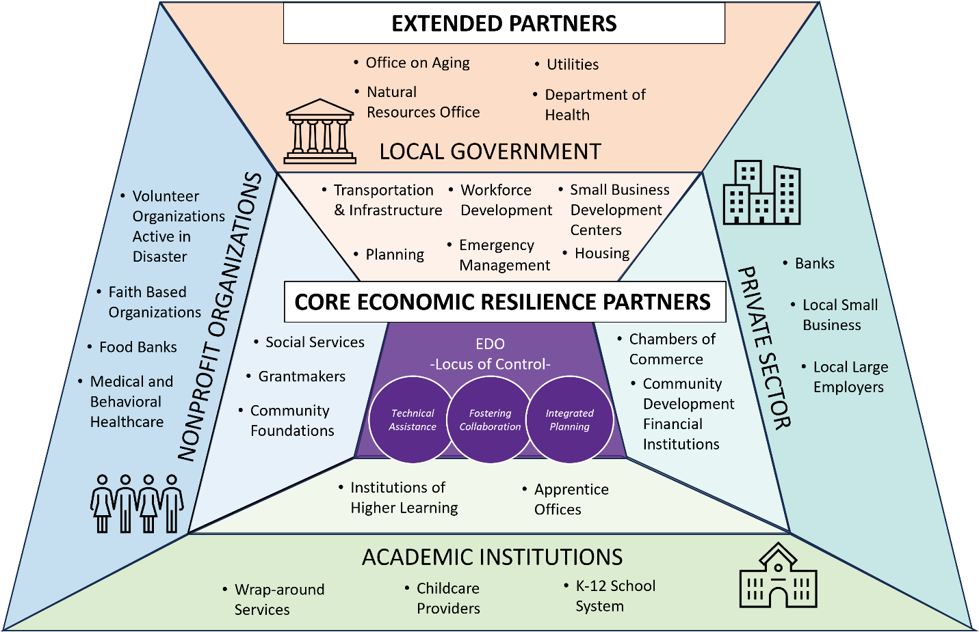
Our Research
Quarterly Research Briefs
Equity in Economic Development
Building Resilience through Economic Development
Identifying Indicators of Economic Distress

Slide 6
Data for Your Community

Slide 7
The 3-D Principals of Data
Diagnosis
Decision Making
Discovery
Discovery
Asking questions
Understanding Space, Time, and Source
Diagnosis
Evaluation of quality
Relationships between metrics
Decision Making
Communication
Coming back to the question

Slide 8
Discovery - Asking the right questions
Diagnosis
Decision Making
Discovery
Determining community questions
Trust your instincts
Write it down
Keep it simple
Aligning with performance metrics

Slide 9
Discovery - Finding the right data
Diagnosis
Decision Making
Discovery
Research
Pros | Cons
Can be done from your office | Can require high technical skill
Shorter time period | May not answer your exact question
Less up-front analysis required | Collaboration with data nerds
Collection
Pros | Cons
Tailored results | Data entry errors
Community trust building | High cost
Survey experience | Potentially high analysis required (aka, collaboration with data nerds)

Slide 10
Discovery - Finding the right data
Diagnosis
Decision Making
Discovery
National Tools
NERDE
Census/American Community Survey
State Data
Bureaus of Business and Economic Research
State procurement offices/state pricing
Local Sources
Assessors
Local traffic data
Emergency call logs

Slide 11
Discovery - NERDE
Diagnosis
Decision Making
Discovery
Distress Statistics Generator
Grant Applications
Data Explorer
CEDS Content Guidelines
Disaster Recovery Plans
Area Fact Sheets
Progress reports
Annual updates
Board reports
EDCI
Measurement and Evaluation

Slide 12
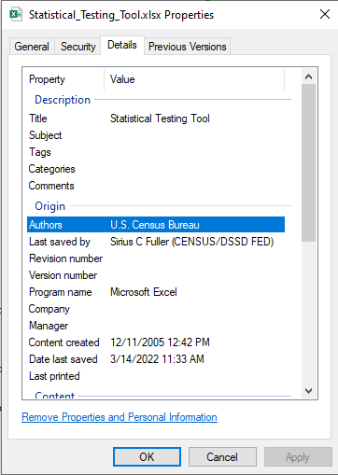
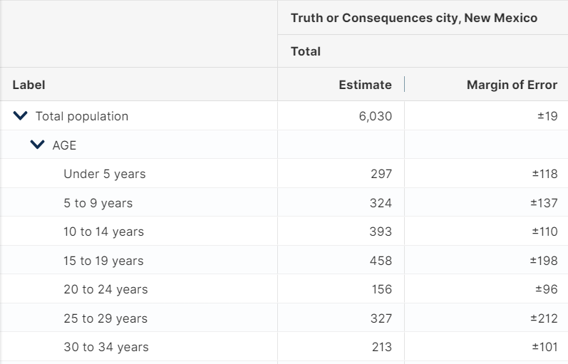
Diagnosis – What’s the quality?
Diagnosis
Decision Making
Discovery
Where did this file come from?
What are the margins of error?

Slide 13
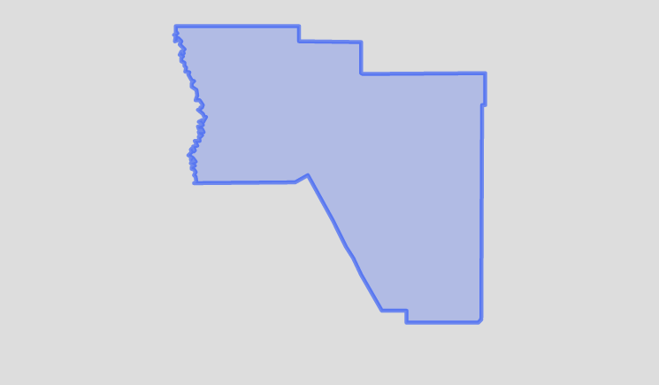
Diagnosis – Geographic Constraints
Diagnosis
Decision Making
Discovery
Sparse populations
Small Areas
Timing
Redistricting
Vignettes
Question consistency

Slide 14
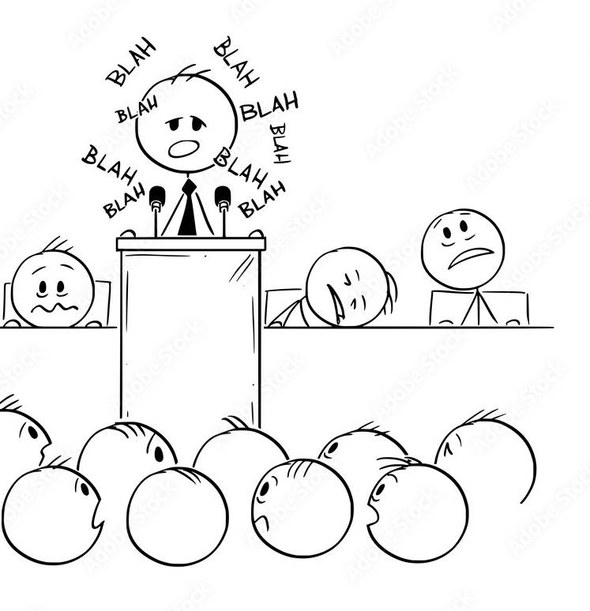
Decision Making – Displaying and Describing Data
Diagnosis
Decision Making
Discovery
Context
Ensure narrative connects
Communication
Create approachable visuals
Connection
Follow up with community members

Slide 15
The Future of Figures

Slide 16
The Future of Figures
Place Based Policy
Large Language Models (AI)
Networks and Machine Learning
Big Data

Slide 17
Place Based Policy
Increased federal focus on local
Local economic strengths
Business recruitment and retention
Workforce development
Economic redevelopment

Slide 18
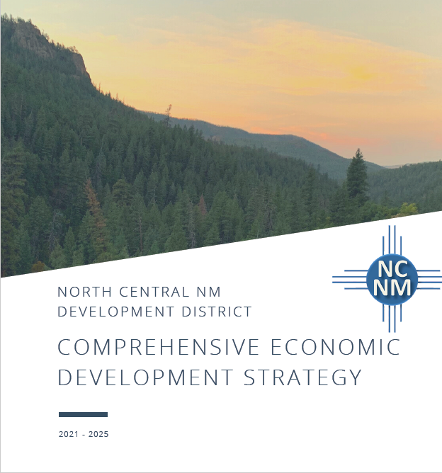
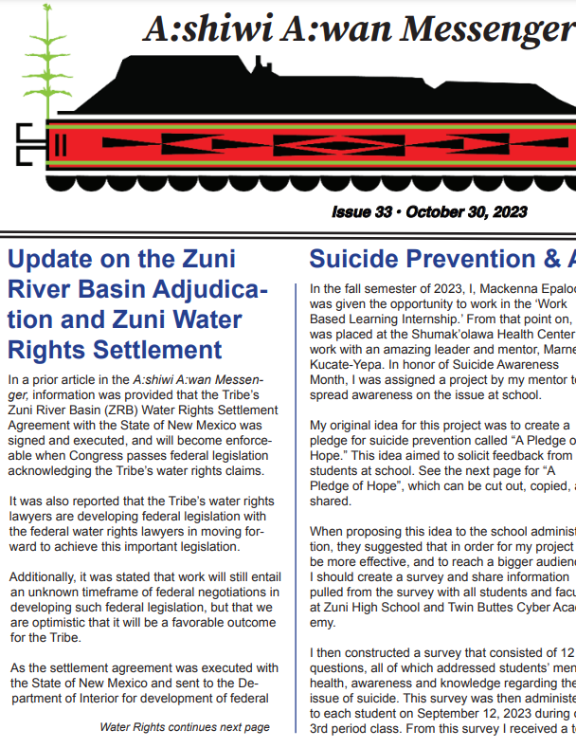
Large Language Models and Natural Language
Use of qualitative data
Data mining
Leaning into stories

Slide 19
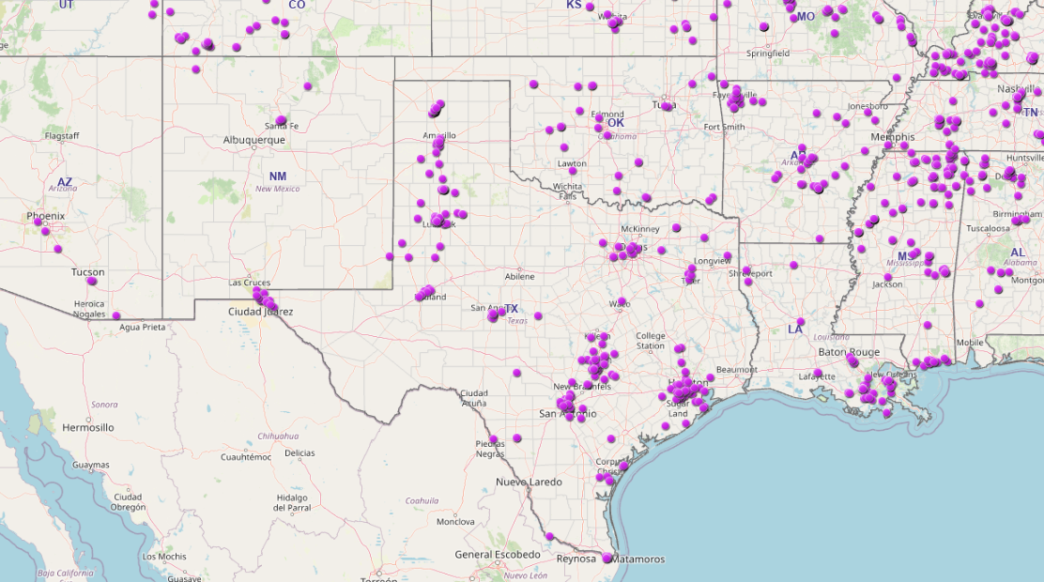
Networks and Machine Learning
Network – How things are connected
Meeting data
Emails
Community structure
Machine Learning – programs ingesting data and finding patterns
Requires large amounts of data
Requires grounding in reality

Slide 20
Big Data
Collecting from new sources
Financial transactions
Social media
Creating a mixed base of information
Supplementation
Validation

Slide 21
Recap
Harnessing good data can increase funding, streamline process, and improve project outcomes
Leveraging local knowledge can increase data quality and reveal bias
Key points when using data for local area planning:
Geographic description
Data validation (and error)
Data collection
Data storage

Slide 22
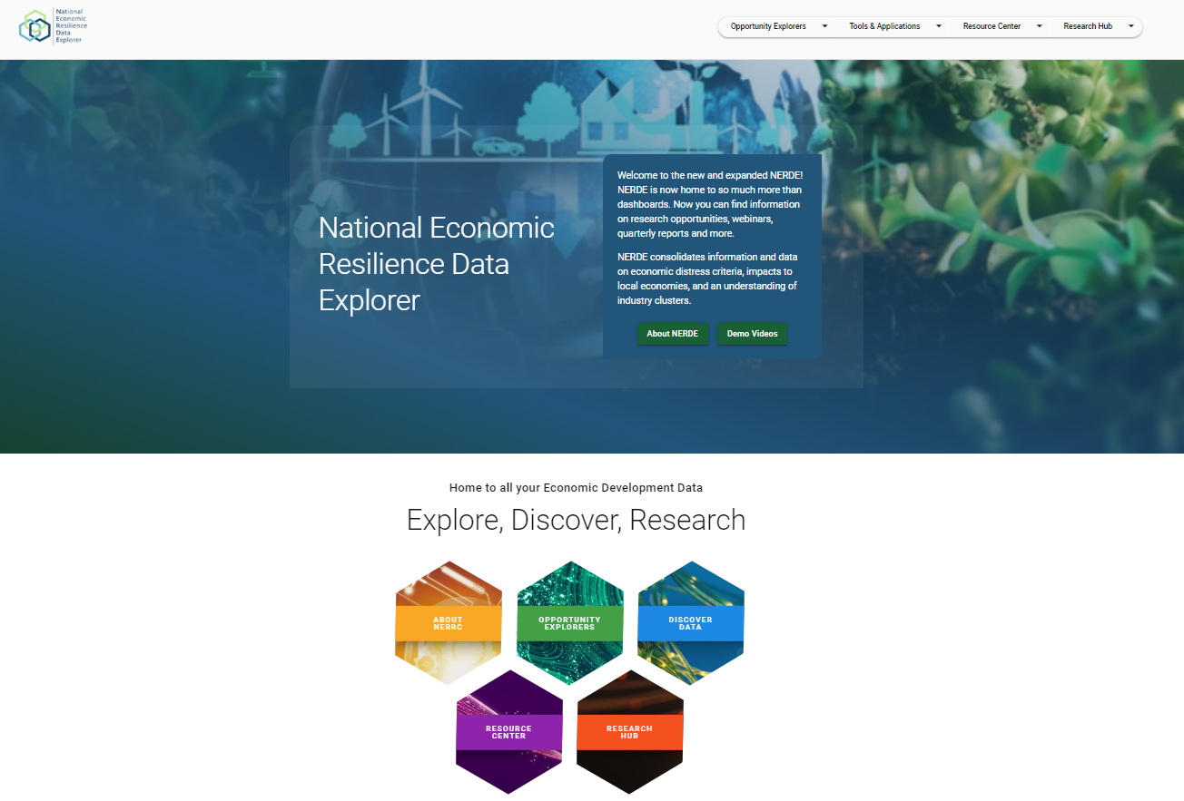
What next?
Think about the data assets in your area
Explore our data tools
Reach out

Slide 23
Resources
National Data and Dashboards
National Economic Resilience Data Explorer (NERDE)
Climate Risk and Resilience Portal
IRS Statistics of Income
Minneapolis Fed – Native Community Data Profiles

Slide 24
Thank you! Contact us: nerrc@anl.gov

