Slide 1
SWREDA Executive Director Institute
Dr. Patton McDowell, MBA, CFRE
May 14, 2024

Slide 2
Session Goals
Maximize Wisdom in the Room
Provide Leadership “Tune-Up”
Assure Fast Pace & Breaks
Create Networking Opportunities
PMAnonprofit.com

Slide 3
Agenda Overview
Module 1: Clarify Vision
Module 2: Develop Leaders
Stretch/Tech Break @ 3pm
Module 3: Board Engagement
Module 4: Collaboration & Community Impact
Module 5: Leadership Assessment & Development
PMAnonprofit.com

Slide 4
Introductions
Who? Where? Why?
PMAnonprofit.com

Slide 5
My Story
Special Olympics International
UNC Wilmington/Queens University
PMA Nonprofit Leadership
15 Years
300 Organizations
260 Podcast Episodes/Book
I help talented individuals excel at nonprofit leadership
PMAnonprofit.com

Slide 6
Pre-Event Survey
When asked on what the Institute should focus,
the top responses were:
Organizational Development
Board Recruitment & Engagement
Succession Planning/Long-Range Goals
PMAnonprofit.com
Notes:
Insights Presentation: Highlight key themes and insights from the pre-event surveys, setting the stage for tailored content in the upcoming modules.

Slide 7
Pre-Event Survey
What are your top challenges?
Staff Retention
Funding
Program Sustainability
PMAnonprofit.com
Notes:
Insights Presentation: Highlight key themes and insights from the pre-event surveys, setting the stage for tailored content in the upcoming modules.

Slide 8
Opening Exercise
PMAnonprofit.com
Notes:
Small Group Discussions: Participants break into small groups to discuss their current challenges and expectations for the institute.
Sharing Insights: A quick share-out from each group to foster a sense of community and collective learning.

Slide 9
The Best Leaders…
Sharpen their Vision
Develop their Talent
Engage their Board
Cultivate Collaboration
Model Leadership
PMAnonprofit.com

Slide 10
The Best Leaders…
Sharpen their Vision
Develop their Talent
Engage their Board
Cultivate Collaboration
Model Leadership
PMAnonprofit.com

Slide 11
Module 1: Sharpen Your Vision
Mission
Vision
Action
PMAnonprofit.com
Notes:
Presentation: Introduction to aligning organizational vision with mission and translating it into actionable strategies.
Group Activity: Participants work in groups to refine their MVA statements and develop actionable plans that reflect their mission.

Slide 12
Mission: What We Do
The Albemarle Commission assists local governments in our 10-county region with Economic Development, Senior Services, Workforce Development, and Rural Planning. The Commission has provided services to our region for over 50 years. . .
Explain what you do in a way that
educates and illustrates the scope of your organization
PMAnonprofit.com

Slide 13
Vision: The Opportunity/Need
The pandemic illuminated areas that our region lags behind the rest of the state. A major need is extending broadband services to every community we serve. Through a Community Development Block Grant, we’ll extend this connectivity and address other needs associated with lost employment.
Make clear the need that exists, and define
a clear and compelling goal
PMAnonprofit.com

Slide 14
Action: How You Can Help
(Learn More) “Let me send you a copy of our study”
(Attend) “Join Us for the 40th Anniversary Senior Games in Elizabeth City”
(Invest/Support) “Here’s exactly how the bill will help us”
Be prepared with three distinct ways someone can support you
PMAnonprofit.com

Slide 15
Discussion
Mission – Vision – Action
PMAnonprofit.com

Slide 16
The Best Leaders…
Sharpen their Vision
Develop their Talent
Engage their Board
Cultivate Collaboration
Model Leadership
PMAnonprofit.com

Slide 17
Module 2: Develop Talent
Emerging Leader
Mid-Career Plateau
Senior Manager
PMAnonprofit.com
Notes:
Presentation: Overview of leadership development strategies tailored to different career stages: emerging leaders, mid-career professionals, and senior executives.
Interactive Discussion: Groups discuss their current leadership development practices and explore new ideas that can be implemented for each level.

Slide 18
Develop Talent
Emerging
Mid-Career
Senior
Aspirational Path?
Sector Leader
Manager
Expert
Experience
PMAnonprofit.com

Slide 19
Your Talented Team Members Want:
Knowledge
Experience
Access
Recognition
Opportunity
PMAnonprofit.com

Slide 20
Discussion
PMAnonprofit.com

Slide 21
Stretch and Technology Break
PMAnonprofit.com

Slide 22
The Best Leaders…
Sharpen their Vision
Develop their Talent
Engage their Board
Cultivate Collaboration
Model Leadership
PMAnonprofit.com

Slide 23
Module 3: Board Engagement
Active Assessment & Mission Alignment
Tools to Recruit & Engage
Dynamic Meetings
PMAnonprofit.com
Notes:
Interactive Presentation: Introduce the four keys to effective board engagement: clear roles and responsibilities, regular communication, mutual respect, and shared vision.
Workshop Activity: Participants develop strategies to enhance board relationships using these four keys.

Slide 24
#1 Active Assessment & Mission Alignment
PMAnonprofit.com

Slide 25
Prepare Board Ambassadors
Mission
Vision
Action
PMAnonprofit.com
Notes:
Presentation: Introduction to aligning organizational vision with mission and translating it into actionable strategies.
Group Activity: Participants work in groups to refine their MVA statements and develop actionable plans that reflect their mission.

Slide 26
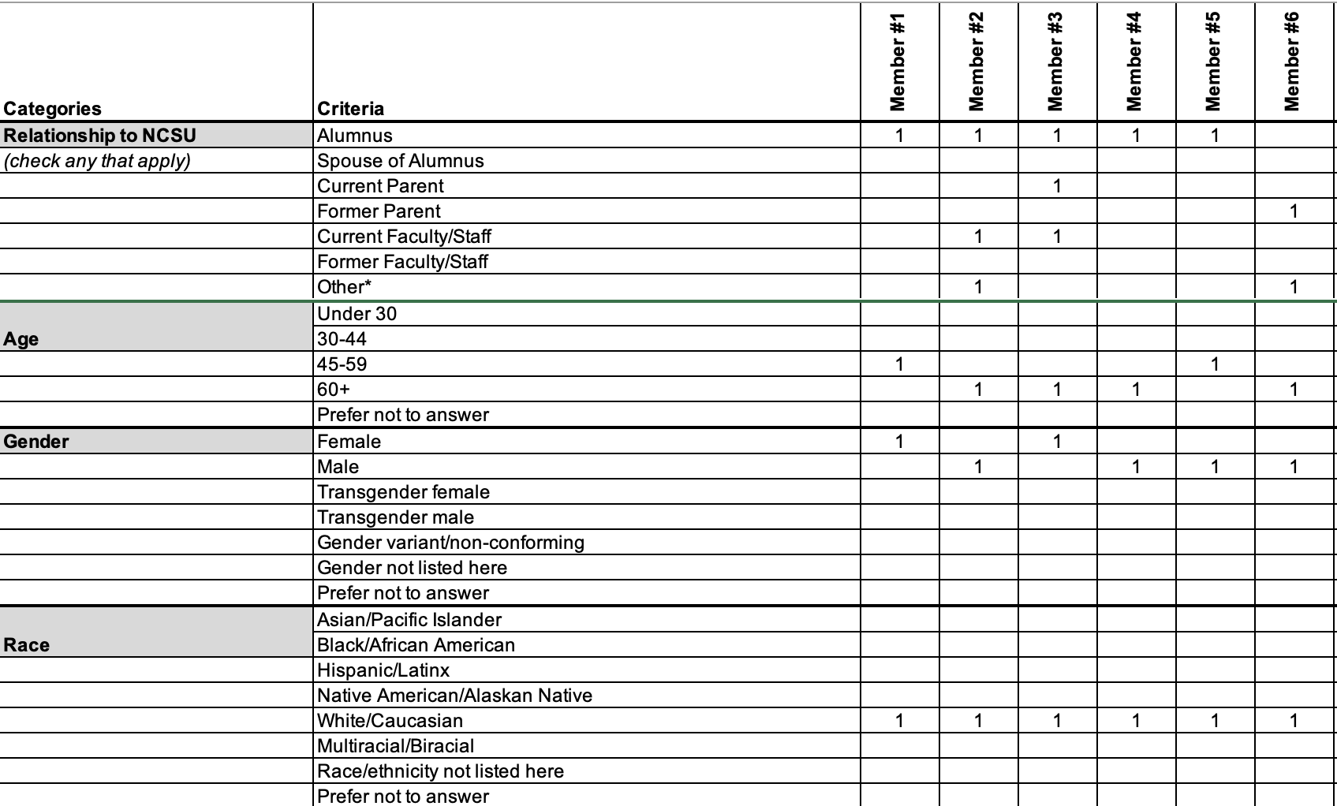
Assessment & Alignment: Current Membership
Use matrix to assess current membership
Measure skills, experiences & demographics
Gaps inform recruitment
PMAnonprofit.com

Slide 27
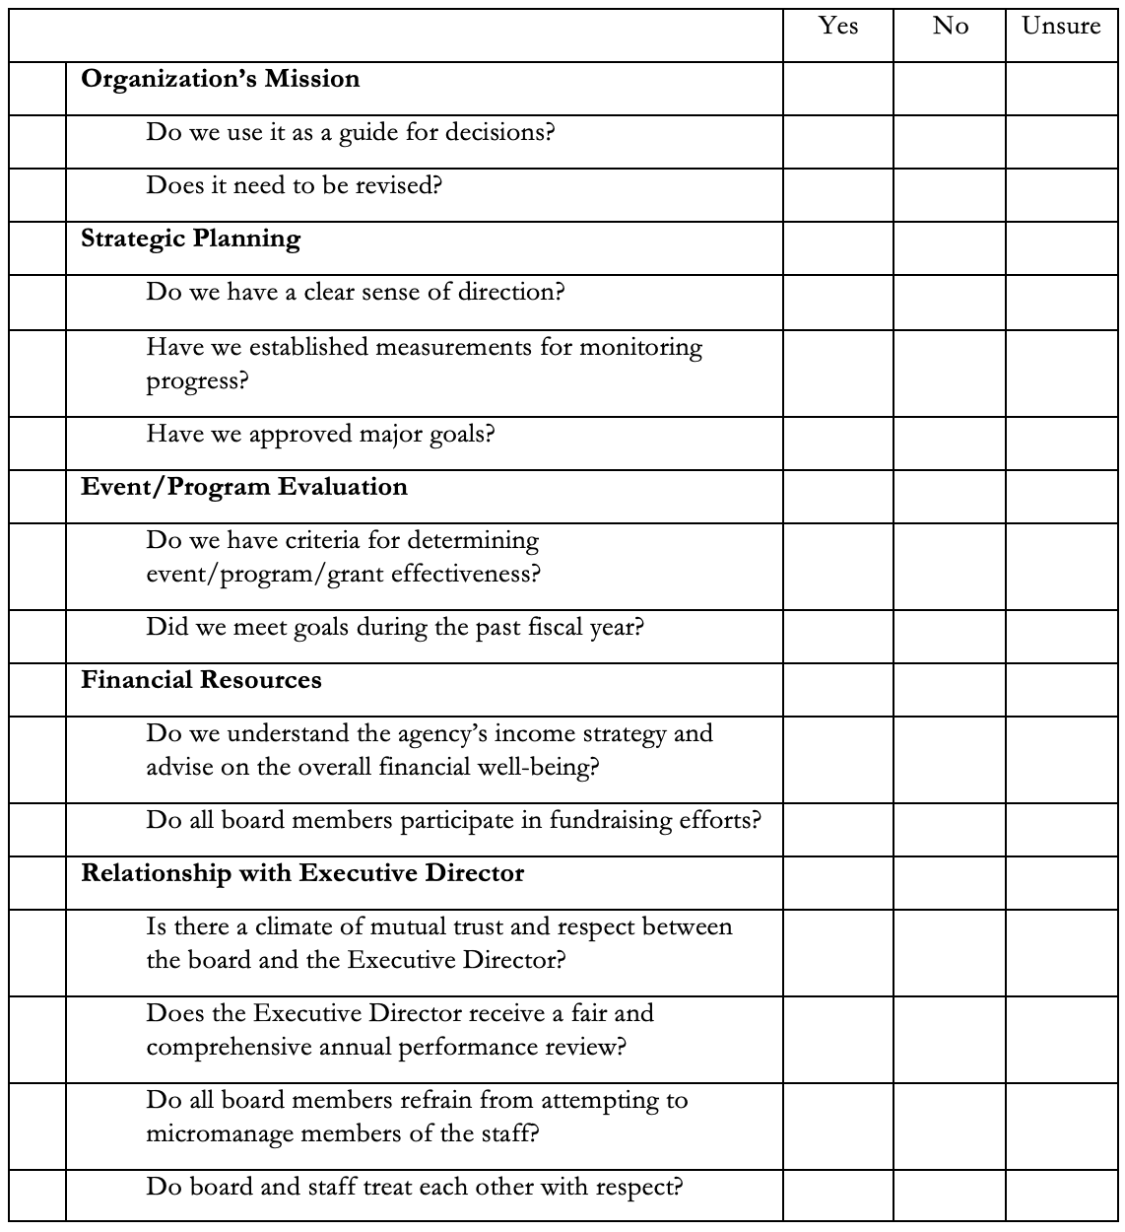
Assessment & Alignment: Yearly Performance Assessment (Organization)
PMAnonprofit.com

Slide 28
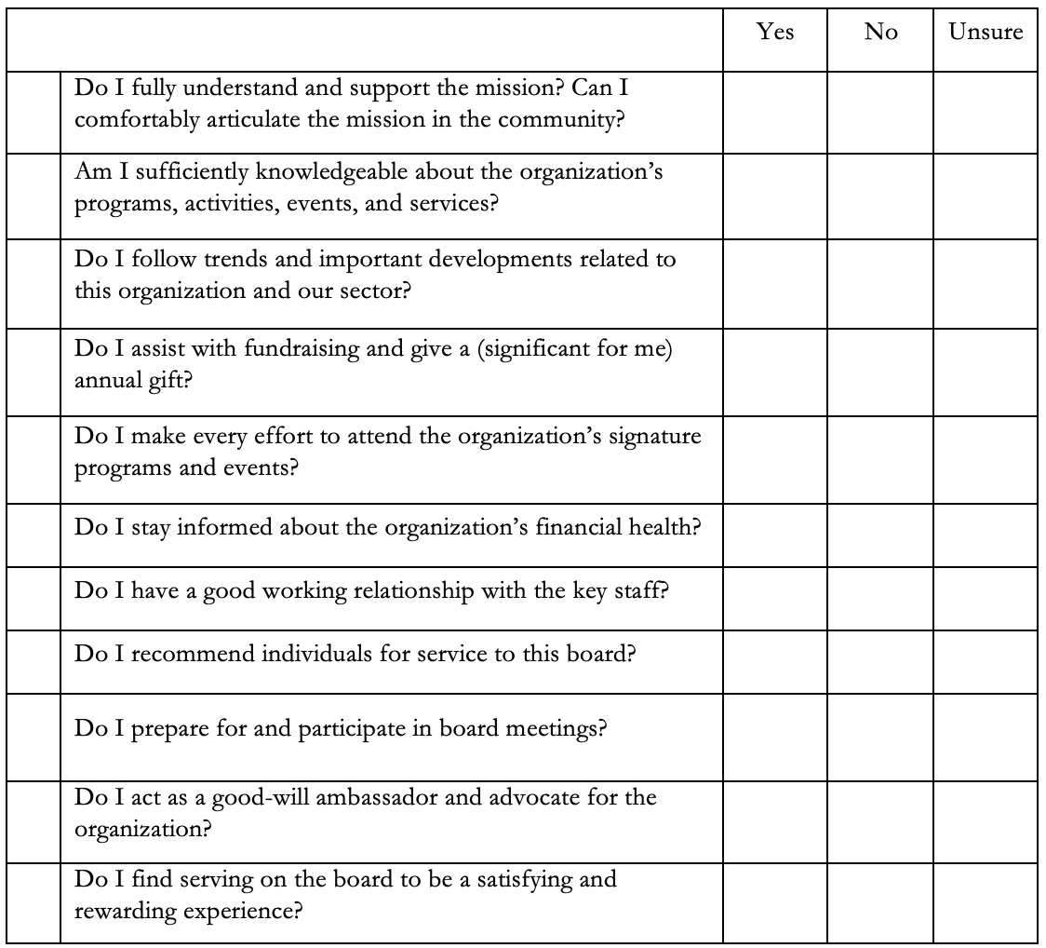
Assessment & Alignment: Yearly Performance Assessment (Individual)
PMAnonprofit.com

Slide 29
#2 Tools to Recruit & Engage
PMAnonprofit.com

Slide 30
Tools: Year-round Recruitment and Nominating Processes
Recruitment Flyer
Expectations & Benefits
Online Application
Board Directory &
bio briefs
PMAnonprofit.com

Slide 31
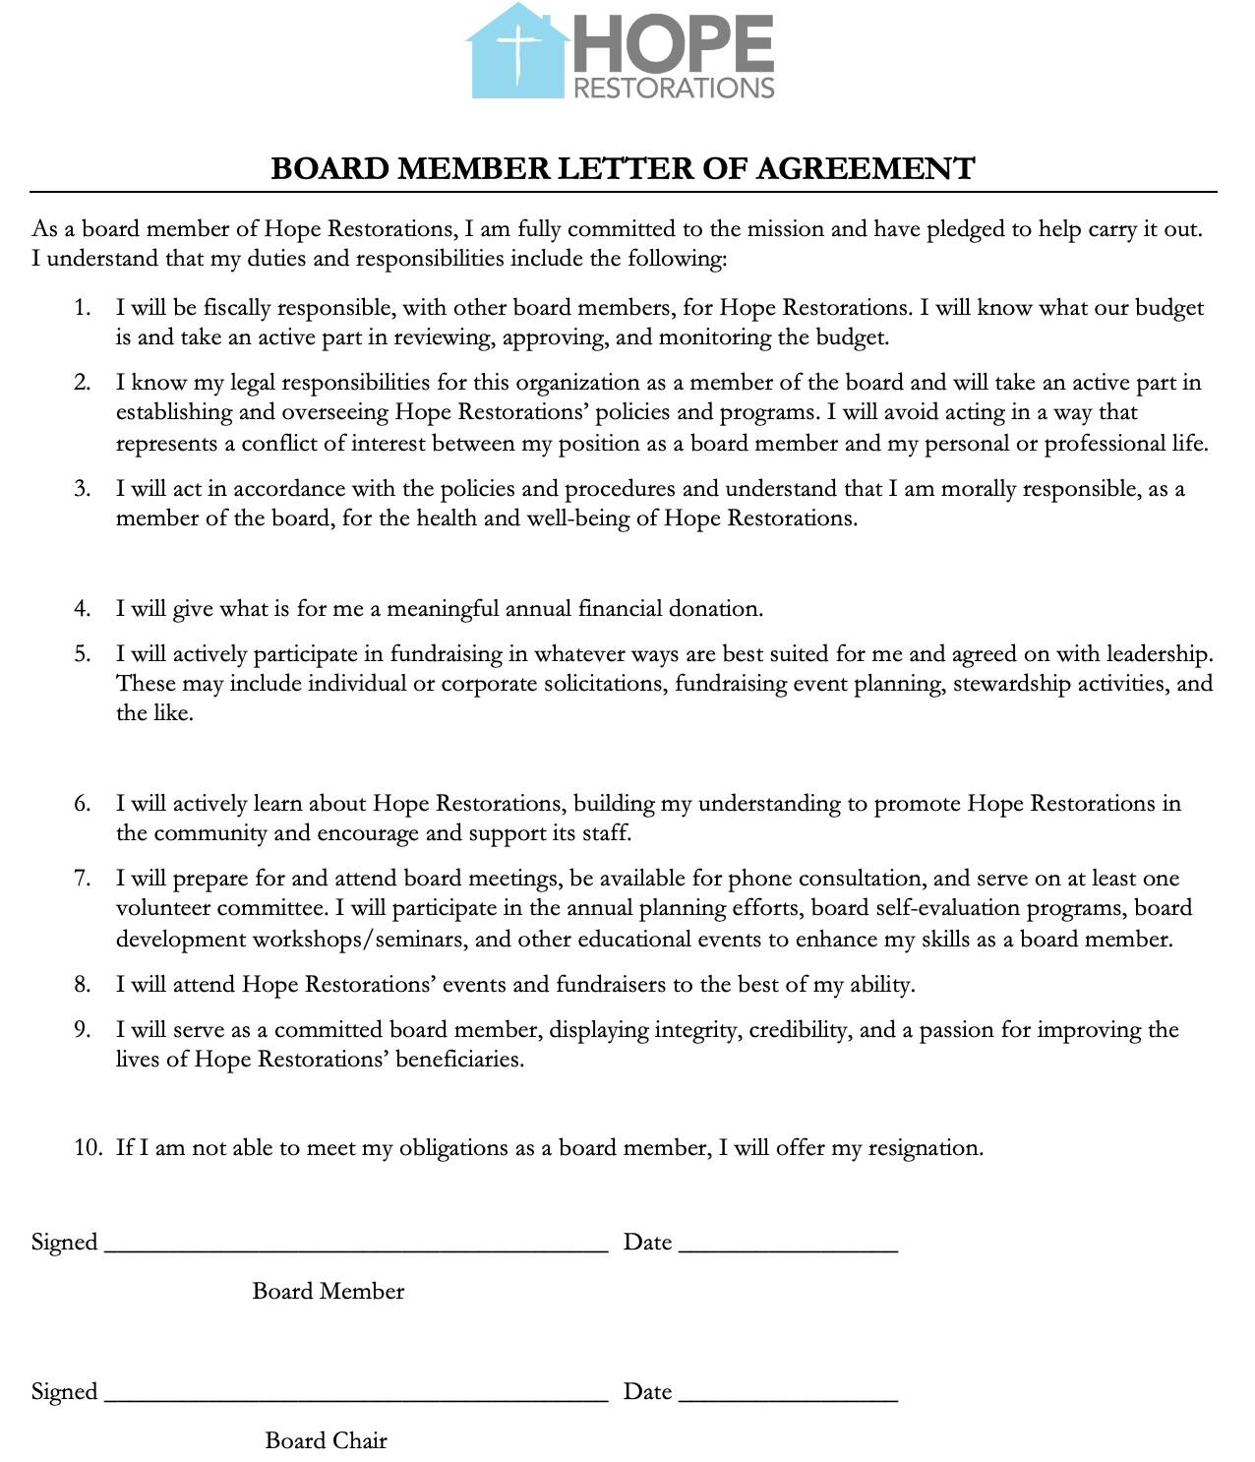
Tools: Board Roles & Success Metrics Letter of Agreement
1: Fiduciary Responsibility
2: Community Ambassador
3: Active Participation
+ “graceful exit” clause
Re-sign annually
PMAnonprofit.com

Slide 32
Tools: Board Roles & Success Metrics Onboarding
Orientation (and re-orientation)
Leadership Path Meeting
Staff Liaison
Board Buddy
PMAnonprofit.com

Slide 33
#3: Better Meetings
PMAnonprofit.com

Slide 34
Thoughtful, Varied & Dynamic Meetings
Thoughtful agenda
Balance operational & strategic
Agenda audit
Board member involvement
Breakout groups for discussion
Role-playing exercises
PMAnonprofit.com

Slide 35
Discussion
PMAnonprofit.com

Slide 36
The Best Leaders…
Sharpen Vision
Develop Talent
Engage Board
Cultivate Collaboration
Model Leadership
PMAnonprofit.com

Slide 37
Rationale for Collaboration
Leverage Resources
Holistic Solutions
Shared Expertise
Stakeholder Engagement

Slide 38
Collaboration Assessment
Who are your three priority partners?
Who are three potential partners?
PMAnonprofit.com

Slide 39
Discussion
PMAnonprofit.com

Slide 40
The Best Leaders…
Sharpen Vision
Develop Talent
Engage Board
Cultivate Collaboration
Model Leadership

Slide 41
Module 5: Leadership Assessment & Development 12 Essential Skills and Experiences
Learning Plan
Productivity & Organization
Strategic Planning
Sector Knowledge
Interpersonal Communications
Management Practices
Financial Acumen
Marketing & Social Media
Governance & Board Development
Data Management & Technology
Inclusive Practices
Strategic Networking
PMAnonprofit.com

Slide 42
Module 5: Leadership Assessment & Development 12 Essential Skills and Experiences
Learning Plan
Productivity & Organization
Strategic Planning
Sector Knowledge
Communication
Management Practices
Financial Acumen
Marketing & Social Media
Governance & Board Development
Data Management & Technology
Inclusive Practices
Strategic Networking
PMAnonprofit.com

Slide 43
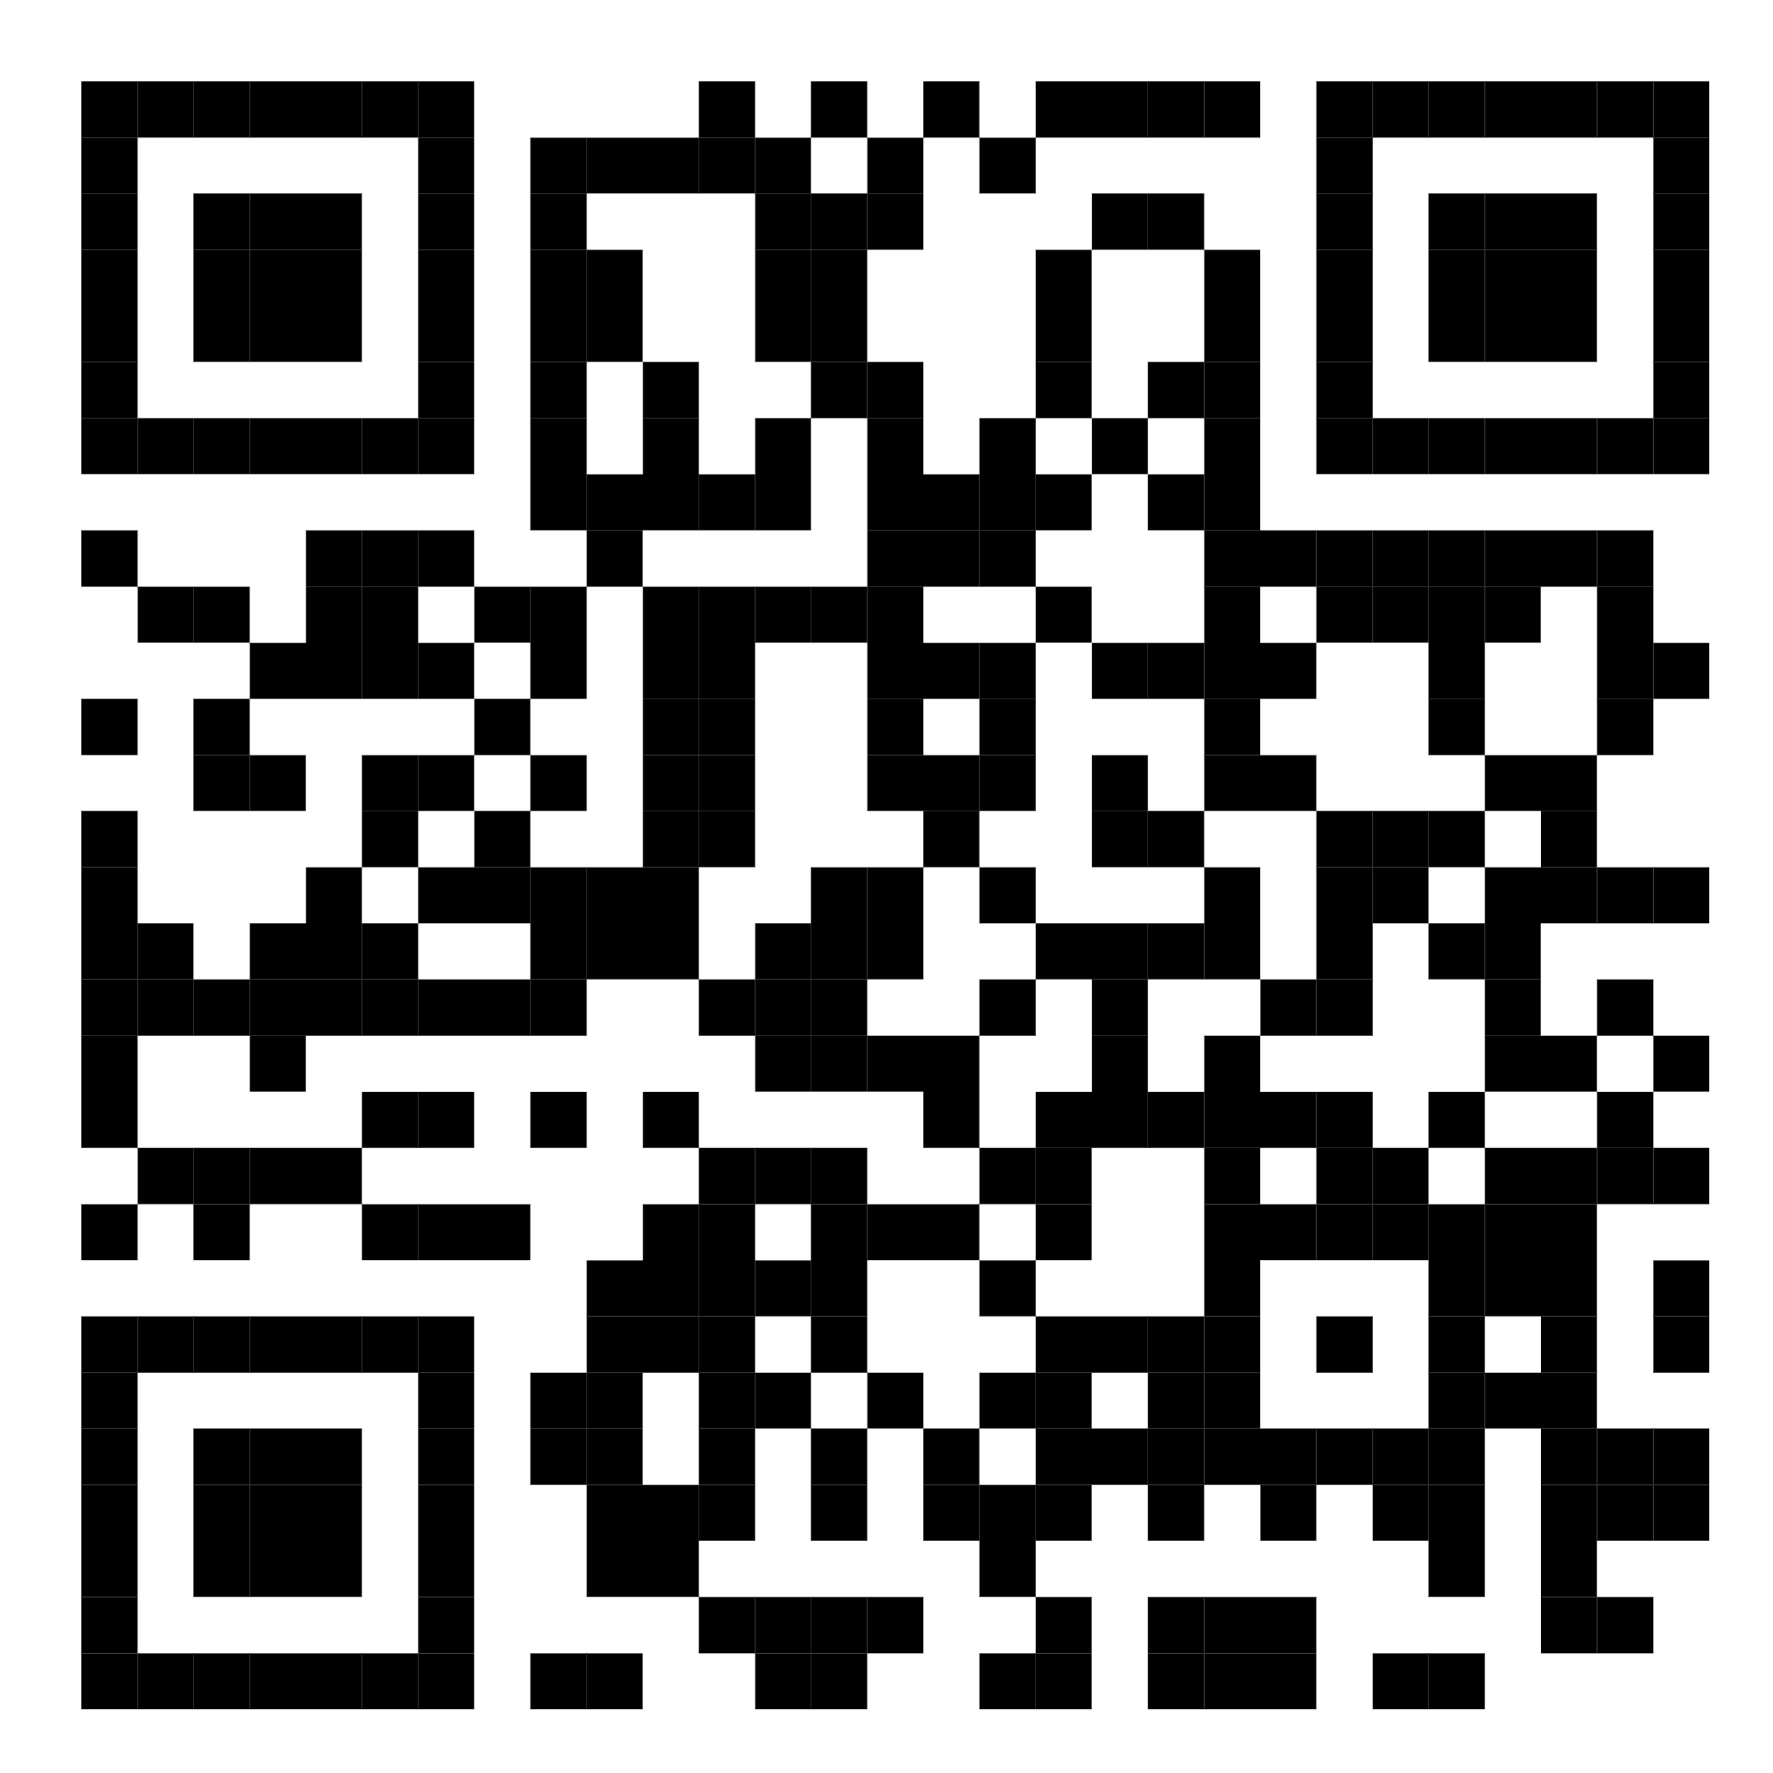
Module 5: Leadership Assessment & Development 12 Essential Skills and Experiences Worksheet
1 = Needs Improvement
4 = Clear Strength
1
Establish a CRP account en route to Certification by 2026
4
Write LinkedIn article about my productivity rituals in the next 90 days
Access 12 Skills Worksheet
PMAnonprofit.com

Slide 44
#2 Self-Assessment 12 Essential Skills and Experiences
Learning Plan
Productivity & Organization
Strategic Planning
Association/Sector Knowledge
What is one strength you can build upon? What is a one challenge you can improve?
Interpersonal Communications
Management Practices
Financial Acumen
Marketing & Social Media
Governance & Board Development
Data Management & Technology
Inclusive Practices
Strategic Networking
PMAnonprofit.com

Slide 45
Final Discussion
PMAnonprofit.com
Notes:
Wrap-Up: Summarize key takeaways and encourage ongoing collaboration and networking among participants.
Feedback Collection: Distribute feedback forms to gather insights on the institute's effectiveness and areas for improvement.

Slide 46
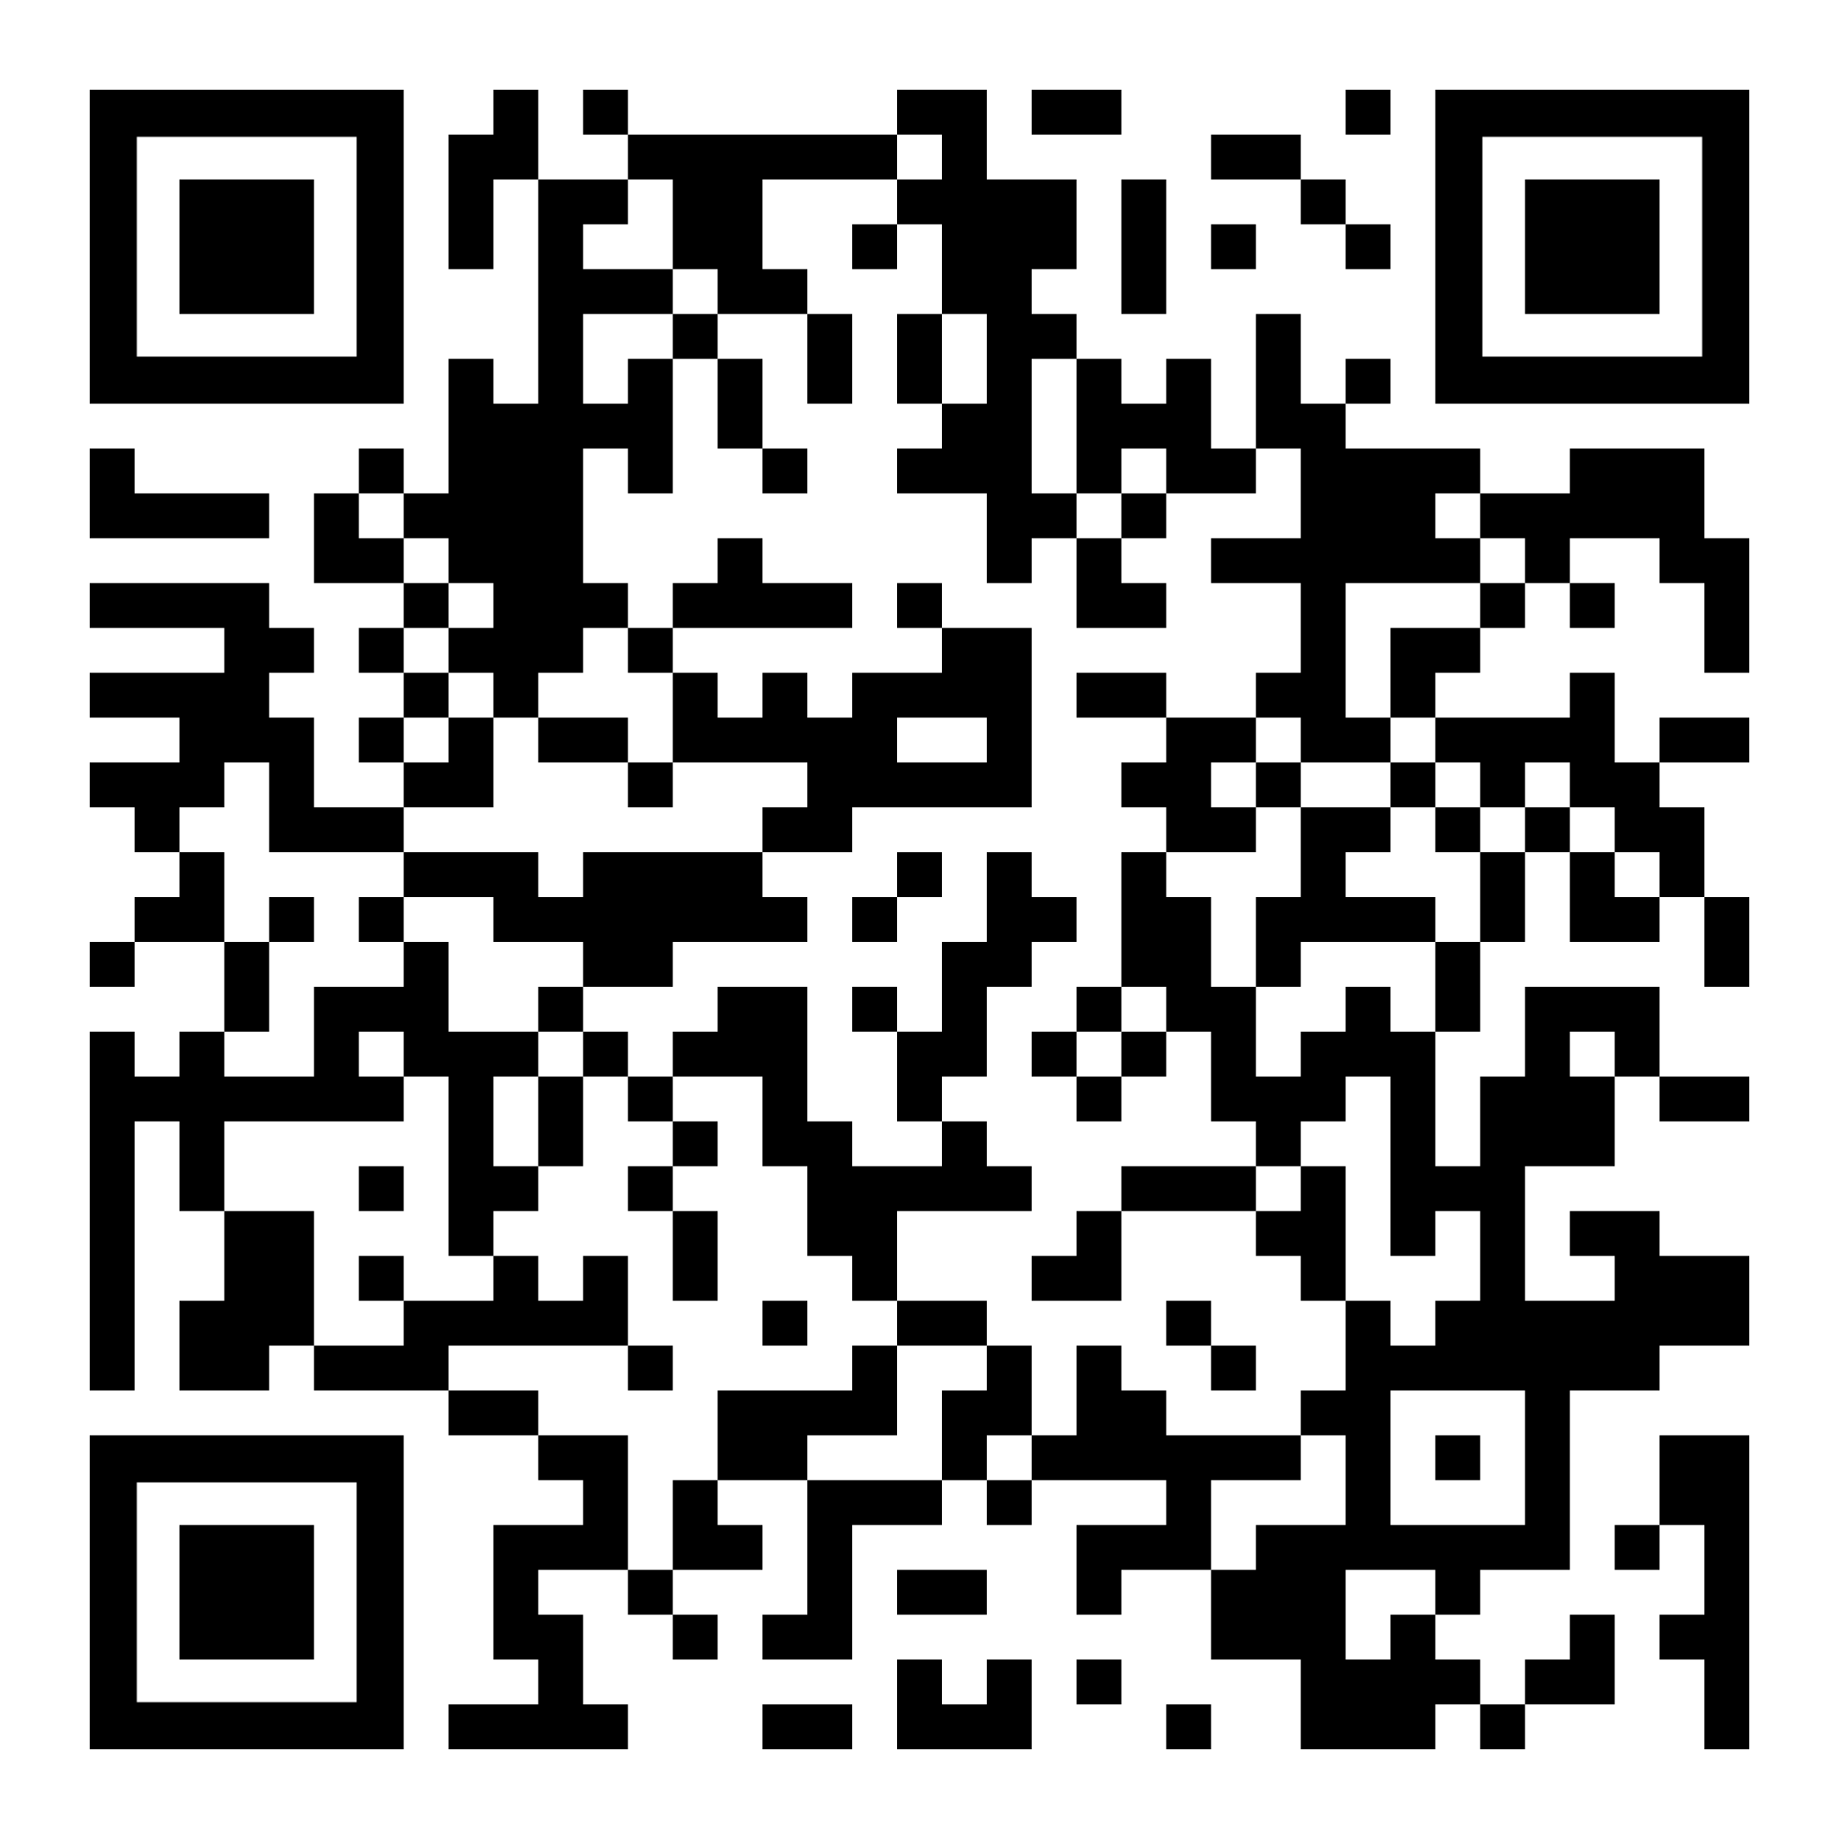
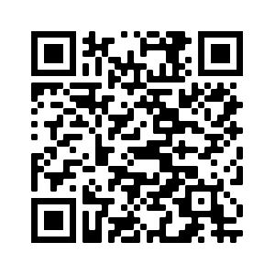
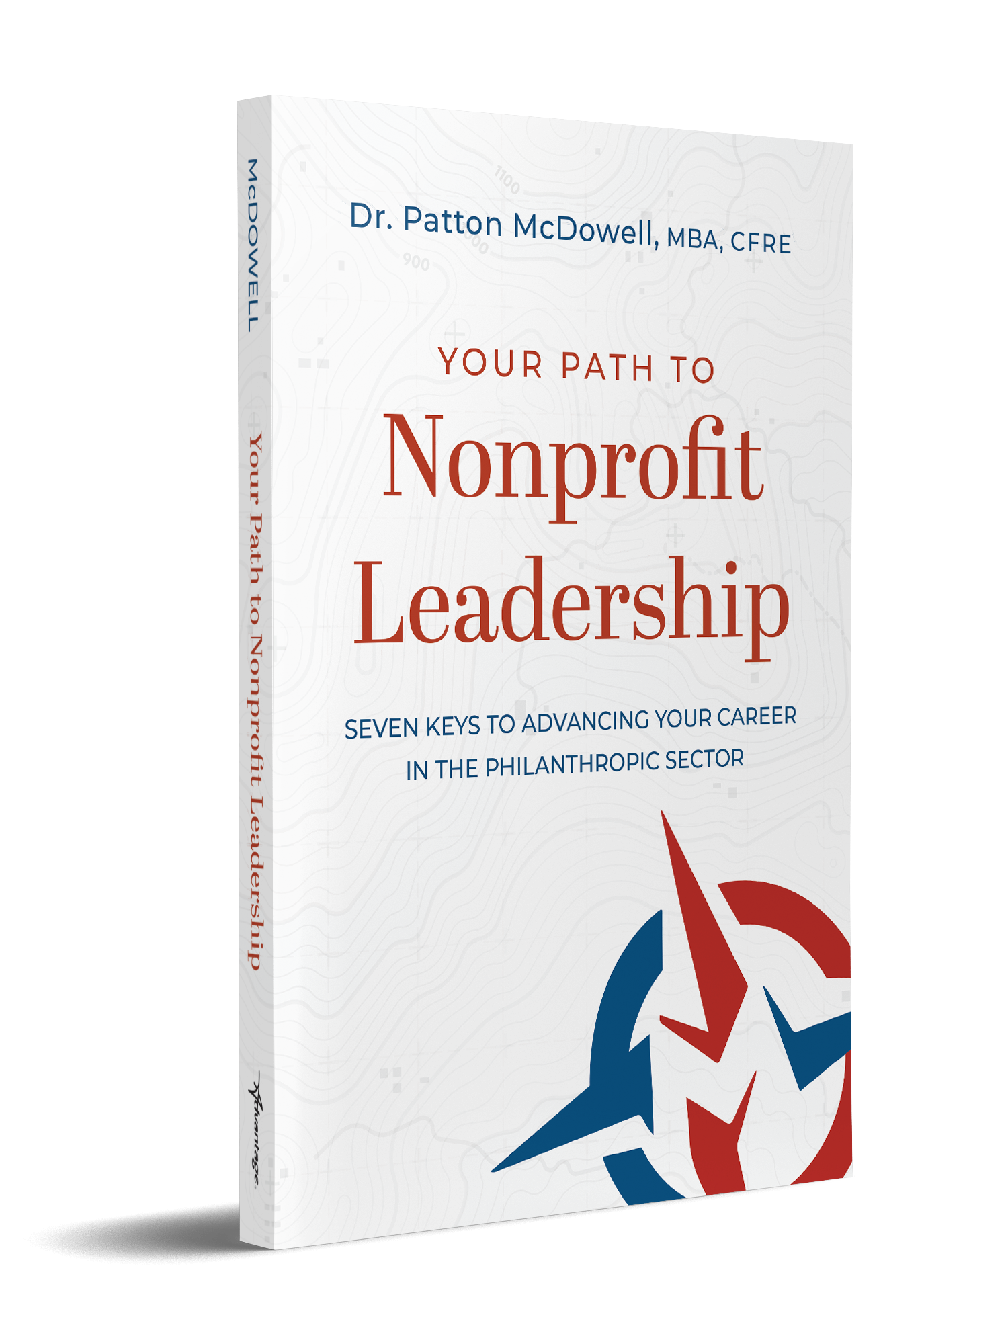
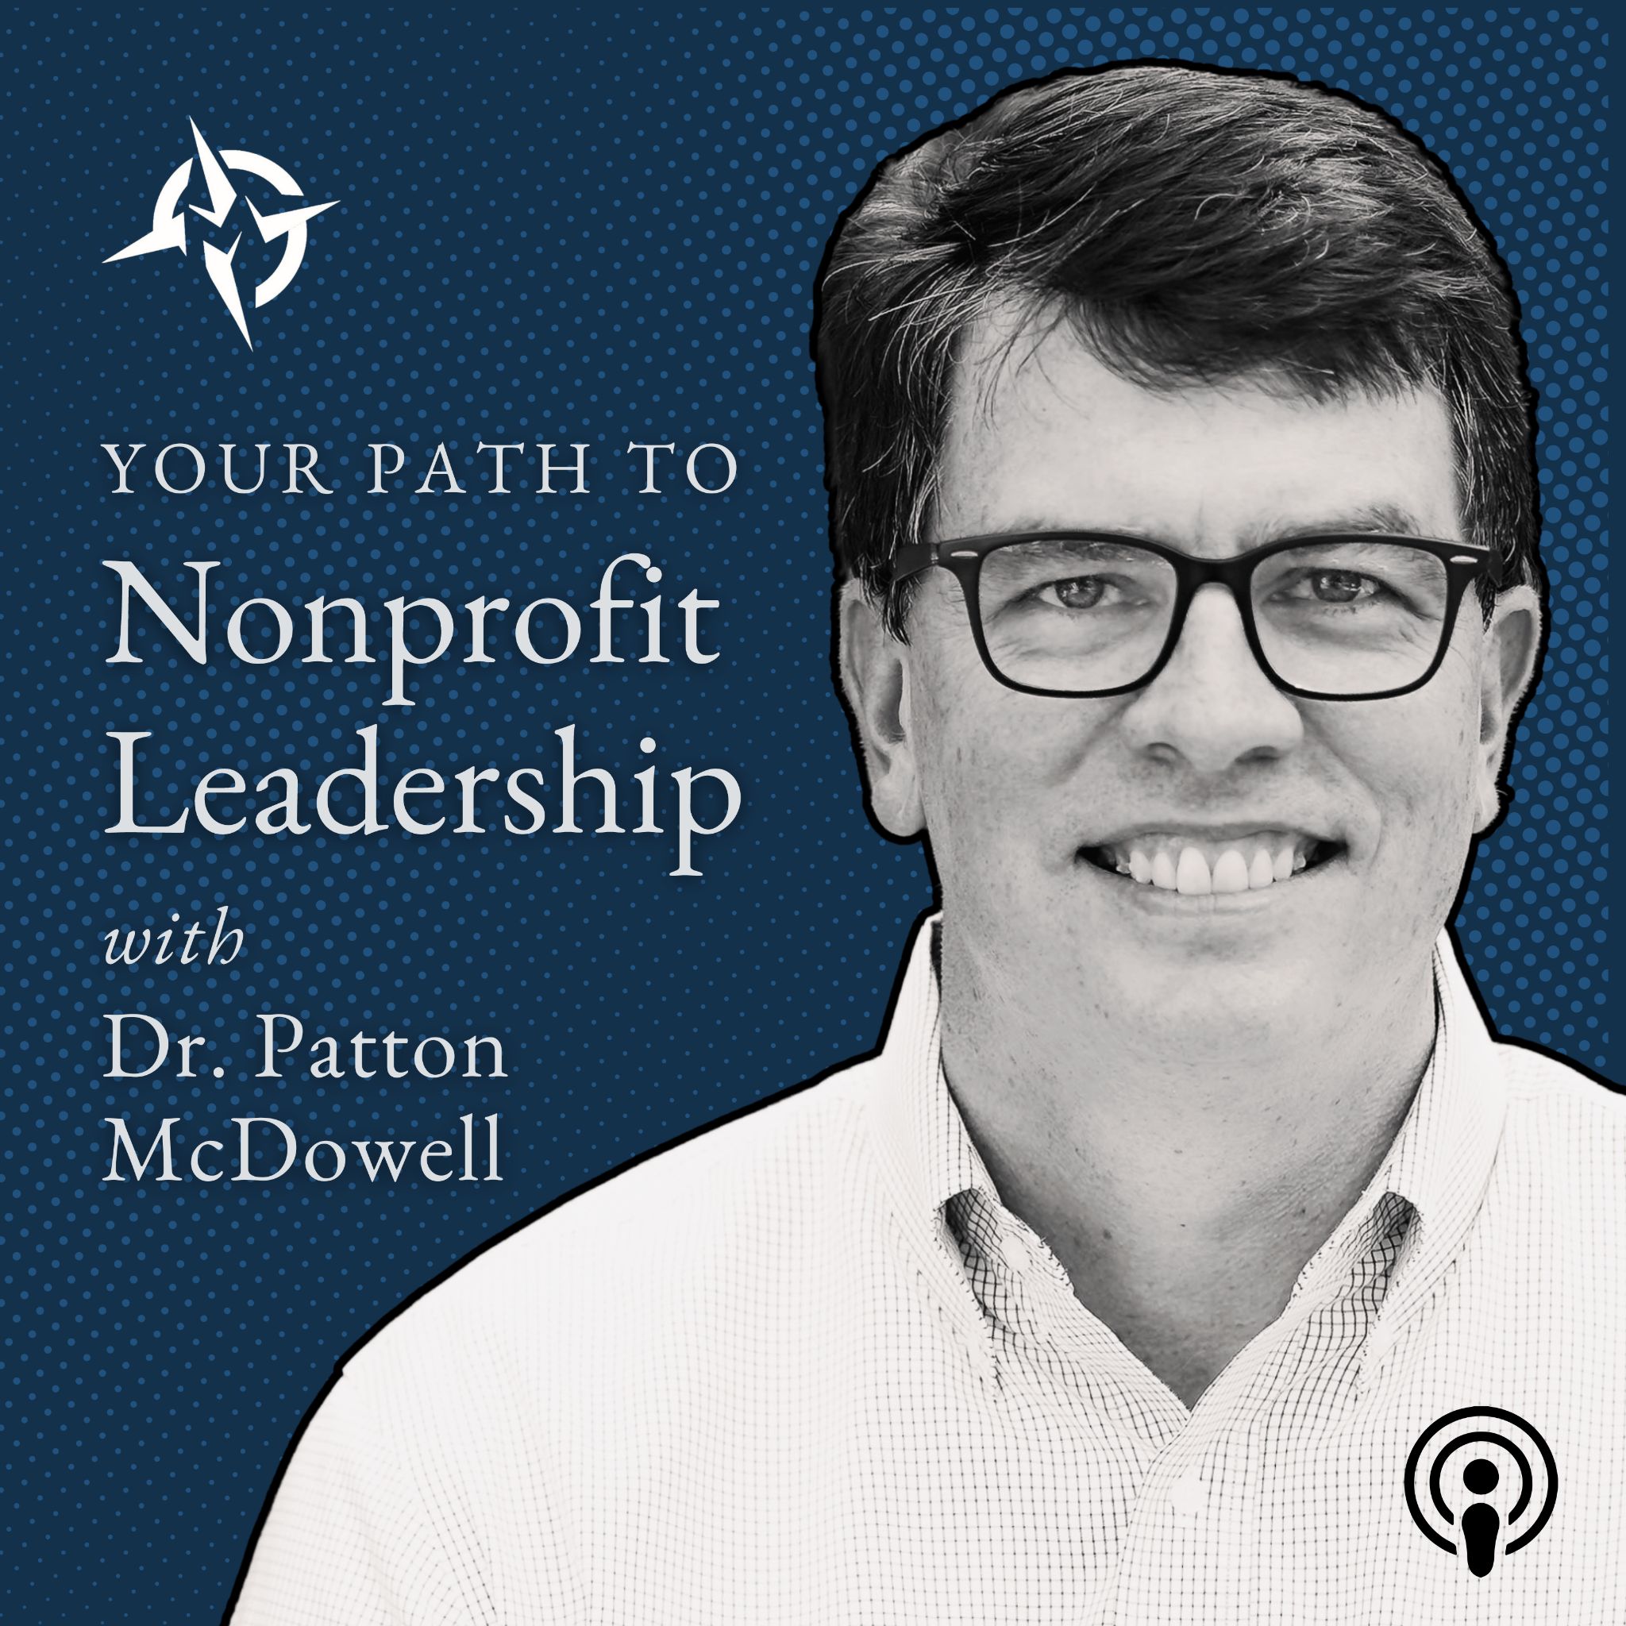
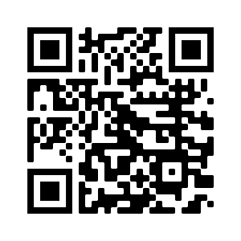
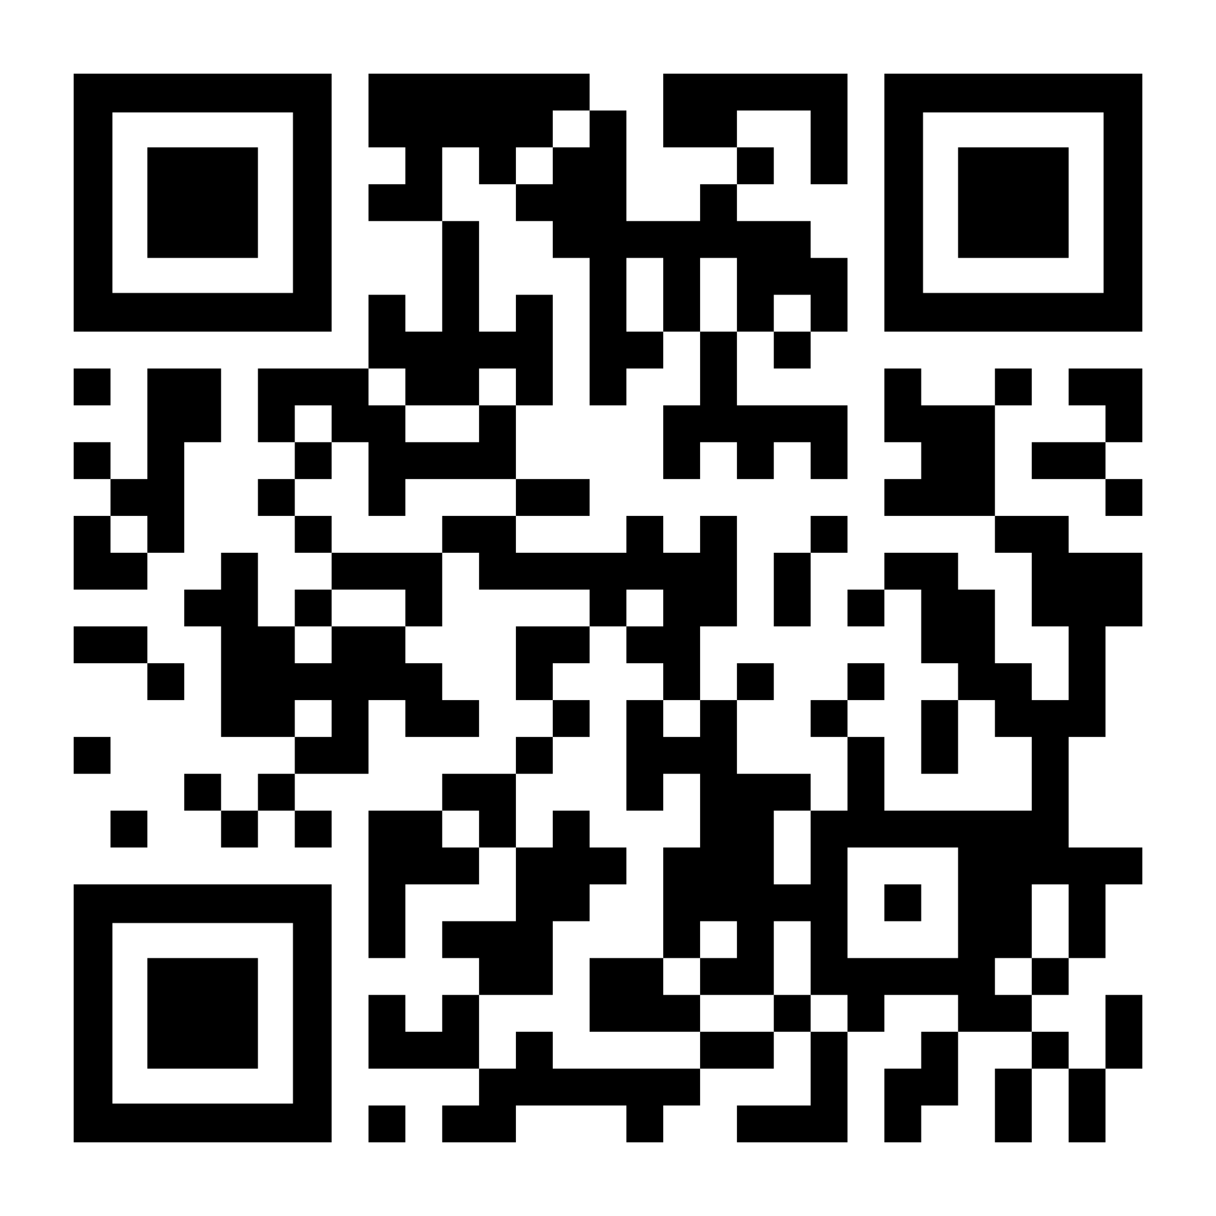
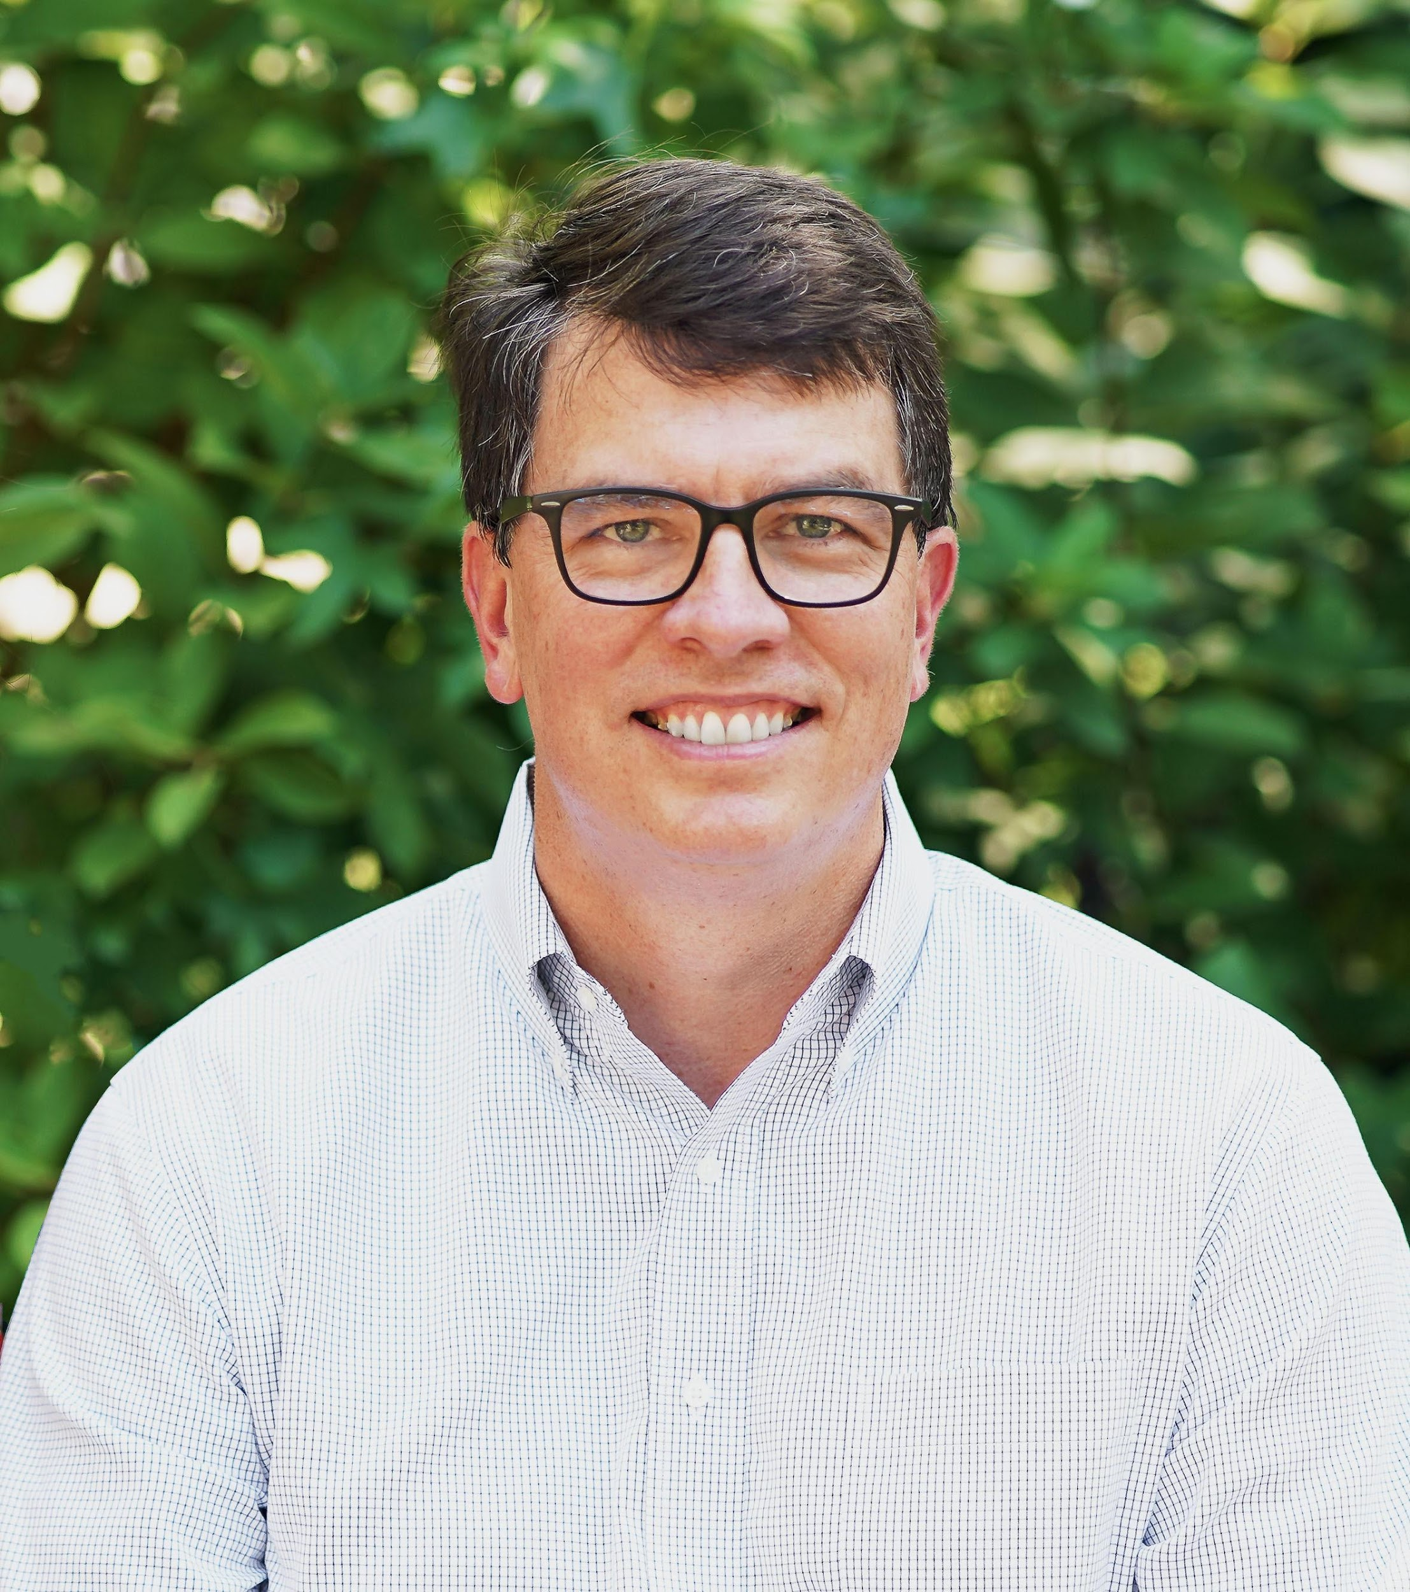
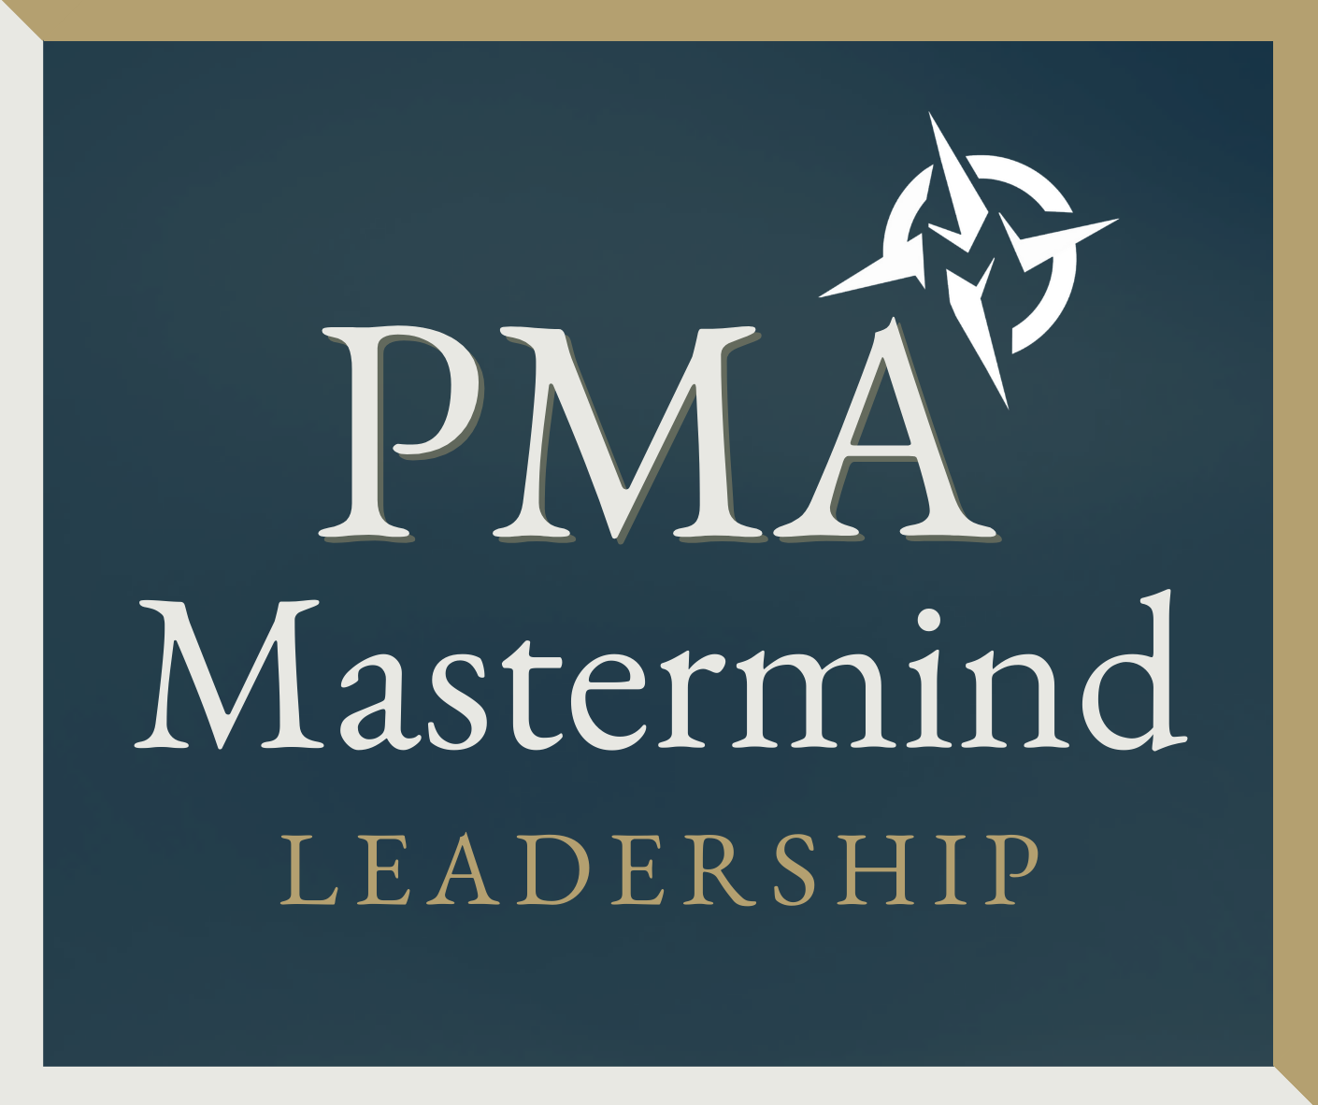
Thank You
PM@pmanonprofit.com
PMAnonprofit.com

