Slide 1
NADO Advocacy Update
May 2024

Slide 2


The National Association of Development Organizations (NADO) is a 501c4 membership association that represents the interests of regional community and economic development practitioners.
Established in 1967, NADO advocates for policies and programs that promote equitable community development, economic competitiveness, rural development, economic mobility, and quality of place.
NADO represents a national network of more than 500 Regional Development Organizations (RDOs) across the country.
The NADO Research Foundation (NADO RF) is a 501c3 non-profit organization that provides technical assistance, education, research, and training to support and strengthen the national network of Regional Development Organizations (RDOs).
Established in 1988, the NADO RF provides thought leadership, conducts research, and produces publications focused on promising practices and innovative approaches to promote regional community development. NADO RF also works with RDOs and their partners to enhance their organizational and professional capacity.
www.NADO.org

Slide 3
NADO Advocacy
    https://www.nado.org/about-nado-advocacy/

Slide 4
EDA Reauthorization

Slide 5
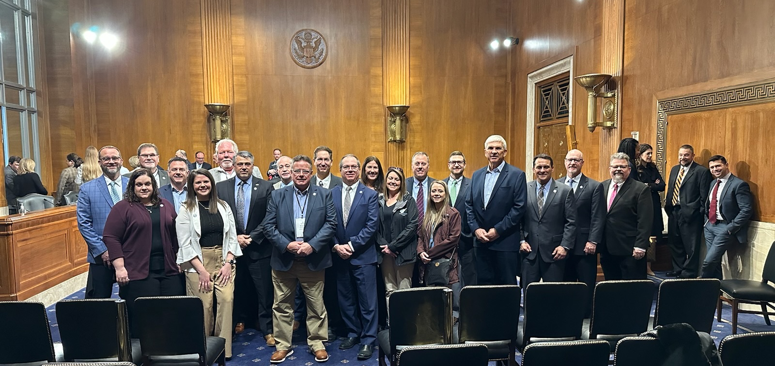
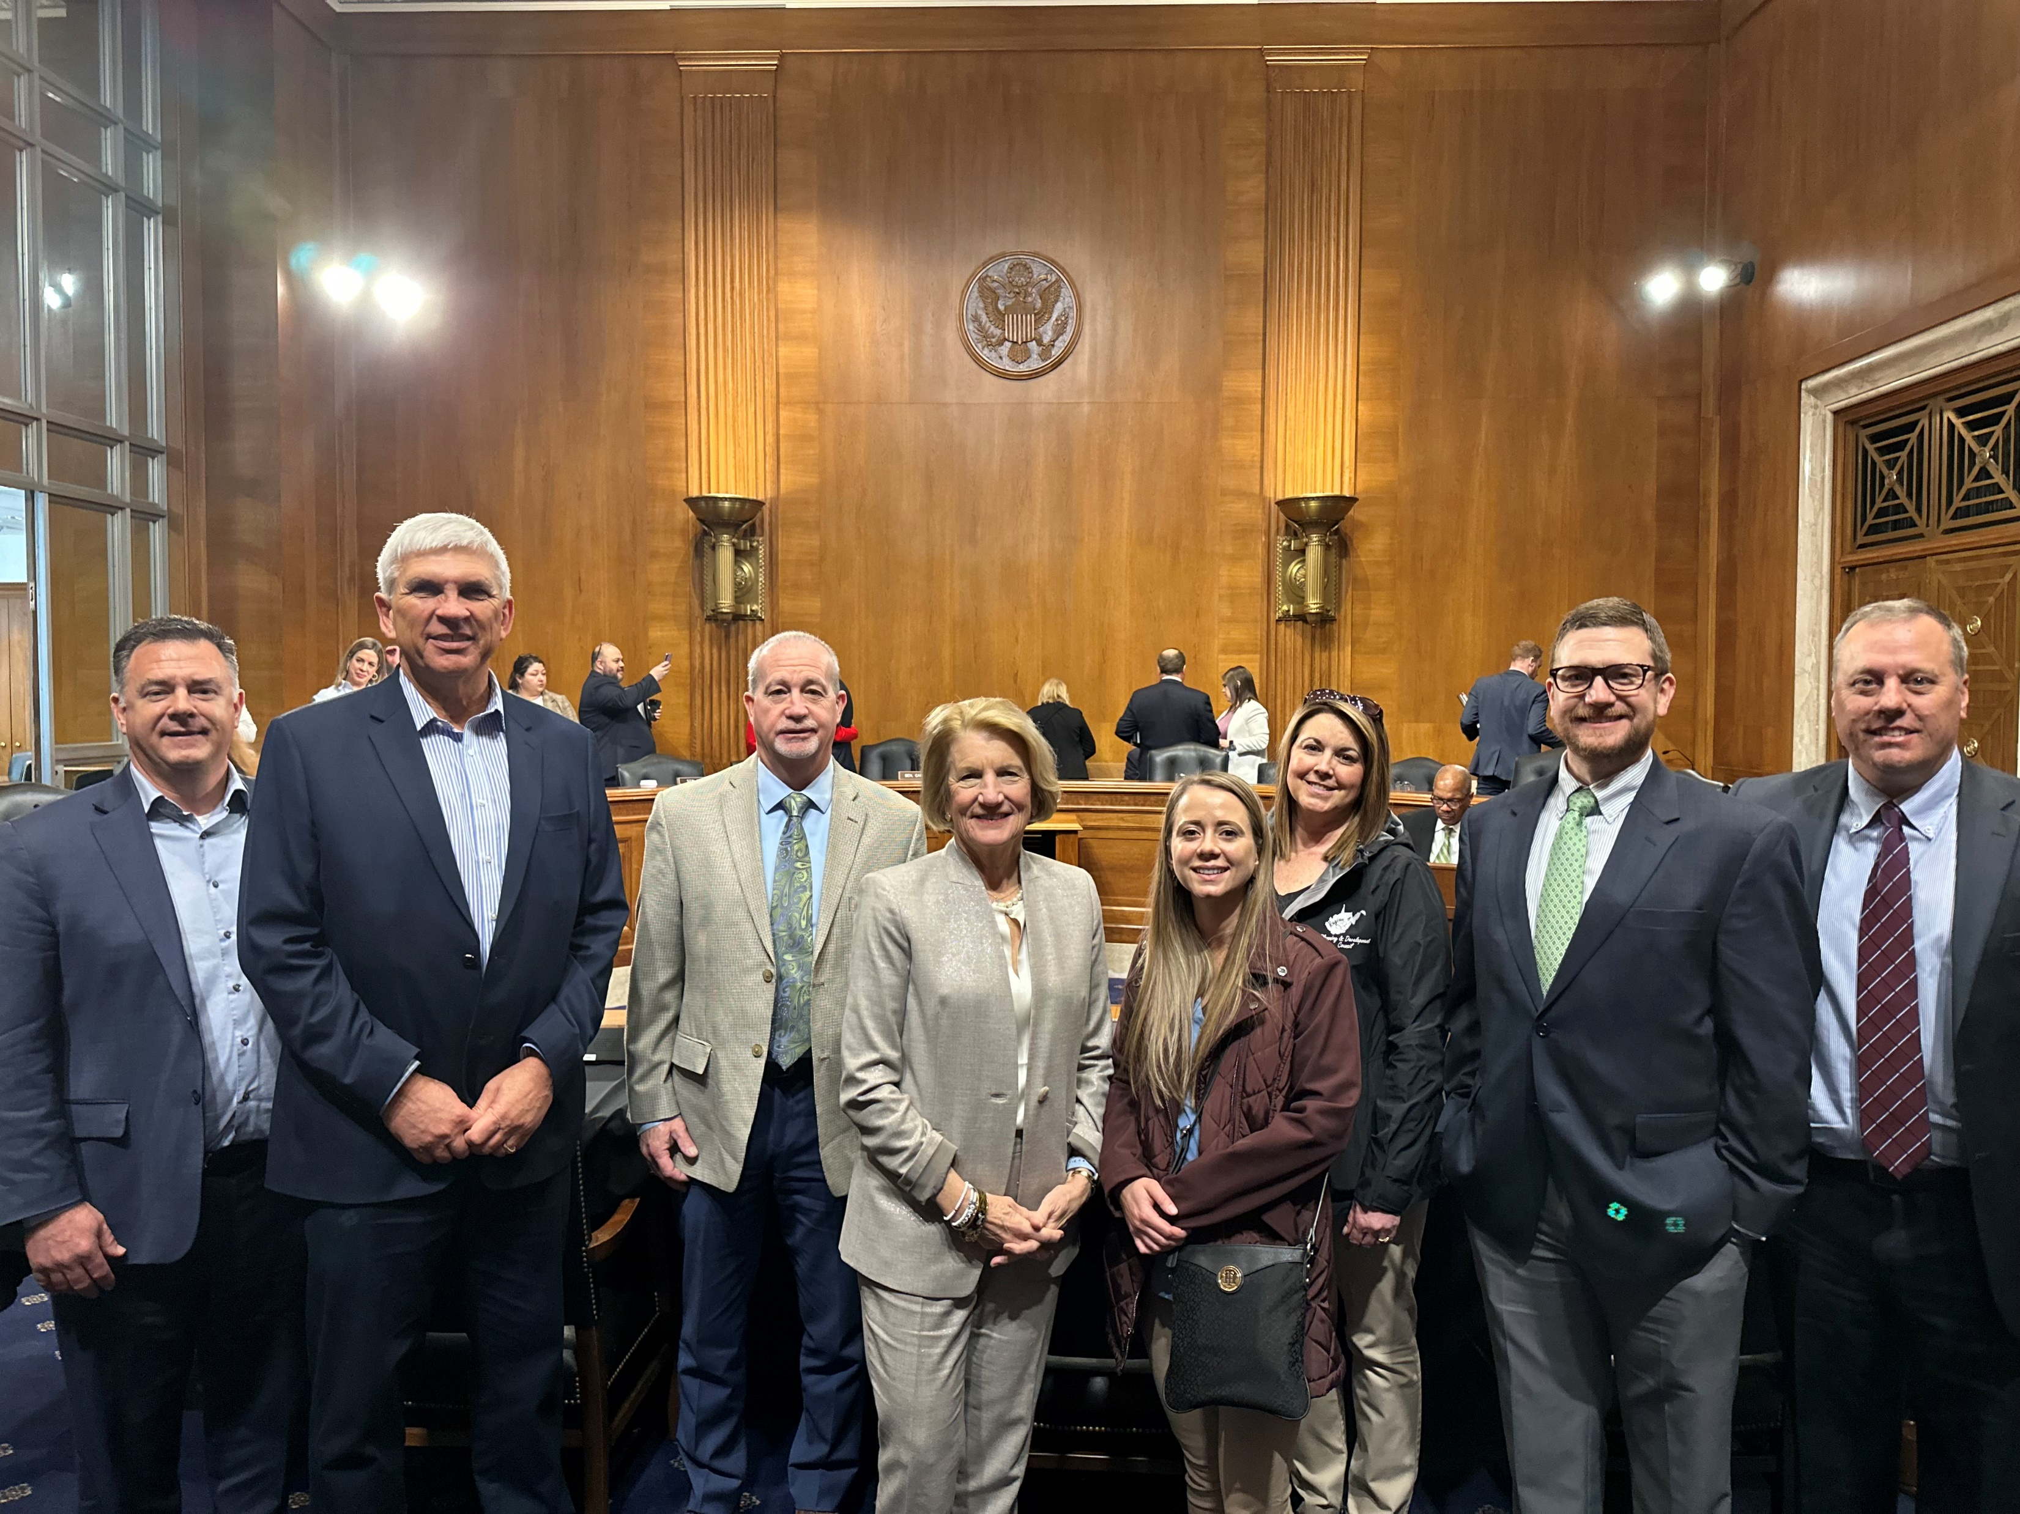
EDA Reauthorization Bill
Introduced and Passed Senate Committee
    On Friday March 8, an EDA reauthorization bill was introduced in the Senate and passed out of the Senate Committee of jurisdiction
    The Economic Development Act of 2024 (S. 3891)
    This is a bipartisan bill
    Champions: Senator Carper (D-DE), Senator Capito (R-WV), Senator Kelly (D-AZ), and Senator Cramer (R-ND)
    On Tuesday March 12, the Senate Environment and Public Works Committee (EPW) advanced the bill by voice vote
    Help is needed from NADO members and EDDs to identify potential House champions to introduce a similar bill in the House, particularly Republican members
Notes:
An EDA reauthorization bill was introduced and passed out of the Senate Committee with bipartisan support in March

Slide 6
EDA Reauthorization Bill Highlights
    If passed, the bill would:
    Increase the authorized funding level for EDA Partnership Planning from $27 million to $90 million
    Give EDA the ability to increase the federal share for Partnership Planning up to 100% (no local match)
    Increase the authorized funding level for many of EDA’s core programs, including: Public Works; Partnership Planning; Training, Research, and Technical Assistance; Economic Adjustment Assistance, and Assistance to Coal Communities
    Enhance EDA’s ability to make investments in broadband, disaster recovery, workforce training, and predevelopment
    Revise EDA’s cost-sharing requirements across the board by increasing EDA’s federal share and reducing local match.
    Reauthorize certain Regional Commissions
Notes:
If enacted, the bill would make a LOT of exciting progress for EDDs, including almost all the key priorities that NADO has put forward

Slide 7
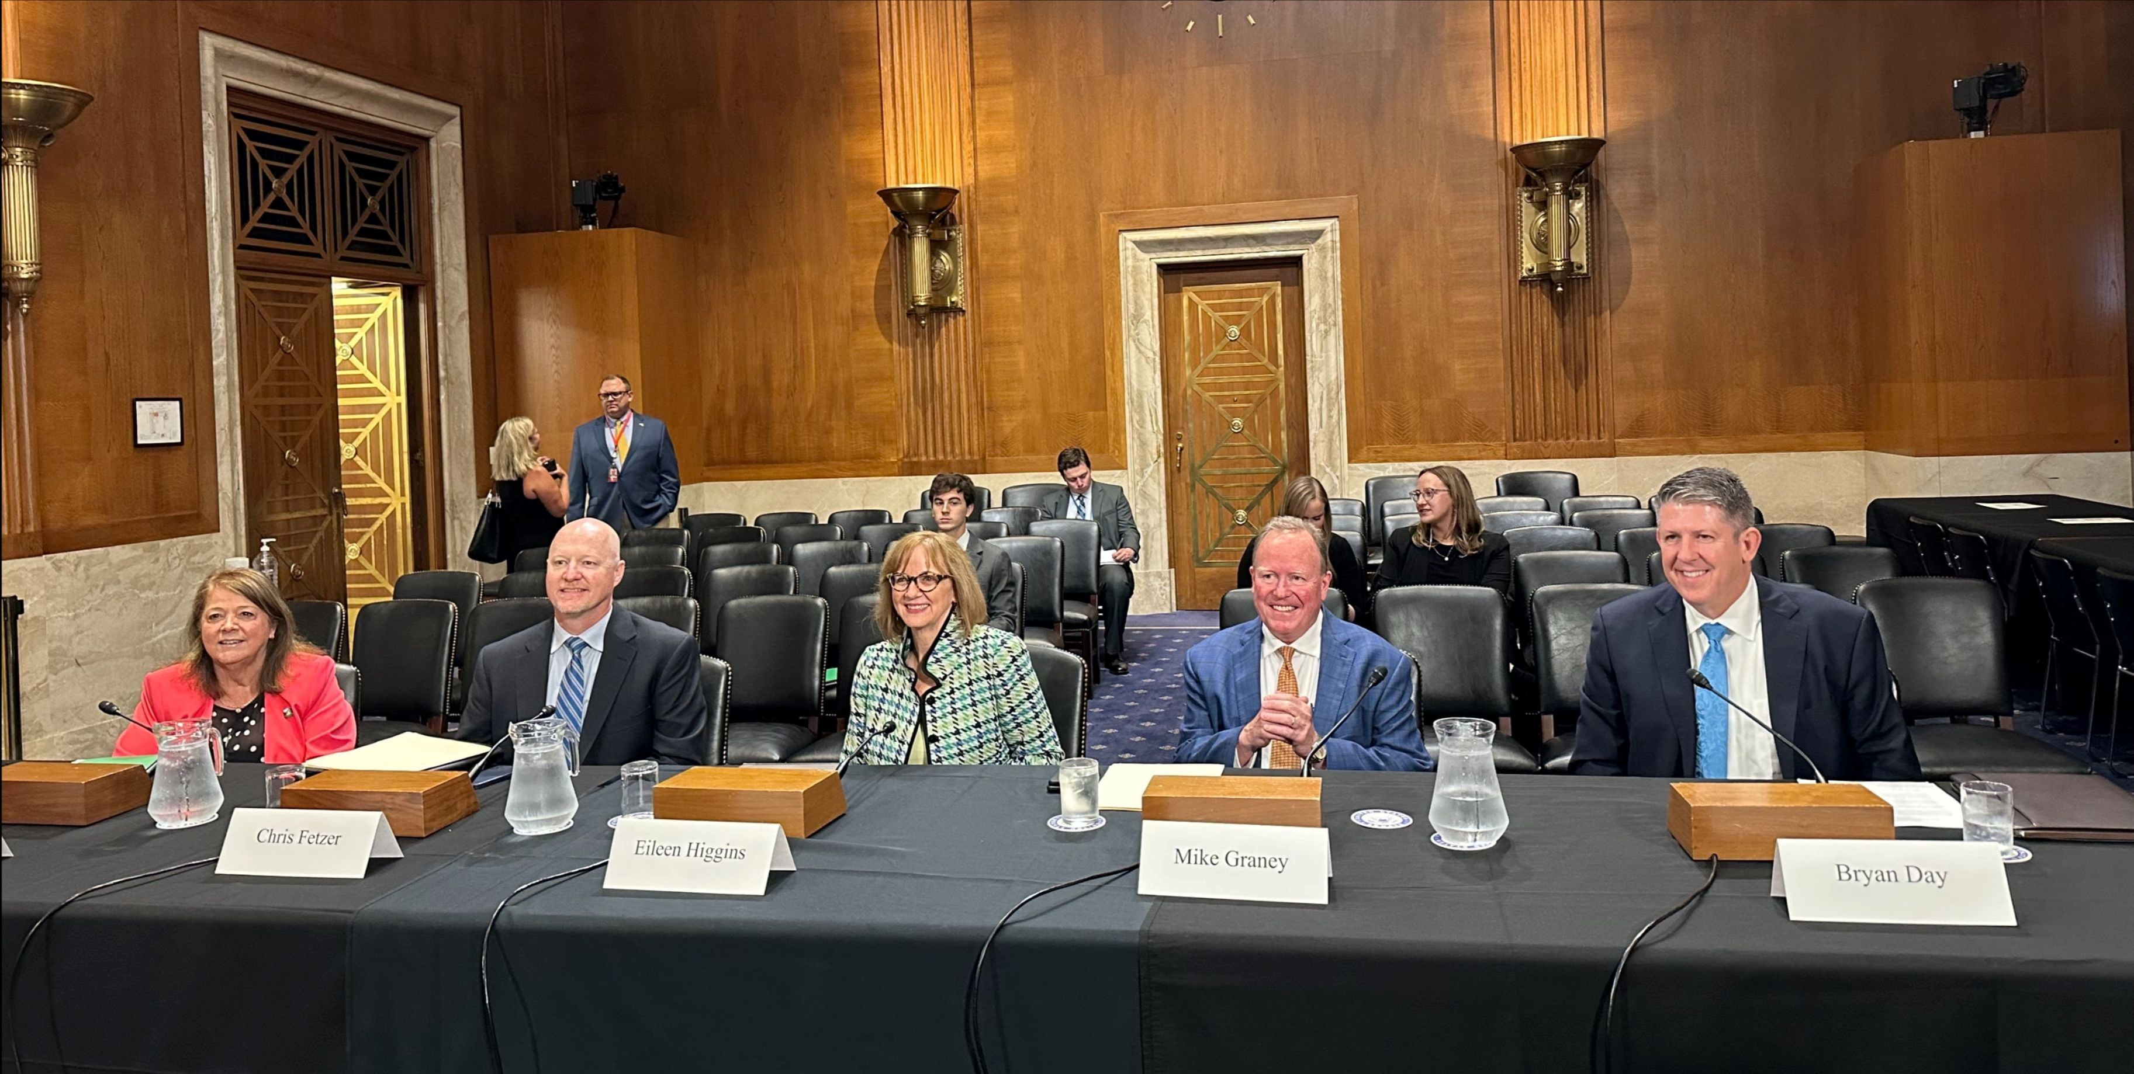
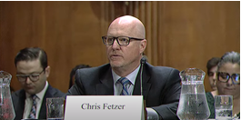
June 2023 EDA Reauthorization Hearing
    NADO President Chris Fetzer testified on the topic of EDA reauthorization before the Senate Environment and Public Works Committee on June 21, 2023
Notes:
Incorporating NADO members’ priorities in the legislative text has been a long process. Many NADO members have testified before Congress about the importance of EDA reauthorization and the specific provisions it should contain.

Slide 8
Senate Hearing – testimony highlights
    Invest in EDD organizational capacity
    Increase the authorized level for EDA Partnership Planning Grants
    Reduce local matching fund requirements
    Authorize a dedicated disaster recovery bureau within EDA
    Invest in EDA’s core programs, instead of creating more new initiatives
    Direct EDA to make more smaller awards, rather than fewer larger awards
    Include rural set-asides within some of EDA’s core programs
    Authorize pre-development as an eligible use of EDA funding
    Authorize the facilitation of high-speed broadband connectivity as eligible
    Increase EDA’s authorized funding level
Notes:
These are some key provisions that Chris Fetzer, NADO’s immediate past president, asked the Senate Committee to include as part of an EDA reauthorization bill, when he testified before the Senate.

Slide 9

EDA Reauthorization – WE NEED YOUR HELP!
Action Needed By PDDs:
    SENATE:
    Please ask your Senators to support Senate Bill 3891.
    HOUSE:
    Please ask your Representatives in the House to introduce and pass similar legislation in the House.
    Please help NADO identify potential champions in the House, particularly Republican champions.
Notes:
We need the help of RDOs to reach out to your members of Congress and tell them how important EDA reauthorization is to you and your organizations

Slide 10
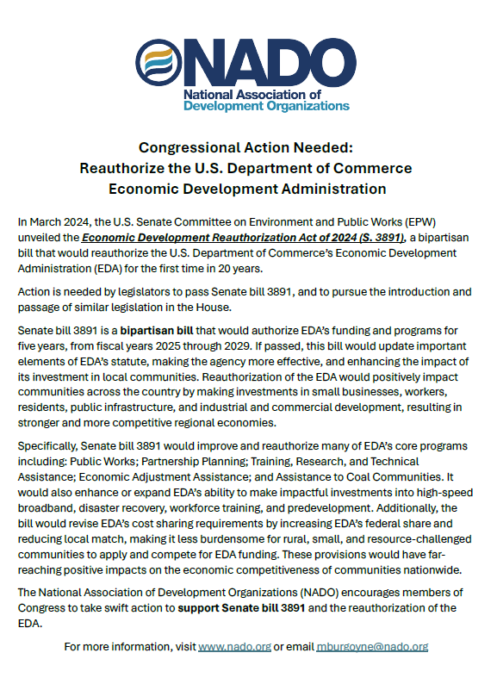
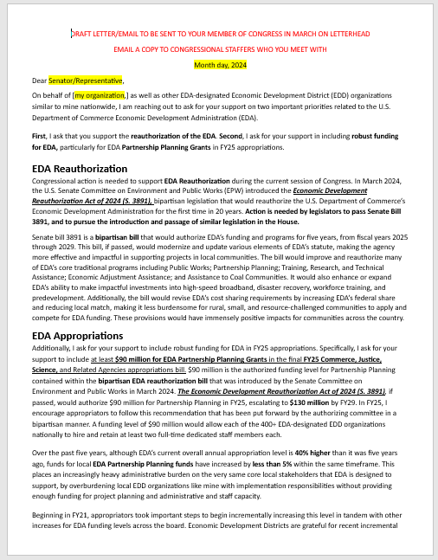
Advocacy Resources
Fact Sheet
Template Letter
NADO members are encouraged to email these resources to your Senators and Representatives
These and other advocacy materials are available here:
https://www.nado.org/advocacy-resources/
https://www.nado.org/wp-content/uploads/2024/03/Congressional-Action-Needed-Reauthorize-EDA.pdf
https://www.nado.org/nado-eda-template-letter-to-congress/
Notes:
Here are some materials you can use to do that outreach, including template emails and letters, which you can find on nado.org

Slide 11
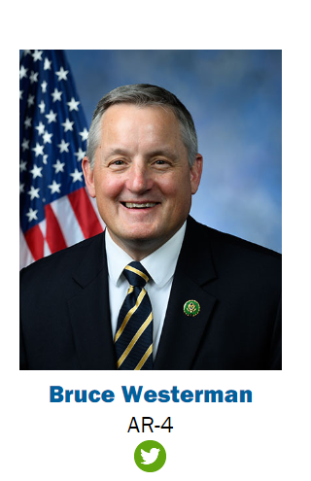
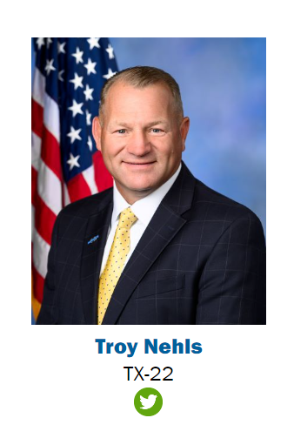
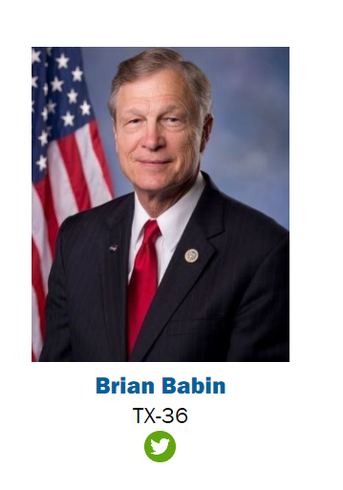
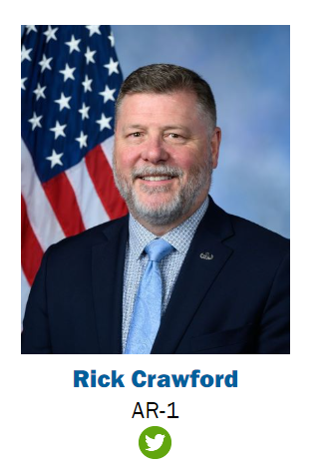
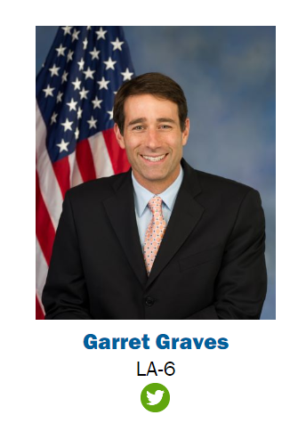
Members of Congress from SWREDA states who serve on the
House Transportation & Infrastructure Committee
The House T&I Committee is the Congressional subcommittee with jurisdiction over EDA on the House side.
This Committee has significant oversight control over EDA reauthorization.
If one of the members below is your member of Congress, they are especially important to EDA reauthorization. Please reach out to them!
Notes:
NADO’s key advocacy focus right now is on the House side.
In the House, the Committee with Jurisdiction over EDA is the House Transportation and infrastructure (T&I) Committee.
This slide shows members of Congress in the House that are from the SWREDA states who serve on the House T&I Committee
If your Congressman is pictured here, that means he is particularly important to reach out to. Please contact them to ask whether they would be willing to champion companion legislation in the House similar to the legislation that has been introduced in the Senate. A House companion bill would help increase our overall chances of success.

Slide 12
Farm Bill
Reauthorization

Slide 13
Farm Bill
Reauthorization Update
The current Farm Bill, which was passed in 2018, technically expired in September 2023 but was extended for one additional year until September 2024
As September draws nearer, Congress must either pass another extension, or pass a reauthorization of the Farm Bill
On May 1, the Senate Committee on Agriculture released some details about its version of the proposed new Farm Bill, entitled the "Rural Prosperity and Food Security Act”
The House also released its proposed version this month
One of the provisions that NADO is most excited about is the inclusion of a brand new program: Rural Partnership Program (RPP) Grants
If enacted, the RPP grants would provide flexible funding for rural organizations for staffing, operations, planning, and pre-development. NADO’s understanding is that RDOs would be eligible for these funds.
Notes:
There has been some recent movement on Farm Bill reauthorization. Both the Senate and House have released details of their proposed versions of a new Farm Bill, but nothing has passed in either the Senate or the House yet. Hopefully we will see more movement on the Farm Bill during this session of Congress.

Slide 14
Appropriations

Slide 15
Final FY 2024 Appropriations
3/9/2024: The first tranche of government funding, including 6 of the total 12 appropriations bills, was signed into law for FY 2024
Agriculture, Rural Development, FDA, and Related Agencies
  Commerce, Justice, Science, and Related Agencies
  Energy and Water Development
  Interior, Environment, and Related Agencies
  Military Construction, Veterans Affairs, and Related Agencies
  Transportation, Housing and Urban Development, and Related Agencies
3/23/2024: The second tranche of government funding, including 6 of the total 12 appropriations bills, was signed into law for FY 2024
Defense
  Financial Services and General Government
  Homeland Security
  Labor, Health and Human Services, Education, and Related Agencies
  Legislative Branch
  State, Foreign Operations, and Related Programs
Notes:
This past fiscal year, FY24, was a difficult year for appropriations, both because of the debt limit deal negotiations, and also because some members in Congress were calling for significant government funding reductions across the board.
As a result, final FY24 appropriations were only finalized as of March 2024.
In general, we saw the pendulum swing toward high levels of funding in the various pandemic relief bills, and now we’re seeing that pendulum swing back.

Slide 16
Economic Development Administration Appropriations
Economic Development Administration | FY 2018 Final | FY 2019 Final | FY 2020 Final | FY 2021 Final | FY 2022 Final | FY 2023 Final | FY24 House proposed | FY24 Senate proposed | FY24 Final
EDA Total Appropriation | $301.5 million | $304 million | $333 million | $346 million | $373.5 million | $498 million | $254.5 million | $466 million | $468 million
Total – Economic Development Assistance Program | $262.5 million | $265 million | $292.5 million | $305.5 million | $330 million | $430 million | $211 million | $396 million | $400 million
EDA Partnership Planning Grants | $33 million | $33 million | $33 million | $33.5 million | $34.5 million | $36 million | N/A | $36 million | $34.5 million
Notes:
EDA appropriations did fall somewhat in FY24, but in terms of Planning Grant funds, this is a fairly standard incremental appropriations fluctuation, so there’s no major cause for concern here.
We do NOT expect individual EDDs’ Partnership Planning Grant allocations to change at all as a result of this.

Slide 17
Appalachian Regional Commission
Appropriations
Appalachian Regional Commission | FY 2019 Final | FY 2020 Final | FY 2021 Final | FY 2022 Final | FY 2023 Final | FY 2024 Final
Total Appropriation | $165 million | $175 million | $180 million | $195 million | $200 million | $200 million
Local Development Districts | $6.2 million | $6.2 million | $6.2 million | $8 million | $8 million | Not specified
Notes:
For ARC, over the past couple of years, NADO has been successful in partnering with the Development District Association of Appalachia (DDAA) to advocate for increases to the Local Development District funding line item that ARC-region LDDs receive.
NADO successfully advocated to raise that level from $6.2 million to $8 million.
This year, Congress didn’t specify the amount for LDDs. But, good news: ARC leadership has made a verbal commitment to try to continue to hold that LDD funding level at $8 million and honor where it is set currently, even without Congress mandating it, which is great news.

Slide 18
Delta Regional Authority
Appropriations
Delta Regional Authority | FY 2021 Final | FY 2022 Final | FY 2023 Final | FY 2024 Final
Total Appropriation | $30 million | $30.1 million | $30.1 million | $31.1 million
Notes:
Overall, DRA also received a $1 million appropriations increase

Slide 19
Southeast Crescent Regional Commission
Appropriations
Southeast Crescent Regional Commission | FY 2021 Final | FY 2022 Final | FY 2023 Final | FY 2024 Final
Total Appropriation | $1 million | $5 million | $20 million | $20 million
Notes:
The Southeast Crescent Regional Commission is now fully operational, they have begun actively making grants. And they received robust funding once again for FY24. So definitely go after that funding, if you’re eligible.

Slide 20
OMB 2 CFR 200
Guidance

Slide 21

NADO Webinar Recording
New OMB 2 CFR 200 Guidance
OMB 2 CFR 200 Guidance Webinar for RDOs
NADO Webinar Was Held on May 1, 2024
This webinar features Bob Lloyd, a respected authority on the policies and practices surrounding federal grant funding and the management of federal awards
The U.S. Office of Management and Budget (OMB) has released its long-awaited revision of the Uniform Administrative Requirements, Cost Principles, and Audit Requirements for Federal Awards (2 CFR 200).
This webinar covers the highlights of the revised policies which must be implemented by October 1.
Webinar Recording Link
Notes:
NADO recently held a webinar focused on updates that were recently made to the Office of Management and Budget 2 CFR 200 Uniform Guidance.
The webinar features Bob Lloyd, a respected authority on the policies and practices surrounding the administration of federal grant funding and the management of federal awards in general.

Slide 22
Upcoming NADO Events
    2024 National Regional Transportation Conference
      July 30-August 1, 2024 – Greenville, SC
    2024 NADO Annual Training Conference
      October 21-24, 2024 – New Orleans, LA
    2025 NADO Washington Policy Conference
      March 9-12, 2025 – Arlington, Virginia and Washington, DC
      https://www.nado.org/upcoming-events/

Slide 23
Questions?
Mirielle Burgoyne
Deputy Executive Director/Director of Government Relations
mburgoyne@nado.org

