Slide 1
IN PARTNERSHIP WITH
A New Partnership for Economic Transformation
The Economic Recovery Corps (ERC) is a new, collaborative initiative designed to accelerate recovery from the COVID-19 pandemic in distressed communities and regions throughout the U.S. by connecting organizations with the talent and capacity needed to advance new ways of doing economic development that promote economic resilience and transformative change.

Slide 2
LOCAL INITIATIVES SUPPORT CORPORATION

Slide 3
Broadband-Led Economic Development in East and Deep East Texas
Support broadband availability, affordability, and adoption by individuals and households.
Leverage broadband as a baseline asset to attract and retain small businesses and industry that is crucial for economic growth, job creation, and digital inclusion.
Connect local governments, COG staff and community anchor leaders for a regional “cross-pollination” effort that better links and advances the regions’ digital infrastructure ecosystem.

Slide 4
Dates | Jan-June 2024 | July-Dec 2024 | Jan-June 2025 | July-Dec 2025 | Jan-June 2026
Key Goals | Meet & Greet | Visibility in field for broadband plans and digital inclusion with partner networks | Visibility in field for broadband, digital inclusion and tech-enabled workforce with expanded regional networks | Visibility in field for broadband, digital inclusion and tech-enabled workforce with expanded regional networks | Funding and capacity building plans
Main Activities | Fellow makes introductions across regions facilitated by COGs & LISC. Build calendar of leverage events. | Participate in leverage events and host community-facing engagements. Coordinate existing broadband planning efforts across 25 counties. Engage w Rural LISC workforce delivery initiatives & ETCOG Rural Set Go. | Participate in leverage events and host community-facing engagements. Ongoing coordination of broadband planning. Ongoing workforce engagement for Rural LISC & ETCOG. RFP planning & support for 3 to 4 micro communities. | Participate in leverage events and host community-facing engagements. Ongoing coordination of broadband planning. Ongoing workforce engagement for Rural LISC & ETCOG. Prospective grant list development for broadband & digital inclusion. | Participate in leverage events and host community-facing engagements. Ongoing prospective grant development.

Slide 5
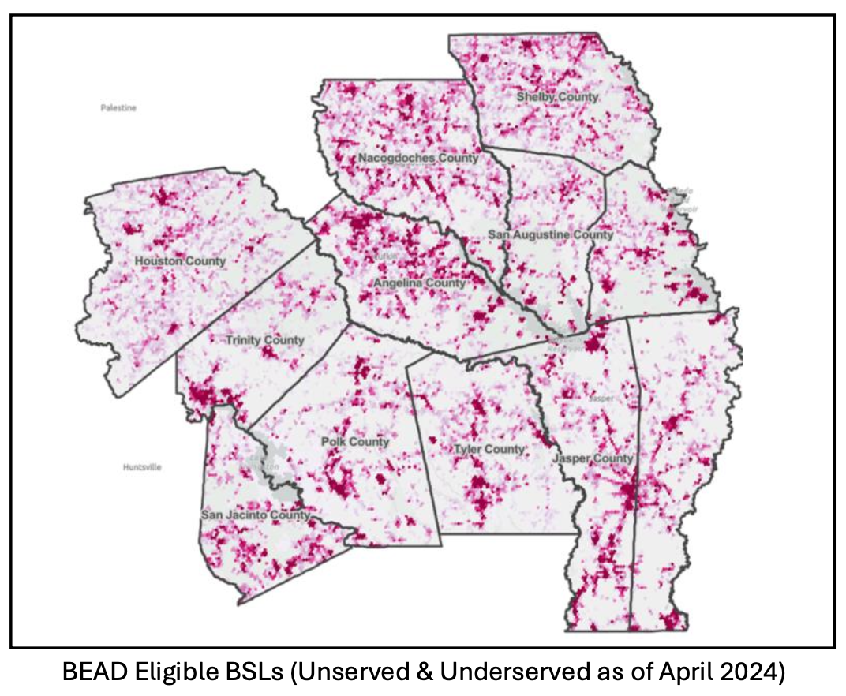
Current State of
Broadband in
Deep East Texas
191,000
Total BSL’s
75,000
Unserved
20,000 Underserved

Slide 6
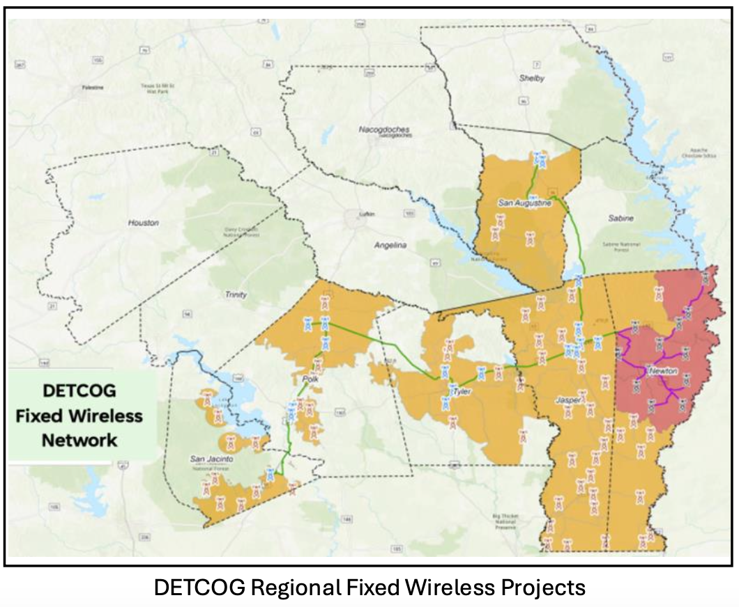
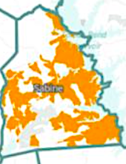
Sabine County
Fiber Project

Slide 7
