Slide 1


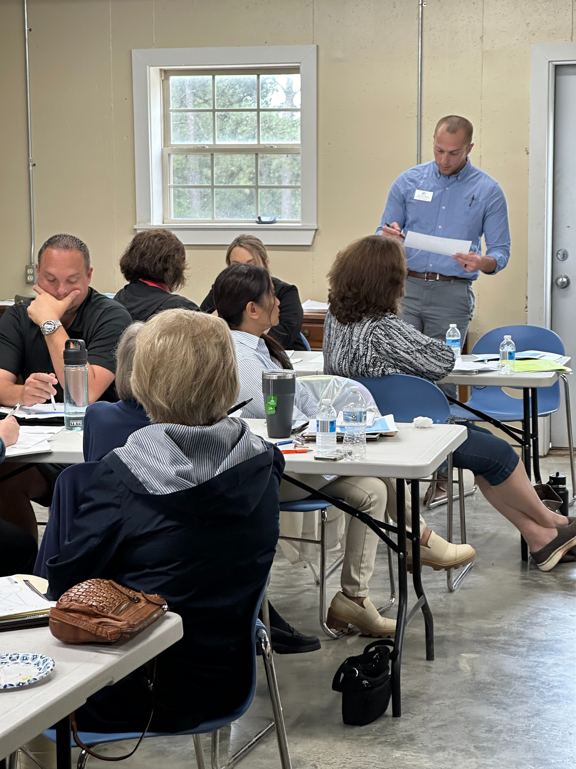




Strategic Partners
“Equipping Arkansans with sustainable, accessible research-based practices and expertise to create vibrant, self-reliant communities where businesses, organizations, and families thrive.”
SWREDA 2024
Notes:
Welcome and introduction
Led by Hunter with transition to Brandon

Slide 2
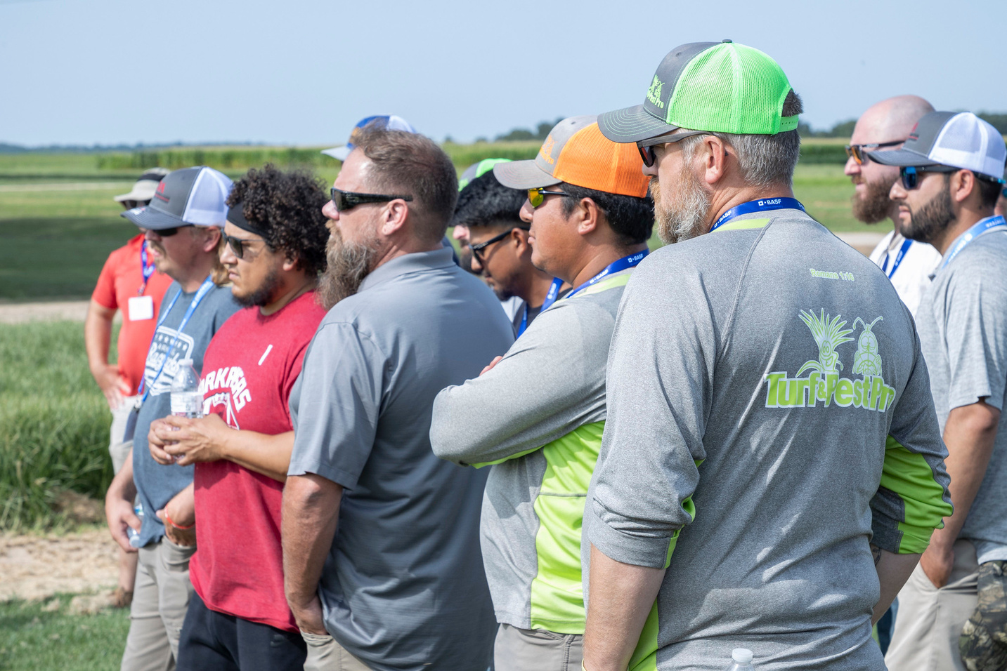

About UADA
The University of Arkansas System Division of Agriculture’s mission is to strengthen agriculture, communities, and families by connecting trusted research to the adoption of best practices. Through the Agricultural Experiment Station and the Cooperative Extension Service, the Division of Agriculture conducts research and extension work within the nation’s historic land grant education system.
The Division of Agriculture is one of 20 entities within the University of Arkansas System. It has offices in all 75 counties in Arkansas and faculty on five system campuses.
About CPED
The Community, Professional, & Economic Development Unit provides support to communities through
  Business Development Support
  Community, Economic, & Workforce Development
  Leadership Training
  Public Issues Education & Local Government
  E-Learning & Professional Development
Notes:
Discuss overview of how UADA Extension works.
We are one of just a few Extensions to lead a University Center.
Unique value-add is our connection to every county, content experts, trust, and non-biased information.

Slide 3




Equity and Workforce Development Investment Priorities
Areas of Focus
Technical Assistance
Applied Research
Dissemination of Information (Storytelling)
Notes:
In terms of EDA Investment Priorities
Invested in the Equity and Workforce lens to conduct our work
Supporting rural, Hispanic, and Marshallese

Slide 4
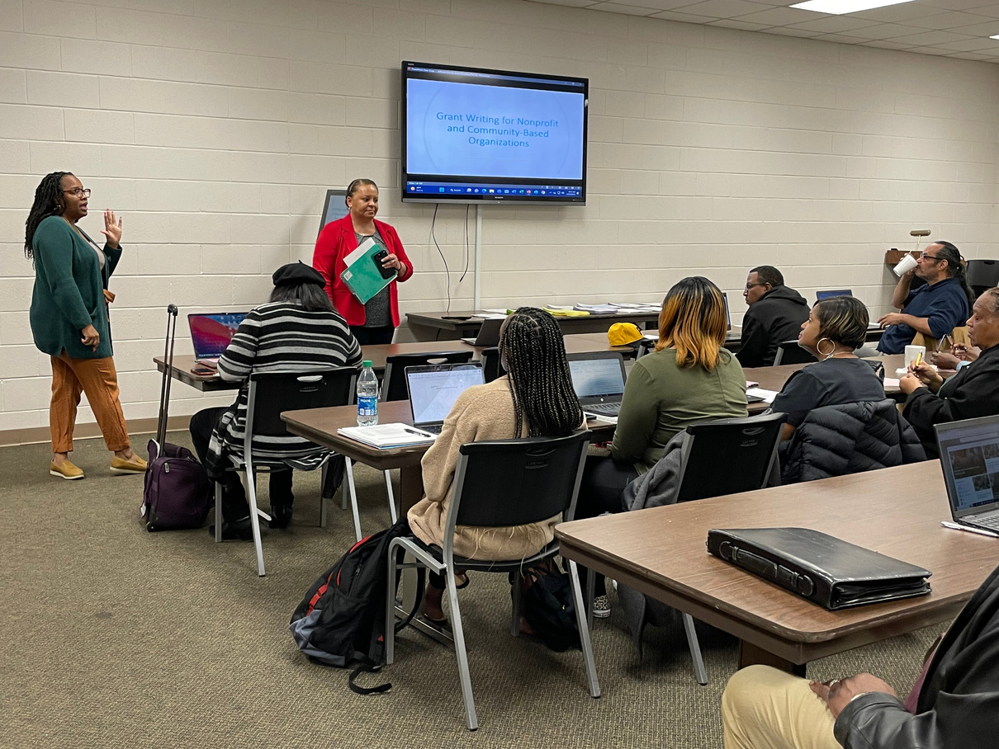
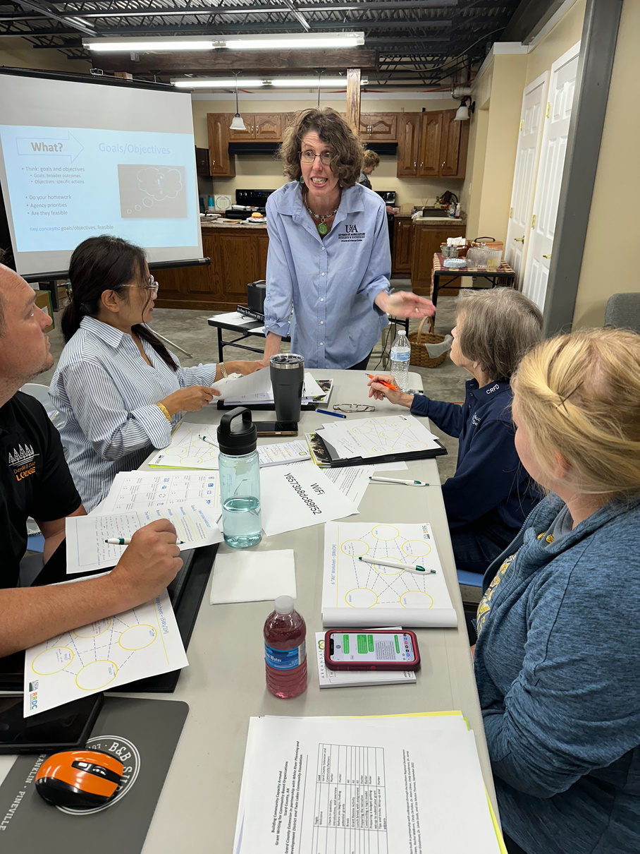
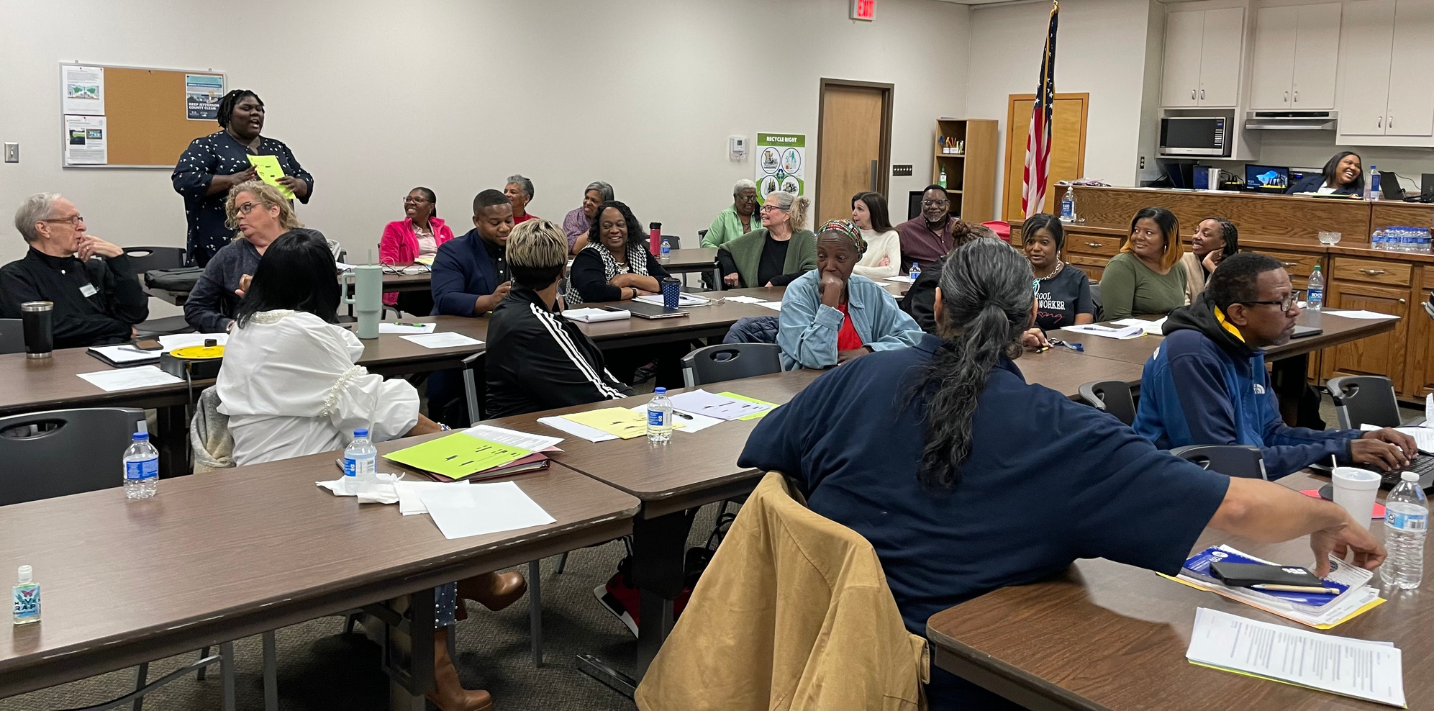
Technical Assistance
Building Capcity Through Grant Writing
By the Numbers:
  4 workshops
  78 participants
  10 counties represented
    51 cities/towns
    county treasures, fire departments, schools, small business owners, nonprofits
Impact (16 surveys):
  100% felt questions were answered
  94% felt “somewhat/very” prepared to use ABCD framework
  94% “probably/definitely” prepared to find grant resources
Notes:
Building Capacity Through Grant Writing Workshops one of the many ways we are providing technical assistance to EDDs and their communities.
Elevate EDDs as an expert and a partner in grant writing related to their priorities.
Workshop lifts the "floor" for knowledge through hands-on, engaging content and practice.

Slide 5
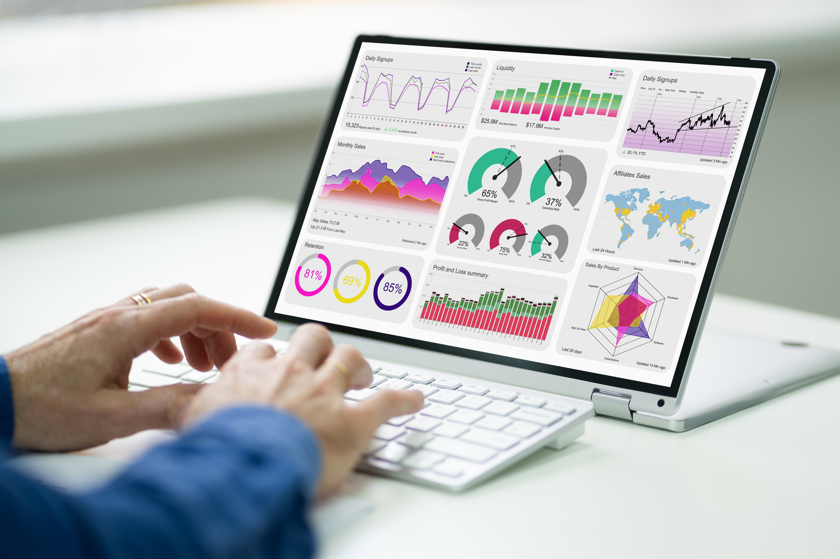
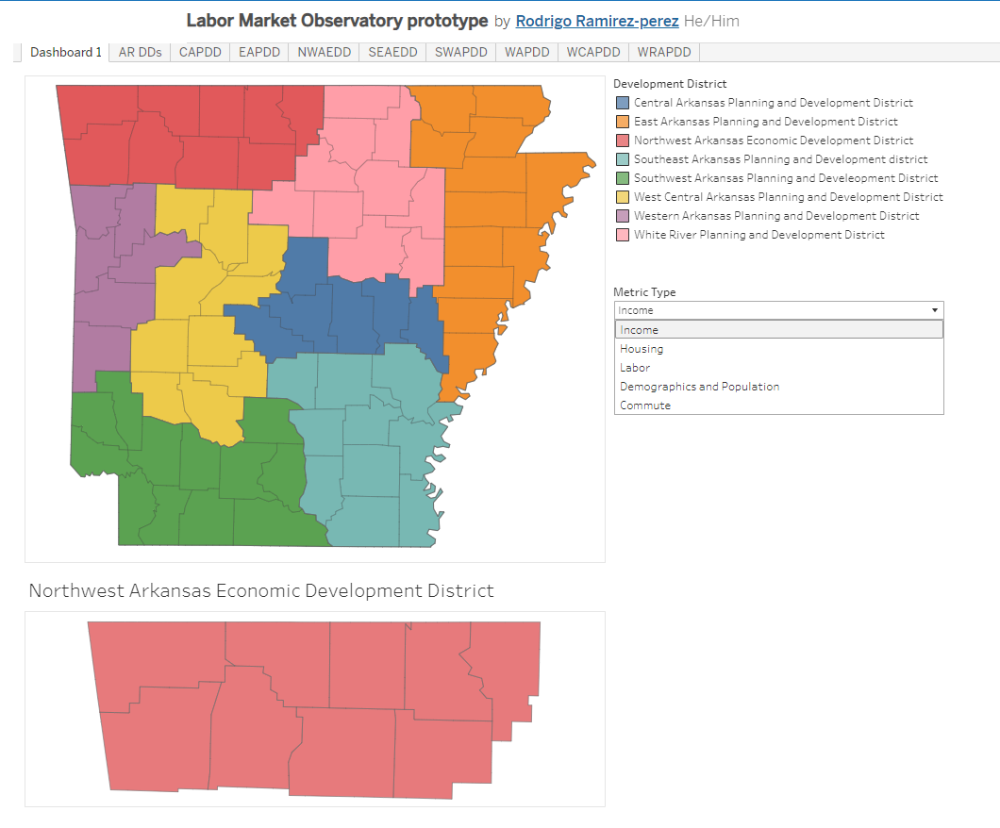
Applied Research
Labor Market Observatory Highlights
  Interactive dashboards for each district
    Data mapped to district
    Hope to drill down to census tracts.
  Workforce data indicators
    Income, Demographics, Housing, etc.
  Regular updates (based on datasets)
Fall 2024 Estimated Launch
Notes:
Labor Market Observatories created for each EDD on key workforce data points.
Benefits include:
- comparison to US, State, and Region-level data
- data will be sorted by the district, removing the need for EDD staff to calculate stats for their service area (not seen in current federal resources)
- empowers EDD staff to use data sourced into one location
Being built in partnership with our strategic partner, Heartland Forward and will also includes training on how to use it and reports from data we collect.

Slide 6

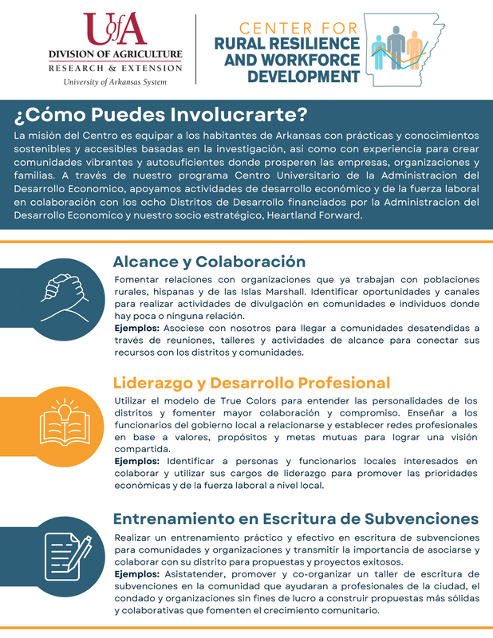

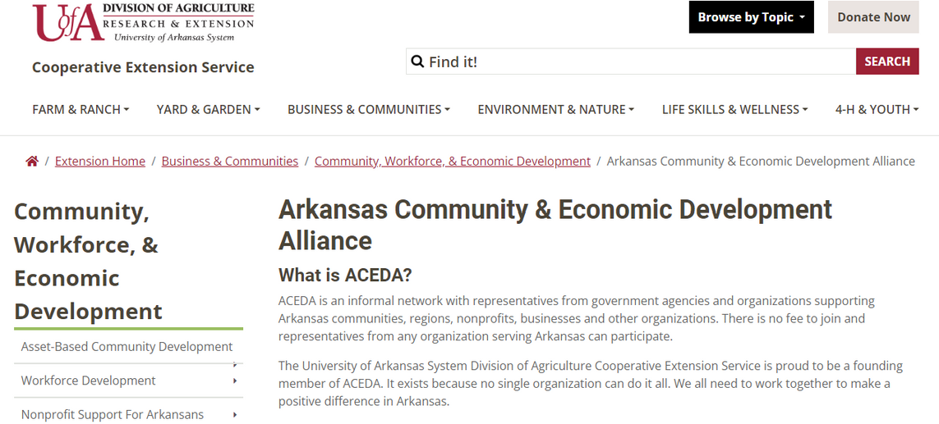
Storytelling
Our Objectives
  Foster collaboration between parallel ecosystems and communities
    workforce, entrepreneurship, EDA, SBA, etc.
    Rural, Hispanic, Marshallese
  Disseminate information about resources
  Share success and impact of districts
Notes:
Storytelling could look like a number of things for UADA EDA UC and for PDDs.
Who is the audience?
What is the information being communicated?
Why is it important?
One-pager: Offered in English and Spanish with Marshallese down the way once we hire someone.
FACT Sheet Newsletter
- biweekly newsletter for community covering Funding, Activities, Community, and Tools related to economic and workforce development.
Arkansas Community Economic Development Alliance (ACEDA)
Group that meets quarterly to leverage resources and ideas to support economic development around the state.
April from AURO EDA office along with Panel of EDDs to be featured in July meeting
- curate questions from the group (150+ listserv)

Slide 7
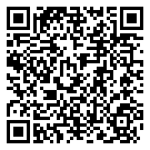



Get In Touch
Our goal is to be as accessible as possible to each of you, whether that is by Zoom, phone, email, or in person.
Hunter P. Goodman | hgoodman@uada.edu
Brandon L. Mathews | bmathews@uada.edu
Rodrigo Ramirez-Perez | rramirez@heartlandforward.org
https://uaex.uada.edu/EDAUC

