Slide 1
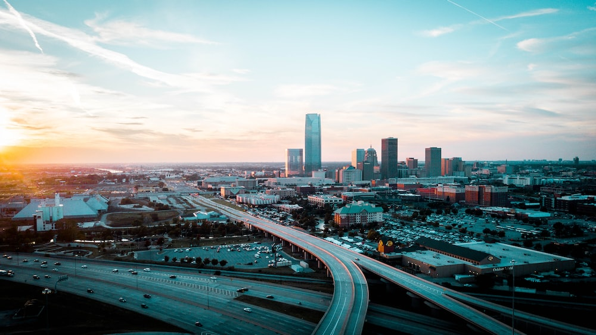
The OKC Region
SWREDA
May 15, 2024
Notes:
1

Slide 2
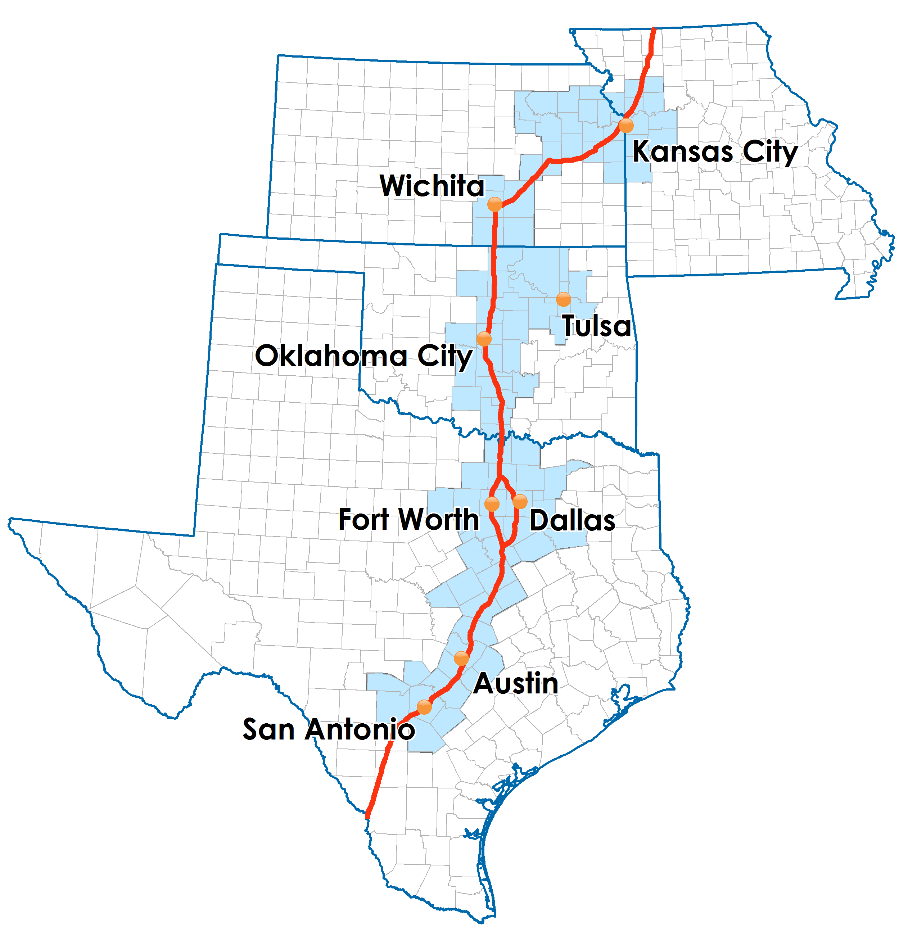
I-35 Megalopolis
Notes:
Oklahoma City is part of that I-35 corridor or Megalopolis.
- As far north as Kansas City, weaving down through Wichita, Tulsa, Oklahoma City, Dallas, Fort Worth, Austin, and San Antonio.
- About 100 counties all together.
So, as an existing employer or a business looking to relocate – you want to know: “How does the I-35 region rank with the other areas in terms of population and job growth?”
2

Slide 3
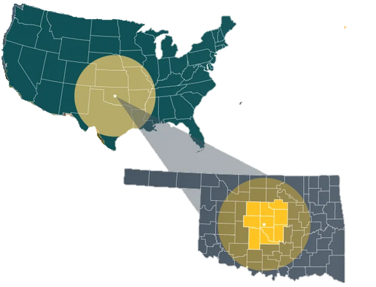
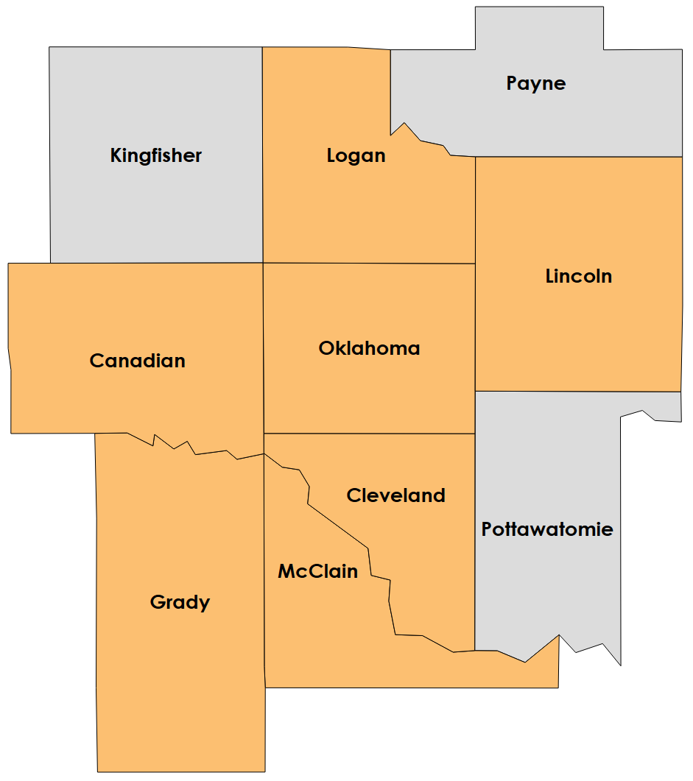
What is the Greater Oklahoma City Region?
7-county Oklahoma City MSA displayed in orange
Notes:
What is the Greater Oklahoma City Region?
The Greater Oklahoma City Regional Partnership was born more than 20 years ago as a way of bringing all of the communities together to improve our economic development opportunities.
Individually, we recognized that on our own, places like Oklahoma City, Norman, Edmond, Moore, Midwest City, Stillwater and Shawnee couldn’t compete for economic development projects. We couldn’t win just doing it ourselves. We didn’t have the labor force or the educational assets. We needed to bring together unique assets from all the communities to showcase the region.
Geographically we are:
The 7 County metro plus 3 additional counties – Payne, Pottawatomie and Kingfisher counties.
The broader region really best describes our labor shed with its 765,000 workers and 1.6 million people.
It is that 50-mile radius of where people live and work.
It includes the 130,000 students enrolled at our 15 colleges and universities.
The 86,000 enrolled in our 9 CareerTech districts.
And, our future - the nearly 300,000 K-12 students in public schools.
It is the 10 counties and 116 cities spread across 8,000 square miles.
It is a region that is weaved together through our location advantages – an interstate system that includes I40, I44, and I35
3

Slide 4
Oklahoma City MSA
From 2010-2020, of 21 metros between 1M to 2M population, OKC experienced the #5th fastest percentage growth (14%)
OKC is now the 42nd largest metro in nation at 1.42M
Of the 41 metros larger than OKC, OKC is growing at a faster rate than 70% of them
OKC MSA shown in Orange
Notes:
WHAT HAS OUR GROWTH LOOKED LIKE COMPARED TO OTHER METROS THROUGHOUT THE COUNTRY?
Of 21 metros between 1M to 2M population, OKC experienced the #5th fastest percentage growth (14%)
OKC is now the 42nd largest metro in nation at 1.42M (moving past Memphis)
Of the 41 metros larger than OKC, OKC is growing at a faster rate than 2/3 thirds of them
4

Slide 5
The GOKC region added 180,000 people over the past decade (2010-2020) (now 1.6 million)
Notes:
HOW MUCH DID THE GREATER OKC REGION GROW OVER PAST 10 YEARS?
The overall Greater Oklahoma City region grew by more than 180,000 people or 12.7% and now is at 1.6 million.
5 of 10 counties in our region enjoyed double digit growth.
Oklahoma County contributed 43% of the total raw population growth in the region over the past decade.
Lincoln County was the only county to show population decline in the past decade. But, in the last 2 years, Lincoln County is now showing positive growth.
What is causing these strong population gains?
1. Job Growth (+75,000 jobs from 2012-2022)
2. Geographic advantages and I-35 corridor
3. Migration from other metros (+10,000 annually)
4. Small international migration from other countries
5. Stronger retention of college graduates
6. Above average birth rate (9% above US). We do a pretty good job of having babies.
7. Average death rate slightly below that of the nation (1% below US)
5

Slide 6
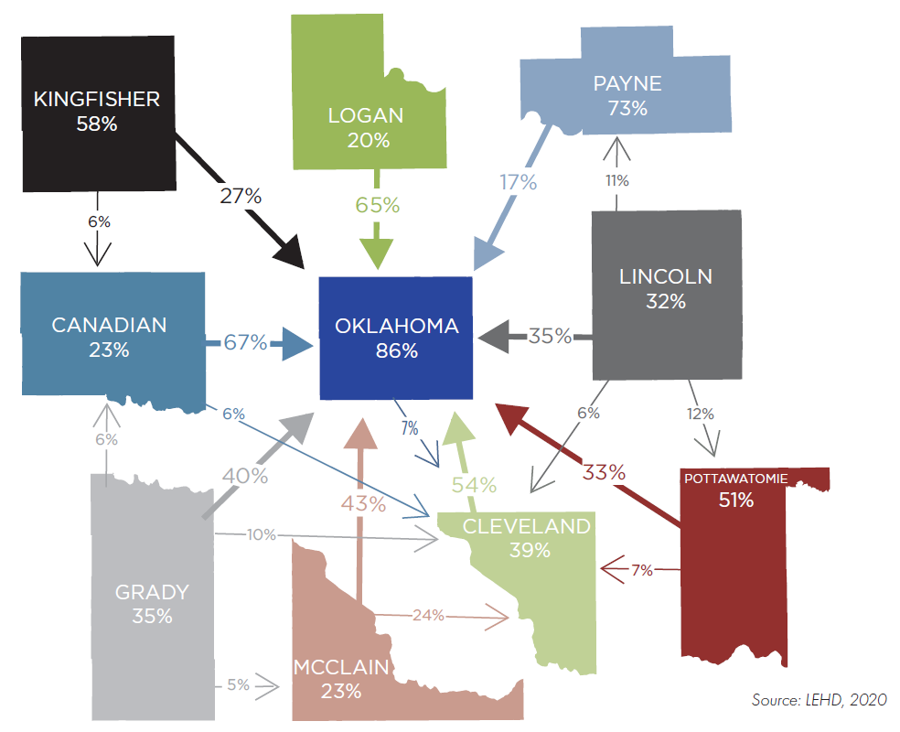
Regional Commuter Patterns
The 820,000 people working in the region benefit from an easy 23-minute commute
The 10-county region functions as a single labor shed
50 miles is 50 minutes
1 in 3 people work in a county different from where they live
Note: The large number within each county represents the % of people who both live and work in the same county. The arrows between counties represent people who drive to work from a different county than they live.
Notes:
The 820,000 people working in the region benefit from an easy 23-minute commute
The 10-county region functions as a single labor shed
50 miles is 50 minutes
1 in 3 people work in a county different from where they live
In our region, we observe a significant number of residents who live in one county but work in another.
1 in 3 people work in a county different from where they live. This is attractive to companies looking at relocating to our market. It is a tangible way to show that people have a number of different housing options because of a very reasonable commute time. The average commute time in the region is 23 minutes. Our transportation system allows for that ease of commute. But, it isn’t something that we should take for granted. As our population continues to grow, we need to look at innovative ways to improve infrastructure to meet those demands.
Our 10-county region serves as a single labor shed where 50 miles is 50 minutes.
NOTE:
1 out of 2 people who live in Canadian County drive to OK county everyday for work; Highest percentage of commuter flow than any other county in the region
More people from Canadian County drive to OK County to work than any other county in the metro
Hints to how interrelated Canadian county is to OKC; a relationship mirrored by the relationships with the other counties
High percentage of people living outside of OK county come to work in OKC
High rates of commuting between counties suggest that the economies of these regions are intertwined. (or high rates of commuting between counties reflect economic interdependence, improved access to employment, infrastructure development, collaboration, and cultural exchange.)
Commuting patterns enable workers to access a broader range of employment options.
This can lead to lower unemployment rates and better career prospects.
Counties that share a workforce often collaborate on projects and initiatives.
The exchange of ideas and talents fosters innovation and regional development.
6

Slide 7
Economic Drivers
Aerospace & Aviation
Government
Healthcare & Social Assistance
Manufacturing
Retail Trade
Professional, Scientific, & Technical
Health Care
And Social
Assistance
88,300 jobs
Professional Scientific, and Technical
40,800 jobs
Aerospace & Aviation
43,300 jobs
Government
134,00 jobs
Manufacturing
40,600 jobs
Retail Trade
77,600 jobs
Source: BLS QCEW 2022 (Greater Oklahoma City Region; Lightcast 2023.3)
Notes:
The economy of the Greater Oklahoma City region is increasingly diverse.
Aerospace makes up one of the fastest-growing sectors, employing more than 43,000 individuals across 290 companies and having experienced a 48% increase in goods & services output from 2015-2020.
A few of the other key economic drivers include Government, Health Care, and Professional Services.
Federal, state and local government account for approximately 20% of all jobs primarily because of the presence of Tinker Air Force Base, the Federal Aviation Administration, tribal employment, and Oklahoma City is the state’s capital.
The largest number of establishments are found within the professional services sector. The oil and gas sector, despite small employment numbers of under 2 percent, remains a major contributor to GDP and wages.
7

Slide 8
Regional-Assisted Companies 2023 Wins
4,365
JOBS
$294
Million Payroll
$6.7
Billion Capital Investment
Source: Greater Oklahoma City Regional Partnership, 2023
Notes:
130 chamber projects (new to market and existing company expansions)

Slide 9
Upcoming Regional Projects

Slide 10
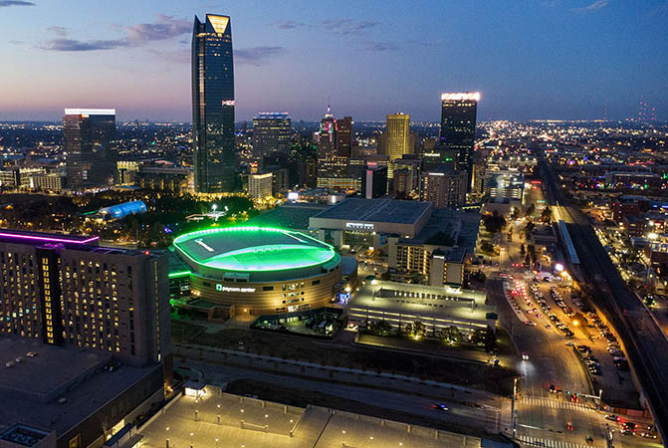
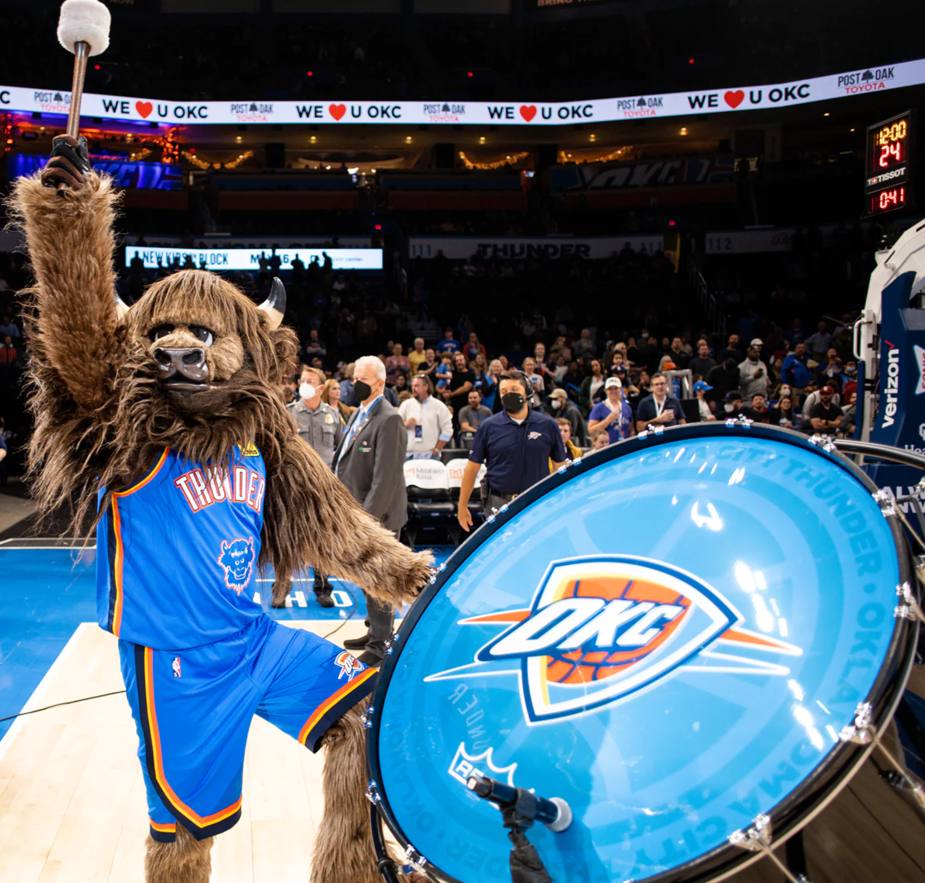
Voters Approve New Oklahoma City Arena – Secures NBA Oklahoma City Thunder Through 2050
Notes:
OKC citizens voted to fund a new nearly $1 billion downtown arena, which almost certainly will be located on the site of the old Cox Center, now home to Prairie Surf Studios.
No debt – pay using an extension of a one penny sales tax
Expect conceptual plans later this year with the goal of the Thunder playing home games in the new facility before the end of the decade.
Anticipated open by the 2029 season (if not sooner)

Slide 11
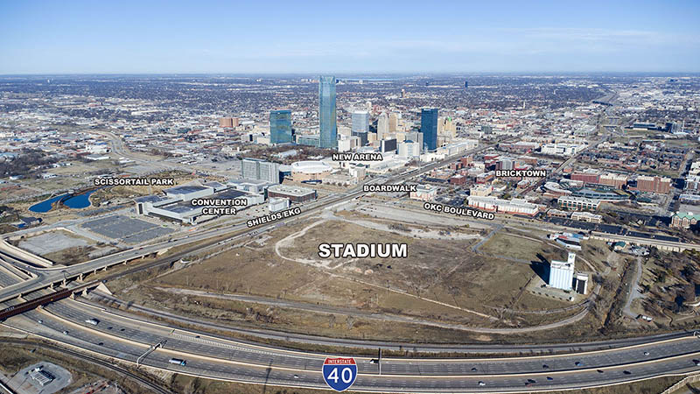
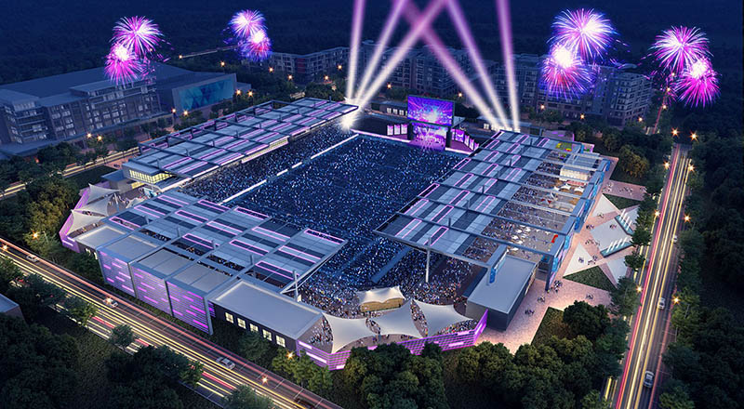
Multi-Purpose Stadium
Notes:
The MAPS 4 Multipurpose Stadium project will dedicate $41 million to construct a new venue capable of hosting high school, collegiate, and professional sporting competitions, as well as concerts and similar events.
The venue is anticipated to be similar in concept to multipurpose stadiums and venues found in other peer markets. This MAPS 4 project will build a regulation-sized playing surface for a variety of purposes. The venue will include approximately 8,000 seats.
The site will be the former Producers Coop south of Bricktown and will be part of a larger retail and entertainment district.

Slide 12
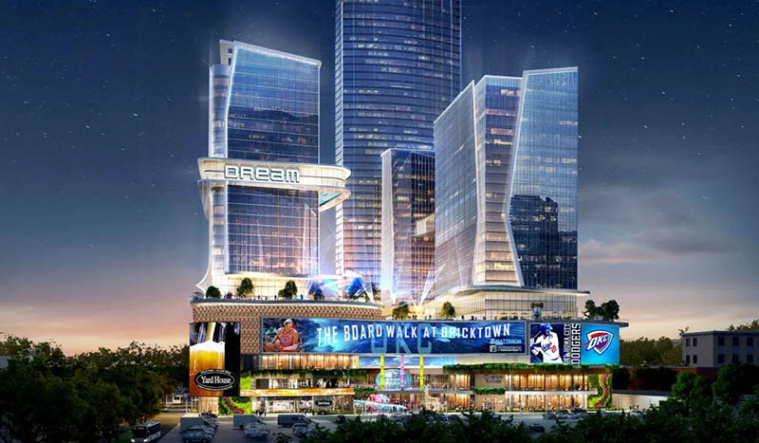
Boardwalk at Bricktown
Notes:
While the ‘aspirational’ tallest tower in the U.S. is high unlikely, what should start to take place this year are the final plans for 3 30+ level towers just to the east of the Harkins Theater in Bricktown.
Named the Boardwalk at Bricktown, it will feature a new Dream Hotel, restaurants, entertainment, and 2 high-rise residential towers.
The mixed-use development is estimated to cost more than $736 million.
Construction should begin summer 2024 on the urban infill project that will include more than 900 apartments, a hotel, multiple commercial spaces and plenty of public parking.
City Council approved a $200 million TIF incentive August 2023 for the project.

Slide 13
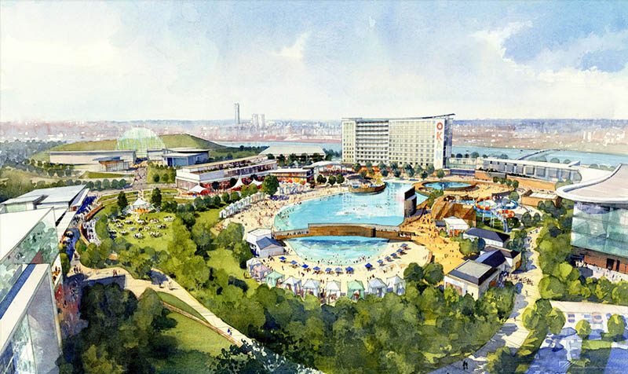
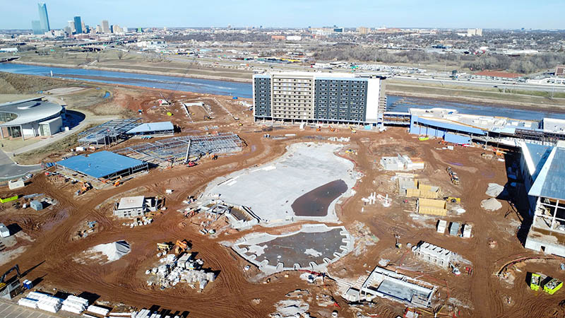
OKANA Resort & Indoor Water Park
Notes:
Chickasaw Nation announced a new $300 million tourist destination adjacent to the First Americans Museum (FAM).
Construction has started and is expected to be complete in 2025.
The resort-hotel will feature an 11-story, 404-room hotel, providing guests with luxurious accommodations, riverfront and lagoon views and proximity to the heart of Oklahoma City and the Boathouse District.
A five-acre outdoor adventure lagoon designed for relaxation and play will sit at the center of the property and will be comprised of one main body of water and two smaller bodies of water – all lined with sandy beaches. A pedestrian bridge will stretch across the main body of water, allowing guests to easily move throughout the property.
The resort also will feature a 33,000 square-foot family entertainment center, over 100,000 square-feet indoor waterpark, 39,000 square-feet of conference center space, spa and golf simulator, and multiple retail outlets, and dining options.
Initially, the resort is projected to employ 400 people and the annualized economic impact year one is projected to be $97 million. Additionally, estimates for the 10-year economic impact of this development are projected to exceed $1 billion, with full-time employment expanding to approximately 700-800.
https://www.okctalk.com/content.php?r=878-Construction-in-full-swing-at-massive-OKANA-project

Slide 14
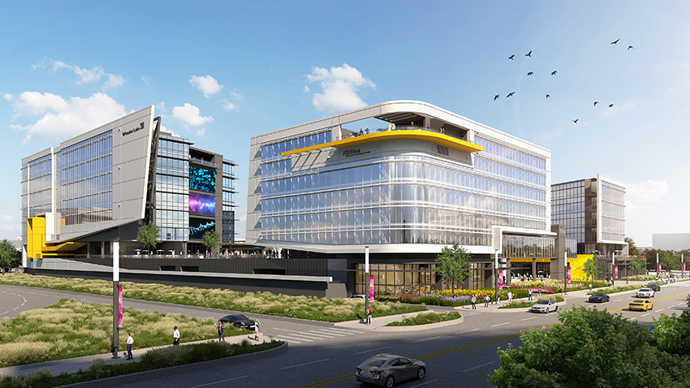
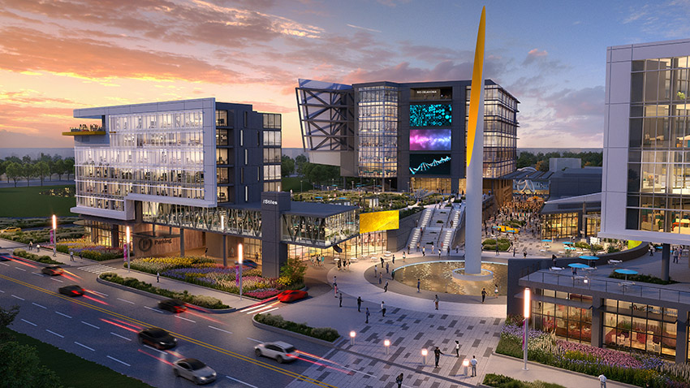
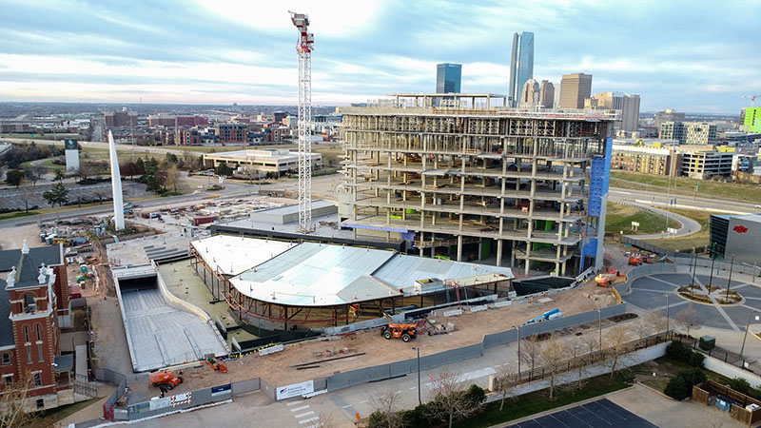
Convergence
Notes:
The Convergence project is well underway and will feature an office building for biotech, a hotel, and a MAPS 4 Innovation Hall.
This $190 million mixed-use development will create a new gateway into the Innovation District.
The site will also be home to Wheeler Labs.
Is set to open in the beginning of 2025 with pre-tours beginning in fall of 2024.

Slide 15
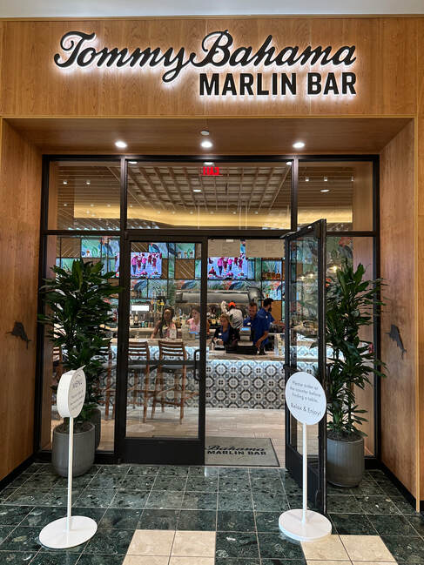
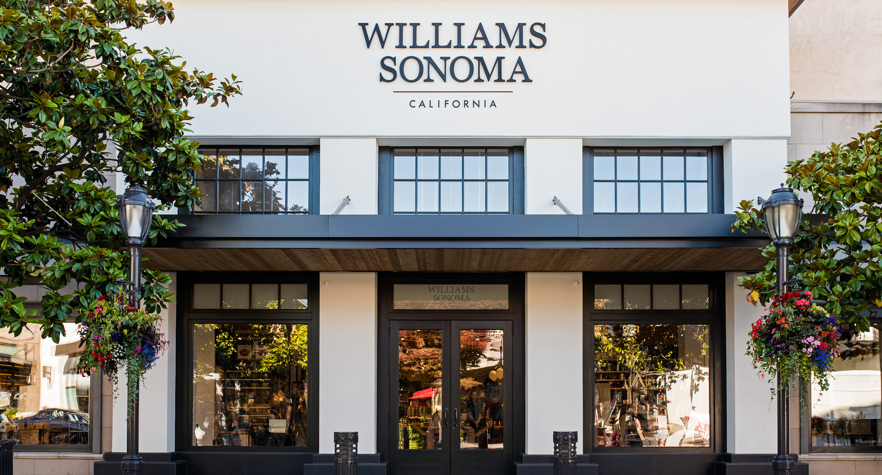
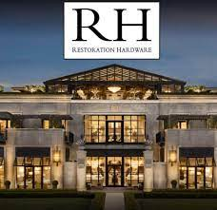
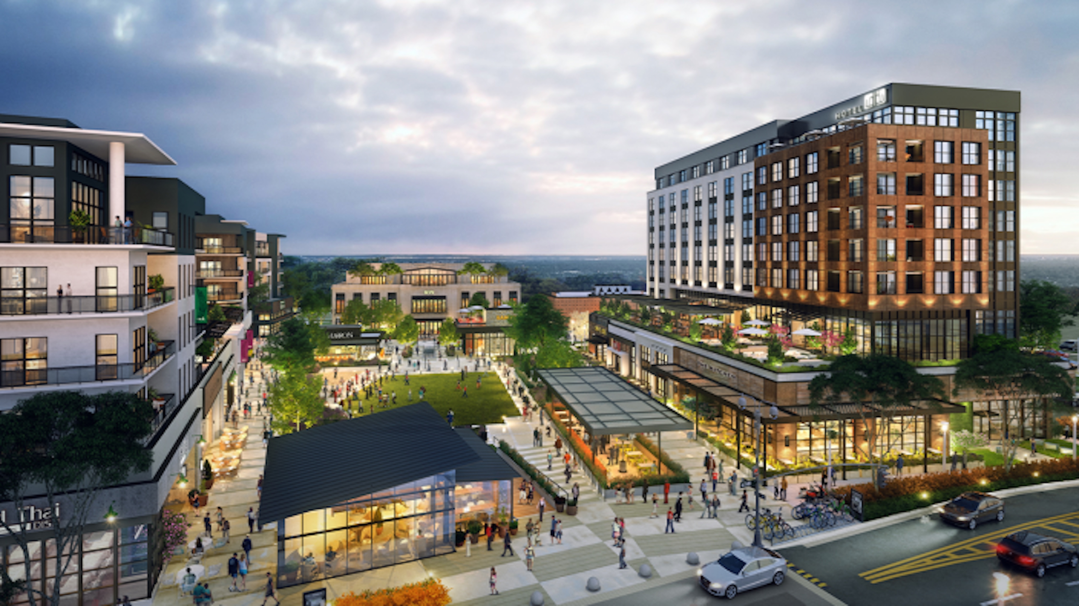
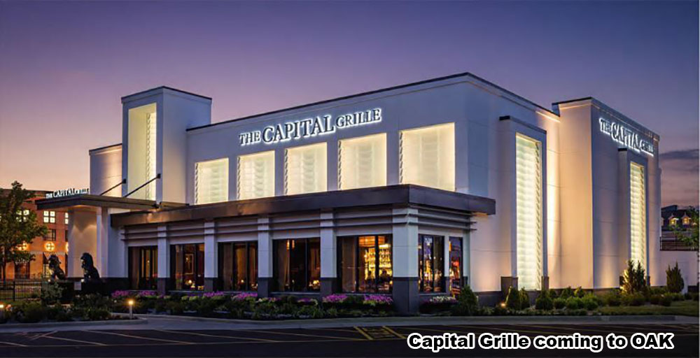
The Oak – Retail / Outdoor Venue
The Lively Hotel
Notes:
Retail & Restaurants at the Oak:
Tommy Bahama Marlin Bar
Williams Sonoma
Restoration Hardware (complete with a rooftop restaurant)
Capital Grille
Lively Hotel
Arhaus (Pronounciation: aar hows) (Furniture)
Outdoor Performance Venue
Veritas Development has released plans for a new 7,000 square foot outdoor concert venue in Oklahoma City’s OAK Mixed-Use District across from Penn Square Mall near Penn and Northwest Expressway. It can hold over 1,700 people.
It will include a $1 million stage for live music and concerts. The stage will be surrounded by a massive art installation, Cloud Trees. At 25.5 feet tall, the three Cloud Trees will encircle the stage with illuminated, bronze tree trunks and a shared canopy of mirror-polished stainless-steel clouds.

Slide 16
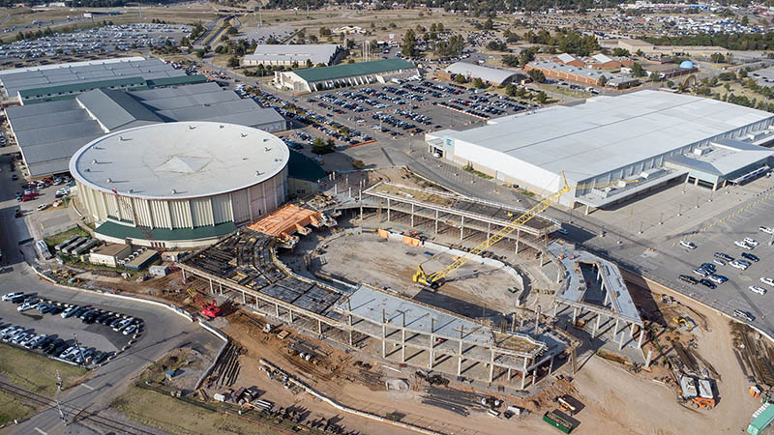
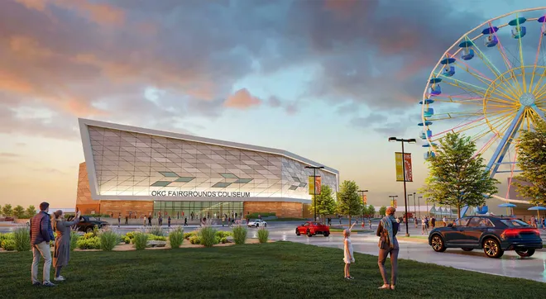
State Fairgrounds Coliseum
Notes:
Well under construction, once complete the neighboring Norick Arena will be demolished and OKC will have a brand new, state-of-the-art facility primarily for hosting horse shows which have become a huge economic engine for the city.
The $126-million project is funded through MAPS 3, MAPS 4, hotel tax revenue and other funding sources.

Slide 17
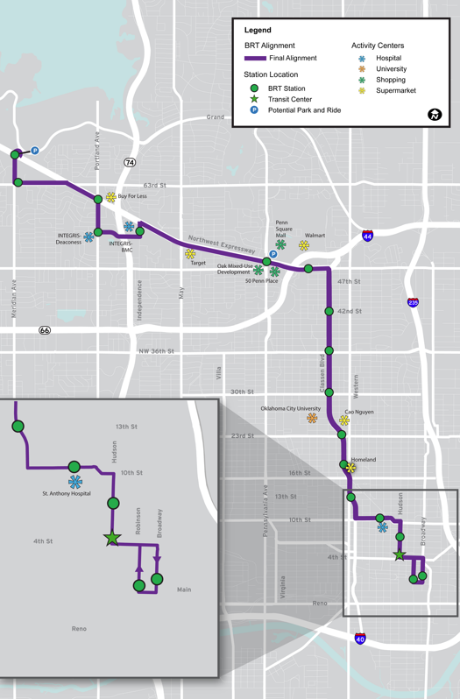
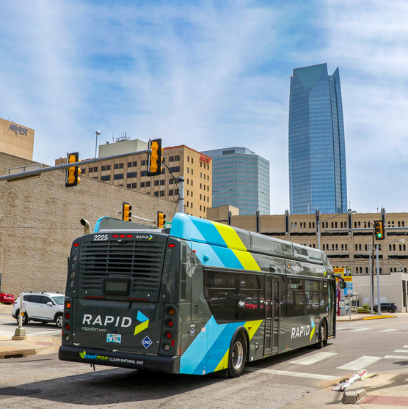
Bus RAPID Transit
Notes:
The first Bus RAPID Transit line provides a premium transit service to Oklahoma City residents through faster and more frequent service with enhanced vehicles, stations, and passenger amenities.
The Northwest line connects downtown Oklahoma City and the Lake Hefner area, serving regional medical centers, commercial centers, the downtown city center, and residents along the Classen Boulevard and Northwest Expressway urban arterials.
The Bus Rapid Transit project is estimated at $29 million. Construction started in Summer 2022 and was completed and operational in Winter 2023.
https://www.okc.gov/residents/better-streets-safer-city-projects/bond-package

Slide 18
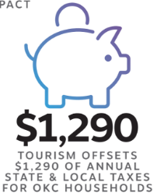
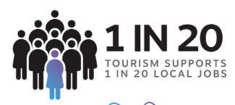
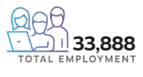
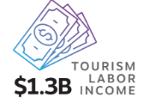
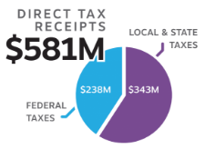
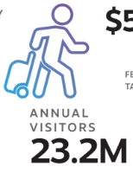
Economic Impact of Tourism

Slide 19
THANK YOU FOR YOUR PARTNERSHIP
Notes:
Without each of you investing in our community, we wouldn’t be where we are today.
The progress we’ve experienced has come because we rallied together in true Oklahoma fashion, and we must continue that partnership to create an even brighter future.
Thank you for the work you are doing and thank you for being here today and we look forward to what’s next for our region.
19

