Slide 1
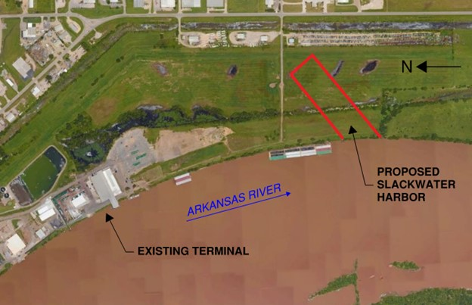

Western Arkansas Intermodal Authority
The Power of Partnerships
& Economic Development!

Slide 2
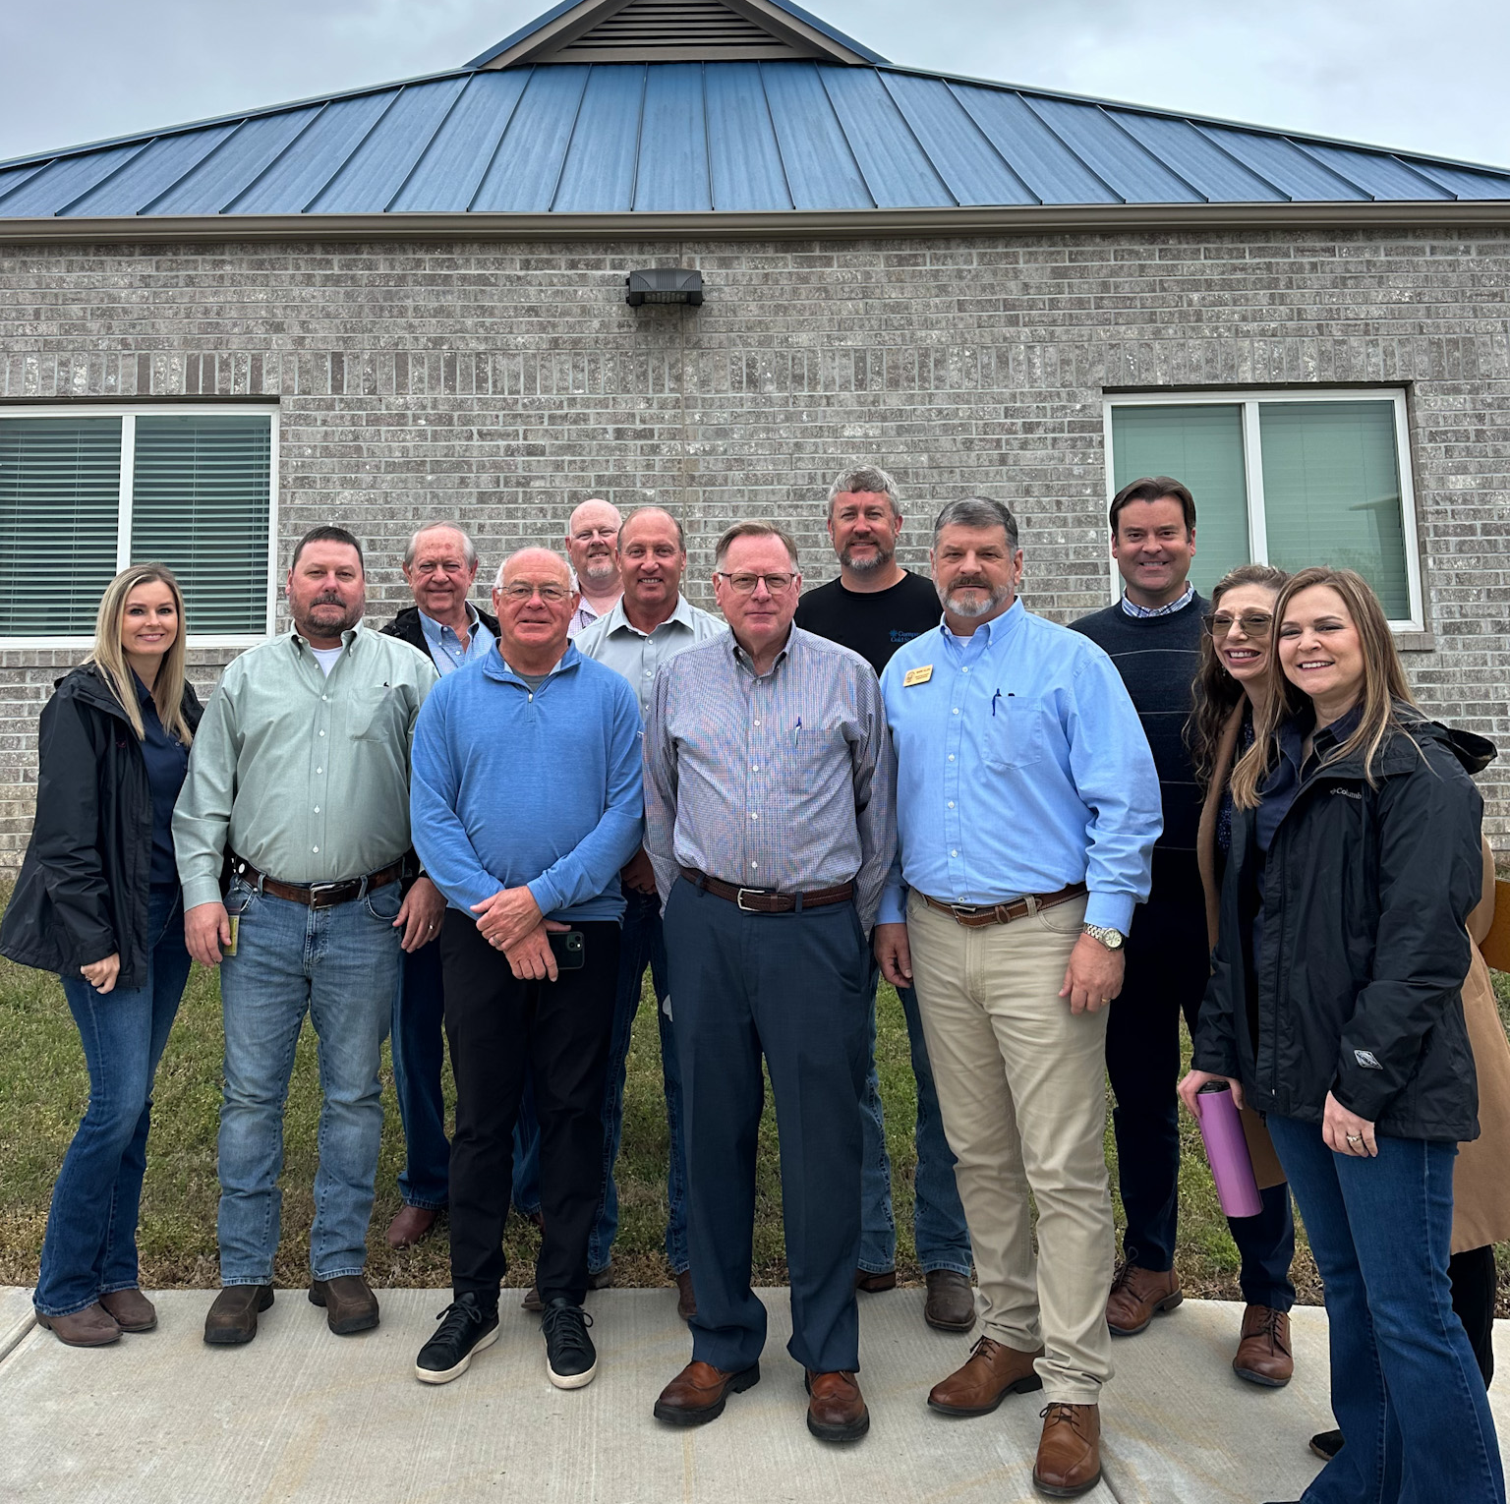
About Us
Our Board
Two Cities, Two Counties, Two Ports – One Vision
WAIA consists of elected officials and private industries. 12 board members from the cities of Fort Smith/Van Buren and Crawford/Sebastian Counties.
Port facility tours –
April 2024

Slide 3












Slide 4
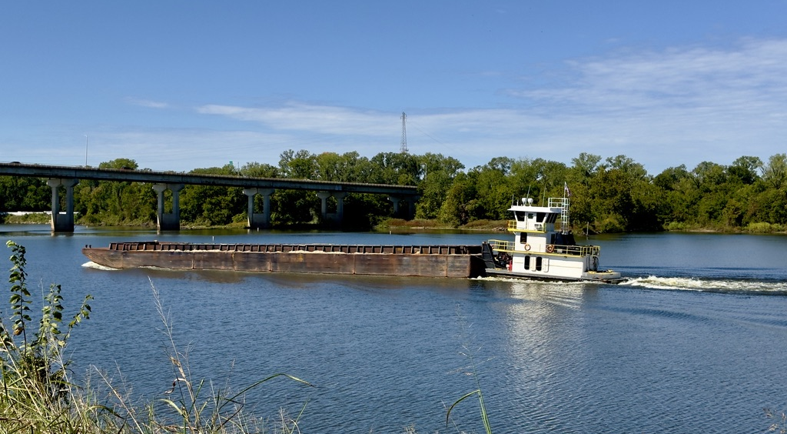

Funding
How is the board funded?
State Funding
_{Board Members}
_{pay dues}
Fort Chaffee Redevelopment Authority
Private Donations
The Arkansas Department of Transportation provides $75,000 each year.

Slide 5
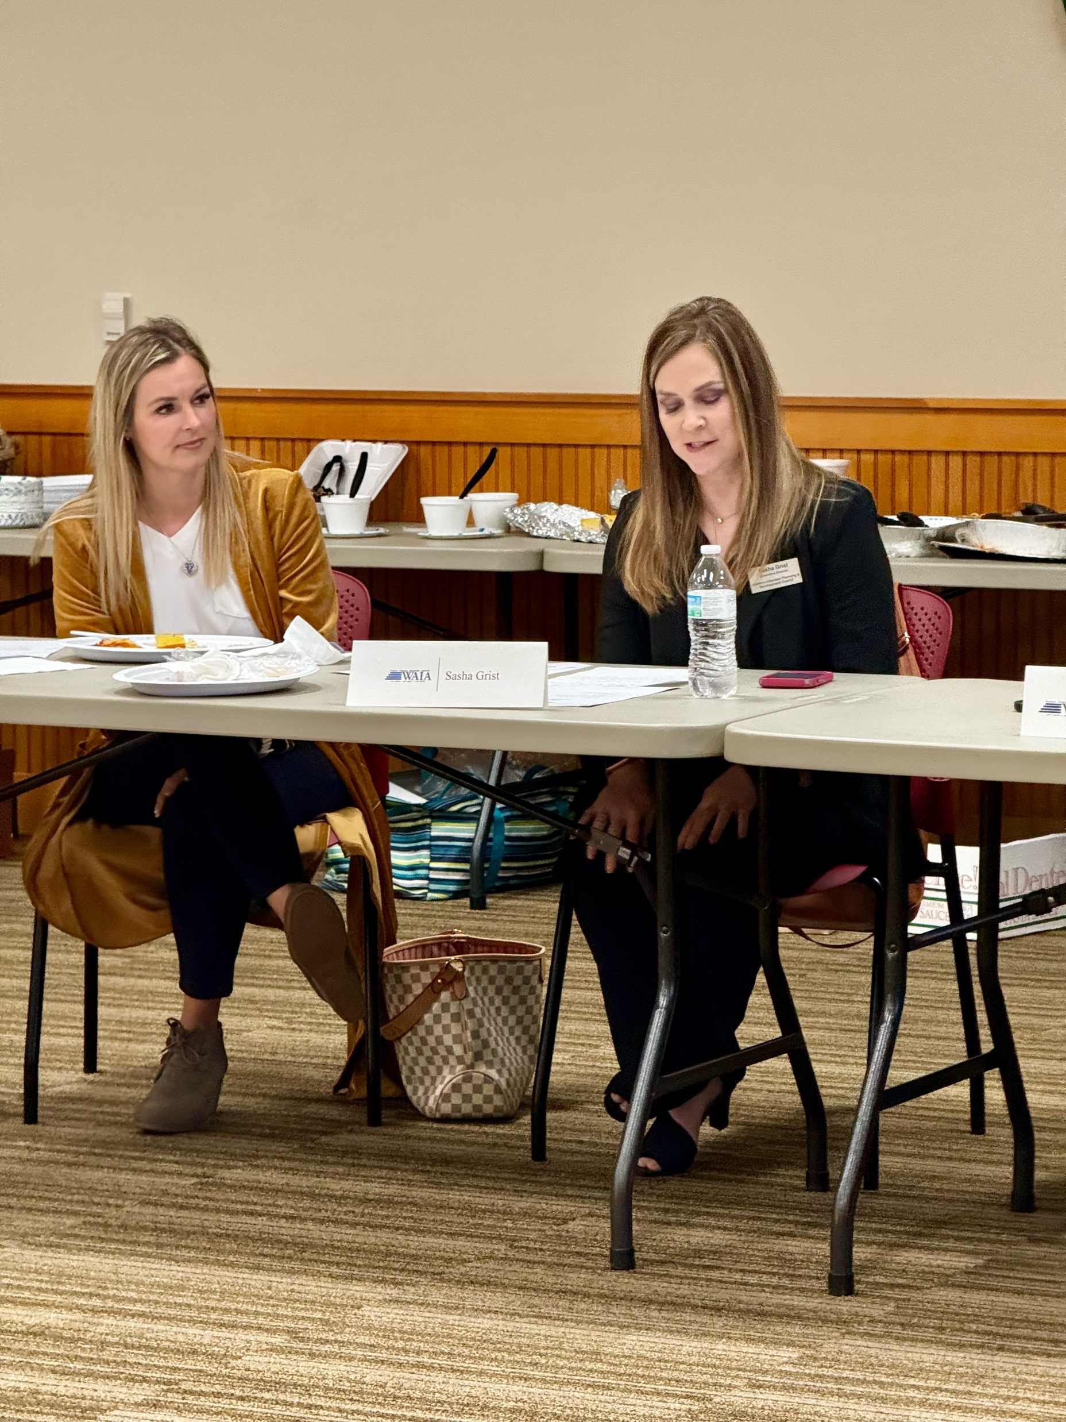

Western Arkansas Planning & Development District
Administrative Entity
Meetings
WAPDD supports WAIA by coordinating meeting logistics and venues, organizing guest speakers, and documenting meeting minutes.
Grants
WAPDD also submits grant proposals on behalf of the board to secure funding for projects aimed at improving our multi-modal infrastructure.

Slide 6
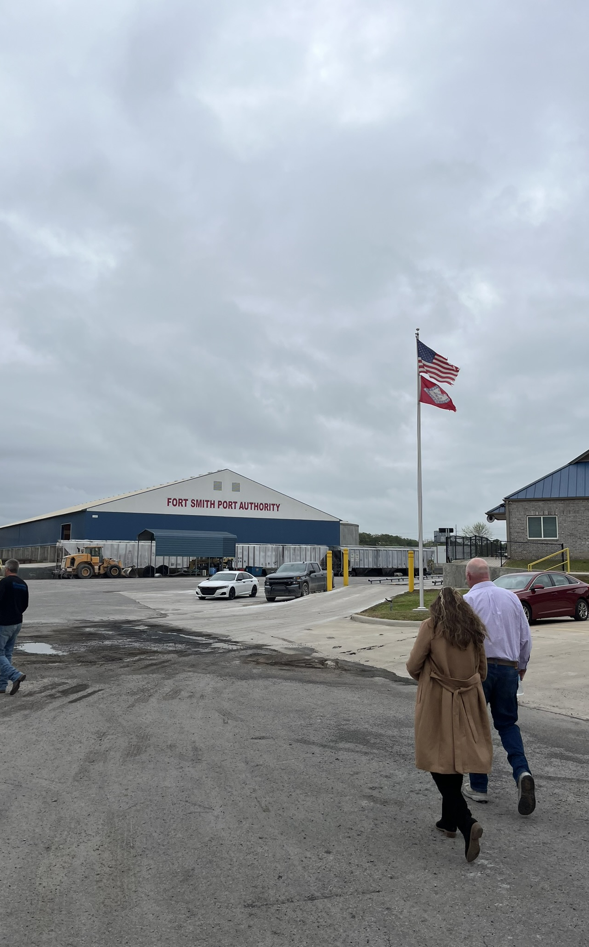
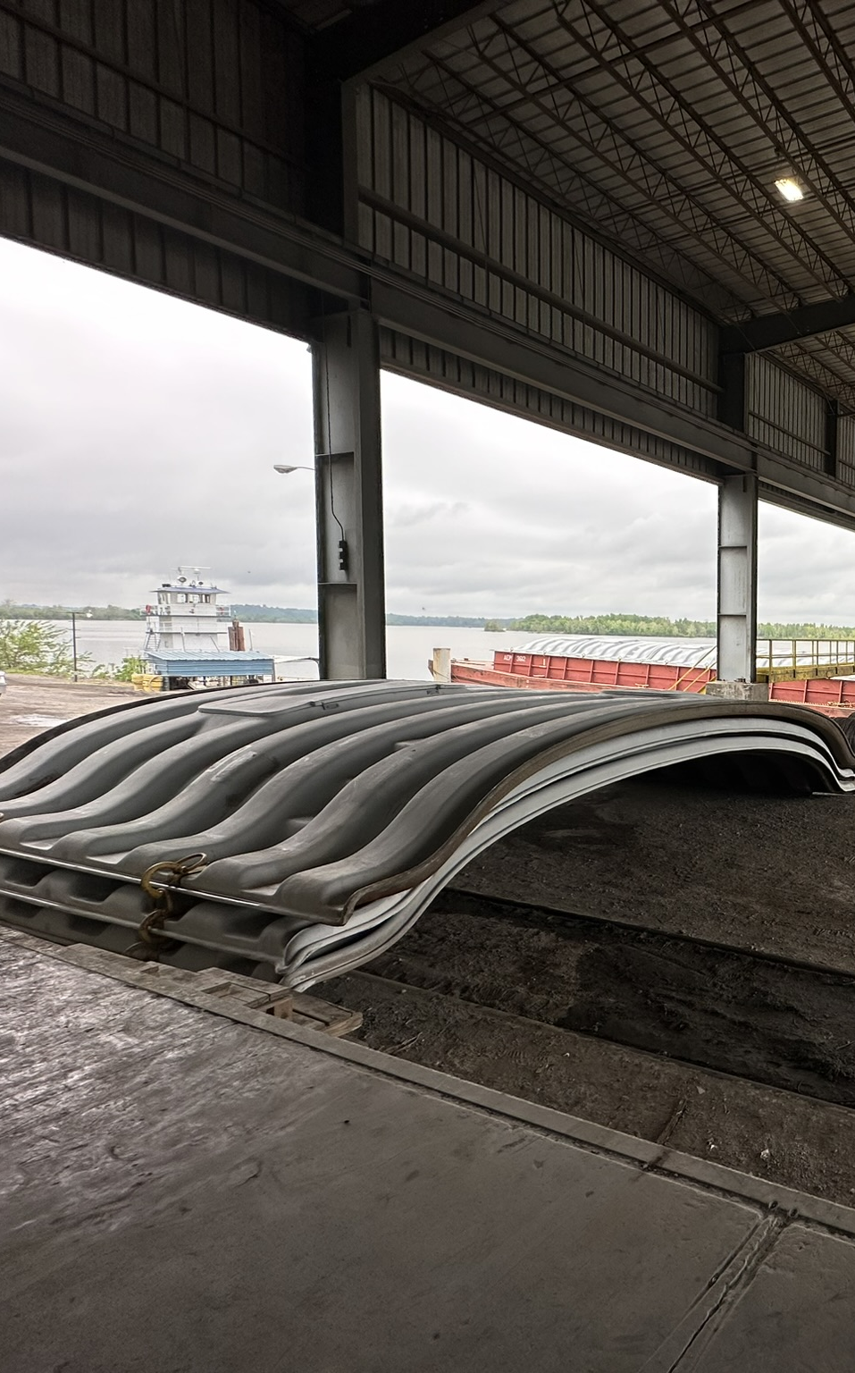
Current Infrastructure
Ports of Fort Smith &
Van Buren

Slide 7
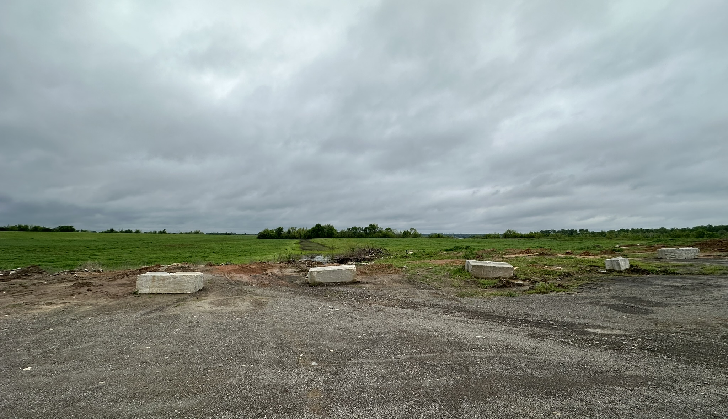
A Bright Outlook
Looking towards the future…
Maritime Administration Grant
$18,870,000.00 project to develop a slackwater harbor in Crawford County.
EDA
Grant
EDA granted WAIA a $485,000 grant to have an environmental assessment completed along with all Corp. permitting.

Slide 8
Partners
Collaboration is key to the success of an economic development initiative.
Partnerships are key for our future successes!
Marty Shell – Five Rivers Distribution | Port of Fort Smith
Arkansas Missouri/Union Pacific Railroads
Arkansas Department of Transportation
Arkansas Economic Development Commission
Arkansas Waterways Commission
Western Arkansas Planning & Development District
Fort Chaffee Redevelopment Authority
Cities of Greenwood, Barling, Alma, & more
US Department of Transportation – Maritime Administration
Economic Development Administration
Local Industry

Slide 9
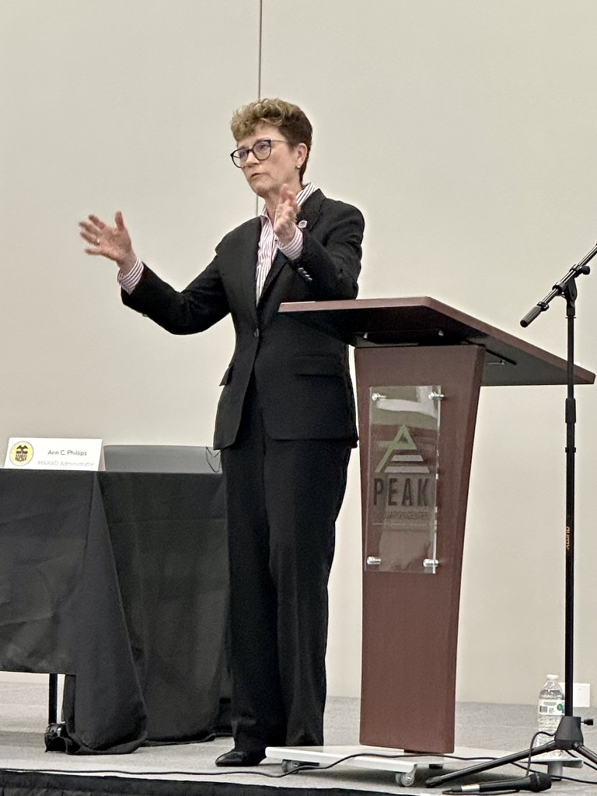

Events
MARAD Roundtable event was a HUGE success!
Business Participation
MARAD Administrator
Local transportation industry representatives came and discussed challenges and opportunities.
Ann C. Phillips was our keynote presenter.

Slide 10
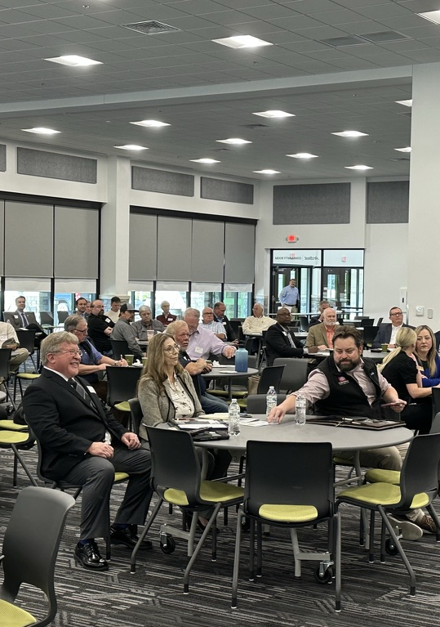


Future Event
Freight Roundtable Event Planned for 2025
04/10/25
PEAK
Save the date!
Venue of the event
More details to come, but we would be thrilled if you could join us!
PEAK Innovation Center
5900 Painter Lane
Fort Smith, AR 72903

Slide 11
Businesses
Some Confirmed Attendees Include:
ArcBest
University of Arkansas
Real Women in Trucking
Clean Freight Coalition
TTI
Ponyy AI
ASPIRE Team
Intramotev
SmartEye
Zeebot

Slide 12
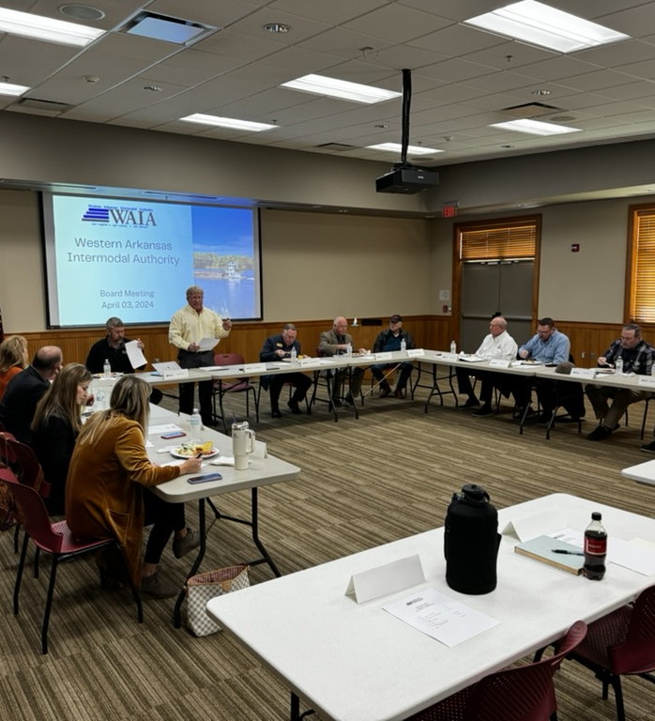


Contact Us!
Interested in these projects or the upcoming freight event? Reach out to us for more information!
Phone | Fax
Address
(479) 785-2651
1109 South 16th Street
Fort Smith, AR 72901
(479) 785-1964
waia@wapdd.org
www.wapdd.org/waia

