Slide 1
EDA Economic Development Grant Experience (EDGE) Recipient Portal Project Kickoff Support
May 2024

Slide 2
Table of Contents
Migrated award vs. Awards in EDGE
Project Workspace on the EDGE Portal for Grant Recipients
How to Add New Team Members
How to Submit a Payment Request
How to Respond to a Curing Request
How to Submit Reports
How to Submit Closeout Items
How to Submit Contract Actions
How to Submit Change Orders
Resources

Slide 3
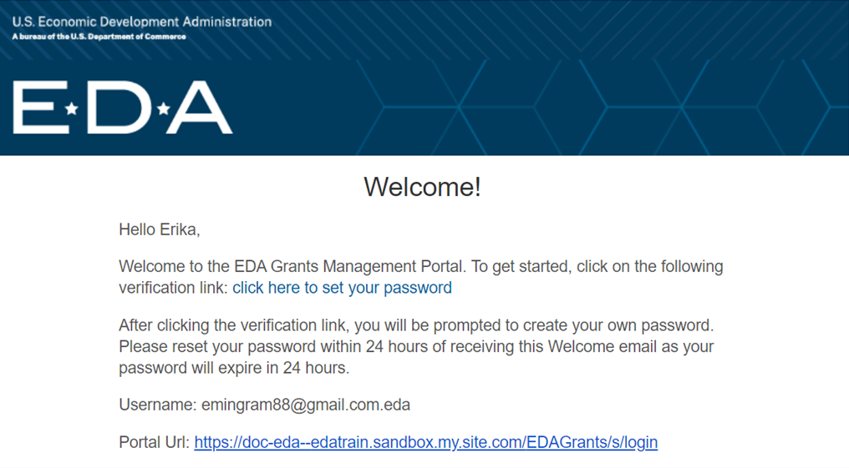
EDGE Account Provisioning

Slide 4
EDGE Resources for Grant Recipients
Reach out to your Regional Project Officer for support!
For EDA Applicants and Grantees, email” GrantHDSupport@eda.gov
From the EDGE Portal, upon login, click “Support” and fill out the inquiry form.
To speed up the response time, include the following details in your inquiry:
Copy & Paste the URL to the EDGE Record
Screen Name, if applicable
Field Name, if applicable
Description
Timeline, if applicable
External resources for recipients can be found on the EDGE Portal at this link:
https://sfgrants.eda.gov/s/resources/training-materials

Slide 5
EDGE Grants Management Process Diagram
Application to Award Process
1
3
5
6
Program Administration - Setup & Publish NOFO
Application Intake & Screening - Assign to Application Owner
- Conduct Technical Review - Send Application Curing
Request
Application Selection - Competitive: Conduct Merit/IRC
Reviews
- Non-Competitive: Area Director
Review
- Send Curing Request
- Approve Selection Decision
Award Preparation
- Conduct Due Diligence Reviews
- Commit & Obligate Funds
- Send Curing Request
- Prepare Award Package and SACs
- Obtain Approvals
- Send to Washington
EDGE Internal
(Process steps for EDA team members only)
EDGE Portal Users
(Process steps for Applicants, Partners & Economic Development Districts)
Application Submission - Review NOFOs
- Complete Application
- Submit Application
Respond to Curing Request (if applicable) - Update Application
- Submit Response to Curing Request
Award Acceptance - Applicant Accepts or
Declines
2
4
7
Notes:
This is a helpful visualization of EDA’s Grants Management Process in EDGE – Application to Award Process. All items depicted above the line are the internal process steps performed by internal EDA team members and everything below the line captures the actions performed by EDGE Portal Users.

Slide 6
EDGE Grants Management Process Diagram Post Award to Closeout Process
8
13
9b
4
10b
15
11b
17
Award Conversion - Prepare for Project Kickoff
Project Initiation - Kickoff Project - Update Project Team/Contacts
Manage Contracts - Review/Approve: A/E, Admin, Site Certificate, Bid Docs, Bid Opening Executed Contract - Manage Curing Requests
Manage Payment Requests - Review/Approve: Payment Requests - Manage Curing Requests
EDGE Internal
(Process steps for EDA team members only)
EDGE Portal Users
(Process steps for Applicants, Partners & Economic Development Districts)
Project Initiation
- Attend Kickoff - Update Project Team/Contacts
Manage Contracts - Initiate: A/E, Admin, Site Certificate Bid Docs, Bid Opening, Executed Contract - Respond to Curing Requests
Manage Payment Requests - Initiate Payment Requests - Respond to Curing Requests
9a
10a
11a
Notes:
This is a helpful visualization of EDA’s Grants Management Process in EDGE – Post Award to Closeout. All items depicted above the line are the internal process steps performed by internal EDA team members and everything below the line captures the actions performed by EDGE Portal Users.
During your project kick-off meeting, please feel free to share this view to orient grantees with the EDGE process flow. Please note, there are prerecorded tutorial videos and quick reference guides available on the internal intranet and EDGE Portal to grantees with step-by-step EDGE guidance.

Slide 7
EDGE Grants Management Process Diagram Post Award to Closeout Process
EDGE Internal (EDA team members only)
13b
14b
13
4
13
15
4
12b
15b
Award Fulfillment and SAC Management - Review/Approve: SAC Documentation, PPR, FFR - Manage Curing Requests
Manage Change Orders - Review/Approve: COs - Manage Curing Requests
Manage Award Modification Requests - Administrative Approval - Manage Amendments - Manage Curing Requests - Send to Washington
- Send to Recipient
Manage Project Closeout - Review Closeout Documentation
- Complete Project Closeout
Award Fulfillment and SAC Management - Submit: SAC Documentation, PPR, FFR - Respond to Curing Requests
Manage Change Orders - Initiate COs - Respond to Curing Requests
Manage Award Modification Requests - Submit AMRs - Respond to Curing Requests - Accept Amendment (if applicable)
Manage Award Modification Requests - Initiate Manual Closeout
- Submit Closeout Documentation
EDGE Portal (Grantees, Partners & EDDs)
12a
13a
14a
15a
18
18
Notes:
This is a helpful visualization of EDA’s Grants Management Process in EDGE – Post Award to Closeout. All items depicted above the line are the internal process steps performed by internal EDA team members and everything below the line captures the actions performed by EDGE Portal Users.
During your project kick-off meeting, please feel free to share this view to orient grantees with the EDGE process flow. Please note, there are prerecorded tutorial videos and quick reference guides available on the internal intranet and EDGE Portal to grantees with step-by-step EDGE guidance.

Slide 8
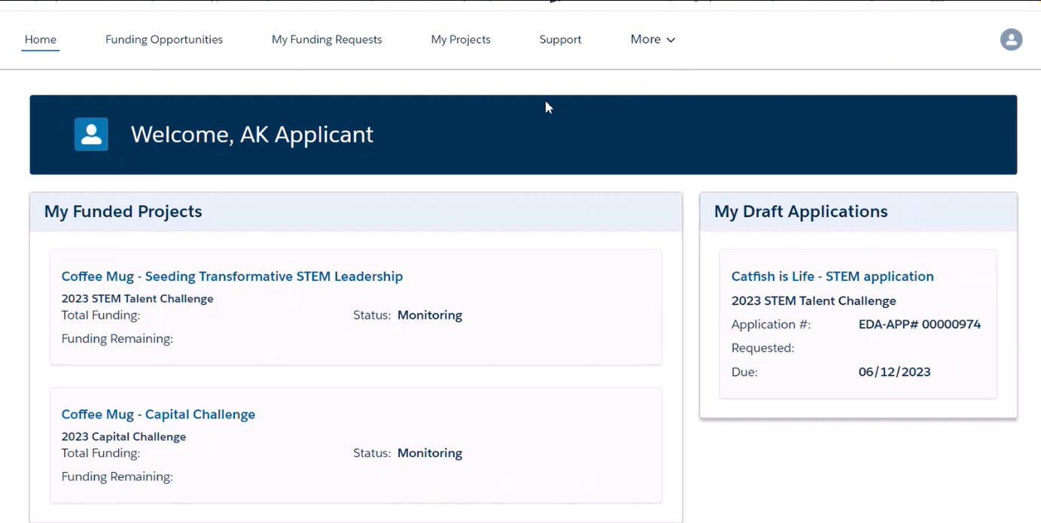
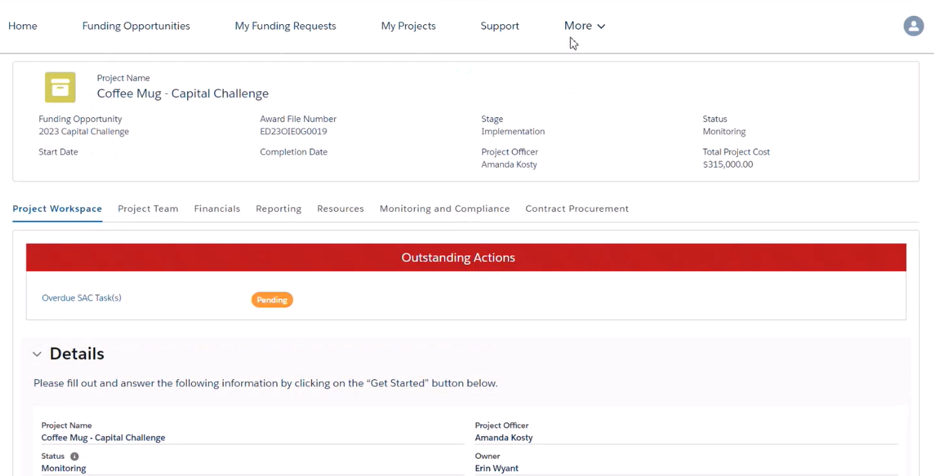
EDGE Project Workspace
Grantees can access their Project Workspace on the EDGE Portal under My Funded Projects or from the My Projects tab on the task bar along the main toolbar.
Under the “Details” section in the Project Workspace tab, Grantees can start Payment Requests, FFRs, SF425, PPRs, AMRs, and Change Orders.

Slide 9
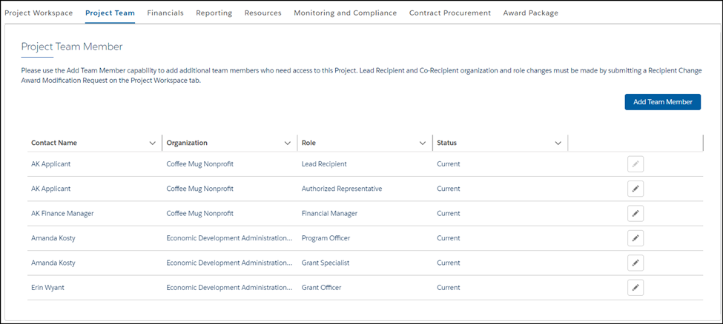
Managing Project Team Members
All team members included on your application will automatically populate in the Project Team Member section.
To add project team members, click on “Add New Member" and select the desired role for this new member. Please note, you can only add team members from your Organization.
You can remove team members by updating the Status from Current to Former.
Project Tasks & Associated Roles
Payment Requests and FFR
Any Team Member can work on the task
Any Team Member can work on the task
Only Authorized Rep and/or Principal Investigator can Submit/Attest
PPR
Only Authorized Rep and/or Financial Manager can Submit/Attest
SAC Tasks (non-reporting)
Any team member assigned to the task can submit
Contract Procurement & Change Orders
Any Team Member can work on the task
Only the Auth Rep and/or Principal Investigator can submit
AMR – Do NOT start before working with your Project Officer
Only Lead Recipient or Auth Rep can work on the request
Only the Authorized Rep can attest/submit
Click the pencil icon to edit

Slide 10
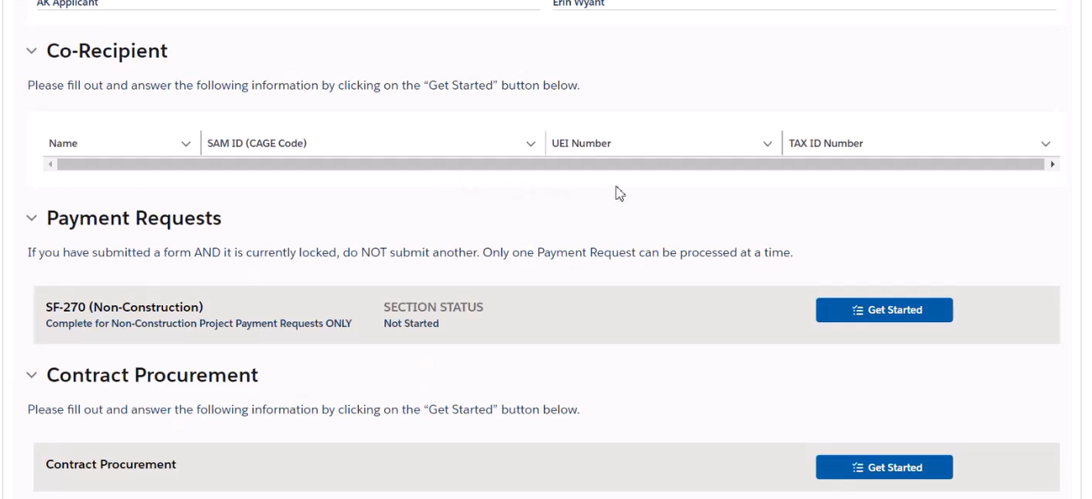
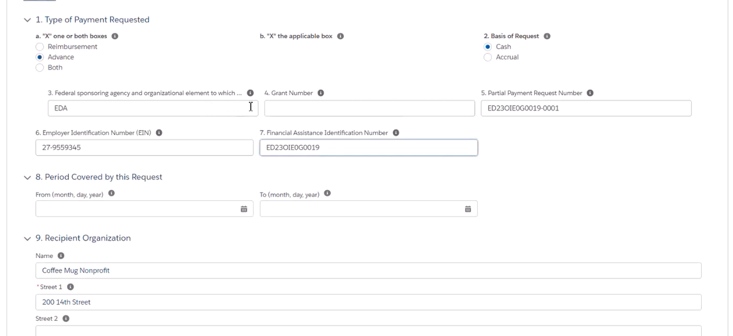
Payment Requests in EDGE
Payment Requests are created in the Project Workspace. If your SF-270 or SF-271 is locked, you have a Payment Request currently In Progress (Submitted, In Review, or Scheduled).
Follow the guidance of your EDA Project Officer on completing the SF-271 correctly.
Some information will auto-populate, including the unique identifier for your grant/award - Financial Assistance Identification Number (FAIN). Please note, the Period Covered by the Request dates will need to be manually entered.
Work with your EDA Project Officer to update your organization information if the address that auto-populates isn’t where the check is meant to be sent.
If you are submitting an SF-271, be sure to use the construction checklist to fill out your SF-271 and attach it to the Payment Request.
For Construction, your Financial Manager will need to certify work completion % before you can attest.
Any Team Member can Get Started and work on payment requests, only Authorized Rep & Financial Manager can attest & submit
Note: Your work will be auto saved, so you can stop and come back to this form as needed.
FAIN will be automatically populated
Period Covered by this Recipient needs to be manually entered

Slide 11
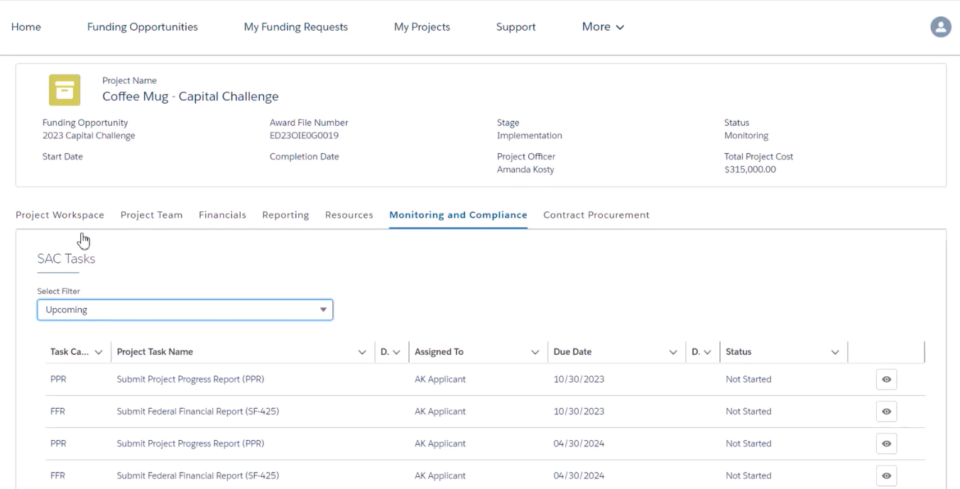
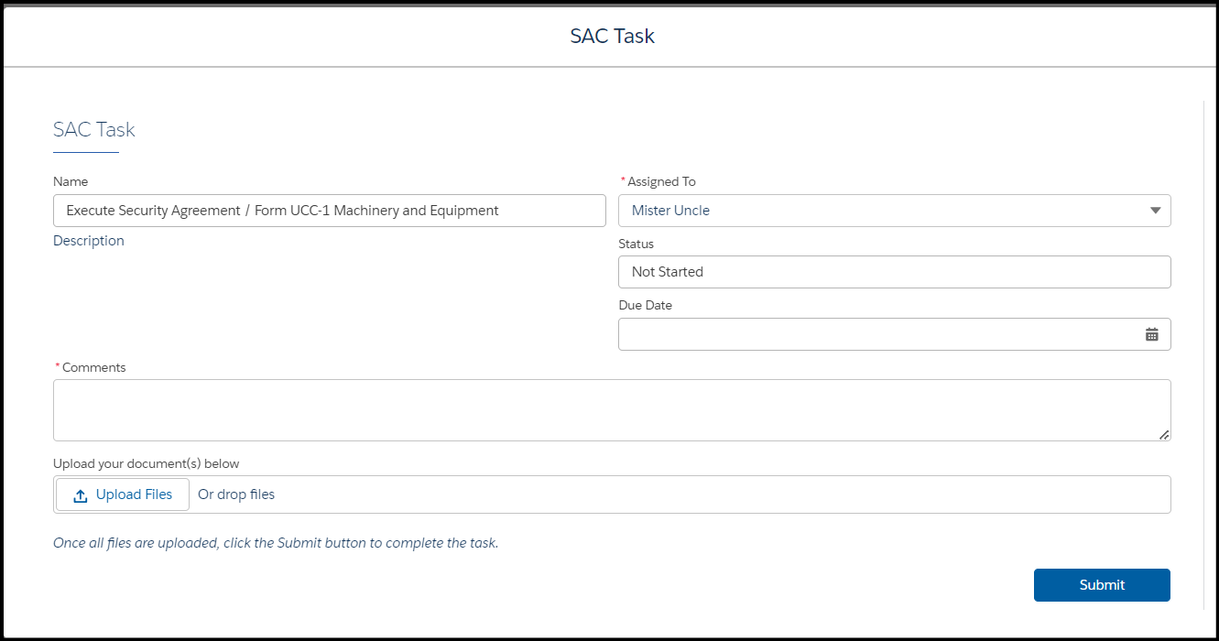
SAC Tasks in EDGE (non reporting)
SAC Tasks are managed in the Monitoring and Compliance tab.
Here, you can filter by Overdue, Upcoming, Completed, or All SAC Tasks. Note, you should NOT have overdue SAC tasks in EDGE at Project Kick-off. Completing tasks on time will ensure you maintain compliance with your grant award conditions. If you see overdue tasks and you believe this is in error, please reach out to your EDA Project Officer.
Any Team Member can be assigned a task by someone in your project team. Do this by clicking the eye on the task that hasn't been submitted and selecting a team member from the Assigned To dropdown. The assigned team member will receive an email notification.
If Curing (more information required) is needed, an email notification will be sent to the Assigned To team member and the curing request will be visible to all team members on the Project Workspace Details tab
Any project team member can start and work on SAC Tasks, only the Assigned Team Members can submit SAC Tasks in EDGE.

Slide 12
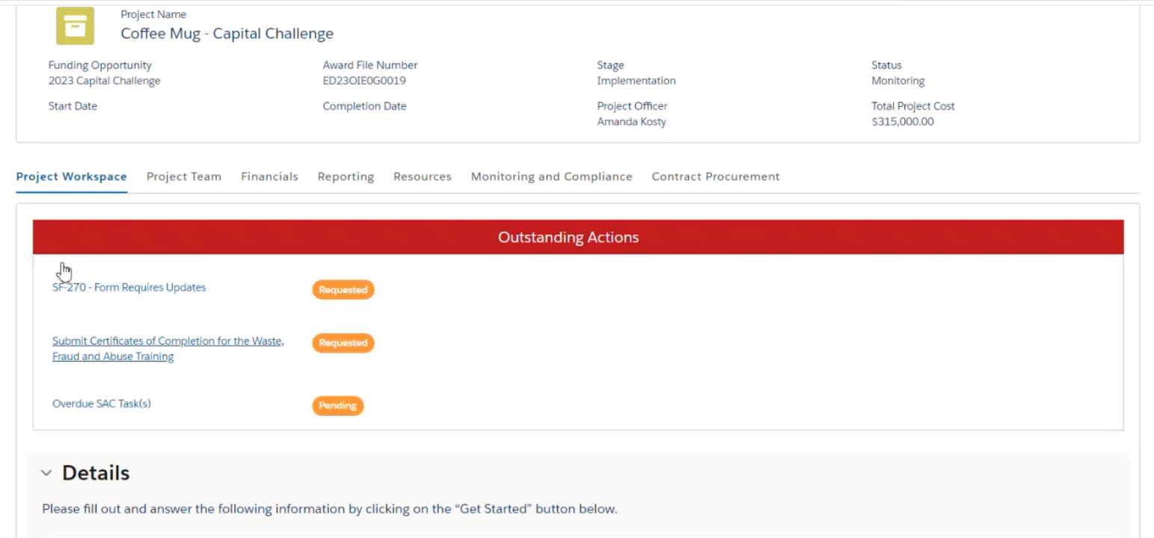
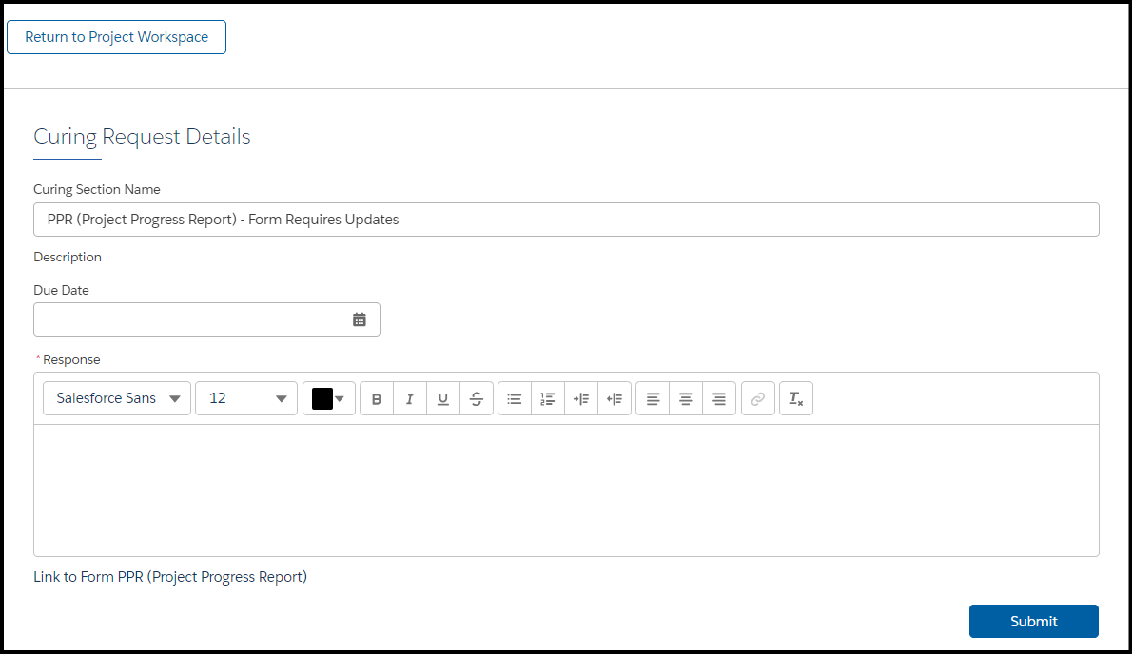
Project Curing Requests
Authorized Representatives and Lead Applicants will receive an email notification when a Cure Request is sent by your EDA Project Officer.
All project team members can view and work on Curing Requests in the Project Workspace.
If you have multiple curing requests, you can submit them separately (unlike application curing requests).
Responding to Curing Requests for SAC Tasks and Procurement Tasks follow the same process.
Responding to Curing Requests for SF-271, PPR, and FFR follow the same process.
Don’t forget to use the link in the curing request to access the SF-271, FFR, or PPR that needs to be cured (see image) before submitting the cure request.
Link Here

Slide 13
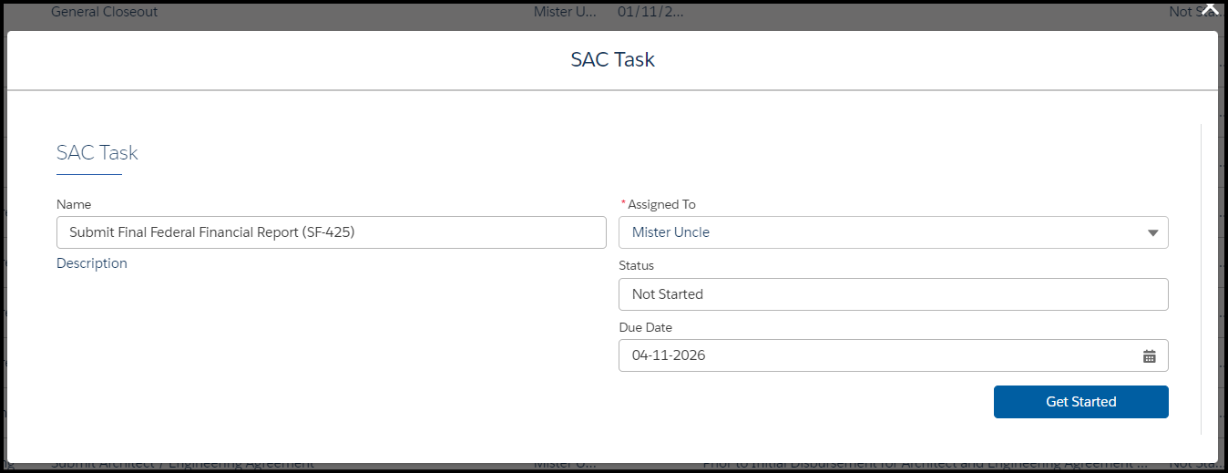
Reports – Federal Financial Reports (FFRs)
FFRs can be started from the Project Workspace Details tab. FFRs can also be started from the Monitoring & Compliance tab by viewing All and clicking on the eye icon next to the FFR task and clicking Get Started. You can also assign the FFR task in this screen. (Note: FFRs can be assigned to any team member, but only the Authorized Rep or Financial Manager can attest and submit.)
You can save an FFR you have started, the draft can be found in the Project Workspace home page under the Federal Financial Report section when you are ready to work on it again.
Be sure you are selecting the most recently due FFR from the listed tasks to complete.
SF-425 can be found in the Reporting tab once it has been submitted. This is where you will track the status (submitted, in review, approved). Click on the eye icon to download the PDF SF-425 and any other files you included.
Any team member can begin and work on FFRs in EDGE, only Authorized Rep & Financial Manager can attest & submit.

Slide 14
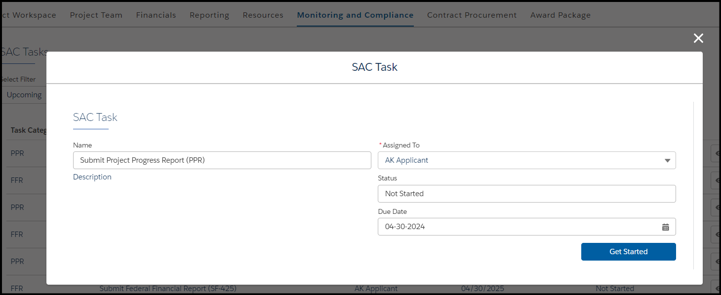
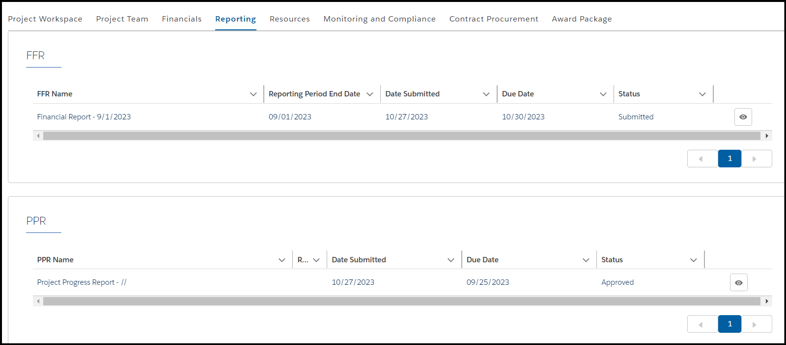
Reports – Project Performance Reports (PPRs)
PPRs can be started from the Project Workspace Details tab or from the Monitoring & Compliance tab.
You are required to upload your Project Progress Report. You can also attach any supporting documents
PPR can be found in the “Reporting” tab once it has been submitted. Use the “Reporting” tab once the PPR has been submitted to track the status (Submitted, In Review, Approved). Click on the eye icon to download the PPR and any other files you included.
Any Team Member can begin and work on PPRs, only Authorized Rep & Principal Investigator can attest & submit

Slide 15
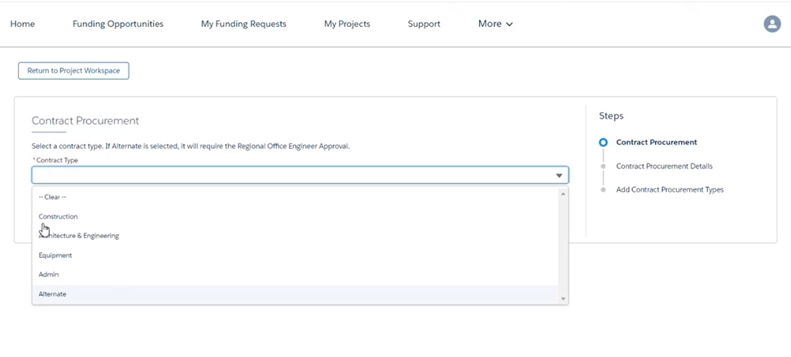
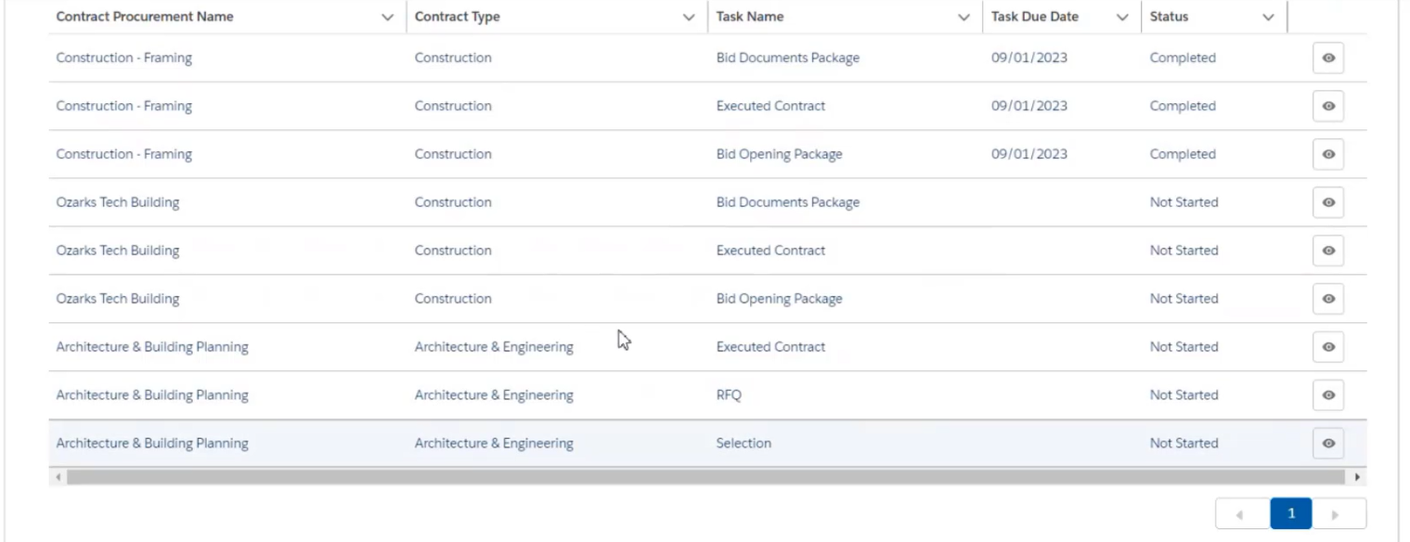
Contract Procurement Tasks (Create)
Contract Procurement Tasks can be found on the Homepage in the Details section labeled Contract Procurement. Click Get Started to create your tasks.
“Alternate” is for non-construction projects.
Name your Contract Tasks something that will be easy for you to understand.
The created tasks will populate into Contract Procurement tab
If you add Task Due Dates when tasks are created, they will sort logically based on the dates assigned (the tasks don't automatically sort in the order they should be submitted).
Any team member can create Contract Procurement Tasks in EDGE.

Slide 16
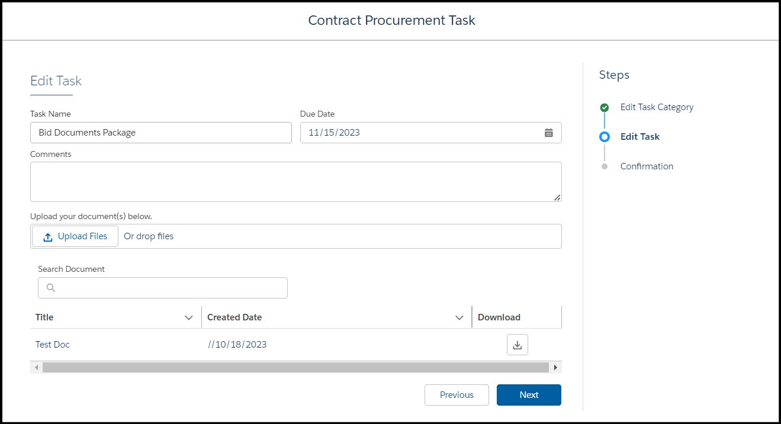
Contract Procurement Tasks (Submit)
Contract Procurement tasks can be located and managed in the tab labeled Contract Procurement.
Always verify you are working on the correct task (if you didn't order them by due date).
Upload any supporting documents with your submission
This is where you will track the Status of contract procurement tasks (Submitted, In Review, Approved) and where you'll be able to download your documents once it's been submitted.
Any Team Member can create and work on Contract Procurement Tasks in EDGE, only Authorized Representative & Principal Investigator can submit

Slide 17
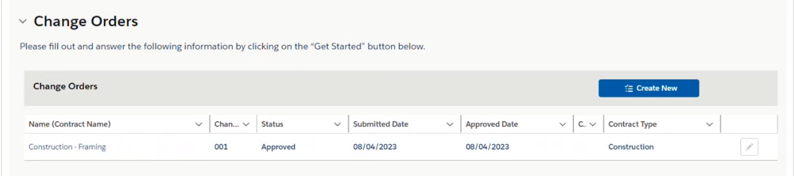
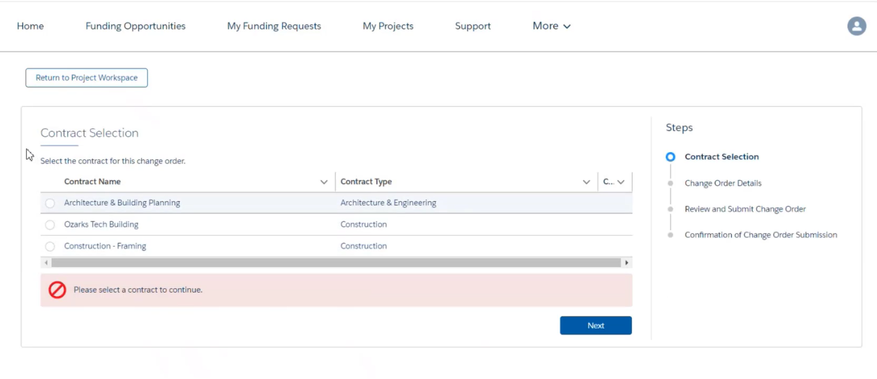
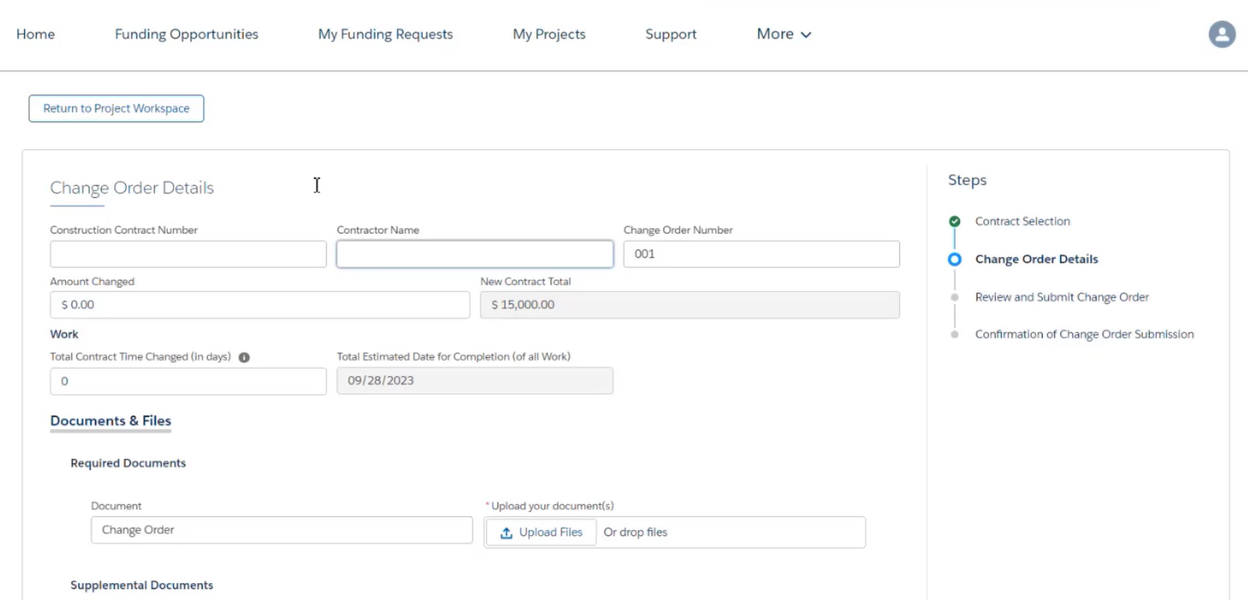
Change Orders
Change Orders can be found on the Homepage in the Details section labeled Change Orders.
Use the Change Order form from the Construction Checklist to upload to this request. Include any other supporting documentation here as well.
Note: The Amount Changed and Total Contract Time Change fields can be negative values if you used less money than anticipated or finished quicker than anticipated.
Any Team Member can begin and work on Change Orders in EDGE, only Authorized Representatives & Principal Investigator can attest & submit.

Slide 18
EDGE Resources for EDA Project Officers
Post Award tutorial videos and quick reference guides for Project Officers are published for use by our internal EDA team members on our EDA Exchange Intranet at: Post Award Library.
Access the EDGE User Guide Release 5, starting at Page 213, for detailed step-by-step instructions for Project Officers. Our complete EDGE User Guide is published for use by our internal EDA team members on our EDA Exchange Intranet at: EDGE User Guide Release 5.pdf.
From the EDGE Grant Manager main menu, Project Officers can see a Project Tab listing all their projects from their Home page. Select Home, click Projects.
From the EDGE Grant Manager main menu, Project Officers can select their preferred Project ListView from their Projects page. Select Projects, click Clone to edit and filter. Then, click Pin.
From the EDGE Grant Manager main menu, Project Officers can view lists of their active projects from their Reports page. Select Reports, All Reports, All Project Report. Click Enable Field Editing, check the checkbox for the desired Projects, and click Export from the Edit drop-down list.

Slide 19
Questions?
Corey Dunn: cdunn@eda.gov
Osvaldo Rocha: orocha@eda.gov
All complaints regarding EDGE functionality can be directly submitted to Area Director Matthew Giannini at mgiannini@eda.gov

