Slide 1
EDA Environmental Review: Demystifying the NEPA Process

Slide 2
AGENDA
Role of the EDA Regional Environmental Officer
National Environmental Policy Act (NEPA)
Levels of NEPA Review
EDA Environmental Review Processes
Common Sources of Information
Questions/Discussion

Slide 3
What Does a REO Do?
Review Applications for Environmental Issues
Technical Assistance
Provide Guidance for Environmental Documentation
Consult with Other Federal Agencies
Consult with Historic Preservation Offices (State and Tribal)
Consult with the Advisory Council on Historic Preservation
Prepare NEPA Document and Determine FONSI

Slide 4
What is NEPA?
40 CFR 1500-1508
Notes:
Title 40 is under the purview of the U.S. EPA
….and reports directly to the POTUS and oversees federal agency implementation of the NEPA process.
NEPA tasks CEQ with ensuring that federal agencies meet their obligations under the Act and works to advance the Administration’s agenda on the environment, natural resources, and energy.
The CEQ acts as a referee when agencies disagree over the adequacy of environmental review
CEQ is currently chaired by Brenda Mallory – sworn in as the 12th Chair of CEQ. She is the first African American to serve in this position

Slide 5
Impetus of NEPA
Post-War Industrial Revolution
Killer Smog
Donora, Pennsylvania
October 1948
Notes:
Uncontrolled industrial development and expansion Post WWII contributed to significant air pollution from industrial emissions.
In western PA, about 24 miles south of Pittsburgh on the Monongahela River, the Town of Donora was the location of U.S. Steel’s Zinc Works and the American Steel & Wire Plant.
Both facilities emitted hydrogen fluoride and sulfur dioxide into the atmosphere on a daily basis.
On the morning of October 27, 1948, a temperature inversion in the river valley created a dense fog that lasted 4 days.
The fog mixed with the hazardous air pollutants causing respiratory problems to 7,000 residents and resulted in 20 deaths.
This event helped trigger the clean air movement in the US and the creation of the first Air Pollution Control Act in 1955 with the primary federal agencies being the U.S. Bureau of Mines (as they were interested in smoke abatement from coal burning) and the US Public Health Service which handled industrial hygiene.

Slide 6
Impetus of NEPA
Historic Pesticide Use
Silent Spring
Rachel Carson
1962
Notes:
RC was a biologist and naturalist who was a nature writer for the US Bureau of Fisheries in the 1950s
She wrote several books on ocean life and the marine environment
In 1962, she wrote Silent Spring, which focused on the harmful affects of synthetic pesticides on the environment
She faced fierce opposition and threats by the large chemical companies
But the book created a grass-roots environmental movement which led to the ban on DDT and other pesticides and ultimately helped in the creation of the USEPA in 1970.

Slide 7
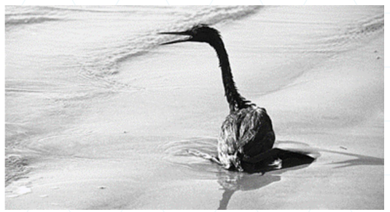
Impetus of NEPA
Environmental Disasters
Santa Barbara Oil Spill
1969
Notes:
The Santa Barbara oil spill in 1969 was caused by a blowout on the Union Oil platform 6 miles off the coast of California (in the Santa Barbara channel). 80-100k barrels of crude oil spilled in the channel made its way to the beaches and severely impacted marine life and killing an estimated 3,500 marine birds
This was the largest spill in the U.S. at the time and ranks as the third worst behind the Deepwater Horizon and Exxon Valdez incidents.
Media coverage led to tremendous public outcry and organized movements to protect the environment
This led to the organization of the first Earth Day in 1970.

Slide 8
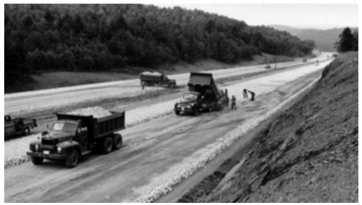
Impetus of NEPA
Uncontrolled Development
Interstate Highway System
1950s-1960s
Notes:
The creation of the interstate highway system in the 1950s-60’s encountered a lot of issues associated with land taking by the government under eminent domain and uncontrolled obliteration of forests and sensitive habitat, not to mention historic and archaeologic resources.
This resulted in public outrage and a demand for the government to be accountable for its actions

Slide 9
When Does NEPA Apply?
NEPA applies whenever Federal agencies propose to take action with the potential to affect the natural and physical environment
Federal actions include policies. Plans, programs and projects
Includes projects with Federal funding and Federal actions (permits/authorizations)
NEPA requires federal decision makers to:
consider the environmental consequences of proposed actions
Involve the public as part of the decision making process

Slide 10
NEPA Roles
Federal Agencies
Lead Agency (Sponsoring or Funding)
Cooperating Agency (Involved)
Council on Environmental Quality (Oversight)
The Public
Involved in Scoping
Provides Comments
Notes:
Various federal agencies consulted include and are not limited to:
US Army Corps
US Fish & Wildlife Service
National Marine Fisheries Service
National Park Service
Various State and Tribal Historic Preservation Offices

Slide 11
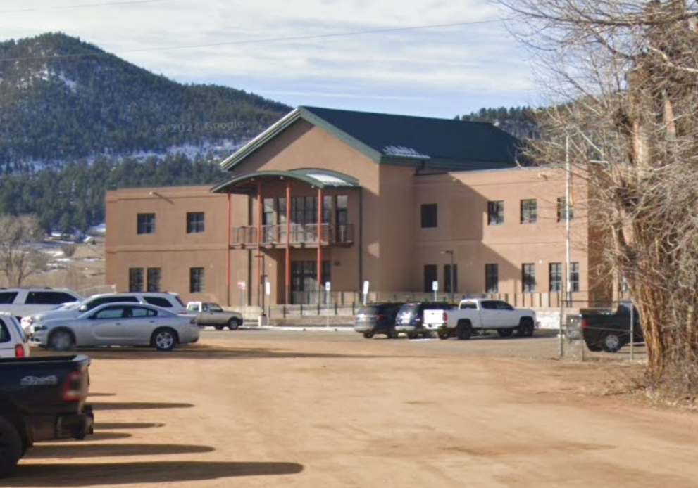
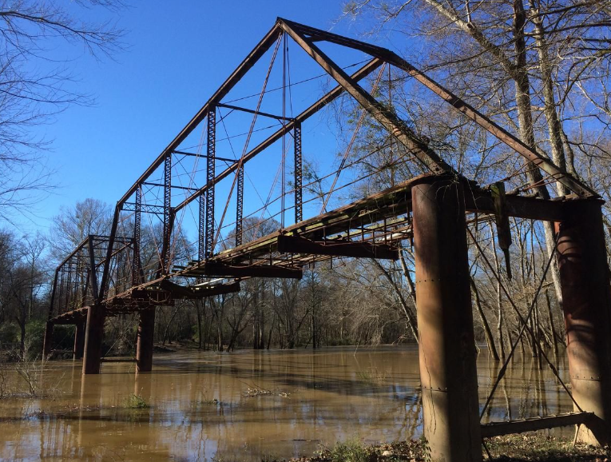
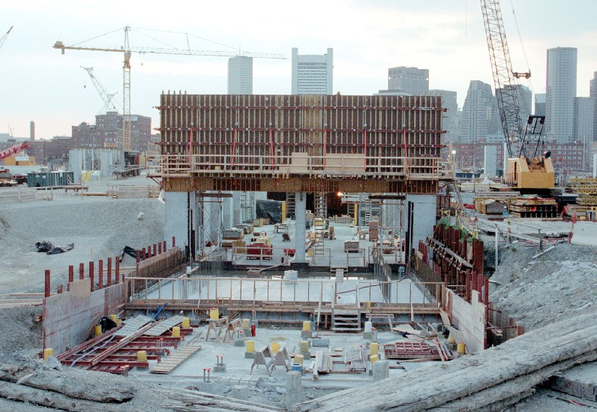
NEPA Documents
Categorical Exclusion (CatEx)
Categories of actions with little or no impact
Common actions
Renovations of existing facilities
Existing disturbed/developed areas
Categories at discretion of agencies
Environmental Assessment (EA)
Concise public document
Purpose and Need
List of alternatives considered
List of agencies consulted
Analysis of environmental topics
Results in a FONSI
Environmental Impact Statement (EIS)
Detailed Public Document
Selection of Preferred Alternative
Draft EIS Published
Public Comment/Public Hearings
Response to Comments
Final EIS Published
Results in a Record of Decision (ROD)
Notes:
Draft EIS is published for public comment.
Minimum public comment period is 45 days
Copies of the EIS are also provided to involved agencies for comments
Comments are received and evaluated; and are addressed in the Final EIS.
Responses to comments often lead to
substantial impr. and/or mods to the preferred alternative,
introduction of new alternatives not previously considered,
factual corrections,
or explanations of why comments do not warrant a response
Upon Issuance of the Final EIS, there is a Post-EIS 30-day comment period before the Lead Fed Agency can Render its Final Decision
This is in the form of a Record of Decision that is prepared/signed by the Lead Agency. The ROD
States What the Decision is
Identifies Alternatives Considered
States What Practical Mitigation Measures were adopted
Commits to a Monitoring and Enforcement Program
Throughout the duration of the project

Slide 12
EDA’s Project Review & Application Processing
EDR Consult with
Applicant
Full Application Submitted
Merits Further Consideration Letter
(if favorably reviewed)
Additional Information
Provided by Applicant
Award
(if approved)
Technical Review/ Address Deficiencies
IRC Reviews Application
Environmental Narrative
Submitted
Additional Docs Requested
REO puts in the good word
Additional Info Requested
We’re Here to Help!
REO Magic Happens
Notes:
Using EDA’s Project Review & Application Processing flow diagram,……this is where the REO fits in.

Slide 13
Environmental Narrative
Use the EDA Template
(found at eda.gov > Resources & Tools > Find Grant Resources)
Includes:
Beneficiaries
Project Description
Need and Purpose
Alternatives Considered
Historic and Archaeological Resources
Affected Environment (Inventory and Impact Analysis)
Mitigation
Applicant Certification Clause
Attachments and Maps

Slide 14
Best Practices for a Complete Environmental Narrative
PROJECT DESCRIPTION
List project beneficiaries
Proposed Construction - Often refers to the Preliminary Engineering Report (PER) – that’s ok, but…
Please identify all the elements of the project to be funded as if you’re describing it to your grandmother (locations, sizes, lengths, areas)
Include concept plan, site plan, cartoon
Include Purpose/Need and whatever alternatives were considered.

Slide 15
Best Practices for a Complete Environmental Narrative
HISTORIC AND ARCHAEOLOGICAL RESOURCES
Although the EN Template notes that the applicant is not required to contact SHPO…..
…consultation should be initiated as soon as possible!
Most SHPO’s take at least 30 days to respond
The EDA will handle all Tribal HPO consultations (gov to gov requirement)

Slide 16
Best Practices for a Complete Environmental Narrative
AFFECTED ENVIRONMENT
Affected Area – Identify dominant vegetative habitat, any State or National Parks, Wilderness Areas, Wildlife Refuges, etc. in proximity to project
Coastal Zones – Identify if the project is in the designated coastal zone and if project would meet the objectives of the CZMP.
Wetlands – Provide NWI Mapping or site-specific study. If there are confirmed or suspected wetlands, consult with the appropriate USACE District for comments.

Slide 17
Best Practices for a Complete Environmental Narrative
AFFECTED ENVIRONMENT…
Floodplains– Provide FEMA mapping and identify any proposed activities in the floodplain
Climate Change– Identify risks (flooding, severe weather, etc.) and steps to mitigate risks. Identify steps taken to reduce carbon footprint (use of renewable energy and/or building materials)
Endangered Species – Provide USFWS iPaC report (species list). If there are confirmed or suspected populations, consult with the USFWS for comments.

Slide 18
Best Practices for a Complete Environmental Narrative
AFFECTED ENVIRONMENT…
Land Use/Zoning– Provide Zoning maps and identify if there any Prime Agricultural Lands (from the NRCS soil survey)
Solid Waste Management– Describe proposed waste stream (collection/disposal)
Hazardous or Toxic Substances– Identify and describe any existing hazardous conditions and any proposed use of hazardous materials. Provide a Phase 1 and/or Phase II ESA if conducted. Complete AND SIGN the Applicant Certification Clause (Appendix A of the Template)

Slide 19
Best Practices for a Complete Environmental Narrative
AFFECTED ENVIRONMENT…
Water Resources– Identify any surface water resources (streams, lakes, etc) on or near the project site. Provide USGS maps or aerial photographs. Identify any proposed groundwater use and if there are any Sole-Source Aquifers affected.
Solid Waste Management– Describe proposed waste stream (collection/disposal)
Water Supply– Identify and describe source and use of potable water
Wastewater- Identify and describe wastewater collection and disposal/treatment systems.

Slide 20
Best Practices for a Complete Environmental Narrative
AFFECTED ENVIRONMENT…
Environmental Justice– Will project result in disproportionate impacts to minority and low income populations
Transportation– Describe local street system serving the project and if the system has capacity to handle increased car/truck traffic
Air Quality– Identify and describe sources of proposed emissions. Is project in a “non-attainment” area for priority pollutants?
Noise- Identify and describe proposed noise sources and if there will be any impact to sensitive receptors. Identify any mitigation measures.

Slide 21
Best Practices for a Complete Environmental Narrative
AFFECTED ENVIRONMENT…
Permits– Identify any permits required or anticipated.
Public Notification/Controversy– Provide any public meeting minutes, news articles, etc.
Cumulative Effects– Identify and describe any anticipated related development Associated with the proposed action.

Slide 22
Common Issues
Project not clearly defined or explained.
SHPO Consultation not initiated or request is vague.
Project location maps not provided.
Applicant Certification Clause not completed or signed.
“N/A” responses.

Slide 23
EDA Environmental Review
Review Submitted Documentation
Environmental Narrative (EDA Template)
Applicant Certification Clause
Preliminary Engineering Report
Other Documents/Reports
Pre-IRC Review
Determine Level of NEPA Review
Identify missing/needed items
Does the Project Fit any of the Cat Ex Categories?
Notes:
State Historic Preservation Office (SHPO) Consultation Documentation (Maybe)
U.S. Army Corps of Engineers Correspondence (Maybe)
Phase 1 Environmental Site Assessment (Maybe)
Review Submitted Documents for EDA Completeness
“Is the most current version (June 2021) Environmental Narrative Template Used/Followed?”

Slide 24
DOC Categorical Exclusions
Department of Commerce CEs Published in July 10, 2009 Federal Register
A-1 Minor Renovations and Additions to buildings, roads, airfields, grounds, equipment and other facilities that do not change the functional use of the property.
A-2 New construction upon or improvement to land, provided:
Already developed/disturbed area.
Compatible with Federal, State, Tribal and Local Planning and Zoning Standards/Programs
Site and scale is consistent with adjacent/nearby buildings.
Does not result in uses that exceed existing support infrastructure capacities

Slide 25
DOC Categorical Exclusions
A-3 Software Development, Data Analysis or Testing
A-4 Siting, Construction and Operation of Microwave/Radio Communication Towers less than 200 feet in height
A-5 Retrofit and/or Upgrade of Existing Microwave/Radio Communication Towers that do no require ground disturbance
A-6 Adding Fiber Optic Cable to transmission structures or burying Fiber Optic Cable in existing Rights-of-Way
A-7 Acquisition, installation, operation and removal of communications systems, data processing equipment and electronic equipment
A-8 Planning activities and classroom-based training using existing conference rooms and facilities

Slide 26
DOC Categorical Exclusions
A-9 Purchase of mobile and portable equipment and infrastructure which is stored in previously existing structures or facilities
A-10 Siting, construction, modification of, and operation of support buildings and support structures within or contiguous to an already-developed area
Includes trailers and pre-fabricated buildings
Active utilities and currently-used roads are readily accessible
A-11 Personnel, fiscal, management and administrative activities

Slide 27
EDA Environmental Review
If Yes – Categorical Exclusion
If No, an Environmental Assessment will be required
Notes:
State Historic Preservation Office (SHPO) Consultation Documentation (Maybe)
U.S. Army Corps of Engineers Correspondence (Maybe)
Phase 1 Environmental Site Assessment (Maybe)
Review Submitted Documents for EDA Completeness
“Is the most current version (June 2021) Environmental Narrative Template Used/Followed?”

Slide 28
Environmental Assessments (EAs)
If an EA is determined to be required:
Request any missing documentation/mapping (curing request)
Initiate SHPO Consultation (if not already started)
Can delegate task to applicant/grantee
Initiate THPO Consultation
Must be initiated by EDA
Request NEPA Public Notice Publication
30 day public comment period
Initiate/Request coordination with USACE (if applicable)

Slide 29
Environmental Assessments (EAs)
EDA Process –
Prepare the Environmental Assessment
Conclude with a Finding of No Significant Impact (FONSI)
Add Special Award Conditions (SACs) as necessary
Use list of approved SACs with any needed guidance from Legal (for rarely-used SACs)
SACs should not be used for things that are supposed to be handled during review period (i.e. SHPO/THPO consultation efforts)

Slide 30
Resources
EPA NEPAssist
https://nepassisttool.epa.gov/nepassist/nepamap.aspx
USGS Maps
https://store.usgs.gov
U.S. Coastal Zone Management Act Boundary
https://koordinates.com/layer/20522-us-coastal-zone-management-act-boundary/
USDA Web Soil Survey
https://websoilsurvey.sc.egov.usda.gov
FEMA Maps
https://msc.fema.gov
National Wetlands Inventory
https://fwsprimary.wim.usgs.gov/wetlands/apps/wetlands-mapper/
USFWS Info. for Planning and Consultation (T&E Species)
https://ipac.ecosphere.fws.gov
U.S. Army Corps of Engineers
https://www.usace.army.mil

Slide 31
QUESTIONS?
Contact Information
Michael L. Francis, Ph.D. – Regional Environmental Officer
202-527-4171
mfrancis@eda.gov

