Slide 2
Oklahoma Biotech Innovation Cluster (OBIC)
More than 60 Partner Organizations
Project Leads
Greater OKC Chamber
Innovation District
OU Health Stephenson Cancer Center
University of Oklahoma
Tom Love Innovation Hub
Stakeholders
Industry
Academia/Research
Entrepreneurs
Investors
Public sector
Community organizations (Tribal Nations, OKC Black Chamber, Latino Community Development Agency)
Notes:
Project Leads
Greater OKC Chamber
Innovation District
OU Health Stephenson Cancer Center
University of Oklahoma
Tom Love Innovation Hub
Stakeholders
Industry
Academia/Research
Entrepreneurs
Investors
Public sector
Community organizations (Tribal Nations, OKC Black Chamber, Latino Community Development Agency)

Slide 3
Notes:
Summary of all 6 projects – Oklahoma Biosciece Innovation Cluster (BIOC)
A coalition of more than 40 member organizations, spearheaded by the Greater Oklahoma City Chamber alongside the University of Oklahoma, and industry leadership and vision from Echo Investment Capital, has been awarded $35 million through the Build Back Better Regional Challenge of the U.S. Economic Development Administration.

Slide 4
Oklahoma Biotech Cluster
High-wage career pathways
R&D programs
Expand critical
scientific infrastructure
EDA BBBRC - $35 million
Notes:
Purpose of the Oklahoma Bioscience Innovation Cluster (BIOC)
Vision: Create an absorptive ecosystem to utilize for home-grown commercialization
Project: Uniting regional research, manufacturing, clinical trial capacities in an integrated value chain to scale domestic production of bioscience products & technologies
Goals: A unique urban-rural region to foster inclusive access to high-wage career pathways, increase R&D programs and partnerships, and expand critical scientific infrastructure that make the central Oklahoma region more conducive to commercialization of high-value innovations.

Slide 5
Project 1: BioScience Cluster Initiative (In Process)
Leadership
Assessment
Regional
Connectivity
Policy
Advocacy
$3 million
Notes:
Project 1 – BioScience Cluster Initiative
An initiative to lead regular convenings of industry leadership, conduct needs assessments, encourage regional connectivity, and spur policy advocacy - $3.0 million

Slide 6
Project 2: University of Oklahoma Stephenson Cancer Center - Clinical Trial Center (In Process)
$3.6 million
Notes:
Project 2 – Clinical Trial Center
An initiative to double the size of the existing clinical trail program at OU Health Stephenson Cancer Center, commensurate with the demand for Phase I trials created through accompanying translational science investments and industry growth - $3.6 million

Slide 7
Project 3: Stephenson Cancer Center - Development Therapeutics Center (In process)
$7.3 million
Notes:
Project 3 – Development Therapeutics Center
Development of 10 translational research labs dedicated to drug discovery within the OU Health Stephenson Cancer Center - $7.3 million

Slide 8
Project 4: OKBio Startup Programs (Completed)
$7 million
Notes:
Project 4 – OKBio Startup Programs
Supportive programming to build a vibrant regional biotech startup pipeline led by the University of Oklahoma- $7.0 million

Slide 9
Project 5: OU Bioprocessing Core Facility (Completed)
$7 million
Notes:
Project 5 – OU Bioprocessing Core Facility
A new facility with state-of-the-art high-throughput, advanced bioprocessing equipment and service for instructors and researchers at OU, local nonprofit organizations like OMRF, and private companies like Wheeler Bio - $7.0 million

Slide 10
Project 6: Bio Workforce Training Center (January 2025)
$7.2 million
Notes:
Project 6 – Bio Workforce Training Center
A new program to meet the growing demand for skilled labor in the OBIC, which will enable the formation of inclusive, non-degreed career pathways into high-wage jobs - $7.2 million

Slide 11
Notes:
Public/Private Partnership
City Initiatives—MAPS 4 + match – BT Development

Slide 12
What would typically take 2-4 years of experience and months of training is accelerated to less than three weeks through our program.
$10k tuition
Partnerships with local industries
$40-60k
average projected starting salary
Notes:
Project 6 – Bio Workforce Training Center
A new program to meet the growing demand for skilled labor in the OBIC, which will enable the formation of inclusive, non-degreed career pathways into high-wage jobs - $7.2 million

Slide 13
Who Benefits?
STAY AT HOME PARENTS REENTERING WORKFORCE
BIO GRADUATES
BIO ORGANIZATIONS
VETERANS
BIPOC INDIVIDUALS
CAREER SWITCHERS
UPSKILL/RESKILL
OKCPS GRADUATES
INDIVIDUALS AGING OUT OF FOSTER CARE
RESEARCHERS
ECONOMICALLY DISADVANTAGED
SECOND CHANCE HIRING

Slide 14
Funding of BioTC – Public/Private Partnership
ARPA
8.4 million
EDA BBBRC
$7.15 million
MAPS 4
$10 million
6 projects, including BioTC ($35m)
+ Private donor match
Notes:
ARPA - $8.4m
EDA BBBRC - $35m across six projects
We have city support and federal support and a level of state support through ARPA; however, we would love to see the state grab the vision that biomanufacturing can be an industry that drives Oklahoma's economic development for the next 30+ years and the positive impact we could have in creating "high-tech", "high paying" jobs of the future.

Slide 15
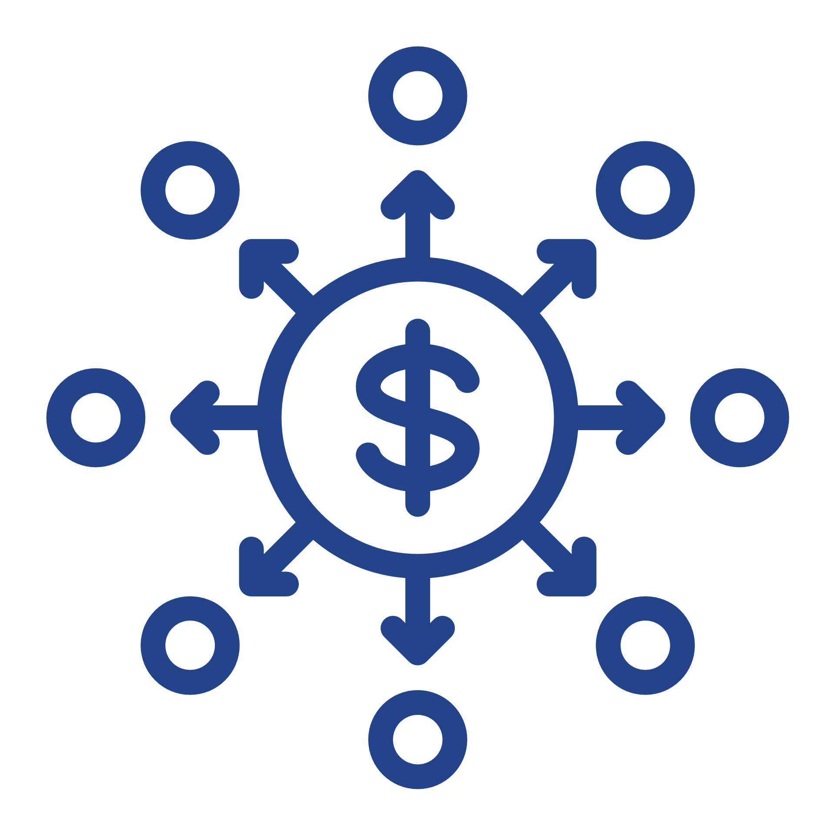
Regional & National Implications
Regional
More viable commercialized products
High wage jobs and diversification
Meet growth needs
National
Diversifying
Increases onshoring
Expand domestic supply chain
Notes:
National - Strengthens US Competitiveness & National Resiliency
Federal Priority: Diversifying innovation/production hubs to protect against future disasters/shocks and to unleash potential in Middle America
Increases onshoring for the biomanufacturing production process
Need for expanded domestic supply chain for pharm production
Regional
Increases regional research in quantity & quality to translate more viable commercialized products
High wage jobs and economic diversification
Meeting growth needs of existing companies

Slide 16
Thank You
www.okcinnovation.com

