Slide 1
SWREDA 2024
16 MAY 2024

Slide 2
Let’s Connect!
Craig Buerstatte
Deputy Assistant Secretary for Regional Affairs
cbuerstatte@eda.gov
or
www.linkedin.com/in/CraigBuerstatte/

Slide 3
WHY WE DO WHAT WE DO
Our Mission
To lead the federal economic development agenda by promoting innovation and competitiveness, preparing American regions for growth and success in the worldwide economy.
Increase America’s global economic competitiveness
Support community-led economic development
Help communities develop resilient and agile local economies

Slide 4
SELF-ACTUALIZATION
“A musician must make music, an artist must paint, a poet must write, if he is to ultimately be at peace with himself.”
abraham maslow

Slide 5
HIERARCHY OF NEEDS
Self- actualization
Esteem: prestige and feeling of accomplishment
Belongingness & love: intimate relationships, friends
Safety: security, safety
Physiological: food, water, warmth, rest
Self-Fulfillment Needs
Psychological Needs
Basic Needs

Slide 6
COMMUNITY ACTUALIZATION
Achieving one’s full potential,
including creative activities
Achieving a community’s full potential, including innovative activities

Slide 8
Basic Infrastructure
BASIC INFRASTRUCTURE
Transportation
Utilities

Slide 10
Technology Infrastructure
TECHNOLOGY INFRASTRUCTURE
BASIC INFRASTRUCTURE
Broadband
Cellular
Wireless
Transportation
Utilities

Slide 12
Business Support
BUSINESS SUPPORT
TECHNOLOGY INFRASTRUCTURE
BASIC INFRASTRUCTURE
Educational Institutions
Workforce development
Access to capital
Broadband
Cellular
Wireless
Transportation
Utilities

Slide 13
Innovation Engines
Incubators
Accelerators
INNOVATION ENGINES
BUSINESS SUPPORT
TECHNOLOGY INFRASTRUCTURE
BASIC INFRASTRUCTURE
Educational Institutions
Workforce development
Access to capital
Broadband
Cellular
Wireless
Transportation
Utilities

Slide 15
EDA Supports Local and Regional Economies
Incubators
Accelerators
HEALTHY REGION
INNOVATION ENGINES
BUSINESS SUPPORT
TECHNOLOGY INFRASTRUCTURE
BASIC INFRASTRUCTURE
Educational Institutions
Workforce development
Access to capital
Broadband
Cellular
Wireless
Transportation
Utilities

Slide 16
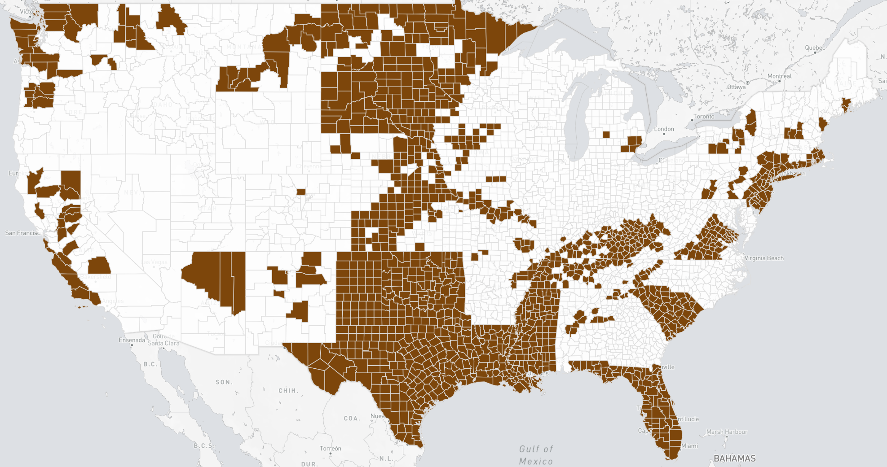
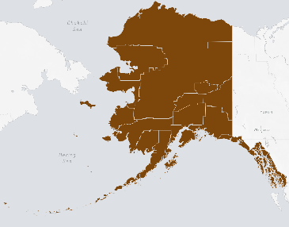
CY 2021 – 2022 Declared Disasters
FEMA CY2021/CY2022 Major Disaster Declared Area
Not a FEMA Declared Area
Some regions are hit more frequently and harder than others by disasters. Planning and infrastructure are important for recovery and resilience of disasters
*Note, due to visualization limitations, this map is not inclusive of disasters impacting Puerto Rico and America Samoa
FY 23 Allocations | Atlanta | $160,000,000
 | Austin | $110,000,000
 | Chicago | $18,000,000
Denver | $57,000,000
Philadelphia | $103,000,000
Seattle | $35,000,000

Slide 17
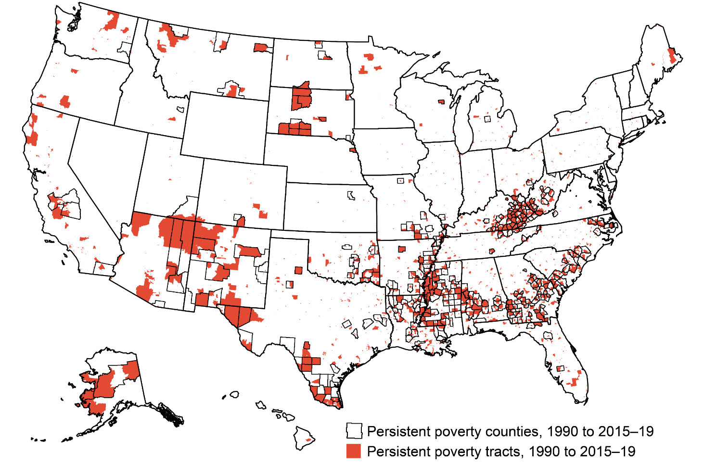
Persistent Poverty Counties & Tracts
Source: USDA ERS - Descriptions and Maps

Slide 18
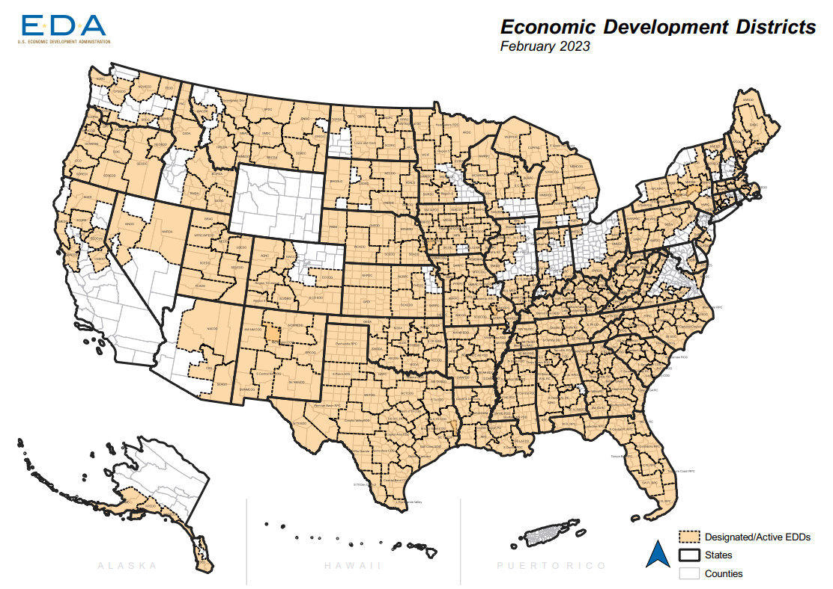
Economic Development Districts - 403 Total – 86% of Nation
Strategic partners providing comprehensive economic development planning and technical assistance to communities across the nation to provide capacity to underserved areas
Key Takeaways
EDDs are key partners in helping navigate economic shifts from business closures, disasters, and industry transition
While they are non-federal organizations – they are critical to EDA’s mission
Where gaps exist, economic development capacity *might* be limited and hinder readiness and resiliency
Updated February 2023

Slide 19
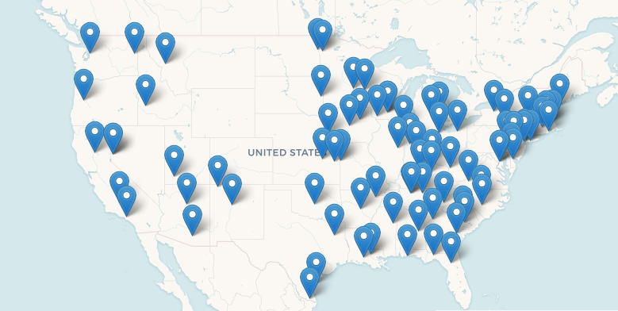
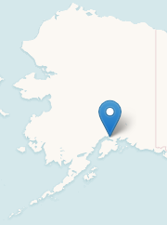
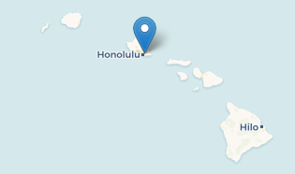
University Centers
University Centers complement and collaborate with other EDA partners by providing expertise, applied research, and data to their service area.
Key Takeaways
University Centers are key EDA partners that help by filling knowledge gaps in specific industries and economic development needs.
Focus on providing technical assistance, data and insights, and program resources to help regions realize their full economic development potential.
EDA funds 71 University Centers on a 3-year cycle.
Updated February 2023

Slide 20
Recent disasters have surged EDA’s investments
New approaches – Build Back Better, Regional Economic Coordination Officers, Economic Recovery Corps
Greater emphasis on Regionalism
New stakeholders entered the economic development field
Capacity Building is becoming hugely important
Largest economic development infrastructure in decades
CARES Act
ARP Act

Slide 21
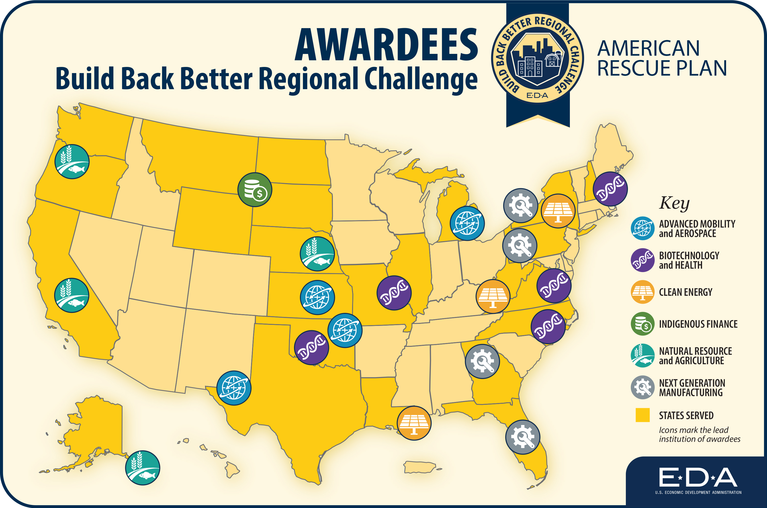
The Build Back Better Regional Challenge is boosting economic recovery from the pandemic, rebuilding American communities and advancing industries of the future to increase American competitiveness and create good jobs, including in regions grappling with decades of disinvestment.

Slide 22
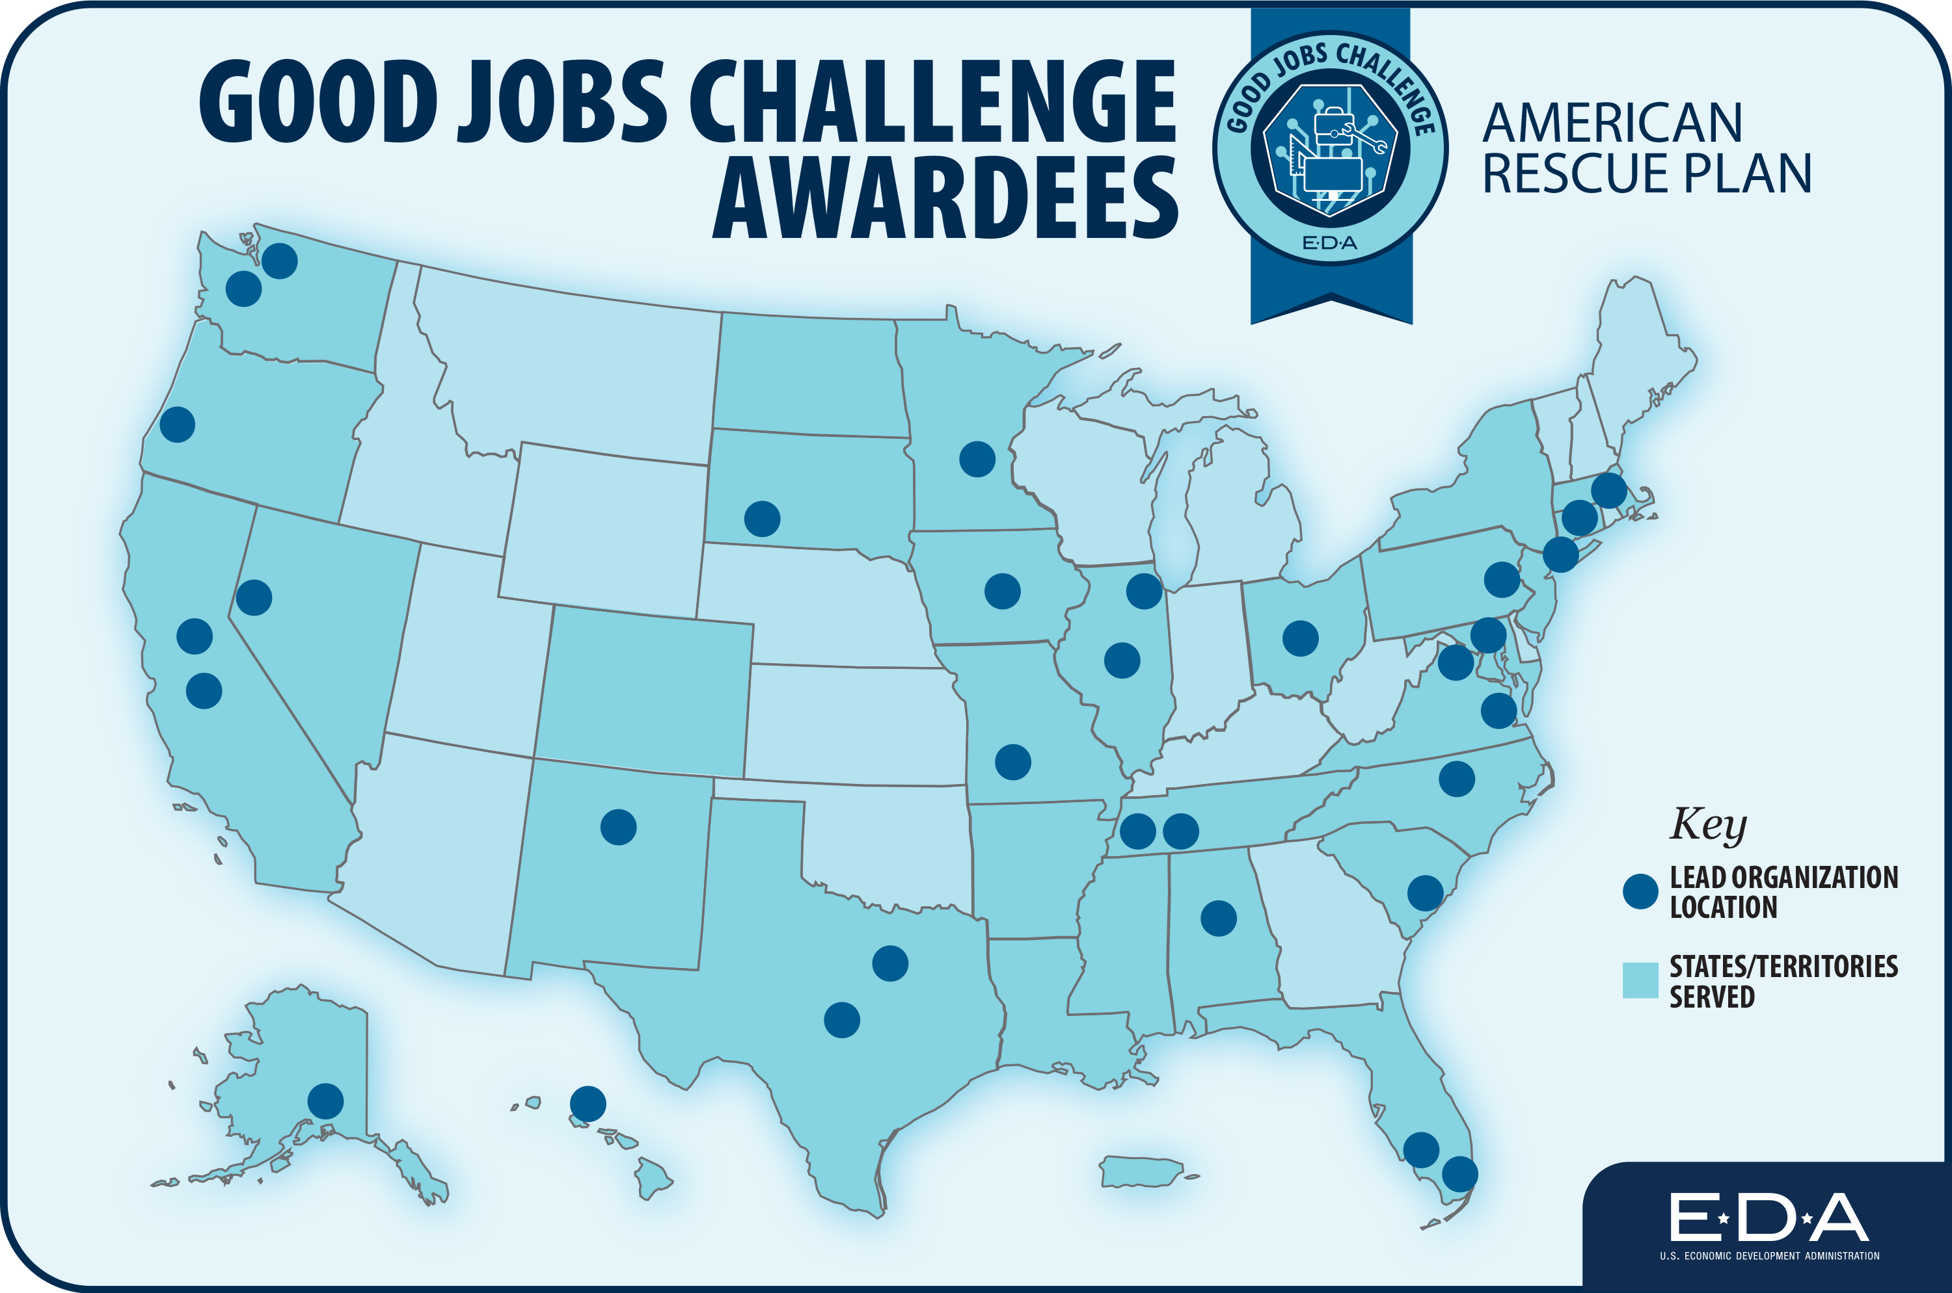
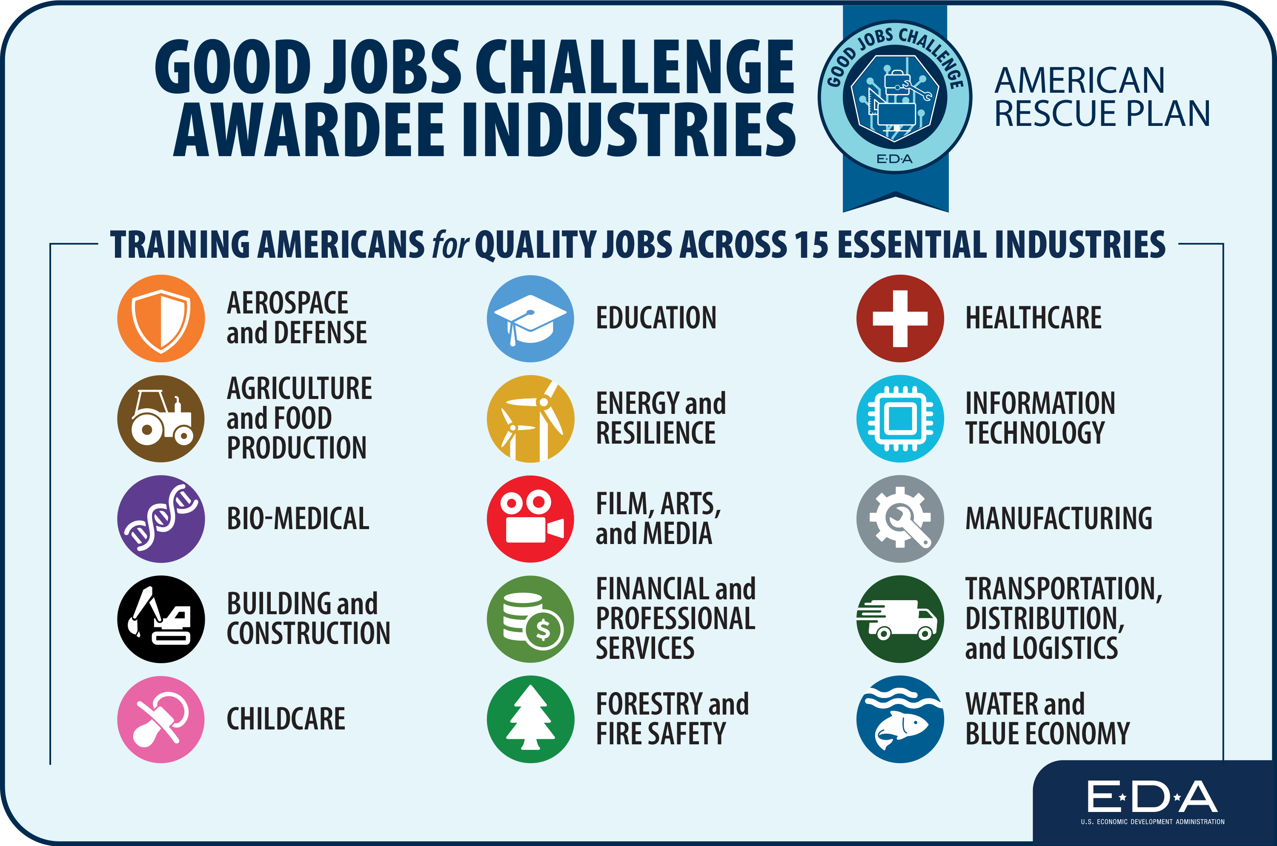
With a focus on equity, the Good Jobs Challenge Program is expanding career opportunities for more Americans to reach their full potential and secure good-paying jobs while producing a skilled workforce to ensure the United States is prepared to innovate, compete, and succeed in a 21st Century global economy.

Slide 23
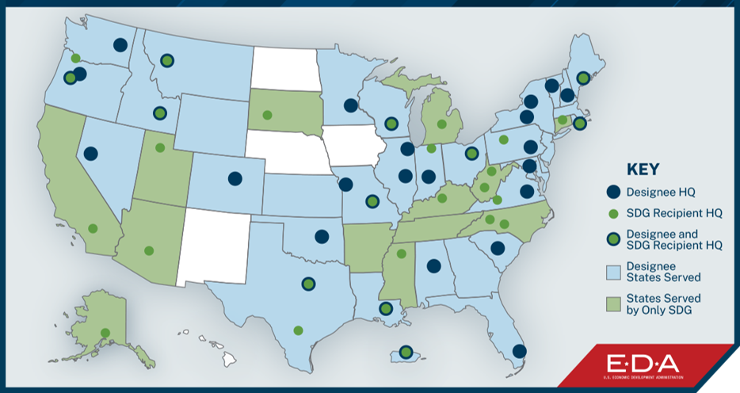
The Tech Hubs Program aims to strengthen U.S. economic and national security by investing in geographically diverse regions across the country to ensure the technologies, industries, and jobs of the future start, grow, and remain in the United States.​
The program is designed to strengthen a region’s capacity to commercialize technology and grow the supply chains and supporting businesses that help these Hubs run.

Slide 24
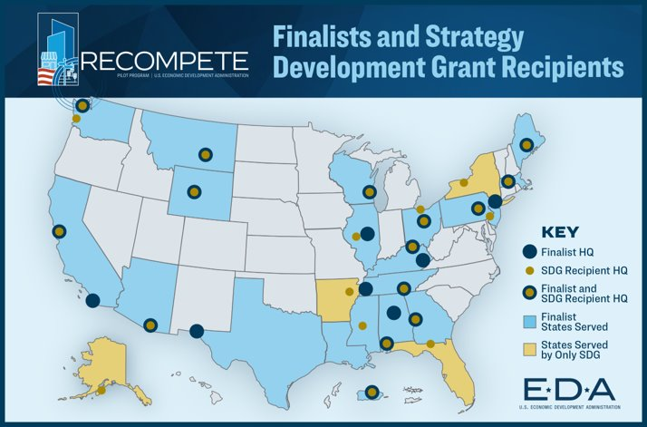
Recompete offers targeted, highly flexible grant opportunities to address the root causes of distress in United States in places that have seen persistent underinvestment.
The program is designed to invest in communities that make up some of the most economically distressed areas of the country—so they can actively grow and chart a new path to prosperity in the modern economy.
Notes:
Add the language I had in the remarks.

Slide 25
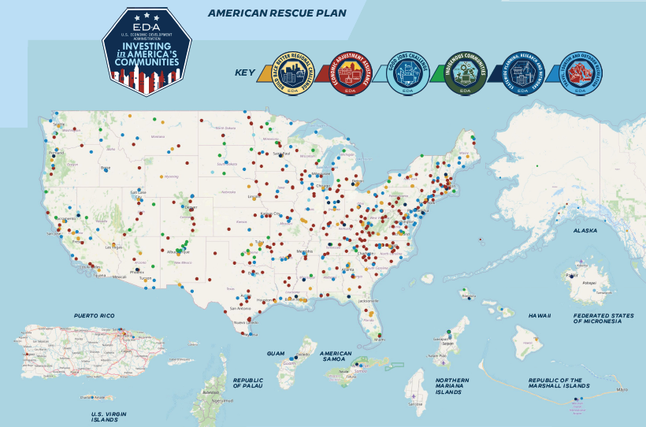
EDA’s American Rescue Plan Impacts Are Broad-Reaching
EDA INVESTMENTS HAVE IMPACTED ALL 50 STATES AND U.S. TERRITORIES

Slide 26
Ideas? What’s next? Impacts today? Impacts tomorrow?

Slide 27
QUESTIONS?
Craig Buerstatte
Deputy Assistant Secretary for Regional Affairs
cbuerstatte@eda.gov
or
www.linkedin.com/in/CraigBuerstatte/

Slide 28
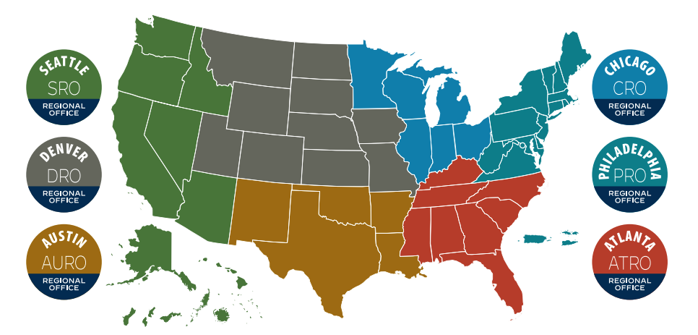
The EDA Regions: Help Wherever You Need It

