Slide 1

STRATEGIES FOR REGIONAL TRANSIT PLANNING
March 12, 2024

Slide 2
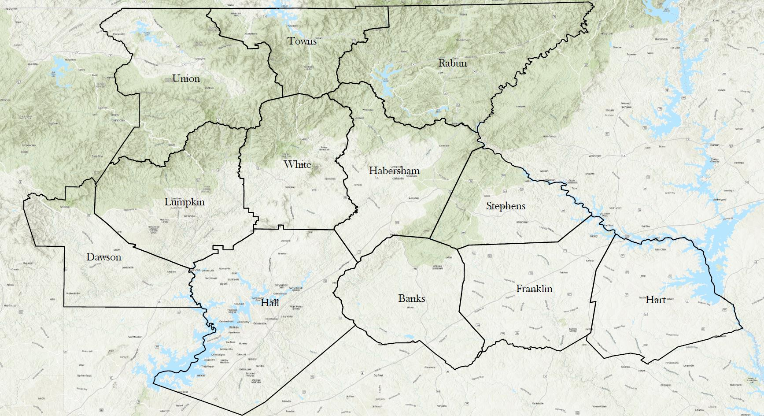


Slide 3



ABOUT THE GEORGIA MOUNTAINS…

Slide 4


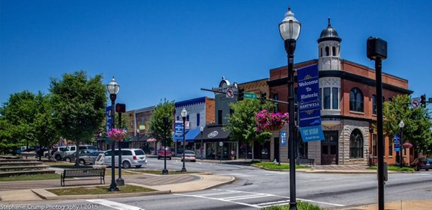
ABOUT THE GEORGIA MOUNTAINS…

Slide 5
ABOUT THE GEORGIA MOUNTAINS…

Slide 6
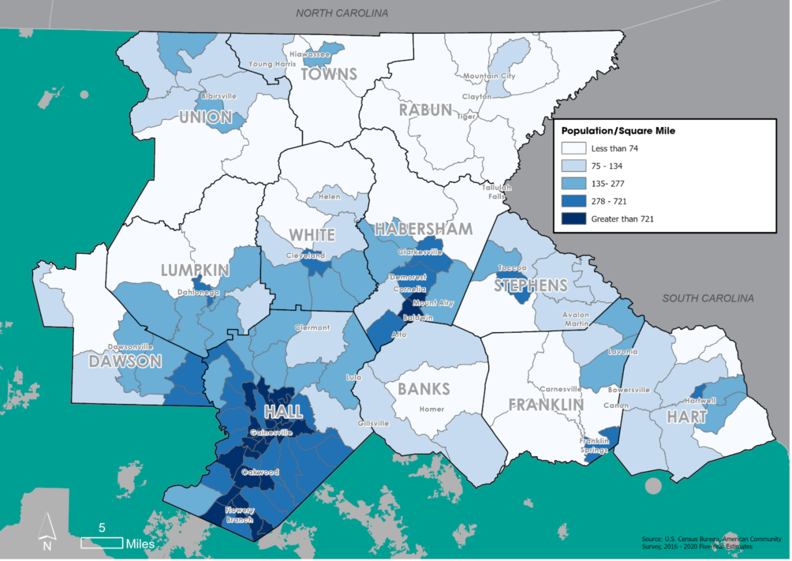

Slide 9
SO, WHAT’S THE ISSUE?

Slide 10
THE ISSUE IS ACCESSIBILITY
Operational Efficiency
Regional Scaling
Auto Dependency

Slide 11
EFFECTS OF AUTO DEPENDENCY
KEY DESTINATIONS
Medical
Civic
Educational
Employment
Commercial
KEY DEMOGRAPHICS
Seniors
Disabled
Low Income

Slide 12
EFFECTS OF AUTO DEPENDENCY
When groups of people are marginalized in their ability to live normally or fully participate in the public realm, they deteriorate individually, economically, and socially.

Slide 13
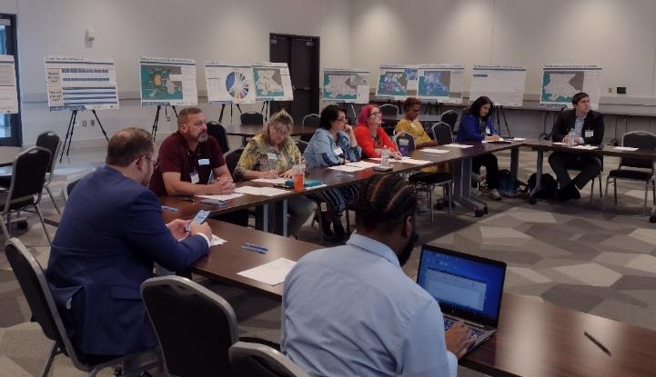
THE GMRC REGIONAL TRANSIT PLAN
Directed by Georgia DOT
1 of 2 pilot efforts by state
Guided by stakeholders
Year-long effort with public input (live & online)
The goal was a guidance document re: performance of existing efforts and opportunities for initial evolution of services.

Slide 15
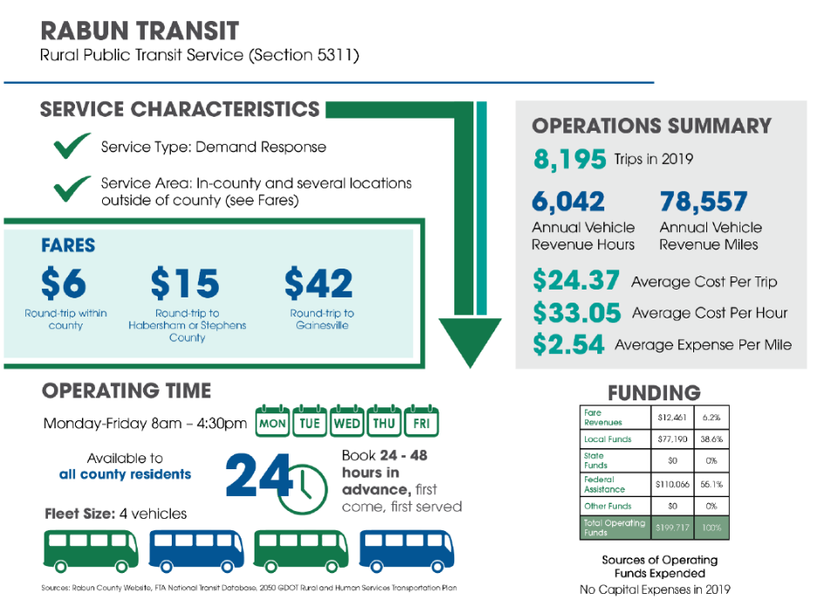
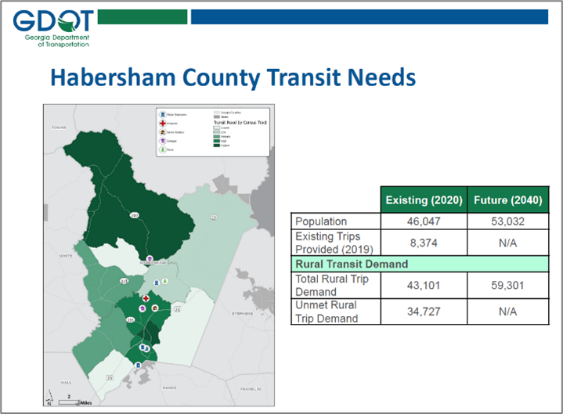

Slide 16
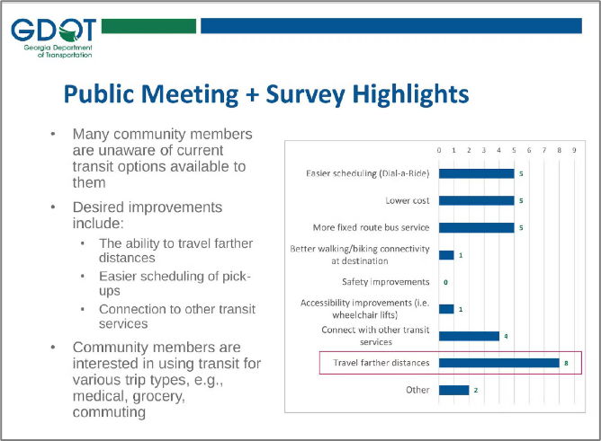
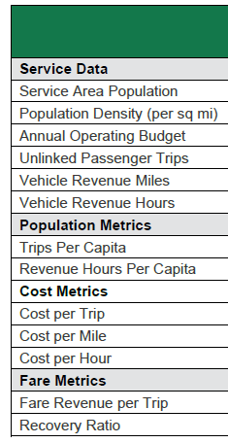
Performance Measures

Slide 18
KEY FINDINGS
Services constrained by geography
Services constrained by time
Several key regional destinations
Demographic projections suggest growing demand
Interest in evolving service models
Concerns about long term funding
Unsure about future of fleet vehicles, private competition

Slide 19
KEY DISCUSSIONS
IMPACT OF RIDE SHARE SERVICES
Services require economy of scale
Can be cost prohibitive to some customers
Minimal/ No special needs services
Service can be inconsistent

Slide 20
KEY DISCUSSIONS
IMPACT OF HOME DELIVERY & TELEVISITS
Does not address all ridership needs
Minimal/ No special needs services
Requires user skills
Requires high-capacity internet

Slide 21
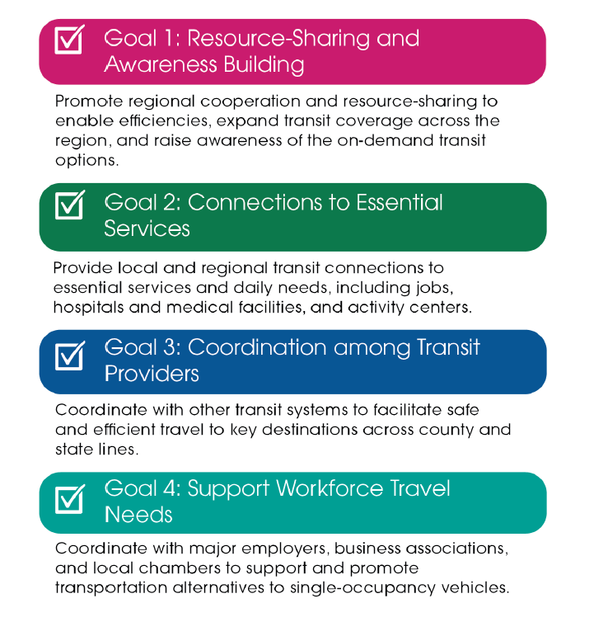
REGIONAL TRANSIT PLAN GOALS

Slide 22
RECOMMENDATIONS
GMRC…
Hire a Regional Mobility Manager
Organize central website with robust information on each transit agency
Organize listserv and resource sharing portal to be accessible by transit agencies
Partner with GDOT on a marketing campaign
Build support, education in counties w/o rural transit

Slide 23
RECOMMENDATIONS
Coordinate specialty transit for key destinations
  Northeast Georgia Medical
  University of North Georgia
  Kubota
  Lanier Technical College
Assess regionalization of operations (scalable)
Microtransit pilot program (Lumpkin Co.)
Voucher program for college students
Help programs sample extending hours

Slide 24
IMPROVING ACCESSIBILITY
Improve land use planning (locations of key destinations and residential clusters)
Help communities see transit/ connectivity as a critical facet of infrastructure
  Both leaders and the public!
  Offer guidance on budgeting
Stay informed about evolving transportation technology

Slide 25
Adam Hazell, AICP
Planning Director
ahazell@gmrc.ga.gov

