Slide 2
Thanks for Joining the Webinar!
Questions or comments can be submitted via the questions box on the right side of your screen in drop down menu
A recording of the webinar will be made available soon at www.nado.org
Please take a moment to complete the post-webinar survey to provide helpful feedback
Contact Melissa Levy at mlevy@nado.org with any questions about the webinar or wealth creation

Slide 3

Poll Questions

Slide 4


NADO provides advocacy, education, research, and training for the nation’s regional development organizations (RDOs). NADO and its members promote regional strategies, partnerships, and solutions to strengthen the economic competitiveness and quality of life across America’s local communities.
The NADO Research Foundation provides education, research, and training designed for RDO executive leadership, staff, and policy board members. It examines new and innovative practices in regional development and strives to improve the organizational and professional capacity of regional development organizations and their partners.
www.NADO.org

Slide 5
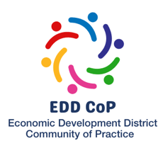
Melissa Levy
Regional Development Researcher/Wealth Creation Specialist
NADO Research Foundation
mlevy@nado.org
www.NADO.org

Slide 6
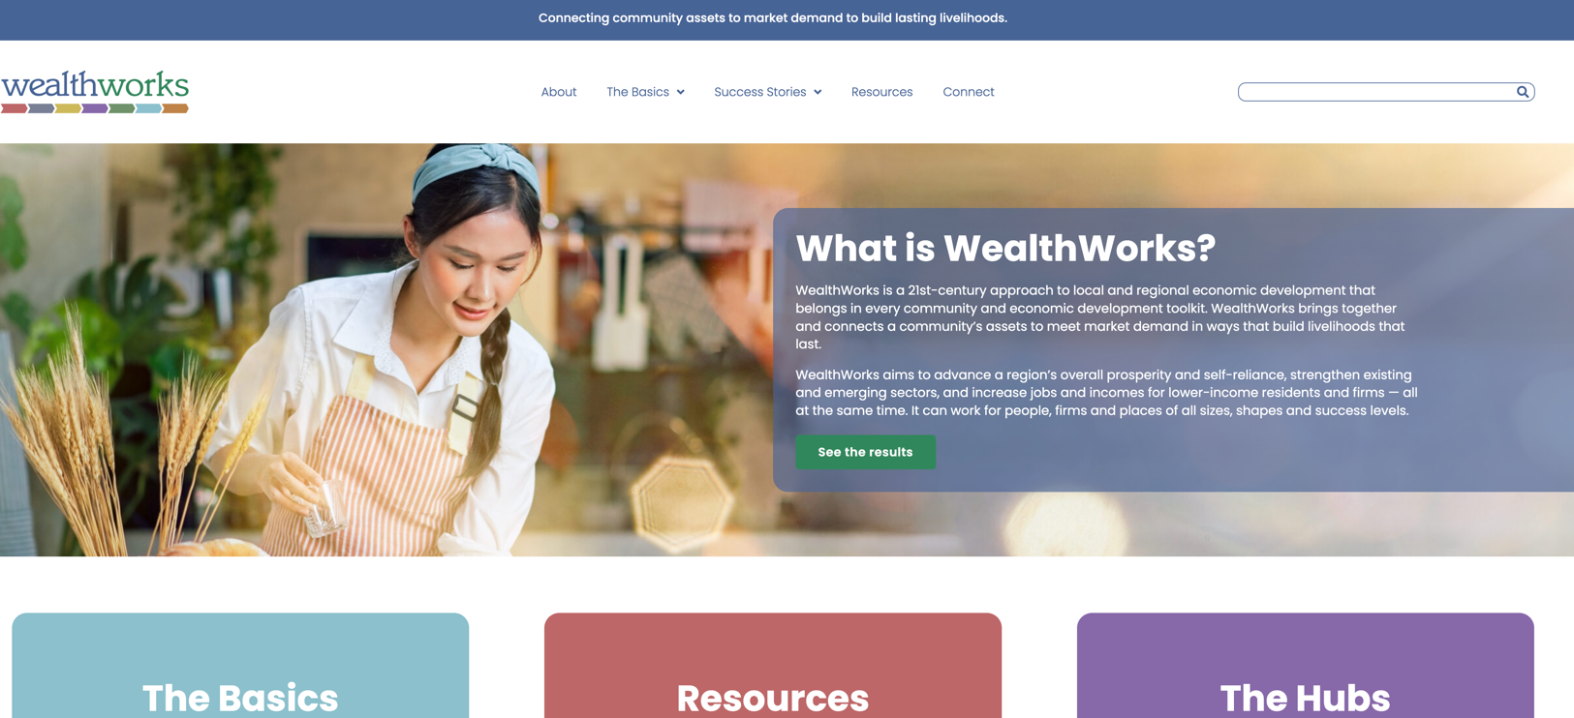
WealthWorks Website - www.wealthworks.org

Slide 7
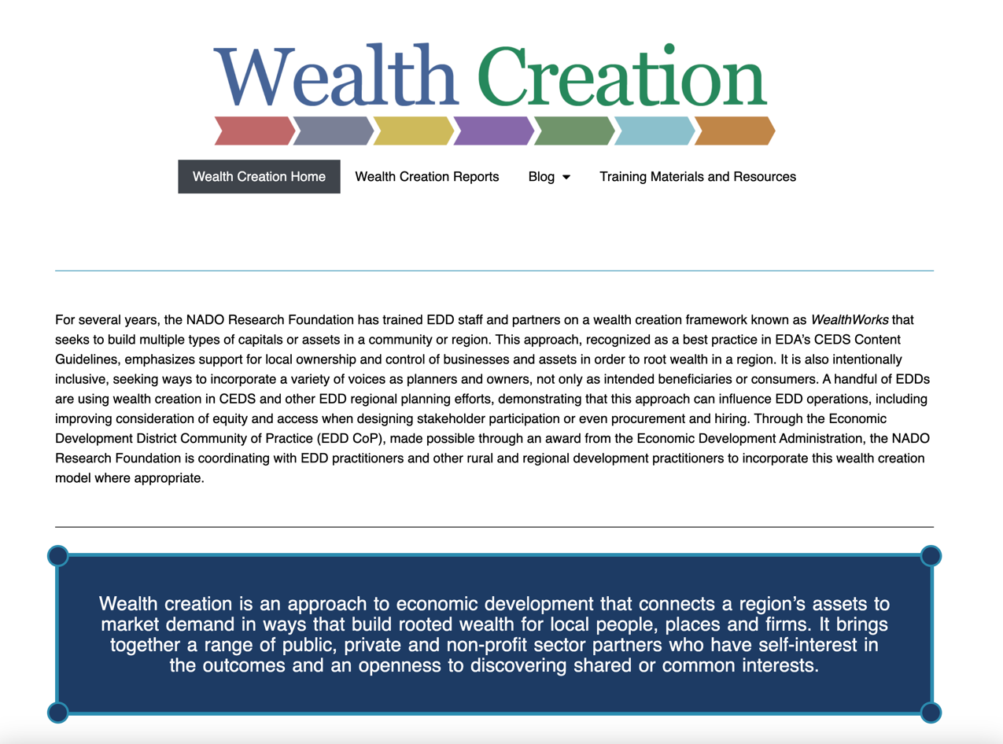
NADO Wealth Creation Website – www.nado.org/wealthcreation

Slide 8
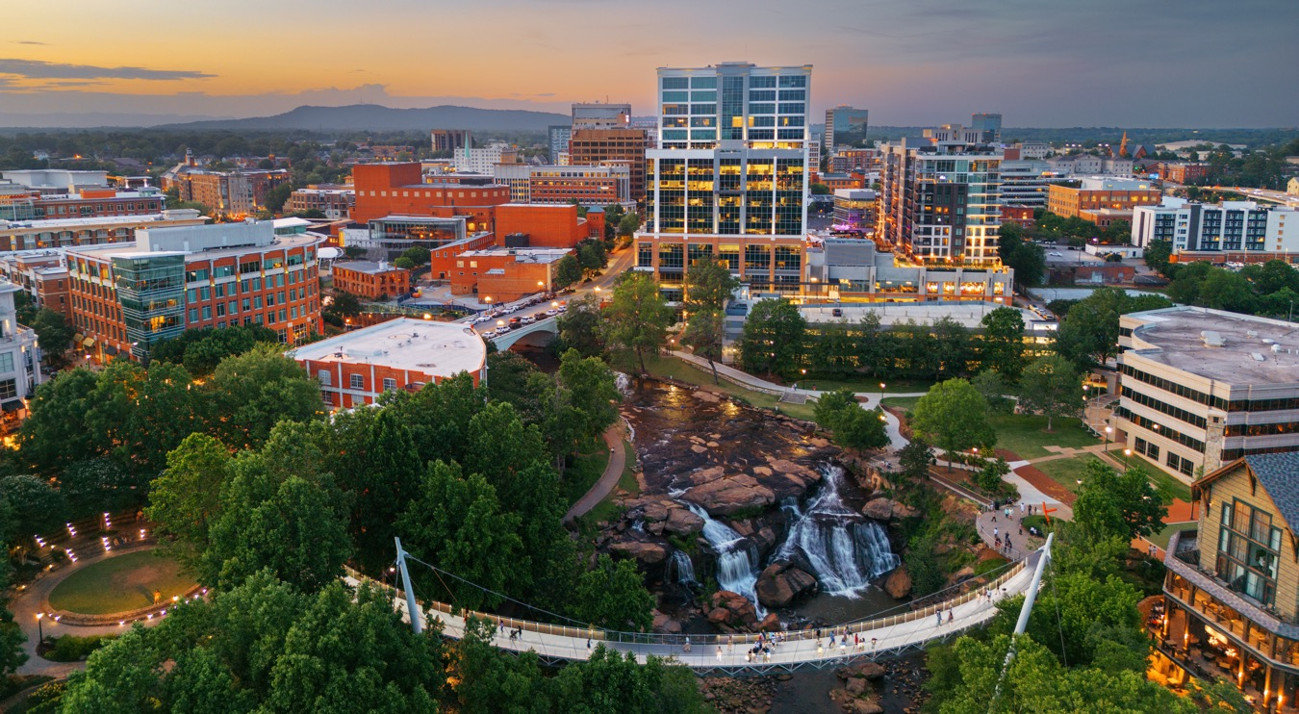
EDD Wealth Creation Summit - Greenville, South Carolina
July 31-August 2, 2024

Slide 9
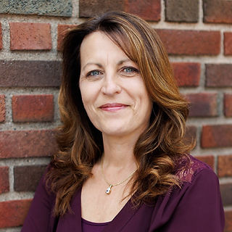
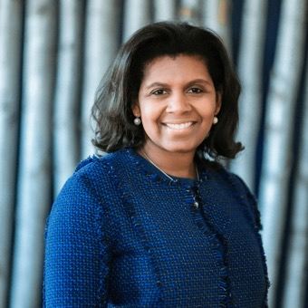


Today’s Presenters
Cheryal Lee Hills, Executive Director
Region Five Development Commission
Bonita Robertson-Hardy, Co-Executive Director
Aspen Institute, Community Strategies Group
(Moderator) Melissa Levy, Regional Development Researcher/Wealth Creation Specialist
NADO Research Foundation

Slide 10
WealthWorks…
an approach to economic development that connects a region’s assets to market demand in ways that build rooted wealth for local people, places and firms.
brings together a range of public, private and non-profit sector partners who have self-interest in the outcomes and an openness to discovering shared or common interests.
focuses on building a sector rather than individual and unrelated businesses.
Notes:
Goal: Advance a region’s prosperity by building wealth that sticks
WealthWorks is a bridge between community development (voice, empowerment, organizing) and economic development (attraction, retention, entrepreneurship).

Slide 11
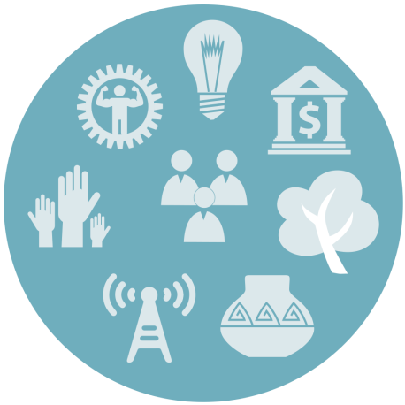


Principles of Wealth Creation
#1 – Create wealth, broadly defined, and aspire to do no harm.
#2 – Root wealth in local people, places and firms through regional ownership, control and influence.
#3 – Build lasting livelihoods by intentionally including people and firms on the economic margins.
Notes:
Wealth building framework has three critical goals:
Create wealth broadly defined – includes 8 capitals. Aspire to do no harm to any.
Root wealth in place – pay attention to who owns, controls and influences the wealth that’s created. Root wealth in local peoploe, places and firms through local ownership, control and influence.
Build lasting livelihoods especially for people and firms on the margins – intentionally including economically-marginalized residents.
Use a systems approach – Wealth Creation Value Chains – to build value in existing and emerging sectors.

Slide 12

#1: Investing in and Building 8 Capitals
Wealth is not just money.
Wealth is the reservoir of all assets that can contribute to the well-being of people, places or economies.
Every place has wealth.

Slide 13
t
Wealth Components: Eight Capitals
Key Concept
Intellectual
  Knowledge and innovation
Assessment
Design
Measurement
Individual
  Skills, education, health
Social
  Trust and relationships
Natural
  Natural resources
Built
  Infrastructure
Political
  Influence on decision makers and shapers
Financial
  Savings and investment
Cultural
  Traditions, customs and ways of doing
Notes:
Realize that you all are familiar with the triple bottom line. This isn’t really different … just unpacks the three capitals into greater detail… The other addition is that this approach focuses on both inventory and then investing in building our “stocks” of these capitals/assets. We recognize that without active investment, resources will depreciate.

Slide 14

#2: Wealth without Ownership isn’t Rooted
Capitals that are “owned” locally build wealth.
Ownership means you capture and control the flow of benefits from the capitals over time. It creates enduring, stable benefits.
Benefits – e.g., income, know-how, better technology – flowing from local ownership of capitals can be re-invested and re-circulated locally, enriching many.
Preserving local ownership or control over your capitals can increase the chances of preserving local jobs.
Local ownership is an anchor that helps wealth and change to stick.

Slide 15
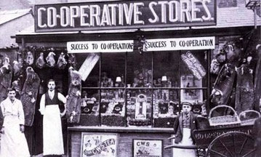
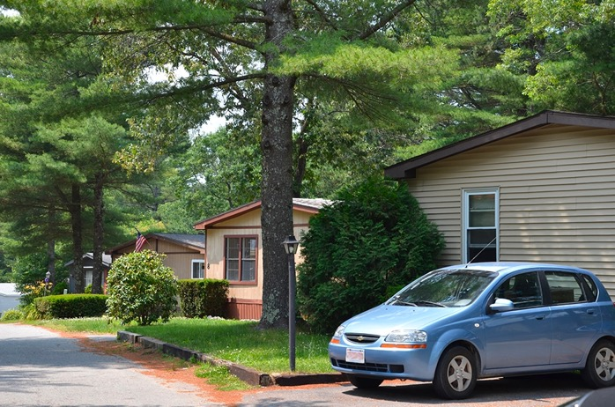
Making Wealth Stick: Local Ownership and Control
Cooperatives
Resident Owned Communities
Buy Local Campaigns
Regional branding
Notes:
Ownership and control looks like…
Many locally-owned businesses committed to the community
Local access to certificates or two-year degrees through the community college
Local endowment in the community foundation or affiliate
Other examples?

Slide 16

#3: Build Lasting Livelihoods
“Lasting livelihoods” means…
Ability to overcome vulnerability, maintain dignity and control, take risks to seize opportunities.
People at the margins are earning (and saving!) more.
They have improved skills to qualify for higher-paying jobs and to build their careers.
They are putting something aside for the future, e.g., building assets, so they are more resilient.
Notes:
Lasting livelihoods” means…
Low-income residents are doing better today, with improved skills to qualify for higher-paying jobs.
They are earning more and building careers.
They are putting something aside for the future, e.g., building assets, so they are more resilient.
They have better future prospects so they can give back their time, talent, and even treasure to the community.
Many places harbor underutilized assets ̶ people’s know-how and energy, natural resources, buildings, influence, connections… – that are not contributing to the broader economy.
Underutilized assets can be connected, developed, and linked to markets in ways that create wealth.
Economically-marginalized people and places are resources –and they (and everyone) will do better if they are connected to larger economies.
Need to include all, but too often economically-marginal are excluded

Slide 17
#4: Tie wealth to place and connect regionally
Wealth Creation Value Chains connect local production to regional demand to bring fresh money into rural communities, defined as:
A network of people, businesses,
institutions, and non-profits
who collaborate to meet market demand
for specific products or services –
each advancing individual self-interest
while together creating greater local wealth.

Slide 18
Connecting a Value Chain
Demand: Final consumers/end market - Buyers
Functions: Those things that must happen to deliver the product or service
Transactional partners: Those people, businesses, or organizations that play a direct role in sourcing, aggregating, distributing, processing, purchasing the product, etc.
Support partners: Those people, businesses, or organizations that provide the infrastructure, technical assistance and support that helps the transactional partners to produce
We are really talking about a Value Chain System!

Slide 19
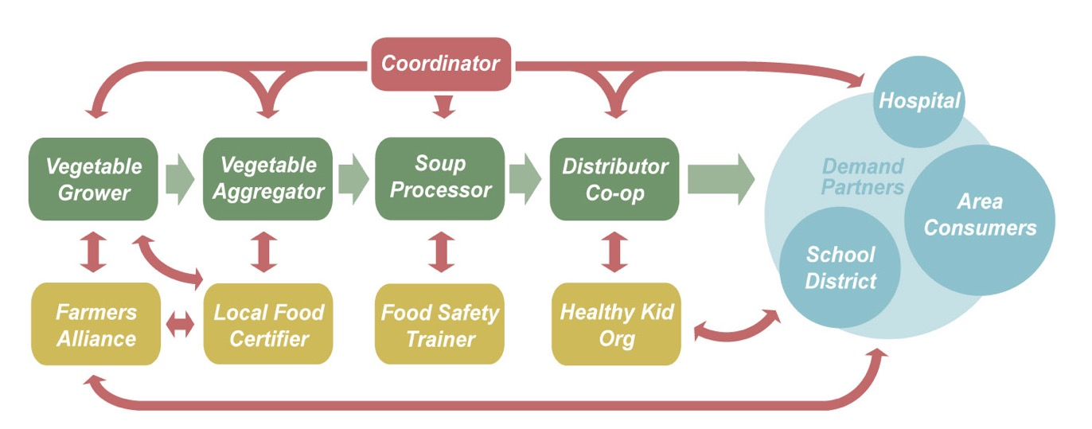

Value Chain Example

Slide 20
A Continuum for EDDs
CEDS
SWOT
Measuring outcomes
Sector-specific
Collaboration
Value chain development
Value chain mapping
Filling gaps in the chain
Coopetition
Notes:
It’s not one size fits all. The entry point is to use the discussion of capitals/assets in your CEDS planning.

Slide 21
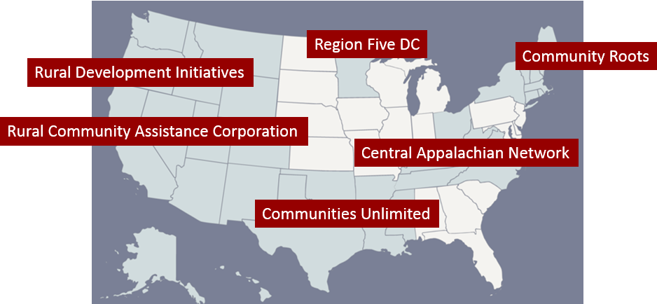
WealthWorks Regional Hubs
http://www.wealthworks.org/connect/hubs

Slide 22
Poll Question

Slide 23
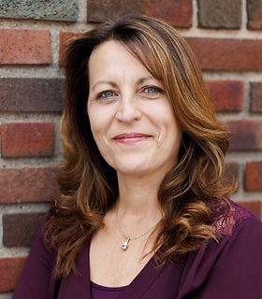
Cheryal Lee Hills
Executive Director
Region Five Development Commission

Slide 24
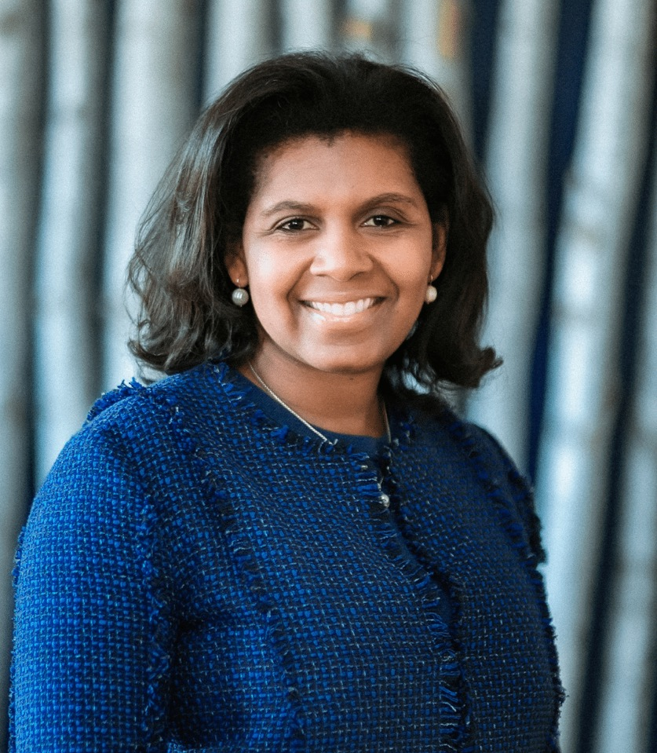
Bonita Robertson-Hardy
Co-Executive Director
Aspen Institute, Community Strategies Group

Slide 25
Breakout Discussion Questions
What challenges have you experienced in thinking about wealth creation at your organization?
What would be most useful to you as you integrate wealth creation thinking into your work?
What do you most want to know about on future webinars or discussions?

Slide 26
EDD Wealth Creation Summit - Greenville, South Carolina
July 31-August 2, 2024

Slide 27



More info at: www.nado.org/EDDCoP
The EDD CoP is made possible through an award from the U.S. Economic Development Administration, U.S. Department of Commerce (ED22HDQ3070106). The statements, findings, conclusions, and recommendations are those of the participants, trainers, and authors and do not necessarily reflect the views of the U.S. Economic Development Administration or the U.S. Department of Commerce.

Slide 28

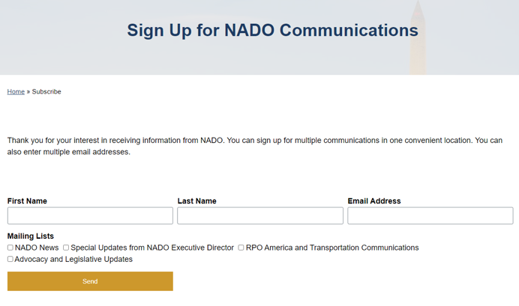
https://www.nado.org/subscribe/

Slide 29
Melissa Levy
Regional Development Researcher/Wealth Creation Specialist
NADO Research Foundation
mlevy@nado.org
www.NADO.org
www.CEDSCentral.com

