Slide 1
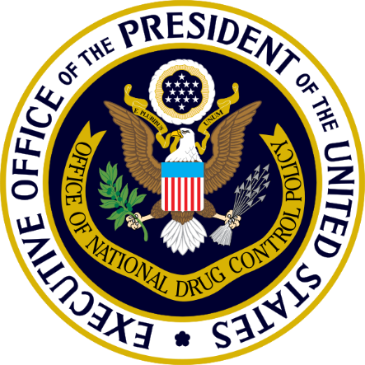
Building a Recovery-Ready Nation: Recovery-Ready Workplace Hub, Toolkit & Model State Act
Office of National Drug Control Policy
2024 NADO & DDAA Washington Conference
Peter Gaumond
March 11, 2024
Crystal Gateway Marriott - Arlington, VA
Notes:
Thank you [NAME]! It’s an honor to join you today I’d like to extend greetings from Director of National Drug Control Policy, Dr. Rahul Gupta. Today, I’m going to talk briefly about federal priorities in the recovery domain and outline the work we have done to promote the adoption of recovery-ready workplace policies.

Slide 2
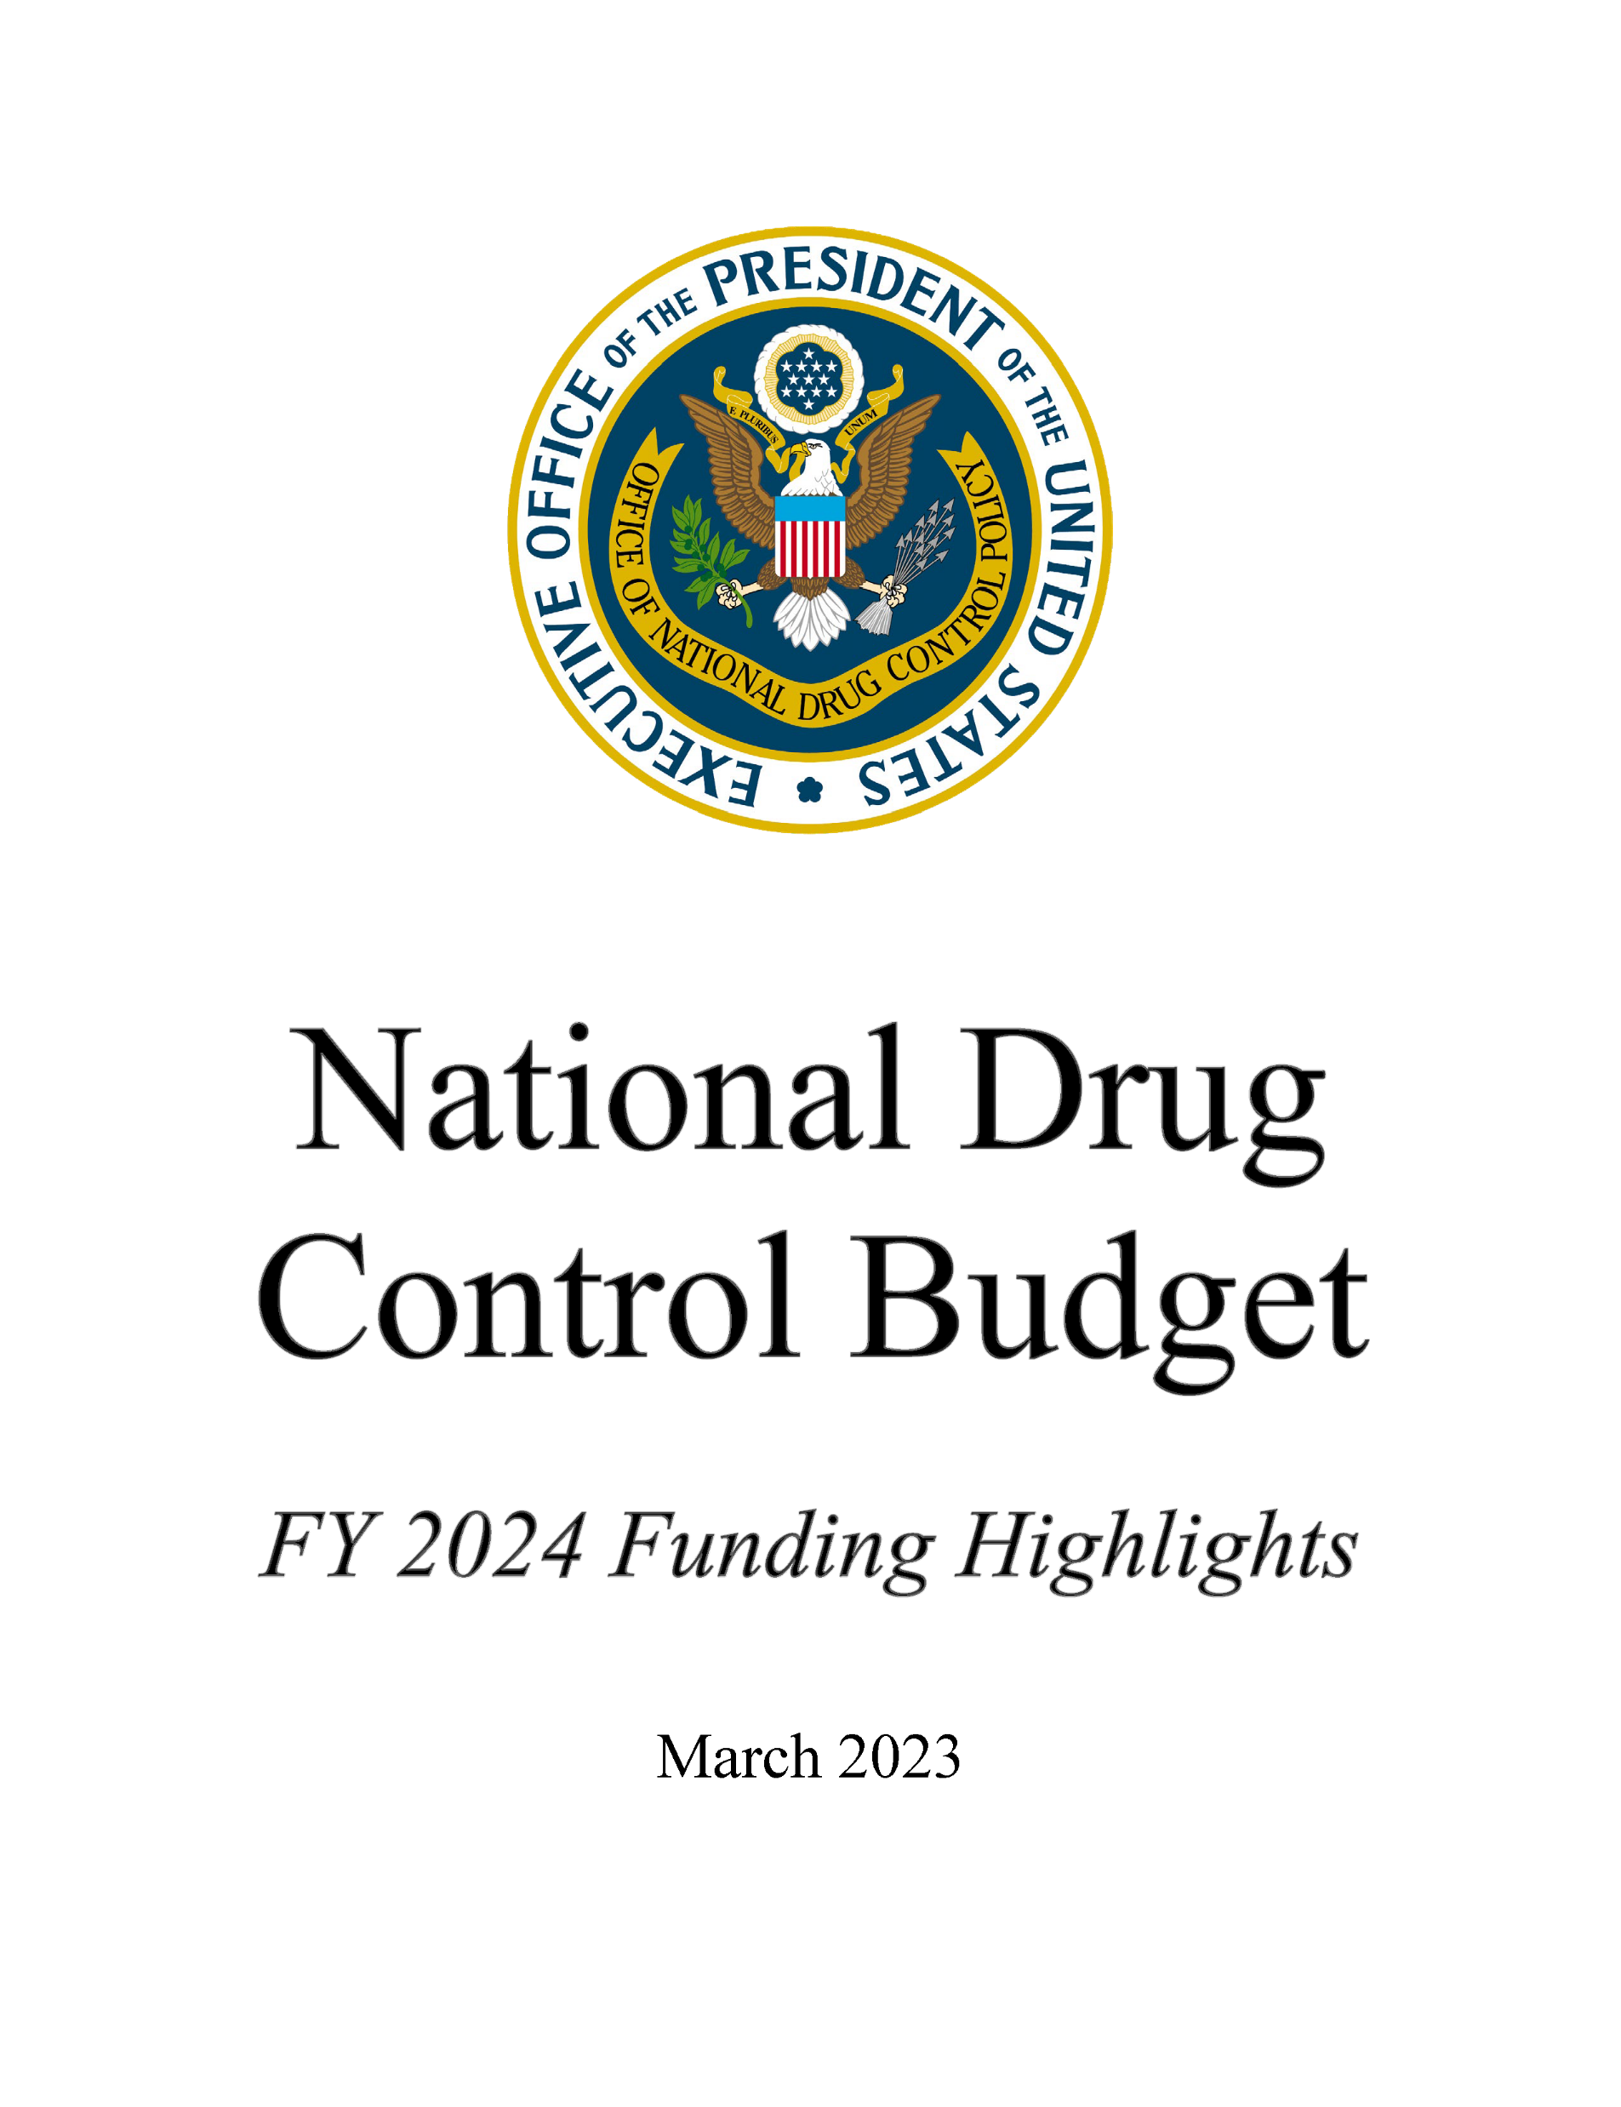
National Drug Control Strategy (NDCS)
President’s strategy and action plan for addressing drug use and its consequences
ONDCP coordinates implementation across 19 Federal departments and independent agencies
Supported by $46.1 billion* drug control budget
*President’s proposed budget. $43.8 billion enacted in 2023.
Notes:
As you probably know, our office is charged with developing and implementing the President’s National Drug Control Strategy, which establishes priorities, action items, goals and measures for addressing drug use and its consequences. We coordinate the implementation of the strategy across the 19 federal departments and agencies that comprise the National Drug Control Budget. We also work with a range of agencies that aren’t part of the drug control budget.

Slide 3
Building a Recovery-Ready Nation
Principle 1: Expand the Science of Recovery
Establish federal recovery research agenda
Implement agenda & make recommendations
Principle 2: Make Recovery Possible for More Americans
Expand PRSS capacity
Foster adoption of more consistent standards
Principle 3: Eliminate Barriers and Increase Opportunities
Ensure Adoption of neutral, science-based, person-first language
Expand, enhance, and improve the coordination of federal anti-stigma efforts related to SU/SUD
Expand employment opportunities & promote recovery-ready workplace policies
To improve outcomes over the long-term, we must recommit to shifting the focus of drug policy from punishment and social exclusion to healing and community reintegration. That is how we will begin to turn the tide, building recovery- ready communities that can effectively respond to and heal from drug use, addiction, and overdose.
Notes:
In the recovery domain, the Strategy is organized around three principles. [Review three principles, touch on efforts under way to implement them, and highlight statement that summarizes the overall perspective.]
Note that we view the terms “recovery-ready,” “recovery friendly,” and “recovery supportive” as synonymous.

Slide 4
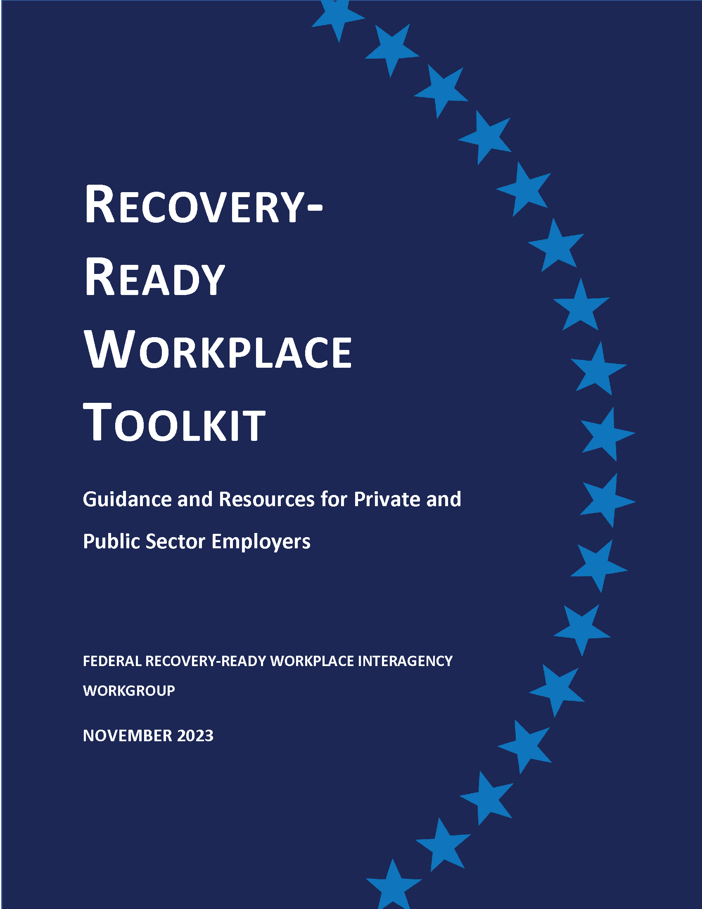
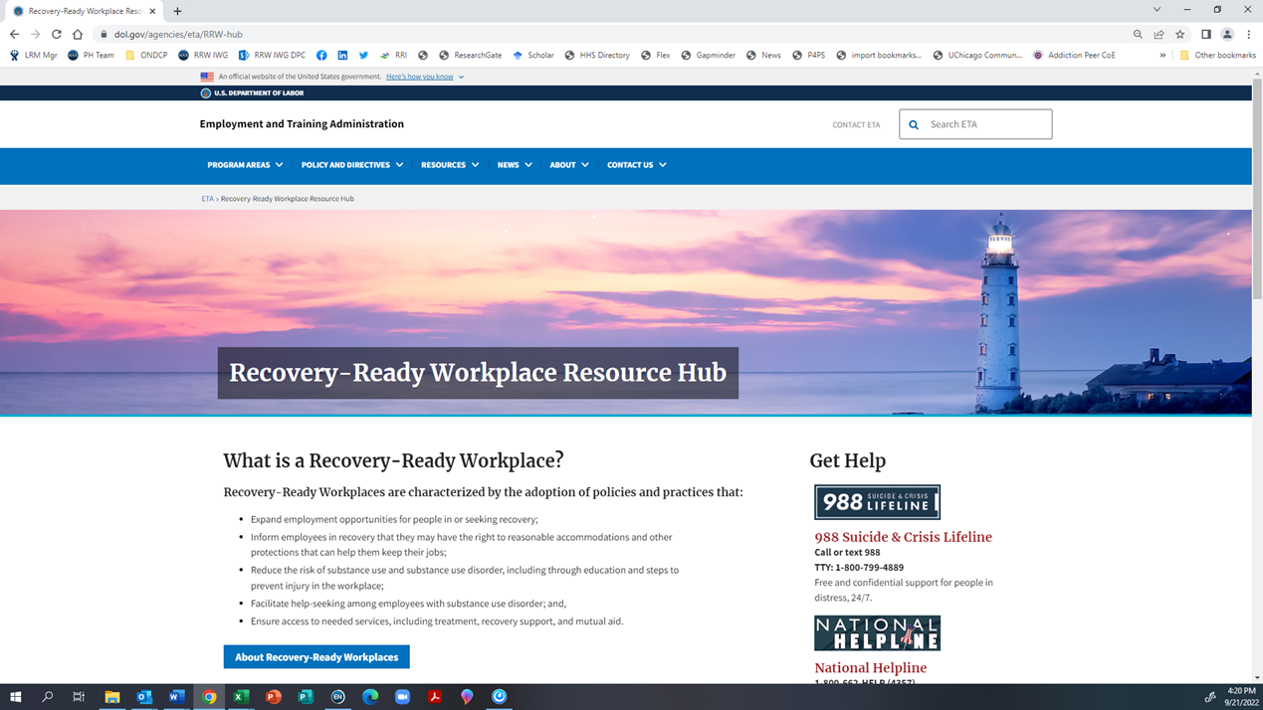
Expanding employment opportunities & Promoting Recovery-Ready Workplace policies
Convened interagency workgroup involving the Domestic Policy Council and 12 departments and independent agencies:
Launched Recovery-Ready Workplace Resource Hub
Developed and released RRW Toolkit
Working to develop strategy for implementing RRW policies in federal workplaces
Launched September 23, 2022
https://www.dol.gov/agencies/eta/RRW-hub

Slide 5
Announcement of Toolkit & Other Resources/Actions
RRW Toolkit (https://www.dol.gov/agencies/eta/RRW-hub/Toolkit)
Launch of National Recovery Friendly Workplace Institute
Google commitment to become recovery-ready workplace
Model State Recovery Ready Workplaces Act
Notes:
Model State Law:
Developed with input from expert stakeholders
Provides two-tiered approach—employers can become “participants” or “certified recovery-ready workplaces”
Encourage employers to institute workplace policies and procedures that:
Establish a culture that values a healthy work environment and offers opportunities for employee recovery and retention;
Help reduce occupational injuries and work-related stressors that might lead to substance misuse;
Encourage hiring of qualified people in recovery, including those with a history of criminal justice system involvement associated with their past substance use;
Eliminate barriers for employees seeking treatment; and
Assist employees in maintaining recovery, wellness, safety, and productivity.
Establishes a tax credit and stipend for employers that are certified as recovery-ready workplaces;
Creates state-based funding mechanism to implement program

Slide 6
Overview: Recovery-Ready Workplaces (RRWs)
Emphasize hiring of people in recovery (and sometimes people with current SUD)
Provide ongoing education, information and work to reduce stigma and misunderstanding
Identify and address injury risk factors/stress in the workplace
Treat SUD in the workforce as a health condition and encourage/facilitate help-seeking
Accommodate treatment and ongoing support needs
Build an informed and supportive workforce, including through volunteer or dedicated peer mentors/consultants
When employees fear that seeking help for a substance use problem may result in discipline, termination, or other negative impacts, they will hide their condition, exposing them, their family members, their fellow workers, and the organization to the consequences of untreated substance use disorder.

Slide 7
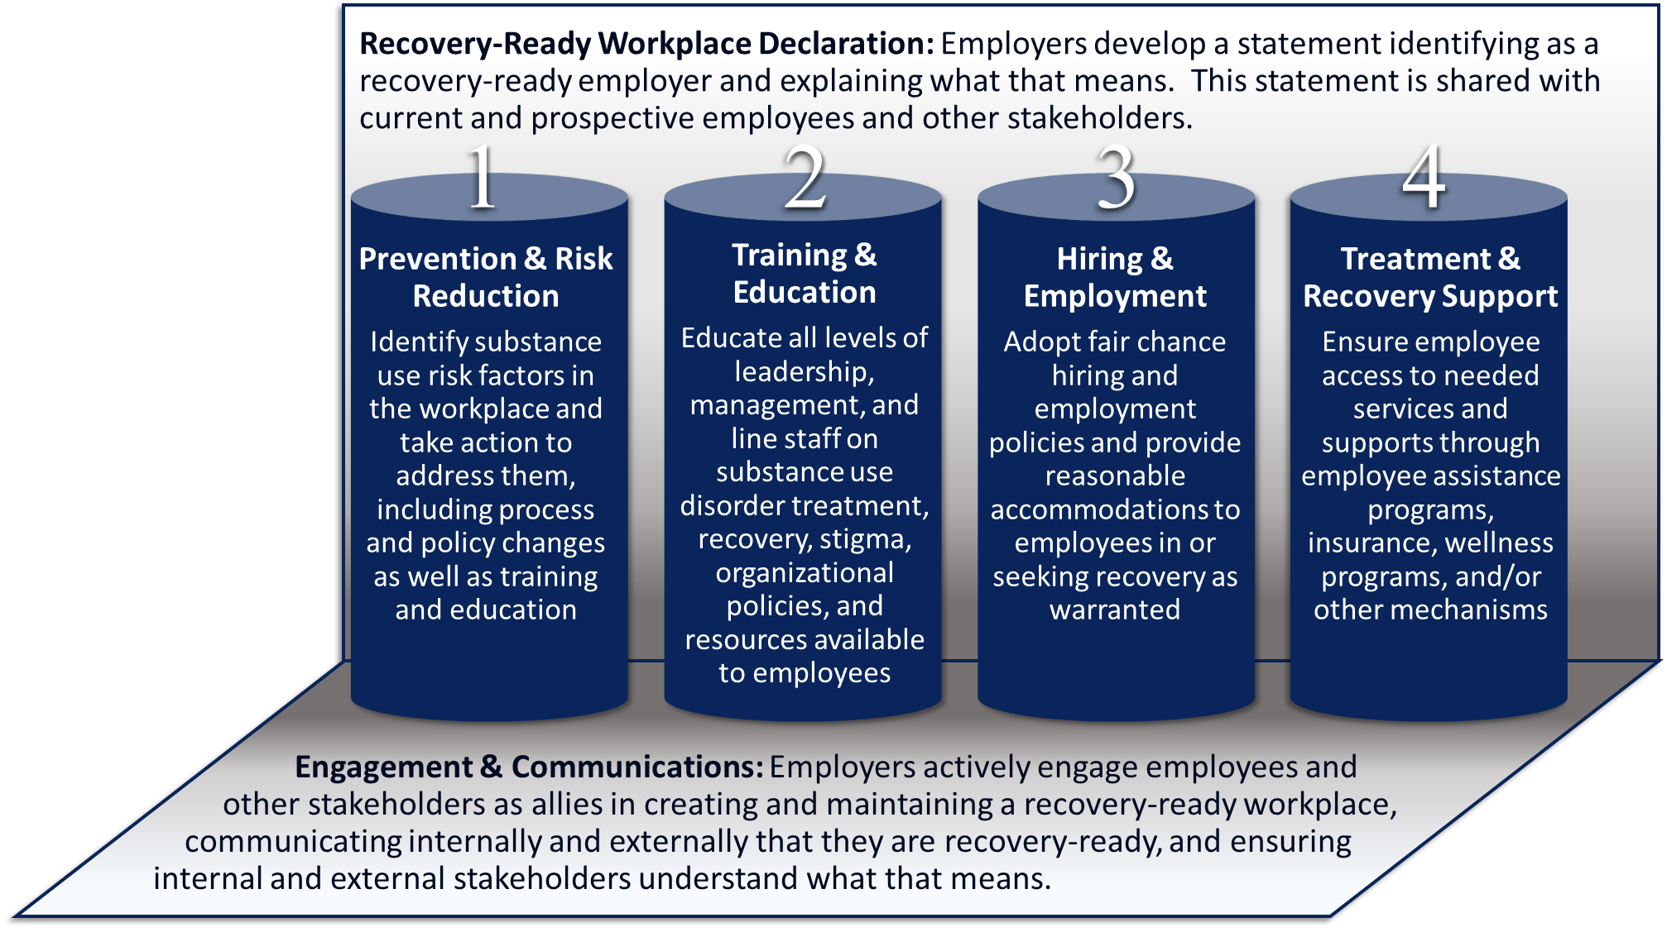
Components of a Recovery-Ready Workplace
RRW policies can thought of as having four primary pillars:
Prevention and Risk Reduction
Training and Education (includes stigma reduction efforts/activities)
Hiring and Employment
Treatment and Recovery Support
Notes:
Provide examples of activities in each of the four domains. Note that culture is seen as a product of efforts in these four domains

Slide 8
Assessment
Current policies, industry, regulatory requirements, resources, organizational culture, etc.
Business case, including impact on:
Productivity
Planning
Identify scope, staging, and process:
Adopt full range of RRW policies or partial?
Staged implementation with schedule or ad hoc process?
Dedicated implementation team or existing divisions (e.g. HR, legal, etc.)
Mechanism for informing and engaging workforce in process?
Engagement of unions?
Identify and engage potential external partners (e.g., RRW/RFW initiative, treatment providers, recovery organizations, etc.)
Availability of support (e.g., from state RRW/RFW initiative, chamber of commerce, etc.)?
Internal and external communication
Implementation
Update policies, orientation process, employee manual/SOPs, etc. and EAP, health and disability insurance, wellness programs as needed
Monitoring
Absenteeism
Turnover costs
Health care costs
Safety
Liability exposure
Marketing/Corporate Image
Workplace culture/employee morale & engagement
Taxes (if applicable)
Communicate changes to staff, partners, customers, community
Launch SU/recovery training/stigma reduction for all staff with possible separate supervisory training
Identify internal champions, including employees openly in recovery, diversity coordinators, union members, etc.
Launch or facilitate workplace peer network
Develop RRW branding and marketing and/or achieve RRW/RFW certification
Implementation
Evaluate implementation process and new policies
Survey employees to:
Evaluate understanding of SUD, recovery, and new policies
Understand attitudes toward SU and recovery, willingness to seek help, and support for employees who are seeking help or in recovery
Review formal and informal partnerships with (RRW/RFW initiatives, treatment providers, etc.)
Make adjustments as needed
Notes:
Like to think of four phases:
Assessment: rates of use among employees, SU-related healthcare utilization, SU-related incidents, positive tests, your industry, your locality and trends there. Employee surveys to learn about attitudes, stigma and to determine employee knowledge of SU/SUD and of YOUR POLICIES. Likely cost of SU to your organization. (SEE NATIONAL SAFETY COUNCIL SU COST CALCULATOR.) If multisite with different functions may need to take more than one lens to the process. Is there an initiative through which you can gain consultation, support, certification This is the decision point if you’re not sure.
Planning: How are we going to take this on? You may want to stage it with targeted work in different areas. Who will do training? What will it include? Will you develop new return to work/accommodation policies? Adjust your benefits/insurance? Rethink your hiring process? You may want to consider a special implementation team, much as SAMHSA recommends for DFWP implementation.
Implementation: When we embark on change processes, we commonly meet resistance. What is your strategy? Who will be your change champions? Are there employees who are openly in recovery who would be willing to take part. (Caution)
Monitoring: Is it going as intended? Have we encountered problems? Is it a vision on paper or a functioning reality?

Slide 9
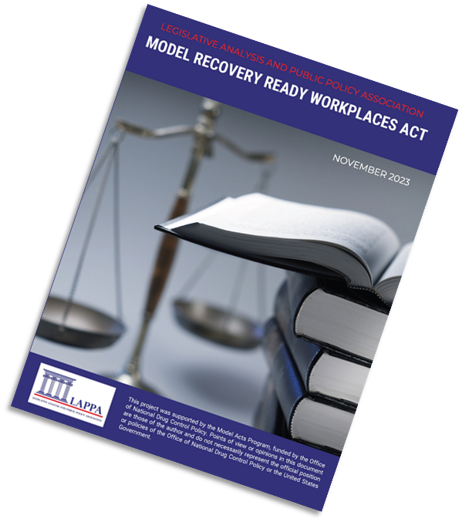
Model State Recovery-Ready Workplaces Act
Developed with input from expert stakeholders
Provides two-tiered approach—employers can become “participants” or “certified recovery-ready workplaces”
Encourage employers to institute workplace policies and procedures that:
Promote a culture that values a healthy work environment and offers opportunities for employee recovery and retention;
Help reduce occupational injuries and work-related stressors that may lead to substance misuse;
Encourage hiring of qualified people in recovery, including those with a history of CJS involvement;
Remove barriers to help-seeking for SUD; and
Support employees in maintaining recovery, wellness, safety, and productivity.
Establishes tax credit and stipend for employers that are certified as recovery-ready workplaces;
Creates state-based funding mechanism to implement program
https://legislativeanalysis.org/model-recovery-ready-workplaces-act/
Notes:
The model law provides a broad template that states can customize to meet their needs. It builds on and incorporates approaches different states have adopted. We recognize that there is no one right way to go about doing this, although we do believe that there are certain key elements that are essential to success and did put a premium on keeping it simple. For example, we reviewed a range of incentive and offset approaches different states have adopted, such as workers compensation premium offsets or tax credits for hiring individuals who are in recovery. In the end, we opted to propose a tax credit for becoming certified as a recovery-ready workplace and a corresponding subsidy for nonprofit employers who become recovery-ready. We felt this would reduce the administrative burden on employers and on the state and make the incentive simpler and more salient. We don’t believe the incentive is a sine qua non of success, because we believe strongly that employers will benefit from becoming recovery-ready, particularly in a time when many parts of the labor market remain tight.

Slide 10
Why Adopt RRW Policies?
SUD in the workplace is common and costly
Employment helps build & sustain recovery
People in recovery can be among the most motivated and dependable workers
Termination or threat of discipline in response to substance use in the workplace costs employers and discourages help seeking
Companies that hire people in recovery and adopt RRW policies can be recognized as a community partner and asset.
Provide a mechanism to access under-tapped segments of the workforce

Slide 11
Business Case
Most U.S. Adults with SUD are employed:
In 2022, 30.6 million adult Americans with an SUD were employed. Of these, 78 percent (23.8 million) worked full-time. SAMHSA (2023). Results from the 2022 National Survey on Drug Use and Health: Detailed Tables
Untreated SUD is costly:
Estimated average per capita annual cost of employees with untreated SUD ranges from $2,689 in agriculture to $13,534 in the information and communications industry. Goplerud at al. (2017)
A 2021 CDC study estimated that opioid use disorder and fatal opioid overdose cost the United States economy $1.02 trillion in 2017. Florence et al. (2021)
Recovery saves money:
Each employee in recovery saves employers from $1,155 annually per capita in agriculture to $8,466 per capita in the information and communications sector Goplerud at al. (2017)
Participation in the Flight Attendant Drug and Alcohol Program (FADAP) was associated with an estimated average savings to employers of $780 per participant per month FADAP (n.d.), Jacobson Frey (2022)

Slide 12
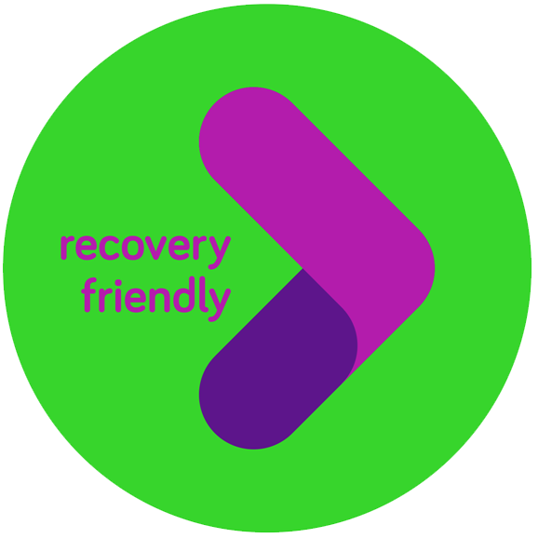
Key Components of RRW Initiatives
Clear standards/criteria
Consultation/support
Certification
Branding
Peer-to-peer consultation support (B2B)
To Consider
IPS and/or networks involving treatment providers, recovery residences, recovery community organizations, and employers
Tax incentive/other incentive
Notes:
“OUR LOGO—WHAT DOES IT MEAN?
The Recovery-Friendly Hamilton County checkmark symbolizes our endorsement of a business as meeting our recovery friendly requirements. The road within the checkmark symbolizes the “Road of Recovery,” an important visual metaphor for people who have overcome substance use disorder. Recovering citizens are resourceful, resilient, and ready to work! We want our symbol to bring them a feeling of pride for their strength and tenacity.”

Slide 13
Summing it Up
Adopting RRW policies is not simply the right thing to do—it makes good business sense.

Slide 14
Thank You
Peter Gaumond, Senior Policy Analyst, ONDCP
Email: ggaumond@ondcp.eop.gov

