Slide 1

What Data Says About the Housing Crisis
The National Association of Development Organizations (NADO) & The Development District Association of Appalachia (DDAA)
2024 Washington Conference
Betsy McGriff
Center for Economic Development Research
Georgia Tech, Enterprise Innovation Institute
www.cedr.gatech.edu
ENGINEERING YOUR ECONOMIC DEVELOPMENT SUCCESS

Slide 2

cedr.gatech.edu
Economic and Fiscal Impact Assessments
Strategic Planning: City, County, Regional, State
Labor Market Analysis and Workforce Development
Cost of Community Services
Economic Recovery and Resilience
Housing Market & Needs Analyses
Downtown Development and Real Estate Redevelopment
Basic Economic Development Course, IEDC
Research Assistance Grants – EDRP
Georgia Artificial Intelligence Manufacturing (GA-AIM)

Slide 3

Post COVID Trends
Impacts
60% Small Business Failure
Remote Work, Telecommuting
Online Shopping
Migration Acceleration
Supply Chain Disruption
Reshoring and Friendshoring
Central Business Districts
Rising Inflation
Increasing Interest Rates
Bank Failures, Lending Impacts
Automation and AI

Slide 4
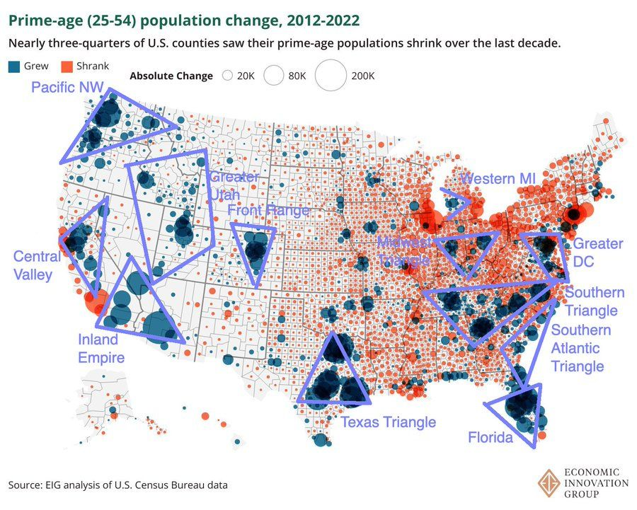
The Great COVID Migration

Slide 5
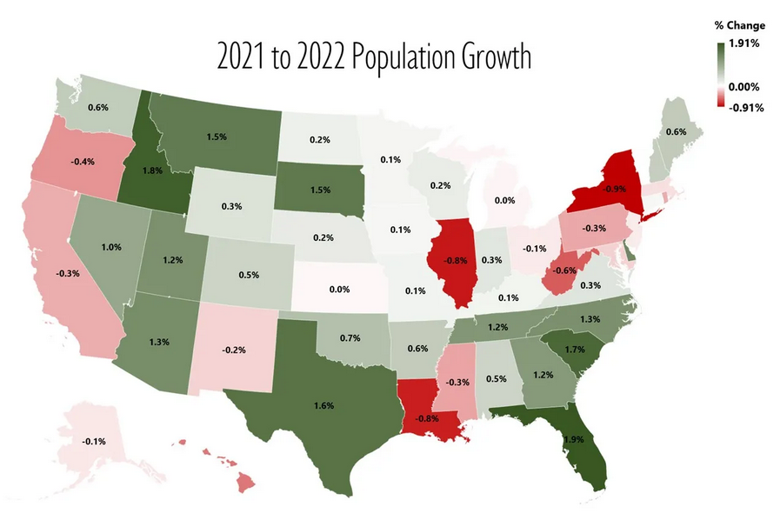
Post COVID State Winners
Top States 2021-2022
Florida (318,855)
Texas (230,961)
North Carolina (99,796)
South Carolina (84,030)
Tennessee (81,646)
Georgia (81,406)
Arizona (70,984)

Slide 6
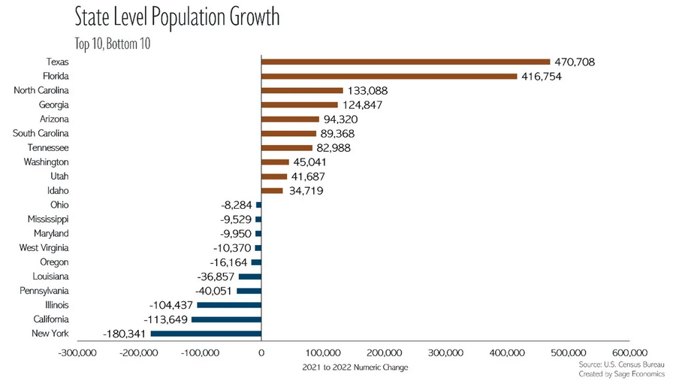
State Migration Totals

Slide 7
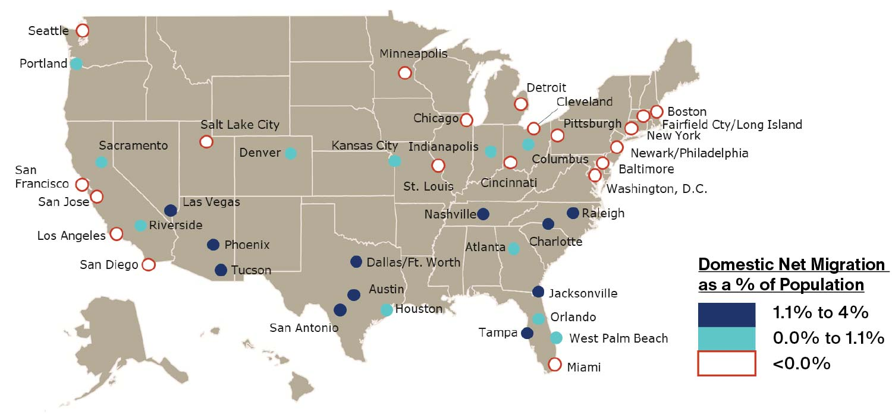
Post COVID Metropolitan Winners
Top Cities 2021-2022
Dallas/Ft Worth
Austin
Tampa
Nashville
Charlotte
Raleigh
Phoenix

Slide 8
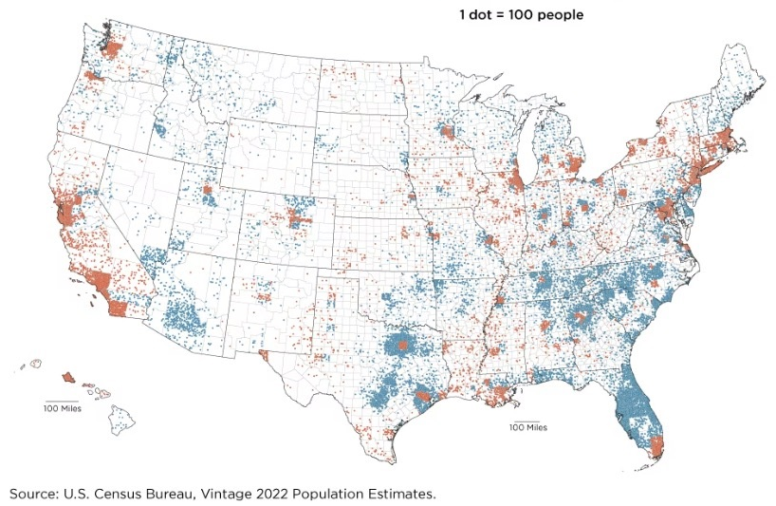
City vs Suburb Relocations
Reasons for Relocation
Quality of Life
Crime
Cost of Living
Business Environment
School Quality

Slide 9
Housing
Nationwide:
4 million housing units short
9 million affordable units lacking (< 30% gross income)
Interest rates are 8% for < 740 FICO
Housing market frozen
Move-up buyers limited
First-time buyers locked out
As rates rise, prices will decline
ENGINEERING YOUR ECONOMIC DEVELOPMENT SUCCESS

Slide 10
HOW DID WE GET HERE?
ENGINEERING YOUR ECONOMIC DEVELOPMENT SUCCESS

Slide 11
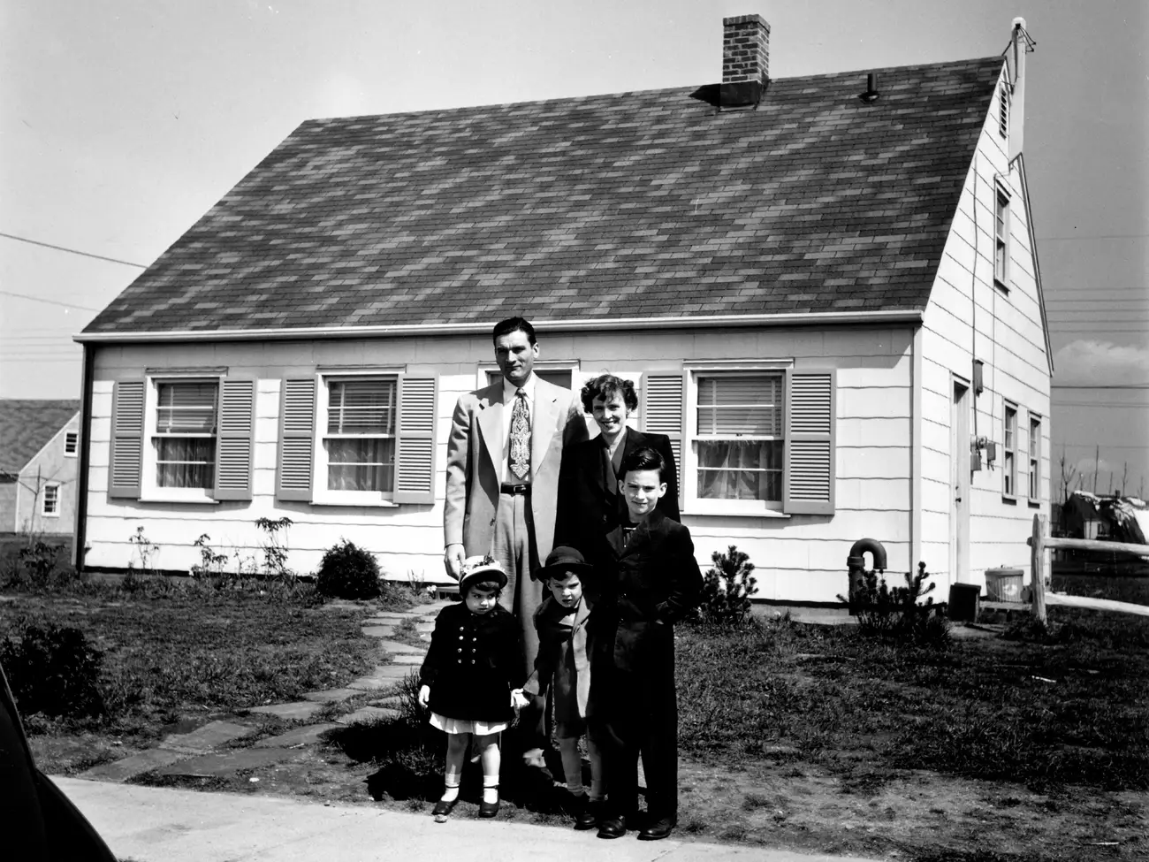

1950
2022
AVERAGE SF OF NEW SINGLE-FAMILY HOME
NUMBER OF PEOPLE PER HOUSEHOLD
SF OF LIVING SPACE PER PERSON
AVERAGE NEW
HOUSE PRICE
983
2,522
3.8
2.5
260
1,008
$12,000
($152,000)
$540,000

Slide 12

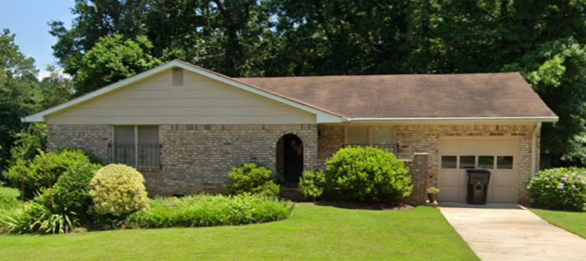
1950: $12,000 ($152,200)
1963: $18,000 ($177,000)
$Avg New Home Price
($Inflation Adjusted 2023 Dollars)
1972: $27,600 ($201,400)

Slide 13
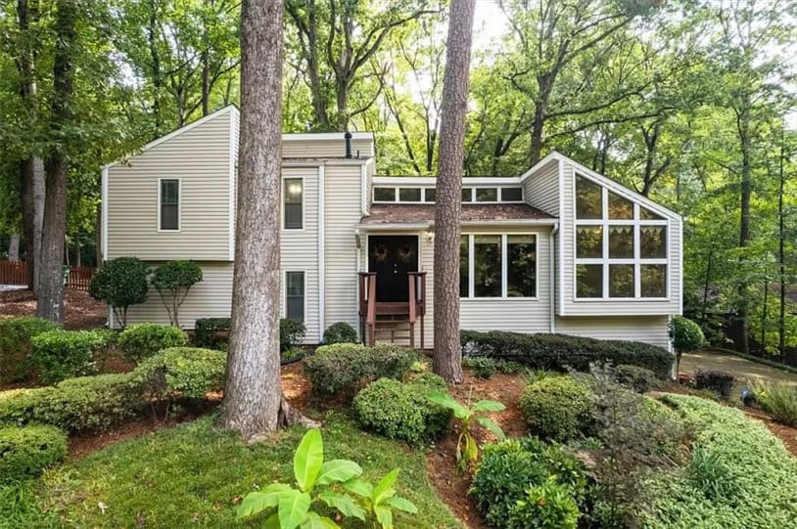
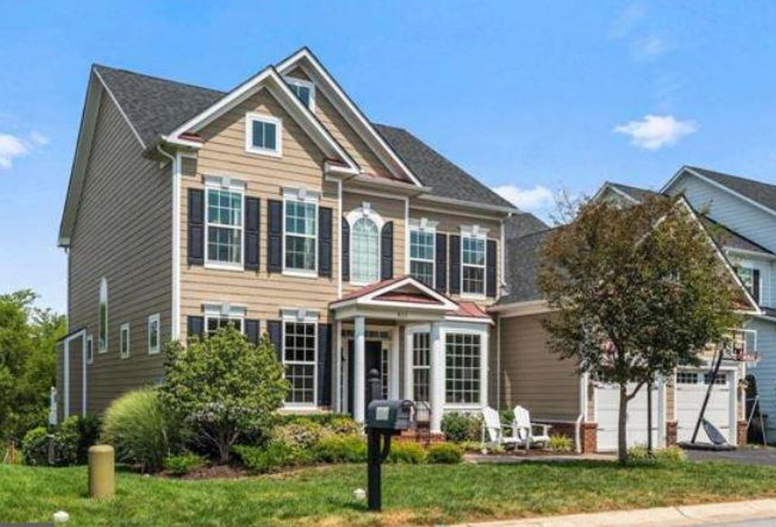
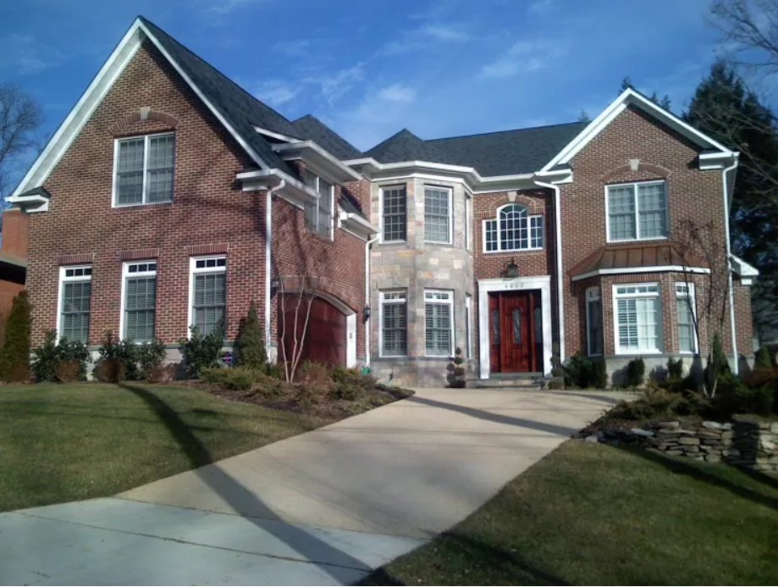
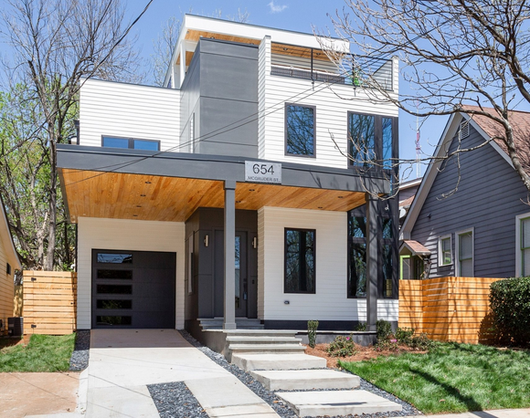
1985
1995
$101,000 ($286,400)
$158,700 ($318,000)
2005
2022
$Avg New Home Price
($Inflation Adjusted 2023 Dollars)
$297,000 ($464,637)
$540,000 ($557,200)

Slide 14
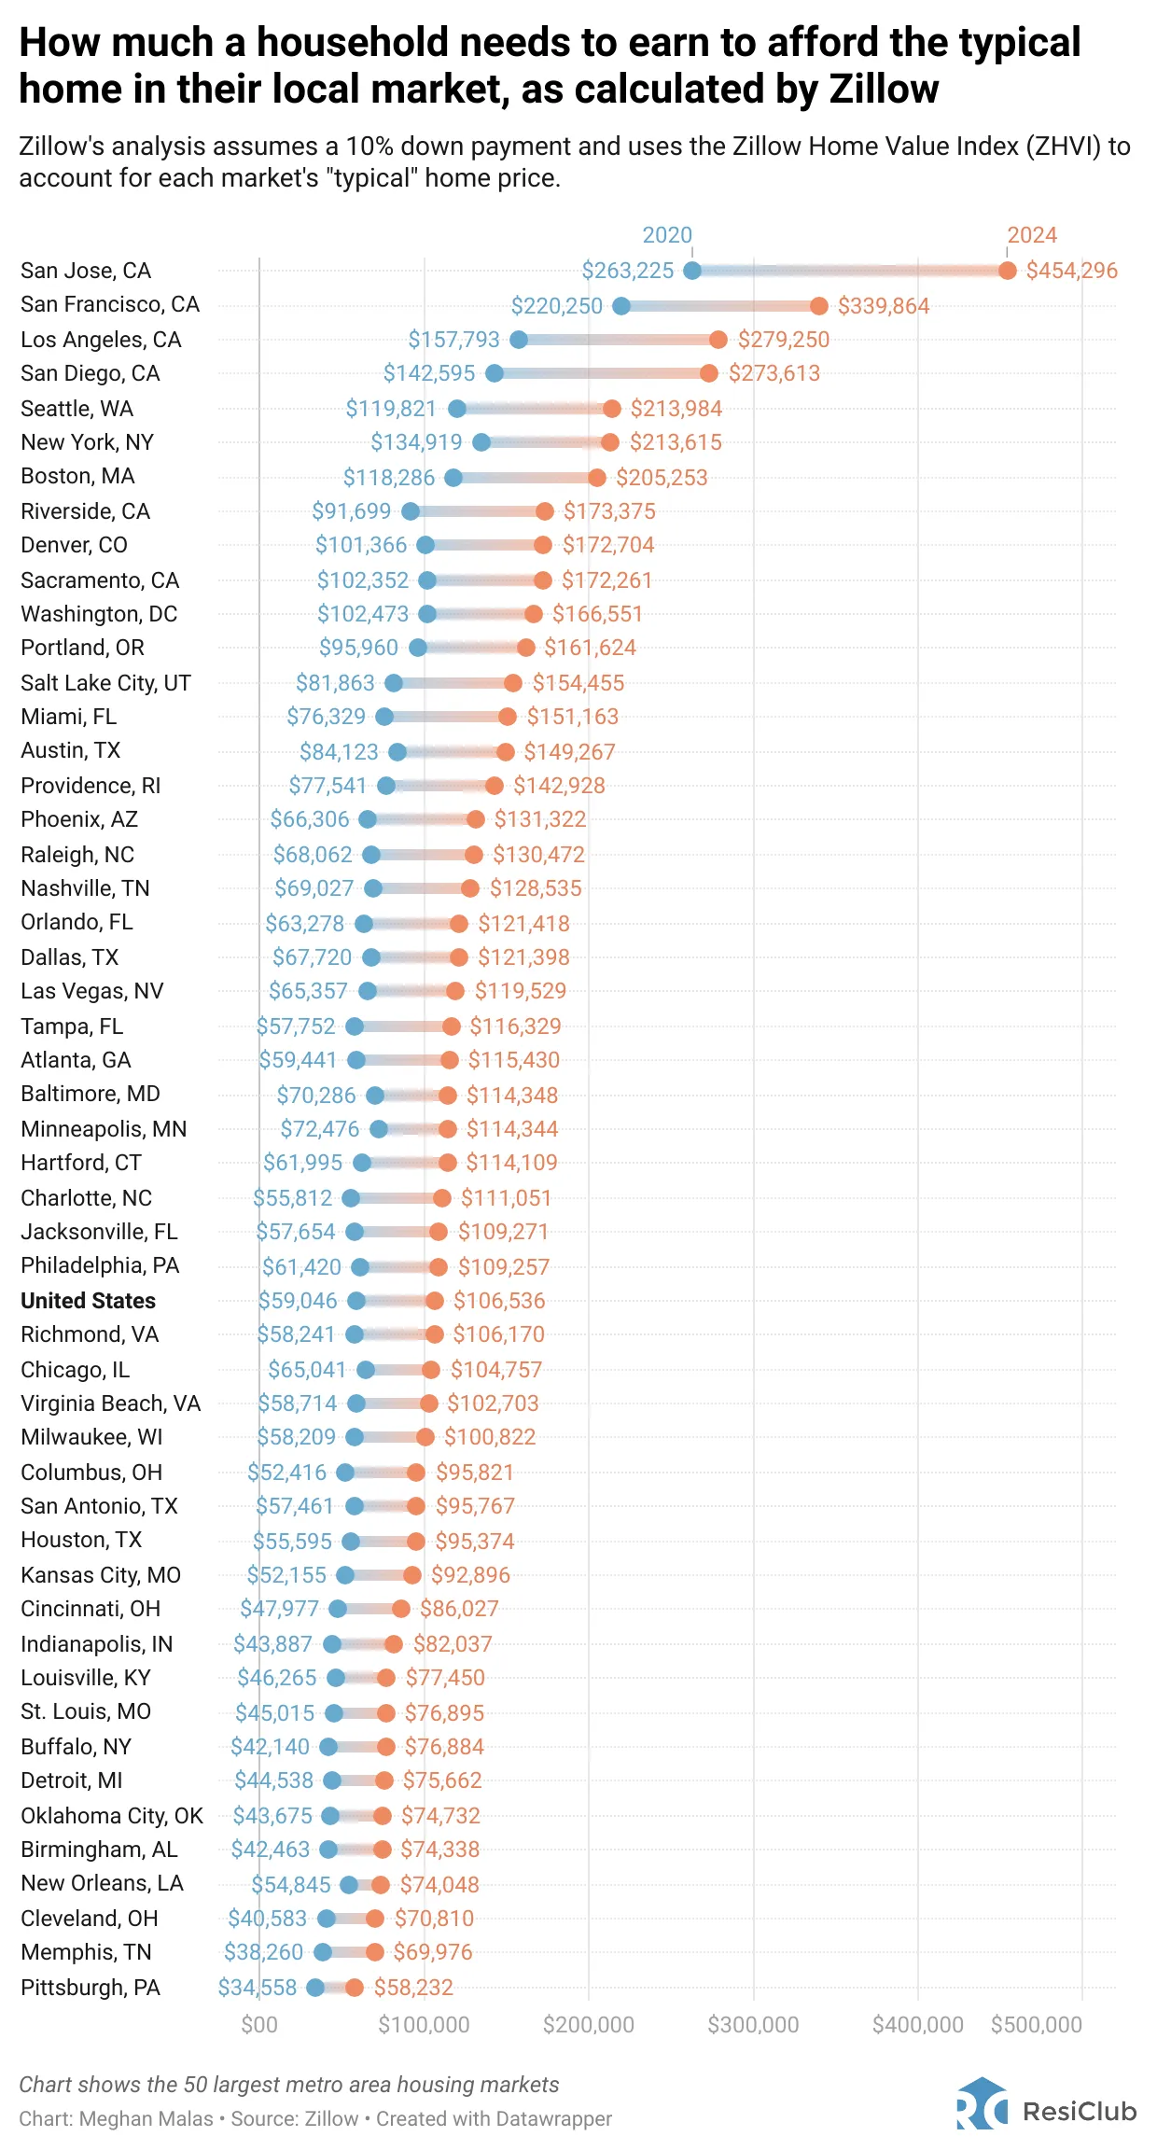


Drastic Decline in Affordability
In 2020, a household earning $59,000 annually could comfortably afford the monthly mortgage on a typical U.S. home, spending no more than 30% of its income with a 10% down payment. That was below the U.S. median income of about $66,000, meaning more than half of American households had the financial means to afford homeownership.
Now, the roughly $106,500 needed to comfortably afford the mortgage payment on a typical home is well above what a typical U.S. household earns each year, estimated at about $81,000.
2020 Mortgage Affordability
$59,000
2023 Mortgage Affordability
$106,500
Zillow: Income needed to comfortably afford a home is up 80% since 2020!

Slide 15
ATTRACTING INVESTMENT
Utilizing Data to Demonstrate Needs
ENGINEERING YOUR ECONOMIC DEVELOPMENT SUCCESS
Notes:
Talked about the larger market trends but now want to discuss data points and trends that can be pulled for your community
Data can be used to focus on attracting investment and growth and to manage growth-I know that we have a diverse set of stakeholders in the room with different markets and needs but a lot of this data is useful during each stage of your housing work
I know we have up there attracting investment but the data and analysis we are talking about can also be used to manage growth you are experiencing so you are pro active and not reactive

Slide 16



Demographics & YOUR Housing Market
Homeowners v Renter Data
  Age
  Income
  Length of Residency
  Future Projections
Existing Property Data
  Monthly Rents
  Layout Mix
  Vacancy
Public Housing Inventory
Community Resident Profiles
Comparable Community Analysis
ENGINEERING YOUR ECONOMIC DEVELOPMENT SUCCESS
Notes:
Example of some of the information that can be pulled for your community but is my no means a comprehensive list and the specific data pulled depends on the community we are working in
Sale value trends
Mortgage status-by age and by race
Cost burdened
Utility burdened
Vacancy rate
Do you have public housing, if so what does it look like, how old is it. If you have affordable housing with income restrictions when do they expire and how much of a role do they play in your overall housing stock?
Why is this important?
Helps determine your baseline and what your issues really are- sometimes the issues are what you think but oftentimes different issues arise out of this work. Also understand the magnitude of the problem and if the perception is worse than reality. If it is then how do you combat the perceptions of the problem and the actual problem?
How you are comparing to other communities your size and what strategies to focus on for your community to improve housing in your community
Helps you be ready for potential funding that becomes available-housing has become an important topic across the state of Georgia and the country so there are new funding sources all the time and being able to articulate your need and how you want to address that need is important. Having a document ready that answers these questions can put you ahead with funding opportunities.
Rural Workforce Housing Fund from the State
PRO Housing from the Federal Government
WORTH- Wealth Opportunities Realized Through Homeownership –private funding through Wells Fargo and is looking at closing the homeownership gap with metro Atlanta selected as one of the communities

Slide 17
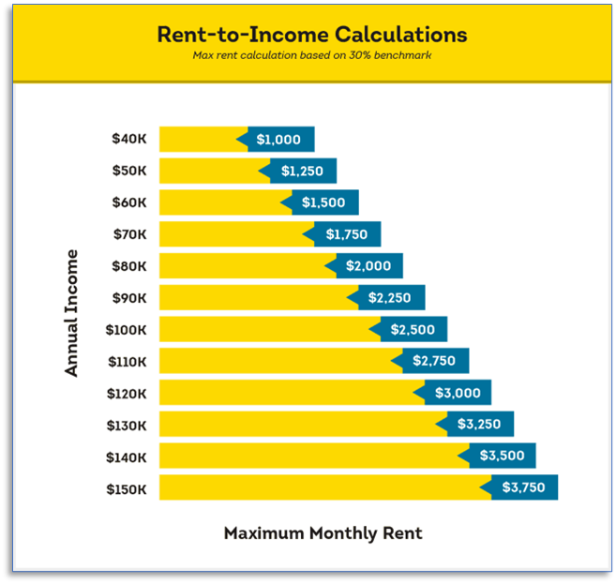
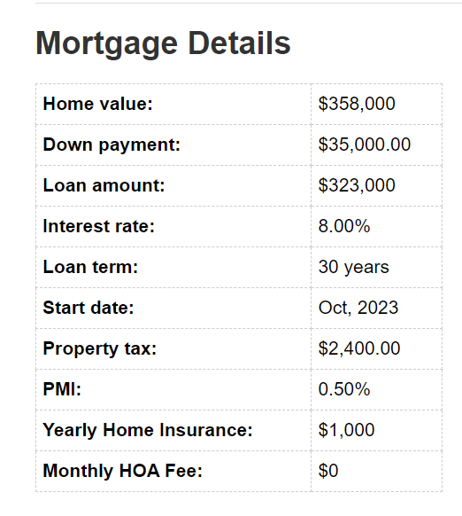
Affordability
Understanding what’s affordable AND community incomes is key to planning sustainable investments.
Monthly Payment = $ 2,788
Requires Annual HH Income of $110,000
Georgia Median Home Price = $358,000
Georgia Median HH Income = $61,224
Notes:
How many units can they absorb and what types of units do they need

Slide 18


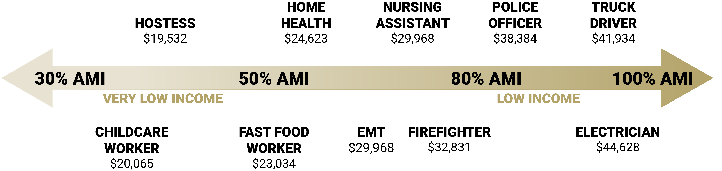


Income Visualization
ENGINEERING YOUR ECONOMIC DEVELOPMENT SUCCESS

Slide 19
Size Mismatch
Source: Social Explorer – ACS 2021 (%-Year Estimates)

Slide 20
Using Data to Tell Your Story
City of Anytown
929
3,017
2,272
Employees commute in each day
Employees commute out each day
Are in-commuters an untapped market?
Consider code enforcement goals and loss of housing to demolition
What is the age of your housing stock?
Employees live and work in Anytown
Projected Population growth (ANy County)
Notes:
On the slide are just some of the questions to ask when you are thinking about your community and housing needs
Commuters as an untapped market means also looking at your current supply and demand-what is the population projection? What are some known projects that could change this projection? This is one of the many reasons it is important to talk to your economic development folks to see what types of projects they are working on and hope to land and what the anticipated income are for these jobs
How is code enforcement in your geography? Are there issues that need to be addressed-how can you create a carrot and stick approach for dealing with code enforcement issues especially if homes with code enforcement issues are also part of your affordable housing stock – a partnership with code enforcement can be really important. Really partnerships across government sectors is important
What is the age of your stock and where is it located? Is it concentrated near a downtown or is it more suburban style? What types of housing are you currently supporting with your land use and capital improvements planning? Does your housing stock address the needs of the current population who lives in your community?

Slide 21

Notes:
ADUs
Rebuild like kind
Consider pre-approved plans
Density
Incentives

Slide 22




Providing Options for ALL Residents
Notes:
What we have been hearing a lot from communities recently-want to ensure that they have housing options for every stage of life in their community-this goes a long way with both attracting and retaining residents
A lot of communities are now in a situation where young people can’t afford to live where they grew up or seniors have no where in their community to go if they want to sell their house and downsize-which issues are your community facing and to what degree?
Have to be intention in your strategies to address these issues
We have talked a lot about numbers so far, but it is also important to talk to your local stakeholders to understand their challenges and any opportunities they see

Slide 23
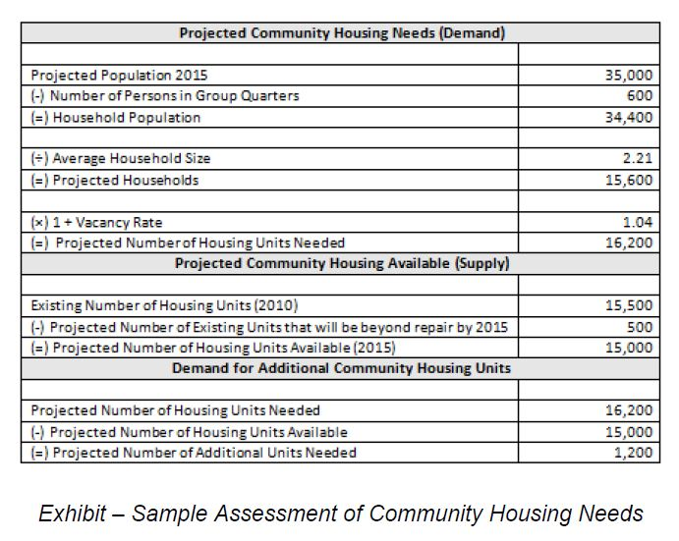
Housing Supply & Demand
Notes:
Mentioned earlier but we want to reiterate the importance of understanding the expected supply and demand of housing in your community so that strategies are in place to support a balanced supply and demand
Important to know how many units you need and what size units you need. Do you expect to need more one-bedroom units or are you expecting to need more larger units?

Slide 24
Site Identification and Marketing
Identify priority sites – greenfield and redevelopment - with proximate infrastructure. This will lower the development cost and efficiently use existing sunk costs.
Provide “proof-of-concept” for new types of development
Create marketing material for selected sites. At a minimum, the marketing material should include:
  Proof of housing demand
  Community commitment to quality housing
  Public infrastructure support
  Any available incentives
Establish an outreach plan for developers and share marketing material with them
Notes:
Example of some strategies that can come out of the data analysis

Slide 25
What do You Want to Know?
ENGINEERING YOUR ECONOMIC DEVELOPMENT SUCCESS

