Slide 1
Founded in 1990
Initial funding from DoD to support defense suppliers – mission has broadened
32 staff, multiple locations in West Virginia
Serves 300+ manufacturers & trains 900+ per year

Slide 2
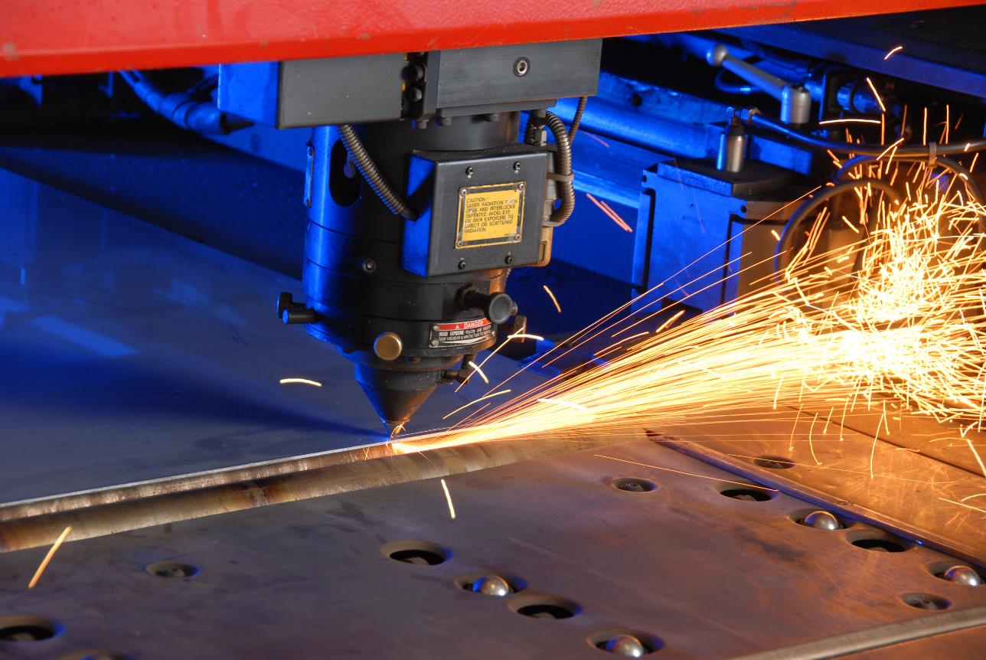
What We Do
For 34 years, we have delivered innovative solutions with leading-edge technology to advance manufacturing, entrepreneurship and
job creation.

Slide 3
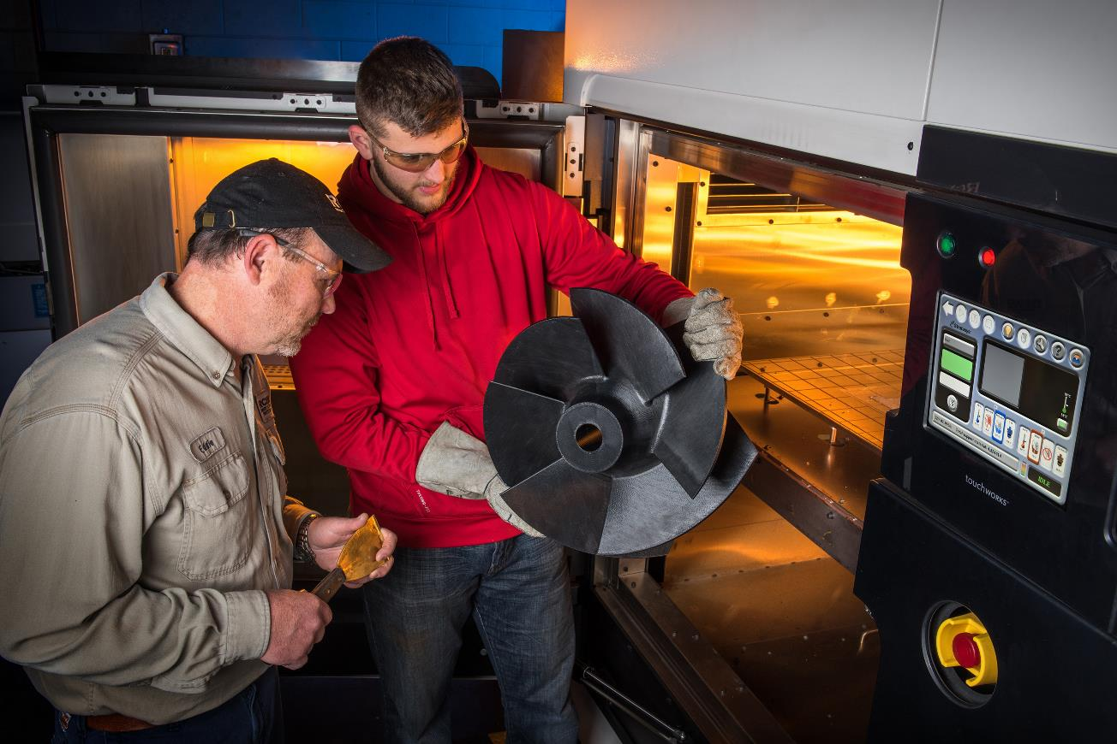
Technical Services
Applied Engineering, Shared Equipment & Private Sector IP
Engineering & technical team w/industry experience
$22million in leading-edge equipment
Multi-axis CNCs
Waterjet, laser cutters & injection molding
3D printing in polymers, resins, carbon fiber & metals
Design Engineering
Reverse Engineering
Product Development/Prototyping

Slide 4
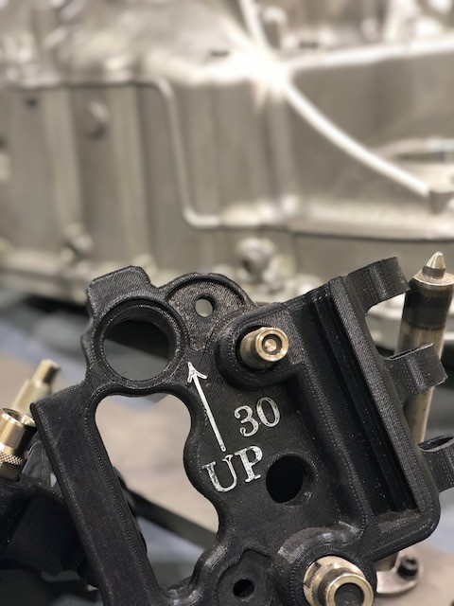
Design Engineering Case Study - Toyota
Transmission coupler jig
Reversed engineered transmission block & mapped connection points
Designed tool for teammates to more quickly test blocks
Repetitive stress & time savings
3DP en masse at MAMC using ULTEM or Carbon Fiber Nylons – multiple iterations developed
Toyota pays for these services & retains 100% of IP
Local Toyota engineering team won global Kaizen award
Jig is used worldwide
Dozens of other similar projects
Notes:
111,000 seconds per month savings at Buffalo plant
Kaizen award

Slide 5
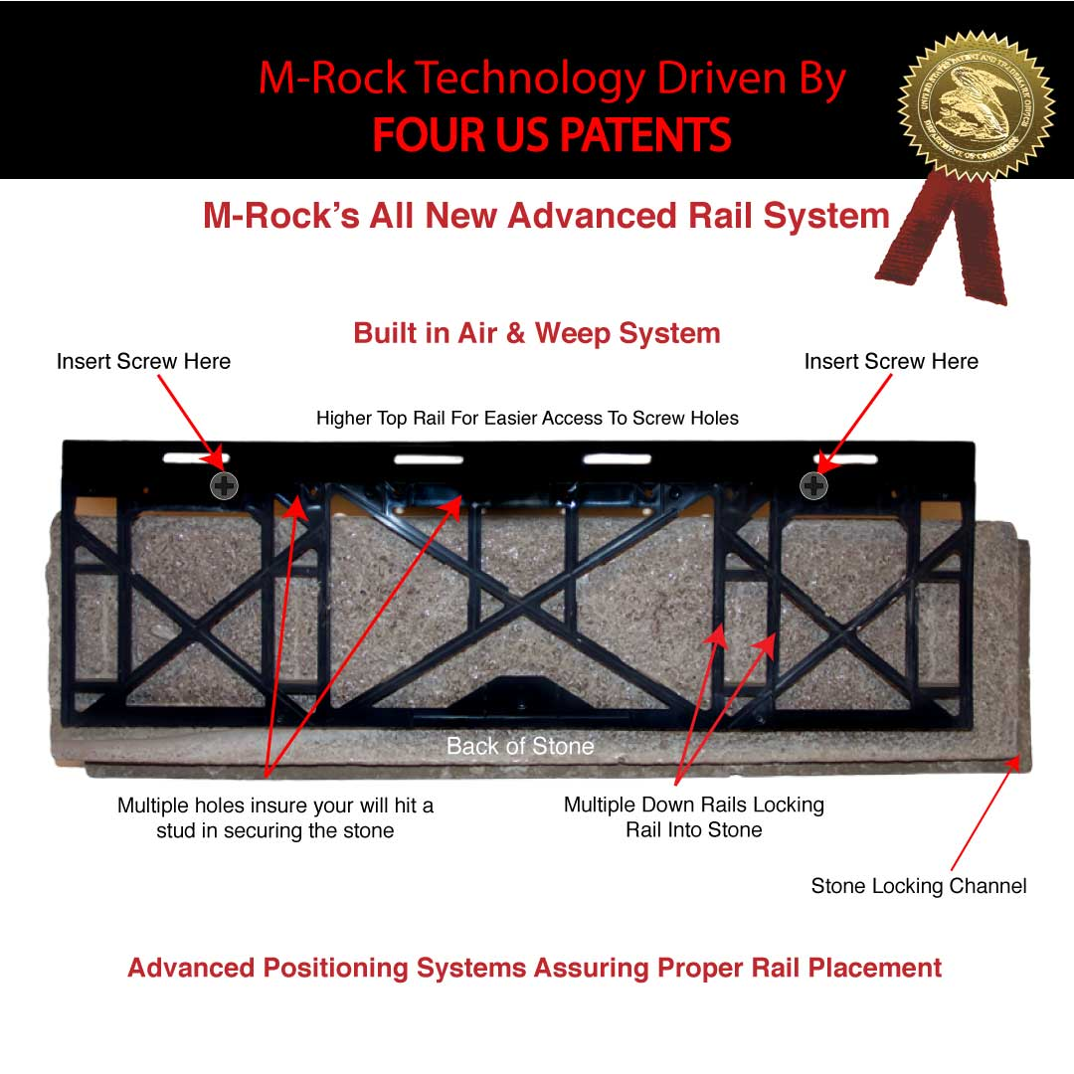
Entrepreneurship Success Story
M-Rock, a Monroe County landscape business, with two employees sought MAMC's help to design a DIY rock-façade hanging system
MAMC engineers designed rack & helped with molds
4 patents awarded, 100% of IP retained by M-Rock
M-Rock began direct to consumer sales
Connected M-Rock with PTI in Mason Co. to mass-produce plastic racks
M-Rock pours concrete into rock molds
Secured nationwide Lowe's sales order
M-Rock now has 23 employees and two PTI jobs supported
M-Rock currently working with MAMC on new product lines
m-rockstone.com

Slide 6
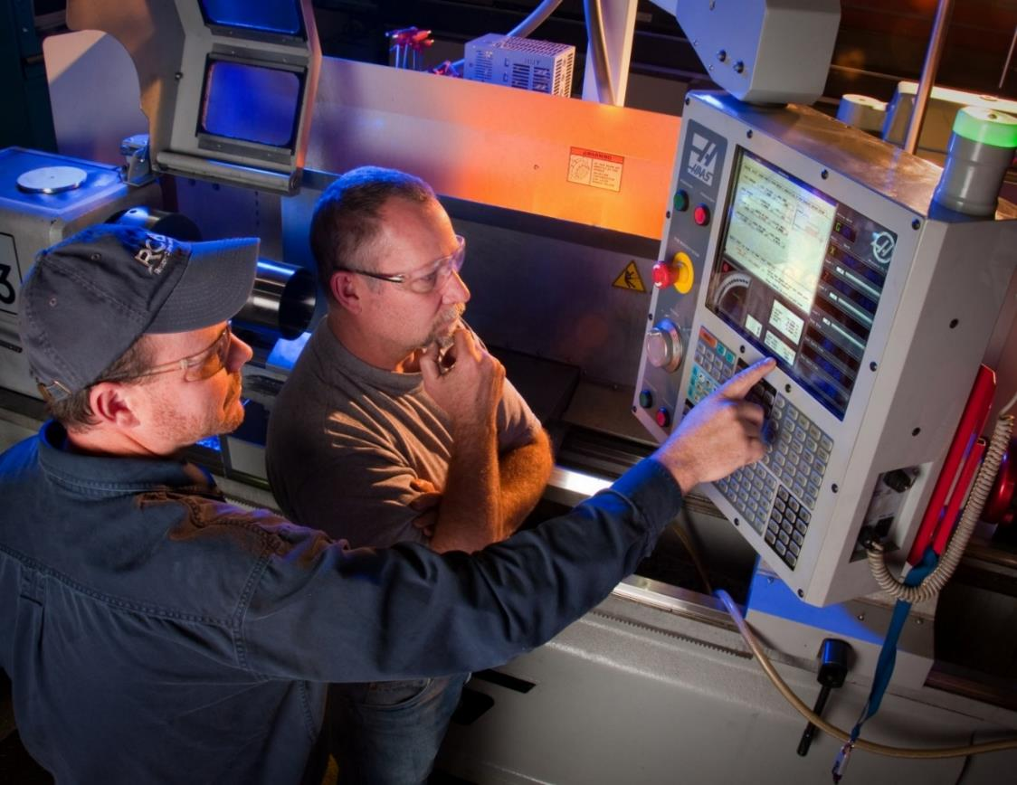
Workforce Development
Solutions for Industry & Individuals
Career Skills Programs
Customized Training
Apprenticeships & Pre-apprenticeships
Quality Implementation
Trained more than 26,000 individuals

Slide 7
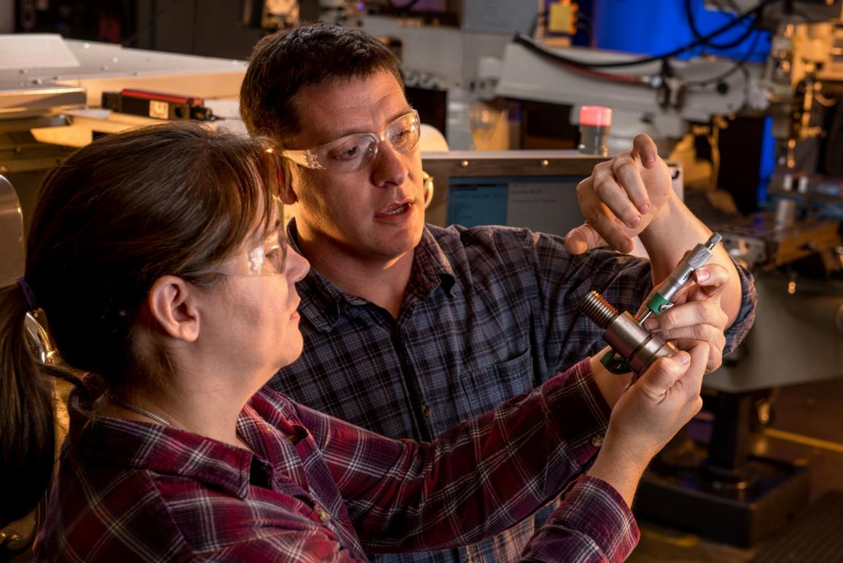
Career Skills Training for Individuals
Academic & Short-Term…with nearly 100% job placement
Associates Programs with CTCs
CNC/Machinist
754 completers, since ‘98
Welding
265 completers, since ’12
Students earn industry credentials (NIMS & AWS, over 2,400 earned
Short Term “Fast Track” options
Cohorts for Veterans, Youth, & Women
New “SMART” Industrial Maintenance tech program…

Slide 8
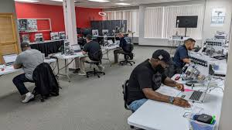
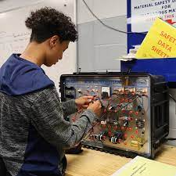
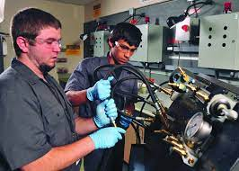
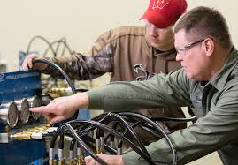
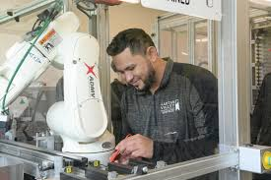
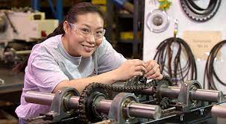
Systems Maintenance, Automation, & Robotics Technology program
new industrial maintenance skills program for 2024

Slide 9
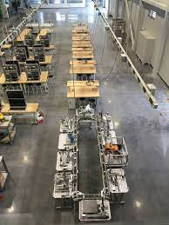
Systems Maintenance, Automation, & Robotics Technology program
To be offered at Point Pleasant & Huntington, Fall 2024
Academic partnership with Mountwest & MAMC
Associates Degree & Short Certificates
Students can earn industry credentials (NIMS)
Will align with new Marshall Engineering BAS well
Student track eligible for various financial programs
Direct, customized training for current industry employees
On-site at companies or at our training facilities
Workforce grants can subsidize costs often
High School pathways in 2025

Slide 10
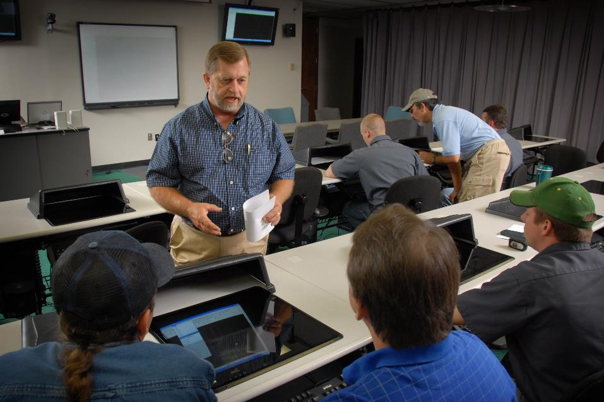
Customized Training for Companies
Flexible solutions for industry…on-the-job or at our facilities
Common examples:
CAD/CAM software training
Machine programming
Cross-training
Leadership
Supervisory
Root Cause
Precision measurement
Blueprint reading
Design engineering
Notes:
RECENT EXAMPLES:
Felman Production – AWS Welding evaluation, training, & certs – 19ppl
Northrup Grumman – Mastercam (yearly class, 6 current)
Walhonde Tool – Fast Track CNC – one week
Level 1 CNC efficiencies, tooling, tolerances, etc. 16 ppl

Slide 11
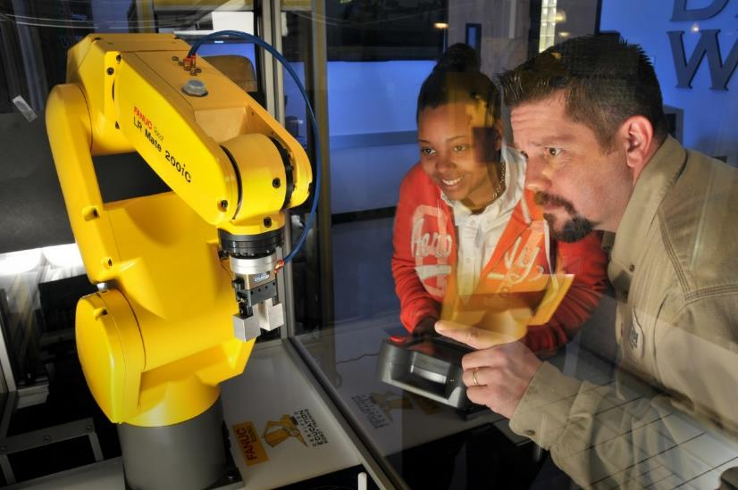
Manufacturing Apprenticeships
US DOL registered & funded nationwide effort
Common Occupations:
Additive Manufacturing/ 3D Printing Technician
CNC Operator/ Programmer
Assembly Technician
Tool and Die Maker
Maintenance Technician
Welding Technician
Industrial Manufacturing Technician
Machinist
Quality Control Technician
Composites Technician
Robotics Technician
Die Setter
Press Brake Operator
Press Operator
Molder
Core Maker
Pattern Maker
Maintenance Electrician
Engineering Assistant
Notes:
Apprenticeships in WV:
AHF Products (Beverly): Industrial Maintenance Mechanic
Brinker Machines (Leon): Precision Machinist
Cyclops Industries (South Charleston): Precision Machinist
Europtec (Clarksburg); Quality Control Technician; CNC Operator/Programmer
Gestamp (South Charleston): Tool & Die Maker; Industrial Maintenance Mechanic
Green Bank Observatory (Green Bank): CNC Operator/Programmer
Huntington Plating (Huntington): Precision Machinist
Koppers Inc. (Huntington): CNC Operator/Programmer
Level 1 Fasteners (Huntington): CNC Operator/Programmer; Quality Control Technician
Niche Polymer (Ravenswood): Electrician, Maintenance
Weyerhaueser (Buckhannon): Industrial Maintenance Mechanic
Weyerhaeuser (Sutton): Industrial Maintenance Mechanic
Navy 3DP techs

Slide 12
Quality Systems Implementation
Quality practices open diversification opportunities in new markets and ensure customer satisfaction with continuous improvement.
ISO 9001 Standards, including:
AS 9100 aerospace
IT 16949 automotive
ISO 14001 environmental
ISO 17025 testing labs
ISO 13485 medical devices
Lean & Six Sigma
Environmental & Energy
Leadership/Supervisor training
99 percent certification rate

Slide 13
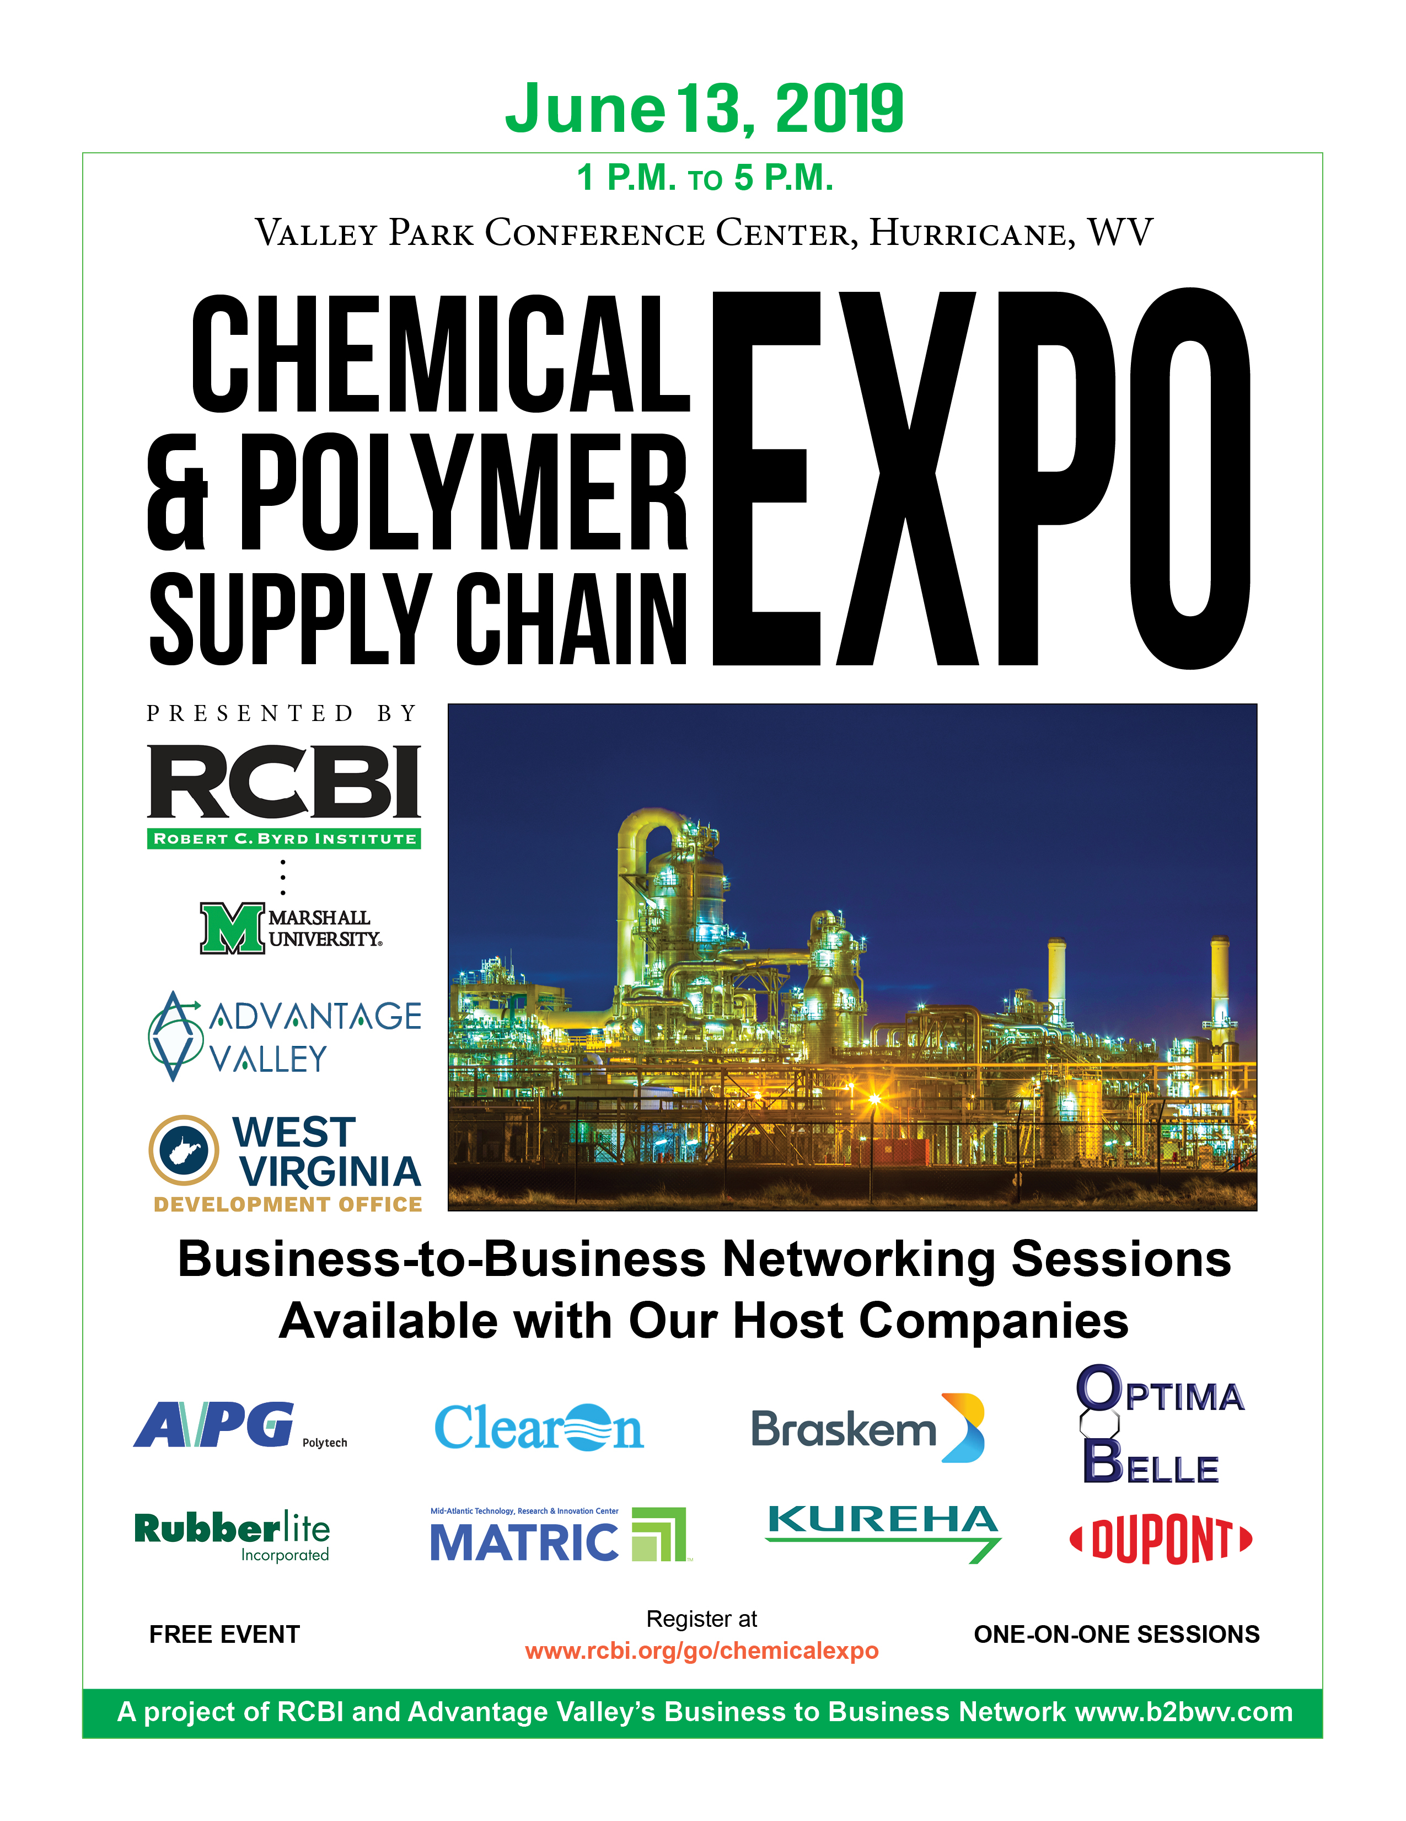
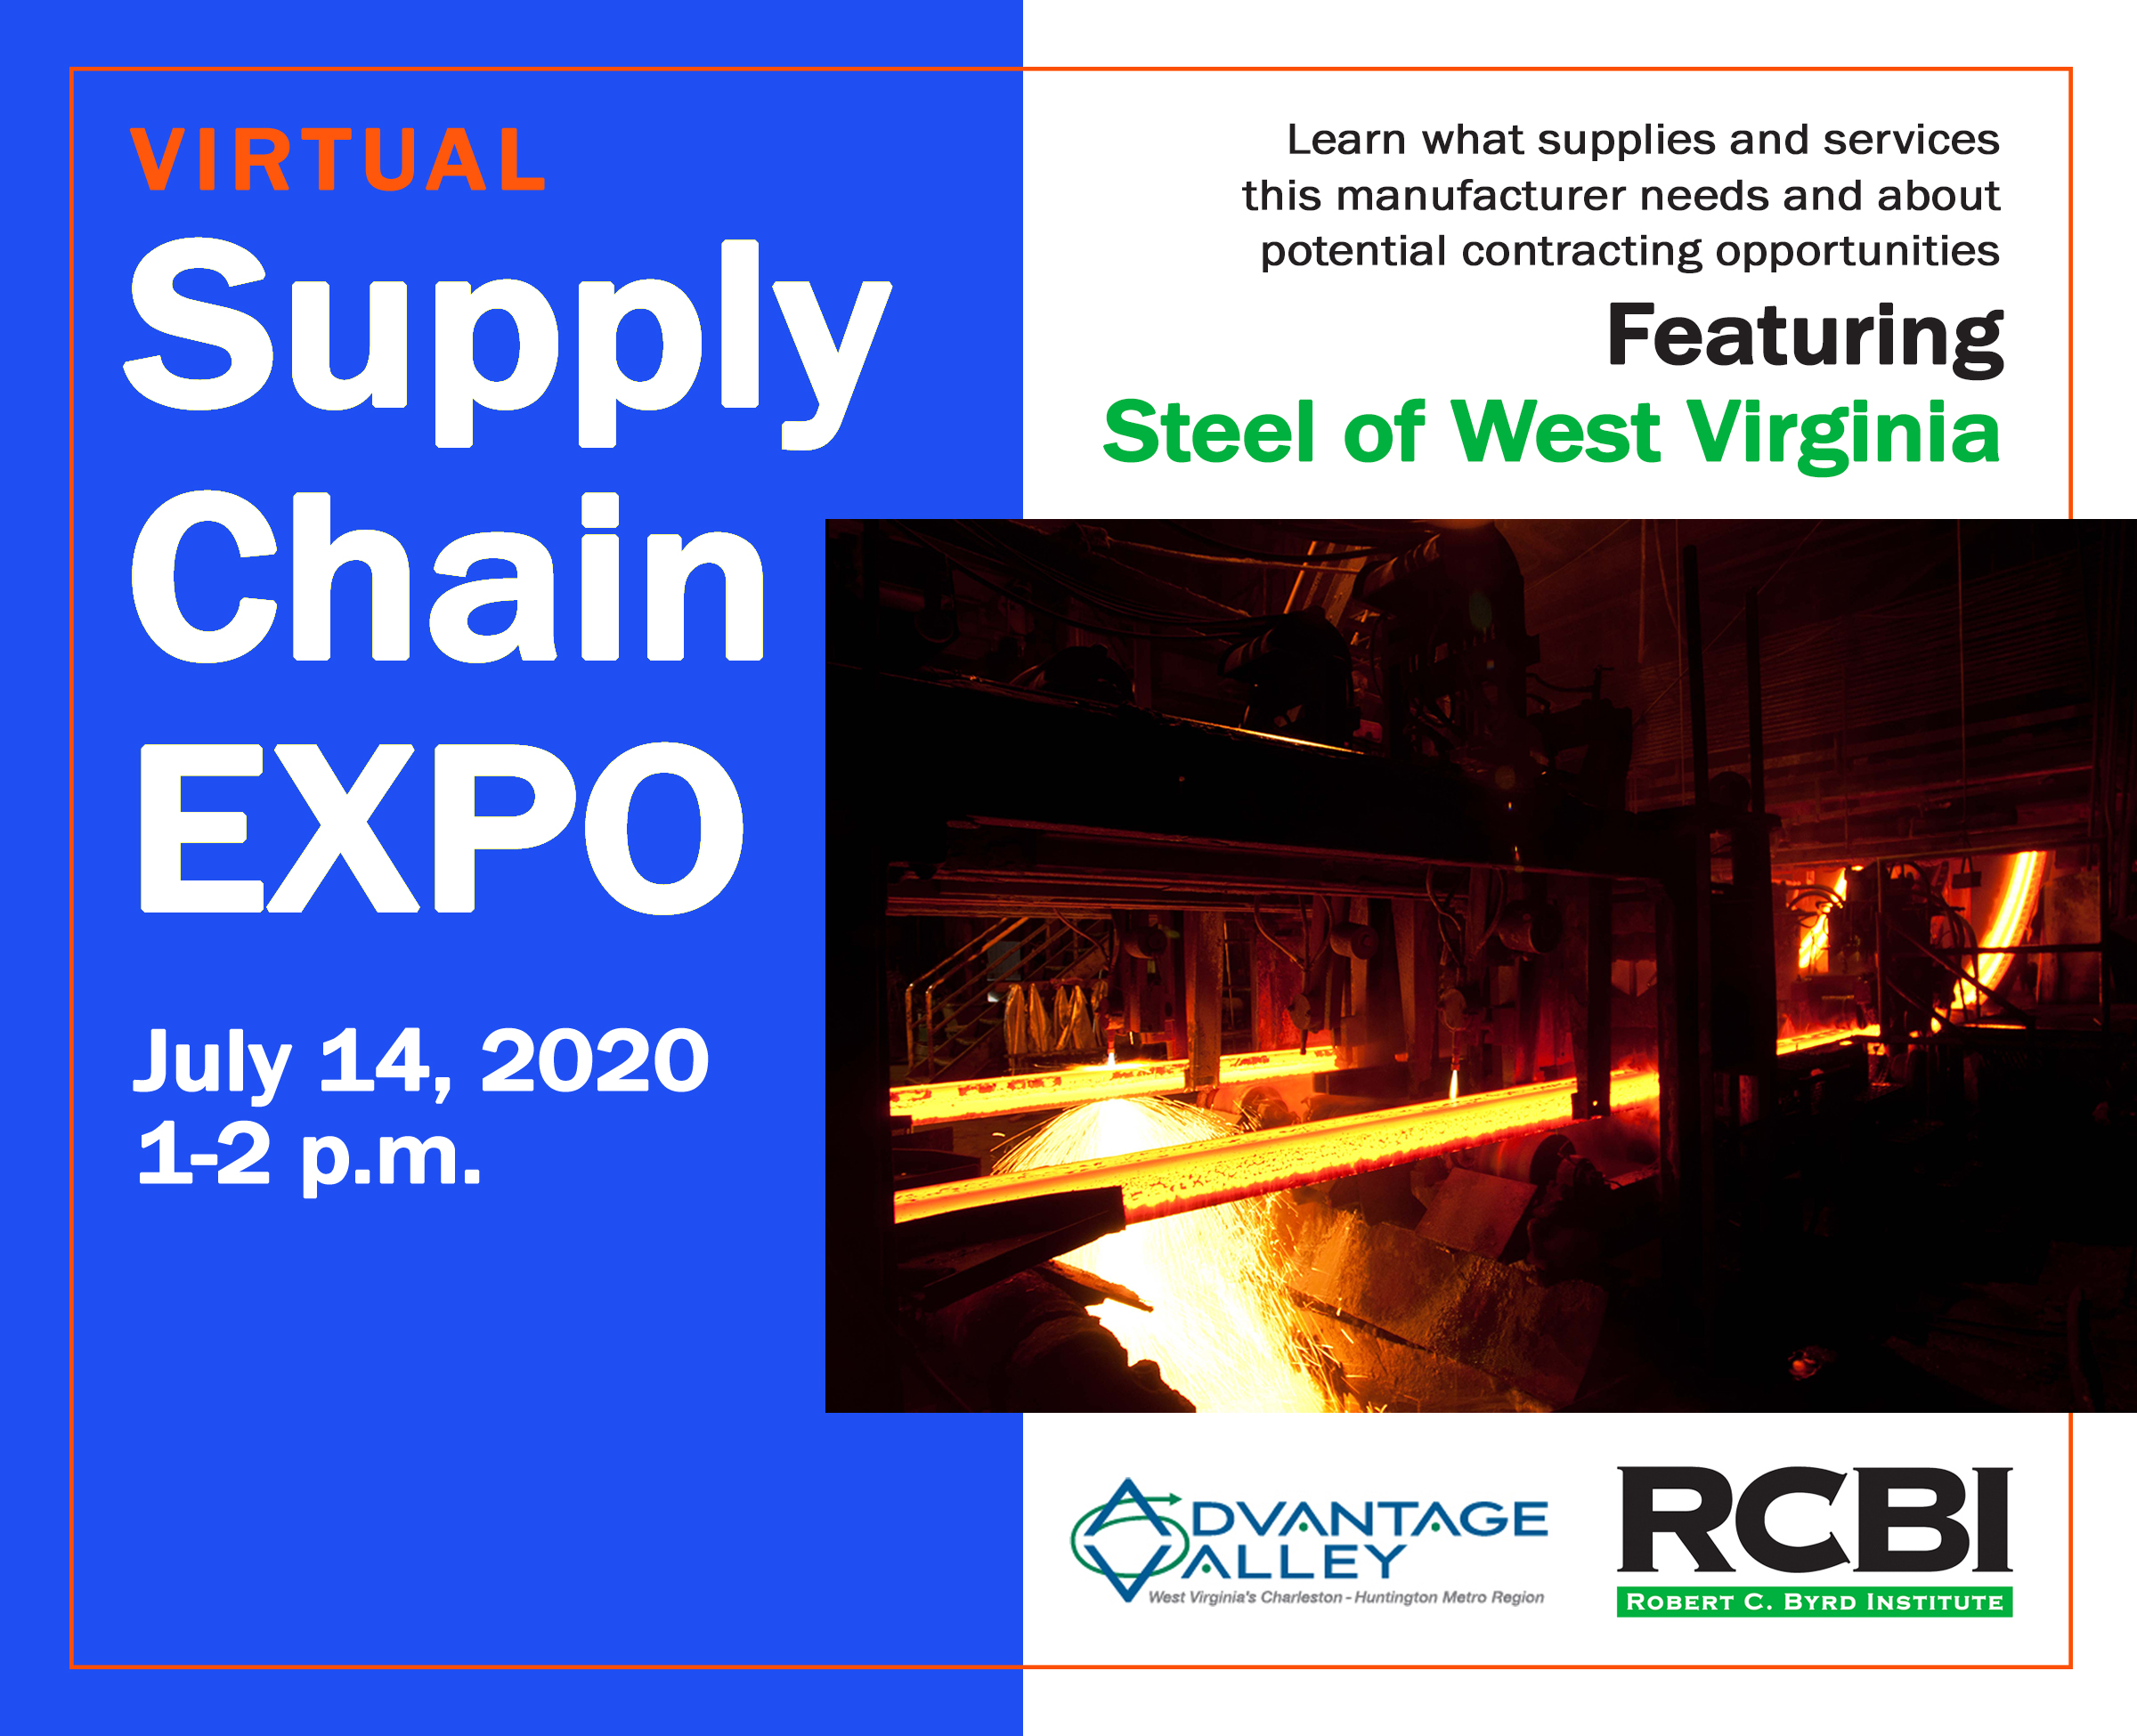
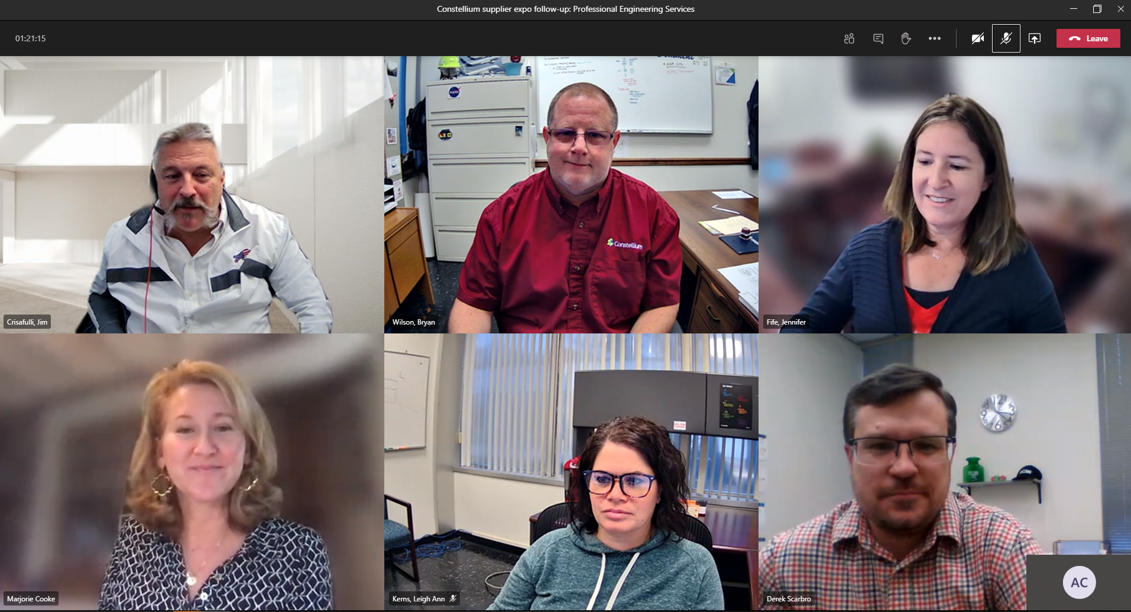
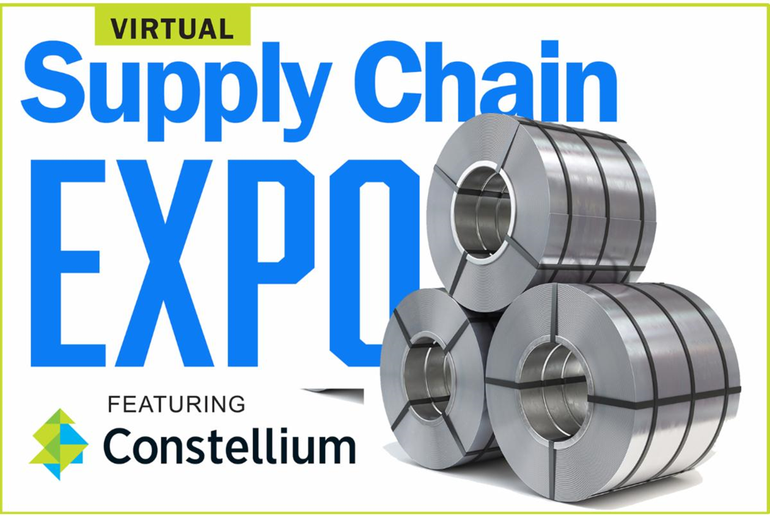
Supply Chain Support
Hosted 14 Supply Chain Expos for larger primes in region
We source suppliers to meet their specs
Hundreds of new B2B connections & contracts
MAMC can help suppliers earn needed certifications to compete for contracts
Government Contracting Support
Partner with local EDAs, Advantage Valley, etc.
Notes:
428 people/companies participated, 379 one-on-one mtgs arranged btw. the prime’s procurement staff and potential suppliers, 69 new contracts (that we know of)
WV DOH
Toyota
NGK
Sogefi
Braskem
DuPont
Kureha
MATRIC
Optima Belle
APG
Clearon
Rubberlite
Steel of WV (and sister co.s)
Constellium
Mountain Health Network
CAMC
Thomas Health Systems

Slide 14
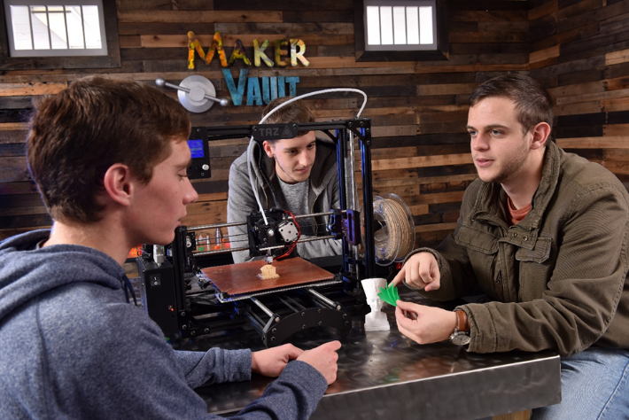
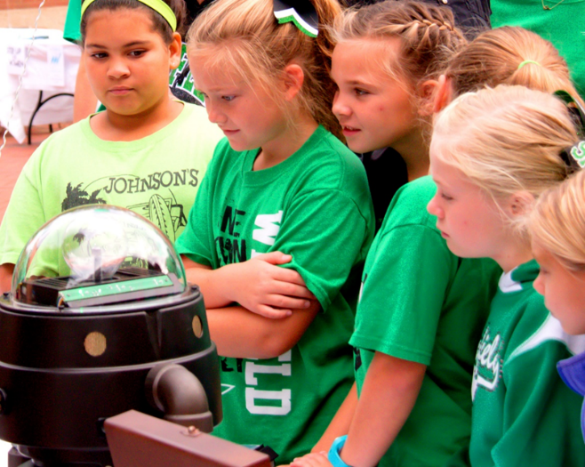
S.T.E.M. Education & Campus Maker Space
6,200 students each year
3D printing summer camps
NASA-VEX sponsored robotics competitions
West Virginia Makes Festival
Workshops and micro-credentials
Career and STEM fairs
Mentored drone teams & competitions
Maker Space memberships – as low as $25

Slide 15
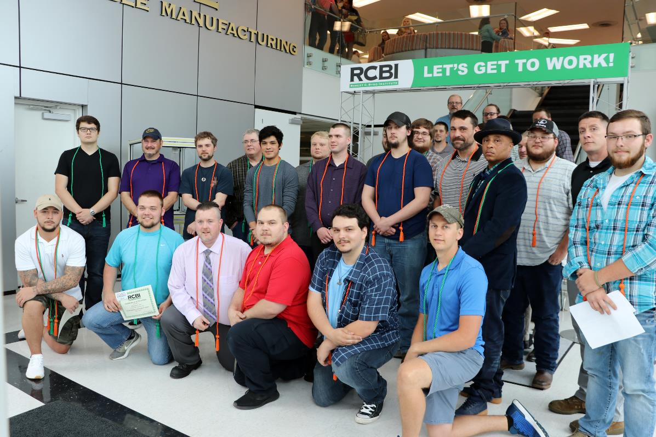
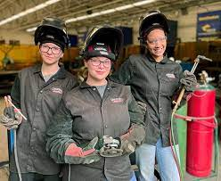
Let’s Get to Work!
Contact us to learn how we can
help you develop a new product, grow your business, connect to new markets, innovate and thrive!
304-781-1625
info@rcbi.org

