Slide 1
RURAL OPPORTUNITIES TO
USE TRANSPORTATION FOR ECONOMIC SUCCESS
Rob Hyman – US DOT
March 11, 2024
Contact Us!
Rural@dot.gov
www.transportation.gov/rural
ROUTES

Slide 2
Agenda
Introduction to ROUTES
Upcoming BIL Rural Funding
Resources and Technical Assistance
Notes:
Add or remove sections as needed.

Slide 3
About the ROUTES Initiative
The Rural Opportunities to Use Transportation for Economic Success (ROUTES) Initiative aims to address disparities in rural transportation infrastructure and improve safety, mobility, and economic competitiveness nationwide.
The ROUTES Office seeks to:
Engage Rural Communities through a series of events to better understand the needs and priorities of rural communities and collect essential data from stakeholders representing different communities, groups, workers, and industries to identify solutions.
Harmonize DOT Programs to implement rural policy by establishing the ROUTES Council to lead and coordinate Departmental activities to implement the Bipartisan Infrastructure Law and better align new and existing funding, financing, and technical assistance programs with the needs of rural and Tribal communities.
Utilize a Whole-of-Government Approach by partnering with other rural-focused federal agencies to expand DOT’s presence in rural America, better promote Departmental resources to their customers, and capitalize on synergies between federal funding programs.
Notes:
The ROUTES Initiative was established to be DOT’s front door for rural communities
And address the disparities in transportation infrastructure that negatively impact rural areas
We work in three main ways
First we engage with rural communities to understand the challenges they face in improving transportation infrastructure
Second, we work with DOT leadership to implement policy solutions that address these challenges
And third, we work across the federal government to enlist resources from other agencies to maximize our impact

Slide 4
Resources and Technical Assistance

Slide 5
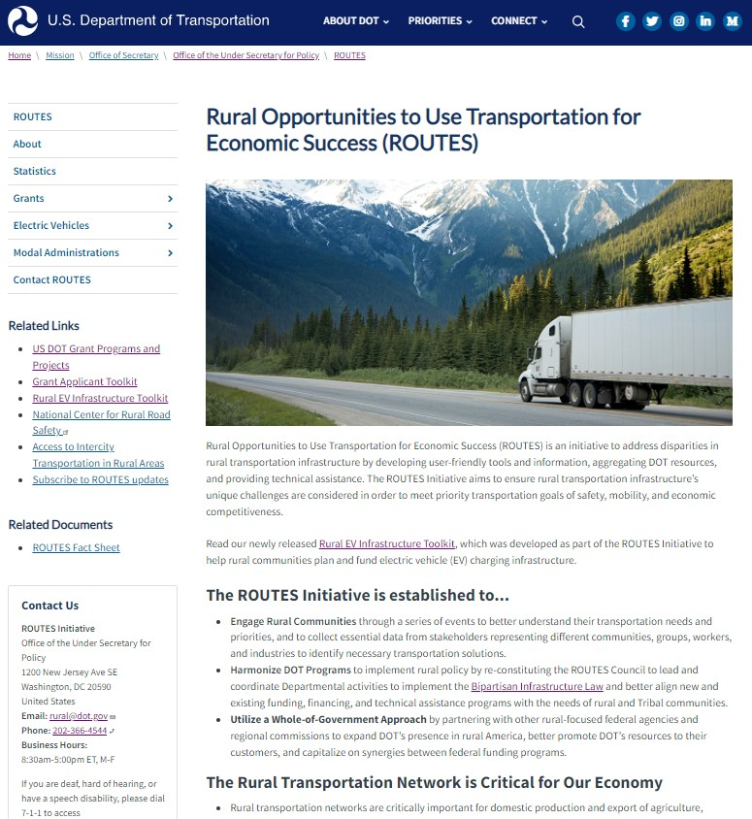
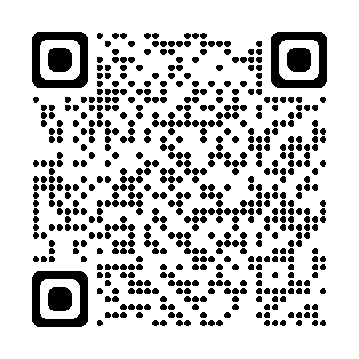
One-Stop-Shop for Rural Resources
The ROUTES website consolidates DOT’s rural resources in one place.
Webinars
Benefit Cost Analyses for Rural Projects
TIFIA Rural Projects Initiative
Transit Resources
National Roadway Safety Strategy
Tools and Toolkits
Rural Eligibility Map
Point of Contact Map
Grant Applicant Toolkit
Rural EV Infrastructure Toolkit
Funding Opportunities
Active & Upcoming NOFOs
Links to Past Awards
Modal Specific Landing Pages
Monthly Newsletters

Slide 6
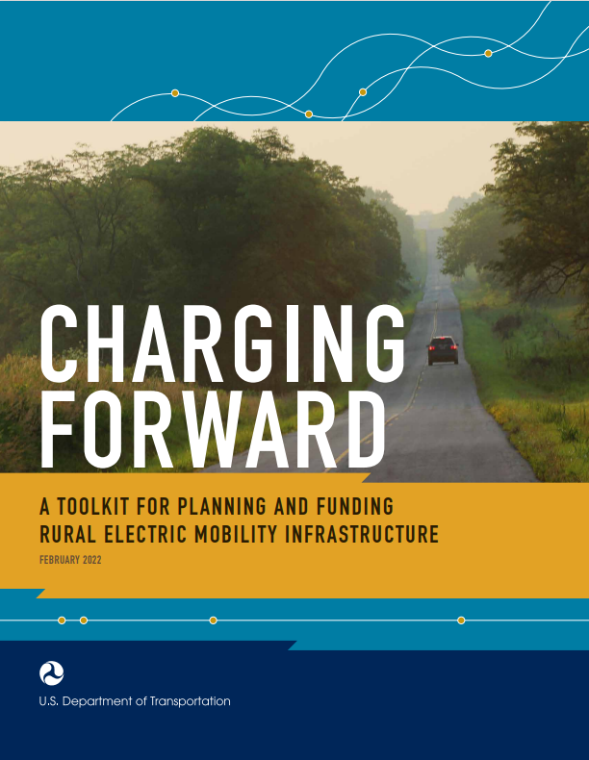
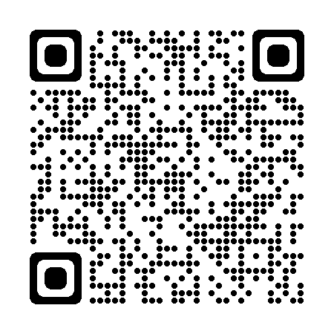
Rural EV Infrastructure Toolkit
Charging Forward: A Toolkit for Planning and Funding Rural Electric Mobility Infrastructure helps rural stakeholders scope, plan, and fund electric vehicle charging infrastructure.
TABLE OF CONTENTS
Electric Vehicle Basics
Benefits and Challenges of Rural Vehicle Electrification
Partnership Opportunities
EV Infrastructure Planning for Rural Areas
EV Infrastructure Funding and Financing for Rural Areas
INCLUDES…
Grant and loan opportunities
Planning tools and resources
Rural success stories
UPDATED (MAY 2023)
Stakeholder feedback
Expanded content on
Transit vehicles
School buses
Micromobility
Accessible design
New funding programs, including the Bipartisan Infrastructure Law (BIL)
National Electric Vehicle Infrastructure Formula Program ($5 billion)
Discretionary Grant Program for Charging and Fueling Infrastructure ($2.5 billion)
Clean School Bus Program ($5 billion)

Slide 7
Key EV Federal Funding Programs
DEPARTMENT OF TRANSPORTATION
Federal Highway Administration
National Electric Vehicle Infrastructure (NEVI) Program
Charging and Fueling Infrastructure (CFI) Discretionary Grant Program
Congestion Mitigation and Air Quality Improvement (CMAQ) program
Federal Land Access Program (FLAP)
Transportation Alternatives Set-Aside Program
Federal Transit Administration
Grants for Buses and Bus Facilities Programs
Office of the Secretary of Transportation
Rebuilding American Infrastructure with Sustainability and Equity (RAISE)
DEPARTMENT OF AGRICULTURE
Rural Development
Community Facilities Direct Loan and Grant Program
Rural Energy Savings Program
DEPARTMENT OF ENERGY
Vehicle Technologies Office
Funding Opportunity Announcements (FOAs)
Office of State and Community Energy Programs
State Energy Program (SEP)
Loan Programs Office
Title XVII Innovative Clean Energy Program
ENVIRONMENTAL PROTECTION AGENCY
Diesel Emissions Reduction Act (DERA) Programs
Clean School Bus Program
INTERNAL REVENUE SERVICE
Alternative Fuel Infrastructure Tax Credit
The Inflation Reduction Act (2022)
Includes provisions to revitalize American manufacturing and create clean energy jobs.
Will enable several new EV-related programs across multiple Federal agencies
Notes:
USDOT funding programs are listed by mode, and details on eligibility are given for each funding program.
Recently added DOT programs include the NEVI formula program created under BIL, with a total of $5 billion to be given to states through FY2026 to strategically deploy EV charging infrastructure, as well as the $2.5 billion CFI grant program, which is a competitive grant program to deploy alternative fueling infrastructure, with half of this funding prioritized for rural areas and low-and moderate-income neighborhoods.
Some USDOT funding programs such as the Transportation Alternatives Set-Aside Program can be used for micromobility projects.
The toolkit also includes resources outside of USDOT – including programs from USDA for rural development, DOE, EPA, and the IRS.
EPA’s Clean School Bus Program is another BIL program, providing $5 billion to help replace existing school buses with clean and zero-emission models.
The Alternative Fuel Vehicle Refueling Property Credit was expanded and extended to 2032 under the Inflation Reduction Act.
The funding section of the toolkit has more information on the typical grant award size for each program.
Also want to note that the Inflation Reduction Act, which was signed into law in 2022, will enable several EV-related programs across multiple Federal agencies, including USDOT, DOE, EPA, HUD, and the Department of the Treasury. Many of these new programs are not captured in the toolkit.

Slide 8
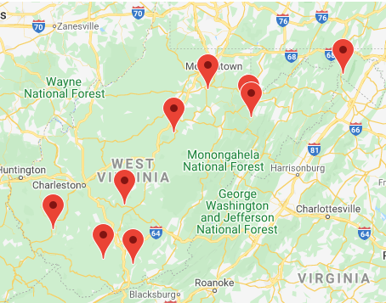
Success Story: Charging at WV State Parks
State parks in West Virginia attract visitors, shoppers, and diners through complimentary EV charging.
CHARGING AT STATE PARK LODGES IN WEST VIRGINIA
In West Virginia, EV charging stations are available at 9 of the 10 State park lodges in the State. Drivers can charge their vehicles for free, but lodge owners noted that while people are charging their vehicles they spend money at the lodges, including in gift shops and restaurants and for overnight stays.
Map of state lodge locations (top) and parking spot for EV charging (bottom) (source: West Virginia State Parks, 2022)
Notes:
To highlight a site host partnership success story:
West Virginia State Parks collaborated with the West Virginia Clean Cities Coalition to install Level 2 chargers at 9 park lodges throughout the state.
Park staff quickly found that providing free Level 2 charging boosted visitorship across the parks, and the folks using the chargers spent more time in gift shops, dining at park lodge restaurants, and even booking over night stays in lodge rooms and cabins.
All of which generated more than enough funds to make up for the costs associated with hosting Level 2 EV charging.

Slide 9
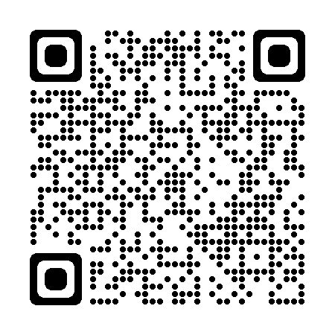
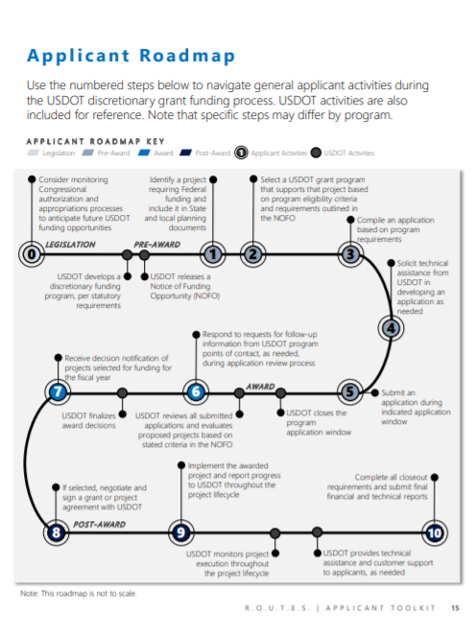
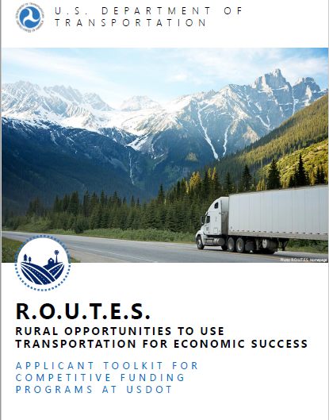
Rural Grant Applicant Toolkit
OVERVIEW
Helps project sponsors navigate the federal discretionary grant process.
Illustrates key applicant activities when participating in the USDOT discretionary grants process
Compiles helpful tools and resources for applicants to maximize the potential for award success
RECENTLY REVISED
Table of Contents
The Critical Role of Rural Communities in the U.S. Transportation System
Federal Funding and Financing
Who Is Eligible to Apply for Discretionary Grants?
The Grant Application Process
Maximizing Award Success
USDOT Discretionary Grant Programs
Non-USDOT Discretionary Grants: Agency Descriptions and Programs
Notes:
Toolkit originally developed in 2020 to guide potential applicants in identifying and navigating USDOT discretionary opportunities for rural transportation projects.
Major enhancements in this revision include:
Update to add new BIL programs.
Expansion to non-DOT federal grants, regional commissions.
Upgrade the static directory of grants to a live, searchable database.
All elements coordinated with and reviewed by OAs and the other federal agencies.

Slide 10
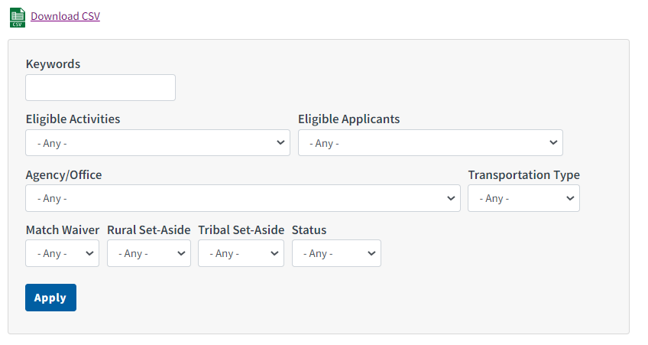
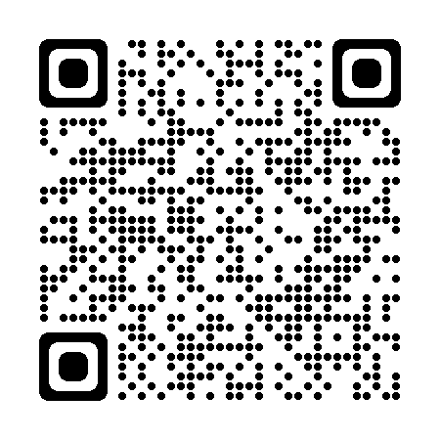
DOT Discretionary Grants Dashboard
HIGHLIGHTS
90+ grant programs
Covers DOT and Non-DOT Agencies
8 DOT Agencies
10+ Non-DOT Agencies
Multiple search filters
Keyword
Eligible Activities
Eligible Entities
Transportation Type
Match Waiver
Status (Open/Closed)
Customized features for Rural and Tribal communities
Save results as Excel csv file
Notes:
The dashboard provides an interactive way to search and filter through federal discretionary grant opportunities, based on your specific needs.
It includes over 90 grant programs across DOT and Non-DOT agencies
Ability to search and filter through grants by criteria such as activity, applicant, and transportation type,
It includes filters specially designed for rural and Tribal communities, so you can quickly identify programs that could have a match or set-aside benefit.
Finally, there’s also a function that allows you to download your results as an Excel CSV file, so you can then attach it to an email and share what you find with others.

Slide 11
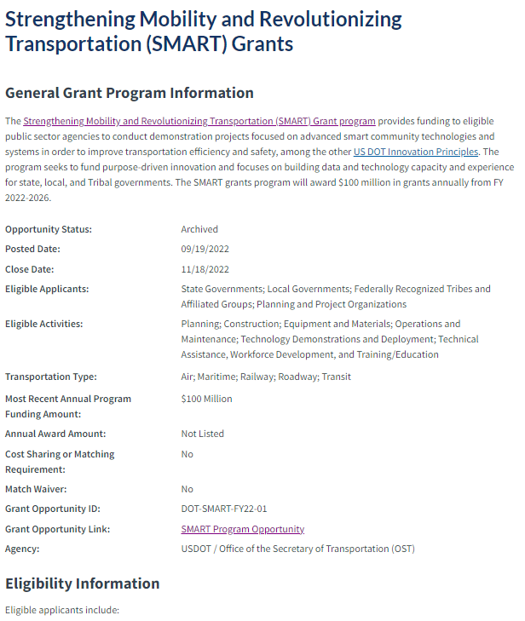
Dashboard Grant Pages
Brief summary
Current status
Eligible applicants, activities, and transportation types
Most recent annual program amount and individual award amount
Match waiver and applicant match requirement
Links to Grants.gov page and additional information
Eligibility, Funding, and Contact Information
Notes:
When you submit your search, it will generate a series of links to individual grant pages that look like this screenshot on the right
Each grant page can include a brief summary on the grant, funding amounts, information about match requirements, and links and point of contact where you can learn more about that grant .
The specific information that you see on the page will depend on what is available at the time.
It’s important to note that this dashboard is a broad overview of discretionary funding opportunities, secondary to the materials that the original program offices provide.
And that you should always refer to the materials from the specific program offices for the most up-to-date and comprehensive information on that grant.

Slide 12
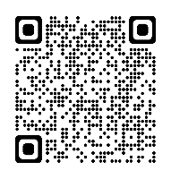
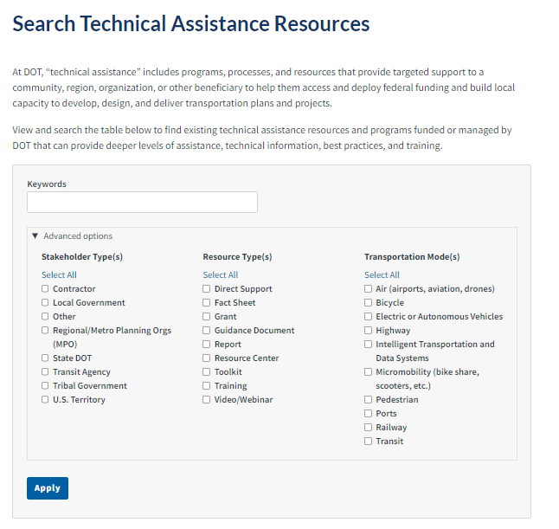
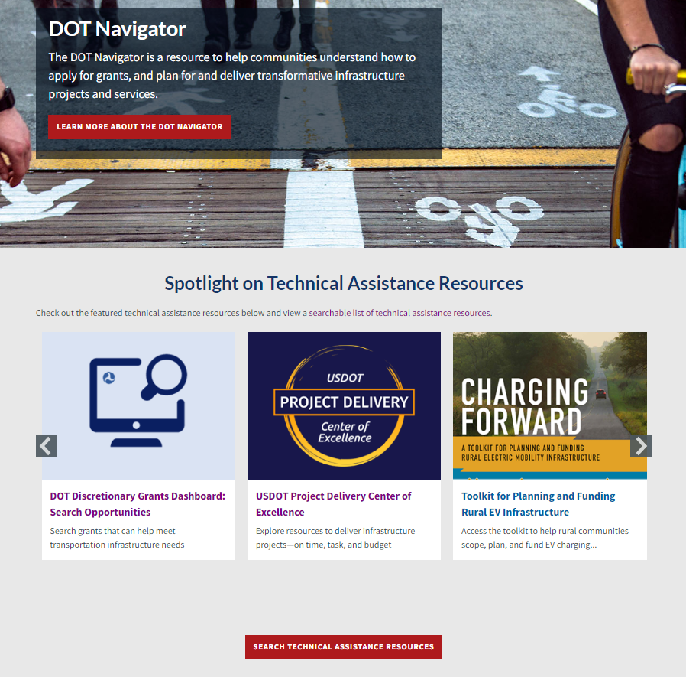
DOT Navigator
Notes:
DOT Navigator helps communities find grant opportunities and access technical assistance
Contacts to DOT regional/field offices
Grant writing resources
Various webinars
Best practice documents
Sample Grant Application Resources
How to Navigate Grants.gov to Submit Applications
Maximizing Award Success: An Introduction to Evaluation Criteria
Understanding Federal Match Requirements
What is a Benefit-Cost Analysis?
Email USDOTassist@dot.gov with additional TA questions

Slide 13
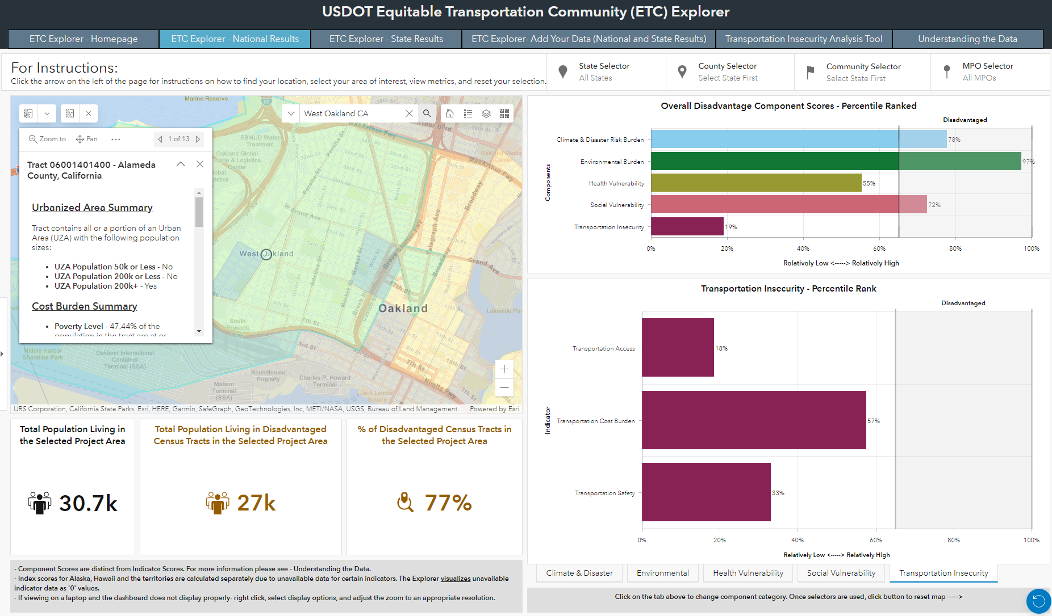
Equitable Transportation Community (ETC) Explorer
OVERVIEW: USDOT creates the first-of-its-kind transportation-specific tool, harnessing the latest census tract data across federally available data sources to provide users a centralized, easy-to-use platform that creates visibility into drivers of transportation disadvantage.
Transportation-specific disadvantage index Incorporates 40+ data elements across 5 categories of disadvantage: Transportation Insecurity, Health Vulnerability, Climate/Hazard Risk Component, Environmental Burden, Socioeconomic Vulnerability Transportation Insecurity & Access Tool (TIAT)* Visually displays the raw data for a select group of indicators related to cost, access, and safety at the state or national level, that reflect transportation insecurity. Latest Census Tracts Incorporates 2020 U.S. Census Tracts and data from sources including NOAA, USDOT, FEMA, EPA, Census Bureau, BIA, MRLC, DHS, CDC, DOI, and Esri.
KEY FEATURES & DATA
CORE USERS
USDOT Support agency-wide priorities and metrics for covered program impacts, distributional equity, and overall effectiveness Applicants Support program scope and application development based on transportation disadvantage insights about communities State Planners/MPOs Understand localized impacts within immediate region to support funding decisions and provide visibility into community impact.
*This is a tab within the ETC Explorer
Notes:
Using maps and data to tell your story
Federal + state and local data + qualitative/lived experience
Which tools to use when
What tools are required when making an application for a federal grant
General Dataset and Mapping Tools
General Dataset and Mapping Tools provides an interactive way to explore and analyze population characteristics of a geographic area to help identify the need for a project, including to identify populations that may be covered by Title VI and Civil Rights federal requirements.
Climate Change, Air Quality, and Sustainability Analysis Tools
Climate Change, Air Quality, and Sustainability Analysis Tools provides resources for measuring transportation greenhouse gas emissions and air quality impacts, and incorporating climate adaptation and resilience features as they relate to a proposed project.
Equity and Justice40 Analysis Tools
Equity and Justice40 Analysis Tools provides resources to identify a disadvantaged community that may face transportation burdens or be impacted by climate change, pollution, environmental hazards, and other social or economic impacts to analyze how a potential project may reduce those identified inequities. These tools can also be useful for analysis needed to address Title VI and Civil Right compliance.
Safety Analysis Tools
Safety Analysis Tools provides resources to help analyze and convey safety benefits and risks, demonstrate safety needs in a community, and communicate the overall impact of a proposed project.
Specialized Data Resources
Specialized Data Resources provides information often needed to prepare a benefit-cost analysis and examine recommended monetized values, and other resources specific to intelligent transportation systems.
Transportation Analysis Tools
Transportation Analysis Tools provides resources to better understand, plan for, and convey trends around efficiencies—including connectivity, access, and frequency—across a transportation system.

Slide 14
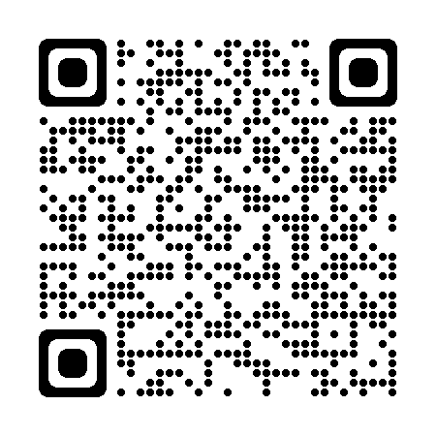
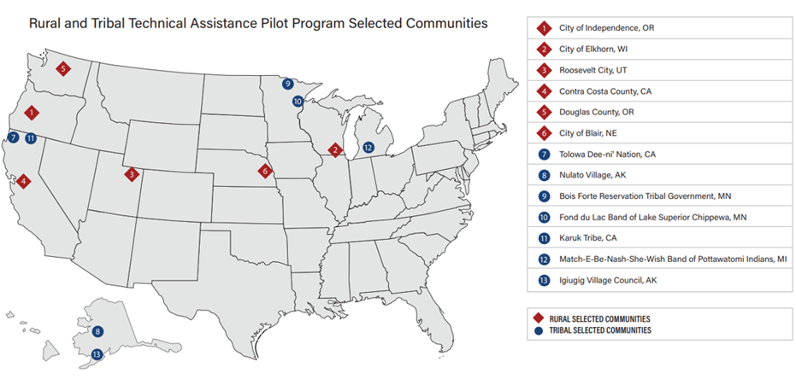
Rural & Tribal Assistance Pilot Program
New BIL technical assistance program for eligible entities to hire financial, technical, and legal advisors
NOFO for FY22/23 - $3.4 million
$1.6 million for tribal governments
406 total applicants requesting $127 million
70 from tribes, requesting $19 million
Applications from 47 states and 3 territories
Notes:
No applications from Hawaii, New Jersey, Rhode Island;
territories were USVI, AS, NMI
The Rural and Tribal Assistance Pilot Program will offer $3.4 million in FY22&23 for eligible entities to hire financial, technical, and legal advisors.
Eligible pre-development-phase activities include:
feasibility studies
project planning
preliminary engineering and design work
environmental review
economic assessments and cost-benefit analyses
value-for-money (VFM) studies

Slide 15
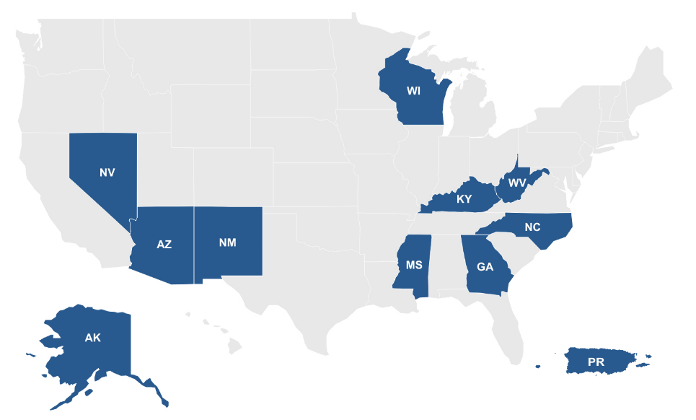
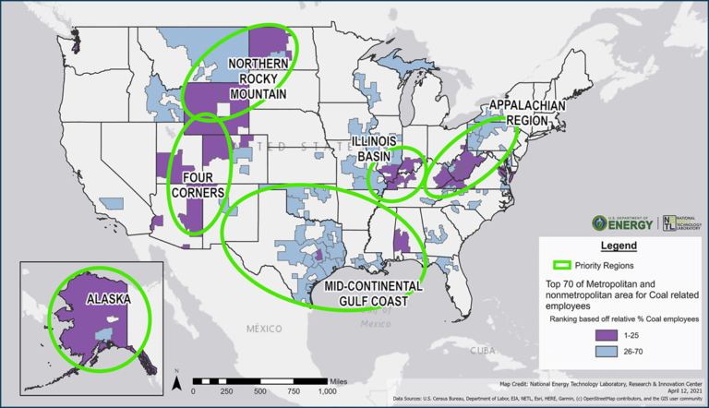
Place-Based Interagency Activities
Rural Partners Networks (USDA)
All-of-government program that helps rural communities find resources and funding to create jobs, build infrastructure, and support long-term economic stability on their own terms
36 RPN community networks across 11 states/territories
More information here: https://www.rural.gov/
Energy Communities (DOE)
Interagency working group to help communities dependent on coal, oil, gas, and power plants revitalize their economies and support energy workers
25 priority energy communities
More information here: energycommunities.gov/
Notes:
Include relevant networks/communities

Slide 16
Thriving Communities Program
The Thriving Communities Program (TCP) facilitates the planning and development of transportation and community revitalization activities.
This support enables disadvantaged and under-resourced communities to access historic infrastructure funding.
Selected communities' infrastructure projects will increase mobility, reduce pollution, and expand affordable transportation options.
FY22 Selected TCP Awardees
FY23 NOFO will be announced in the next few months.
Notes:
Include relevant FY22 awardees.
Through the Thriving Communities Program, USDOT selects and funds Capacity Builder teams to provide deep-dive technical assistance, planning, and capacity building support to under-resourced and disadvantaged communities across the U.S. to help ensure these communities have the technical tools and organizational capacity to comprehensively plan for and deliver quality infrastructure projects and community development projects that enable their communities and neighborhoods to thrive.

Slide 17
Upcoming Rural Grant Opportunities in BIL

Slide 18
BIL Overview for Rural America
More than $44 Billion over the next 5 years for rural transportation infrastructure
New rural-specific programs (including Rural Surface Transportation Grant Program and the Rural & Tribal Assistance Program)
Increased funding for programs with rural set-asides (including RAISE and INFRA)
Codifies ROUTES Initiative and ROUTES Council
BIL resources
White House Bipartisan Infrastructure Law Playbook
White House Bipartisan Infrastructure Law Rural Playbook
DOT Bipartisan Infrastructure Law Hub
DOT Fact Sheet for Rural Communities

Slide 19
MPDG Program Grants
3 programs combined into 1 NOFO under Multimodal Project Discretionary Grant (MPDG) program
FY23 & FY24 NOFO closed August 21, FY25 NOFO expected summer 2024
Program | Description | Additional Considerations | FY23 & FY24 Funding
Infrastructure for Rebuilding America (INFRA) | Supports multimodal freight and highway projects of national/regional significance to improve the safety, efficiency, and reliability of the movement of freight and people across rural and urban areas | 25% of large (grants > $25 Million) grants & 30% of small (< $25 Million) grants for projects in rural areas | $3.1 Billion
National Infrastructure Project Assistance (Mega) | Supports large, complex projects that are difficult to fund by other means and likely to generate national/regional economic, mobility, or safety benefits | 50% of funds set-aside for projects > $500 million | $1.8 Billion
Rural Surface Transportation Grant (Rural) | Supports projects to improve and expand the surface transportation infrastructure in rural areas to increase connectivity, improve the safety and reliability of the movement of people and freight, and generate regional economic growth and improve quality of life | At least 90% of funding must be awarded to grants > $25 Million | $675 Million

Slide 20
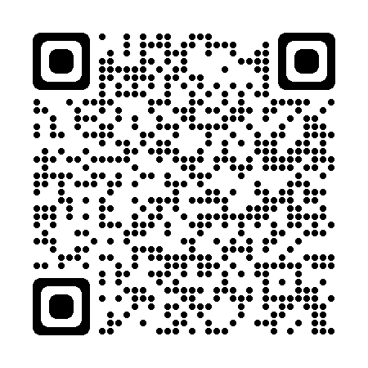
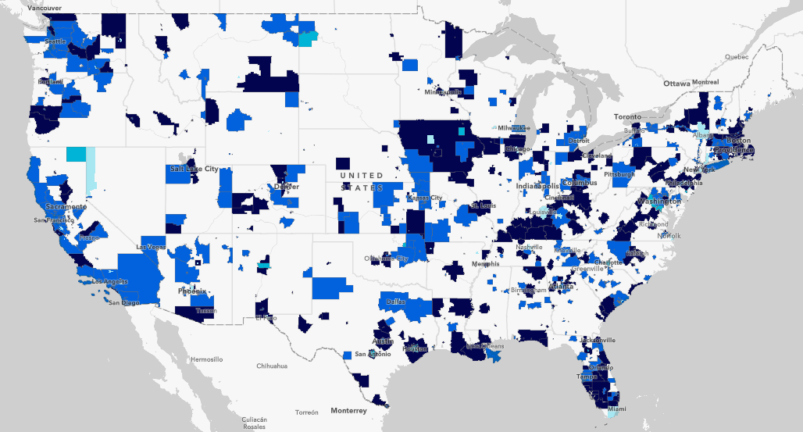
Safe Streets and Roads for All (SS4A)
Purpose: To prevent deaths and serious injuries on our roadways.
Focus is on comprehensive safety action planning and implementing those plans.
Over $1.7 Billion has been awarded to over 1,000 communities in FY22 & FY23
FY24 funding available!
April 4, 2024, 5 p.m. (EDT): Deadline #1 for Planning and Demonstration Grants
May 16, 2024, 5 p.m. (EDT): Sole deadline for Implementation Grants. Deadline #2 for Planning and Demonstration Grants
August 29, 2024, 5 p.m. (EDT): Deadline #3 for Planning and Demonstration Grants. NOFO closes
Notes:
In FY23 304 awards were made to rural communities totaling $189,054,161 (~1/2 of all award recipients).
Next Notice of Funding Opportunity is expected in February 2024.
City of Globe, Arizona (population 7,162)
Received $124,846 to develop comprehensive safety action plan and use temporary solar-powered pedestrian beacon installations, crosswalk surface treatments, signing, pop-up bike lanes, narrowing corridor treatments with surface treatments, curb extensions (bulb-outs) with landscaping elements with recycled materials planters, and plastic delineators.
City of Thomasville, Georgia (population 18,867)
Received $175,000 to conduct a demonstration project on the West Jackson corridor to test proposed safety measures such as buffered bike lanes, on‐street parking, landscape planters, mid‐block crossings, and curb extensions.
City of Decorah, Iowa (population 7,747)
Received $283,286 to develop a comprehensive safety action plan and supplemental planning to update the ADA Transition Plan and an evaluate the streetlights.

Slide 21
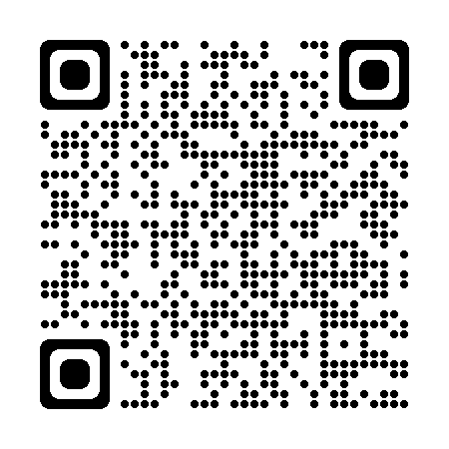
Subscribe to the ROUTES Newsletter --->
OR
Contact Us!
Rural@dot.gov
www.transportation.gov/rural
Notes:
QR code takes you to the subscribe pages for routes.

