Slide 1
How GIS Mapping Helped Respond to EPA Regulations
NADO – DDAA 2024 Washington Conference
March 12, 2024
Faith Bryan, GISP
Georgia Mountains Regional Commission

Slide 2
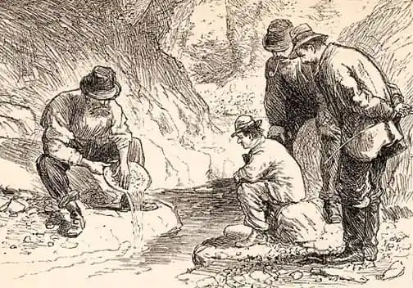
History
Discovery of gold in 1828 caused one of the first major gold rushes in the nation
In 1833, an unnamed site, which would become the City of Dahlonega was established as the official county seat of Lumpkin County

Slide 3
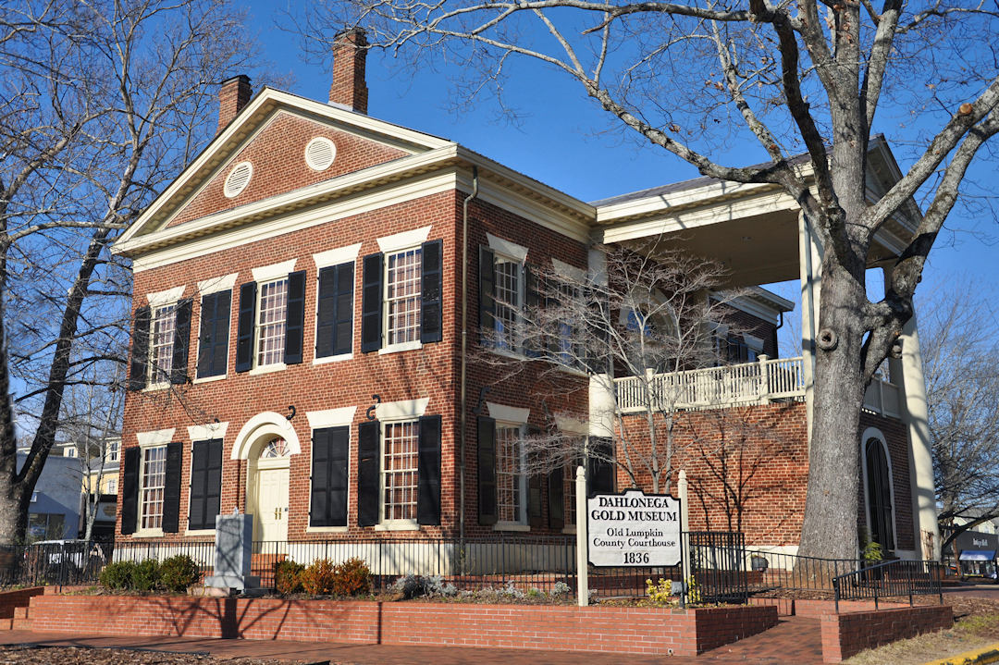
History
The new town was surveyed and the present-day gridiron pattern with a public square was laid out
A permanent courthouse was built on the square in 1836 and residential and commercial uses developed around it

Slide 4
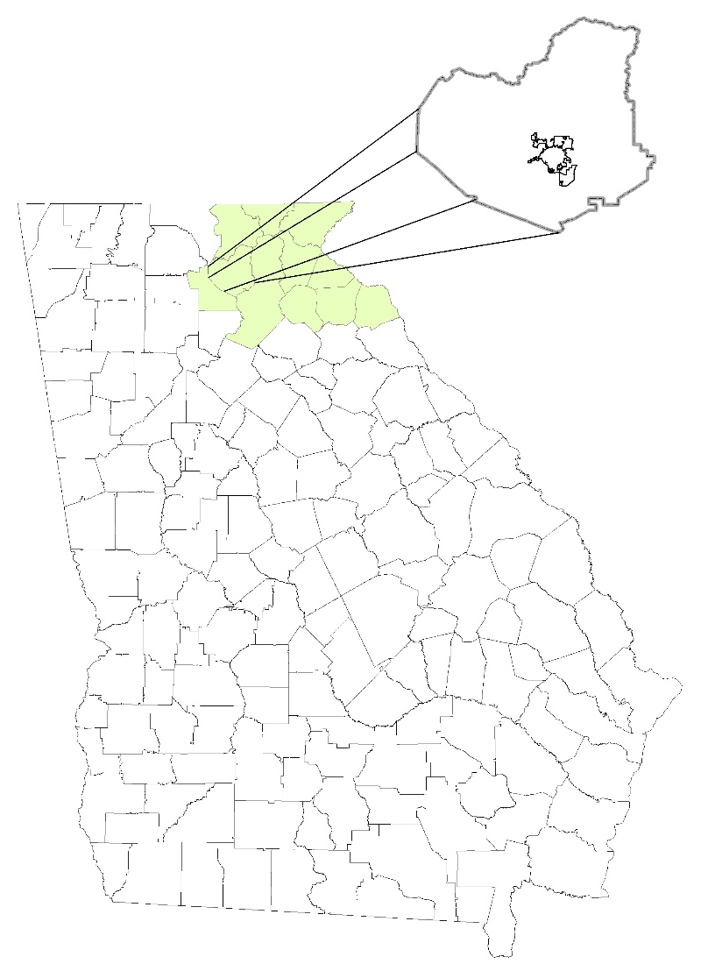
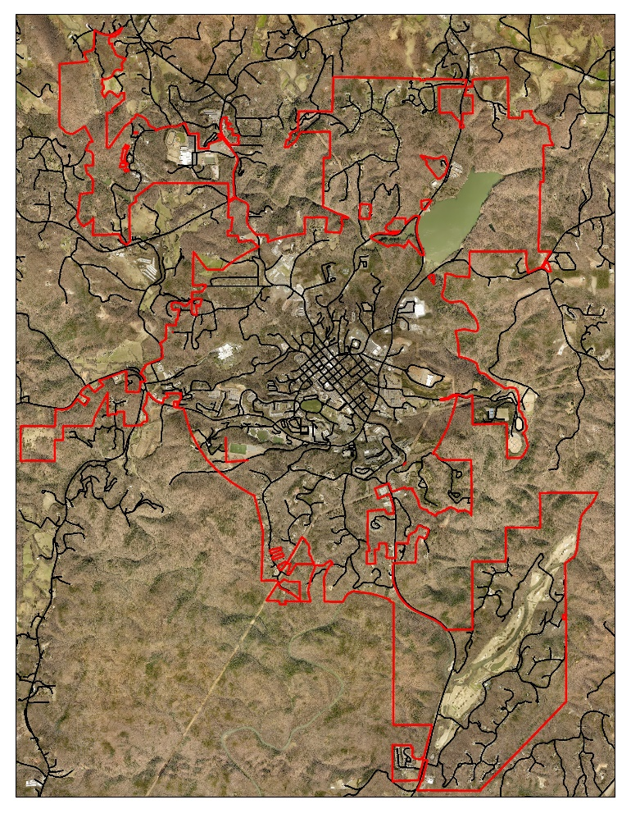
Located in the foothills of the North Georgia Mountains
Approximately 70 miles north of Atlanta
Incorporated on December 21, 1833

Slide 5
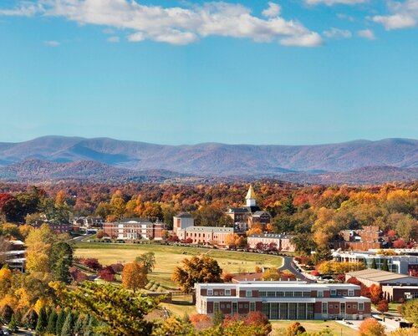
History
The US Government recognized the importance of gold mining in Lumpkin County and in 1838 established the US Branch Mint at Dahlonega
The Branch Mint operated until the start of the Civil War, ceasing operation in June 1861
In 1871, ownership of the mint was passed to the State of Georgia for the establishment of North Georgia Agriculture College, now known as University of North Georgia

Slide 6
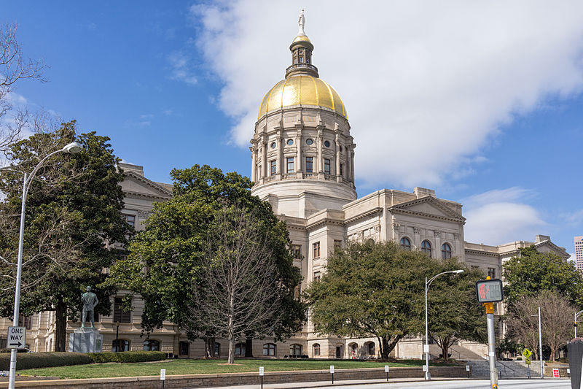
History
Price Memorial Hall was built on the site of the US Mint after it burned down in 1878
The gold steeple was added to Price Memorial Hall in 1972 with genuine Dahlonega gold
This building is one of two in the State of Georgia to use Dahlonega gold
Georgia State Capitol is the second building

Slide 7
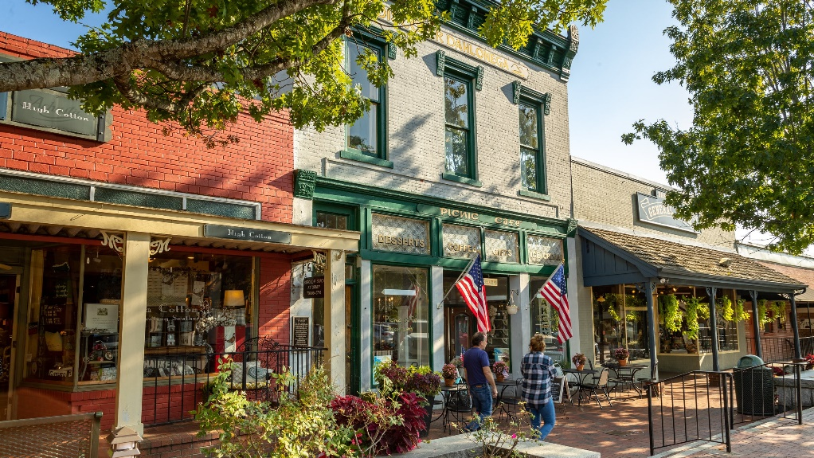
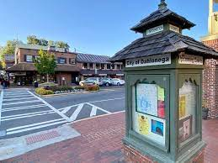
Dahlonega
Southern gateway to Chattahoochee National Forest
Springer Mountain, southern terminus of the Appalachian National Scenic Trail, 15 miles northwest of the City
Camp Frank D Merrill, a US Army Ranger training installation
University of North Georgia
Eight wineries located in Dahlonega - Lumpkin County area

Slide 8
City of Dahlonega Water/Sewer/Storm Water Project
GMRC was contacted by the City for assistance
Accuracy of existing data was of great concern, no trust in data
Storm water information was non-existent
City was using a combination of .kml’s (Google based), Engineer project data, spreadsheets, paper maps, and utility crew location knowledge

Slide 9
City of Dahlonega Water/Sewer/Storm Water Project
2 ½ Year Multi-Phase Project
Phase I (August 2020 through January 2021)
Acquisition of City files and existing data sets
Acquisition of Lumpkin County GIS data
Parcels, Road Centerlines, Aerial Photography (Pictometry/Eagleview)
Creation of Project Progress Online Map
Field collection (GPS) of:
Water and Wastewater Treatment Plants
Intakes, Booster Pumps, Lift Stations, Discharge Points
Clear Well
Water Storage Tanks

Slide 10
https://storymaps.arcgis.com/stories/b87eaad844b94f7f9fa448f61883ea6b

Slide 11
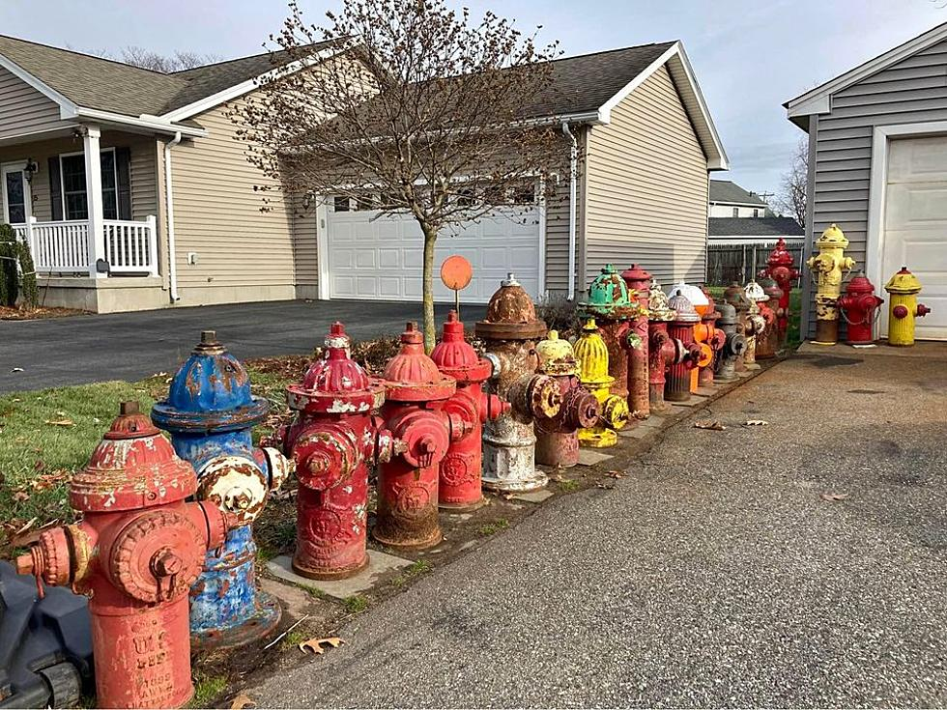
City of Dahlonega Water/Sewer/Storm Water Project
Phase II – Field Data Collection (February 2021 through January 2023)
Water System
Fire Hydrants (428)
Water Valves (883)
Water Meters (1452)
Water Lines (In-office created and attributed)

Slide 12
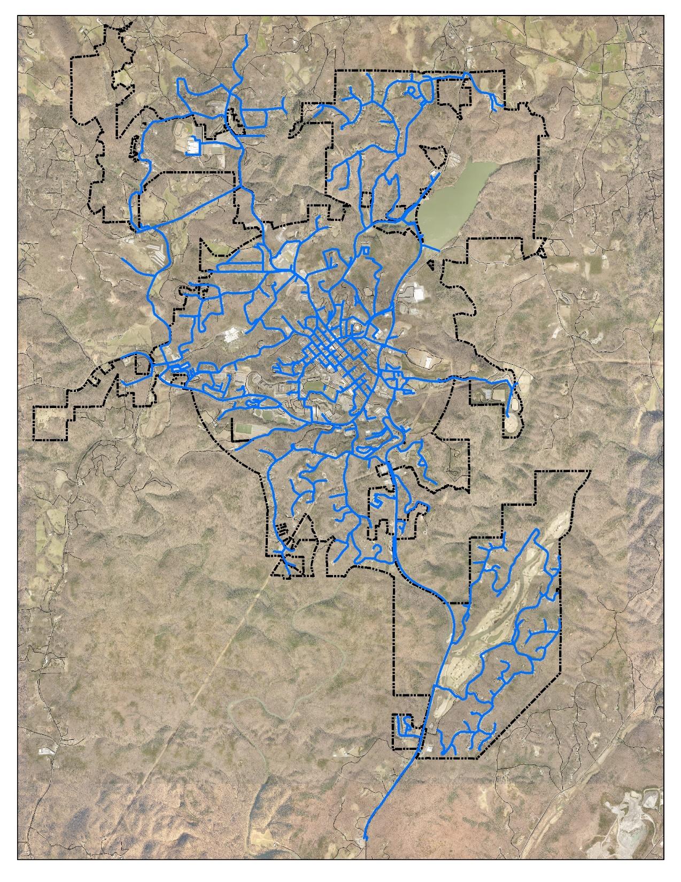

Slide 13
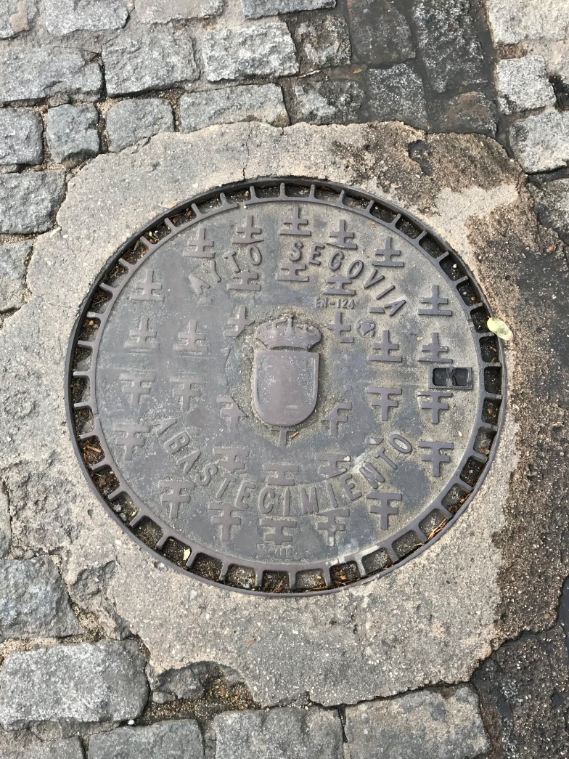
City of Dahlonega Water/Sewer/Storm Water Project
Phase II – Field Data Collection
Sewer System
Manholes (725)
Sewer cleanout
Sewer Valves (59)
Grinder Pump Locations (Converted from address list)
Sewer Lines (In-office created and attributed)

Slide 14
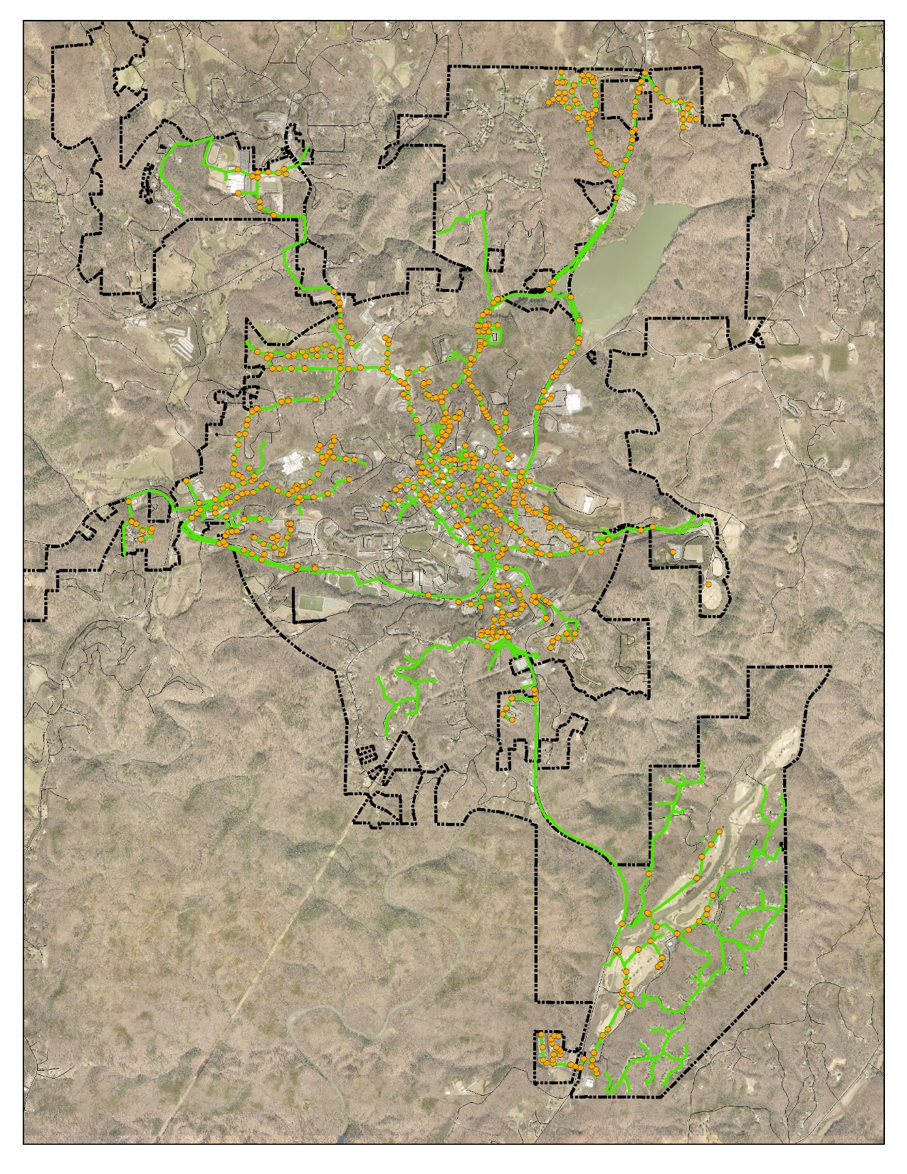

Slide 15
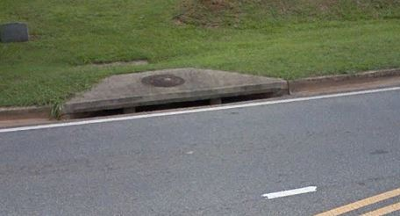
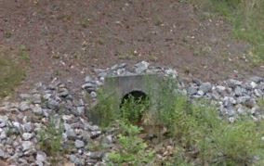
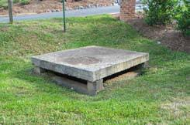
City of Dahlonega Water/Sewer/Storm Water Project
Phase II – Field Data Collection
Storm Water System (1,164 structures)
Weir, Combo, Curb, Drop, and Yard Inlets
Storm water manholes (100)
Flumes
Headwalls
Detention Ponds
Catch Basins
Storm Water Lines

Slide 16
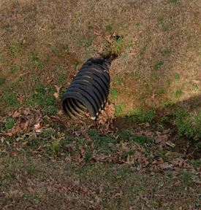
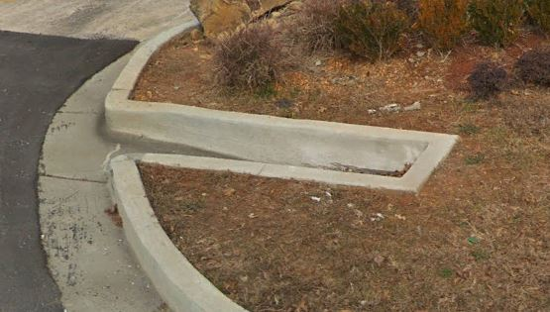
City of Dahlonega Water/Sewer/Storm Water Project
Phase II – Field Data Collection
Storm Water Lines
Closed Conduit (8.4 miles)
Ditches (27.6 miles)
Culverts

Slide 17
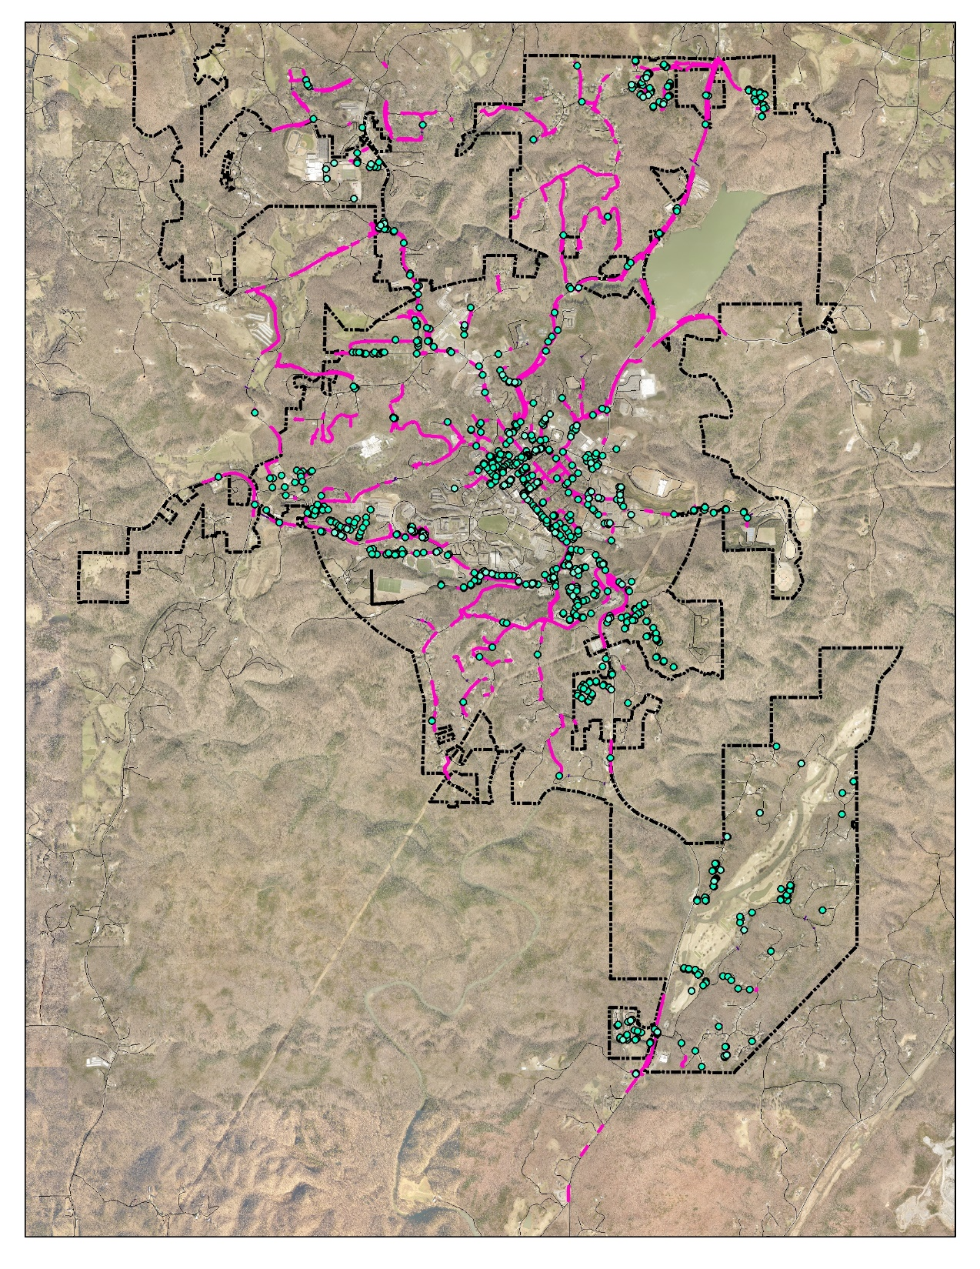

Slide 18
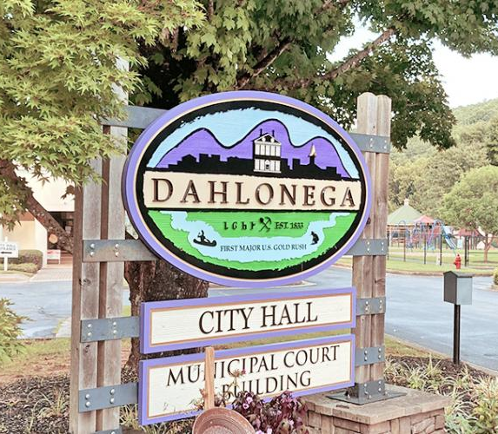
City Project Requests
All field collected features were photographed (fire hydrants, manholes, valves, storm water, meters, lift stations, etc.)
Attributes such as material type, size, identification number or name, condition were to be added in the field or office (defined by the City)
Monthly project calls and reports with City Project Manager, City Staff, and GMRC Staff

Slide 19
City Project Requests
During one of our project meetings the City Project Manager mentions an amendment to the Safe Drinking Water Rules regarding lead pipe inventory.
We added the following attributes to the Customer Water Meter point data:
Installation Date
Customer side pipe material
Customer side pipe size
City side pipe material
City side pipe size

Slide 20
Rule 391-3-5-.25 Treatment Techniques, Lead and Copper Requirements
(13) All water systems must develop an initial lead service line inventory by October 16, 2024 in accordance with 40 CFR 141.84(a), and submit it to the Division in accordance with 40 CFR Part 141.90 (e) in an electronic format prescribed by the Director.

Slide 21
Service Line Inventory Overview
All Community Water Systems must develop and submit a comprehensive Service Line Inventory (SLI) to the Georgia EPD on or before October 16, 2024
After initial SLI is submitted, updates are due to EPD each year on or before July 1
Must submit using the GA EPD LCRR Service Line Inventory Spreadsheet
Water systems must make their SLIs publicly available. Water systems serving a population exceeding 50,000 must make their inventory available online
Consumer Confidence Reports must indicate where customers can find their SLI
Water systems must provide notification to persons served with a service line classified as Lead, Galvanized Requiring Replacement (GRR), or Lead Status Unknown within 30 days of submitting their SLI.

Slide 22
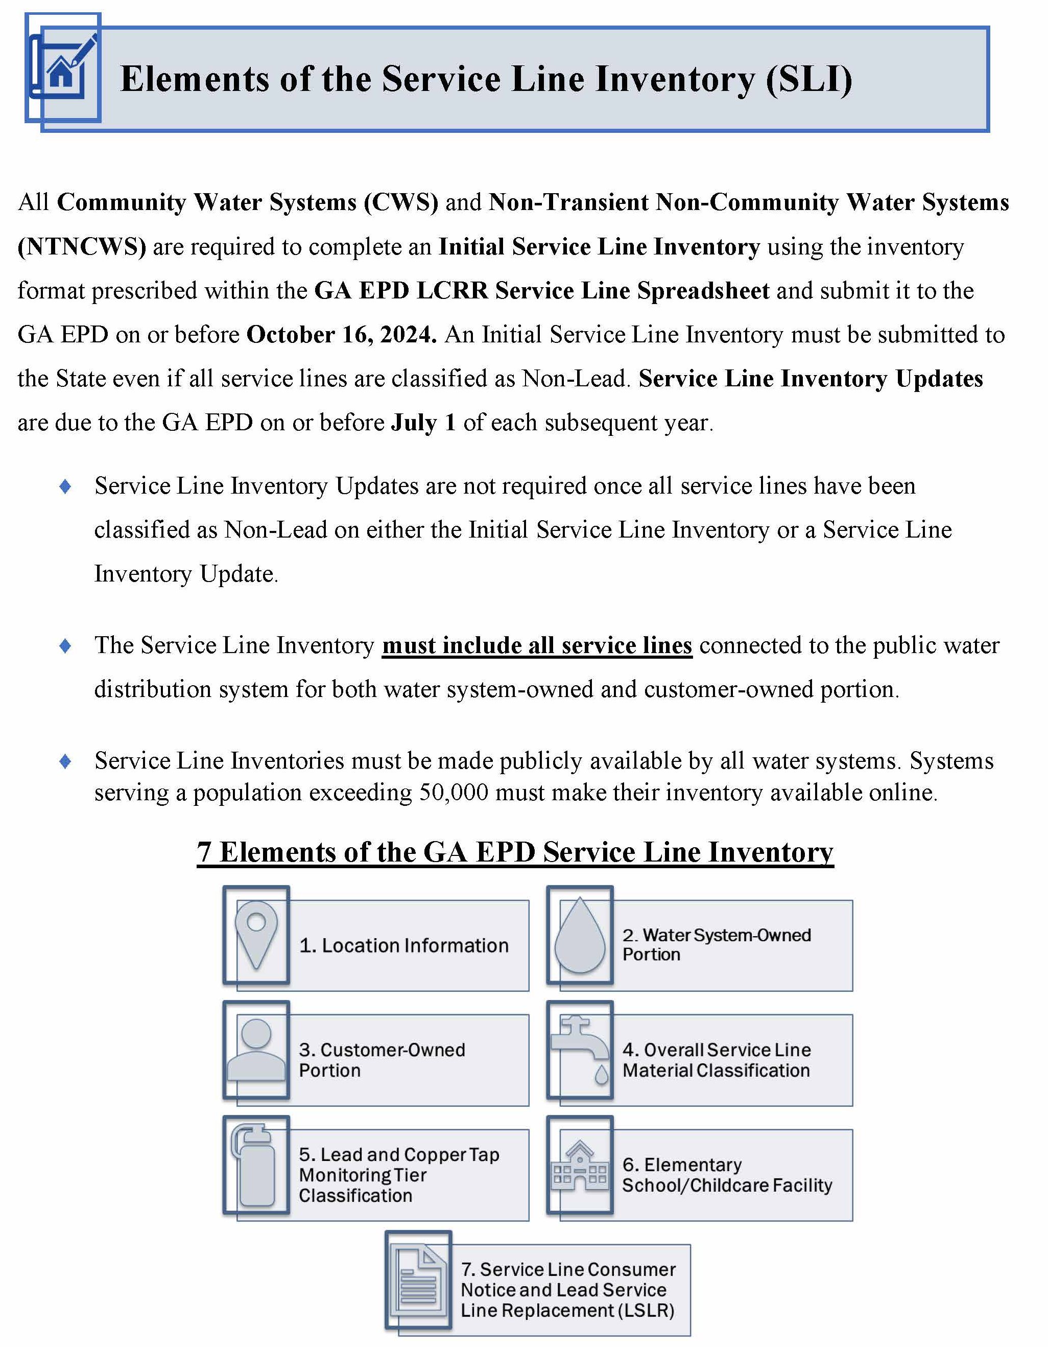

Slide 24
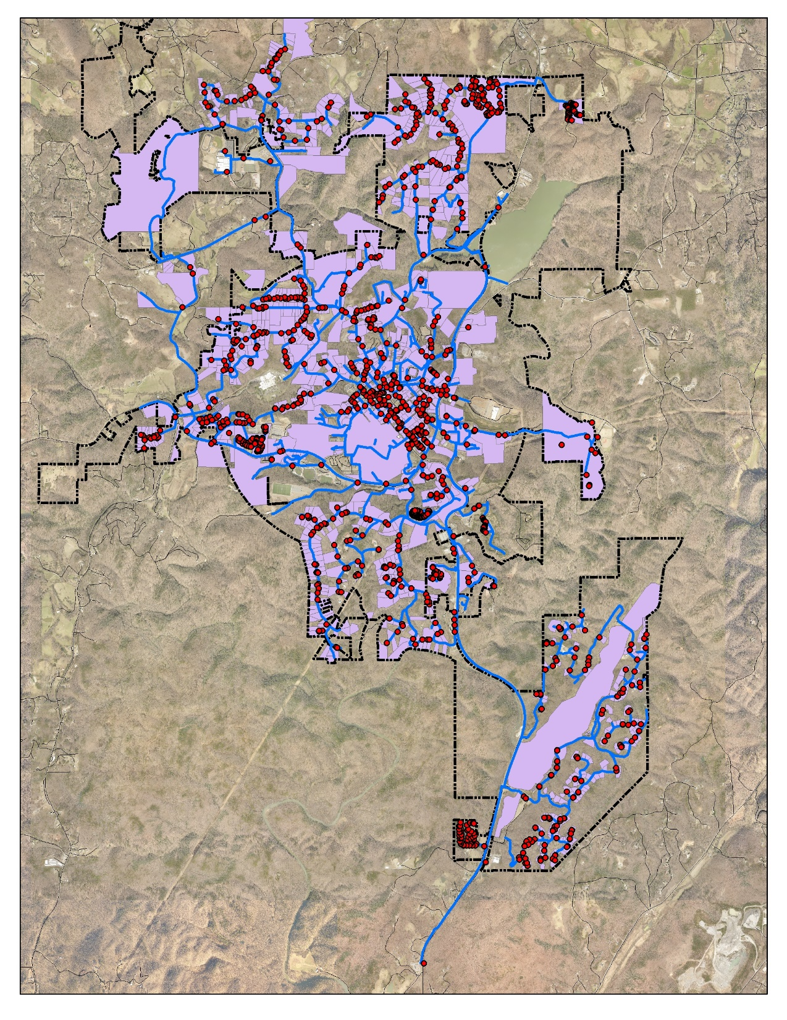
1,452 Customer Water Meters
Any service lines installed after January 1, 1990 can be considered Non-Lead based on the effective dates of the Federal/State lead ban
GMRC Staff joined the Dahlonega water customer database (points) with the Lumpkin County Tax Parcels
Within the tax parcel database, information such as date home or business built and owners or business name

Slide 26
ESRI Tools Available
Web Map Application
Field Maps Application

Slide 27
Each Meter pit/box was opened and assessed
Photo was taken
Service line information was recorded for each water customer meter on both sides
As of February 22nd, Dahlonega has completed the assessment of all Meters
Most difficult area was downtown where all meters were in the sidewalk
No Lead service lines were located on Dahlonega’s water system

Slide 28
Service line inventory and assessment can be exported to the GA EPD LCRR Service Line spreadsheet and submitted electronically
Next steps for Dahlonega?
Replacing galvanized service lines found on the water system

Slide 30
Questions?
Faith Bryan, GISP
Director of Information Services
Georgia Mountains Regional Commission – www.gmrc.ga.gov
fbryan@gmrc.ga.gov
(770)538-2614

