Slide 1
Using Data to Better Understand Housing Affordability Challenges in Appalachia
National Association of Development Organizations (NADO) and the Development District Association of Appalachia (DDAA) Washington Conference
Keith Wiley
3-11-2024

Slide 2
Housing Assistance Council
Housing Assistance Council’s mission is to improve housing conditions for the rural poor, with an emphasis on the poorest of the poor in the most rural places.
National Office
1828 L Street, N.W., Suite #505
Washington, DC 20036
202-842-8600
Housing Assistance Council
Building Rural Communities since 1971

Slide 3
Outline
Background
Home Price Increase
Workforce Housing
Rental Market
Other Needs

Slide 4
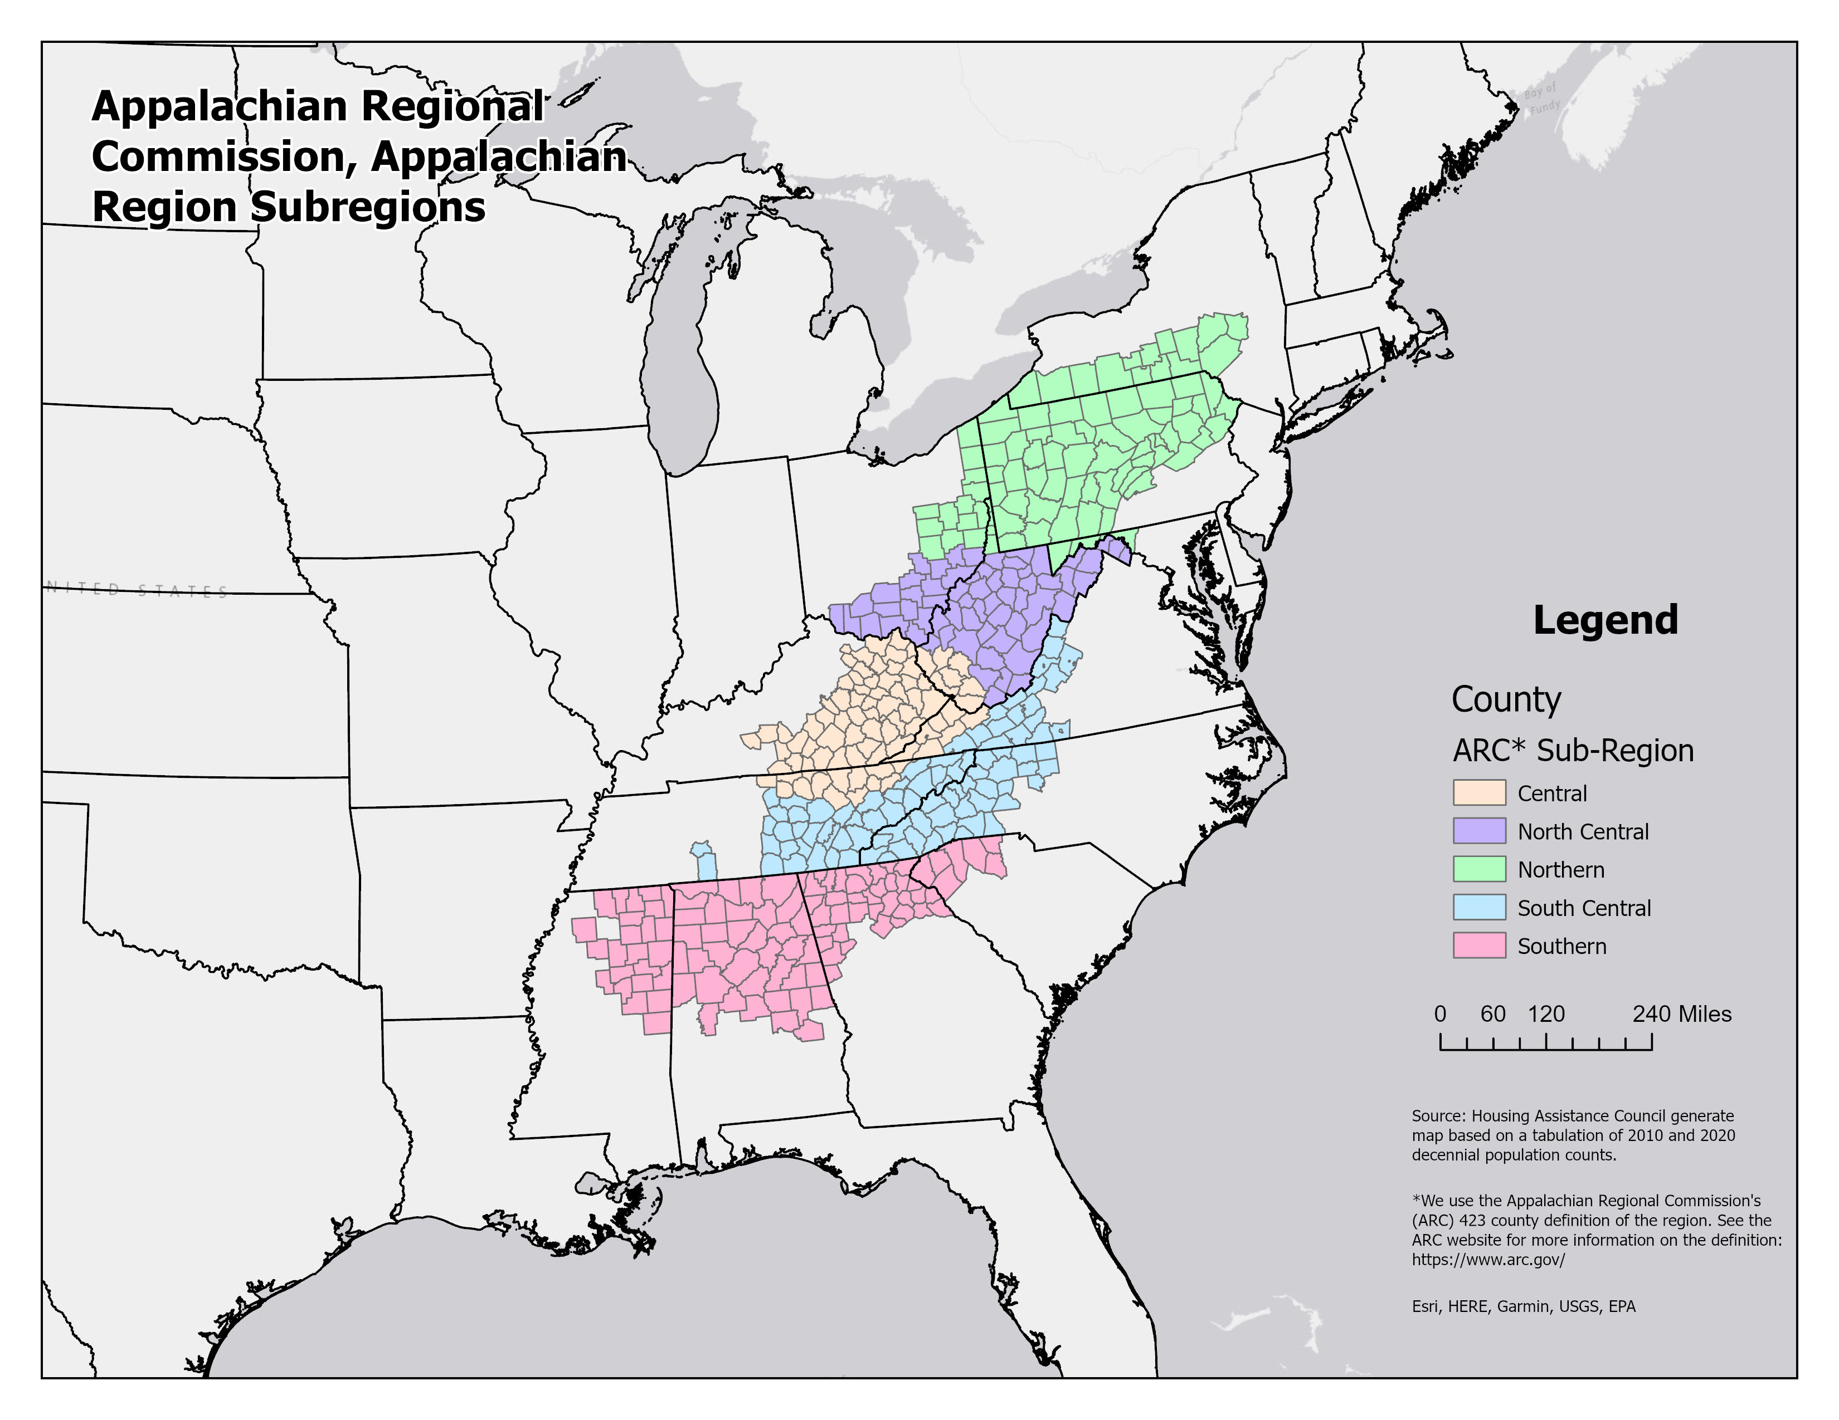

Slide 5
Usual Story - Decline
“Red America is Growing Because Blue America is Shrinking”, by Phillip Bump, The Washington Post, 3-30-2023 https://www.washingtonpost.com/politics/2023/03/30/red-america-is-growing-because-blue-america-is-shrinking/
“Regional Population Loss ‘Metastasizes’ in the Last Decade”, Robert Cushing, The Daily Yonder, 4-1-2021 https://dailyyonder.com/regional-population-loss-metastasizes-in-the-last-decade/2021/04/27/
“Fighting Population loss in the rural U.S.”, Dylan Lysen, NPR-All Things Considered, 7-7-2023 https://www.npr.org/2023/07/07/1186531913/fighting-population-loss-in-the-shrinking-rural-u-s

Slide 6
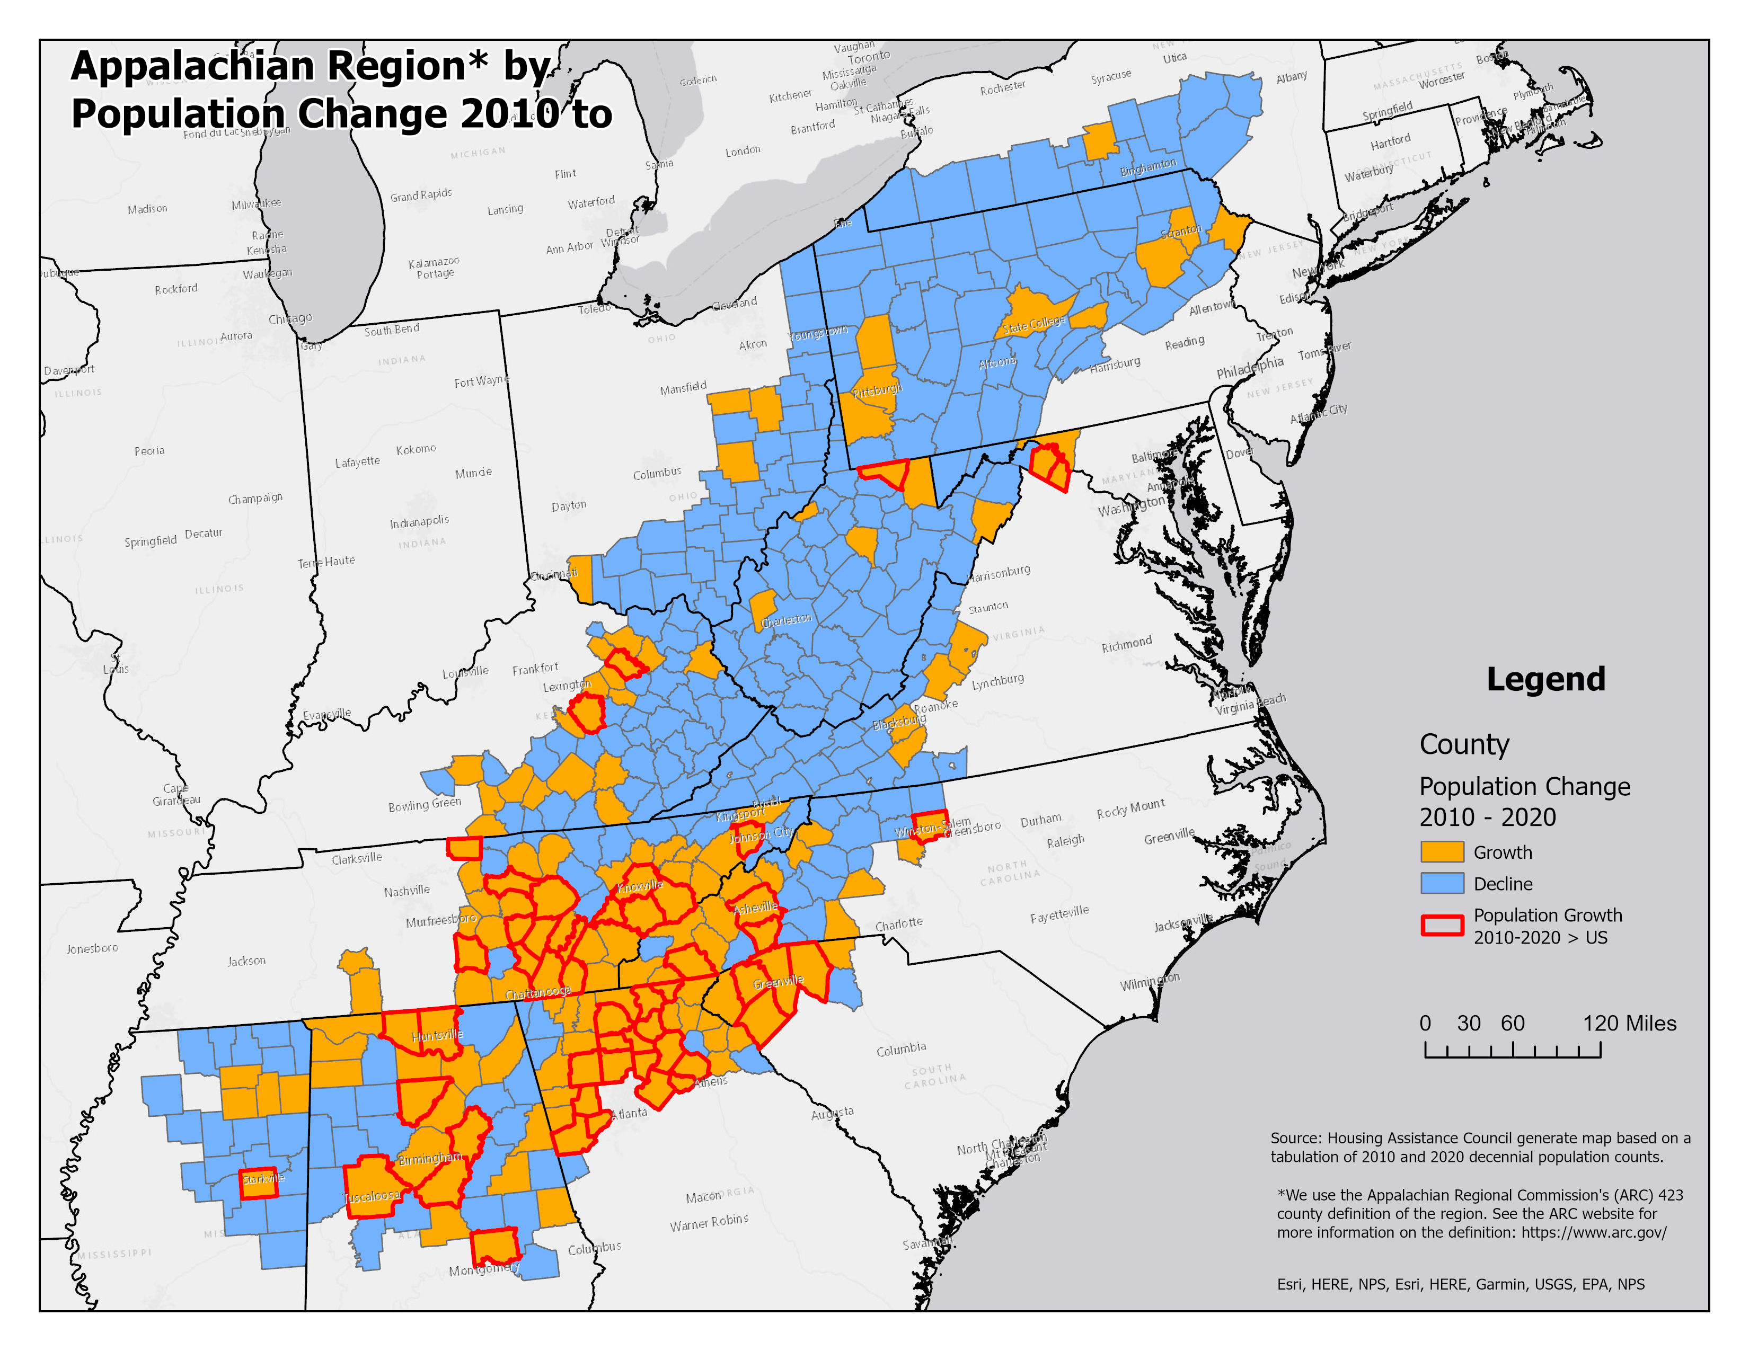
Nuanced Story
38% of Appalachian counties (159) gained population 2010-2020
1/3rd of these counties (52) had a growth rate exceeding the U.S. rate (>7.4%)

Slide 7
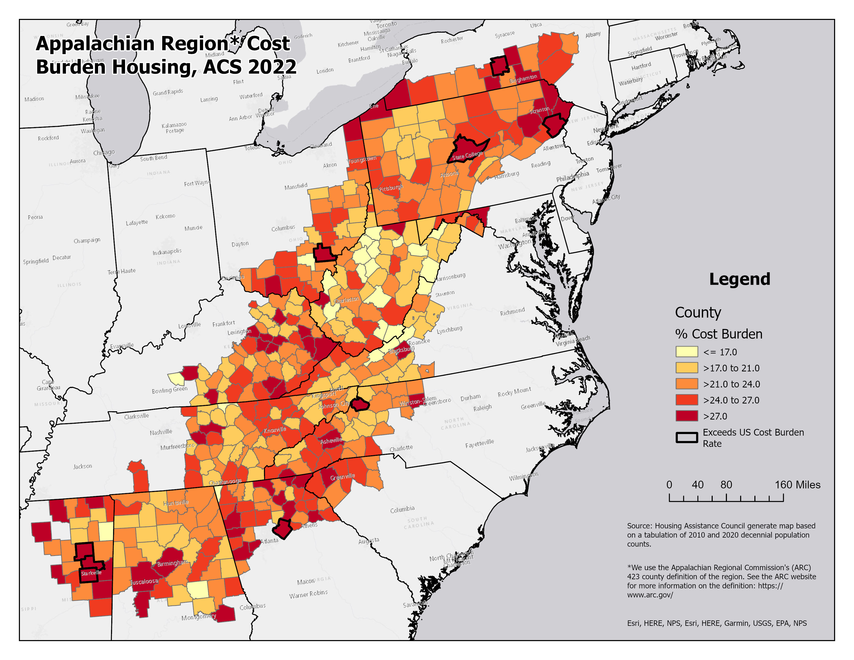
Housing Affordability
Over the last few decades:
Significant reduction in substandard housing
1970- 12% lacked plumbing
2022- 0.4% lacked plumbing
Housing affordability worsened
1980- 21% Cost Burdened
2022- 25% Cost Burdened

Slide 8
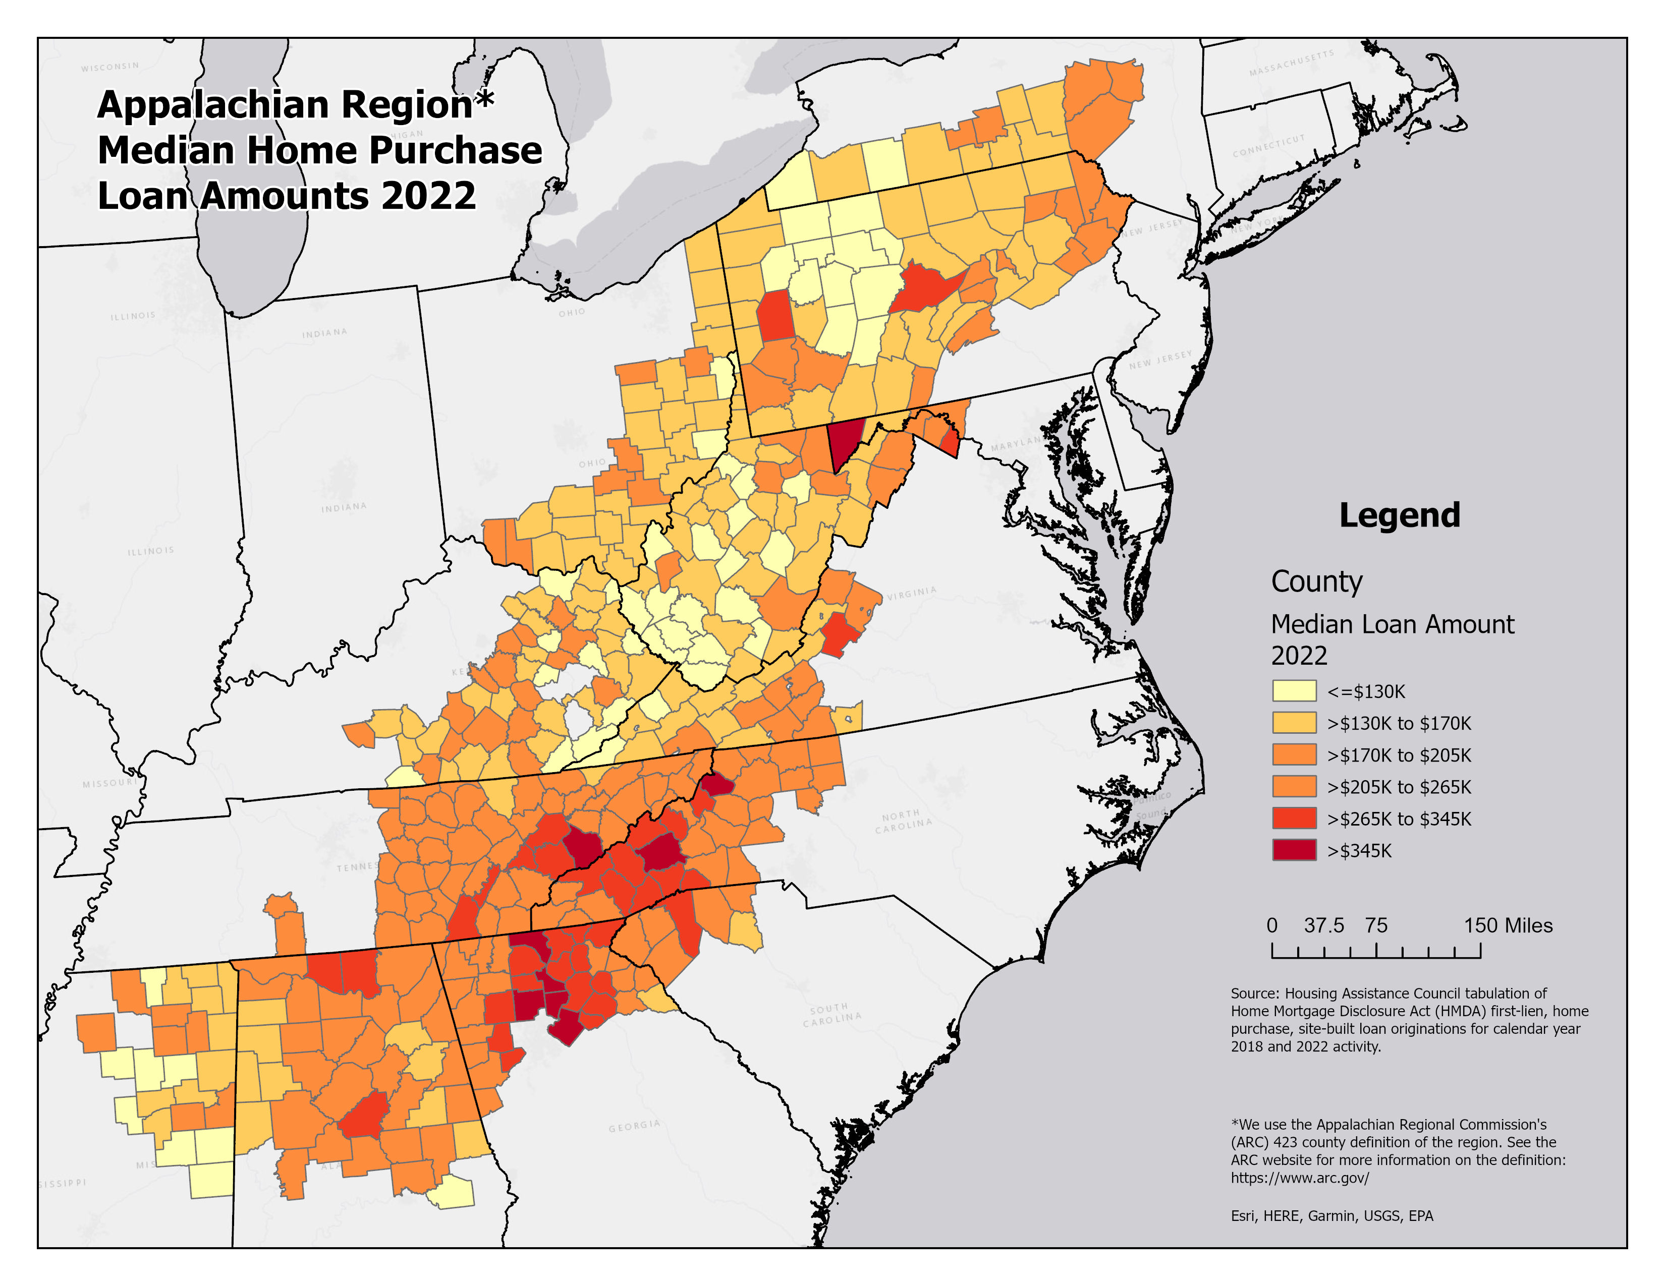
Home Loans
Median loan amount was $205K or higher for 39% of counties.
Highest concentration of counties with loans exceeding $205K are in Georgia, Tennessee, and North Carolina.
High amenity and exurban areas standout.

Slide 9
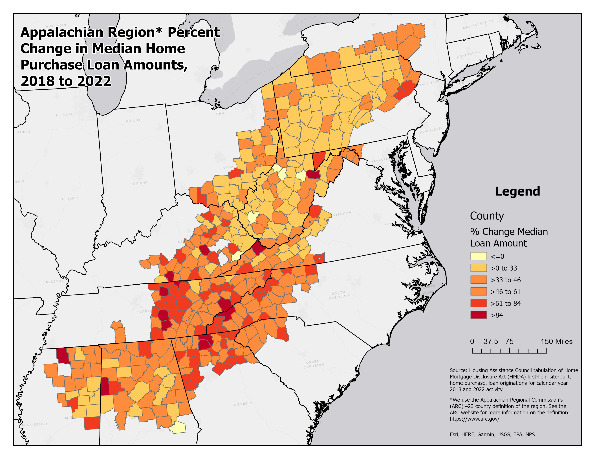
Increasing Home Loan Amounts
Median home loan amount increased by 50% or more in 3 of 10 counties.
Greatest area of concentration again in South and South-Central Appalachia.
Widespread increase overall, 38% of Kentucky and 25% of Virginia counties experienced a more than 50% increase in median loan amount.

Slide 10
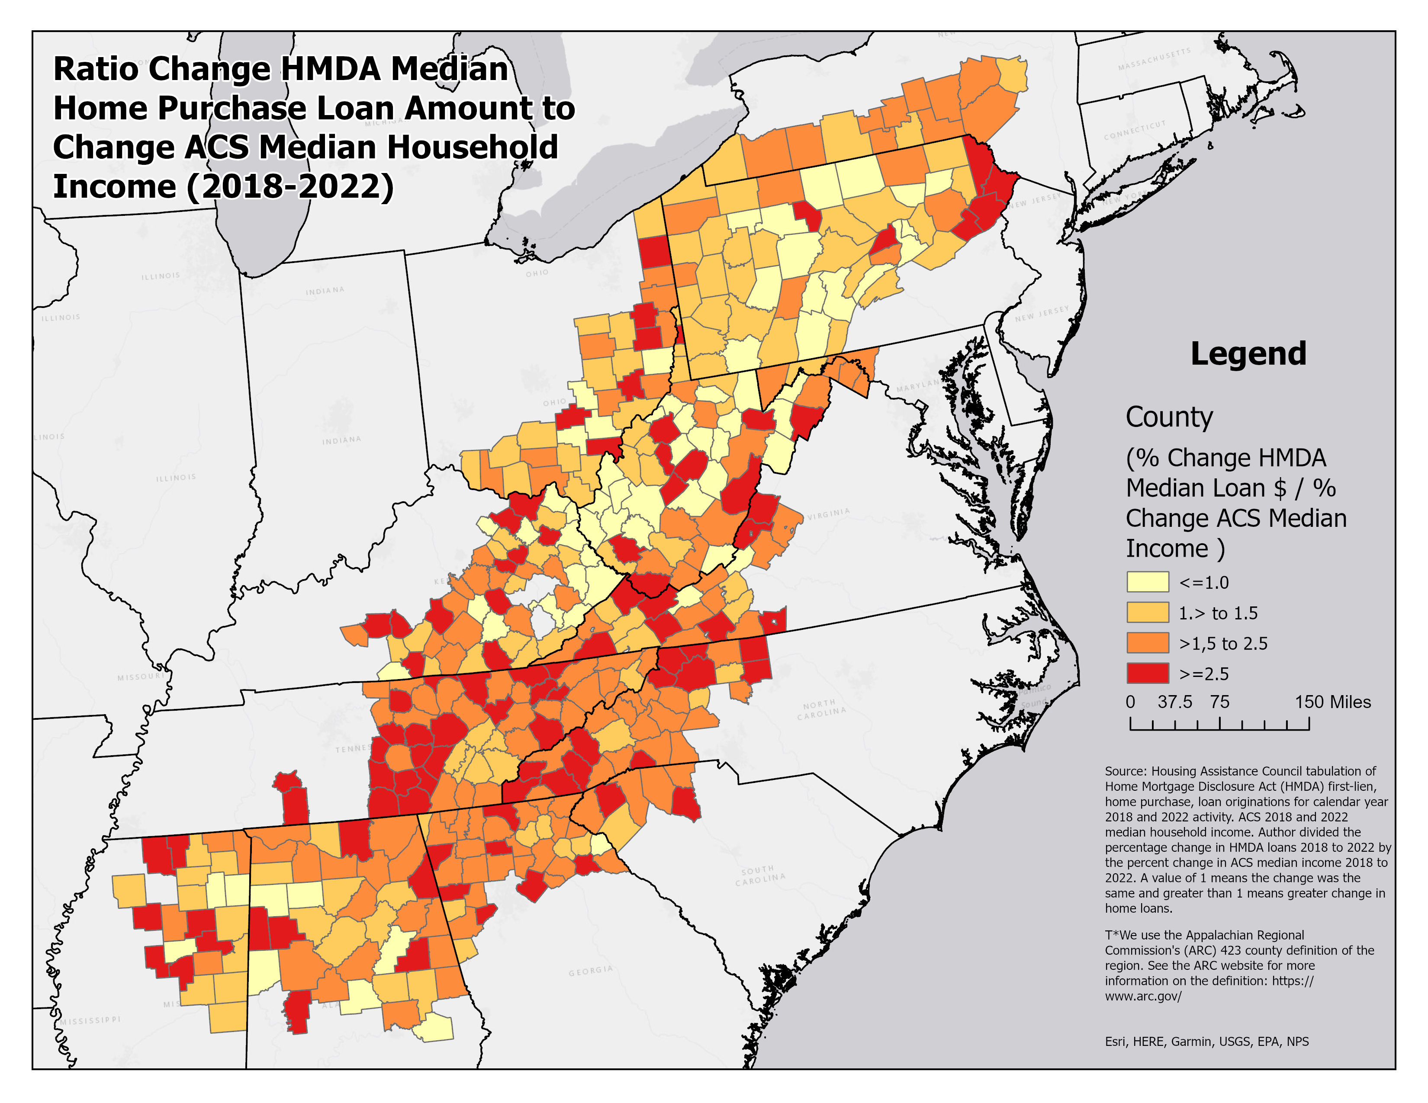
Home Loan Increase Outstrips Income Growth
In 40% of counties, the increase in median home loans was twice as large as the increase in median household income.
Homeownership is more difficult to obtain under these circumstances.
Caveat - Only includes site-built homes.

Slide 11
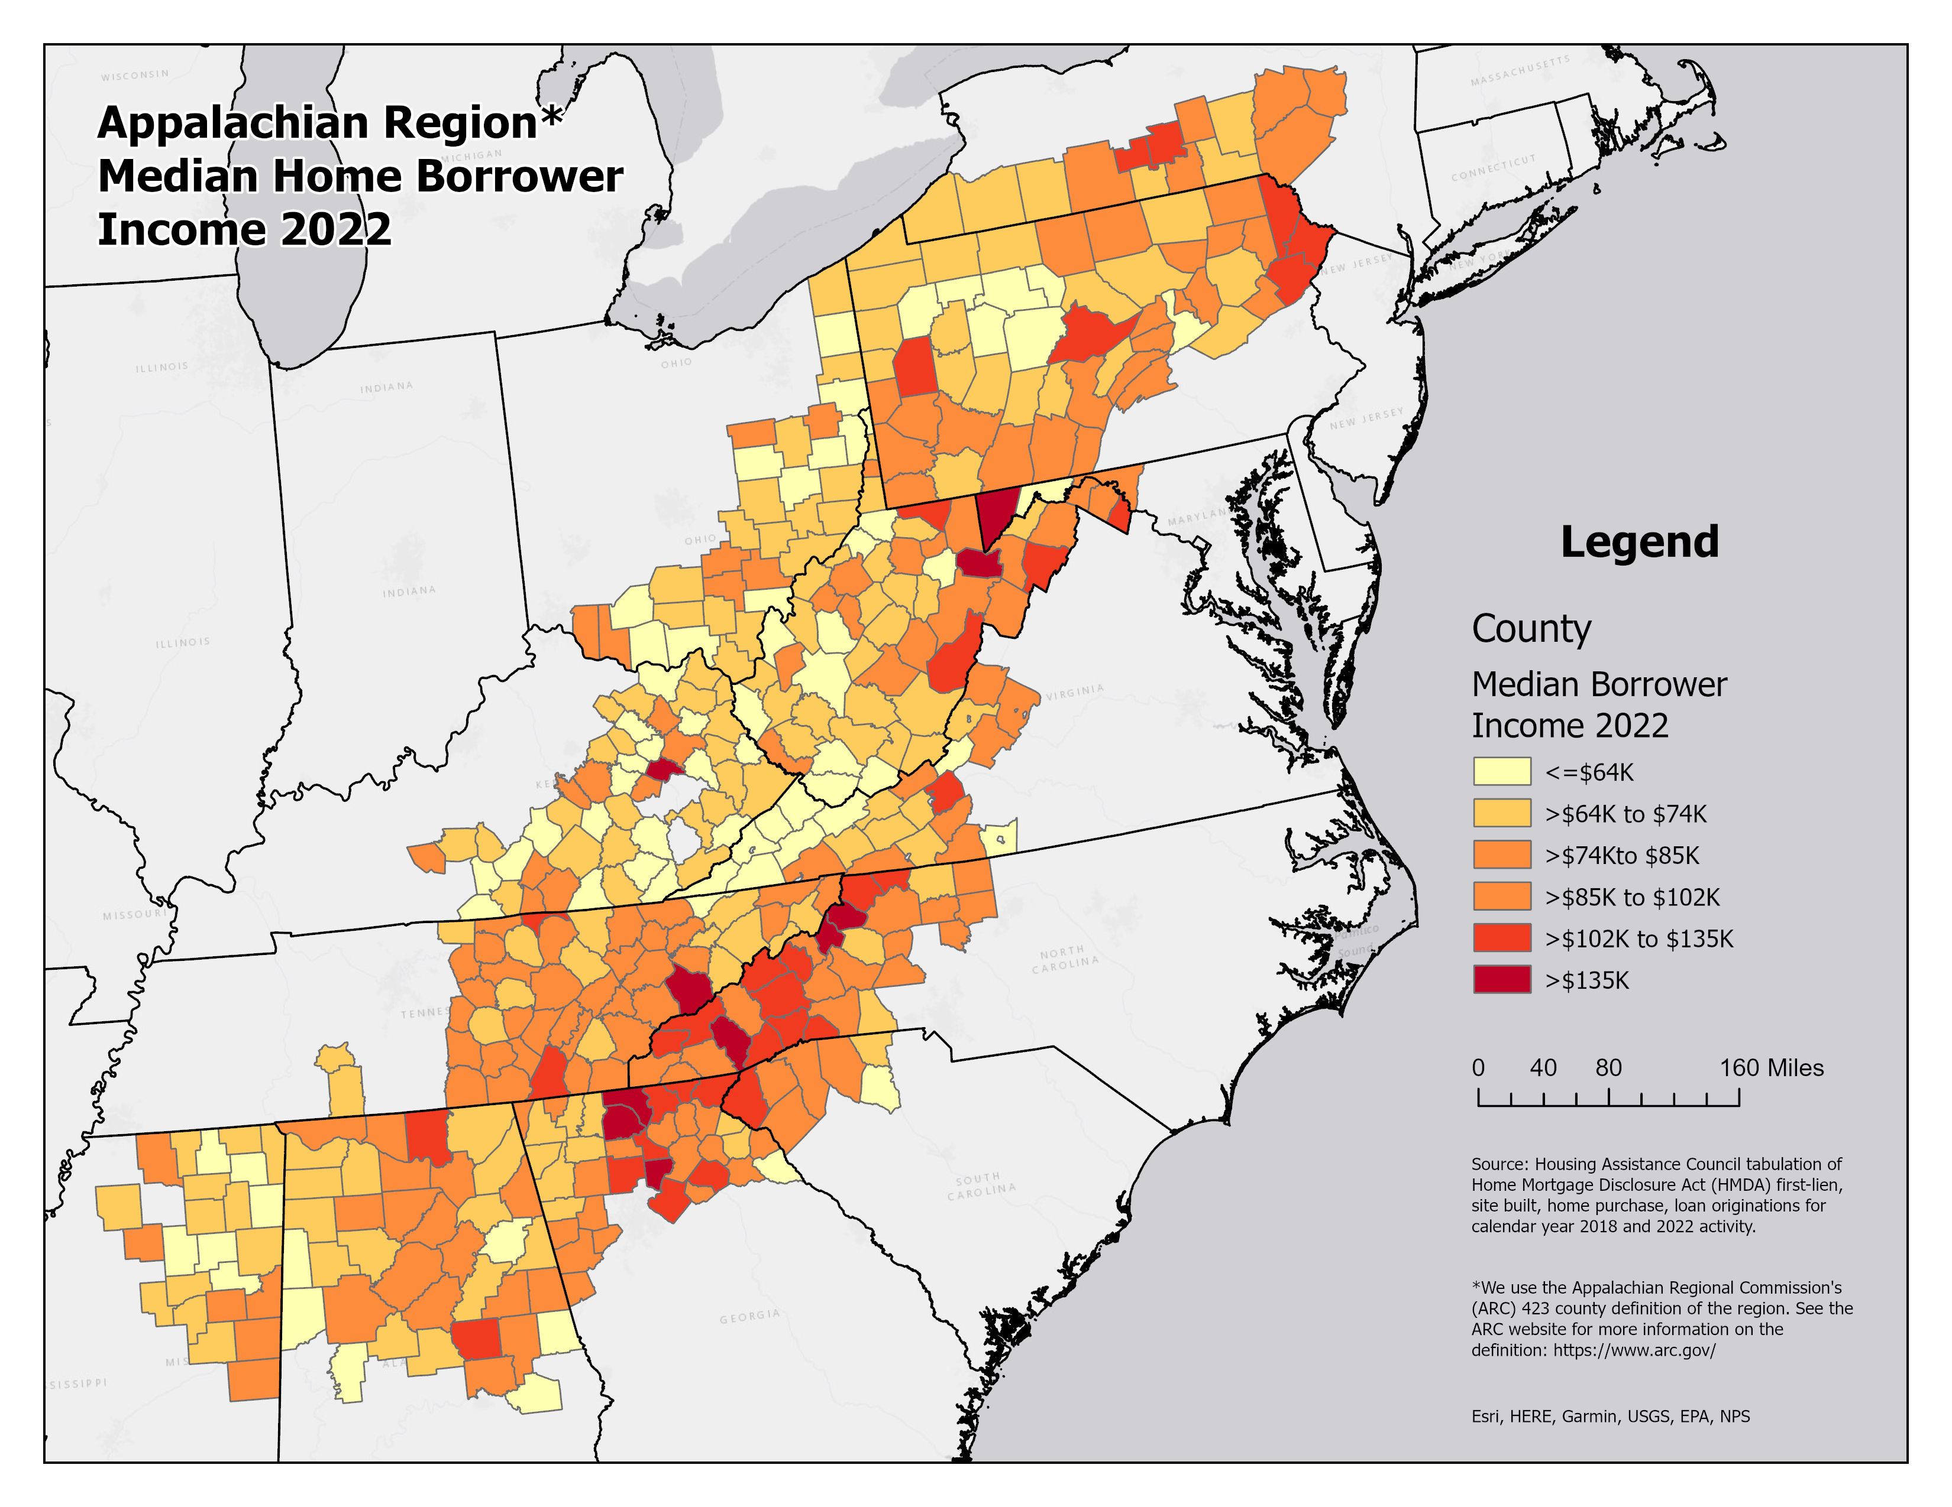
Borrower’s Income
The 2022 median borrower income was more than 100k in 12% of counties.
Recreation/retirement areas stand out.
Fannin County, GA ($205K)
Garrett County, MD ($195K)

Slide 12
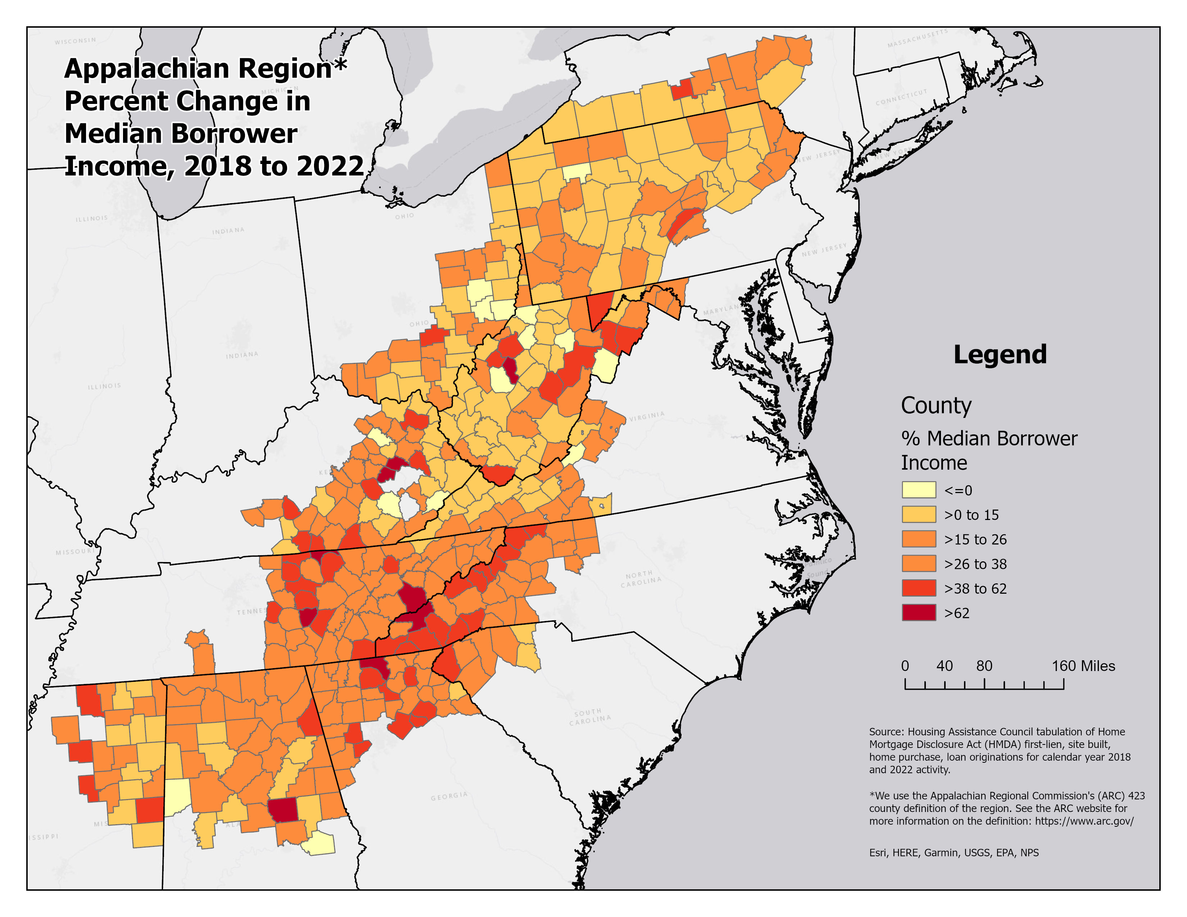
Change in Borrower’s Income
Areas with smaller populations experienced biggest gains.
Similar to pattern of home price changes.
Impact of remote work/pandemic – will it continue?

Slide 13
USDA Section 502 Decline

Slide 14
Work Force Housing
Increased home prices make homes unaffordable.
Unaffordability reaches people making more than the area median income (AMI).
Expands workforce housing needs (households earning 80 to 120 AMI).

Slide 15
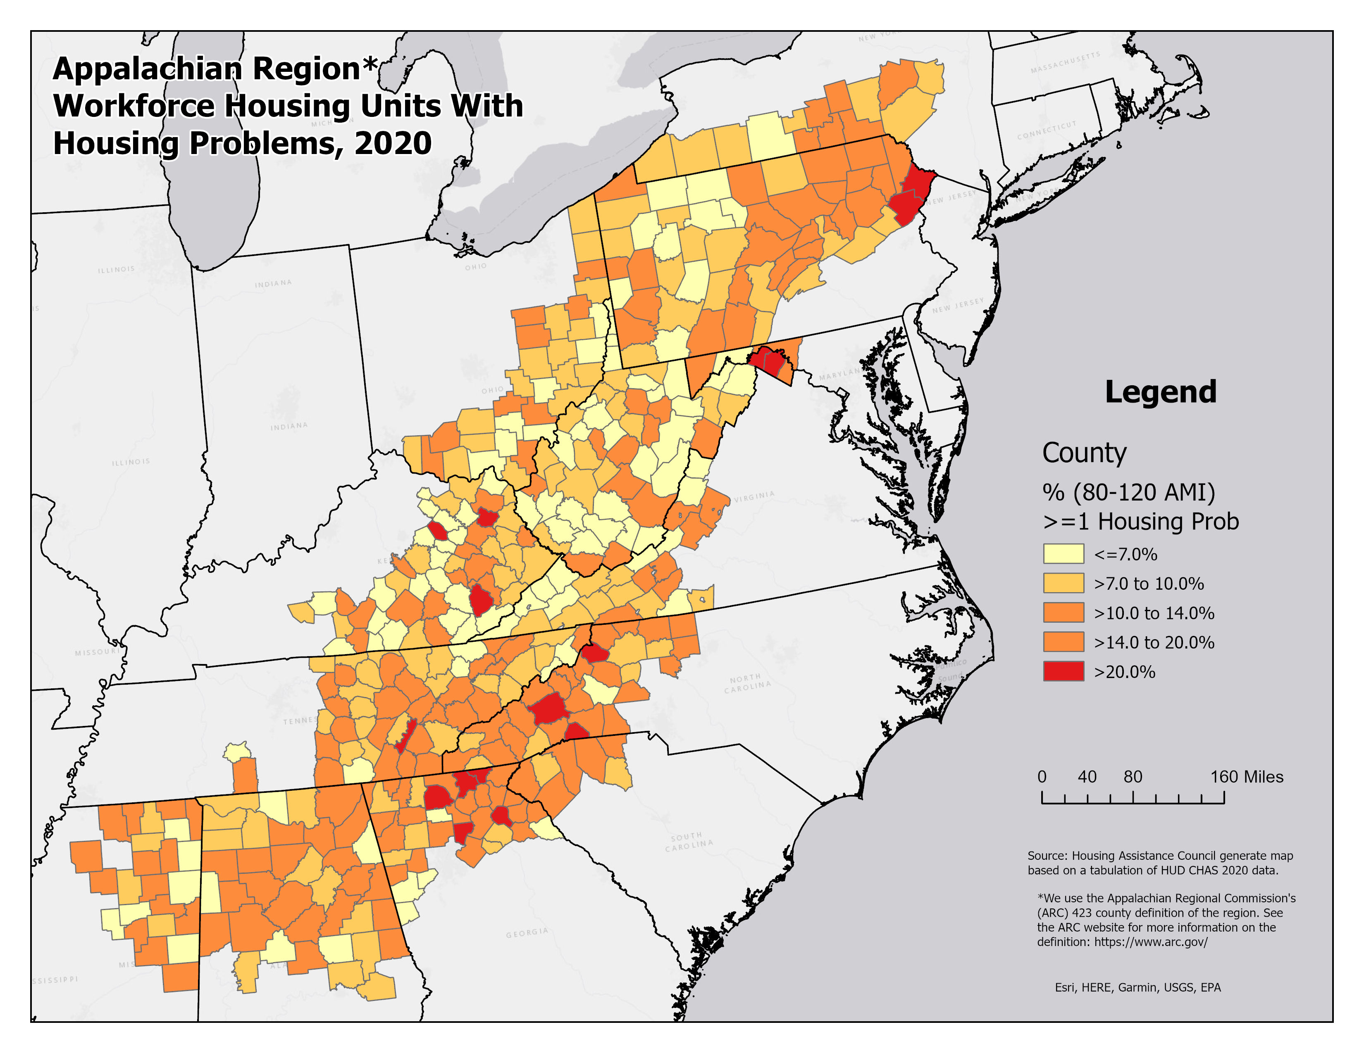
Work Force Housing - Housing Problems
Housing problems (lack plumbing, lack kitchen, crowded, cost- burden).
In nearly half (47%) of counties, 10 percent of households earning between 80 and 120% AMI have at least 1 housing problem.

Slide 16
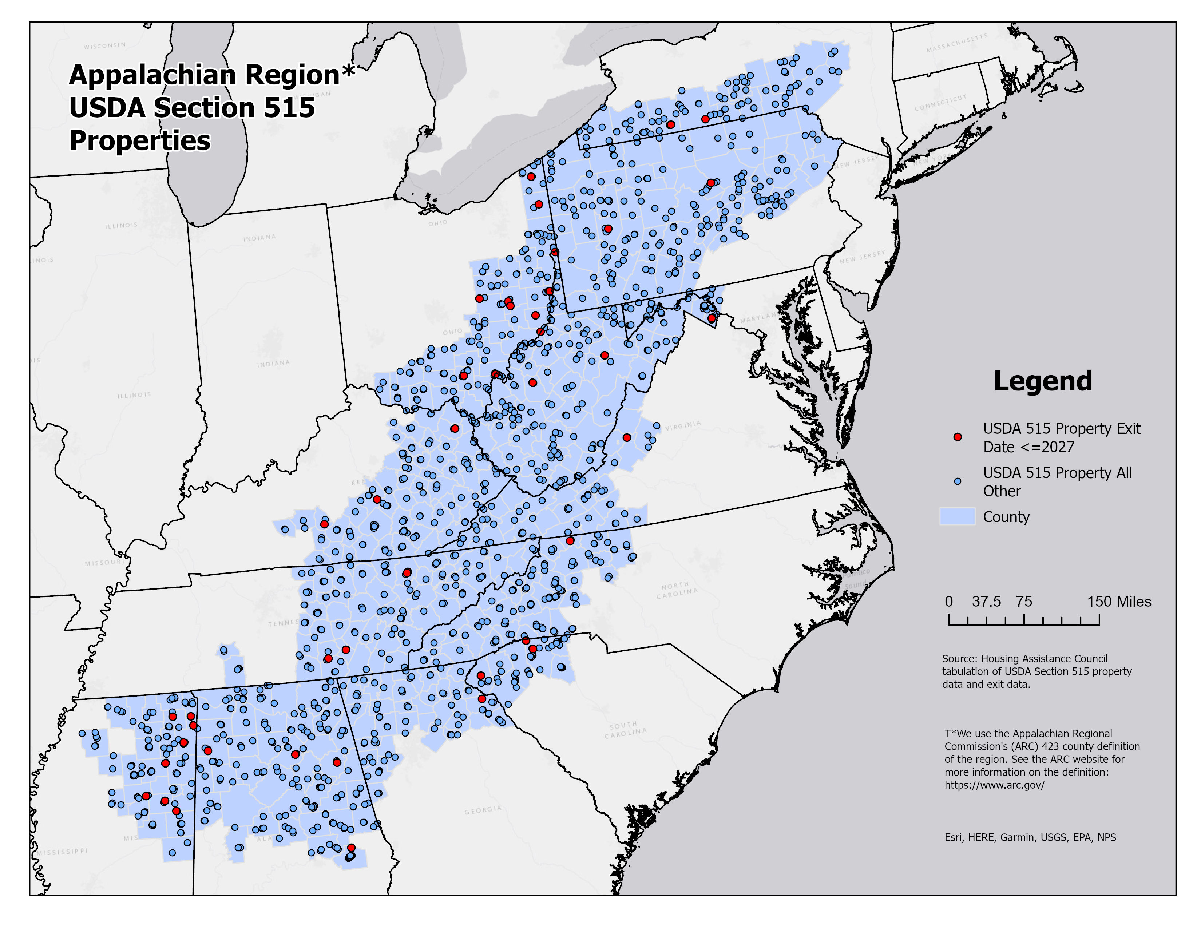
Rental Markets
Rental cost-burden is almost universally high.
Made worse by risk to market associated with USDA 515 properties.
Renter Occupied Cost Burdened Units, ACS 2022
Geography | Outside of Metropolitan Area | Inside Metropolitan Area | Total
Appalachian Region | 45.6% | 47.3% | 46.8%
U.S | 45.6% | 50.5% | 49.9%

Slide 17
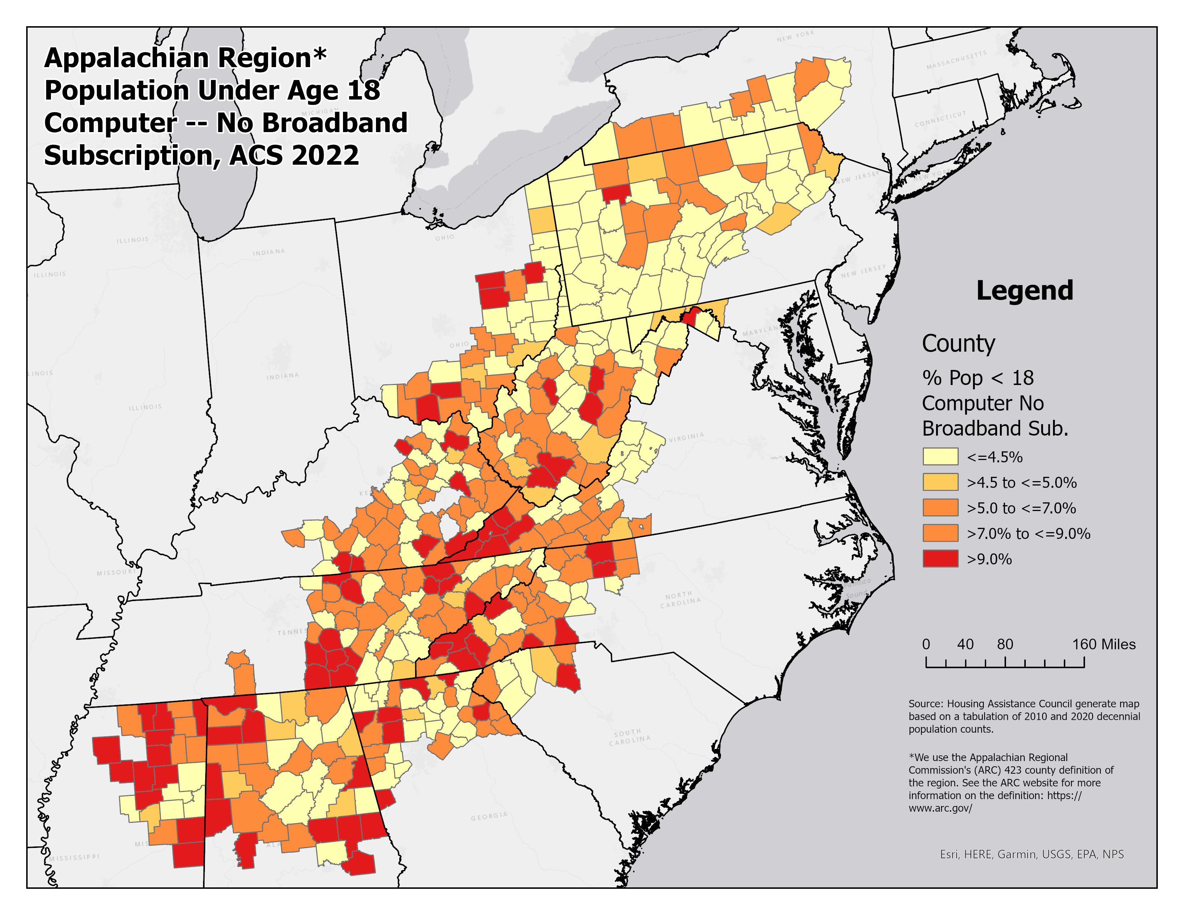
Broadband Subscription
% Population <18 in household with computer but no broadband subscription | Appalachian Region Counties
 | Count | %
Under 4.5% | 172 | 40.7%
4.5 to 9% | 173 | 40.9%
More than 9% | 78 | 18.4%
Total | 423

Slide 18
Conclusion
About 38% of the region’s counties grew last decade.
Growth was concentrated in Southern Appalachia.
Home prices increased at a faster rate than incomes.
25 counties with median loan amounts of $250,000 or more.
Affordability issues made worse, and it impacts workforce housing needs.
Renters most impacted – threat of losing USDA 515.
Along with housing needs, improved infrastructure, like broadband.

Slide 19
Questions?
This Photo by Unknown Author is licensed under CC BY

