Slide 1
Building Capacity to Support Business Development Across Appalachia
March 12, 2024
U.S. Department of Commerce | International Trade Administration | U.S. Commercial Service

Slide 2
Our Global Presence
The U.S. Commercial Service, creates jobs in the United States and strengthens U.S. economic and national security by promoting U.S. exports, and ensuring market access and a level playing field in international trade for U.S. companies.
Strategically located in 106 U.S. and 127 foreign locations in 80 countries, our global network of trade and investment professionals are well-positioned to help U.S. companies succeed internationally and ensure that U.S. businesses and commercial interests have a robust advocate and first line of defense against unfair foreign trade practices and market access barriers.
U.S. Commercial Service Offices Worldwide
U.S. COMMERCIAL SERVICE Overview
trade.gov/export-solutions

Slide 3
Export Counseling
International Business Development
The U.S. Commercial Service provides you with reliable information and personalized counseling at every step of your export journey- from strategy and planning, ﬁnancing and logistics, market entry and expansion, to advocacy, and even eCommerce counseling. Our trade experts are here to address your concerns and guide you to success in the global marketplace.
eCommerce Innovation Lab
The eCommerce Innovation Lab helps U.S. business by identifying export opportunities across the ecommerce sales channels, through concentration on client digital strategy development, use of Website Globalization Review gap analysis tools, and the online eCommerce Export Resource Center business library to help companies adapt and grow in the digital economy.
U.S. COMMERCIAL SERVICE Overview
trade.gov/export-solutions

Slide 4
Market Intelligence
Country Commercial Guides
Prepared by trade and industry experts, Country Commercial Guides provide information on market conditions, opportunities, regulations and business customs for over 125 countries. Country Commercial Guides detail important factors to help you decide if a market is right for your product or service.
U.S. COMMERCIAL SERVICE Overview
trade.gov/export-solutions

Slide 5
Business Matchmaking
Single Company Promotion
Provides U.S. companies with promotional services to help increase the awareness of their product or service in a speciﬁc market. The promotional event may consist of a technical seminar, press conference, luncheon, dinner, or reception with targeted direct mail or email campaigns.
International Partner Search
Provides U.S. ﬁrms with a list of up to ﬁve prospective agents, distributors and partners that have expressed an interest in your product or service. Virtual introduction via teleconference to the identiﬁed contacts also available.
Business Service Provider Listing
An online program to help U.S. exporters identify a professional export service provider to support them in the assessment, ﬁnancing, or completion of an export transaction.
Gold Key Service
Provides U.S. ﬁrms traveling to a foreign market with up to ﬁve pre-screened appointments to establish relationships with potential overseas agents, distributors, sales representatives, business partners and other local, in-country entities.
U.S. COMMERCIAL SERVICE Overview
trade.gov/export-solutions

Slide 6
Trade Events
Commercial Service
Presented Events
Certified Trade Missions
Organized with select trade organizations, missions are customized to meet the needs of groups of U.S. companies participating. Missions may include activities such as market brieﬁngs, Gold Key Service, receptions, site visits, and technical seminars.
International Buyer Program
At major domestic industry trade shows, the U.S. Commercial Service provides services including on-site introductions to foreign buyers; networking; export counseling; market analysis; and business matchmaking.
Organized by the U.S. Commercial Service, these annual business development forums focus on an industry and/or world region. The conferences feature one-on-one meetings with U.S. Commercial Service diplomats visiting from abroad; panel discussions on the latest industry trends; export education; and extensive networking with U.S. trade ofﬁcials and leading private sector experts.
Trade Show Representation
The Trade Show Representation Service provides U.S. companies and economic development organizations with the ability to increase their marketing exposure at an overseas trade show when they are unable to attend in-person. Multiple clients’ products and services may be showcased by the Commercial Service at the event.
International Trade Fairs
Certiﬁed trade fairs feature a U.S. Pavilion and represent a U.S. Department of Commerce endorsement that the fair offers a high-quality, multifaceted opportunity for American companies to successfully market their product/services overseas. Participating companies receive U.S. Commercial Service assistance with access to prospective foreign buyers, agents, and industry representatives. Other services include pre-show industry/country market brieﬁngs, one-on-one export counseling, onsite promotion, and more.
Organized by the U.S. Commercial Service, Trade Winds missions include a business development forum in its host city, consisting of regional and industry speciﬁc conference sessions as well as pre-arranged consultations with U.S. Diplomats representing commercial markets throughout the region. Participating companies can customize a business matchmaking schedule with multiple stops, based on input from our in-country Commercial Specialists, and grow their international sales through meetings with pre-screened potential buyers, agents, distributors and joint-venture partners during the mission.
U.S. COMMERCIAL SERVICE Overview
trade.gov/export-solutions

Slide 7
Commercial Diplomacy
Advocacy Center
The Advocacy Center coordinates U.S. Government Advocacy efforts for U.S. exporters competing on foreign projects or procurement opportunities that involve foreign government decision-makers, including foreign government-owned corporations. U.S. Government Advocacy assistance helps level the playing ﬁeld on behalf of U.S. exporters and workers competing for international contracts against foreign firms and to promote the growth of exports of U.S. goods and services around the world.
Report a Trade Barrier
File a complaint with the International Trade Administration’s Trade Agreements Negotiations and Compliance Ofﬁce. This ofﬁce works with U.S. businesses to help ensure that foreign governments adhere to and do not impose trade barriers inconsistent with their trade agreement obligations.
Trade Dispute Resolution
We can provide information to help you resolve common trade disputes like customs issues. In some instances, we may be able to make inquiries directly with the foreign government.
U.S. COMMERCIAL SERVICE Overview
trade.gov/export-solutions

Slide 8
The world is open for your business.
Let our global network work for you.
Our global network of experienced trade professionals is located throughout the United States and in U.S. Embassies and Consulates worldwide. Whether you’re looking to make your ﬁrst export sale or expand to additional markets, we offer the expertise you need to connect with opportunities and increase your bottom line.
Worldwide Recognition
As the U.S. government, we can open doors in markets around the world.
Our Services
Global Network
Our global network with trade experts in more than 76 markets can provide you with on-the-ground knowledge and connections.
Export Counseling
• Learn about the export process and develop eﬀective market entry and sales strategies.
• Find out about export documentation requirements and import regulations of foreign markets.
• Learn about U.S. government export controls, compliance and trade ﬁnancing options.
Results Driven
Our expert, in-person counseling is designed to help you succeed in global markets.
Market Intelligence
• Analyze market potential and foreign competitors.
• Obtain useful information on best prospects, ﬁnancing, laws, and cultural issues.
• Conduct background checks on potential buyers and distributors.
Business Matchmaking
• Connect with pre-screened potential partners.
• Promote your product or service to prospective buyers at trade events worldwide.
• Meet with international industry and government decision makers in your target markets.
Commercial Diplomacy
• Address trade obstacles to successfully enter international markets.
• Beneﬁt from coordinated U.S. government engagement with foreign governments to protect U.S. business interests.
U.S. COMMERCIAL SERVICE Overview
trade.gov/export-solutions

Slide 9
Exports Matter
More than 70% of the world's purchasing power is outside of the United States.
Competitors are increasing their global market share while the U.S. is underperforming.

Slide 10
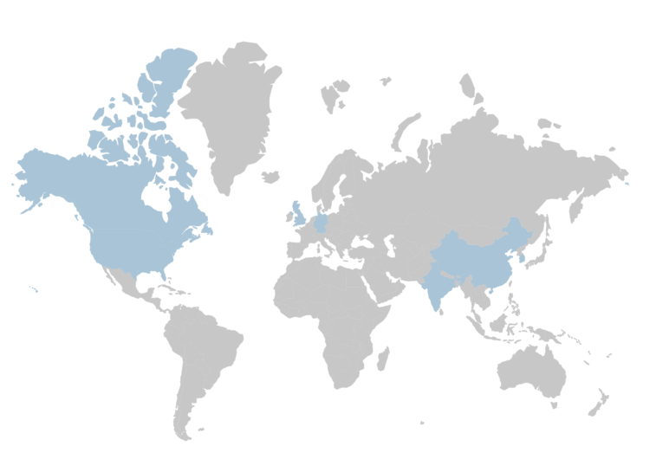
28%
United Kingdom
31%
Canada
Opportunity
20%
China
With only 11% of the United States GDP generated by exports, it’s safe to say we have a lot of room for growth.
The U.S. Commercial Service works to fill that space
42%
Korea
11%
United States
21%
India
47%
Germany
U.S. COMMERCIAL SERVICE Overview
EXPORTS OF GOODS & SERVICES (% GDP)
WorldBank2021
Notes:
Export promotion programs in countries around the world have significant funding and staffing to provide assistance and services to their local businesses.
Less than 5% of U.S. SME’s export; and of those that do, 58% sell to just one market.

Slide 11
The Rural
Export Center
Every Company Has a Research Need
U.S. Department of Commerce | International Trade Administration | U.S. Commercial Service

Slide 12
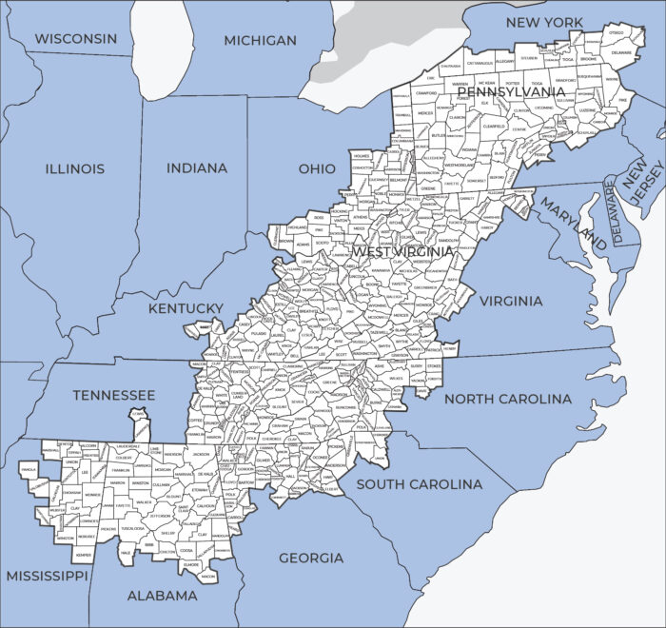
Appalachia is made up of 423 counties across 13 states and spans 206,000 square miles, from southern New York to northern Mississippi. The Region’s 26.3 million residents live in parts of Alabama, Georgia, Kentucky, Maryland, Mississippi, New York, North Carolina, Ohio, Pennsylvania, South Carolina, Tennessee, and Virginia, and all of West Virginia. The Region also comprises three federally recognized and five state recognized Native American Tribal Communities, with Tribal entities in Appalachian Alabama, Georgia, Mississippi, New York, and North Carolina.
MAP OF APPALACHIAN DESIGNATED COUNTIES
Ohio Valley Specialist
Louisville, KY
Jefferson County
Appalachian Specialist
Charleston, WV
Kanawha County
Southern Specialist
Jackson, MS
Hinds County

Slide 13
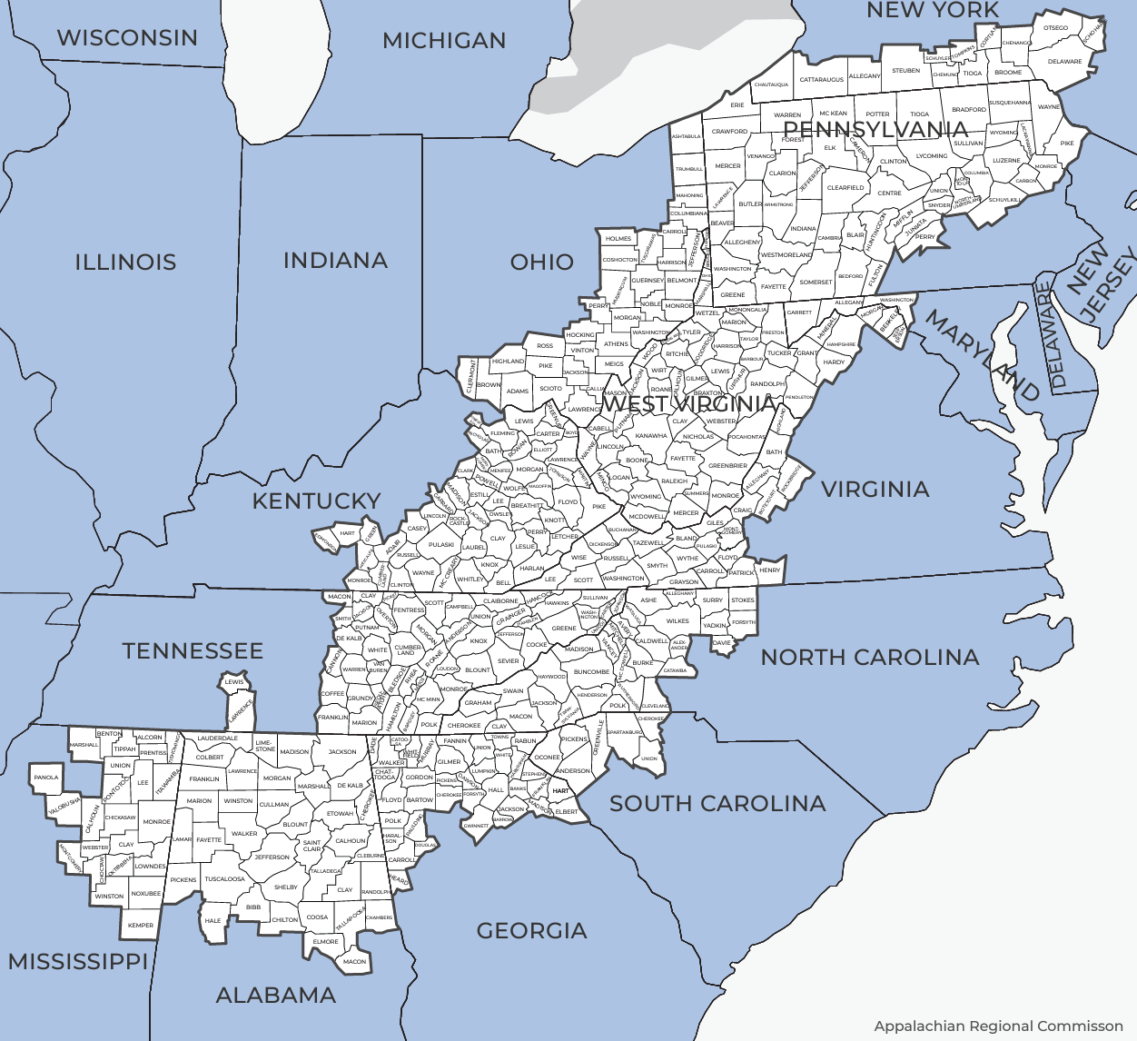
Our Presence in the Appalachian Region
26 CS offices covering the Appalachian Counties
AL: 1 Office - Birmingham
GA: 1 Office Atlanta
KY: 2 Offices – Louisville, Lexington
MD: 1 office – Baltimore
MS: 1 Office - Jackson
NY: 3 Offices – Buffalo, Rochester, Westchester
NC: 2 Offices – Charlotte, Greensboro
OH: 4 Offices – Cleveland, Toledo, Columbus, Cincinnati
PA: 3 offices - Pittsburgh, Harrisburg, Philadelphia
SC: 1 office - Greenville
TN: 3 offices: Knoxville, Memphis, Nashville
VA: 2 Offices – Arlington, Richmond
WV: 2 Offices – Charleston, Wheeling
3 CS Rural Export Centers
Appalachian – Charleston WV
Ohio Valley – Louisville KY
Southern – Jackson, MS
U.S. COMMERCIAL SERVICE Rural Export Centers
trade.gov/rural-export-center

Slide 14
In-Depth Research
Questions RAISE Helps Answer
Matrix
Which country do I go to?
Polling
What is the current status
of a foreign market?
Country Reports
What are the trends, size, and growth
of my chosen market?
Who can I partner with or sell to?
Potential Partner List
Who can I partner with or sell to?
U.S. COMMERCIAL SERVICE The Rural Export Center
trade.gov/rural-export-center
trade.gov/rural-export-center

Slide 15
How does RAISE solve rural export problems?
Analytics-centric - consultative, step-by step
approach to export expansion
Action - 93% of companies acting after research
Specialization – database knowledge
Integrated – complements other CS services
U.S. COMMERCIAL SERVICE Fargo, North Dakota
trade.gov/fargo-contact-us

Slide 16
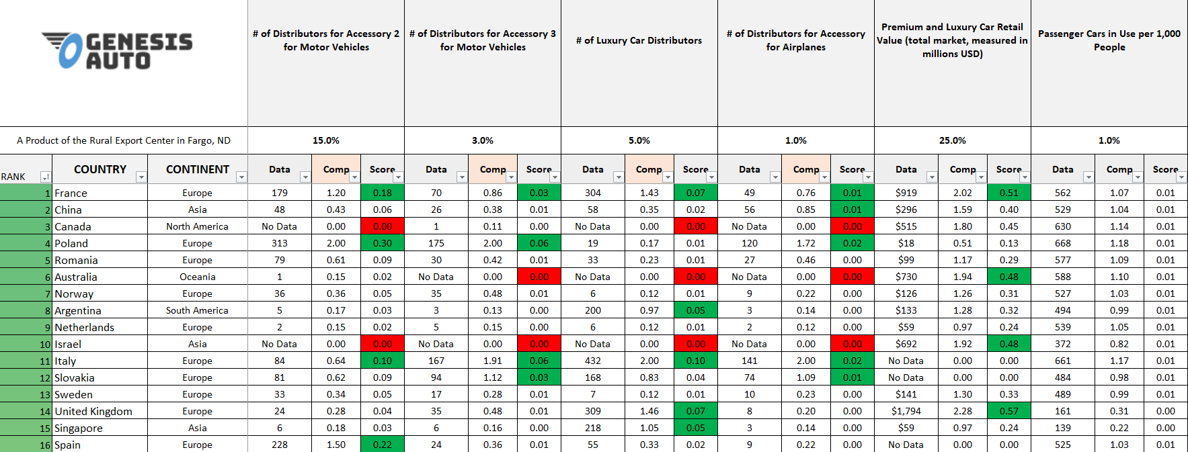
What is a “Matrix”?
U.S. COMMERCIAL SERVICE The Rural Export Center
trade.gov/rural-export-center

Slide 17
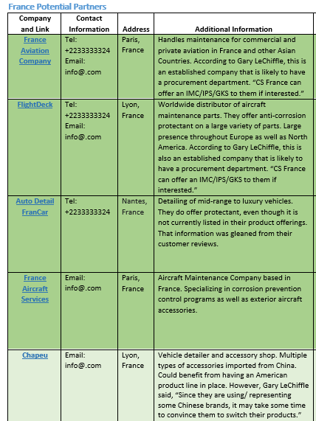
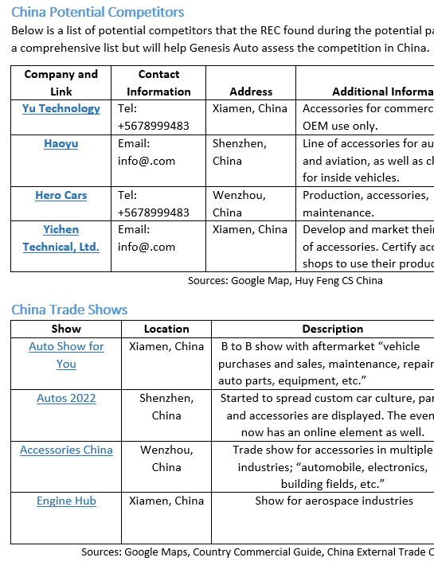
Country Reports and Potential Partners
U.S. COMMERCIAL SERVICE The Rural Export Center
trade.gov/rural-export-center

Slide 18
What is a “Potential Partner List”?
Company and Link | Contact Information | Address | Additional Information | Type
Mazter Maderas | Tel: +52 (81) 8381-0929 Email: Contact Page | Garcia, Nuevo León | Imported over 25,000 cubic meters of sawn red oak from the U.S. in 2023. Offers plywood, boards, MDF, pallets, and wood packaging. A member of IMEXFOR, CANAINMA, and CAINTRA Nuevo Leon. | Lumber Wholesaler
Sample Genesis Lumber PPL.pdf
U.S. COMMERCIAL SERVICE The Rural Export Center
trade.gov/rural-export-center

Slide 19
What is YOUR Research Need?
Matrix | Country Report | Potential Partner List | Website Review
I need to deprioritize difficult markets and focus on low hanging fruit
I need to know if the market is worth the time to pursue
I need a list of buyers to determine if there is an opportunity
I need to know if the market is stagnant
I need more customers in general and/or prior to a trade show!
I need market knowledge before a trade show or country visit
I need to understand an industry in a country
I need to attract more and better international visitors to my website
U.S. COMMERCIAL SERVICE The Rural Export Center
trade.gov/rural-export-center

Slide 20
Who is an Ideal Client?
Established companies with bandwidth to proactively follow the plan
Companies with dedicated international sales staff
Ambitious, data-driven, strategic companies
Companies with new staff who are seeking to learn and be strategic
U.S. COMMERCIAL SERVICE Fargo, North Dakota
trade.gov/rural-export-center

Slide 21
RAISE Value to Companies
Cost-Effective:
Customized, Objective Product
Over $1 million in databases
Customized to the client’s industry and product with an outsider’s unbiased analysis
Time-Saving:
Experienced Researchers and Reviewers:
Over 140 hours spent on 3 Country Reports
5-step expert review process
Valuable Connections:
Return on Investment:
In-Country U.S. Commercial Service industry contacts
Cost < than 1 new partner
U.S. COMMERCIAL SERVICE The Rural Export Center
trade.gov/rural-export-center

Slide 22
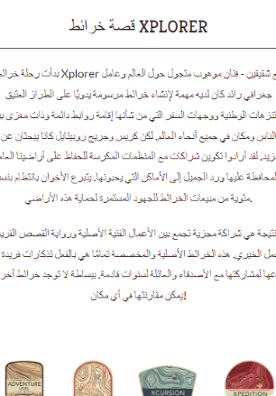
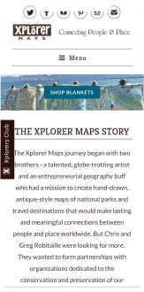
Website Globalization Review
Are you attracting international inquiries that lead to business?
Is your website responsive and welcoming to international visitors?
The analysis focuses on:
Backend Issues
Internationalization
Digital Strategy
3 Reports in 1!
1 Globalization Analysis
2 Crawler Reports
$100
U.S. COMMERCIAL SERVICE The Rural Export Center
trade.gov/rural-export-center

Slide 23
Internationalization Best Practices
Is your website reaching international audiences?
Search Engine Optimization- can your website be found when it should?
Make it clear on your webpages that you do international sales.
Continually adding new content (keywords & backlinks).
Looking at website analytics for “website visitor country of origin”.
International Consumers Enter Here!
trade.gov/website-internationalization

Slide 24
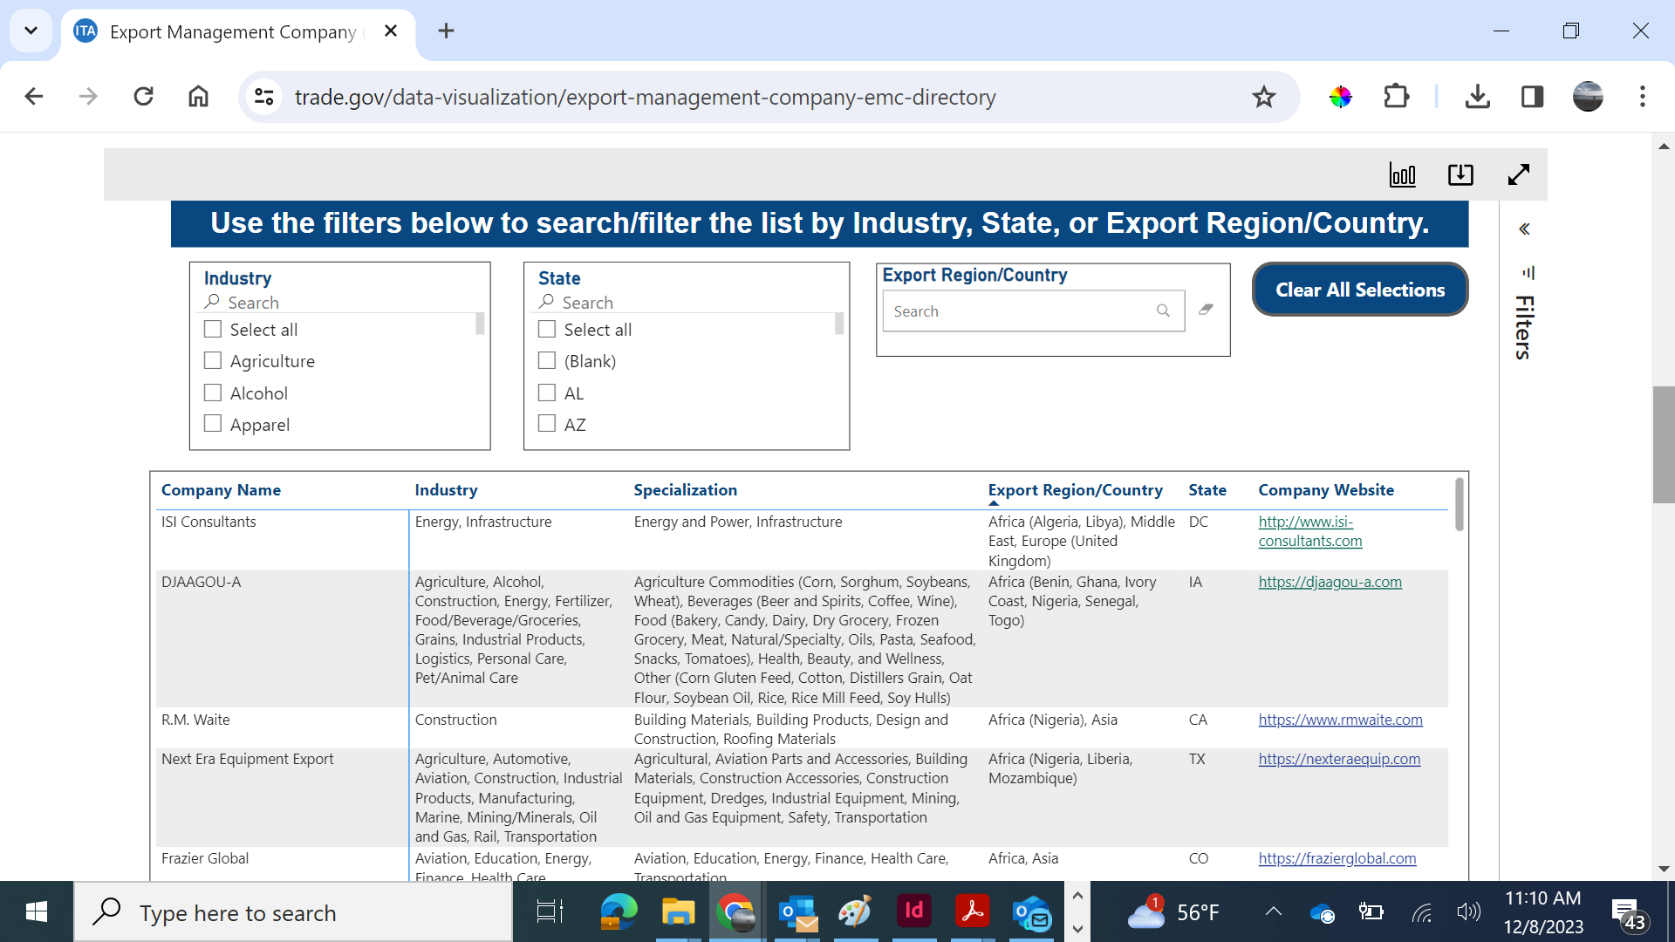
Export Management Company Directory
An Export Management Company (EMC) is a company that acts as an outside export department for small and mid-sized U.S. manufacturers.
The EMC Directory provides a listing of vetted and experienced U.S. companies ready to help U.S. companies export more.
U.S. COMMERCIAL SERVICE The Rural Export Center
trade.gov/rural-export-center
Notes:
Allows for the U.S. company to focus on U.S. market and product manufacturing. The REC has a database of EMCs …..

Slide 25
Quick Due Diligence
with the
REC Check – Quick Due Diligence Report
Search of multiple subscription databases
Report on Internet and social media presence
Recommendations
$150
U.S. COMMERCIAL SERVICE The Rural Export Center
trade.gov/rural-export-center

Slide 26
RAISE Research Pricing
Matrix
Country Report
Potential Partner List
Matrix +
3 Country Report
Assess export potential
Find a market
Compare regions
Make an export plan
Identify business partners
Understand industries in key countries
Evaluate trade shows
Develop an action plan
Identify potential partners
Maximize travel time
Build a network
Contact buyers prior to a trade show
$950
$950
$400
$3,750
Website Globalization Review
REC Check
Export Management
Company Directory
Technical assessment focused
on internationalization
A quick due diligence report on
a potential partner
Develop overseas distribution channels for your company
$100
$150
No Cost
U.S. COMMERCIAL SERVICE The Rural Export Center
trade.gov/rural-export-center

Slide 27
Visit Our Website
RAISE Program
Learn more about how this unique program can
provide you with customized market intelligence
Rural Successes
Read how clients used a variety of different
Reports to reach their full potential in overseas markets
Rural Voices
Learn to face and overcome challenges with advice
from rural exporters and leaders
Rural Training
Learn how to proactively approach a new market
through customizable research and trainings
U.S. COMMERCIAL SERVICE The Rural Export Center
trade.gov/rural-export-center

Slide 28
How can the U.S. Commercial Service support economic development in Appalachia?
Exports help Appalachian businesses expand
Exports help Appalachian businesses diversify
U.S. COMMERCIAL SERVICE
trade.gov
Notes:
Enybe – example of generating a pipeline
Jennifer – example of ROI

Slide 29
How to Partner with the
US Commercial Service
Joint Company Outreach & Counseling
Inclusion in Industry Events
Inclusion of International Trade Facilitation Programs in ARC grants
Industry Referrals
U.S. COMMERCIAL SERVICE
trade.gov

Slide 30
U.S. COMMERCIAL SERVICE

Slide 31
USEAC Charleston
Leslie Drake
Director West Virginia Offices
Charleston, WV
Tel: 304-347-5123
Leslie.Drake@trade.gov
U.S. COMMERCIAL SERVICE
trade.gov

