Slide 1
Western Piedmont Housing Growth Toolkit
NADO/DDAA 2024 Washington Conference
March 11, 2024

Slide 2
The Ongoing Housing Crisis
Estimates vary, but studies consistently show a nationwide shortage of at least several million homes given new household formation rates.
People with lower and extremely-low incomes are at serious risk of housing instability.
Many are spending more than half their income on housing costs.
Demographic trends: Newly-forming households who need smaller “starter” homes are competing with older residents looking to downsize.

Slide 3
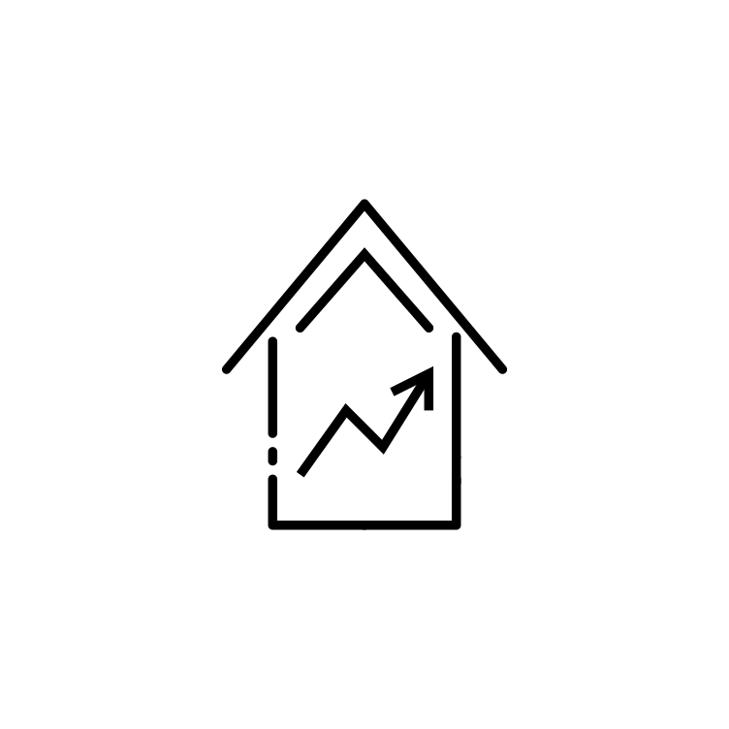
Regional Needs
Housing for Our Diverse Workforce
Our economy must provide both jobs and housing for people of all skills.
Price Stabilization
The median sales price of a home in the region rose from approximately $120,000 in 2013 to more than $250,000 in 2023. Median rent is up 10% year-over-year statewide.
Sufficient Population Growth
Regional targets call for between 1% and 2% population growth per year for a healthy economy.
Replacing Aging Housing Stock
Nearly half (48%) of housing in the Hickory MSA was built before 1980 – the highest percentage of all MSAs in the state.

Slide 4
What Can We Do?
The Housing Growth Toolkit focuses on optimizing zoning and development review regulations and procedures to enable new and diverse types of housing production.
Goals
Allow and promote more types of housing
Preferences are changing
Aging population and early-career workers are competing for housing
Family size is shrinking, yet most new homes are very large
Allow and promote denser housing
Increasing supply can help stabilize costs
Higher densities provide fiscal and environmental benefits to local government
Quicker, predictable development reviews
Optimize standards, and allow staff to administer
Boards don’t need to review technical plats and plans.
Hearings only for major projects

Slide 5
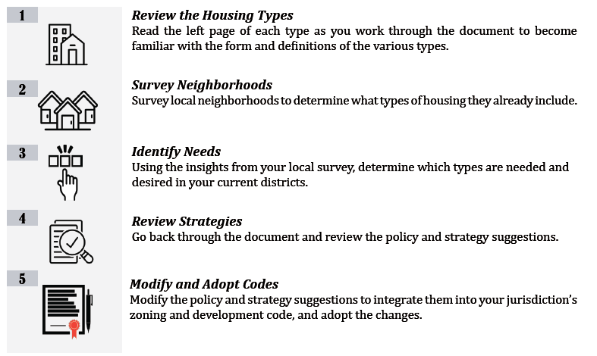
How to use the Tool Kit

Slide 6
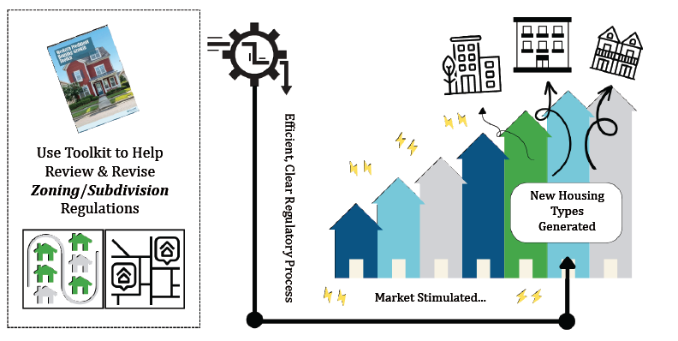
The Hope…. New Housing Types

Slide 7
More Choice and Density = Better Value for Taxpayers
Higher density housing leads to more efficient local services, and can help lower overall taxpayer costs.
Cost Savings: Higher density housing allows the same amount of infrastructure to serve a larger number of people.
Environmental Benefits: Higher density housing allows more land to be conserved as countryside, and protects water supplies and the natural beauty of the area.
Increased Revenue: Higher density housing can increase the tax base, leading to greater revenue and potentially lowering the cost burden per residents while allowing for improved services.
Same amount of pipe can serve many more people

Slide 8
Ten Practices for Enabling Housing Production
Allow more housing types across districts
Reduce minimum lot sizes
Reduce setback requirements
Revise street frontage requirements
Reduce parking minimums
Enable unique PUD projects
Allow accessory dwelling units
Shift reviews to staff
Reduce street width requirements
Consider incentives for density/design

Slide 9
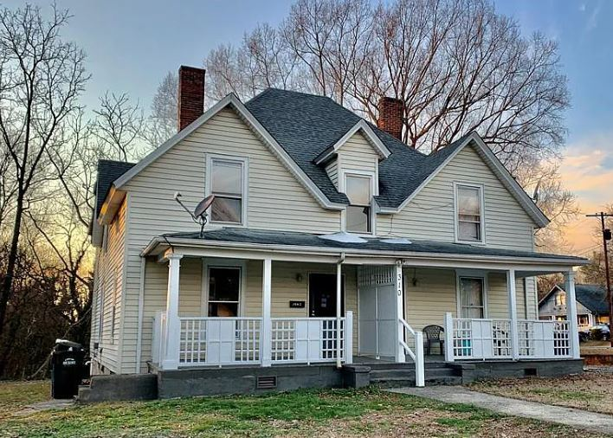
1. Allow More Housing Types Across Districts
Allow different housing types across residential districts.
Duplex, triplex, quadplex+
Multifamily
“Missing middle”
Increase choice of housing options for different living situations.
Design and placement standards can help infill fit into existing neighborhoods.

Slide 10
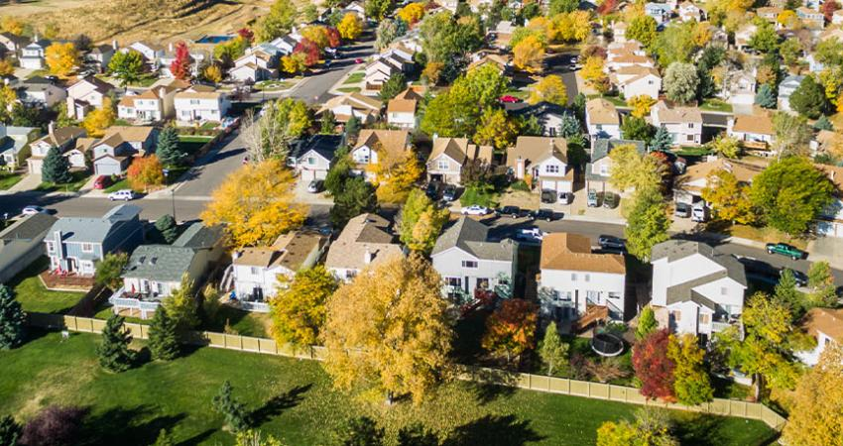
2. Decrease or Eliminate Minimum Lot Sizes
Minimum lot sizes can increase the cost to buy and build.
Can incentivize sprawl, as infrastructure and streets have to be run across more land to reach fewer people.
Flexibility is needed for people to determine their own desires for the size of their land.
Minimum lot sizes may still be required for well/septic and watershed regulations.

Slide 11
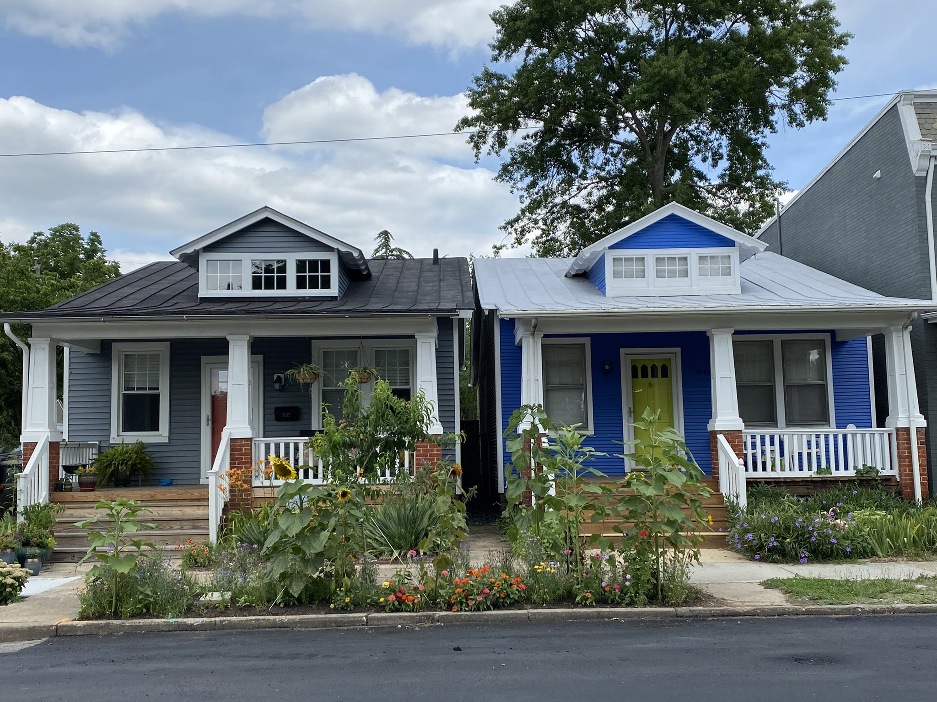
3. Reduce Setback Requirements
Setback requirements are often overly large. This adds cost and reduces the ability for adaptive design on unusual or small lots.
Builders will often exceed the minimums.
Smaller setbacks, or even build-to lines, can bring structures closer to the street and limit impervious surface.
Front and rear setbacks should balance privacy and connection to the street.
Side setbacks can be lowered to 5-8 feet or offset from one side to allow for a shared driveway or rear parking .

Slide 12
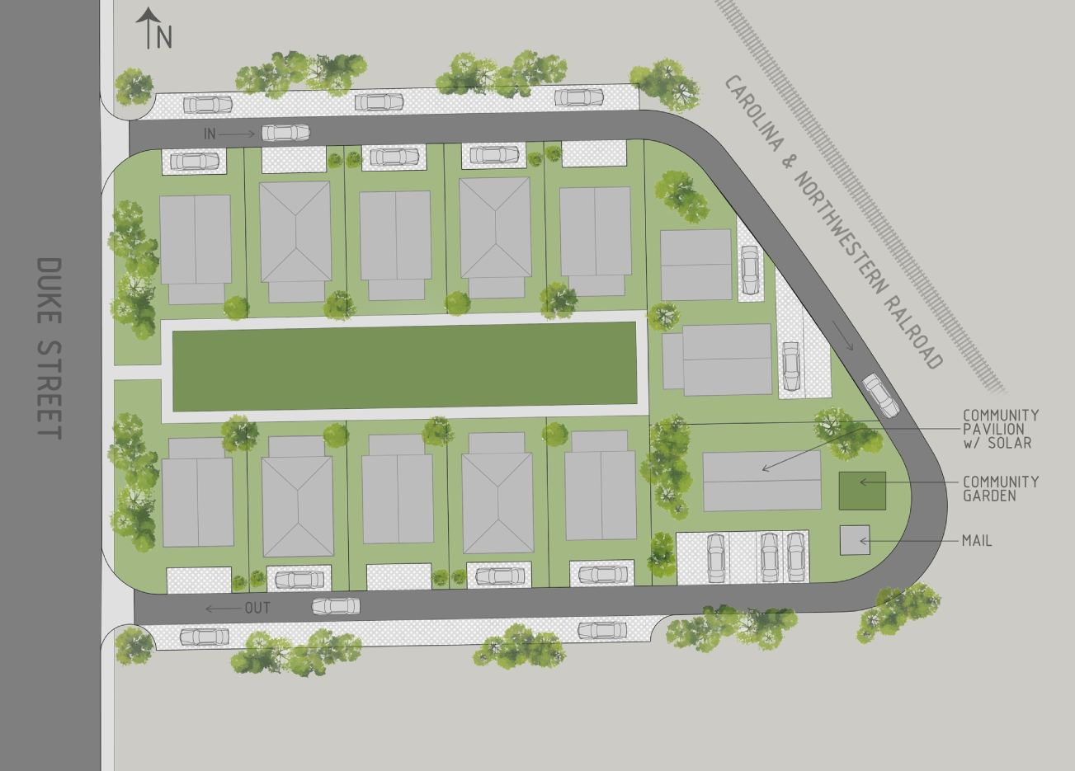
4. Revise Street Frontage Requirements
As long as projects have access as a whole, not every lot needs to front a public street.
Cottage courts and pocket neighborhoods could front green spaces with private access through alleyways.
Other options could be greenways, plazas, courtyards, squares, etc.
Opens up development possibilities for unusual lot shapes and contexts

Slide 13
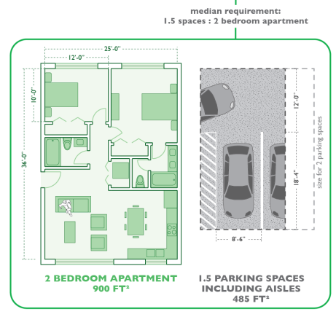
5. Lower or Eliminate Minimum Parking Standards
Parking minimums are often arbitrary.
Excess parking causes environmental damage and increases cost.
Builders should bear the risk of developing too little parking.
Site plan review should note potential problems (lack of space for guests) and allow for creative placement.
Parking residential homes should not have to be permanently paved.
Parking can take up huge amounts of land.

Slide 14
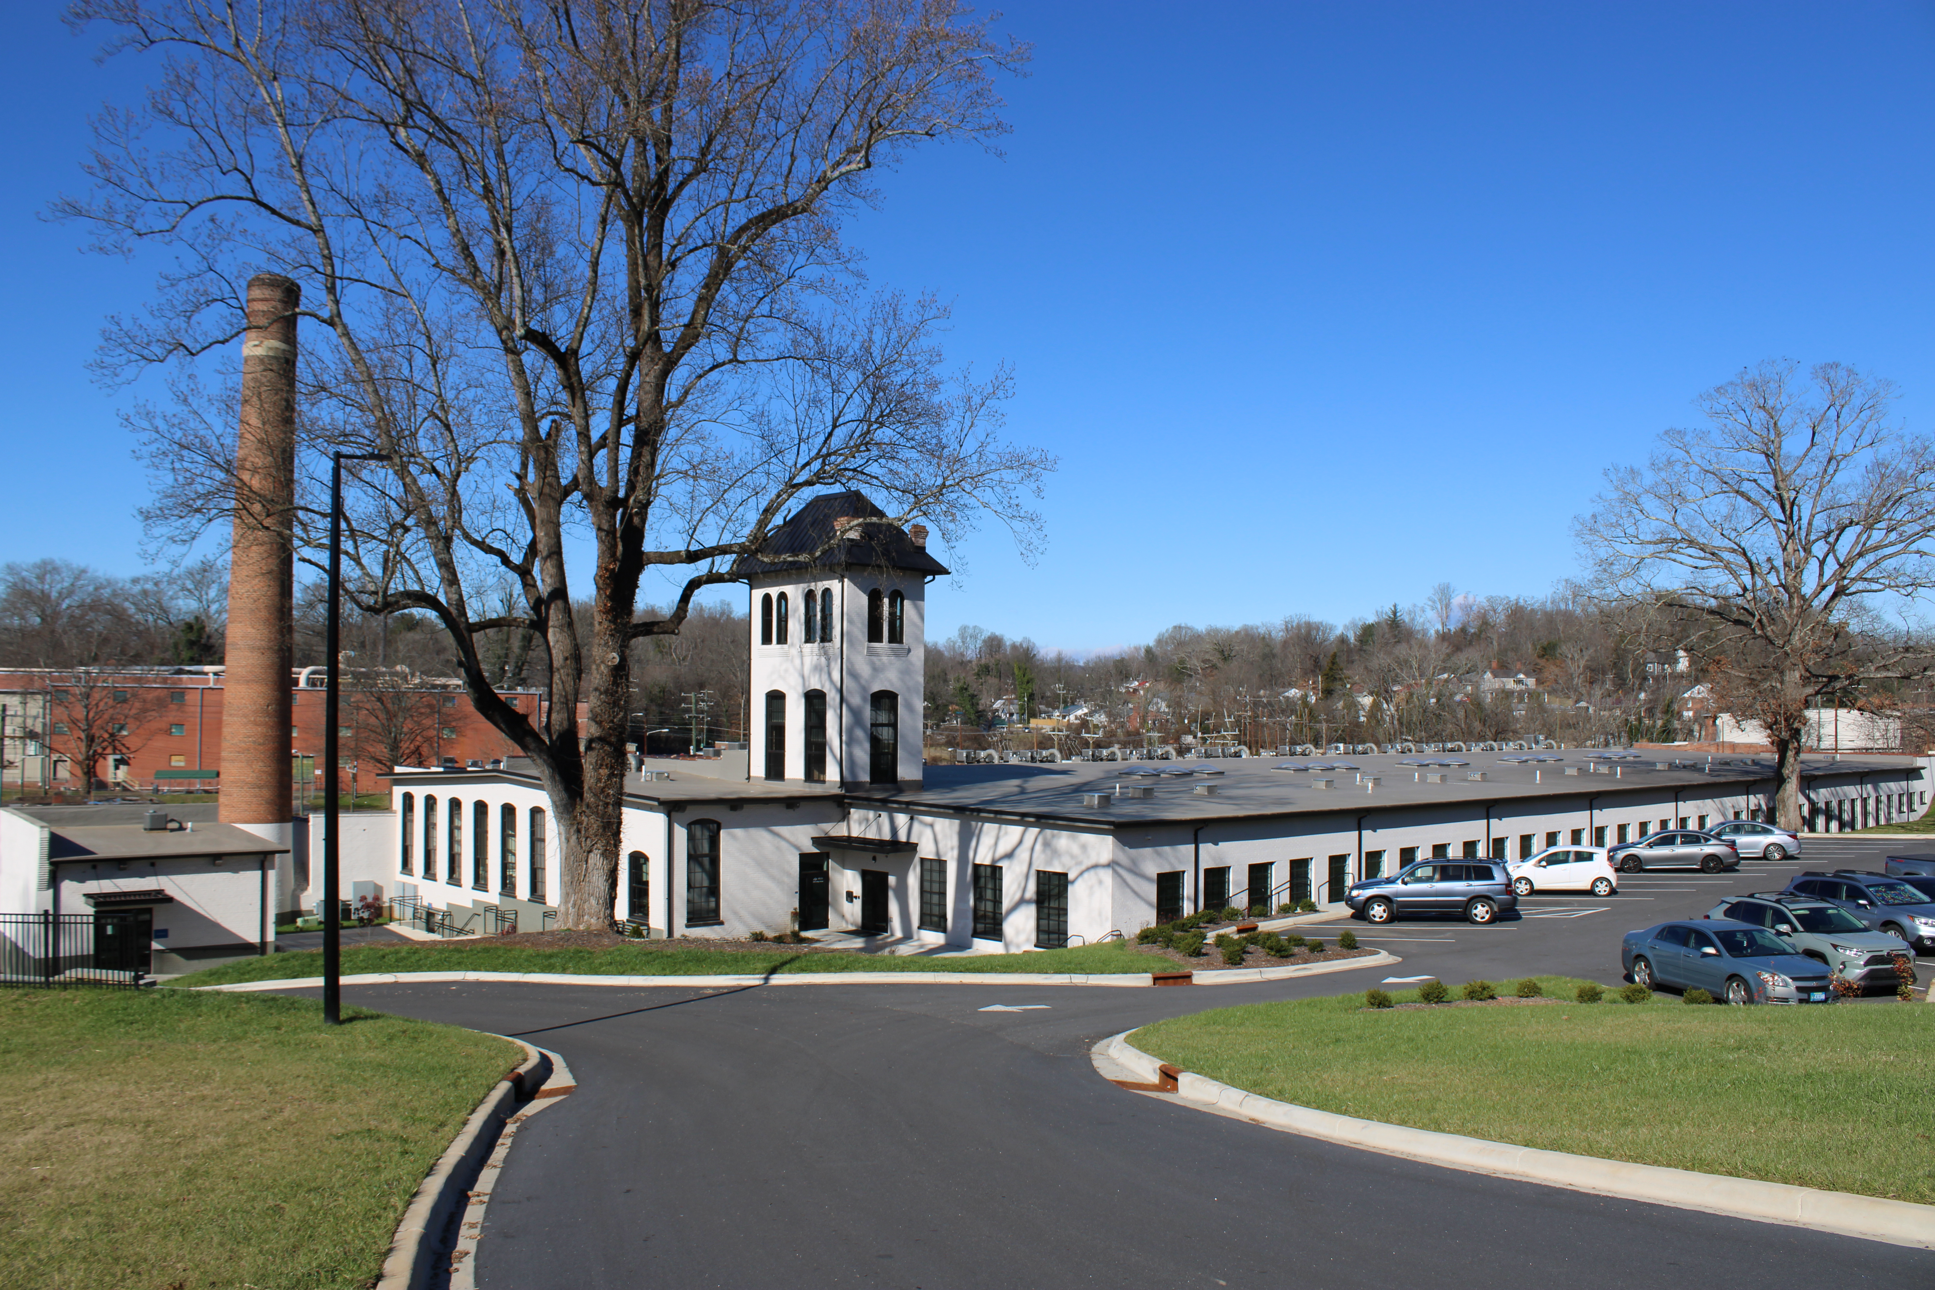
6. Allow Unique PUD and Adaptive Reuse Projects
Planned unit developments like cottage courts, mixed use, or adaptive reuse can generate new projects.
Opens up possibilities on unusual/difficult lots, brownfield redevelopment, downtown projects, etc.
Can be done using staff review as well if ordinance has clear standards.
Creative funding strategies may also exist for these projects, particularly adaptive re-use of older buildings.

Slide 15
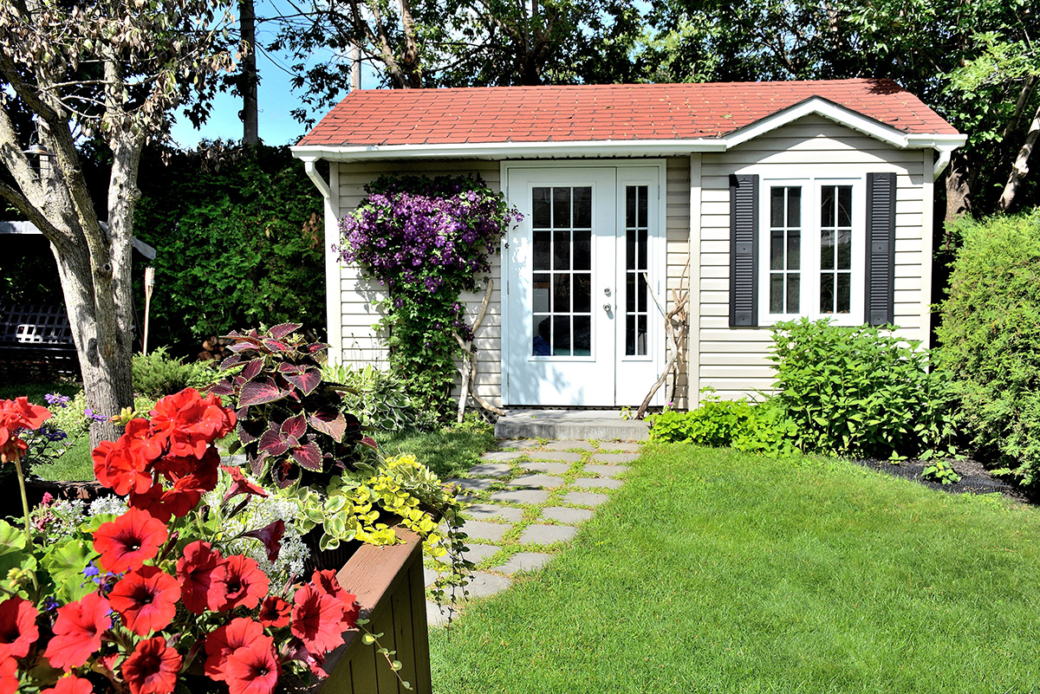
7. Allow ADUs in Residential Districts
Accessory dwelling units can add gentle density in existing residential districts.
ADUs can add space for family members, caretakers, renters, singles, etc.
Can usually fit well into existing accessory structure standards.
Many new options are coming on the market for modular ADUs.

Slide 16
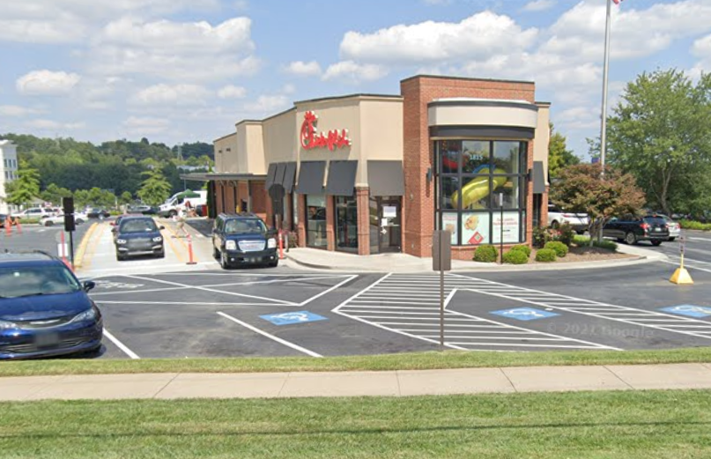
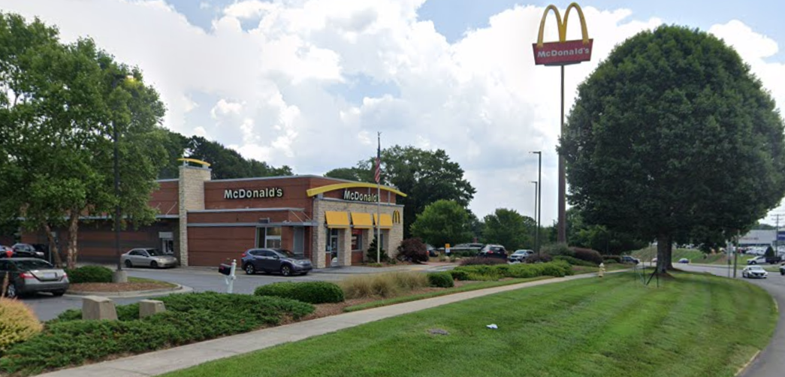
Commercial site plans often do not need board review, but can involve large amounts of traffic…
Chic-fil-A in Hickory – 12 month 5 day average of 1493 trips
McDonalds in Hickory – 12 month 5 day average of 543 trips

Slide 17
Why require board review to address traffic concerns for residential projects, but not for commercial?
Chic-fil-A in Hickory – 12 month 5 day average of 1493 trips
McDonalds in Hickory – 12 month 5 day average of 543 trips
Assuming a housing unit generates 8 trips per day…
That is equivalent to:
186 Housing Units
67 Housing Units

Slide 18
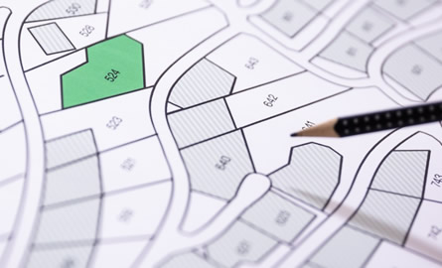
8. Shift Project Reviews to Staff
Most technical site plans and plats do not need to be reviewed by boards.
Boards should reserve their time for truly large and transformative projects
Public meetings can cause uncertainty about the approval process and create expectations that local governments have more authority on projects than they do
Instead, effort can be placed into crafting high-quality codes, approved by the government boards, that allow for administrative review.

Slide 19
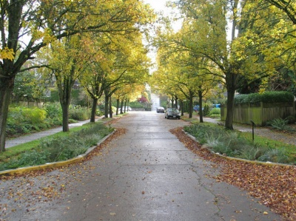
9. Reduce Required Street Paving Widths
Roads for new residential subdivisions can be reduced in width as much as feasible.
Wider, overbuilt roads lead to more impervious surface and increase cost, which is passed on to the owner/renter/taxpayer.
Where feasible, alleys with ribbon curb can be used instead of large access roads.
On-street parking can be encouraged to lessen parking and maneuvering space, and helps to slow traffic.

Slide 20
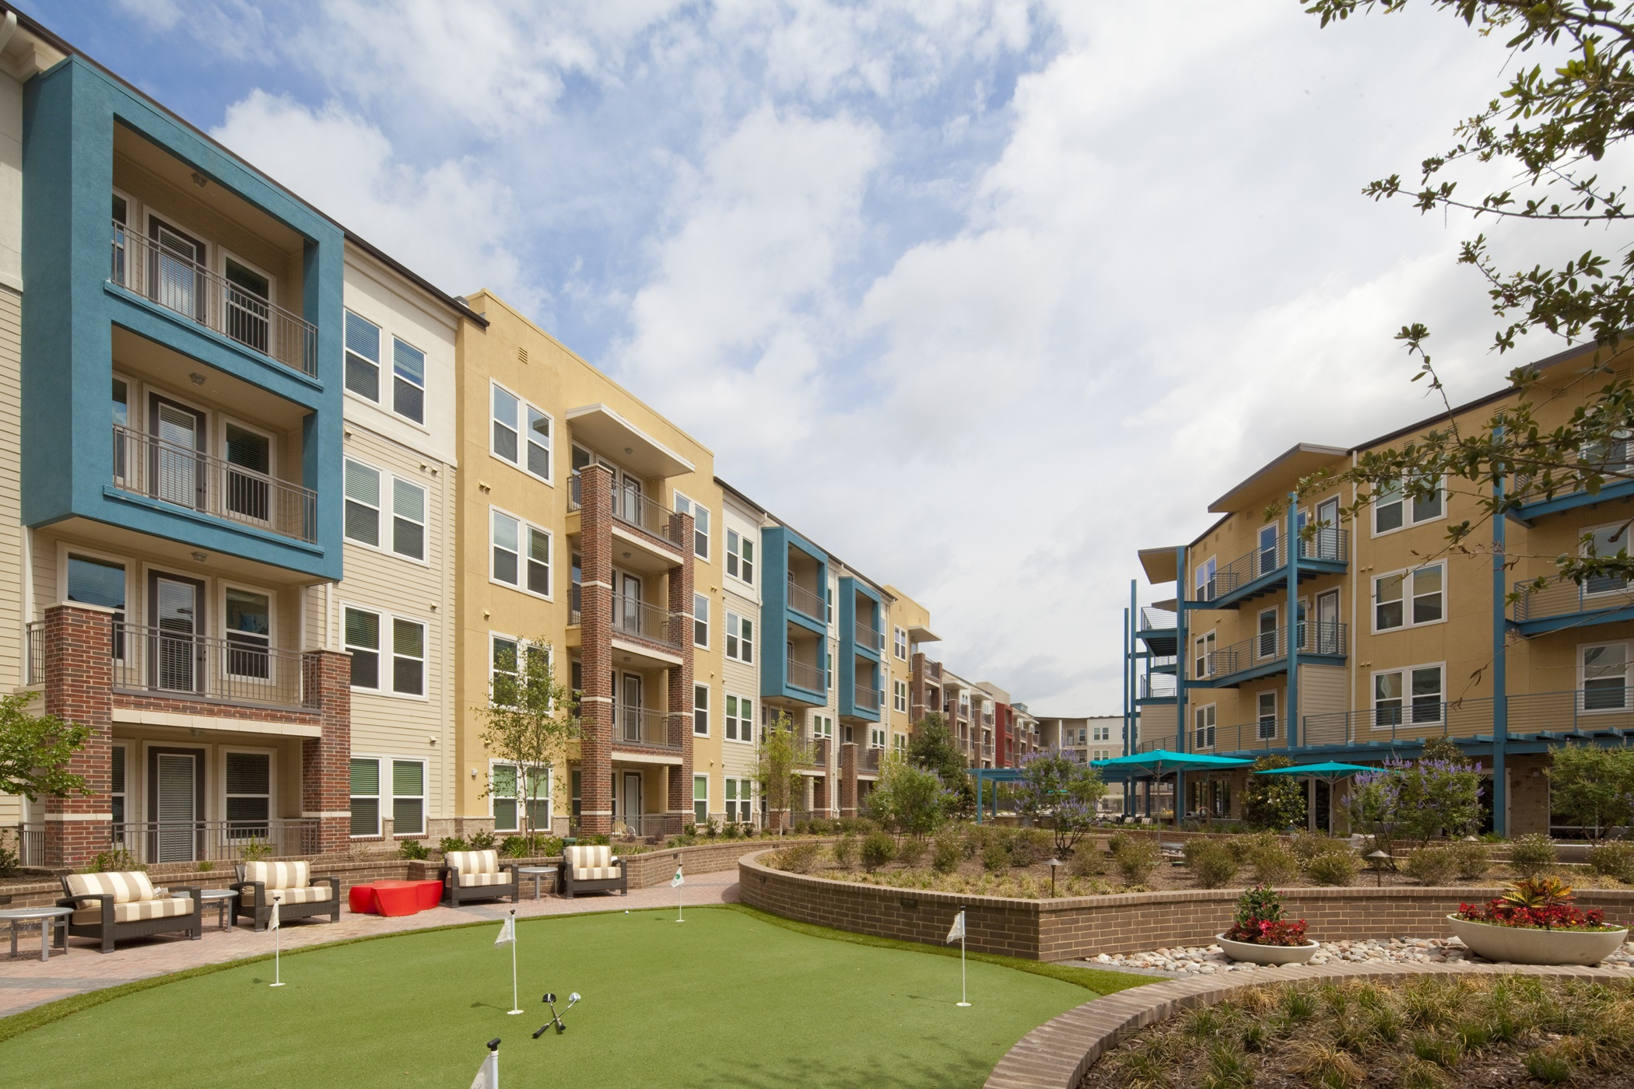
10. Consider Incentives for Design + Density
Performance zoning or density bonus programs can award increases in floor area ratio and density, or a reduction in fees, in exchange for voluntary design features.
May include things like innovative stormwater management, public space, transit stop, etc.

Slide 21
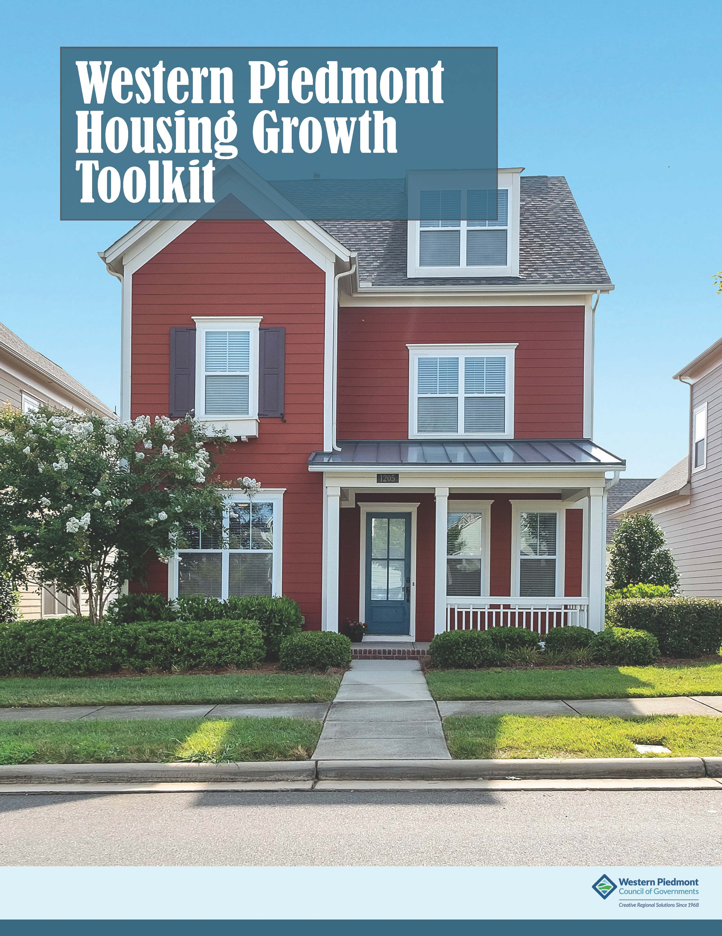
Housing Growth Toolkit
Specific policy suggestions and briefings for different housing types are included.
Can be used as a process guide for examining neighborhoods in your jurisdiction.
Policy recommendations can be compared to current zoning code, and changes considered.

Slide 22
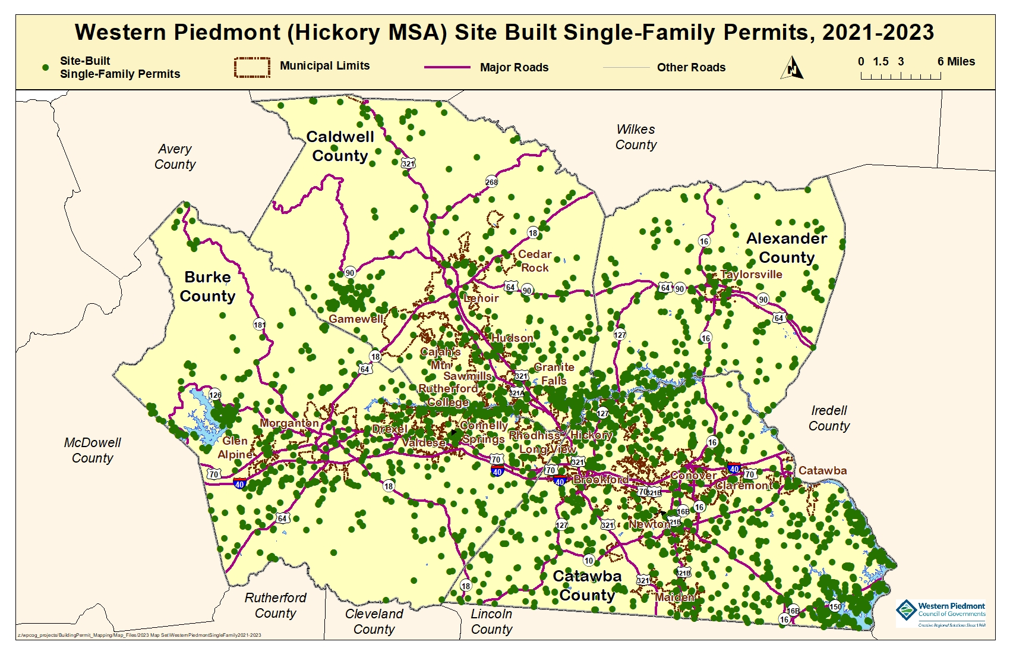
We are tracking progress in our region

Slide 23
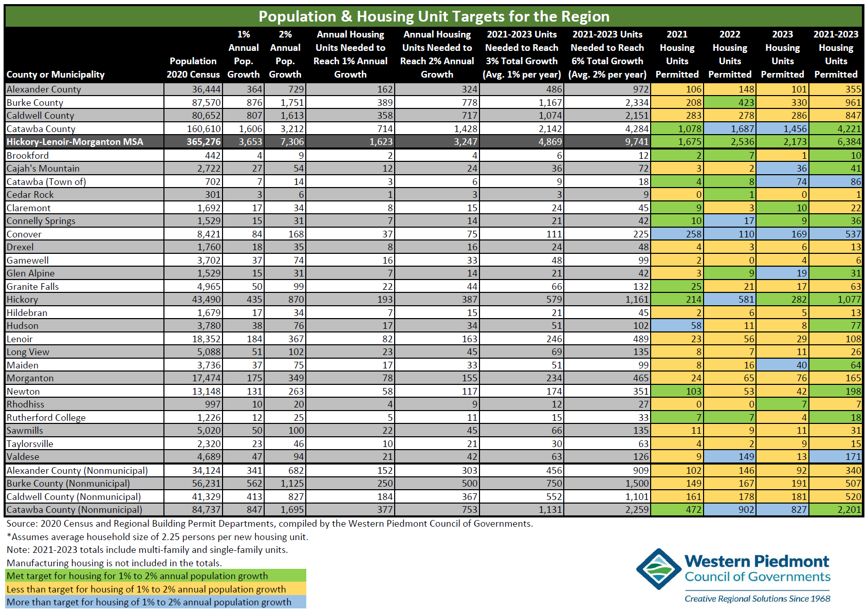
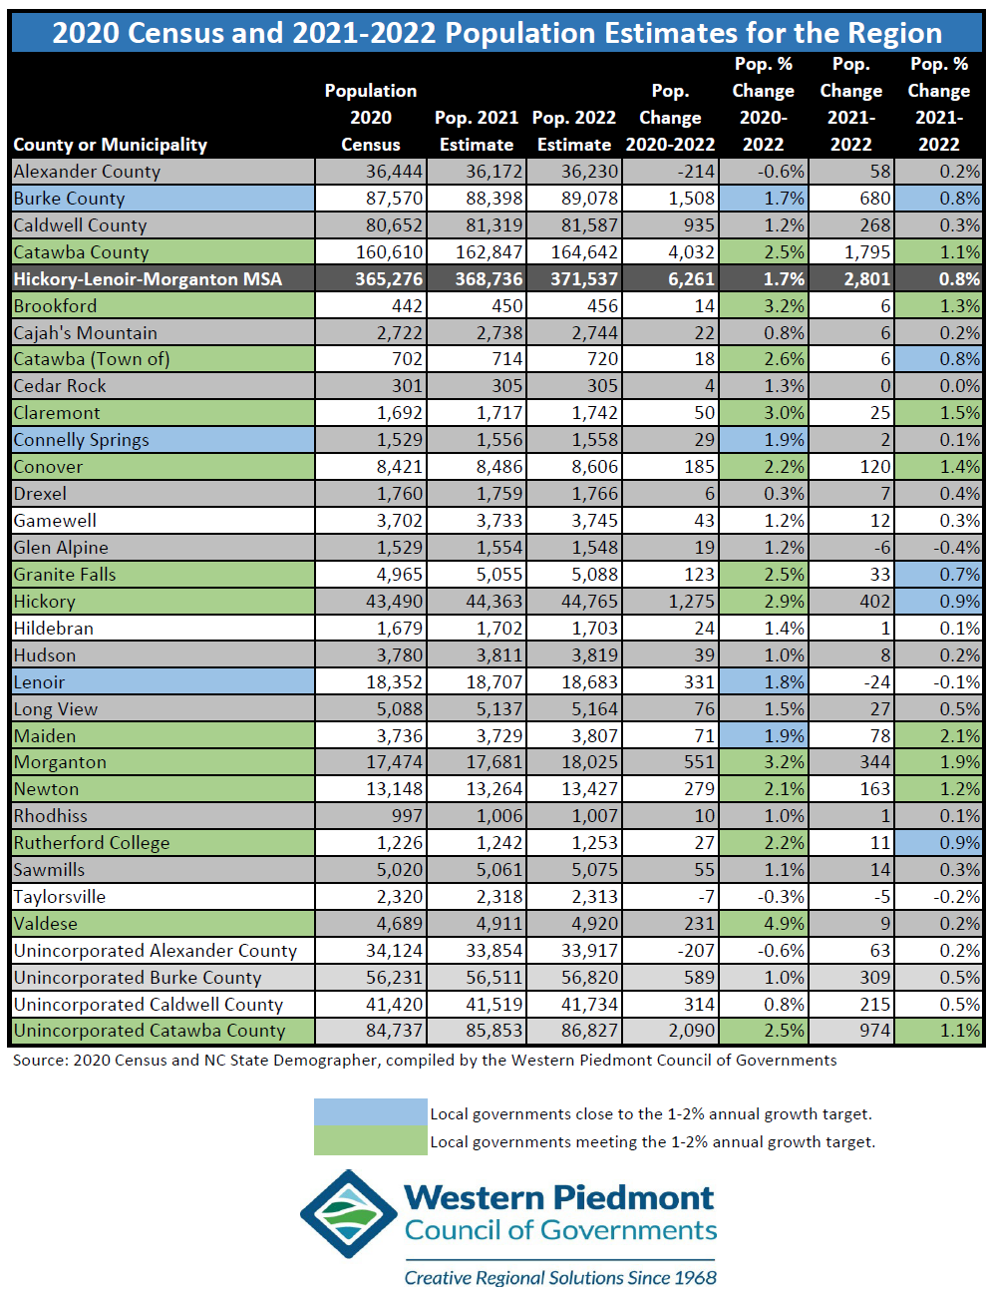
We are tracking progress in our region

