Slide 1
Twin Tiers ARISE Program
Transforming your region with BIG IDEAS!
Notes:
Frank Welcomes everyone

Slide 2
Introduction
Northern Tier Regional Planning and Development Commission
New Leadership – 2 years as director
Provides: Workforce Development, Business Services, Transportation Planning, LDD for ARC and EDD for EDA.
Southern Tier Central Regional Planning and Development Board
New Leadership - 5 years as director
Provides: Land Use Planning Technical Assistance, Local Government Assistance, Flood Mitigation, Economic Development, LDD for ARC and EDD for EDA.
Notes:
Chelsea, Frank, Jenn and Kyle introduce ourselves
Frank talk about NT; Chelsea talk about STC

Slide 3
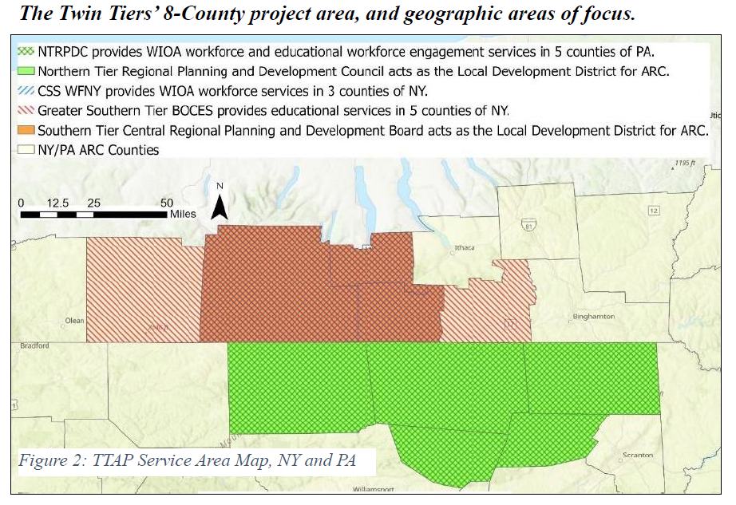
Notes:
Frank explains map of NT and Chelsea explains map of STC

Slide 4
Twin Tiers Relationship Building
CARES Act planning in 2020
STC reached out to NT discuss a shared workforce study component with CARES funds.
Agreed to share findings but not work together due to difference in organizational spending of CARES money.
ARISE Announced!
The Southern Tier is a border community (this fact is mentioned heavily in our CEDS). With ARISE, we can use the border to access additional grant funding.
Notes:
We wanted to work together!
Chelsea present

Slide 5
Commonalities
Live in NY work in PA
Equivalent pay
Higher income taxes, higher property taxes.
About 5% of Southern Tier residents work in the Northern Tier
Live in PA work in NY
Lower income taxes and lower property taxes
Historically higher wages (minimum wage and average compensation was higher)
About 10% of Northern Tier residents work in the Southern Tier
Reporting on housing builds in the Northern Tier has been part of the STC CEDS historically.
Notes:
Frank Presents
Twin Tiers share major Employers this area has one integrated workforce

Slide 6
Why Workforce?
Workforce features prominently in BOTH Region’s CEDS.
Wages/workforce are incorporated goals into all ARC Programs.
No program to our knowledge looks at workforce options between the two states.
Demographic and migration concerns
Both NT and STC’s Partners had similar programs, with positive impacts, with inconsistent funding and no cross state or even cross agency partnership.
Northern Tier’s – BEP program
Southern Tier’s – CDC program / CSS Workforce NY
All had different incentives and metrics usually focused on students served
Notes:
Chelsea Present

Slide 7
Elevator Pitch – What is TTAP?
Twin Tiers Arise Program
Promote and formalize engagement between the region’s employers, the existing youth service/education providers, and the region’s youth to enhance the Appalachian workforce and strengthen the Appalachian workforce ecosystem.
Deliverables:
Engage with the youth of the region to increase career education, work experience opportunities and positive employment outcomes.
Engage parents, guardians and student support systems around the benefits – career education and exploration.
Partner with employers to enhance career pathways, awareness of occupations within the region and to secure long-term financial partnerships.
Implement data tracking to improve performance and demonstrate success.
Partners:
Northern Tier – Expand the successful Business Education Partnership Program
Southern Tier Central – Provides data analytical and project management
Corning Community College – Expand the successful Accelerated College Education program in PA.
Career Development Center– In NY, the CDC will expand existing career exploration and workforce readiness.
GST BOCES – Will purchase equipment for Career and Technical Education students to enhance training.
CSS Workforce NY – Expand awareness of TTAP and WIOA services to youth.
Notes:
Take what exist, make it bigger, make it better, offer to more geographies, serve folks that otherwise wouldn’t qualify. Coordinate between all partners. Referrals between partners
Frank & Chelsea Presents

Slide 8
ARISE Program Design
Early Process
Paired border location makes our partnership ARISE eligible
Similar workforce needs
Matching at 50% was a challenge, partners could deliver match
Interest in same approach -“Strange New Things with Strange New Money”
Complementary organizational capacities
Mid Process
Map Partners and Capacity
Pair NYS Partners work with PA Partners work
Consider partners funding source and new funding means new outcomes?
Late Process
Finalize four-page proposal
Last minute changes to meet partners needs
Figure out Sustainability
Figure out Match
Notes:
Frank Presents

Slide 9
State Program Managers
Work with your State Program Managers to see what assistance your State may be able to bring to the table:
For example: PA provides assistance through a series of consultants
Back and forth between states and LDD’s to fully understand:
Anticipated outcomes
Needs of the region
Regional Impact and importance
States Program Managers present the project for consideration & conversation
Notes:
Jenn & Kyle Presents
Your State Program Managers are your Friends!

Slide 10
ARISE Project Summary Process
Project Summary sent to State Program Managers
Program Managers give comment
ARISE applicants are asked to summit Concept paper to ARC
Bi-Monthly meetings reviewing Concept papers occur
This is where you are graded and either asked or not asked to apply
Notes:
Jenn and Kyle

Slide 11
Arise Process Development
TTAP Application 1.6 (narrative and supporting documentation)
Formed a working functional collaboration
Checklist
Matrixes of completed work
Individual meetings
Notes:
We were invited to apply!!!
Onward! – Revision, supporting documentation, relationship building, understanding, meetings, matrix, checklist…scope, budget, MATCH!
I don’t know or understand why one-on-one meetings were needed to address each important topic (scope and budget). But this was the only way I got material from the partners. In the end it worked, so I am sharing that information with you.
Chelsea Present

Slide 12
Memorandum of Understanding Written with future success in mind
Safeguards how unallocated ARISE money will be spent,
Safeguard and allocate stakeholder support funding for ARISE activities.
Still encourage grant applications for partners, allow new funding for future success of the project, without losing any ARC grant funding due to “backing out” / “ARC last funding –in problems”
Include a framework for expansion
Local organizations can join, but can’t receive any ARISE money.
Adjacent counties can join, but they can’t receive any direct ARISE money.
Notes:
Important to outline our goals and how the process will go. This will probably change in the future. Much of our time was spent on the MOUs
Gives us the rules of engagement; rules of the game
Can talk a little about challenges with the process and partners here.
Frank Present

Slide 13
PA Support for ARISE with consultant Thank you to Jeff Schwartz
TTAP Application 2.0
Substantial changes to the format
Condensed Sections
The original was complex and sections 3, 4, & 6 did not work separately (because of the level of collaboration and in-kind match from the partners)
Final Budget… tears were shed (even developing this application was capacity building among the partners)
Notes:
Frank to Present
Jenn to comment….

Slide 14
Delivery Day
STC has completed their piece and hands over all materials to NT for submittal.
NY now considers other funding options to #1 match and supplement work with ARISE and #2 continue the momentum in case ARISE is not funded.
NT Submits to ARC!
6/30/2023
AWARDED to NT in October (Announcement)
October – today: Contract is place between NT and ARC & MOUs with all partners have JUST been signed.
Notes:
Frank Present
From award to start….it’s slow. But we are finally ready to begin!

Slide 15
WRAPPING UP!
Lessons Learned by STC and NT
Takes time to build trust in your partners
Everyone responds to different incentives and funders
One-on-One meetings were required to understand the needs of each partner
Bring accountants on earlier
Keep the project a manageable size, capacity and geographies
Data and tracking is a real bear and will take a lot of work to manage
Two states, six partners and three languages
Notes:
Chelsea Present

Slide 16
QUESTIONS about PROCESS?

Slide 17
Let’s Workshop!

Slide 18
7 – Minutes - Introductions
Identify the States present at your table?
Are any in a close proximity to your state?
Any existing ARISE projects that YOU are involved in or tangential to?
BIG IDEAS - What are your State’s BIG initiatives, goals, challenges you think an ARISE project could solve?
WRITE IT DOWN!

Slide 19
7 – Minutes – BIG IDEAS!
Do any of your Big Ideas Overlap at the table?
Who?
What?
Is the state physically close? Do they need to be?
CHOOSE a Big Idea to develop.
Who’s involved?
What activities will you do?
What will grant funding be spent on?
What do the project partners have to offer in the way of match?
WRITE IT DOWN!

Slide 20
7 Minutes – Challenges and Implementation
CHALLENGES
What are the challenges with your BIG IDEA?
Ideas on how to overcome your challenges?
IMPLEMENTATION
What connections and conversations do you need to make to initiate your BIG IDEA?
Who are the partners?
What information do you need to determine a budget?
What ideas of match do you have?
TIMING – When can this happen? When can applications be initiated?

Slide 21
REPORTING OUT
PRESENT YOUR TABLE’S BIG IDEAS!
What is the idea?
What state(s) are involved?
Who are the partners?
What are the challenges?
Ideas on where match is coming from?
What is the next steps for this Big Idea?

Slide 22
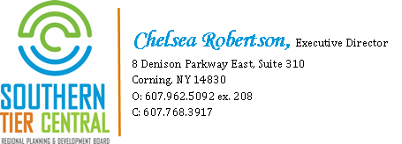
Thank You!
Frank Thompson
Executive Director
NTRPDC
312 Main St
Towanda, PA 18848
P 570.265.1515
F 570.265.7585

