Slide 1
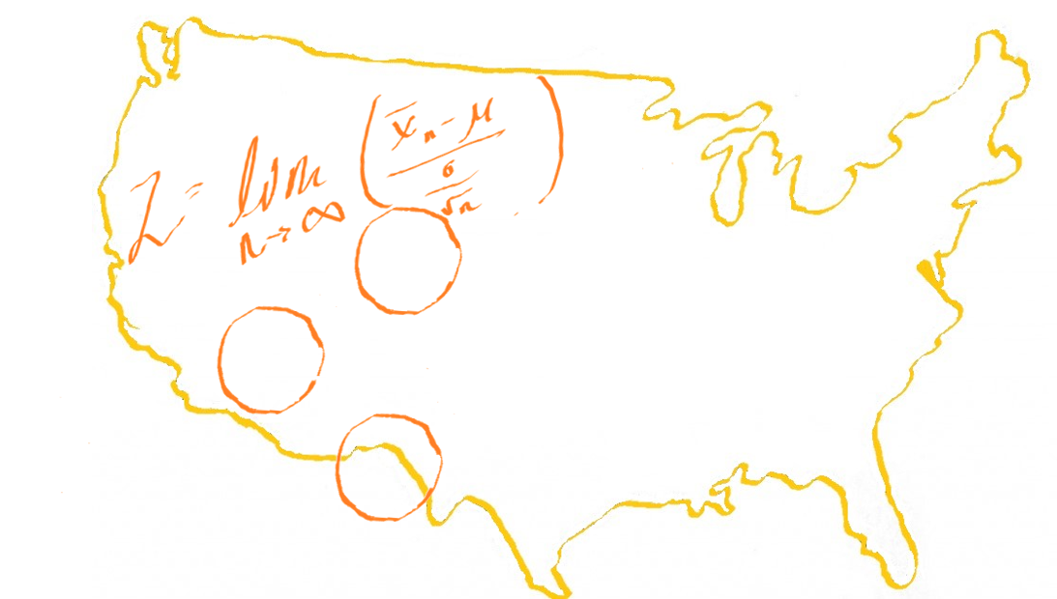
Data for Regional Planning
Alison Turner
Metrics Together
July 21, 2022
Notes:
Hi everyone welcome it is so nice to be here and even nicer to be introduced by Raul it’s always great to share the stage with other new Mexicans especially so far from home here in Kansas City Missouri I was telling NATO staff before I got here how excited I am to be in Kansas City because it’s one of my favorite places to talk about data and geographic data specifically, will get into that a little bit later but thank you all for being here I know that I am up against Joe McKinney and Steve etcher so especially appreciate all of you choosing this session and I’ll try to keep it as entertaining as possible for you all.

Slide 2
Welcome!
Alison Turner
M.S. Statistics
Founder of Metrics Together
Economic Research
Municipal Finance
Economic Development
Notes:
As Raul mentioned my name is Alison Turner and I hold a masters in statistics and other degrees in economics anthropology math and Spanish and I am the founder of Metrics Together I started my economic development journey in economic research kind of you’re more traditional planning and modeling so on and so forth I’ve been transitioned over into municipal finance being a traitor on a municipal trading desk municipal bonds trading desk and then finally made my way into the the wonderfully varied world of economic development which drew me in because of the kind of complex problems that we have in terms of planning evaluating measuring how we first see our Konomi is transportation systems on and so forth to end up doing

Slide 3
Why is data important?
Federal requirements
GPRA
Measurement and evaluation sections in applications
Planning Continuation
Measurement and evaluation of plans and projects
Creation of new plans and reports
Notes:
So today’s presentation is really gonna focus on one very large question which is why is data important right why should we be putting it in these reports especially when I think the relationship that economic development offices often have what date that can be a little bit tense so the first reason is where is my money coming from federal requirements are now requiring more data to be used not only for the grand application process and getting those funds for media or whoever else but also in recording how things are going progress reports to be coming slightly more quantitative and the gift bra was a new environment for data collection and hopefully did analysis on the federal level to get things going there also I don’t know how many of you have recently put an idiot grant application together a federal grant application in general but the vast majority now have a data management section so the federal government is focusing on how are people using data how are we evaluating projects using data and I think often times when faced with that question organizations have a tendency to be at a halt the second thing will talk about is planning continuation so the importance of data and putting another proposal together putting another plan together and how to best to do that for the next duration of a report or for a dashboard I know that now we’re looking at a lot more interaction interaction action and engagement with data for regions how are you presenting that how is that being engaged with all that feeds into the data cloud and what’s collected

Slide 4
Why is data important?
Accountability
Fairness
Equity
This Photo by Unknown Author is licensed under CC BY-SA-NC
This Photo by Unknown Author is licensed under CC BY-SA-NC
Notes:
The second series of things that will be focusing on in terms of qualifying why it is important is a little bit less tangible so we have our financing we have our measurement evaluation and we have the ease of creating more projects but we also have these more femoral pieces of information so accountability fairness and equity are all things that have been proposed prioritized by the current administration and something that they’re really looking to quantify more often often times when we think about accountability fairness and equity we don’t think in a quantitative way and so a big question spurs from these how do we start to take qualitative data and use it in a qualitative way that’s compelling for regional planning

Slide 5
Getting the Data
Federal Data
US Census
Bureau of Economic Analysis
Bureau of Labor Statistics
Department of Transportation
Department of Energy
Internal Revenue Service (IRS)
Census based tools
Stats America
Census Maps
This Photo by Unknown Author is licensed under CC BY-NC
Notes:
https://maps.kcmo.org/apps/parcelviewer/

Slide 6
Getting the Data
State Data
Gross Receipts Data
Departments of Corrections
Department of Education
State Economic Forecasts
Jobs and Wage Data
State Budget and Capital Outlay
Notes:
https://www.sos.state.nm.us/about-new-mexico/state-capitol/

Slide 7
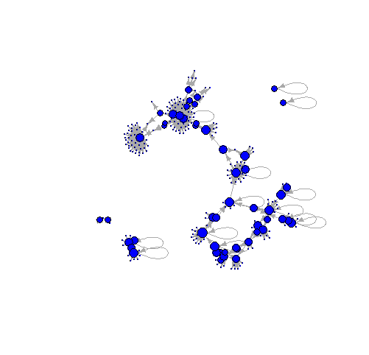
Getting the Data
Local Data
Local surveys
Assessors information
Local maps
Newspapers and publications
Interviews
Local radio
University and College data
This Photo by Unknown Author is licensed under CC BY
Notes:
Qulaitative and interviews!!!!

Slide 8
Getting the Data
Private Sector data
Utilities information (gas, electricity, broadband)
Business data
Property data (Zillow, Redfin, Realtor.com)
Phone numbers, addresses
Health data
Google

Slide 9
Data Difficulties for Regional Planning
Geographic constraints
Data Accuracy
Asking the right question
Finding the right data – time is money, so is data
Notes:
Gegraphic recap – do I have to go to different places to create these? How do I combine data from different places? Who should I contact? – taking an impressed map of not real to real

Slide 10
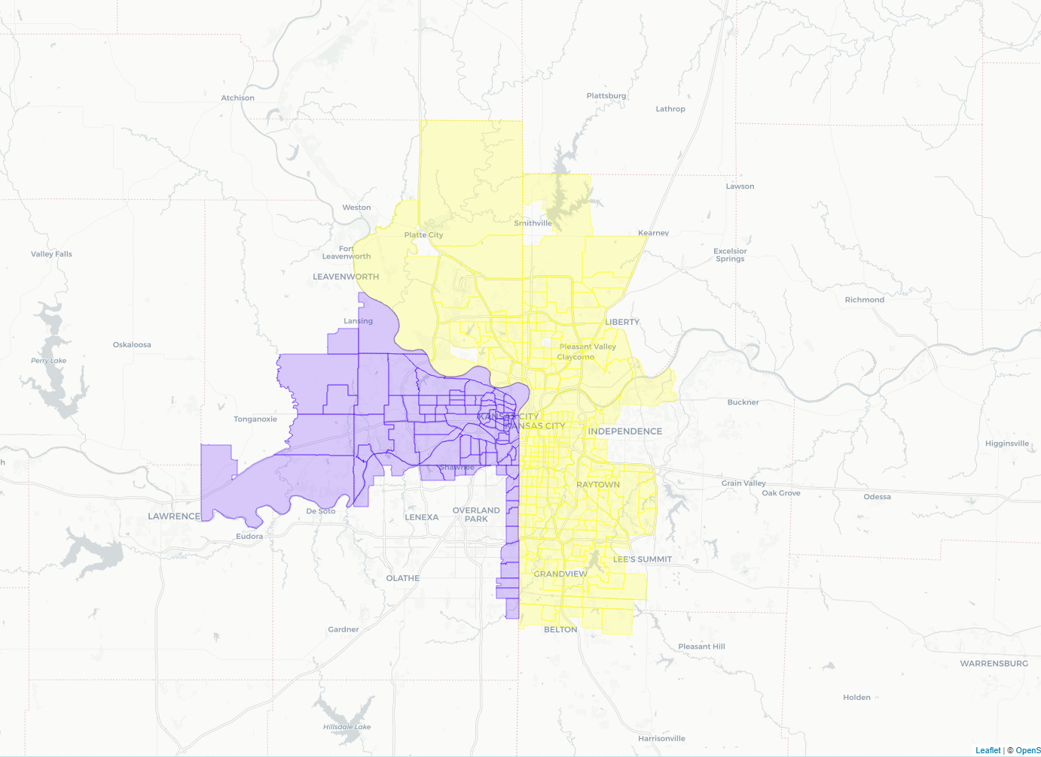
Geographic Constraints
Complex neighborhoods – Boston - Brighton, Cambridge, Somerville, Newton
Sparse populations – Luna County, NM
The beauty of Kansas City (Missouri, Kansas)
Notes:
As I said before geographic constraints is are one of the things that become the most painful for me when working with data in Metrics Together works with very small communities we work with very sparse populations in a lot of ways and then we also work with very complex population dense populations like Boston for example talking about geographic constraints here and Kansas City could not be more perfect for me as we sit in on the Missouri side the Kansas side sits across the street and with those jerks jurisdictional or political boundaries we see a lot of problems in debt collection data comparison and data use
Hidalgo County NM – 4178 people in 3438 sq miles
https://maps.viewprogis.com/ecp/kansascity-ks#
Podcast on Econmic issues spurred by data problems - https://www.npr.org/sections/money/2018/11/16/668769284/episode-699-kansas-city-vs-kansas-city
Info on KS division - https://www.kcur.org/community/2014-09-10/how-the-state-line-has-divided-the-kansas-city-metro
Those divisions reach back as far as the early 1800s, as pro-slavery Missourians and abolitionist Kansans politically and physically clashed.

Slide 11
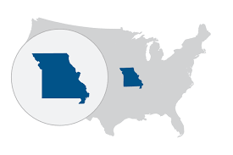
Geographic Constraints
Getting to the “right” geography
County constraints
Tract level data
Timing
Years (vignettes)
Redistricting
Notes:
Census tracts were invented in 1910 and only applied to very few metropolitan areas
The pop is blank bla bla bal
Tract how many people – 4000 (1200-8000)

Slide 12
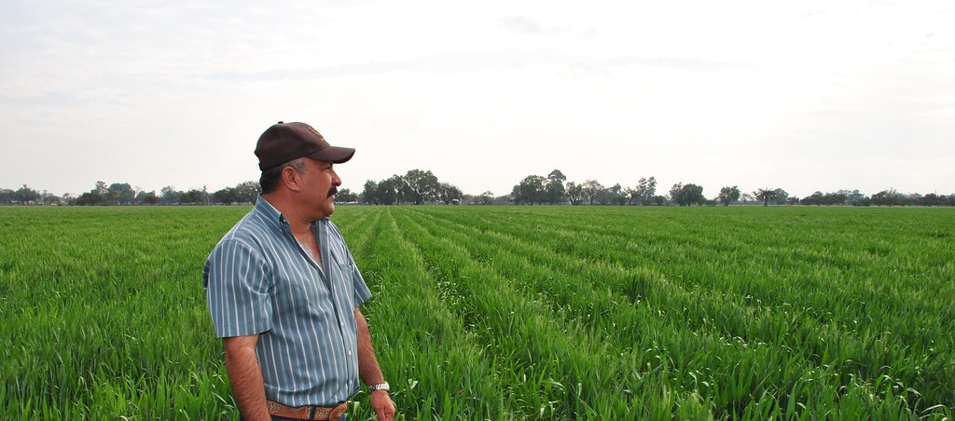
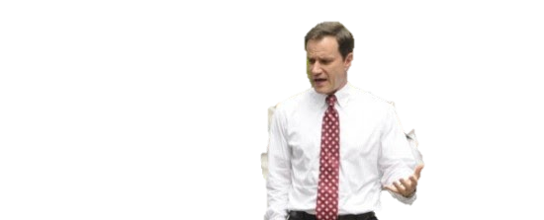
Geographic Constraints
Data collection in different places
California data privacy
State required data collection efforts
Administrative capacity
Data privatization (rural areas)
This Photo by Unknown Author is licensed under CC BY-SA-NC
This Photo by Unknown Author is licensed under CC BY-SA-NC
Notes:
Add
Attention to detail on individuals
Administrative capacity
State required data collection efforts

Slide 13
Data Difficulties for Regional Planning
Geographic constraints
Data Accuracy
Asking the right question
Finding the right data – time is money, so is data
Notes:
Gegraphic recap – do I have to go to different places to create these? How do I combine data from different places? Who should I contact? – taking an impressed map of not real to real

Slide 14
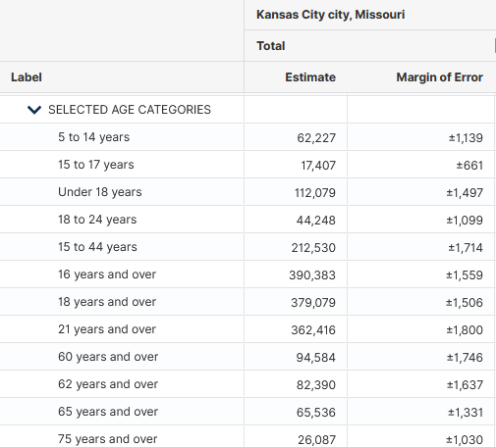
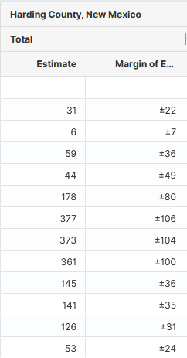
Data Accuracy
How do I know if my data is accurate?
Does it look like you would expect?
Response rates
Error rates
Notes:
Chart on error rates and how to read them
From the transportation perspective, this is really where comparisons to state and local data is imperative

Slide 15
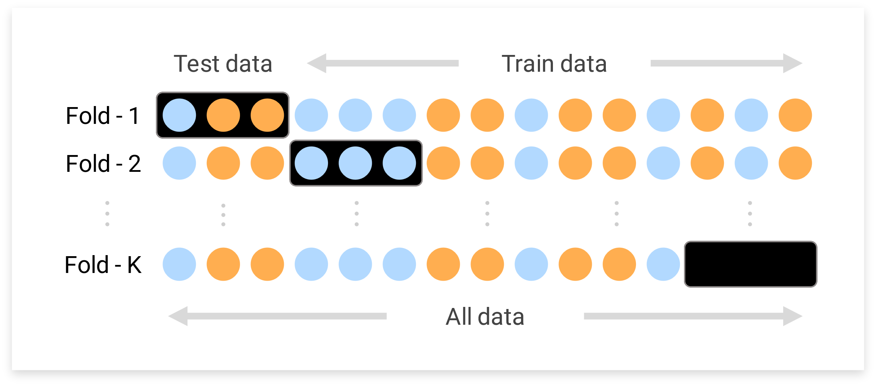
Data Accuracy
How can I improve data accuracy?
Tracking
Supplementation
Check and check again
Notes:
Replace pic

Slide 16
Data Difficulties for Regional Planning
Geographic constraints
Data accuracy
Asking the right question
Finding the right data – time is money, so is data
Notes:
What’s a good question?
Ho can we get business to work togetehr? – mutual benefit? How do we do it, what can we ask business ownders -

Slide 17
Determining a Question
Trust your instincts
Write it down
Keep it simple
Notes:
Ask kthe community
Write it down
Keep it simple
Keep a journal

Slide 18
Determining a Question
Kansas City Economic Development Incentives

Slide 19
Research or Collection
Research
Pros | Cons
Can be done from your office | Can require high technical skill
Shorter time period | May not answer your exact question
Less up front analysis required | Collaboration with data nerds
Notes:
Pros/cons

Slide 20
Research or Collection
Collection
Pros | Cons
Tailored results | Data entry errors
Community trust building | High cost
Survey experience | Potentially high analysis required (aka, collaboration with data nerds)
Notes:
Pros/cons

Slide 21
Data Difficulties for Regional Planning
Geographic constraints
Data Accuracy
Asking the right question
Finding the right data – time is money, so is data

Slide 22
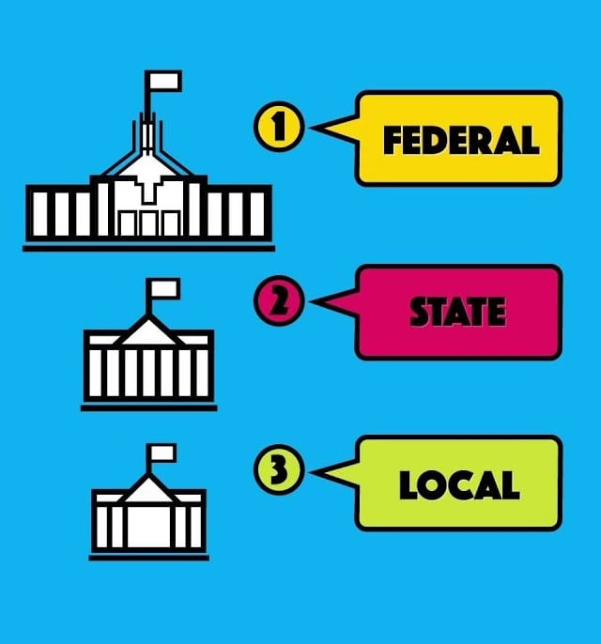
Data locations recap
PRIVATE
Federal
State
Local
Private
PRIVATE
PRIVATE

Slide 23
The Collection Map
Federal Dashboards
Federal source data
State Dashboards
Free private data tools (Google)
Local data and community perspective review
Notes:
State, local, StatsAmerica or Data.Census.Gov Dashboards
(ACS API, DOT Maps, USDA Census of Agriculture)

Slide 24
Collecting data
Interviews – combining qualitative and quantitative
Libraries and text analysis
Highlighting
Scrapbooking
Notes:
Dealing with burnout – working together – gathering on what exists
Go in with a good question
Options options options
Cost benefit
Building trust

Slide 25
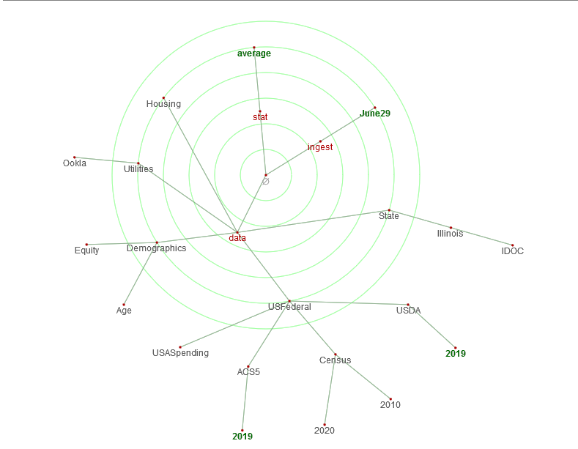
Using Data Effectively
Storing
Data sheets (excel, csv)
Database
SQL
Microsoft Access
Google Cloud
Metrics Together
GIS
ESRI
Folders
Notes:
How to find creator information and metratada
Column header
Examples of good data management
Tag map

Slide 26
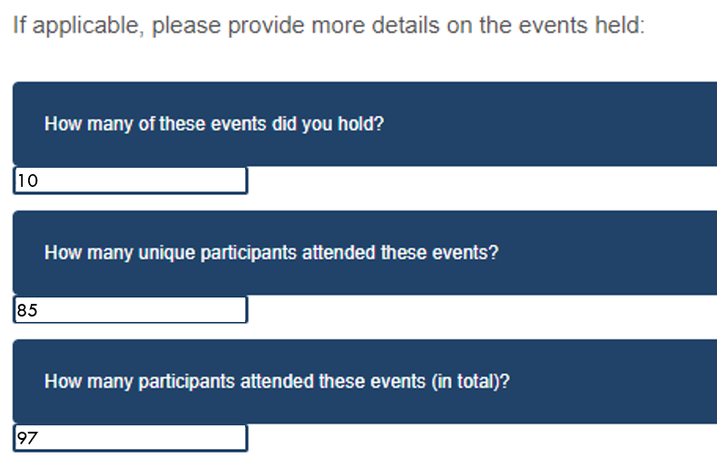
Using Data Effectively
Good storage = Easy reporting
Create a space for all progress reports and living data
How many of these events did you hold?
 | 10 | (8 ASAP community meetings, one TEN webinar, Working now Q&A webinar)
How many unique participants attended these events?
 | 85 | (64 for ASAP meetings, 15 TEN, 6 Working Now)
How many attended these events (in total)?
 | 97 | (64 for ASAP meetings, 21 TEN, 12 Working Now)

Slide 27
The Metrics Together Data Cheat Sheet
Federal
Data.census.gov
StatsAmerica
Federal High-Way Administration Public Data
IRS Personal Income Data (county level)
State
Economic Development Department
Department of Transportation
Local
Your State Demographer
Native Land Information System
Private
Google Places
The Eviction Lab
Notes:
Federal
Data.census.gov - https://data.census.gov/cedsci/
StatsAmerica - https://www.statsamerica.org/
Federal High-Way Administration - https://www.google.com/publicdata/explore?ds=gb66jodhlsaab_
IRS - https://www.irs.gov/statistics/soi-tax-stats-county-data
State
Economic Development Department -
Department of Transportation -
Local
Native Land Information System - https://data.nativeland.info/dataset
Private
Google Places
The Eviction Lab

Slide 28
Recap
Harnessing good data can increase funding, streamline process, and improve project outcomes
Leveraging local knowledge can increase data quality and reveal bias
Key points when using data for Regional Planning:
Geographic description
Data validation (and error)
Data collection
Data storage
Notes:
Why is data important?
- feds said so (financing and report compliance)
Ongoing reporting strategy
Equity access and fairness
What are data issues
Geography (check and check again)
Validation
Collection
Storage

Slide 29
Thank you
www.metricstogether.com
alison@metricstogether.com
Slides and additional tools can be found at this QR code or at this link

