Slide 1
DATE HERE
EDD Advocacy Presentation

Slide 2
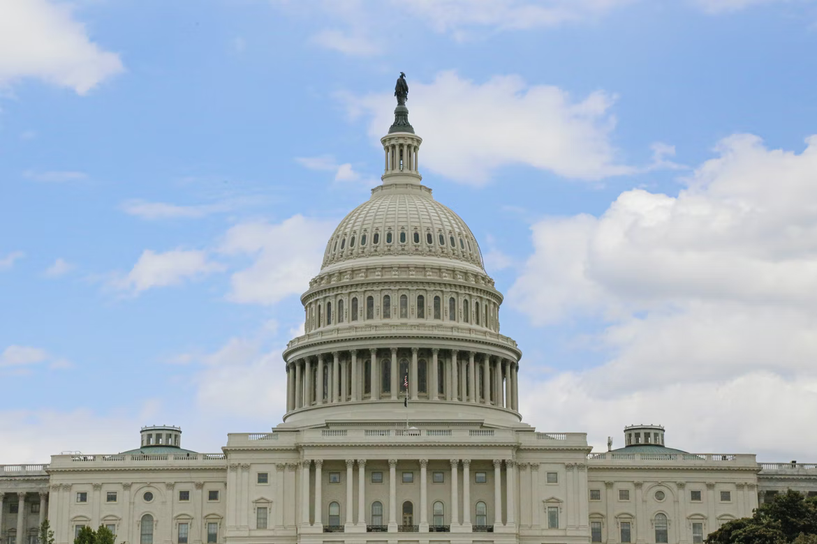
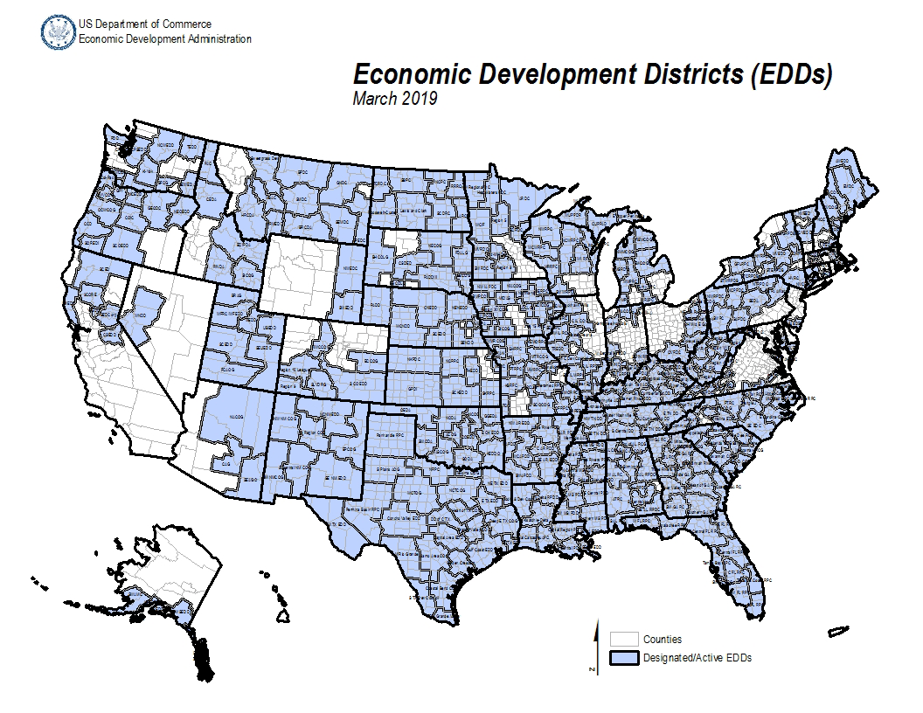
WHAT IS THE NATIONAL ASSOCIATION OF DEVELOPMENT ORGANIZATIONS (NADO)?
NADO represents hundreds of Regional Development Organizations (RDOs/EDDs) across the country. These organizations collectively assist thousands of cities and counties with activities related to economic development, workforce training, transportation planning, public infrastructure, affordable housing, disaster prevention, rural capacity-building, public health, regional planning, and the provision of other community services.
WHAT ARE EDA ECONOMIC DEVELOPMENT DISTRICTS (EDDs)?
EDDs are locally-based, multi-county entities designated by the U.S. Department of Commerce Economic Development Administration (EDA). EDDs are tasked with carrying out certain EDA mandated responsibilities such as facilitating regional economic development planning. EDDs are EDA’s core institutional partners at the local level. EDDs facilitate initial planning activities to ensure the ultimate success of federally-funded projects. There are nearly 400 EDDs across the country.
EDD Advocacy Presentation

Slide 3
ECONOMIC DEVELOPMENT DISTRICTS As designated by EDA
One of the key responsibilities EDDs are tasked with by EDA is to lead a regionally-driven economic development planning process which leverages the involvement of public, private, and non-profit sectors. EDDs are responsible for developing a strategic “roadmap” for economic development and regional collaboration. States have a varying number of EDDs:
1 – 2 EDDs
3 – 6 EDDs
7 EDDs
8 – 9 EDDs
10 – 11 EDDs
12 + EDDs
EDD Advocacy Presentation

Slide 4
LOCAL PROJECT SUCCESS EXAMPLE 1
Insert project photo here
Provide an overview and example of a successful project which was based on an EDD Partnership Planning grant and/or EDA funding.
Highlight outcomes and ROI.
Update with a high-quality project picture.
Bullet 1
Bullet 2
Bullet 3
EDD Advocacy Presentation

Slide 5
LOCAL PROJECT SUCCESS EXAMPLE 2
Insert project photo here
See previous slide.
OPTION FOR A SECOND EXAMPLE
Emphasize partnerships with community and EDA
EDD Advocacy Presentation

Slide 6
ECONOMIC DEVELOPMENT ADMINISTRATION APPROPRIATIONS While overall EDA funding has increased, EDD Partnership Planning Grants have remained nearly stagnant Budget figures are in Millions
EDD Advocacy Presentation

Slide 7
FY24 EDA Funding Request for Congressional Action
ACTION NEEDED: Congress should allocate $55 million in FY24 Appropriations for EDA EDD Partnership Planning Grants
Congress should ensure that EDA Partnership Planning funding for EDDs is provided at no less than $55 million in FY24 appropriations
Annual appropriations for EDA assistance programs have increased by 62% over the last five years while Partnership Planning funds have increased by only 9% in the same timeframe
EDDs are relied upon to coordinate and administer increasingly large volumes of EDA funding, and to work with a widening set of stakeholders. Yet EDD funding for administrative and planning support has not been adequately increased accordingly.
COVID-19 relief funding has widened the gap between EDA grant dollars and EDD admin/planning dollars further
EDD Advocacy Presentation

Slide 8
EDA Reauthorization Priorities
NADO Encourages EDA Reauthorization with Key Modifications
Increase authorized funding level for EDA Partnership Planning Grants to $100 million annually
The planning process lays the groundwork for the success of subsequent federal investments into projects
Currently, each EDD only receives approx. $70,000 annually
An authorized level of $100 million for EDA Partnership Planning would provide approx. $250,000 per EDD
2. Increase EDA’s federal cost share to 90% for EDA Partnership Planning Grants, and reduce EDD local match to 10%
The CEDS planning process is an EDA-mandated process
EDA should cover a larger portion of the overall costs
Currently, EDA’s federal investment rate is often 50%, which leaves the EDD responsible for providing a 50% local match
EDD Advocacy Presentation

