Slide 1
DEVELOPMENT DISTRICT ASSOCIATION OF APPALACHIA
DATE HERE
DDAA Presentation Title Here

Slide 2
WHAT IS THE DEVELOPMENT DISTRICT ASSOCIATION OF APPALACHIA (DDAA)?
DDAA proudly represents the 74 Local Development Districts (LDDs) which stretch from northern Mississippi to southern New York and help support the Appalachian Regional Commission (ARC) in executing successful and sustainable initiatives. DDAA seeks to provide education, awareness and technical expertise to and for LDDs.
WHAT IS A LOCAL DEVELOPMENT DISTRICT (LDD)?
Throughout the ARC region, LDDs help:
Conduct locally driven strategic community planning work
Support project development and implementation
Provide grant writing assistance to other community stakeholders
Facilitate workforce development and job creation
Provide technical assistance to help communities access and responsibly administer public and private sector funding
Improve infrastructure and broadband accessibility
Support economic resiliency and disaster resiliency
DDAA Presentation Title Here

Slide 3
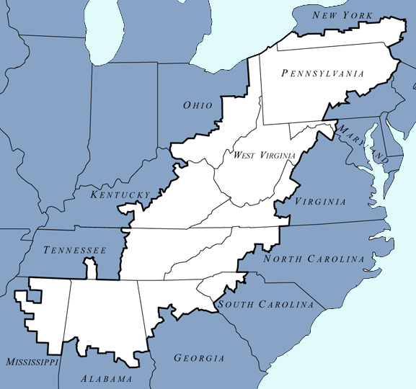
WEST VIRGINIA
LDDs:
Roanoke Valley-Alleghany Regional Commission
Region 9- Eastern Panhandle Regional Planning and Development Council
Region 5- Mid-Ohio Valley Regional Council
Region 2- Planning and Development Council
Region 3- B-C-K-P Regional Intergovernmental Council
Region 1- Planning and Development Council
Region 4- Planning and Development Council
Region 11- Brooke-Hancock Regional Planning and Development Council
Region 10- Bel-O-Mar Regional Council and Interstate Planning Commission
Region 7- Planning and Development Council
Region 6- Planning and Development Council
Region 8- Planning and Development Council
DDAA Presentation Title Here

Slide 4
GEORGIA
LDDs:
Northeast Georgia Regional Commission
Atlanta Regional Commission
Georgia Mountains Regional Commission
Three Rivers Regional Commission
Northwest Georgia Regional Commission
DDAA Presentation Title Here

Slide 5
ALABAMA
LDDs:
Regional Planning Commission of Greater Birmingham
West Alabama Regional Commission
Central Alabama Regional Planning & Development Commission
Northwest Alabama Council of Local Governments
East Alabama Regional Planning & Development Commission
Top of Alabama Regional Council of Governments
North Central Alabama Regional Council of Governments
South Central Alabama Development Commission
DDAA Presentation Title Here

Slide 6
KENTUCKY
LDDs:
Buffalo Trace Area Development District
Big Sandy Area Development District
Bluegrass Area Development District
Lake Cumberland Area Development District
Barren River Area Development District
Gateway Area Development District
Kentucky River Area Development District
FIVCO Area Development District
Cumberland Valley Area Development District
DDAA Presentation Title Here

Slide 7
MISSISSIPPI
LDDs:
North Delta Planning and Development District
East Central Planning & Development District
Golden Triangle Planning & Development District
Northeast Mississippi Planning and Development District
North Central Planning and Development District
Three Rivers Planning and Development District
DDAA Presentation Title Here

Slide 8
TENNESSEE
LDDs:
Southeast Tennessee Development District
First Tennessee Development District
South Central Tennessee Development District
Upper Cumberland Development District
East Tennessee Development District
DDAA Presentation Title Here

Slide 9
VIRGINIA
LDDs:
Mount Rogers Planning District Commission
Central Shenandoah Planning District Commission
West Piedmont Planning District Commission
LENOWISCO Planning District Commission
Cumberland Plateau Planning District Commission
New River Valley Regional Commission
Roanoke Valley-Alleghany Regional Commission
DDAA Presentation Title Here

Slide 10
NEW YORK
LDDs
Southern Tier Central Regional Planning & Development Board
Southern Tier 8 Regional Board
Southern Tier West Regional Planning & Development Board
DDAA Presentation Title Here

Slide 11
OHIO
LDDs:
Ohio Mid-Eastern Governments Association
Eastgate Regional Council of Governments
Ohio Valley Regional Development Commission
Buckeye Hills-Hocking Valley Regional Development District
DDAA Presentation Title Here

Slide 12
PENNSYLVANIA
LDDs:
Southwestern Pennsylvania Commission
Northeastern Pennsylvania Alliance
Northwest Pennsylvania Regional Planning & Development Commission
North Central Pennsylvania Regional Planning and Development Commission
SEDA- Council of Governments
Northern Tier Regional Planning & Development Commission
Southern Alleghenies Planning & Development Commission
DDAA Presentation Title Here

Slide 13
NORTH CAROLINA
LDDs:
Western Piedmont Council of Governments
High Country Council of Governments
Piedmont Triad Regional Council
Land of Sky Regional Council
Southwestern North Carolina Planning and Economic Development Commission
Isothermal Planning & Development Commission
DDAA Presentation Title Here

Slide 14
SOUTH CAROLINA
LDDs:
South Carolina Appalachian Council of Governments
Catawba Regional Council of Governments
DDAA Presentation Title Here

Slide 15
MARYLAND
LDDs:
Tri-County Council for Western Maryland
DDAA Presentation Title Here

Slide 16
Insert project photo here
SUCCESS EXAMPLE 1
Provide an overview and example of a successful project administered by the LDD, using ARC funding.
Highlight outcomes and ROI.
Update with a high-quality project picture.
16
DDAA Presentation Title Here

Slide 17
SUCCESS EXAMPLE 2
Insert project photo here
Provide an overview and example of a successful project which was based on ARC funding grant and project design. Highlight outcomes and ROI.
Update with a high-quality project picture.
DDAA Presentation Title Here

Slide 18
APPALACHIAN REGIONAL COMMISSION FUNDING The Growing Gap in ARC Local Development Dollars and Overall Grant Dollars Budget figures are in Millions
DDAA Presentation Title Here

Slide 19
FY23 Request for Congressional Action Support Local Development District Funding
DDAA REQUEST:
Congress should provide $18 million in FY23 for LDD admin.
The President’s FY22 Budget Request recommended and the FY22 Consolidated Appropriations Act includes $8 million for ARC LDD admin.
This constitutes a $1.8 million increase over FY21, but still falls short of need
Further LDD admin funding increases are needed to address significant staffing demands and the pressure of administering larger volumes of ARC grants.
LDDs provide critical technical assistance, project coordination and implementation support, and ARC grant writing and grant administration assistance.
Over the past five years, annual appropriations for ARC have increased by ~50% while LDD funding has remained flat.
Moreover, the IIJA bipartisan infrastructure bill provided ARC with $1B in grant funds, but with no dedicated LDD administrative support funding for grant administration.
THANK YOU.
DDAA Presentation Title Here

