Slide 1
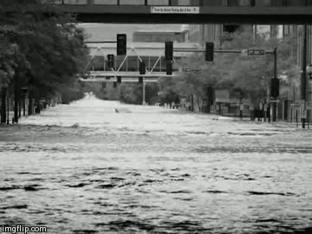
Resiliency
Doug Elliott, Executive Director East Central Iowa Council of Governments

Slide 2
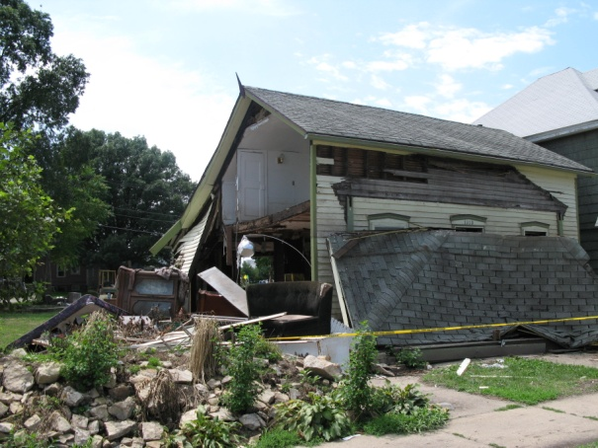
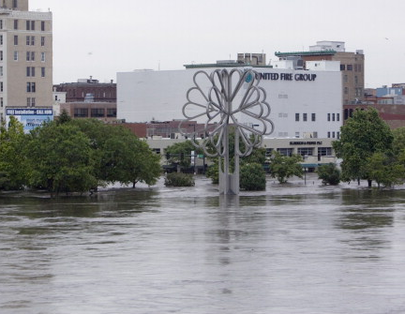
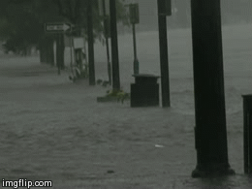
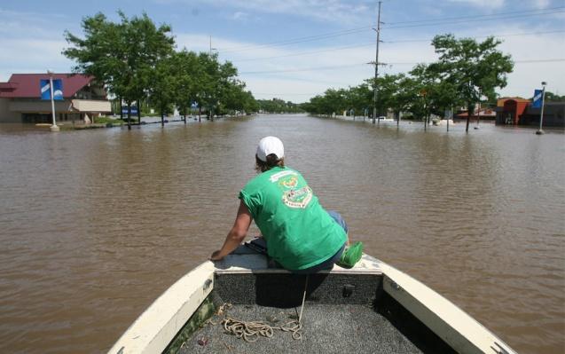
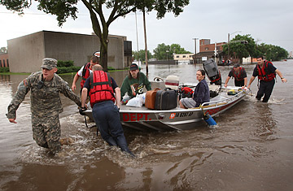
Broad range of natural disasters
Flooding, severe winter weather, tornado and windstorm, and severe thunderstorms
Experienced a major natural disaster in 2008
Vulnerabilities
Credit: Scott Olson, Getty Images

Slide 3
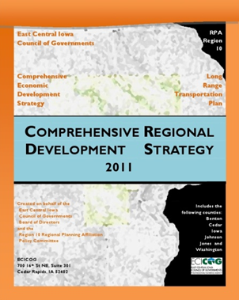
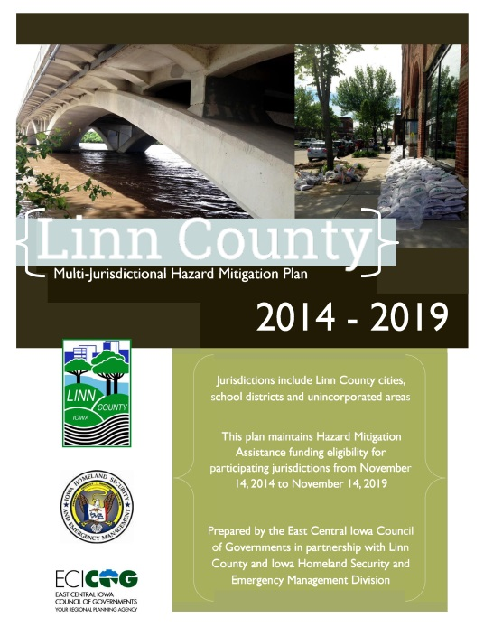
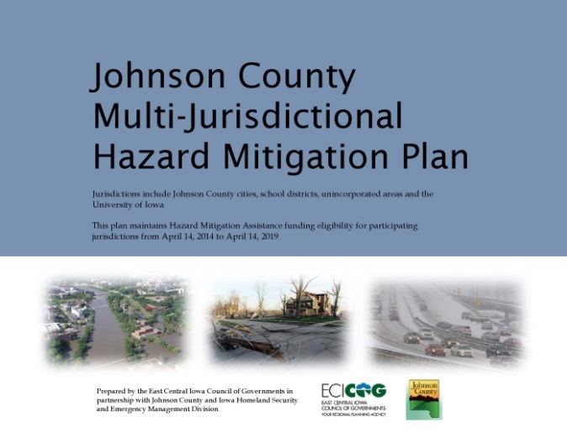
Integrating Resilience

Slide 4
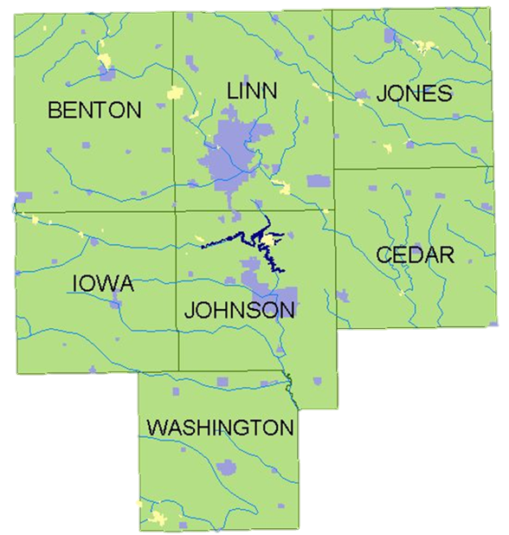
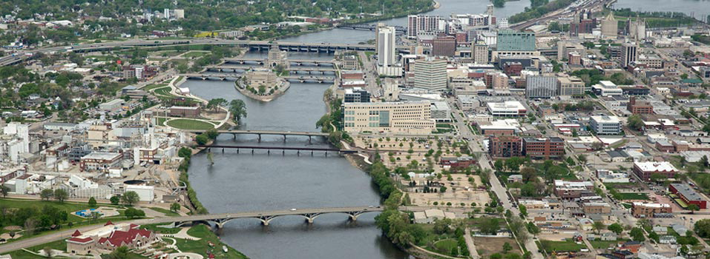
The coordination of planning under a regional framework has been both the productive of, and incentive for, the re-emergence of regionalism
Linn County was selected as a pilot project for the National Academy of Sciences Resilient America
ECICOG is a member of the planning team and an active participant, and will include the results of the Linn County process in the CEDS
Success Stories

Slide 5
The Federal Role

Slide 6
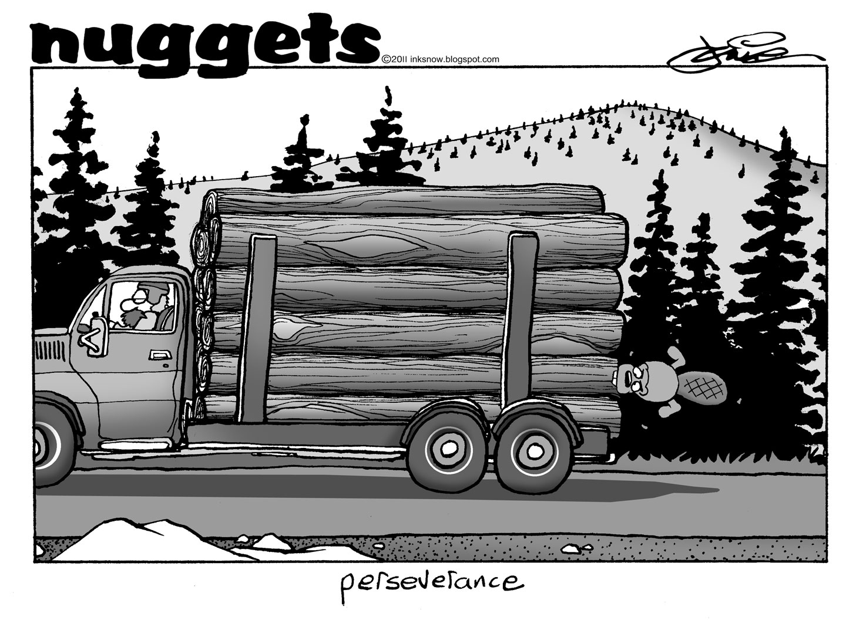
Effort to further planning efforts under a central regional framework
No significant barriers have been faced, in part because we are putting "standing" programs in our regional framework of resilience
Define resilience by the economic, social and environmental
Equating resilience with economic competitiveness
Looking Toward the Future

