Slide 1
Integrated Resilience
San Francisco Bay Area
Miriam Chion
miriamc@abag.ca.gov
Director of Planning & Research
Association of Bay Area Governments
@ABAG_resilience

Slide 2
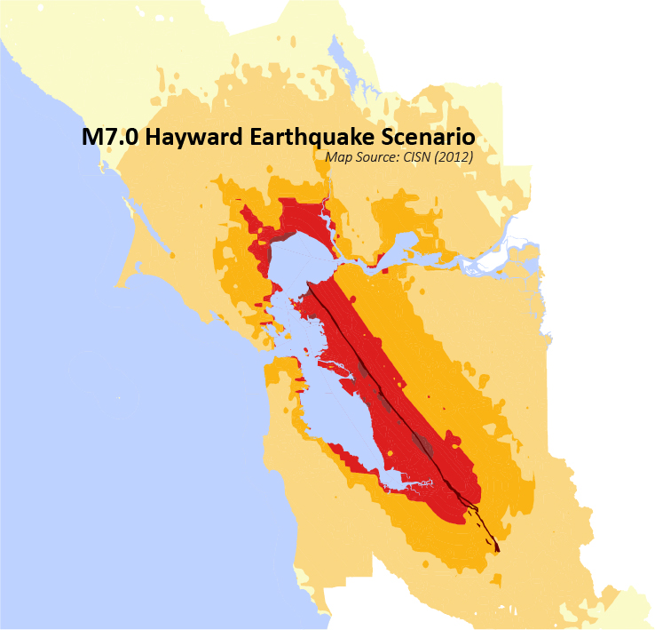
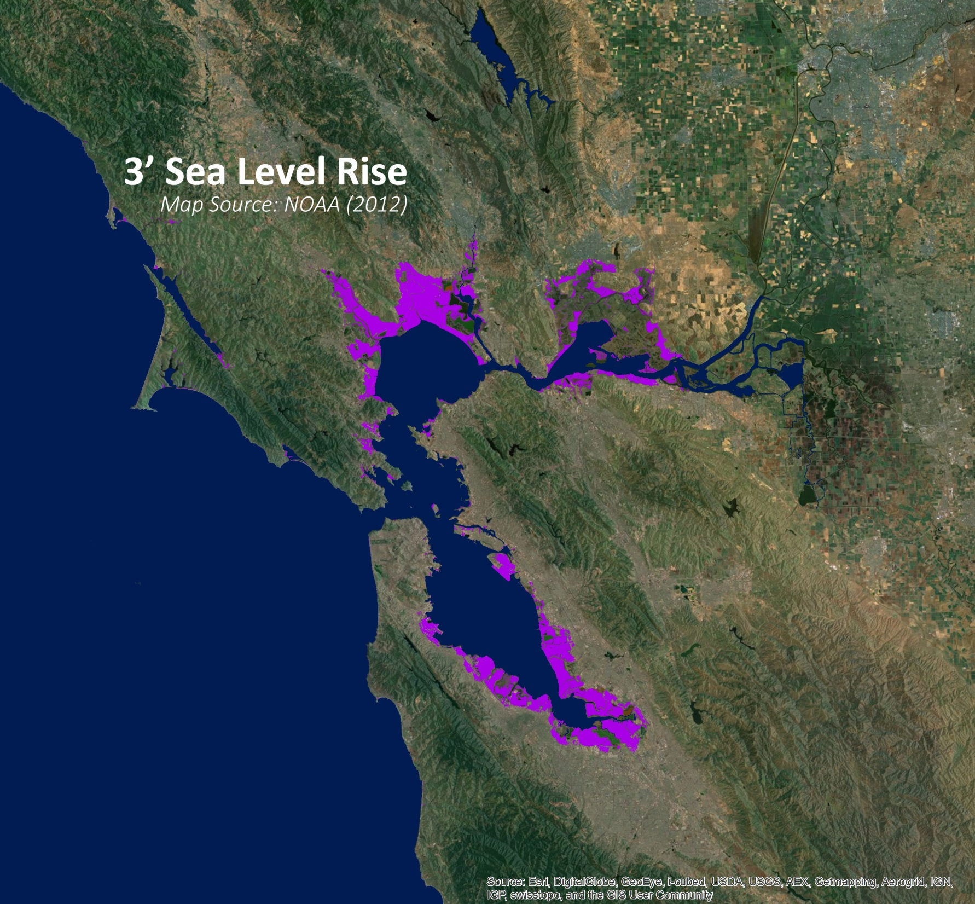
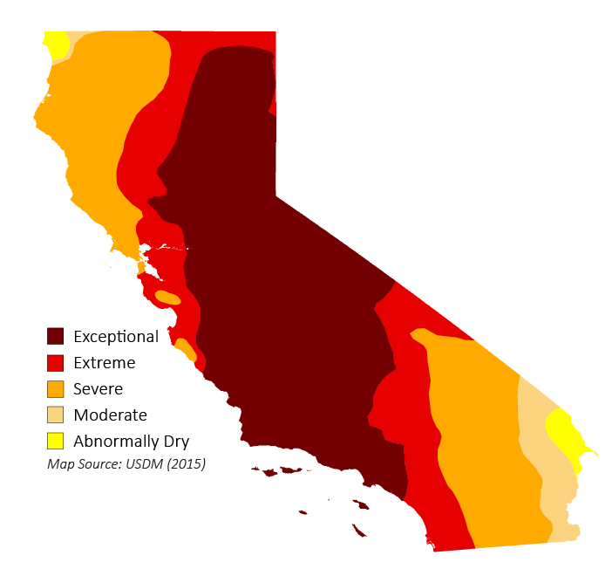
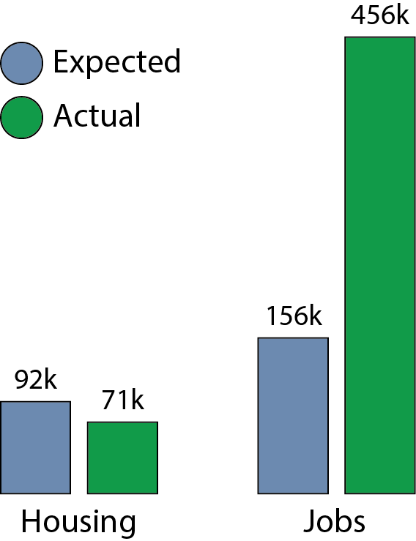
Drought Severity (May 2015)
Notes:
Drought: The Bay Area is not only impacted by dry, fire prone hillsides, but two-thirds of the regions water supply comes directly from the Sierra where the drought is the worst, and where snow-pack levels have been at record lows in 2015.
Sea Level Rise:
Earthquake:
Housing:
Additional Notes
Sea Level Rise: This map shows 3’ of sea level rise, we have good data in 1’ increments from 0-6’
Earthquake: The shades of red range from MMI 9 to 5. Their shaking intensity is violent, very strong, strong, moderate, light. The dark line down the side is the hayward fault which is likely to produce ground fault rupture where you see displacement on the ground, and where linear infrastructure that crosses is likely to be severely damaged.

Slide 3
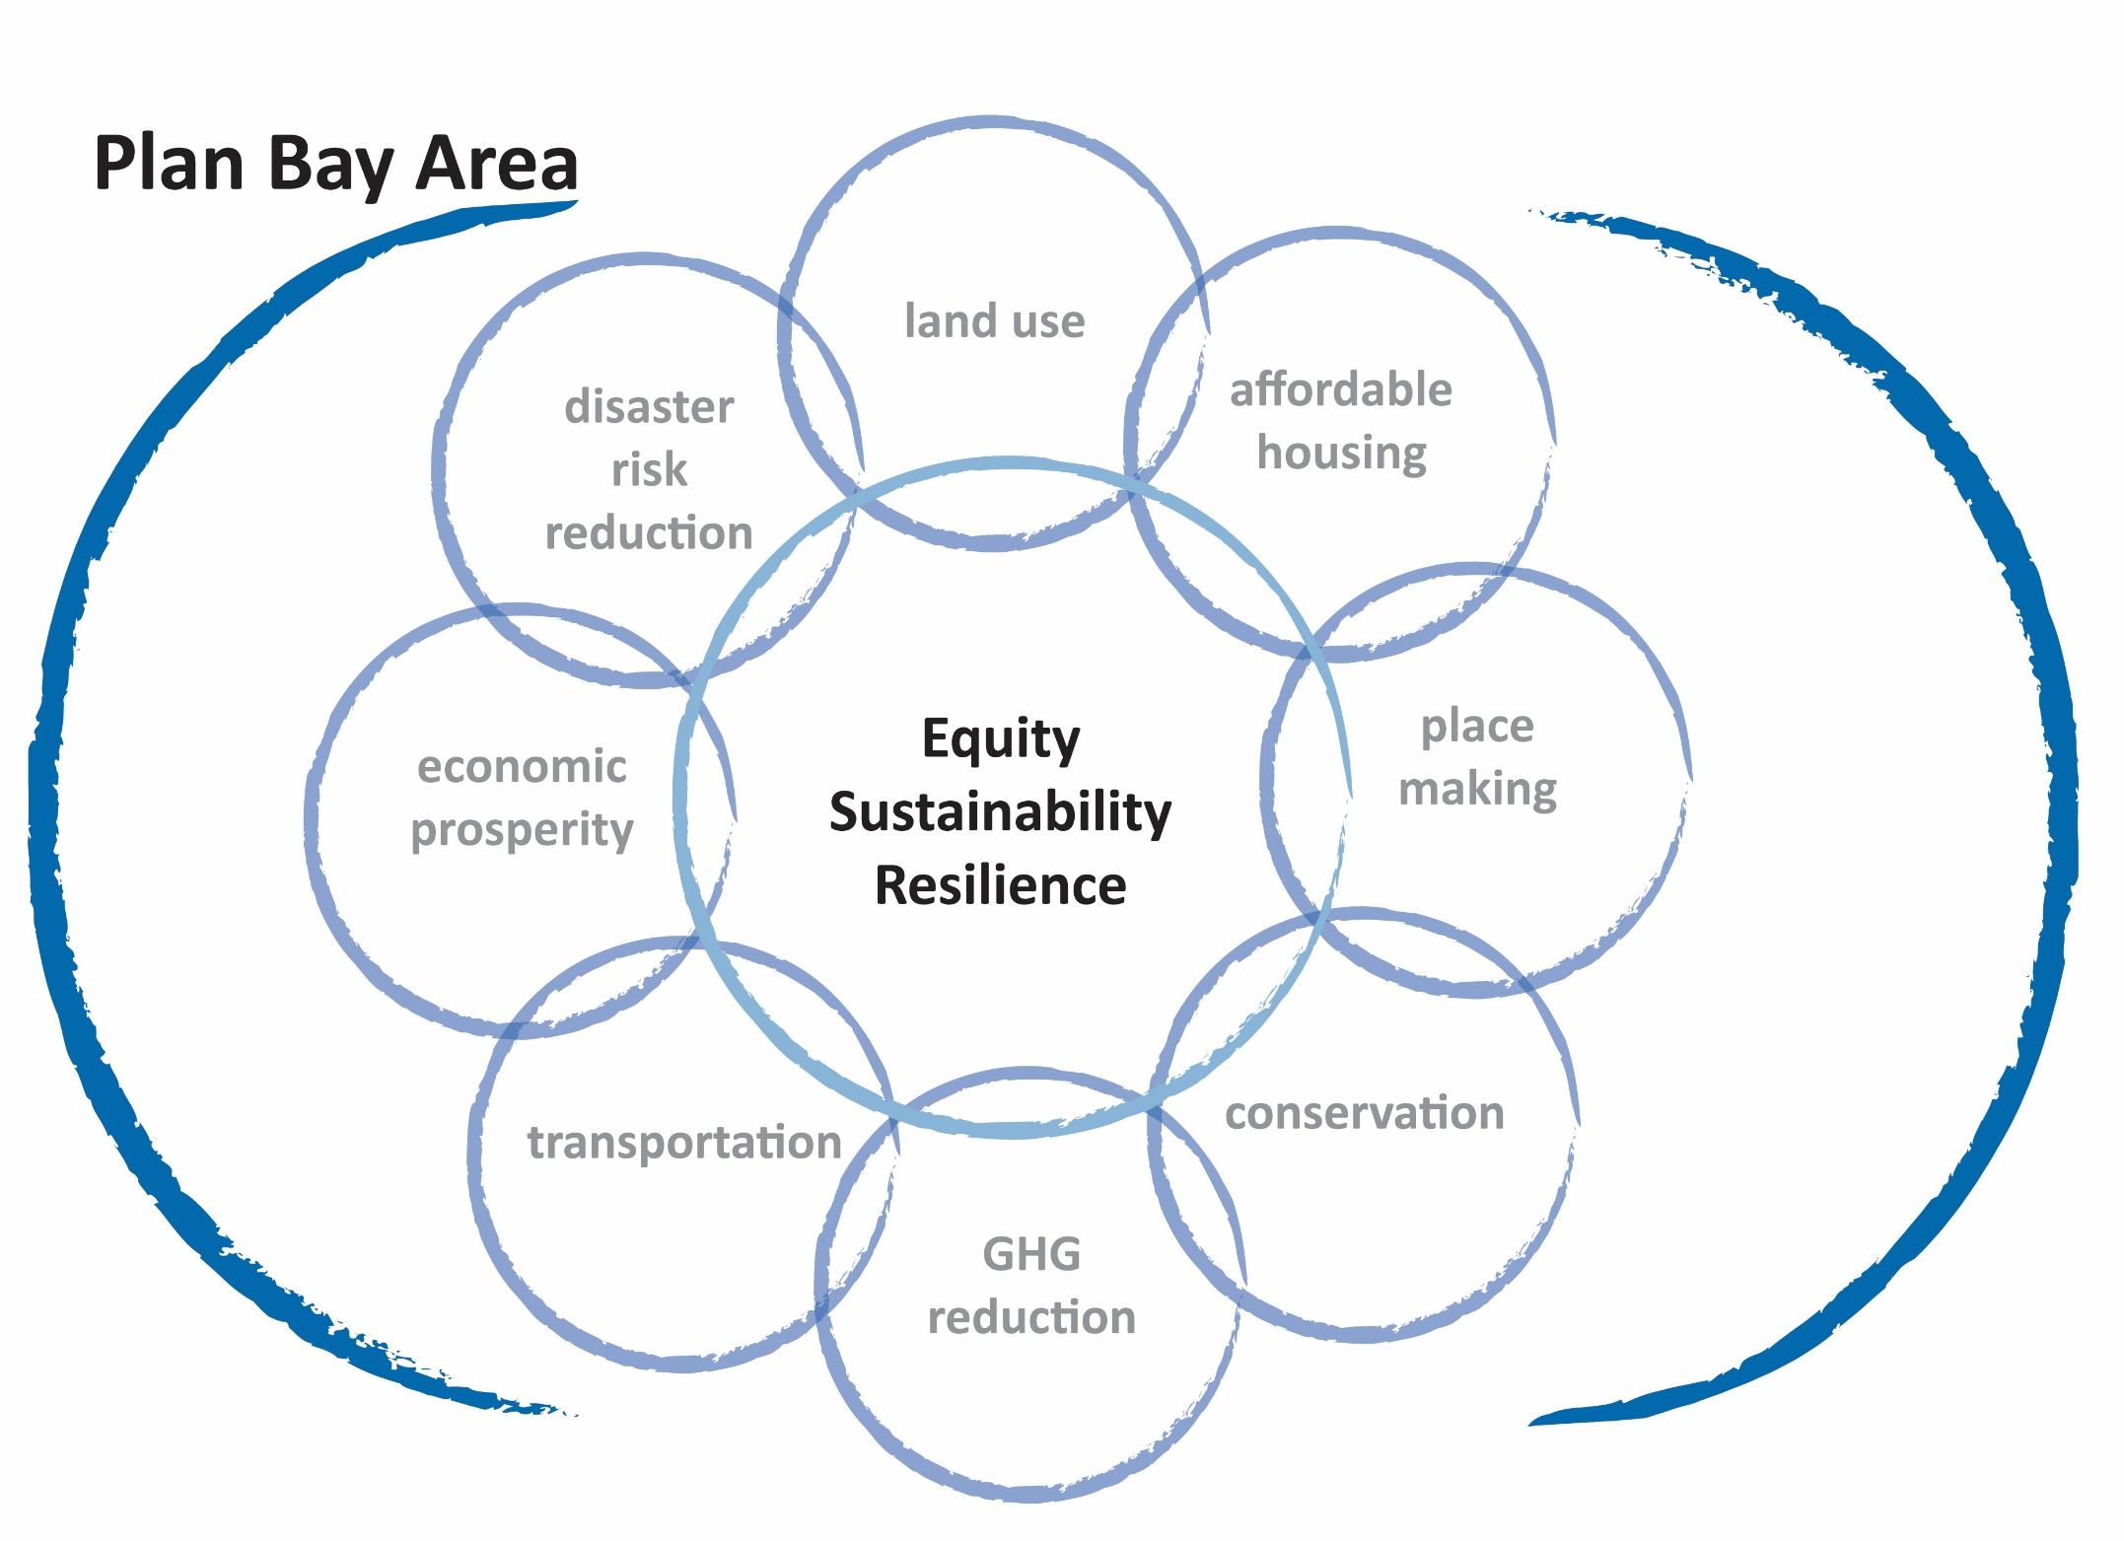
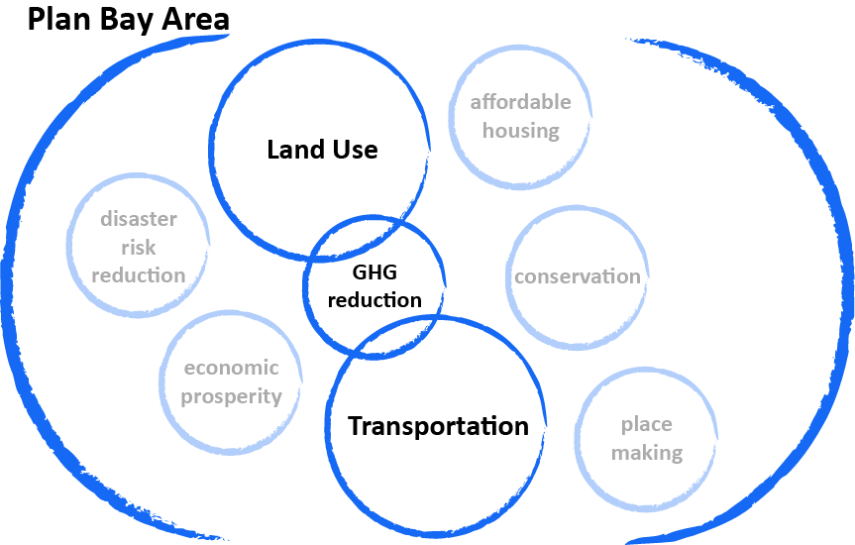

Slide 4
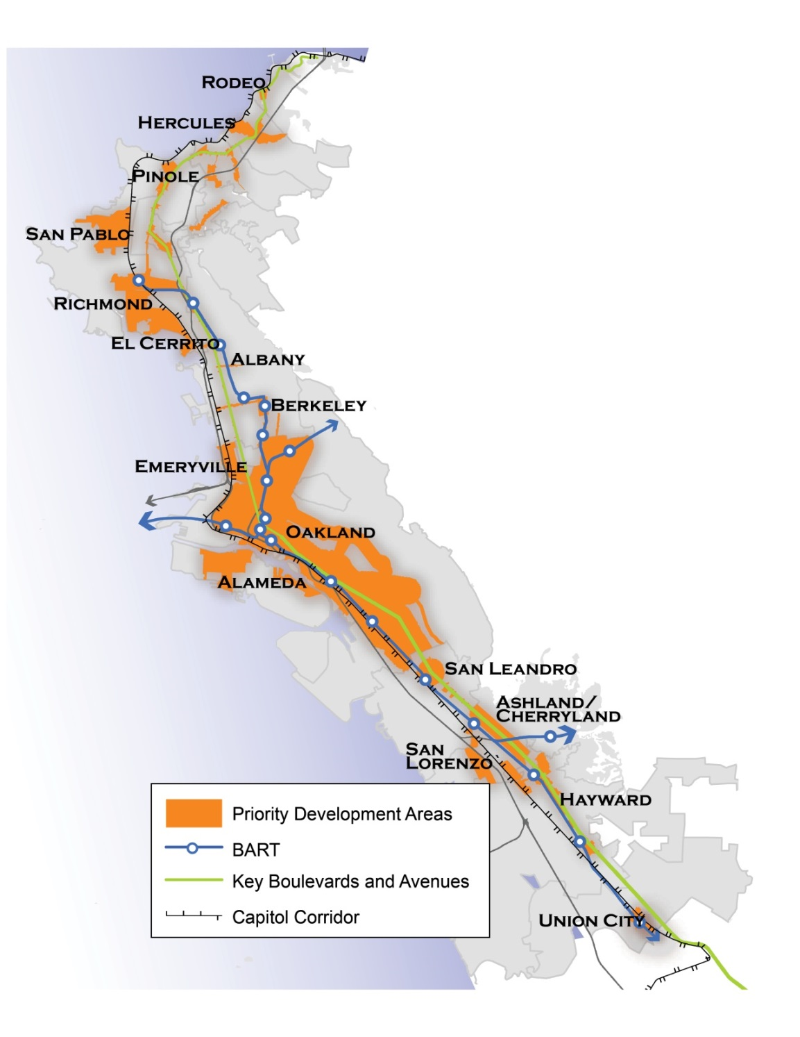
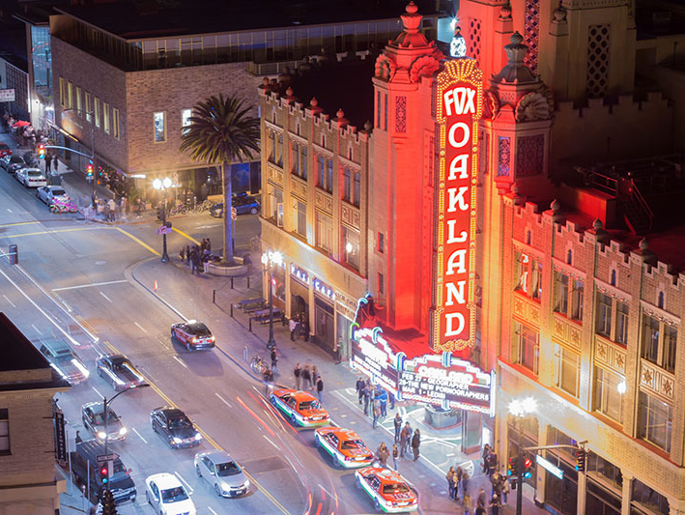
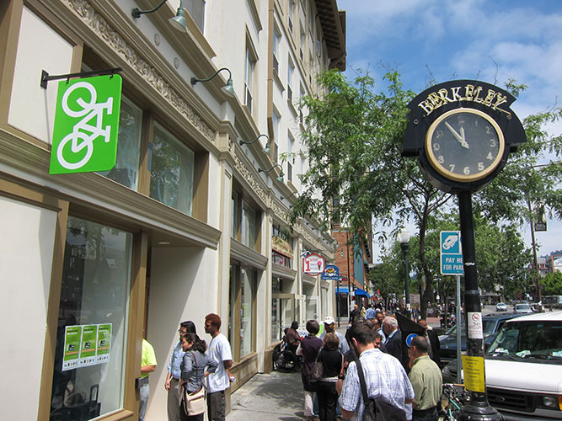
Plan Bay Area polices focused along the East Bay Corridor.
Notes:
“The East Bay Corridor is wedged between rising sea levels and the Hayward fault”
“Communities of concern”
“The integrated approach to planning along the EBC has a strong focus in preventing displacement. Strategies are being developed to keep existing units affordable today while improving the conditions of the housing with energy, water, and seismic retrofits, to keep them affordable in the future and ensure they are not damaged and replaced with condos in a future Bay Area earthquake.”

Slide 5
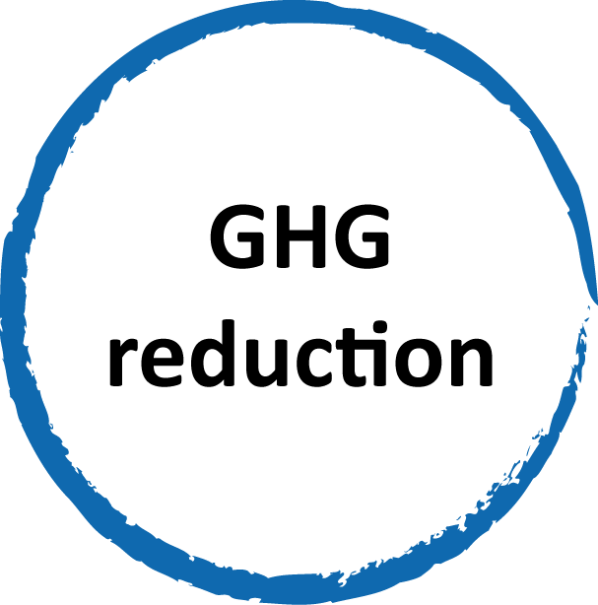
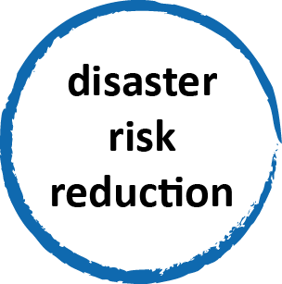

Slide 6
collaboration & partnerships
Notes:
Federal funding to support collaboration across scales and across tasks to be more effective at addressing equity, prosperity, and resilience.
Regional Planning better connected to local planning
Connecting concepts to specific strategies
We have a solid foundation, need more federal support.

