Slide 1
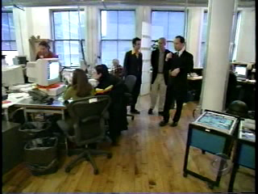

Slide 2


Slide 3


Slide 4


Slide 5


Slide 6
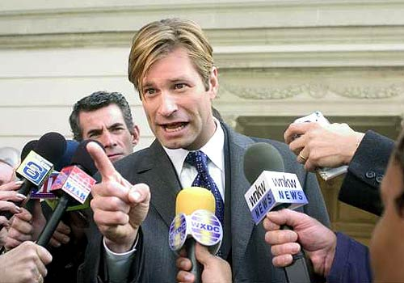

Slide 7
“We Oglalas do the best we can to take care of our own people. This little piece of land we have is our home. We don’t want to be anywhere else. This is all we have left. We know it is up to us Oglalas to make it happen. No one else really seems to give a #%*!, because they are too busy taking care of themselves most of the time.”
“The light at the end of the tunnel is to look at all of our problems, to bring them forward, to admit they exist, and then address them. We need to bring these things out in the open and express ourselves instead of acting like nothing is wrong. If we can do this, then that’s when the healing starts.”

